Slide 1
Oxygen and Carbon dioxide Transport
Dr. Laila Al-Dokhi

Slide 2
Objectives
Understand the forms of oxygen transport in the blood, the importance of each.
Differentiate between O2 capacity, O2 content and O2 saturation.
Describe (Oxygen- hemoglobin dissociation curve)
Define the P50 and its significance.
How DPG, temperature, H⁺ ions and PCO₂ affect affinity of O₂ for Hemoglobin and the physiological importance of these effects.
Describe the three forms of carbon dioxide that are transported in the blood, and the chloride shift.

Slide 3
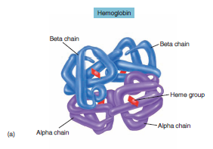
Transport of O2 and CO2 in the blood and body fluids
O₂ is mostly transported in the blood bound to hemoglobin
If the P_{O2} increases Hb binds O₂
If P_{O2} decreases Hb releases O₂
O2 binds to the heme group on hemoglobin, with 4 oxygens /Hb

Slide 4
3% dissolved in plasma
97% bound to hemoglobin (oxyhemoglobin)
Higher PO2₂ results in greater Hb saturation.
The relation between PO2 and Hb-O2 is not linear. The curve is called Oxyhemoglobin Saturation Curve
Which is S- shaped or sigmoid

Slide 5
O2 capacity, content and saturation.
O₂ content: amount of O₂ in blood (ml O₂/100 ml blood)
O₂-binding capacity: maximum amount of O₂ bound to hemoglobin (ml O₂/100 ml blood) measured at 100% saturation.
Percent saturation: % of heme groups bound to O₂
% saturation of Hb = oxygen content x 100
oxygen capacity
Dissolved O_{2:} Unbound O₂ in blood (ml O₂/100 ml blood).

Slide 6
Transport of oxygen in arterial blood
When blood is 100% saturated with O2: each gram of Hb carry 1.34 ml O2
So O2 content = 15g Hb x 1.34 O2=20 ml.
But when the blood is only 97% saturated with O2:each 100 ml blood contain 19.4 ml O2).
Amount of oxygen released from the hemoglobin to the tissues is 5ml O2 per each 100ml blood.
So O2 content in venous blood =19.4-5= 14.4 ml.
During strenuous exercise the oxygen uptake by the tissue increases 3 folds so 15 ml O2 is given /100 ml blood
So O2 content in venous blood =19.4-15=4.4 ml O2 /100ml blood.
At rest tissues consume 250 ml O2 /min and produce 200ml CO2

Slide 7
The oxygen-haemoglobin dissociation curve
It shows the progressive increase in the percentage saturation of the Hb with the increase in the PO₂ in the blood.
The PO₂ in the arterial blood is about 95mmHg and saturation of Hb with O₂ is about 97%.
In the venous blood returning from the tissues, the PO₂ is about 40mmHg and the saturation of Hb with O₂ is about 75%.

Slide 8
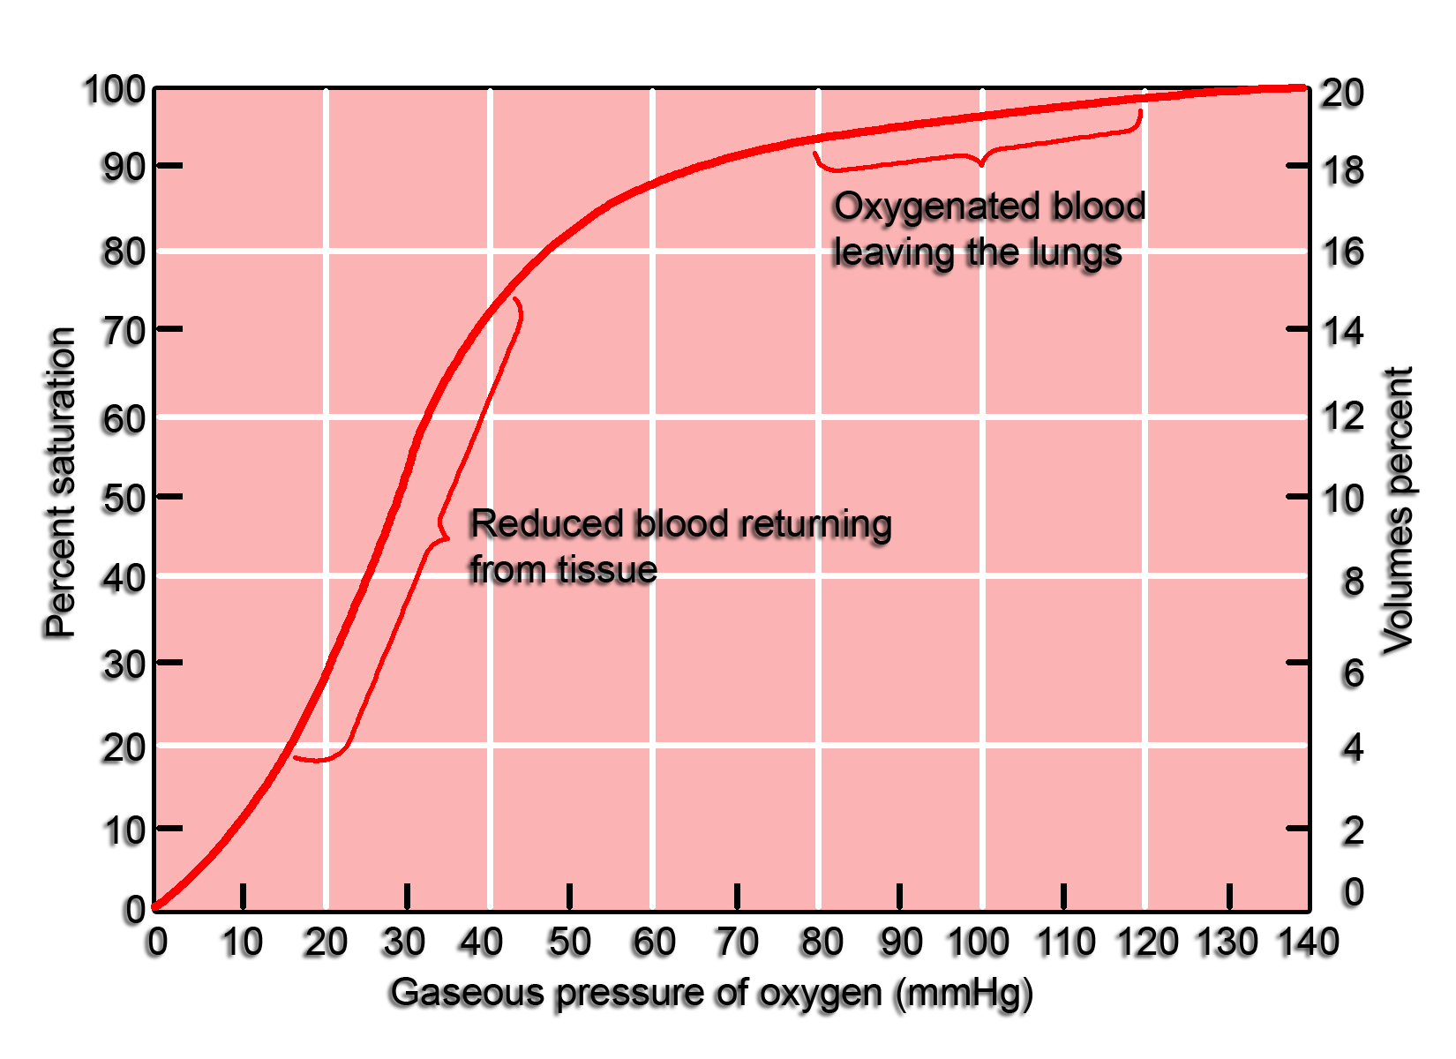

Slide 9
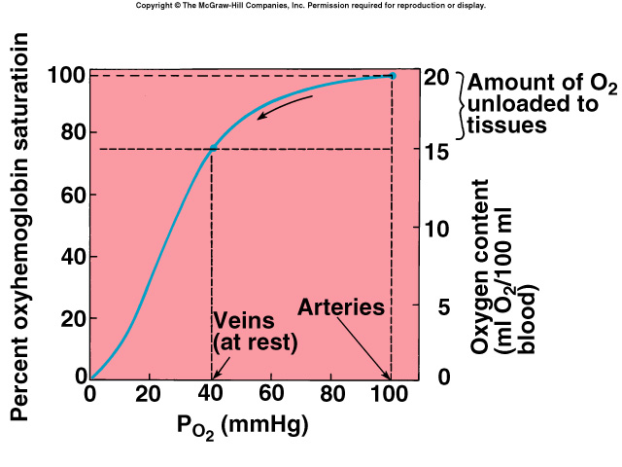
The oxygen-haemoglobin dissociation curve

Slide 10
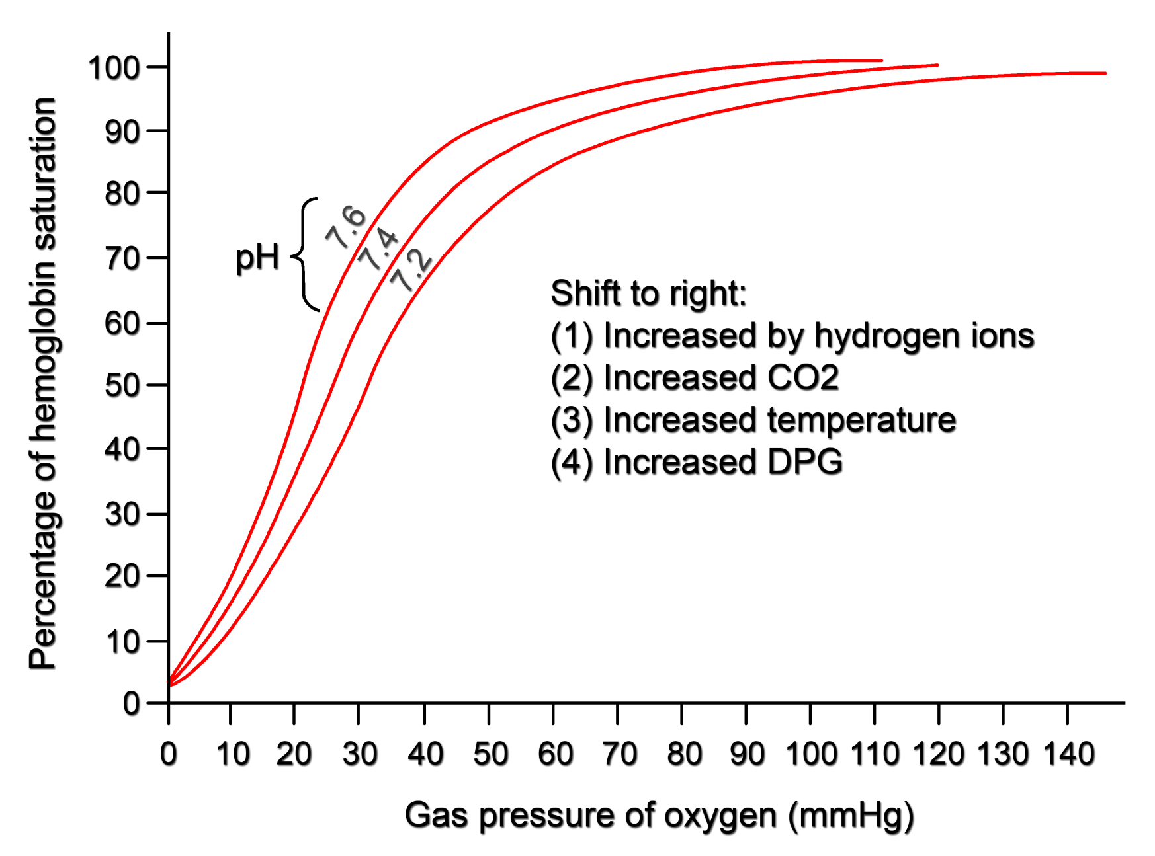
Factors shifting oxygen-haemoglobin dissociation curve to the right

Slide 11
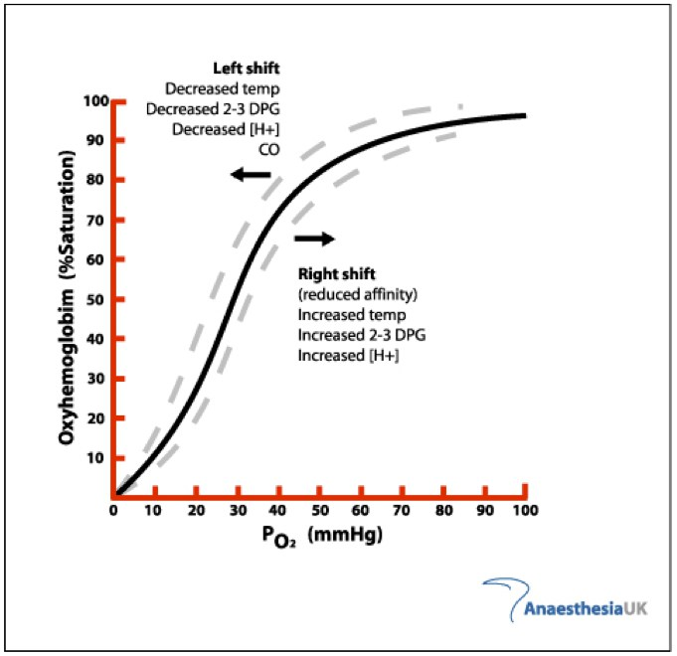

Slide 12
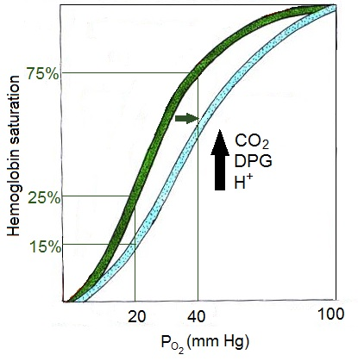
Factors affecting oxygen-haemoglobin dissociation curve

Slide 13
Factors affecting the affinity of Hb for O₂
4 important factors
The ↓ pH or ↑(H+ conc),
the ↑ temperature,
and the ↑ concentration of 2,3 diphosphoglycerate (2,3-DPG).
↑ PCO₂ concentration (Bohr effect) → all shift the curve to the right.
P50: it is the partial pressure of O₂ at which 50% of Hb is saturated with O₂.
↑ P50 means right shift → lower affinity for O₂.
↓ P50 means left shift → higher affinity for O₂.

Slide 14
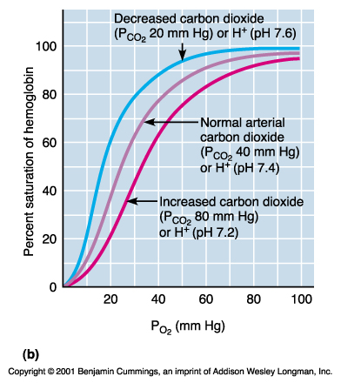
Bohr Effect

Slide 15
The Rt and Lt shifts:
Definition:
Rt shift means the oxygen is unloaded to the tissues from Hb
Lt shift means loading or attachment of oxygen to Hb.
Increased 2,3DPG, H+, Temperature , PCO2 shift the curve to right.
2,3DPG is synthesized in RBCs from the glycolytic pathway , it binds tightly to reduced Hb. increased 2,3 DPG facilitate the oxygen release and shifts the dissociation curve to Rt.
2,3 DPG increases in the RBCs in anemia and hypoxemia, and thus serves as an important adaptive response in maintaining tissue oxygenation
Fetal Hb: has a P50 of 20 mmHg in comparison to 27 mmHg of adult Hb.

Slide 16
The Rt and Lt shifts:
Effect of carbon dioxide and hydrogen ions on the curve
( Bohr effect)
At lung:
Movement of CO2 from blood to alveoli will decrease blood CO2 &H+ →shift the curve to left and
Increase O2 affinity of Hb allowing more O2 transport to tissues
At tissues:
Increase CO2 &H+ in blood leads to →shift the curve to right and
Decrease O2 affinity of Hb allowing more O2 transport to tissues

Slide 17
Shift of dissociation curve during exercise
Exercise increases Temp, H+, 2,3 DPG and shift the curve to Rt.
Utilization Coefficient :The percentage of the blood that gives up its oxygen as it passes through the tissues capillaries is called utilization coefficient.
Utilization Coefficient = O2 delivered to the tissues
O2 content of arterial blood
Normally at rest = 5ml/20 ml= 25% ,
During exercise it = 15 ml/20 ml= 75 % - 85%

Slide 18
Transport of oxygen in the dissolved state.
Only 3% of O2 is transported in the dissolved state,
At normal arterial PO2 of 95 mmHg , about 0.29 ml of oxygen is dissolved in each 100ml of blood.
When the PO2 of the blood falls to 40 mmHg in tissue capillaries, only 0.12 of oxygen remains dissolved.
Therfore 0.17 ml of oxygen is normally transported in the dissolved state to the tissues per each 100 ml of blood

Slide 19
Combination of Hb with CO ----- displacement of oxygen
CO combines with Hb at the same point on the Hb molecule as does oxygen,
It binds with Hb about 250 times as much as O2 (affinity of Hb to CO is very high (250 times) that to O2.It causes Lt shift of the O2-Hb curve.

Slide 20
Transport of carbon dioxide in the blood
Carbon dioxide is transported in three forms:
Dissolved CO2 7%
Bicarbonate ions 70 %
Carbaminohemoglobin ( with Hb) 23%.
Each 100 ml of blood carry 4 ml of CO2 from the tissues.

Slide 21
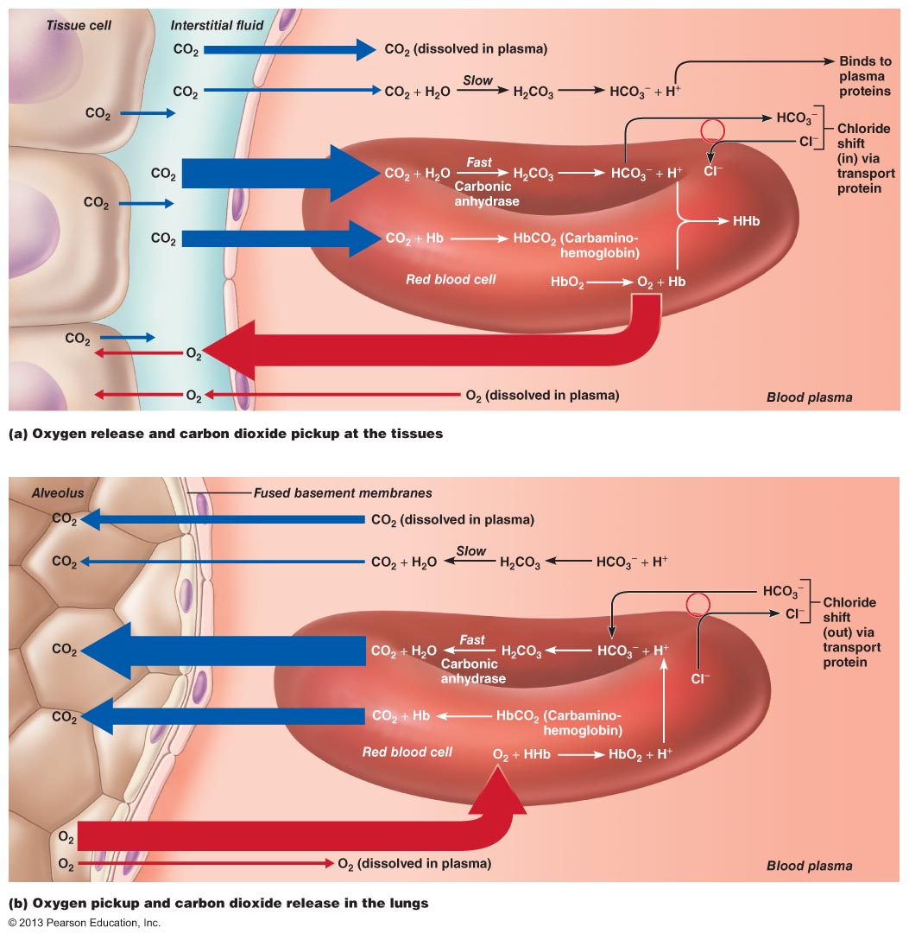

Slide 22
The Haldane effect
When oxygen binds with hemoglobin , carbon dioxide is released- to increase CO2 transport
Binding of Hb with O2 at the lung causes the Hb to become a stronger acid and , this in turn displaces CO2 from the blood and into the alveoli
Change in blood acidity during CO2 transport.
Arterial blood has a PH of 7.41 that of venous blood with higher PCO2 falls to 7.37 ( i.e change of 0.04 unit takes place)

Slide 23
Respiratory Exchange ratio ( Respiratory Quotient)
R= Rate of CO2 output
Rate of O2 uptake
Normally it is 4/5= 82%
When Carbohydrate diet is used
R = 1
When fats only is used R=0.7
A person on normal diet R=0.825

