Slide 1
Control of Breathing
Dr. Aida Korish
Assoc. Prof. Physiology KSU
iaidakorish@yahoo.com

Slide 2
Objectives
By the end of this lecture you should be able to: -
•
Understand the role of the medulla oblongata in
determining the basic pattern of respiratory activity.
List some factors that can modify the basic breathing pattern like e.g.
a- The Hering-Breuer reflexes, b- The proprioreceptor reflexes, and c- The protective reflexes, like the irritant, and the J-receptors.
Understand the respiratory consequences of changing
PO₂, PCO₂, and PH.
Describe the locations and roles of the peripheral and
central chemoreceptors.
Compare and contrast metabolic and respiratory acidosis and metabolic and respiratory alkalosis.

Slide 3
Controls of rate and depth of respiration
Arterial PO2
When PO2 is VERY low (Hypoxia), ventilation increases
Arterial PCO2
The most important regulator of ventilation is PCO2, small increases in PCO2, greatly increases ventilation
Arterial pH
As hydrogen ions increase (acidosis), alveolar
ventilation increases.

Slide 4
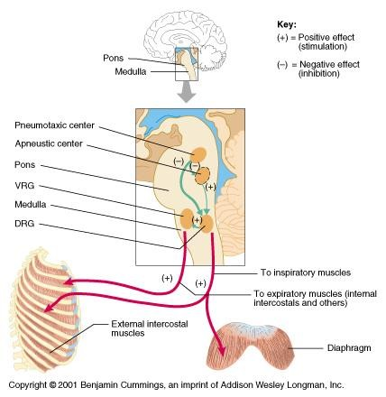
Respiratory Centers

Slide 5
Medullary Respiratory centers
Inspiratory area (Dorsal Respiratory Group) DRG
-Determines basic rhythm of breathing
-Causes contraction of diaphragm and external intercostals
Expiratory area (Ventral Respiratory Group) VRG
-Inactive during normal quiet breathing
-Activated by inspiratory area during forceful breathing
-Causes contraction of internal intercostals and abdominal
muscles
The medullary respiratory center stimulates basic inspiration for about 2 seconds and then basic expiration for about 3 seconds (5sec/ breath = 12breaths/min).

Slide 6
Pontine Respiratory centers
Transition between inhalation and exhalation is
controlled by:
Pneumotaxic area
Inhibits inspiratory area of medulla to stop inhalation.
Breathing is more rapid when pneumotaxic area is
active.
Apneustic area
Stimulates inspiratory area of medulla to prolong
inhalation.

Slide 8
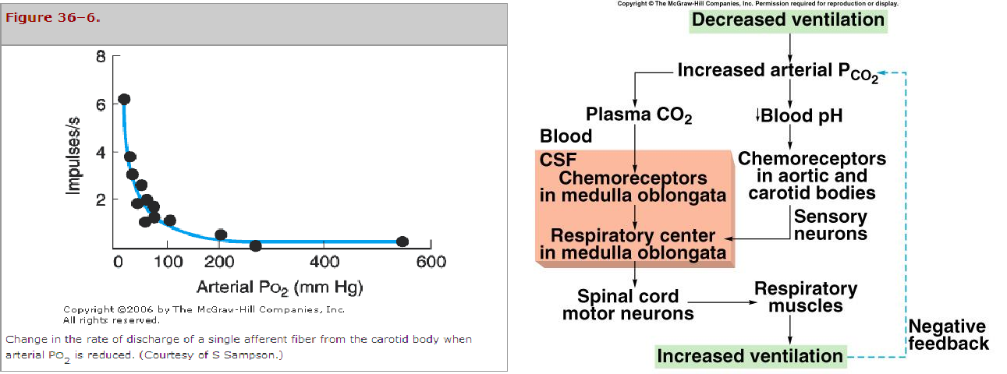
Chemoreceptor Control of Breathing

Slide 9
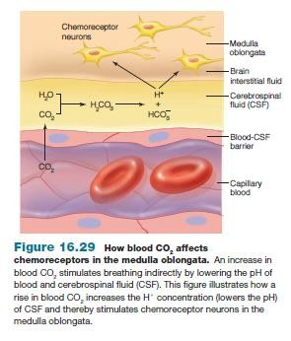
Effect of blood CO2 level on central chemoreceptors

Slide 10
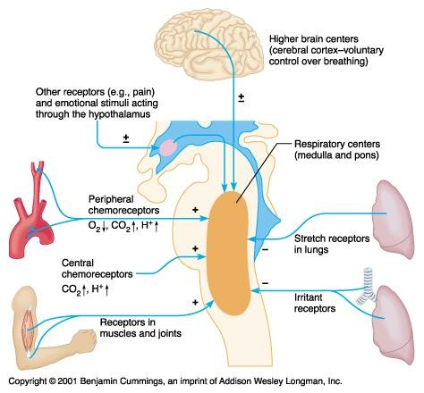
Factors Influencing Respiration

Slide 11
Hering-Breuer inflation reflex
When the lung becomes overstretched (tidal volume is 1 L or more), stretch receptors located in the wall bronchi and bronchioles transmit signals through vagus nerve to DRG producing effect similar to pneumotaxic center stimulation
Switches off inspiratory signals and thus stops further inspiration .
This reflex also increase the rate of respiration as does the
pneumotaxic center.

Slide 13
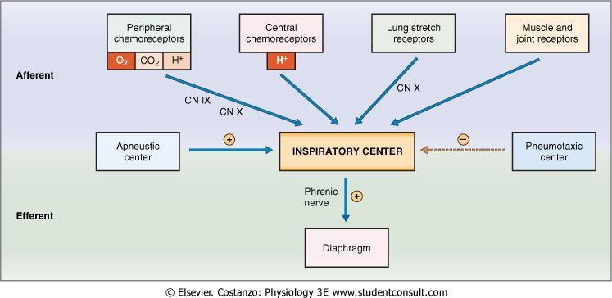
Cont..factors affecting respiration

Slide 14
Respiratory Acidosis
Respiratory Alkalosis
Hypoventilation.
Accumulation of CO₂ in
the tissues.
P_{CO2} increases
pH decreases.
Hyperventilation.
Excessive loss of CO₂.
P_{CO2} decreases ( 35
mmHg).
pH increases.

Slide 15
Metabolic Acidosis
Metabolic Alkalosis
Ingestion, infusion, or
production of a fixed acid.
decreased renal excretion of
hydrogen ions.
loss of bicarbonate or other bases from the extracellular compartment
Excessive loss of fixed
acids from the body
Ingestion, infusion, or excessive renal reabsorption of bases such as bicarbonate
pH increases.
The respiratory system can compensate for metabolic
acidosis or alkalosis by altering alveolar ventilation

