Slide 2
Objectives
Use a spirometer and determine lung
volumes and capacities
Define and provide values for the various
lung volumes and capacities
Recognize the physiological and some
pathological factors that modify lung
volumes and capacities

Slide 3
What is spirometry ?
Spirometry is a pulmonary
function test that measures
lung volumes and capacities

Slide 4
Why a spirometry test ?
To determine the cause of shortness of
breath.
To rule out any kind of obstructive or
restrictive disease.
To diagnose and monitor lung problems.
To monitor how well medications for
lung problems are working .
■
■
■
■

Slide 5
Simple Spirometer
Drum inverted over a chamber of water with
the drum counterbalanced by a weight
In the drum is air or Oxygen
A Tube connects the mouth with the gas
chamber
When one breathes in and out of the chamber,
the drum rises and falls and an appropriate
recording is made on a moving paper

Slide 6
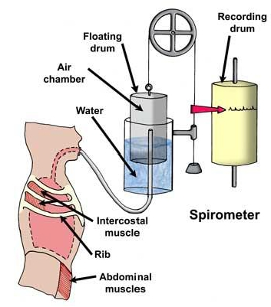
Spirometer

Slide 7
Method
Insert a sterilized mouthpiece
Close the nose with the nose clip
Take a normal breath through the mouthpiece for a
short time then take a deep inspiration to fill the lungs
completely, then breathe normally for a short time.
Expire, forcibly as completely as possible, then
breathe normally for a short time.
Take a deep forceful inspiration and immediately
expire forcibly and as completely as possible, then
breathe normally.
The spirogram is recorded on a moving drum

Slide 8
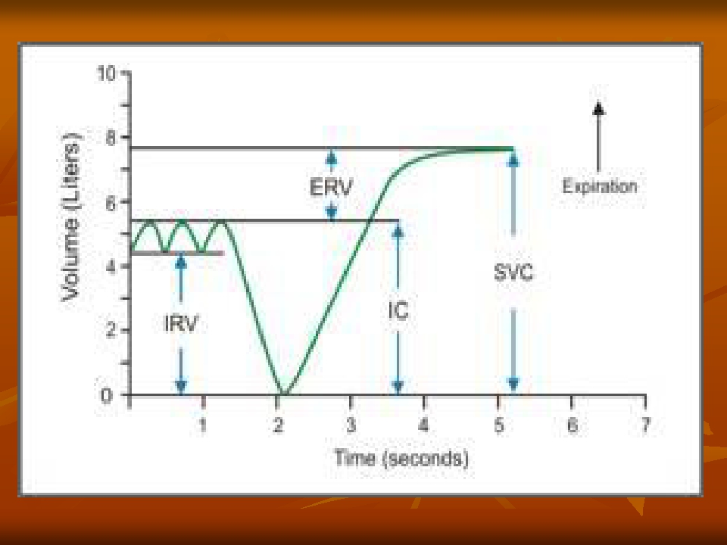
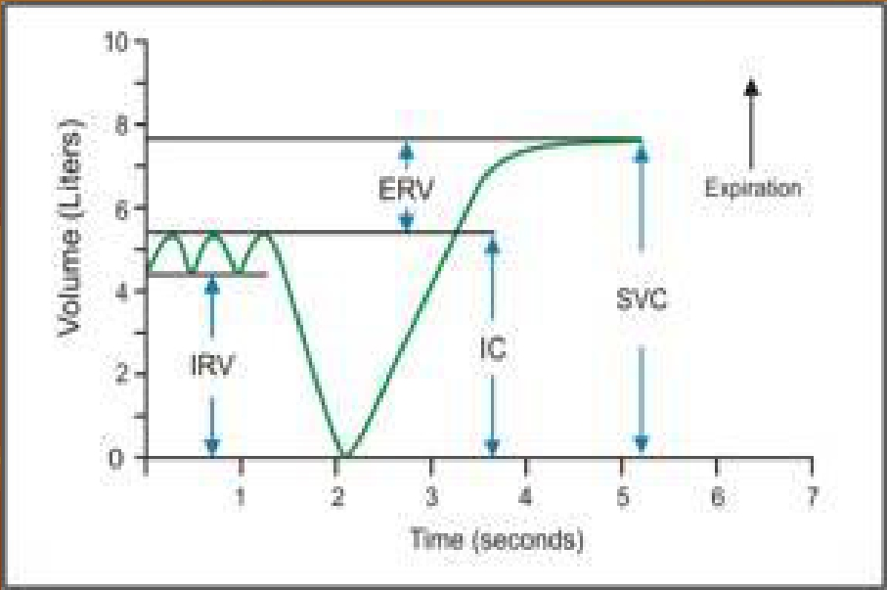

Slide 9
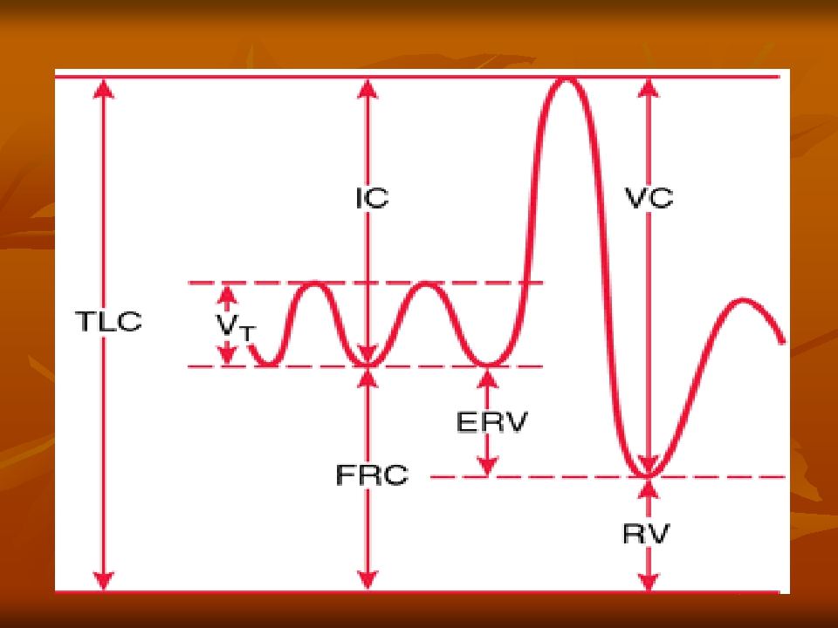
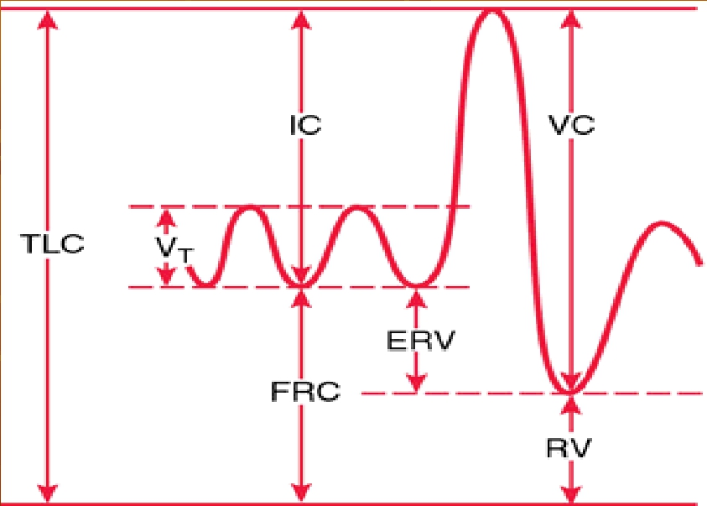

Slide 10
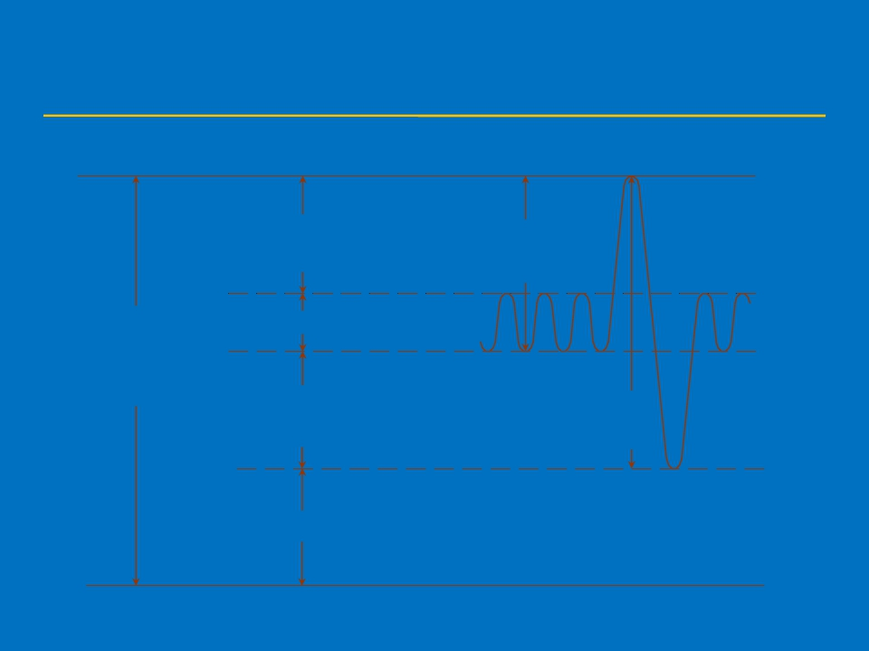
Inspiratory reserve
volume
Tidal volume
Expiratory reserve
volume
Residual volume
Inspiratory
capacity
Vital
capacity
Total
lung
capacity

Slide 11
The air in the lungs can be subdivided
on this diagram into 4 volumes and 4
capacities:

Slide 12
Lung volumes
Tidal volume:
The amount of air that moves into the lungs
with each inspiration (or the amount that
moves out with each expiration) = 500ml.
Inspiratory reserve volume:
The extra volume of air that can be inspired
above the normal tidal volume = 3000ml

Slide 13
Expiratory reserve volume:
The volume expelled by an active
expiratory effort after passive
expiration ( after the end of a normal
tidal expiration) = 1100ml
Residual volume:
The air left in the lungs after the most
forceful expiration = 1200ml

Slide 14
Lung Capacities
The inspiratory capacity :
IC= TV+IRV
The amount of air a person can breathe
beginning at the normal expiratory level and
distending the lungs to the maximum amount
= 3500ml
The functional residual capacity :
FRC= ERV+RV
The amount of air that remains in the lungs at
the end of normal expiration =2300ml

Slide 15
The vital capacity:
VC= IRV+TV+ERV
The maximum amount of air a person can
expel after maximal inspiration = 4600ml
The total lung capacity:
TLC= VC+RV
The max volume to which the lungs can be
expanded with the greatest possible
inspiratory effort = 5800ml

Slide 16
Physiological factors influencing
lung volumes and capacities
Sex: female 20-25% less
■
■ Age:
■ Obesity:
■ Height:
↓ VC
↓ VC
↑VC
■ Athletes: ↑ VC

Slide 17
Pathological factors
Vital capacity is decreased with :
↓lung volume:
eg: surgical removal of lung tissues
large tumors
Restrictive lung disease: inability to fully expand
the lungs.
eg: Pneumonia, pulmonary edema, broken ribs
Obstructive lung disease
eg: Chronic bronchitis, asthma, foreign body
Loss of elastic recoil
eg: emphysema

