Slide 1
Dr.ThourayaSaid

Slide 2
Spirometry
It provides an objec4ve
measurement of lung func4on.
It analyzes volume and velocity
of expired air

Slide 3
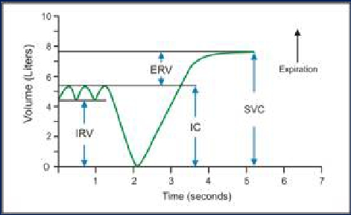
Sta4c test
Performed without regard to 4me
Relaxed Vital capacity: Max Volume of air
expired during relaxed expira4on aCer a
maximal inspira4on

Slide 4
Dynamic test
Performed at forcible and max eﬀort against 4me
Measures the rate at which the lung changes
volume during forced breathing.
Forced vital capacity
The max volume of air that can be forcibly and
rapidly exhaled following a max inspira4on.

Slide 6
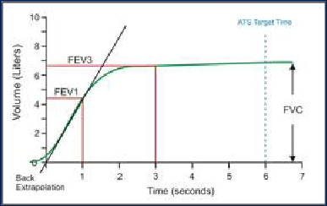
Forced Expiratory Curve
Ø The subject takes a maximal inspira4on and
then exhales as rapidly, as forcibly,& as
maximally as possible.
Ø Dura4on of the forced eﬀort: 6sec
Ø A plot of exhaled volume against 4me:

Slide 7
FEV1 : Volume of air expelled in the 1st sec of
forced expira4on star4ng from full
inspira4on
Plateau: FVC
FEV1 % or ra4o = (FEV1/FVC) * 100
Frac4on of the VC expired during the 1st
sec of a forced expira4on (NL 70%-80%)

Slide 8
• FEV1 is useful measure of how quickly the
lungs can be emp=ed.
• The ra=o is useful index of airﬂow limita=on

Slide 9
Normal Trace Showing FEV1 and FVC
FVC
5
4
3
2
1
FEV1 = 4L
FVC = 5L
FEV1/FVC = 0.8
Volume, liters
1
2
3
4
5
6
Time, sec

Slide 10
The curve
helps ≠
obstruc=ve
LD
Restric=ve
LD

Slide 11
Obstruc4ve lung disease
A
B
5
4
3
2
1
FVC
Expired Volume (l)
0
1
2
3
4
5
Time (s)

Slide 12
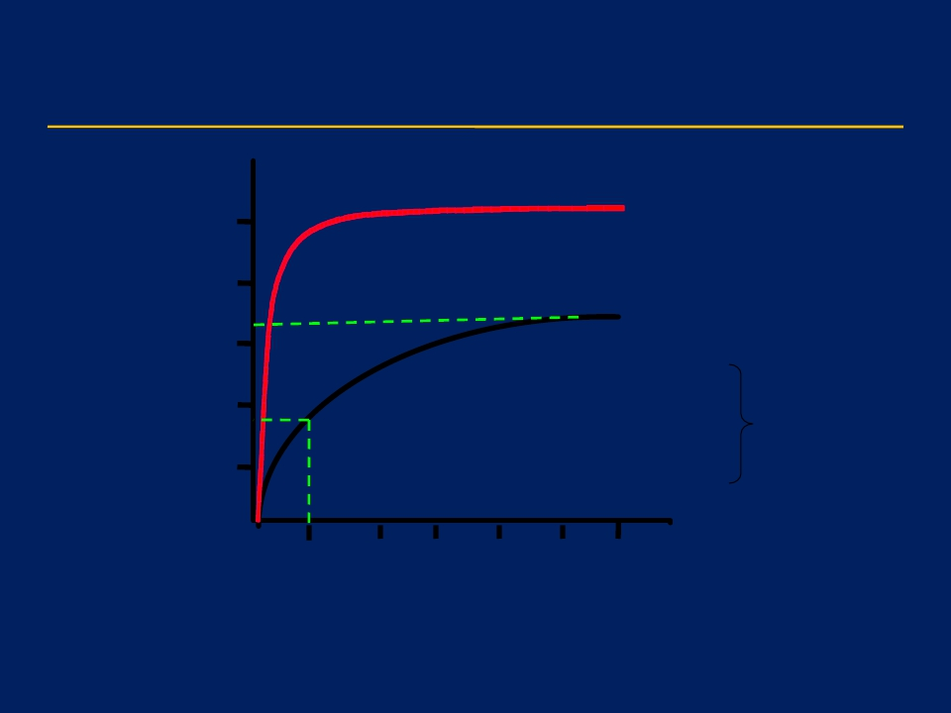
Obstruc=ve Disease
Normal
FEV1 = 1.8L
FVC = 3.2L
FEV1/FVC = 0.56
5
4
3
2
1
Volume, liters
Obstructive
1
2
3
4
5
6
Time, seconds

Slide 13
Restric4ve lung disease
A
C
5
4
3
2
1
Expired Volume (l)
0
1
2
3
4
5
Time (s)

Slide 14
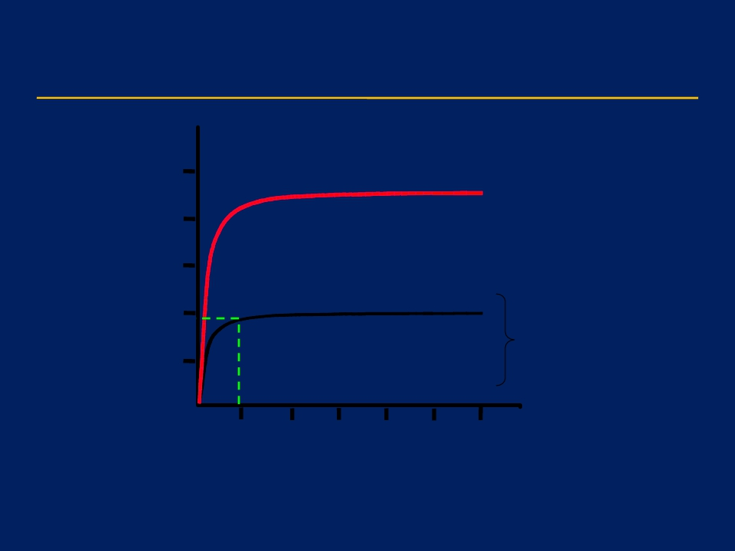
Restric=ve Disease
Normal
5
4
3
2
1
Volume, liters
Restric=ve
FEV1 = 1.9L
FVC = 2.0L
FEV1/FVC = 0.95
1
2
3
4
5
6
Time, seconds

Slide 15
5
4
3
2
1
A
B
C
Expired Volume (l)
0
1
2
3
4
5
Time (s)

Slide 16
• The normal and restric=ve expire fully in 2 sec.
• The obstruc=ve needs more than 2 sec, the curve
rises slowly to reach its highest point.
• He may need more than 6 sec.
• He can or not get rid of all VC depending on the
severity of the disease.

Slide 18
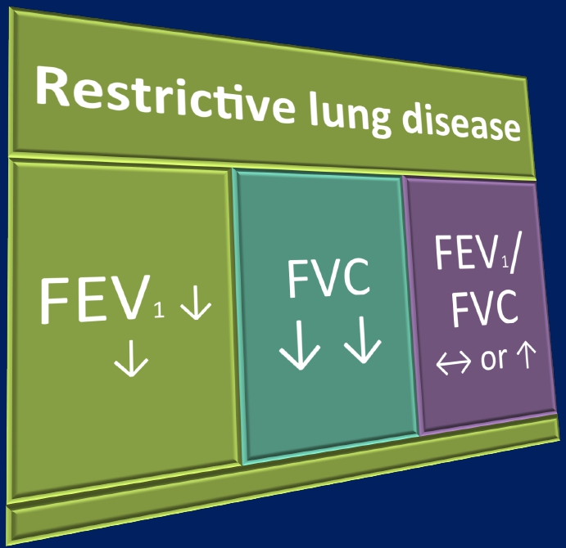

Slide 19
Volume | Normal | Obstruc4ve | Restric4ve
FVC | 5 | ↓ or ↔ (5) | ↓ (3)
FEV1 | 4 | ↓↓↓ (2) | ↓ (2.7)
FEV1% | 80% | ↓ (40%) (↓ airﬂow) | ↔ or ↑ (90) (Normal airﬂow)

Slide 20
Results interpreta=on
• Results are reported as absolute values (litre) ,and
as percentages of predicted values based on age,
height, sex, ethnicity.
• Normal: Both FVC and FEV1 ≥ 75% of predicted
• If any of FVC and FEV1 is < 75% of predicted,
calculate FEV1 ra=o:
• FEV1% ≥ 70% ------à Restric=ve
• FEV1% < 70 % ------à Obstruc=ve

Slide 21
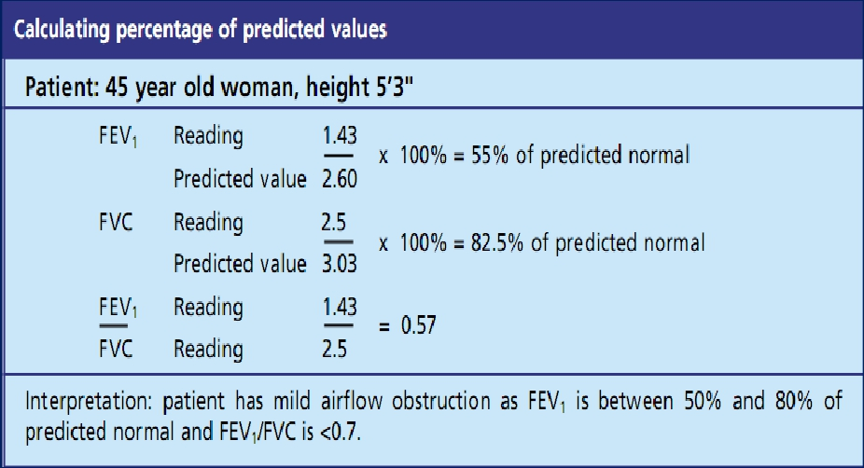

Slide 22
Flow
Volume loop
breathes
normally
(TV)
rapid
max
inspirato
max
inspirato
Exhales
Fast

Slide 23
This measures exp & insp ﬂow as a
func=on of exhaled volume rather then
against =me.
Maximum
expiratory flow
(PEF)
Expiratory
flow rate
L/sec
FVC
Volume (L)
RV
TLC
Inspiratory
flow rate
L/sec

Slide 24
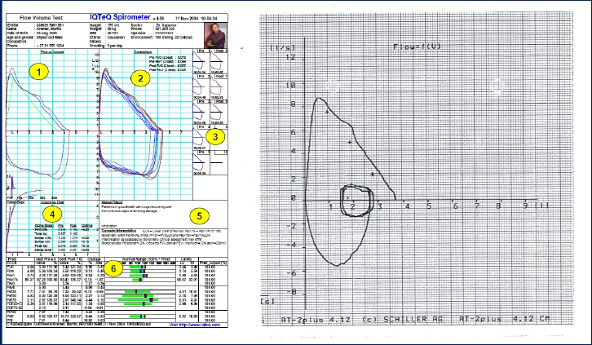

Slide 25
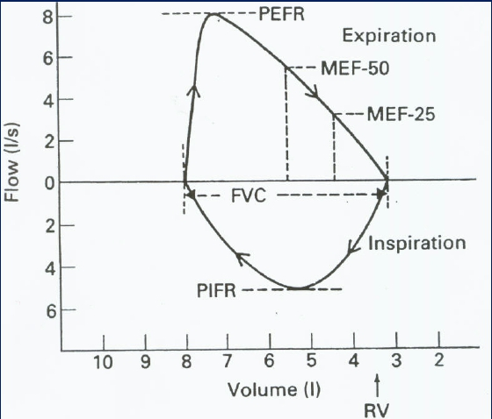
Flow Volume loop

Slide 26
• Measurements on ﬂow V loop
• PEFR : Greatest ﬂow achieved during
the maneuvre = 6- 12l/sec
• PIFR = max ﬂow speed achieved during
forceful inspiratory eﬀort=6l/sec
• MEF50: max expiratory ﬂow at 50% of
FVC = 4-6 l
• FVC measured over the X-axis

Slide 27
Maximal Flow
The inspiratory and the 1st early expiratory ﬂow
rates (ﬂows generated near the TLC) are eﬀort
(muscle) dependent: the greater one can raise
pleural pressure (the harder one forces the air out),
the greater the resul=ng air ﬂow.

Slide 28
Flow Volume Loop and Flow
Limita4on
At low lung volume, as RV is approached, aeer a certain
pleural pressure (Pip) is reached, ﬂow rate is eﬀort
independent (it depends on the size of the bronchi): harder
eﬀort generates higher Pip but no greater airﬂow, this is
because the posi=ve Pip that tends to collapse the airway
exceeds the airway pressure that tends to keep the airways
open: the airways narrow, preven=ng any further increase
in airﬂow despite greater eﬀort.

Slide 29
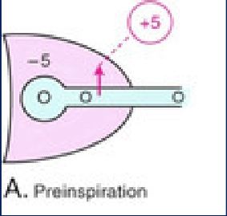
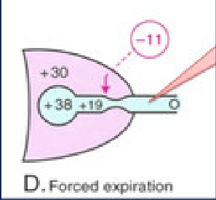
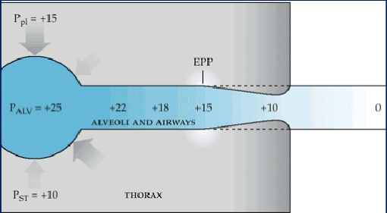

Slide 30
Between breaths: no airﬂow.
• Palv = Patm = 0.
• Pip is nega=ve (subatmospheric, e.g. -5).
• Transpulmonary pressure (Ptrans)
= Palv - Pip = 0 - (-5) = +5.
• Ptrans: force ac=ng to expand the lungs is
opposed by the elas=c recoil ac=ng to collapse
the lungs.
• Volume of lungs stable.

Slide 31
During forced exhala4on:
• The expiratory muscles contract, raising both
Palv and Pip.
• As air exits: gradual loss of pressures (↓ Pip,
↓ Palv).
• Palv drops signiﬁcantly.
• As pressure within the airway ↓, a point is
reached where Palv = Pip: Equal Pressure Point
(EPP). Here, Ptrans is 0.

Slide 32
• Any further loss of pressure within the airways
leads to a nega=ve Ptrans (because Pip > Palv)
and collapse of the airways.
• This occurs at low lung volume. Any ↑in Pip
tends to collapse the airways more, and
makes the expiratory ﬂow eﬀort independent.

Slide 33
• In normal healthy lungs the EPP occurs in the
most central airways of the lungs: collapse
doesn’t occur because airway is supported by
car=lage. The eﬀects of nega=ve Ptrans are
minimised.
• In obstruc4ve disease EPP occurs in more
peripheral collapsible airways: ﬂow limita=on is
established. The shape of the downward slope
becomes concave.

Slide 34
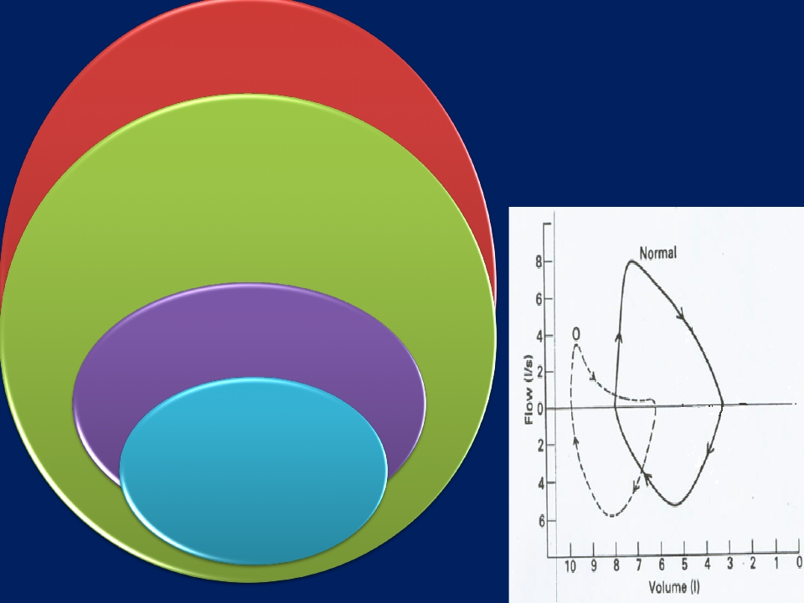
Obstructive
LD
MEF50↓
Eﬀort
independent
part of
curve:
concave
PEFR↓
Inspiratory
loop
Normal

Slide 35
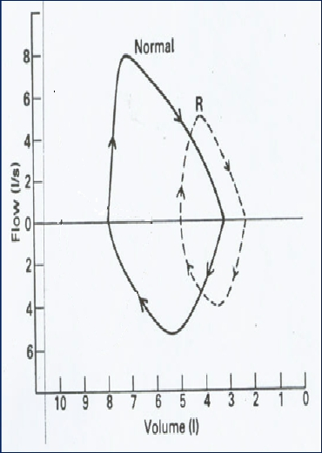
Restrictive LD
Miniature loop
(ellip4cal)
All ﬂow
parameters ↓

Slide 36
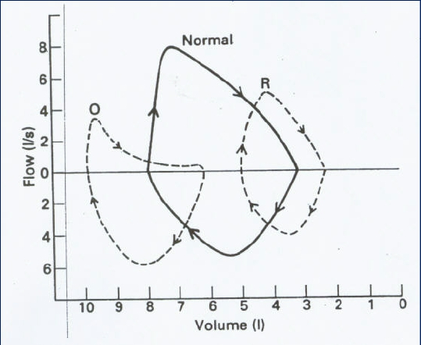

Slide 37
Importance of spirometry
Assess physical ﬁtness.
Helps in the diagnosis of certain
pulmonary diseases (obstruc=ve &
restric=ve).
Follow disease progression.

