Slide 1
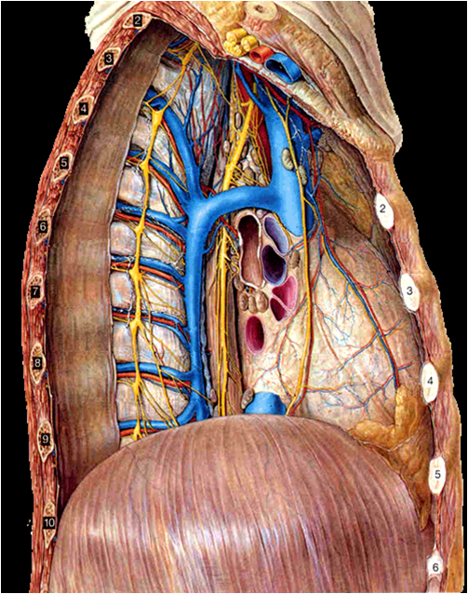
THE mediastinum
3
4
1
Identify:
Heart
Diaphragm
Thoracic vertebra
Sternum
2
Prof. Ahmed Fathalla Ibrahim

Slide 2
OBJECTIVES
At the end of the lecture, students should be able to:
Define the “Mediastinum”.
Differentiate between the divisions of the mediastinum.
List the boundaries and contents of each division.
Describe the relations between the important structures in each division.

Slide 3
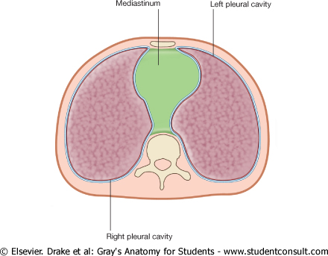
THE MEDIASTINUM
It is a partition
between right & left pleural
sacs & lungs.
It includes all the structures which lie in the intermediate compartments of the thoracic cavity.

Slide 4
BOUNDARIES OF MEDIASTINUM
Superior: Thoracic outlet
Inferior: Diaphragm
Anterior: Sternum
Posterior: Thoracic vertebrae
Lateral: Lungs & pleurae

Slide 5
DIVISIONS OF THE MEDIASTINUM
It is divided by a horizontal plane
extending from sternal angle to
lower border of 4th thoracic vertebra into:
1. Superior mediastinum (S): above the plane
2. Inferior mediastinum: below the plane,
Inferior mediastinum is subdivided into:
Middle mediastinum (M): contains heart
Anterior mediastinum (A): in front of heart
Posterior mediastinum (P): behind heart
S
A
M
P

Slide 6
BOUNDARIES OF SUPERIOR MEDIASTINUM
Superior: Thoracic outlet
Inferior: Horizontal plane
Anterior: Manubrium of sternum
Posterior: Upper 4 thoracic vertebrae
Lateral: lungs & pleurae

Slide 7
CONTENTS OF SUPERIOR MEDIASTINUM
Trachea
Thoracic duct
Left vagus nerve
Right vagus nerve
Left common carotid artery
Left subclavian artery
Brachiocephalic artery
Left brachiocephalic vein
Right phrenic nerve
Thymus
Right brachiocephalic vein
Arch of aorta
Left phrenic nerve
S
V
C
Esophagus

Slide 8
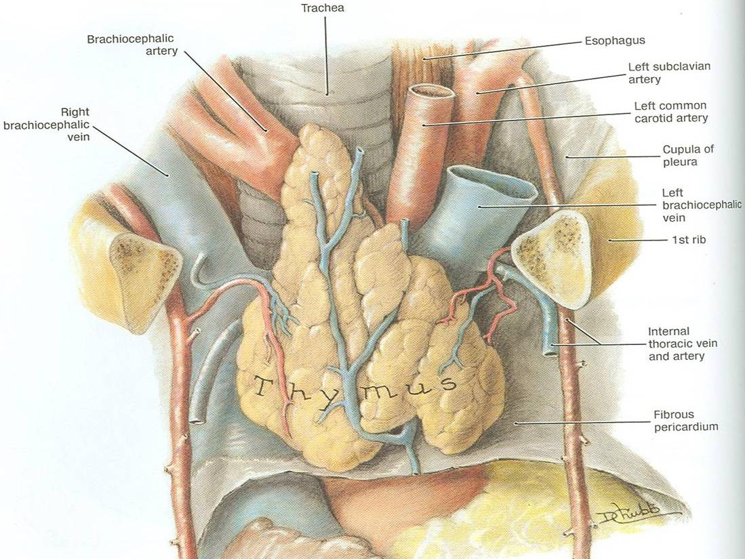
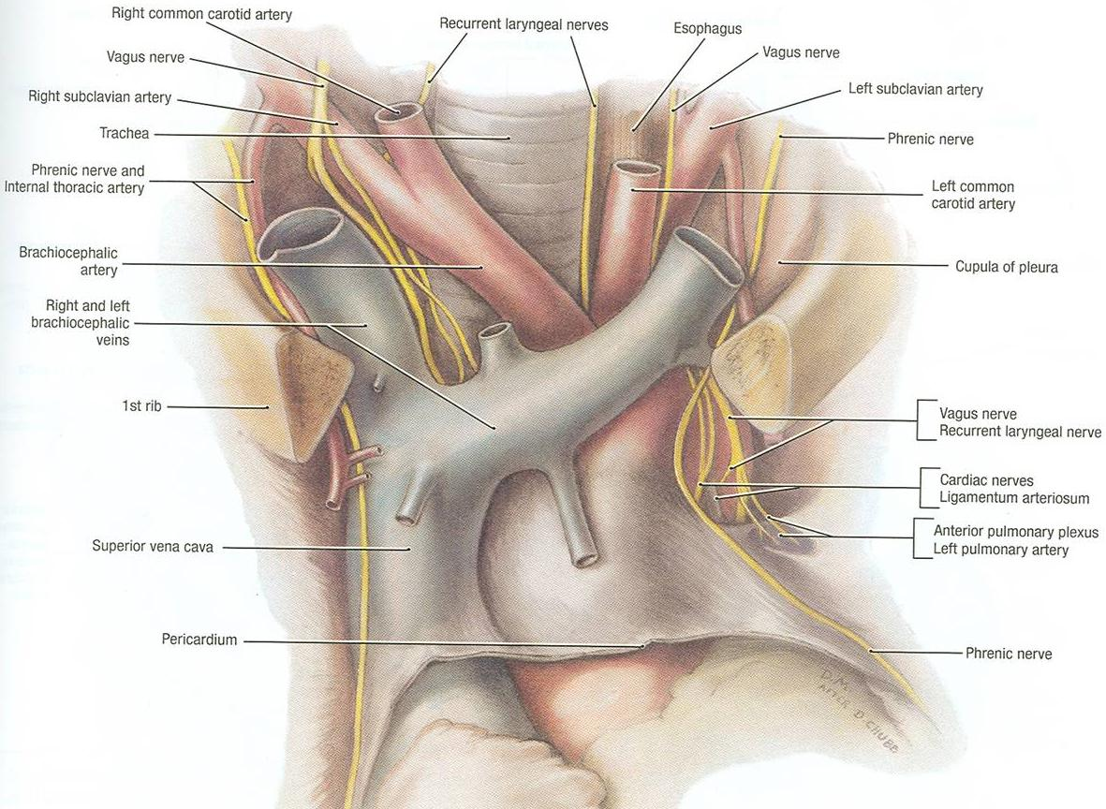
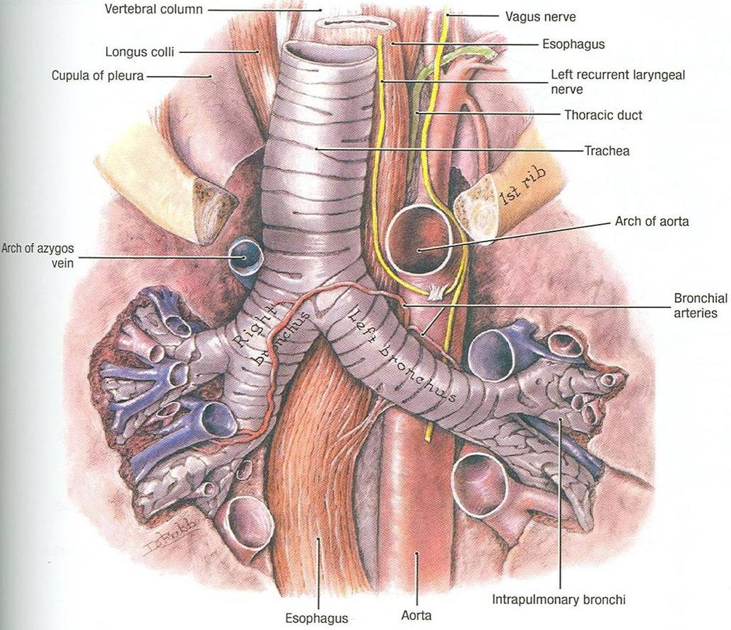
CONTENTS OF SUPERIOR MEDIASTINUM
c
b
a
A
A
B
FROM SUPERFICIAL TO DEEP:
Thymus gland
Veins:
-Right & left brachiocephalic
-Superior vena cava
Arteries:
-Arch of aorta (A) & its branches
a-Brachiocephalic artery
b-Left common carotid
c-Left subclavian
Nerves:
- Right & left vagus
-Right & left phrenic
5. Trachea
6. Esophagus
7. Thoracic duct
8. Lymph nodes
C

Slide 9
CONTENTS OF SUPERIOR MEDIASTINUM
4 ARTERIES: arch of aorta, brachiocephalic, left common carotid, left subclavian
4 NERVES: right & left vagus, right & left phrenic
3 VEINS: right & left brachiocephalic, SVC
2 TUBES: trachea & esophagus
1 GLAND: thymus
1 DUCT: thoracic duct

Slide 10
BOUNDARIES OF POSTERIOR MEDIASTINUM
Superior: Horizontal plane
Inferior: Diaphragm
Anterior: Heart
Posterior: Thoracic vertebrae from T5 to T12
Lateral: Lungs & pleurae

Slide 11
CONTENTS OF POSTERIOR MEDIASTINUM
Esophagus
Vagus nerves: around esophagus
Thoracic duct: posterior to esophagus
Azygos vein: posterior & to the right of esophagus
Descending aorta: posterior & to the left of esophagus
Right & left sympathetic trunks
Lymph nodes

Slide 12
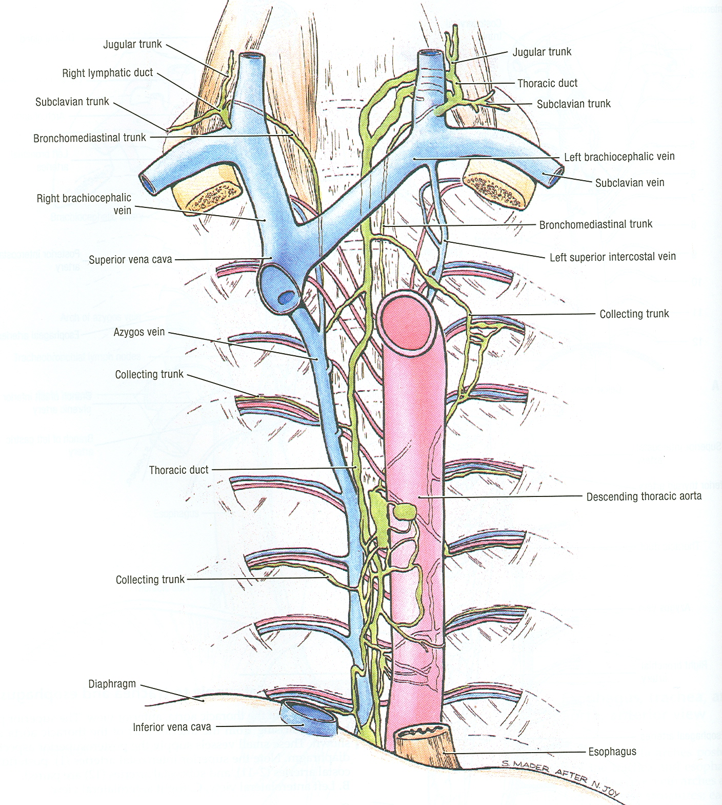
CONTENTS OF POSTERIOR MEDIASTINUM
E
S
O
P
H
A
G
U
S
Right & left
Vagus nerves
(esophageal plexus)
Right
Sympathetic
Trunk
Left
Sympathetic
Trunk

Slide 13
MIDDLE MEDIASTINUM
SITE:
Between anterior & posterior mediastinum
CONTENTS:
Heart & pericardium
Ascending Aorta
Pulmonary trunk
Superior & inferior vena cava
Right & left pulmonary veins
Right & left phrenic nerves
Lymph nodes
Left
Pulmonary
veins
Right
Pulmonary veins
Left
Phrenic
nerve
Right
Phrenic nerve
Heart
Diaphragm
Inferior
vena cava

Slide 14
ANTERIOR MEDIASTINUM
BOUNDARIES:
Superior: Horizontal plane
Inferior: Diaphragm
Anterior: Body & xiphoid process of sternum
Posterior: Heart
Lateral: Lungs & pleurae
CONTENTS:
Thymus gland
Lymph nodes

Slide 15
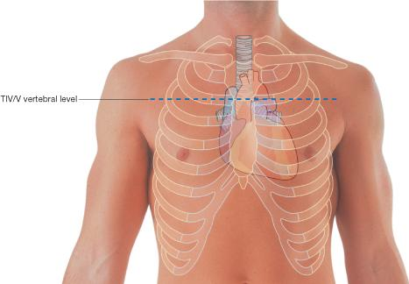
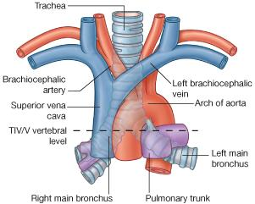
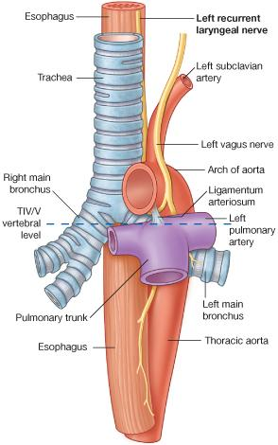
LEVEL OF T4
Level of:
Sternal angle
Second costal cartilage
Level of:
Bifurcation of trachea
Bifurcation of pulmonary
trunk
Beginning & termination of
arch of aorta

Slide 16
VAGUS NERVE
It is the 10th cranial nerve.
The right vagus descends to the right side of trachea, forms the posterior esophageal plexus & continues in abdomen as posterior gastric nerve.
The left vagus descends between left common carotid & left subclavian arteries, forms the anterior esophageal plexus & continues in abdomen as anterior gastric nerve.
Left common carotid
Left subclavian

Slide 17
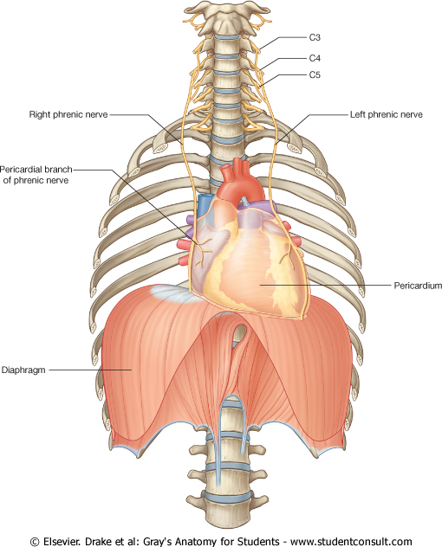
PHRENIC NERVE
ROOT VALUE:
C3,4,5
COURSE IN THORAX:
The right phrenic descends on the right side of SVC & heart.
The left phrenic descends on the left side of heart.
Both nerves terminate in the diaphragm
SUPPLY:
1) Motor & sensory fibers to diaphragm
2) Sensory fibers to pleurae & pericardium

Slide 18
LYMPHATIC VESSELS IN THORAX
Lymph form right
side of head & neck
Lymph from left
side of head & neck
Lymph from
right upper limb
Lymph from left
upper limb
end
end
Lymph from right
side of thorax
Lymph from left
side of thorax
Superior
Mediastinum
E
S
O
P
H
A
G
U
S
Posterior
Mediastinum
Cysterna chyli
(contains lymph from lower half of body)

Slide 19
THORACIC DUCT
BEGINNING:
It is the continuation of cysterna chyli.
COURSE:
It passes through aortic opening of diaphragm.
It ascends in posterior mediastinum (posterior to esophagus).
It ascends in superior mediastinum (to the left of esophagus).
TRIBUTARIES: It receives:
Lymphatics from all body EXCEPT: right side of thorax, right upper limb & right side of head & neck.
END:
It ends in the left brachiocephalic vein.

Slide 20
AORTA
ASCENDING AORTA:
Beginning: at aortic orifice of left ventricle.
Course: in middle mediastinum
End: continues as arch of aorta (at level of T4)
ARCH OF AORTA:
Course: in superior mediastinum
End: continues as descending thoracic aorta (at level of T4)
DESCENDING AORTA:
Course: in posterior mediastinum
End: continues as abdominal aorta through diaphragm
Arch
Asc.
Ao.
Descending aorta

Slide 21
QUESTIONS

Slide 22
QUESTION 1
Which one of the following structures is present in the superior mediastinum?
Ascending aorta
Arch of aorta
Descending aorta
Pulmonary trunk

Slide 23
QUESTION 2
Which one of the following structures is present in both superior & posterior mediastinum?
Superior vena cava
Pulmonary trunk
Trachea
Esophagus

Slide 24
QUESTION 3
Which one of the following structures lies on the left side of esophagus in the posterior mediastinum?
Superior vena cava
Descending aorta
Azygos vein
Pulmonary trunk

Slide 25
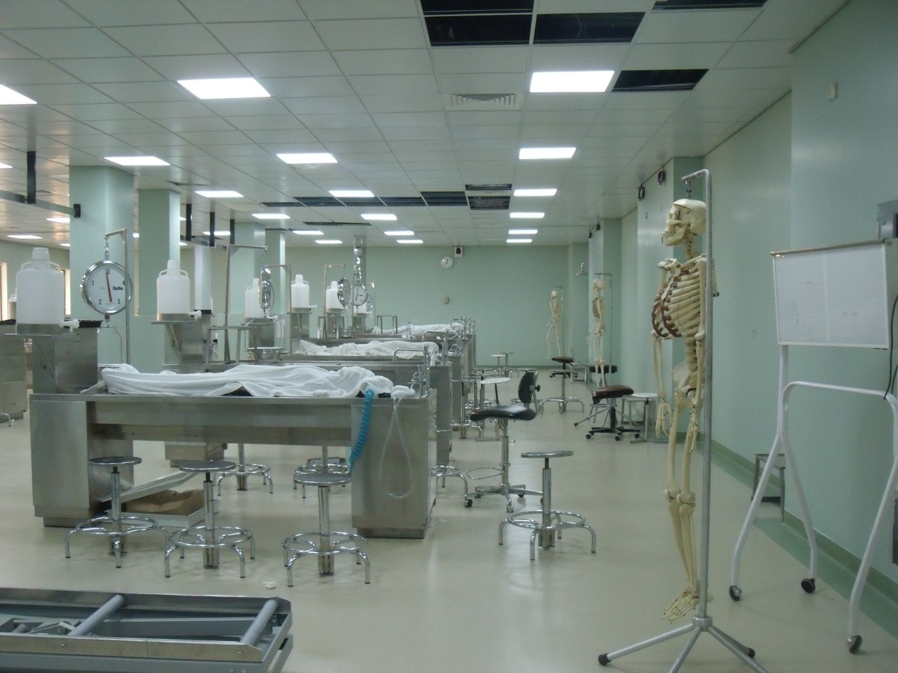
THANK YOU

