Slide 1
Mycobacterium Tuberculosis
Ali M Somily MD
King Saud University, College of Medicine

Slide 2
Objectives
Recognize that tuberculosis as a chronic disease mainly affecting the respiratory system.
Know the epidemiology of tuberculosis world wide and in the kingdom of Saudi Arabia
Understand the methods of transmission of tuberculosis and the people at risk.
Know the causative agents and their characteristic and classification and methods of detection.
Understand the pathogenesis of tuberculosis.

Slide 3
Objectives
Differentiate between primary and secondary tuberculosis and the clinical features of each.
Understand the method of tuberculin skin test and result interpretation.
Know the laboratory and radiological diagnostic methods.
Know the chemotherapeutic and other methods of management of tuberculosis cases.
Describe the methods of prevention and control of tuberculosis.

Slide 4
Introduction
Tuberculosis (TB) is an ancient, chronic disease affects humans, caused by Mycobacterium tuberculosis complex.
A major cause of death worldwide.
Usually affects the lungs, other organs can be affected in one third of cases.
If properly treated is curable, but fatal if untreated in most cases.

Slide 5
Epidemiology
TB affects 1/3 of human race ( 2 billions) as a latent dormant tuberculosis.
Incidence: a world wide disease, more common in developing countries.
Affects all age groups who are subject to get the infection.
The WHO estimated 8.9 million new cases in 2004 & million death.
Incidence :
  KSA : 32-64 cases /100,000
  USA : 5.2 cases/100,000
  South Ease Africa : 290 cases /10,000 due to coupling with HIV infection.

Slide 6
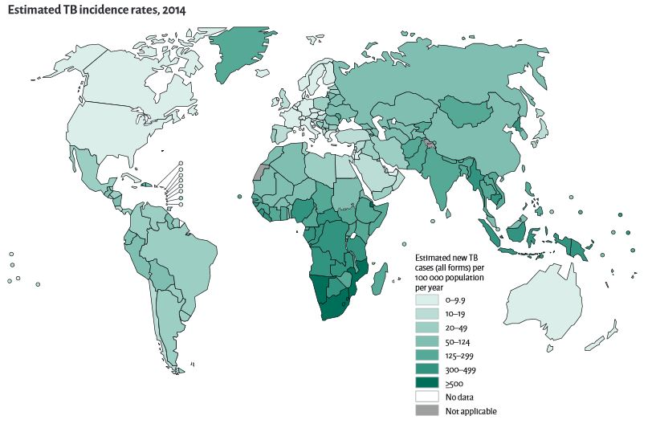
Estimated TB Incident Rate in 2014

Slide 7
Epidemiology
Transmission mainly through inhalation of airborne droplet nuclei ( < 5 μm) in pulmonary diseases case, rarely through GIT & skin
Reservoir: patients with open TB.
Age: young children & adults
People at risk : lab. technicians, workers in mines, doctors, nurses.
HIV pts., diabetics end stage renal failure, contacts with index case.

Slide 8
Characteristics of the Genus Mycobacteria
Slim, rod shaped, non-motile, do not form spores.
Do not stain by Gram stain. Why ?
Contain high lipid conc. ( Mycolic acid ) in the cell wall which resist staining.
It is called Acid- alcohol fast bacili (AFB), Why ? It resists de-colorization with up to 3% HCL, 5%ethanol or both.

Slide 9
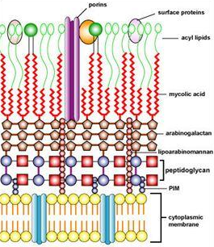
Mycobacterium Cell Wall Structure

Slide 10
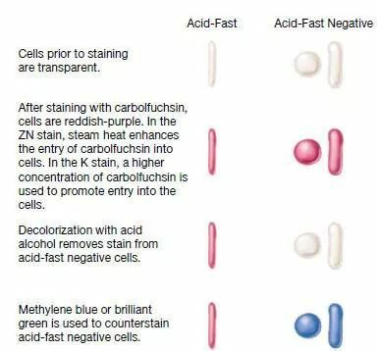
Acid Fast Stain

Slide 11
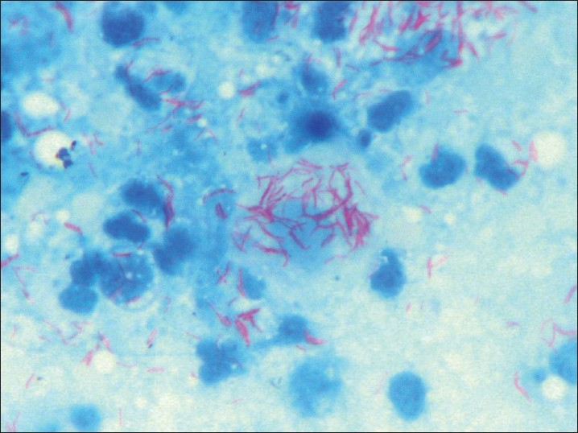
Acid- alcohol fast bacili

Slide 12
Acid-Fast Bacilli (AFB)
Stain used : Ziehl-Neelsen stain (ZN stain)
Strict aerobe
Multiply intracellularily
Delayed hypersensitivity reaction type of immune response
Slowly growing ( wks.)

Slide 13
Mycobacterium tuberculosis complex
1- M.tuberculosis (Human type)
2- M. bovis (Bovine type)
3- M. Africanum
4- BCG strains All are called Mycobacterium tuberculosis Complex and cause tuberculosis ( TB).

Slide 14
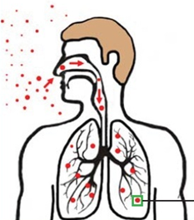
Pathogenesis of Tuberculosis
Mycobacteria acquired by airborne droplet reaches the alveolar macrophages, able to survive their ( main virulence factor).
This starts cell mediated immune response which controls the multiplication of the organism but does not kill it.
Granuloma formed, organism lives in dormant state ( latent tuberculosis infection)

Slide 15
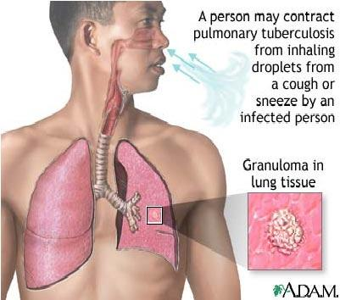
Pathogenesis of Tuberculosis
Patient show evidence of delayed cell mediated immunity ( CMI ).
Disease results due to destructive effect of CMI.
Clinically the disease is divided into primary or secondary.
Primary Tuberculosis occurs in patients not previously infected.
Inhalation of bacilli
Phagocytosis lymph nodes calcify to produce GHON focus (or Primary Complex) at the periphery of mid zone of lung.

Slide 16
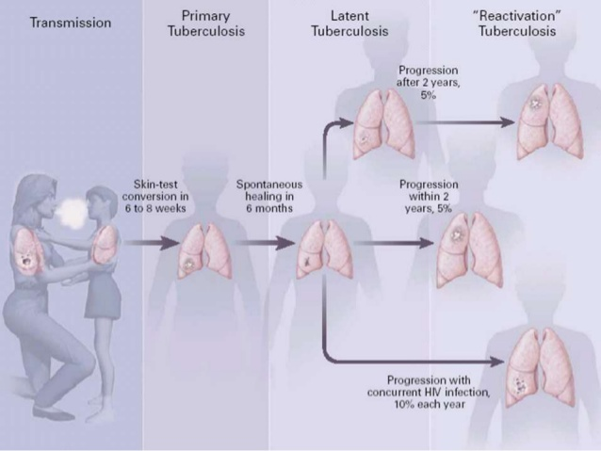
Stages of Tuberculosis

Slide 17
Histopathology
Micrographs of tissue specimens from patients with tuberculosis Low-power micrograph (×100) of a haematoxylin and eosin stained tissue section
from an immunocompetent patient with tuberculosis that shows a well formed tuberculous granuloma with a central area of caseous necrosis surrounded by epithelioid macrophages, giant cells, and T lymphocytes, and surrounding outer fibrosis (A). Medium-power (×250) micrograph of tissue from a patient infected with HIV with advanced immunodeficiency that shows mononuclear infiltrate but absence of granuloma formation (B). High-power (×400) tissue section from the same specimen from the patient with advanced immunodeficiency with Ziehl-Neelsen staining showing numerous acid-fast bacilli with little evidence of a cellular immune host response (C). Micrographs provided by Colleen Wright, Stellenbosch University, South Africa.

Slide 18
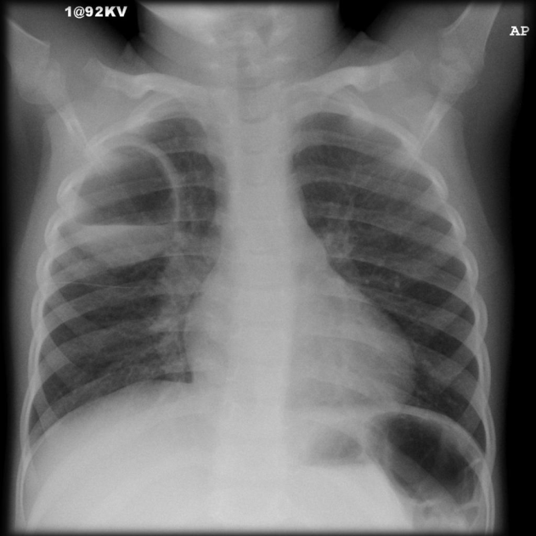
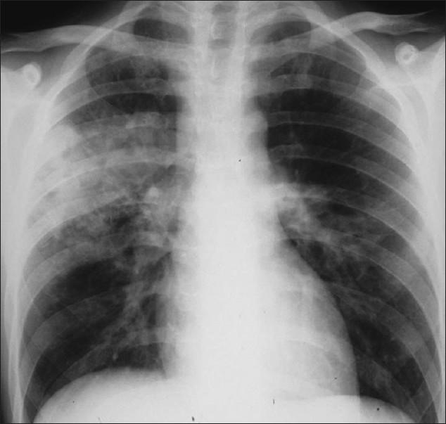
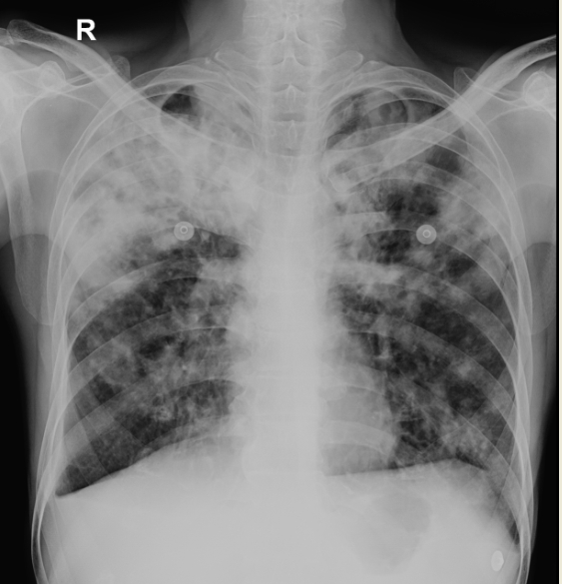
Radiology

Slide 19
Primary Tuberculosis
Genitourinary TB
Miliary TB (blood and other organs)
Soft tissue (cold abscess): lack of inflammation with caseation.
Caseation: due to delayed hypersensitivity reaction.
Contains many bacilli, enzymes, O 2,N 2 intermediates, necrotic center of granuloma cheezy material.

Slide 20
Secondary TB (reactivation)
Occurs later in life
Lung more common site
Immunocompromised patients.
Lesion localized in apices
Infectious & symptomatic
Microscopy: many bacilli, large area of caseous necrosis cavity (open TB) with granuloma and caseation.

Slide 21
Secondary TB
Clinically: fever, cough, hemoptysis, weight loss & weakness.
Source of secondary TB : -
  Endogenous (reactivation of an old TB)
  or
  Exogenous (re-infection in a previously sensitized patient who has previous infection with the organism).

Slide 22
Immunity to Tuberculosis
Cell-mediated immunity associated with delayed hypersensitivity reaction.
Detected by tuberculin skin test.
Tuberculin test takes 2-10 weeks to react to tuberculin and becomes positive.

Slide 23
Tuberculin Skin Test
Uses purified protein derivative (PPD).
Activity expressed by Tuberculin unit.
Activates synthesized lymphocytes to produce CMI which appear as skin induration.
May not distinguish between active and past infection except in an individual with recent contact with infected case.
Low level activity induced by environmental mycobacteria, previous vaccination.

Slide 24
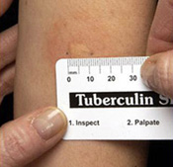
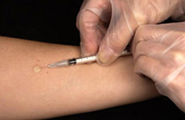
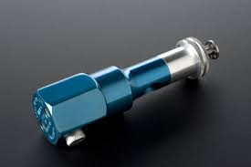
Methods of Tuberculin Skin Test
Intradermal inoculation of 0.1 ml of PPD, 5TU.
Read after 48-72hrs.
Methods of tuberculin skin test :
  1- Mantoux test.
  2- Heaf test (screening).

Slide 25
Positive Tuberculin Skin Test
1- >5mm induration positive in :
  Recent contact with active TB.
  HIV or high risk for HIV
  Chest X-ray consistent with healed TB.
2- > 10mm induration positive in:
  IV drugs user
  HIV seronegative patient.
  Medical conditions eg. diabetes, malignancy.
  Residents & employee at high risk
  Patients from country with high incidence.
  Children < 4yrs or exposed to adult high risk group.
  Mycobacteriology lab. personnel.

Slide 26
Positive Tuberculin Test
3- >15 mm induration positive in : ▪ any persons including those with no risk factors for TB.

Slide 27
Negative Tuberculin Skin Test
No induration, either due to:
No previous infection
Pre-hypersensitivity stage
Lost TB sensitivity with loss of antigen.
AIDS patients are anergic and susceptible to infection.

Slide 28
Laboratory Diagnosis of TB
1- Specimens:
Pulmonary TB: 3 early morning sputum samples ( or induced cough),or bronchial lavage, or gastric washing (infants),…etc.
Cerebrospinal fluid ( CSF) ( TB meningitis)
3 early morning urine
Bone, joint aspirate
Lymph nodes, pus or tissues NOT swab.
Repeat sample.

Slide 29
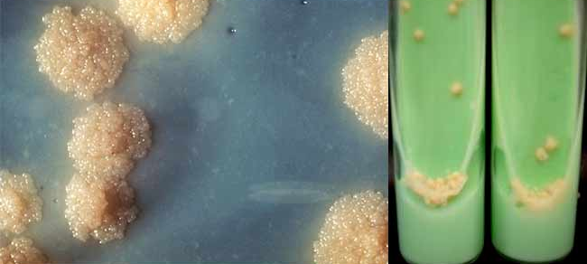
Laboratory Diagnosis of TB
2- Direct microscopy of specimen :
Z-N or (Auramine ) stain.
3- Culture: the gold standard test for identification and sensitivity.
Media used: Lowenstein-Jensen media (L J).
Media contains: eggs, asparagin, glycerol, pyruvate/ malachite green.

Slide 30
Laboratory Diagnosis of TB
Colonies appear in LJ media after 2-8 weeks as eugenic, raised, buff, adherent growth enhanced by glycerol (MTB) or by pyruvate (M.bovis).
Other media plus LJ media may be used:
Fluid media (middle Brook)
MGIT ( mycobacteria growth indicator test )
Automated methods :- eg. Bactec MGIT.
Measurement of interferon –gamma ( IF-γ) secreted from sensitized lymphocytes challenged by the same mycobacterial proteins in a patient previously exposed to disease, will produce interferon gamma. Has a specific significance than tuberculin skin test.
PCR: molecular test directly from specimen (CSF).

Slide 31
Identification
Morphology, growth at 37C % CO 2
Biochemical tests : Niacin production & Nitrate test.
Sensitivity testing
Guinea pig inoculation: rarely done.

Slide 32
Management of a TB case
1- Isolation for days ( for smear positive cases i.e. > 1000 organisms / ml of sputum considered infectious case ).
  Triple regimen of therapy.Why ?
  To prevent resistant mutants
  To cover strains located at different sites of the lung.
  To prevent relapse
2- Treatment must be guided by sensitivity testing.

Slide 33
First Line Treatment
Isoniazide (INH)
Rifampicin (RIF)
Ethmbutol (E)
Pyrazinamide (P)
Streptomycin (S) INH+ RIF +P for 2 months then continue with INH+RIF for 4-6 months.
Multidrug resistant TB is resistance to INH & RIF.
Directly Observed Therapy (DOT).

Slide 34
Second Line
Second Line Used if the bacteria was resistant to first line drugs.
More toxic than the first line drugs.
PASA ( Para-Amino Salicylic acid)
Ethionamide
Cycloserine,
Kanamycin,
Fluroquiolones

Slide 35
Prevention of TB
Tuberculin testing of herds.
Slaughter of infected animals.
Pasteurization of milk to prevent bovine TB
Recognition of new cases.
Prophylaxis with INH of contacts.
Follow up cases.
Immunization with BCG to all new borne.

