Slide 1
Pneumonia
Community acquired pneumonia
(CAP)

Slide 2
Definition
Pneumonia is acute infection leads to inflammation of the parenchyma of the lung (the alveoli) (consolidation and exudation)
It may present as acute, fulminant clinical disease or as chronic disease with a more protracted course
The histologically
Fibrinopurulent alveolar exudate seen in acute bacterial pneumonias.
Mononuclear interstitial infiltrates in viral and other atypical pneumonias
Granulomas and cavitation seen in chronic pneumonias

Slide 3
Epidemiology
Overall the rate of CAP 5-6 cases per 1000 persons per year
Mortality 23%
Pneumonia are high especially in old people
Almost 1 million annual episodes of CAP in adults > 65 yrs in the US
Risk factors
Age < 2 yrs, > 65 yrs
alcoholism
smoking
Asthma and COPD
Aspiration
Dementia
prior influenza
HIV
Immunosuppression
Institutionalization
Recent hotel : Legionella
Travel, pets, occupational exposures- birds(C- psittaci )

Slide 4
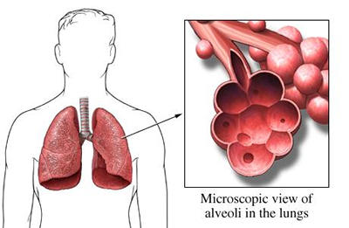
Etiological agents
• Bacterial
Fungal
Viral
Parasitic
Other non-infectious factors like
Chemical
Allergen

Slide 5
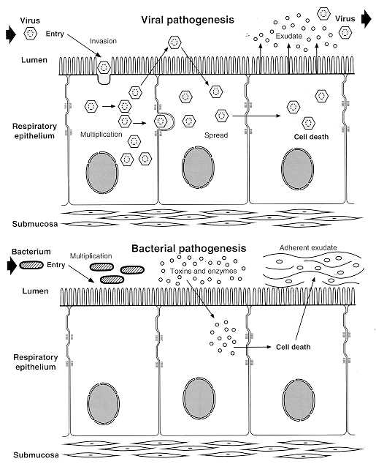
Pathogenesis
Two factors involved in the formation of pneumonia
Pathogens
Host defenses.

Slide 6
Defense mechanism of respiratory tract
Filtration and deposition of environmental pathogens in the upper airways
Cough reflux
Mucociliary clearance
Alveolar macrophages
Humoral and cellular immunity
Oxidative metabolism of neutrophils

Slide 7
Pathophysiology :
Inhalation or aspiration of pulmonary pathogenic organisms into a lung segment or lobe.
Results from secondary bacteraemia from a distant source, such as Escherichia coli urinary tract infection and/or bacteraemia(less commonly).
Aspiration of Oropharyngeal contents (multiple pathogens).

Slide 8
Classification
Bacterial pneumonia classified according to:
Pathogen-(most useful-choose antimicrobial agents)
Anatomy
Acquired environment
Typical pneumonia
Gram-positive bacteria as
Streptococcus pneumoniae is the most common cause of typical pneumonia
Staphylococcus aureus
Group A hemolytic streptococci
2. Gram-negative bacteria
- Klebsiella pneumoniae
- Hemophilus influenzae
- Moraxella catarrhal
- Escherichia coli
3. Anaerobic bacteria

Slide 9
Atypical pneumonia
Legionnaies pneumonia
Mycoplasma pneumonia
Chlamydophila pneumonia
Chlamydophila Psittaci
Rickettsias
Francisella tularensis (tularemia),
Fungal pneumonia
Candida
Aspergilosis
Pneumocystis jirvocii (carnii) PCP
Viral pneumonia
the most common cause of pneumonia in children < than 5 years
-Respiratory syncytial virus
Influenza virus
Adenoviruses
Human metapneumovirus
SARS and MERS CoV
- Cytomegalovirus
- Herpes simplex virus
Pneumonia caused by other pathogen
Parasites
- protozoa

Slide 10
CAP and bioterrorism agents
Bacillus anthracis (anthrax)
Yersinia pestis (plague)
Francisella tularensis (tularemia)
Coxialla . burnetii (Q fever)
Level three agents

Slide 11
Classification by anatomy
1. Lobar: entire lobe
2. Lobular: (bronchopneumonia).
3. Interstitial

Slide 12
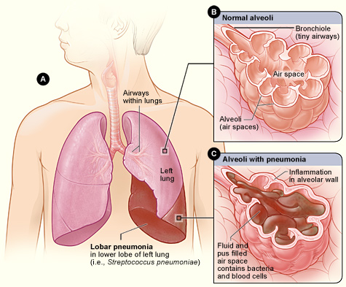
Lobar pneumonia

Slide 13
Classification by acquired environment
Community acquired pneumonia (CAP)
Hospital acquired pneumonia (HAP)
Nursing home acquired pneumonia (NHAP)
Immunocompromised host pneumonia (ICAP)

Slide 14
Outpatient | Streptococcus pneumoniae Mycoplasma / Chlamydophila H. influenzae, Staph aureus Respiratory viruses
Inpatient, non-ICU | Streptococcus pneumoniae Mycoplasma / Chlamydophila H. influenzae, Staph aureus Legionella Respiratory viruses
ICU | Streptococcus pneumoniae Staph aureus, Legionella Gram neg bacilli(Enterobacteriaceae, and Pseudomonas aeruginosa), H. influenzae

Slide 15
CAP- Cough/fever/sputum production + infiltrate
CAP : pneumonia acquired outside of hospitals or extended-care facilities for > 14 days before onset of symptoms.
Streptococcus pneumoniae (most common)
Haemophilus influenzae
mycoplasma pneumoniae
Chlamydia pneumoniae
Moraxella catarrhalis
Staph.aureus
Drug resistance streptococcus pneumoniae(DRSP) is a major concern.

Slide 16
Classifications
Typical
Atypical
Typical pneumonia usually is caused by bacteria
Strept. Pneumoniae
(lobar pneumonia)
Haemophilus influenzae
Gram-negative organisms
Moraxella catarrhalis
S. aureus
Atypical’: not detectable on gram stain; won’t grow on standard media
Mycoplasma pneumoniae
Chlamydophilla pneumoniae
Legionella pneumophila
Influenza virus
Adenovirus
TB
Fungi

Slide 17
Community acquired pneumonia
Strep pneumonia 48%
Viral 23%
Atypical orgs(MP,LG,CP) 22%
Haemophilus influenza 7%
Moraxella catharralis 2%
Staph aureus 1.5%
Gram –ive orgs 1.4%
Anaerobes

Slide 18
Clinical manifestation lobar pneumonia
The onset is acute
Prior viral upper respiratory infection
Respiratory symptoms
Fever
Shaking chills
Cough with sputum production (rusty-sputum)
Chest pain- or pleurisy
Shortness of breath

Slide 19
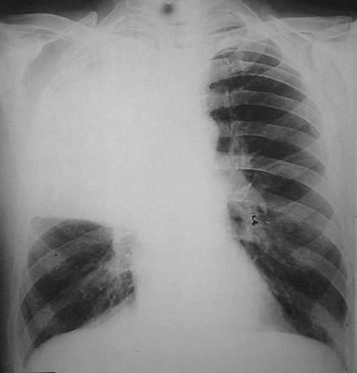
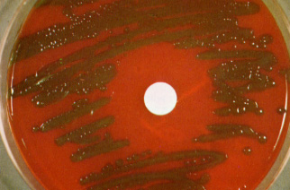
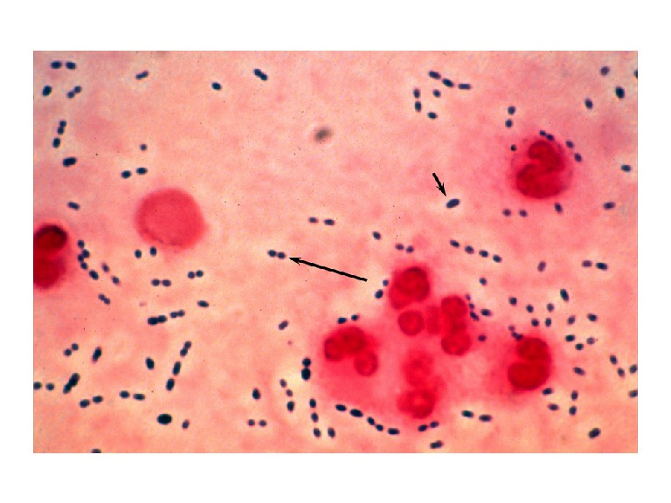
Diagnosis
Clinical
History & physical
X-ray examination
Laboratory
CBC- leukocytosis
Sputum Gram stain- 15%
Blood culture- 5-14%
Pleural effusion culture
Pneumococcal pneumonia

Slide 20
 | PCN Minimum Inhibitory Concentration (MIC) mcg/mL to Streptococcus Pneumonmoniae:
 | Susceptible | Intermediate | Resistant
2011CAP Guidelines | MIC <2 | 4 | MIC > 0.12
Meningitis | MIC <0.06 | --- | MIC >0.12
Pneumococcal CAP: Be cautious if using PCN if MIC >4. Avoid using PCN if MIC >8.
Remember that if MIC <1, pneumococcus is PCN-sensitive in sputum or blood (but need MIC <0.06 for PCN-sensitivity in CSF).
MIC Interpretive Standards for S. pneumoniae. Clinical Laboratory Standards Institute (CLSI) 2011; 28:123.

Slide 21
Drug Resistant Strep Pneumoniae
40% of U.S. Strep pneumo CAP has some antibiotic resistance:
PCN, cephalosporins, macrolides, tetracyclines, clindamycin, bactrim, quinolones
All MDR strains are sensitive to vancomycin or linezolid; most are sensitive to respiratory quinolones
For Pneumonia, pneumococcal resistance to β-lactams is relative and can usually be overcome by increasing β-lactam doses (not for meningitis!)

Slide 22
Atypical pneumonia
Chlamydia pneumonia
Mycoplasma pneumonia
Legionella spp
Psittacosis (parrots)
Q fever (Coxiella burnettii)
Viral (Influenza, Adenovirus)
AIDS
PCP
TB (M. intracellulare)
Approximately 15% of all CAP
Not detectable on gram stain
Won’t grow on standard media
Often extrapulmonary manifestations:
Mycoplasma: otitis, nonexudative pharyngitis, watery diarrhea, erythema multiforme, increased cold agglutinin titre
Chlamydophilla: laryngitis
Most don’t have a bacterial cell wall→ Don’t respond to β-lactams
Therapy: macrolides, tetracyclines, quinolones (intracellular penetration, interfere with bacterial protein synthesis)

Slide 23
Mycoplasma pneumonia
Eaton agent (1944)
No cell wall
Common
Rare in children and in > 65
People younger than 40.
Crowded places like schools, homeless shelters, prisons.
Mortality rate 1.4%
Usually mild and responds well to antibiotics.
Can be very serious
May be associated with a skin rash, hemolysis, myocarditis or pancreatitis
Notes:
Associated with M.E. in some literature

Slide 24
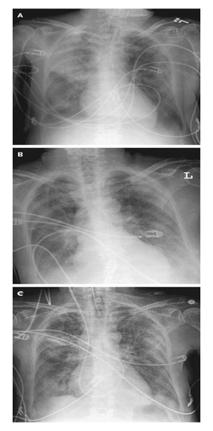
Mycoplasma pneumonia Cx-ray

Slide 25
Chlamydia pneumonia
Obligate intracellular organism
50% of adults sero-positive
Mild disease
Sub clinical infections common
5-10% of community acquired pneumonia

Slide 26
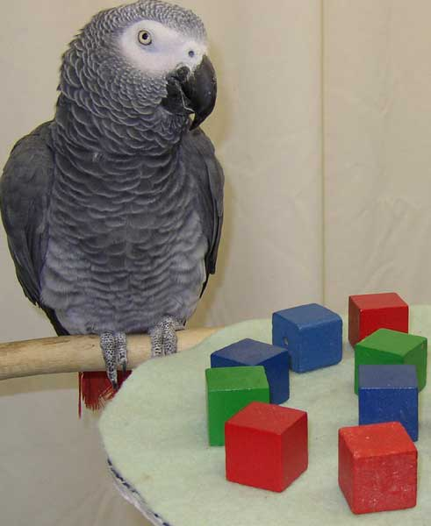
Psittacosis
Chlamydophila psittaci
Exposure to birds
Bird owners, pet shop employees, vets
Parrots, pigeons and poultry
Birds often asymptomatic
1st: Tetracycline
Alt: Macrolide

Slide 27
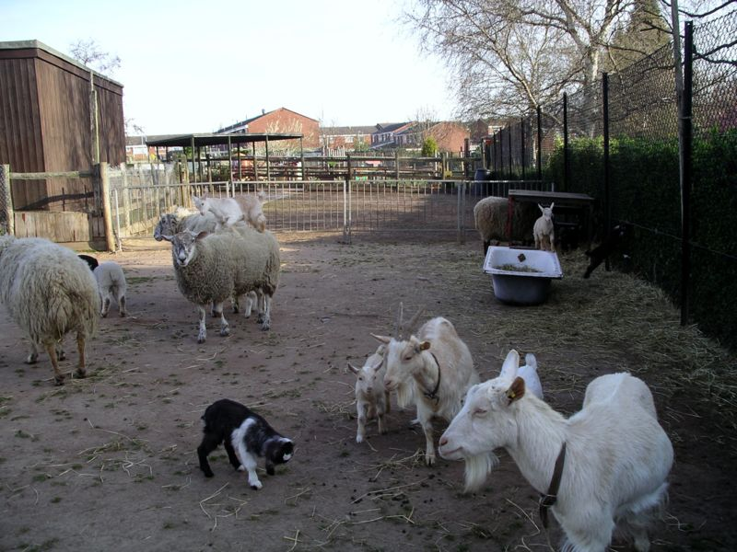
Q fever
Coxiella burnetti
Exposure to farm animals mainly sheep
1st: Tetracycline, 2nd: Macrolide

Slide 28
Legionella pneumophila
Legionnaire's disease.
Serious outbreaks linked to exposure to cooling towers
ICU admissions.
Hyponatraemia common
(<130mMol)
Bradycardia
WBC < 15,000
Abnormal LFTs
Raised CPK
Acute Renal failure
Positive urinary antigen

Slide 29
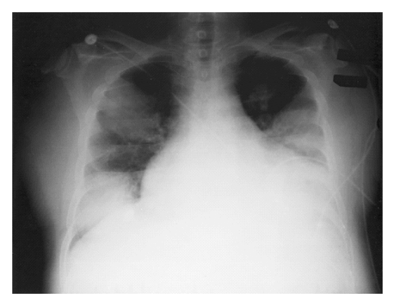
Legionnaires on ICU

Slide 30
Symptoms
Signs
Insidious onset
Mild URTI to severe pneumonia
Headache
Malaise
Fever
Dry cough
Arthralgia / myalgia
Minimal
Few crackles
Rhonchi
Low grade fever

Slide 31
Diagnosis & Treatment
CBC
Mild elevation WBC
U&Es
Low serum Na (Legionalla)
Deranged LFTS
↑ ALT
↑ Alk Phos
Culture on special media BCYE
Cold agglutinins (Mycoplasma)
Serology
DNA detection
Macrolide
Rifampicicn
Quinolones
Tetracycline
Treat for 10-14 days
(21 in immunosupressed)

Slide 32
Differential diagnosis
Pulmonary tuberculosis
Lung cancer
Acute lung abecess
Pulmonary embolism
Noninfectious pulmonary infiltration

Slide 33
Evaluate the severity & degree of pneumonia
Is the patient will require hospital admission?
Patient characteristics
Co-morbid illness
Physical examinations
Basic laboratory findings

Slide 34
The diagnostic standard of sever pneumonia (Do not memorize)
Altered mental status
Pa02<60mmHg. PaO2/FiO2<300, needing MV
Respiratory rate>30/min
Blood pressure<90/60mmHg
Chest X-ray shows that bilateral infiltration, multilobar infiltration and the infiltrations enlarge more than 50% within 48h.
Renal function: U<20ml/h, and <80ml/4h

Slide 35
Patient Management
Outpatient, healthy patient with no exposure to antibiotics in the last 3 months
Outpatient, patient with comorbidity or exposure to antibiotics in the last 3 months
Inpatient : Not ICU
Inpatient : ICU

Slide 36
Antibiotic Treatment
Macrolide: Azithromycin, Clarithromycin
Doxycycline
Beta Lactam :Amoxicillin/clavulinic acid, Cefuroxime
Respiratory Flouroquinolone:Gatifloxacin, Levofloxacin or Moxifloxacin
Antipeudomonas Beta lactam: Cetazidime
Antipneumococcal Beta lactam :Cefotaxime

Slide 37
 |  | Macrolides | Doxycycline | Levofloxacin | B-lactam And Macrolide | B-lactam And Levo
Outpatient, healthy patient with no exposure to antibiotics in the last 3 months | S pneumoniaes, M pneumoniae, Viral
Outpatient, patient with comorbidity or exposure to antibiotics in the last 3 months | S pneumoniaes, M pneumoniae, C. pneumoniae, H influenzae M.catarrhalis anaerobes S aureus
Inpatient : Not ICU | Same as above +legionella
Inpatient : ICU | Same as above + Pseudomonas

