Slide 1
Treatment of Acute and Chronic Rhinitis and Cough

Slide 2
Learning objectives:
1. Definition of rhinitis and cough
2. To understand pharmacology of different drug group
used in the treatment as, Antihistamines, leukotriene
antagonists, corticosteroids, decongestants and
anticholinergics.
3. An overview of the pharmacology of different
expectorants and mucolytics used in the treatment of
productive cough.
4. To understand pharmacology of antitussives(cough
suppressants)

Slide 3
Rhinitis:
Rhinitis is the irritation and/or inflammation of the
mucous membranes inside the nose.
Types: 1. Allergic(seasonal, perennial)
2. infectious( infection with bacteria ,fungi and
virus)
Rhinitis may be acute ( 7-14 days)
Rhinitis may be chronic( persistent more than 6
weeks)

Slide 4
Signs and symptoms of rhinitis:
Runny nose(Rhinorrhoea)
Sneezing
Nasal congestion/stuffy blocked nose
Post nasal drip
Systemic effects may be( fever, bodyache etc.).

Slide 5
Treatment of Rhinitis:
A. Preventive Therapy:
1. Environmental control
2. Allergen immunotherapy

Slide 6
B. Pharmacotherapy:
1. Anti histamines( H₁- Receptor antagonists)
2. Anti - allergics
a) Cromolyn sodium(mast cell stabilizer)
b) Leukotriene receptor antagonists(montelukast)
3. Corticosteroids
4. Decongestants ( alpha- adrenergic agonists)
5. Anticholinergics

Slide 7
6. Antibiotics( if bacterial infection occur).
what is histamine?
Histamine is a chemical messenger mostly generated
in mast cell that mediates a wide range of cellular
responses, including allergic and inflammatory
reactions, gastric acid secretion and
neurotransmission in parts of the brain.
Histasmine has no clinical application but
antihistamines have important therapeutic
applications.

Slide 8
1. Antihistamine (H_{I} –Receptor antagonists):
The term antihistamine, without modifying
objective, refers to the classic H₁ – receptor blockers.
These drugs do not interfere the formation or release
of histamine.
They block the receptor- mediated response of a
target tissue.

Slide 9
1- ANTIHISTAMINES
H₁ receptor blockers
CLASSIFICATION [Chemical / Functional] USES vs ADVERSE EFFECTS
First GENERATION Second GENERATION Third GENERATION
1) ALKYLAMINES Chlorpheniramine 2) ETHANOLAMINES Dimenhydrinate Diphenhydramine 3) ETHYLENEDIAMINES Antazoline` 4) PHENOTHIAZINES Promethazine 5) PIPERAZINE Cyclizine Cetirizine Levocetirizine
6) PIPERIDINES Azatidine Fexofenadine
Loratadine Desoloratadine
Ketotifen 7) MISCELLANEOUS Cyproheptadine
Short duration
Longer duration = better control
Interactions; with enzyme inhibitors
[ macrolides, antifungals, calcium antagonists]
+ additive pharmacodynamic ADRs
No drug interactions & minimal ADRs
All are used systemic or topical

Slide 10
The older first generation drugs still widely used because they are effective and inexpensive. These drugs penetrate the CNS and cause sedation. Furthermore, they tend to interact with other receptors, producing a variety of unwanted adverse effects.
Second generation agents are specific for H₁ receptors and they carry polar groups ,they do not penetrate the blood brain barrier causing less CNS depression.

Slide 11
Actions:
The action of all the H₁ receptor blocker is qualitatively similar.
they are much more effective in preventing symptoms than reversing them once they have occurred.
Most of these drugs have additional effects unrelated to their blocking H₁ receptors, which probably reflect binding of H₁ antagonists to cholinergic, adrenergic or serotonin receptors.

Slide 12
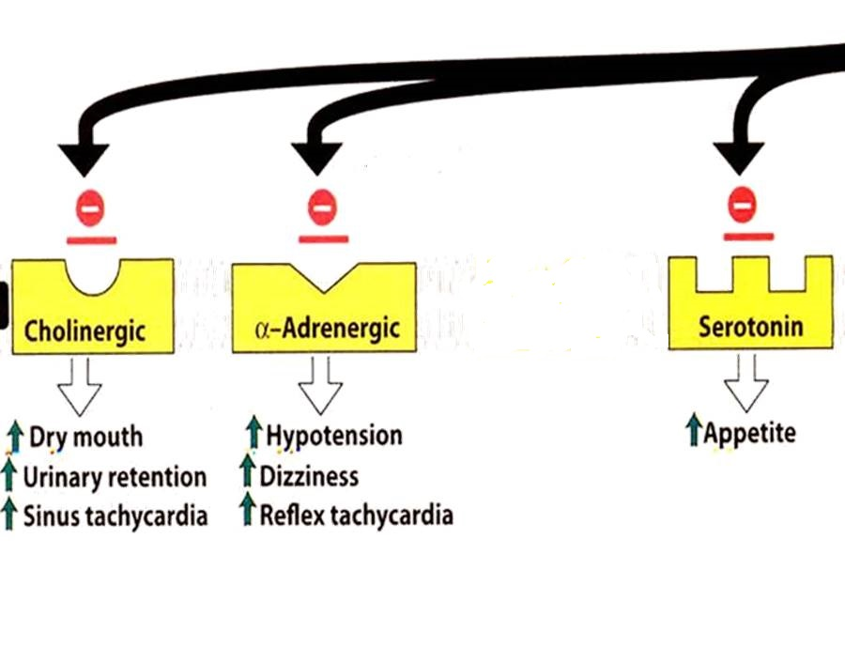
GOOD CONTROL of Rhinitis, Conjunctivitis, Urticaria, Flu (cough & sneezing)
ALLERGIES
POOR CONTROL of Asthma, Otitis, Anaphylaxis, Sinusitis, Atopic dermatitis
INDICATIONS linked to H1 block
ITCHING
Even if
non-allergic
INDICATIONS not linked to H1 block
ANTIHISTAMINES
Others
Insomnia
Sleep aid
Vertigo
Anxiety
Cough
Side Effects
Interactions
Side Effects
Interactions
Side Effects
Interactions

Slide 13
Therapeutic uses:
1.Allergic and inflammatory (allergic rhinitis, urticaria)
2. Motion sickness
3. Nausea and vomiting
;

Slide 14
Pharmacokinetics:
H₁ receptor blockers are well absorbed after oral administration
Maximum serum levels occurring at 1-2 hours
Average plasma half life is 4 to 6 hours
H₁- receptor blockers have high bioavailability and distributed all tissues including CNS.
metabolized by the hepatic cytochrome p450 system.
Excretion occur via kidney except fexofenadine excreted in feces unchanged.

Slide 15
Adverse effects:
1. sedation, tinnitus, fatigue, dizziness blurred vision
2. Dry mouth
Drug interaction: CNS depressants,
cholinesterase inhibitors
overdose: The most common and dangerous effects of acute poisoning are those on CNS, icluding hallucinations, excitement,ataxia and convulsions.

Slide 16
2-ANTI-ALLERGICS
CROMOLYN & NEDOCROMYL
◉ Histamine release [mast cell stabilizer by inhibiting Cl channels] i.e. can act only prophylactic; it does not antagonize released histamine
Used more in children for prophylaxis of perennial allergic rhinitis
Should be given on daily base and never stop abruptly.
Can induce cough, wheezes, headache, rash, …etc.
LEUKOTRIENE RECEPTOR ANTAGONISTS
Block leukotriene actions
For prophylaxis of lower respiratory [i.e perennial allergen, exercise or aspirin-induced asthma] > upper respiratory allergies [chronic rhinosinusitis]
ADRs; as in asthma
3-CORTICOSTERIODS
Anti-inflammatory blocks phospholipase A₂ 
arachedonic a. synthesis   prostaglandins & leukotrienes
Topical; steroid spray; beclomethasone, budesonide, & fluticasone
Given if severe intermittent or moderate persistent symptoms
ADRs; Nasal irritation, fungal infection, hoarseness of voice

Slide 17
4. DECONGESTANTS
α-Adrenergic agonists
For treatment of nasal stuffiness
SYSTEMIC
TOPICAL
PSEUDOEPHEDRINE
PHENYLETHYLAMINES
IMIDAZOLINE
Phenylephrine
Methoxamine
Naphazoline
Oxymetazoline HCI
Xylometazoline HCI
Can cause nervousness, insomnia, tremors, palpitations, hypertension.
Better avoided in hypertension, heart failure, angina pectoris, hyperthyroidism,glaucoma
But can cause Rebound nasal stuffiness (repeated administration (10 days -2 weeks)
5. ANTICHOLINERGICS
Ipratropium
Given as nasal drops to control rhinorrhea (excess nasal secretion & discharge) So very effective in vasomotor rhinitis (watery hyper-secretion).
Its indication as bronchiodilator in asthma and ADRs  see asthma

Slide 18
Effectiveness of different drug groups in controlling symptoms of RHINITIS
Drug Groups | Main Symptom
 | Sneezing | Blockage Stuffiness | Secretions Rhinorrhea
Anti-histamines | ++ | - | +
Anti-allergics (cromolyns) | + | + | +
Topical corticosteroids | ++ | ++ | ++
Decongestant | - | ++ | -
Anticholinergics | - | - | ++

Slide 19
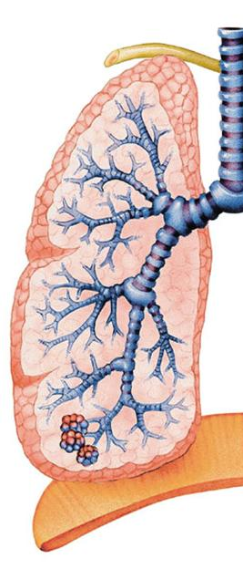
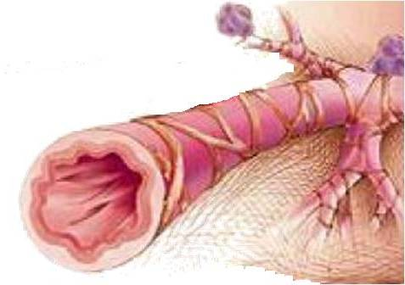
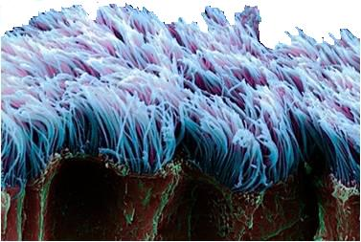
DRUGS USED
IN TREATMENT OF COUGH

Slide 20
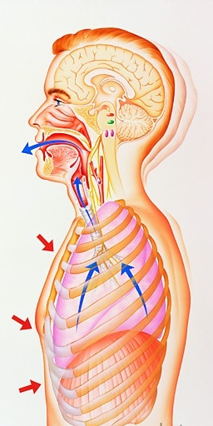
is protected mainly by
The respiratory tract
1. MUCOCILIARY CLEARANCE  ensures optimum tracheobronchial clearance by forming sputum (in optimum quantity & viscosity ) exhaled by ciliary movement s.
2. COUGH REFLEX  exhales sputum out, if not optimally removed by the mucociliary clearance mechanisms
Coughing is sudden expulsion of air from the lungs through the epiglottis at an amazingly fast speed (~100 miles/ hr) to rid breathing passage ways of unwanted irritants. Abdominal & intercostal muscles contract, against the closed epiglottis  pressure   air is forcefully expelled to dislodge the triggering irritant.
Cough is meant to be useful “wet or productive”
May not be useful & annoying 2ndry to irritant vapors, gases, infections, cancer “dry or irritant”
EXPECTORANTS
MUCOLYTICS
For Productive Cough
TREATMENT
ANTITUSSIVE AGENTS
For Non-productive (dry) Cough

Slide 21
EXPECTORANTS
Act by removal of mucus through
Reflex stimulation
Irritate GIT  stimulate gastropulmonary vagal reflex  loosening & thinning of secretions  Guaifenesin
ADRs ; Dry mouth, chapped lips, risk of kidney stones(uric a. excretion)
Direct stimulation
Stimulate secretory glands   respiratory fluids production  Iodinated glycerol, Na or K iodide / acetate , Ammonium chloride, Ipecacuahna
ADRs; Unpleasant metallic taste, hypersensitivity, hypothyroidism, swollen of salivary glands( overstimulation of salivary secretion), & flare of old TB.
INDICATIONS
Final outcome is that cough is indirectly diminished
Common cold
Bronchitis
Pharyngitis
Chronic paranasal sinusitis

Slide 22
MUCOLYTICS
Act by altering biophysical quality of sputum becomes easily exhaled by mucociliary clearance or by less intense coughing
MECHANISM OF ACTIONS
Mucolysis occurs by one or more of the following;
◉ Viscoelasticity by water content; Hypertonic Saline & NaHCO₃
◉ Adhesivness; Steam inhalation
Breakdown S-S bonds in glycoproteins by reducing its SH Gp  less viscid mucous; N-Acetyl Cysteine
Synthesize serous mucus (sialomucins of smaller-size) so it is secretolytic + activate ciliary clearance & transport; Bromohexine & Ambroxol
Cleavage of extracellular bacterial DNA, that contributes to viscosity of sputum in case of infection; rhDNAase (Pulmozyme)
INDICATIONS
Most mucolytics  effective as adjuvant therapy in COPD, asthma, bronchitis, …etc. (when there is excessive &/or thick mucus….)
In bronchiectasis, pneumonia & TB  they are of partial benefit
Hardly any benefit in cystic fibrosis & severe infections  Give rhDNAase

Slide 23
1. N-Acetylcysteine
It is also a free radical scavenger  used in acetaminophen overdose
ADRs; Bronchospasm, stomatitis, rhinorrhea, rash, nausea & vomiting
2. Bromhexine & its metabolite Ambroxol
They also immuno defence so  antibiotics usage
They also  pain in acute sore throat
ADRs; Rhinorrhea, lacrymation, gastric irritation, hypersensitivity
3. Pulmozyme (Dornase Alpha or DNAse)
 A recombinant human deoxyribo-nuclease-1 enzyme that is neubilized .
Full benefit appears within 3-7 days
ADRs;
Voice changes, pharyngitis, laryngitis, rhinitis, chest pain, fever, rash

Slide 24
ANTITUSSIVE AGENTS
Stop or reduce cough by acting either primarily on the peripheral or CNS components of cough reflex.
1. PERIPHERALLY ACTING ANTITUSSIVES
A. Inhibitors of airway stretch receptors
In Pharynx  Use Demulcents  form a protective coating
Lozenges & Gargles
In Larynx  Use Emollients  form a protective coating
menthol & eucalyptus.
In Tracheobronchial Airway Use aerosols or inhalational of hot steam tincture benzoin compound & eucalyptol
During bronchoscopy or bronchography  Use local anaesthetic aerosols, as lidocaine, benzocaine, and tetracaine
B. Inhibitors of pulmonary stretch receptors in alveoli
Benzonatate   sensitivity (numbing) of receptors by local anesthetic action.
ADRS; drowsiness, dizziness, dysphagia, allergic reactions
Overdose  mental confusion, hallucination, restlessness & tremors

Slide 25
ANTITUSSIVE AGENTS
2. CENTRALLY ACTING ANTITUSSIVES
A. OPIOIDS
activating µ opioid receptors
e.g. Codeine & Pholcodine
B. NON-OPIODS
Antihistaminics (>sedating)
Dextromethorphan
It  threshold at cough center. It has benefits over opiods in being 
1. As potent as codeine.
2- But no drowsiness.
3- Less constipating
4- No respiratory depression.
5- No inhibition of mucociliary clearance.
6- No addiction.
ADRs
Nausea, vomiting, dizziness, rash & pruritus in normal doses
In high doses, hallucinations + opiate like side effects on respiration & GIT

Slide 26
GOOD LUCK

