Slide 1
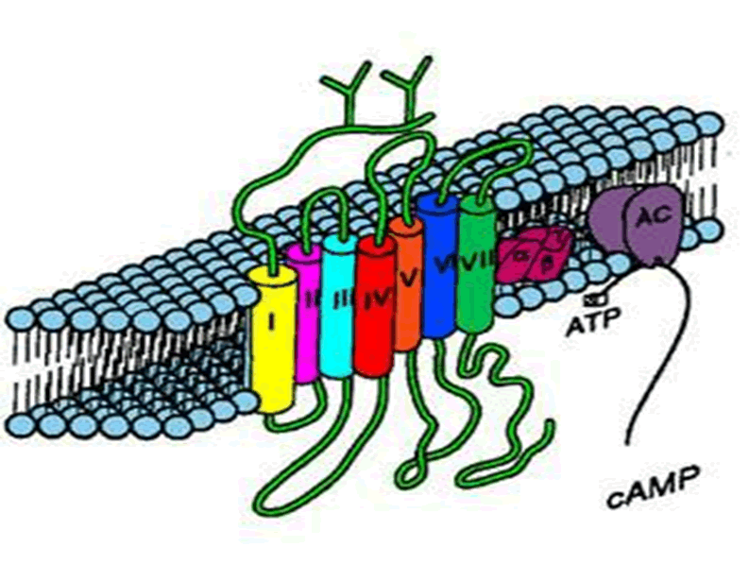
Adrenergic agonist:
PHARMACOLOGY OF SNS

Slide 2
ADRENERGICS STIMULANTS [AGONISTS]
Direct Sympathomimetics
Indirect Sympathomimetics
Dual Sympathomimetics

Slide 3
ADRENERGIC STIMULANTS
According to chemistry; Catecholamines; Natural; NE, E, Dopamine
Synthetic; Isoprenaline
Rapidly acting / Degraded by MOA & COMT
Sparse CNS effects / Parenterally administered
Non-Catecholamines; Ephedrine
Delayed action / Resist degradation by MOA
Prominant CNS effects / Orally administered
According to spectrum of action;
Non-Selective;
Norepinephrine, epinephrine, dopamine, isoprenaline, ephedrine,…etc
Selective;
α₁; Phenylephrine
α₂; Clonidine
β₁; Dobutamine
β₂; Salbutamol

Slide 4
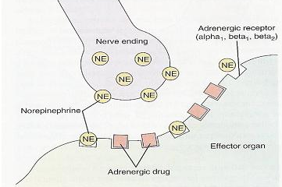
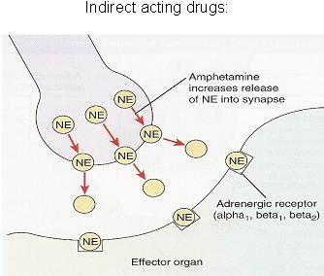
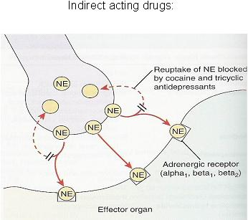
ADRENERGIC STIMULANTS
According to mode of action;
Direct; Stimulate adrenergic receptors directly.
e.g. adrenaline, noraderanaline, dopamine, isoprenaline, phenylephrine, methoxamine, naphazoline, clonidine, dobutamine, salbutamol….etc
Indirect; Release of NE from presynaptic stores at adrenergic nerve terminals
e.g. amphetamine
Or Inhibit uptake its availability in synapse.
e.g. Cocaine & antidepressants
Dual; Direct and indirect stimulation of adrenergic receptors
e.g. ephedrine, pseudoephedrine

Slide 5
ADRENERGICS AGONISTS
Direct Sympathomimetics

Slide 6
ADRENERGIC STIMULANTS
DIRECT Acting Sympathomimetics
ADRENALINE
Naturally released from adrenal medulla  2^{ndry} to stress, hunger, fear
Inactivated by intestinal enzymes, so given parentral & by inhalation
Acts on all ADR; β =/> α .
Pharmacological actions
Heart  inotropic, chronotropic, dromotropic (excitability)(β₁)
BP  systolic (β₁) / diastolic   low dose (β₂) &  high dose (α₁)
Vascular SMC; constrict skin + peripheral (α₁) / dilate coronary+skeletal (β₂)
Non vascular SMC;
Lung  bronchiodilatation (β₂)
Pregnant uterus  tocolytic (β₂)
Eye  mydriasis (α₁) /  no effect on accommodation or intraocular P
CNS little, headache, tremors & restlessness

Slide 7
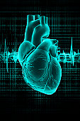
ADRENALINE
Indications
Used locally; as haemostatic (in epistaxsis) & as decongestant (α₁) !!!
with local anesthetics  to its absorption & toxicity +  bleeding from incision
Used systemically for treatment of
Allergic reactions  drug of choice in anaphylactic shock as it is the physiological antagonist of histamine
  BP & cause vasoconstricton
In status asthmatics  given parentally  bronchodilatation (β₂) +  mucosal edema (α₁)
N.B. Selective β₂ are better in asthma by inhalation
In cardiac arrest  direct but now through central line
N.B. Selective β₁ are better

Slide 8
ADRENALINE
ADRs
Tachycardia, palpitation, arrhythmias, angina pains
Headache, weakness, tremors anxiety and restlessness.
Hypertension  cerebral hemorrhage and pulmonary edema.
Coldness of extremities  tissue necrosis
Nasal stuffiness; rebound congestion if used as decongestion
Contraindications
CHD, hypertension, peripheral arterial disease.
Hyperthyroidism.
Closed-angle glaucoma (ciliary relaxation  filtration angle   IOP

Slide 9
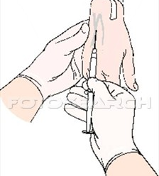
ADRENERGIC STIMULANTS
Direct Acting Sympathomimetics
NOREPINEPHRINE = NORADRENALINE
It is naturally released from postganglionic adrenergic fibres
Not used much therapeutically  severe vasoconstriction
Acts on α > β₁
Only administered IV - Not IM or Subcutaneous necrosis
It  BP [ systolic & diastolic]  reflex bradycardia (vagal stimulation)
 CO not much changed
Indications
Used systemically; hypotensive states (in spinal anesthesia, in septic shock if fluid replacement and inotropics fail) !!!
Used topically; as a local haemostatic
with local anesthetic
(< tachycardia & irritability
& > necrosis & sloughing)

Slide 10
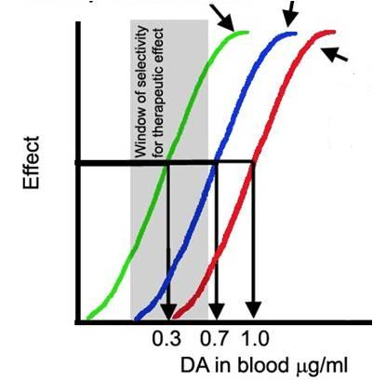
ADRENERGIC STIMULANTS
Direct Acting Sympathomimetics
ISOPRENALINE
It is synthetic ; show no presynaptic uptake nor
breakdown by MOA  longer action. Acts on β > > α
10 times > broncho-dilatation Was used by inhalation in acute asthma
Used in cardiac arrest but contraindicated in hyperthyroidism & CHD
DOPAMINE
Kidney D₁ vasodilatation
+ diuresis
Heart β₁  force
It is a natural CNS transmitter.
Released from postganglionic
adrenergic fibres (> renal vessels)
Releases NE from postganglionic adrenergic fibres
Acts on D₁ > β₁ > α₁
Vessels α₁

Slide 11
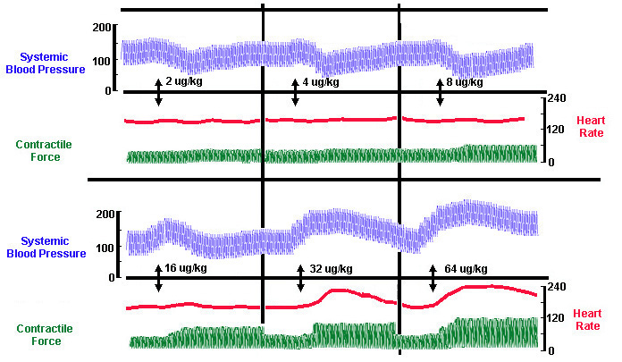
ADRENERGIC STIMULANTS
Direct Acting Sympathomimetics
DOPAMINE
On heart 
Inotropic, no chronotropic effect
On BP  According to dose;
first  D₁
then  due to β₁
followed by α₁ effect
Given parentrally by infusion
Indications
It is the drug of choice in treatment of SHOCK septic, hypovolaemic (after fluid replacement), cardiogenic
It  BP & CO (β₁), without causing renal impairment (D₁)
Can be given in acute heart failure (HF) but better dobutamine

Slide 12
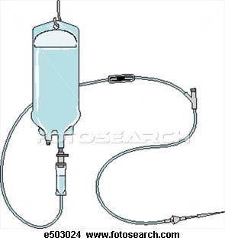
ADRENERGIC STIMULANTS
Direct Acting Sympathomimetics
DOBUTAMINE
It is synthetic. Given IV.
Acts on β₁ > β₂ > α₁
On heart  Inotropic with little chronotropic effect
On BP  No or little  in therapeutic dose
(β₁ & β₂ counterbalance + no α₁ )
Indications
Given parentrally by infusion for short term management of cardiac decompensation after cardiac surgery, in acute myocardial infarction (AMI) & HF.
It is preferred because
it does not  oxygen demand

Slide 13
ADRENERGIC STIMULANTS
Direct Acting Sympathomimetics
PHENYLPHERINE
It is synthetic, noncatecholamine.
Given orally & has prolonged duration of action.
Acts as selective α₁
MIDODRINE
Peaks in 20 min.
t_{½} 30 min.
On heart  reflex bradycardia
On BP   due to vasoconstriction (α₁ )
Indications
In Hypotension
Systemically; Pressor agent in hypotensive states. Infusion
Terminate atrial tachycardia (reflex bradycardia)
Nasal decongestant. Oral
Topically; Local Haemostatic, with Local anesthesia.
Decongestant (nasal & ocular)
Mydriatic (no cycloplegia so facilitate eye examination)

Slide 14
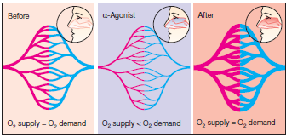
ADRENERGIC STIMULANTS
Direct Acting Sympathomimetics
Nasal & Ocular Decongestants
PHENYLETHYLAMINES
IMIDAZOLINE
Pseudoephedrine
Phenylephrine
Methoxamine
Naphazoline
Oxymetazoline HCI (Afrin)
Xylometazoline HCI (Otrivine)
Used for treatment of nasal stuffiness
But can cause Rebound nasal stuffiness
It is synthetic, imidazoline
Given orally or as patch.
Acts selectively on presynaptic α₂
◉ BP  by action on (α₂ ) at nucleus tractus solitarius to  sympathetic outflow to heart & vessels.  Antihypertensive agent
CLONIDINE
N.B. Brimonidine is an imidazoline  α₂ agonist used in glucoma

Slide 15
ADRENERGIC STIMULANTS
Direct Acting Sympathomimetics
SALBUTAMOL
It is synthetic. Given orally, by inhalation or parentral.
Acts selectively on β₂  on bronchi. Hardly effect on heart (β₁)
Bronchodilater  asthma & chronic obstructive airway disease (COPD)
N.B. Because t_{1/2} is 4 hrs longer acting preparations exist ; Salmeterol & Formoterol
Other selective β₂ agonists :
Terbutaline; Bronchodilator & Tocolytic
Ritodrine; Tocolytic  postpone premature labour
(labour that begins before the 37th week of gestation).

Slide 16
ADRENERGICS STIMULANTS [AGONISTS]
Indirect Sympathomimetics

Slide 17
ADRENERGIC STIMULANTS
INDIRECT Acting Sympathomimetics
AMPHETAMINE
It acts indirectly;
Releasing NE from adrenergic nerve endings > Blocking of its reuptake
Because it depletes vesicles from stored NE tachyphylaxsis
Absorbed orally, not destroyed by MAO, excreted mostly unchanged (by acidification of urine)
Acts on α& β  similar to epinephrine but has CNS stimulant effects;
mental alertness, wakefulness, concentration & self-confidence / followed by depression & fatigue on continued use
 euphoria  causes its abuse…..
◉ Weight   appetite
 increase energy expenditure
No more used therapeutically  induces psychic & physical dependence and psychosis + the CVS side effects

Slide 18
ADRENERGICS STIMULANTS [AGONISTS]
Dual Sympathomimetics

Slide 19
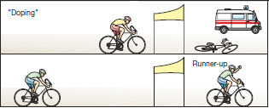
ADRENERGIC STIMULANTS
DUAL Acting Sympathomimetics
EPHEDRINE
Plant alkaloid, synthetic, mixed sympathomimetic;
Prolonged direct action on receptors  receptor down regulation
Release NE from adrenergic nerve endings depletes stores
 tachyphylaxsis
Absorbed orally, not destroyed by MAO or COMT  prolonged action
Acts on α& β
+ > facilitation of neuromuscular transmission & retention of urine
+ has CNS stimulant effects (less than amphetamine)
No more therapeutically used  but is abused by athletes and prohibited during games.
Abuse in Athletes
Pseudoephedrine, dual acting < CNS & pressor effects compared to ephedrine. Used as nasal & ocular decongestant & in flue remedies.

Slide 20
Agents specifically indicated for hypotension
Midodrine, Phenylephrine, Norepinephrine,
Agents specifically indicated for cardiogenic shockAHF
Dobutamine, Dopamine, Epinephrine
Agents specifically indicated for shock
Dopamine, Norepinephrine
Agents specifically indicated for cardiac arrest Dobutamine, Epinephrine, Norepinephrine
Agents specifically indicated for bronchial asthma
Salbutamol, Salmeterol, Formoterol, Terbutaline, Isoprenaline
Agents specifically indicated for premature labour
Ritodrine, Terbutaline
Agents specifically indicated for nasal decongestion
Pseudoephedrine, Naphazoline, Oxymetazoline, Phenylephrine, Xylometazoline
Agents specifically abused in sports  Ephedrine, Amphetamine

Slide 21
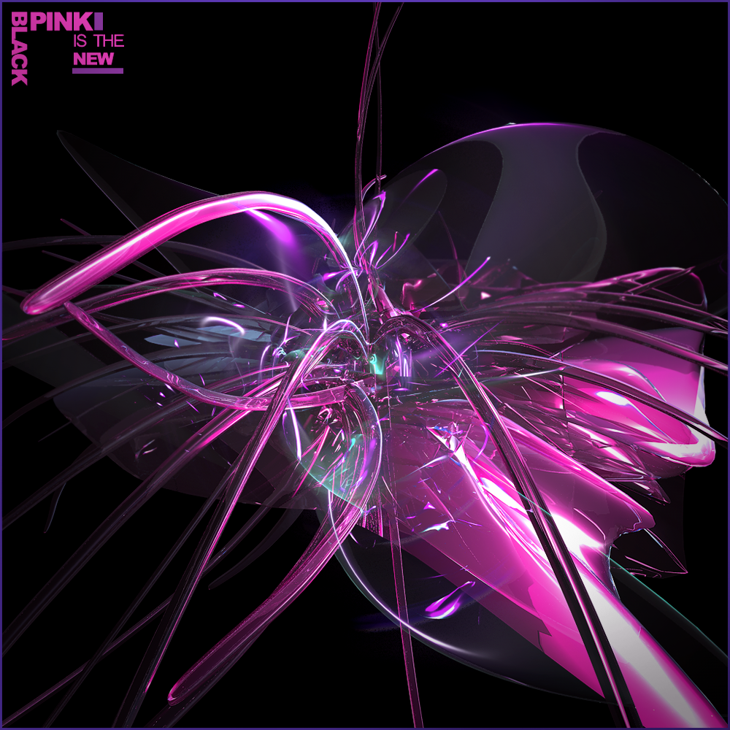
GOOD LUCK

