Slide 1

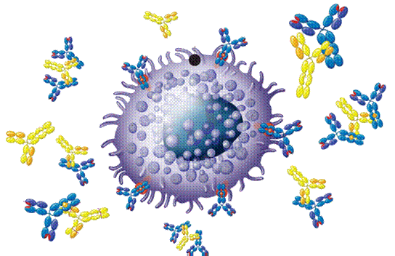
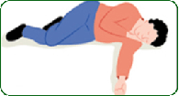
DRUGS USED IN
ANAPHYLAXSIS
ANAPHYLAXSIS

Slide 2
DRUGS USED IN
ANAPHYLAXSIS
ILOs
By the end of this lecture you will be able to:
Perceive the differences between anaphylactic shock and other
types of shock
Recognize its nature, causes & characteristics.
Specify its diagnostic features
Identify its standard emergency management protocol
Justify the mechanism of action and method of administration of each of the different used drugs to limit its morbid outcomes

Slide 3
ANAPHYLAXSIS
Is a sudden, severe allergic reaction affecting the whole body
symptoms including:
Rash
Mucosal swelling
Difficulty breathing
Reduced blood pressure
SHOCK
ANAPHYLACTIC SHOCK
  A life-threatening allergic reaction that causes shock (hypoperfusion) and airway swelling
What TYPE of shock is it ???

Slide 4
SHOCK
Generalized circulatory derangement causing multiple organ HYPOPERFUSION [Inadequate oxygen delivery to meet metabolic demands ] & strong sympathetic activation
when intense or sustained enough, irreversible derangements sets  permanent functional deficit or death
Hypovolemic
    Haemorrhage / fluid loss (plasma, ECF)
Cardiogenic
Inability to contract & pump myocardial infarction
Obstructive
Extracardiac obstruction  Pul. embolism, cardiac tamponade
Distributive
    ◉ PR  septic shock, neurogenic, anaphylactic shock
Severe, life-threatening, generalized or systemic hypersensitivity reaction in response to allergen

Slide 5
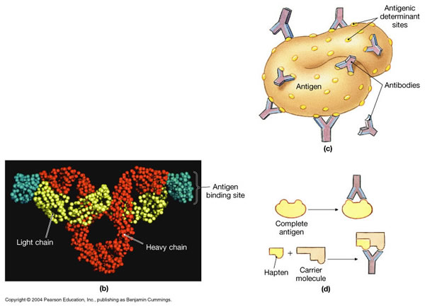
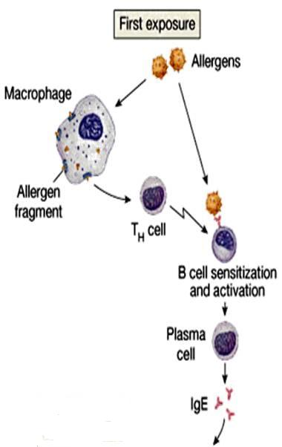
ANAPHYLACTIC SHOCK
Nature
• Belong to TYPE I HYPERSENSITIVITY REACTION
Occurs after exposure to foreign substances [antigen ];
food, insect or animal venom, drugs, blood products, …..
• IN PREVIOUSLY SENSITIZED PERSONS (antigen-specific IgE are present)
What happens ???
Mast Cell
  N.B. Non-Immunologic Anaphylaxis
  (ANAPHYLACTOID)
    Exogenous substances directly degranulate mast cells Radiocontrast dye, Opiates, Depolarinzing drugs, Dextrans

Slide 6
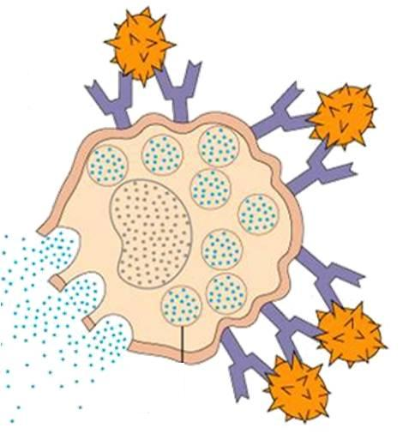
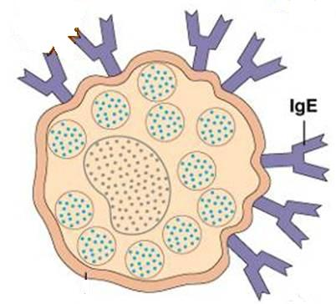
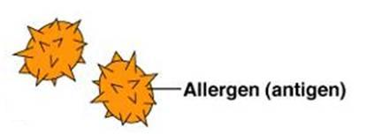
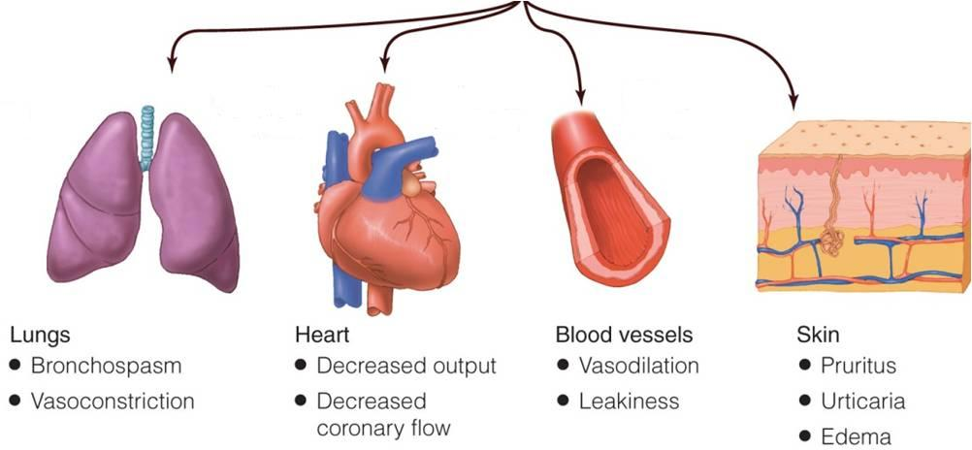
ANAPHYLACTIC SHOCK
Second or later exposure
Mast Cell DEGRANULATION
Characters
Antigen Re-exposure
Histamine, Leukotrienes, others
2.
Mucous Swelling
Rhinitis 16%
Angioedema 88%
Airway 56%
GIT 30%
4.
Circulatory Collapse
Hypo-perfusion
1.
3.
47%
88%
33%
Shortness of breath
Rapidly developing [ 5/30 min.can be hours ]
Severe, life-threatening
Multisystem involvement
Mortality: due to respiratory (70%) or cardiovascular (25%)

Slide 7
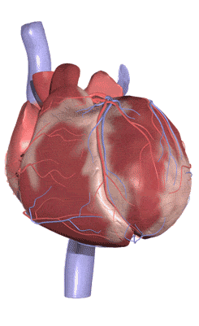
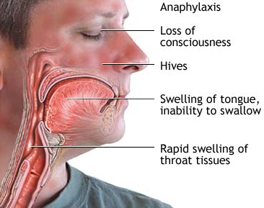
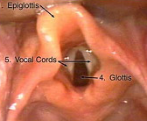
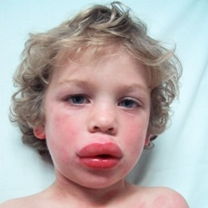
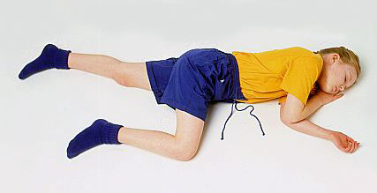
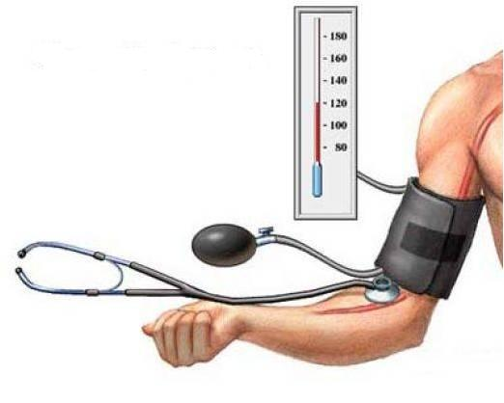
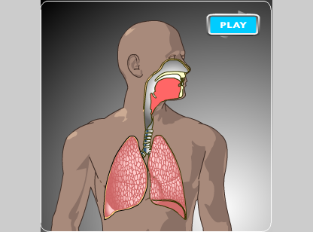
Fainting, Syncope
ANAPHYLACTIC
SHOCK
IS A MEDICAL EMERGENCY WHERE IMMEDIATE TREATMENT IS NEEDED TO PREVENT POTENTIAL DEATH.

Slide 8

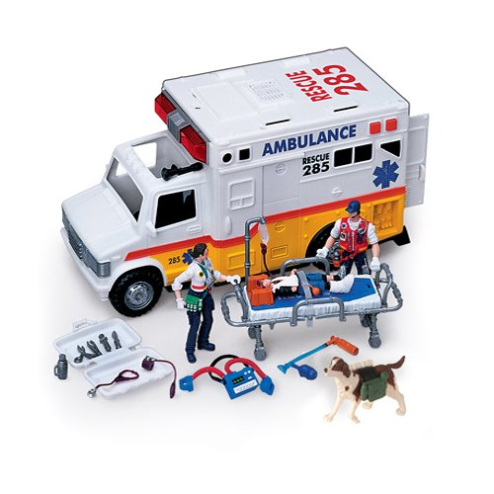
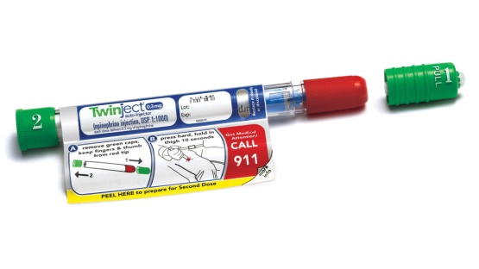
ANAPHYLACTIC
SHOCK
Open Airway
O₂ Inhalation
Respiratory Support
DIAGNOSIS IS MADE
START
EMERGENCY
TREATMENT
Circulatory Support
Lay down / Legs up
Fluid Replacement
Adrenaline
IM by Auto-injector
Or by syringe

Slide 9
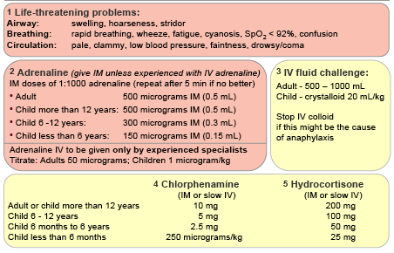
ANAPHYLACTIC SHOCK THERAPY PROTOCOL
RESCUE
1st Line
2nd Line
Adjuvant to 2nd line
6. Bronchodilators
7. Glucagon
8. H₂ Blockers

Slide 10
ANAPHYLACTIC SHOCK THERAPY PROTOCOL
Adjuvant to 2nd line
Bronchodilators
  Salbutamol nebulizer / Ipratropium nebulizer / Aminophylline IV
Glucagon
  For patients taking β-blockers & with refractory hypotension1 mg IV q 5 minutes until hypotension resolves
  H₂ blocker
  Ranitidine 50 mg IV / No cimetidine in elderly, renal/hepatic failure, or if on β-blockers

Slide 11
ANAPHYLACTIC SHOCK THERAPY PROTOCOL
Adjuvant to 2nd line
  To support the respiratory & circulatory deficits
  To halt the existing hyper-reaction
  To prevent further hyper-reaction of immune system
  Objective of Therapy
    Biphasic phenomenon
      2nd release of mediators without re-exposure to antigen (in up to 20% )
      Clinically evident 3-4h after the initial manifestations clear

Slide 12
Adrenaline
A Sympathomimetic.
1st Line
  Mechanism
A nonselective AD agonist [α₁, α₂, β₁, β₂ ]
  Actions
As an α-AD agonist
Reverses peripheral vasodilation  maintains BP & directs blood flow to major organs
edema  reverse hives, swelling around face & lips & angioedema in nasopharynex & larynx
As a β-AD agonist 
Dilates bronchial airways +histamine & leukotriene release from mast
cells  β₂ effect
 force of myocardial contraction  β₁ effect
  Contraindications
PHYSIOLOGICAL ANTAGONIST
Attenuates the severity of IgE-mediated allergic reactions.
Rare in a setting of anaphylaxsis
Not given > 40 y cardiac patient
  ADRs
Dysrrhythmias
  Indication
DRUG OF CHOICE

Slide 13
Adrenaline
1st Line
  Administration
Best is (IM) route in anaphylaxsis. Why ?
Easily accessible
Greater margin of safety  no dysrrhythmias as with IV
No need to wait for IV line  if present
 given by physician under monitoring
Auto-injectors Kits;
Disposable, prefilled
devices  automatically administer a single dose of epinephrine in emergency
Repeat every 5-10 min as needed
  Patients observed for 4-6 hours. Why ?
  Fear of biphasic anaphylaxsis
  N.B. Caution
  Patients taking β-blockers either are 
  Refractory; as it may antagonize β effects of adrenaline
  Rebound hypertension  [ unopposed α effect], specially when adrenaline
  is repeated
If hypotension persist  start dopamine. Why not noradrenaline?

Slide 14
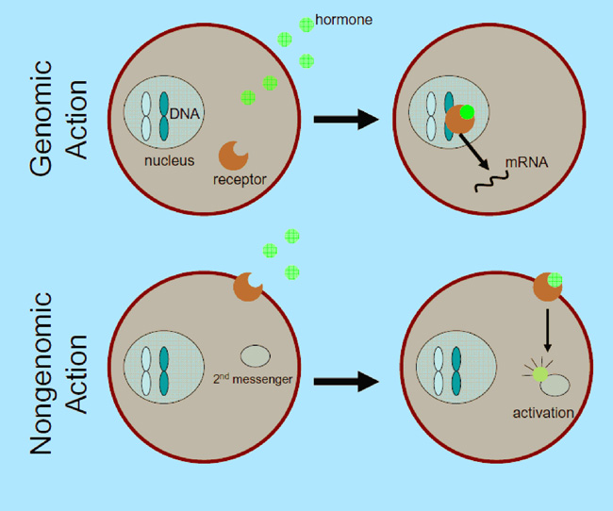
CORTICOSTEROIDS
2ND Line
It can not be used alone  not life saving
Given slowly intravenously or intramuscularly.
Reverse hypotension & bronchoconstriction   release of inflammatory mediators (anti-chemotactic & mast cell stabilizing effects).
Also decrease mucosal swelling and skin reaction.
This is through immediate GCs actions on Membrane-bound receptors  modulating levels of 2nd messengers  (within seconds or minutes)  Non-genomic action (genomic action is slow may take hrs to days)
May help to limit biphasic reactions   allergic mediators

Slide 15
H₁ BLOCKERS
2ND Line
It can not be used alone  not life saving
Given slowly intravenously or intramuscularly (e.g phenaramine).
Though mast cells have already de-granulated, yet these drugs can still help to counter act histamine-mediated vasodilation & bronchoconstriction.
May help to limit biphasic reactions by  more histamine release
H₂ Blockers
The significance of H2 blockers is not established , these drugs are assocaited with serious adverse drug interactions.

Slide 16
Bronchodialators
Inhalational
Salbutamolβ₂-AD agonist short acting, rapid relief onset relax bronchial smooth muscle and may decrease mediator release from mast cells and basophils.
It may also inhibit airway microvascular leakage.
IpratropiumAnticholinergic longer duration of action   secretion
Less rapid in action
Parentral
Aminophylline IV  may be useful in the treatment of anaphylaxis when inhaled broncho-dilators are not effective & bronchospasm is persistent.
Given in hospital setting as levels of drug should be Therapeutically Monitored  has narrow therapeutic index

Slide 17
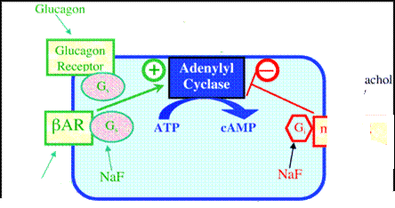
Glucagon
2ND Line
Drug of choice for severe anaphylaxis in patients taking β-blockers
Has both positive inotropic & chronotropic effects on heart   cardiac cyclic AMP  an effect entirely independent of AR
That is why effective in spite of beta-adrenergic blockade.
Efficacy of acting on bronchi < heart  no evident bronchodilation
Glucagon
G_{s}
G_{s}
M₂ & M₃
Sympathomimetics
Ipratropium

Slide 18
DRUGS USED IN
ANAPHYLAXSIS
GOOD LUCK

