Slide 1
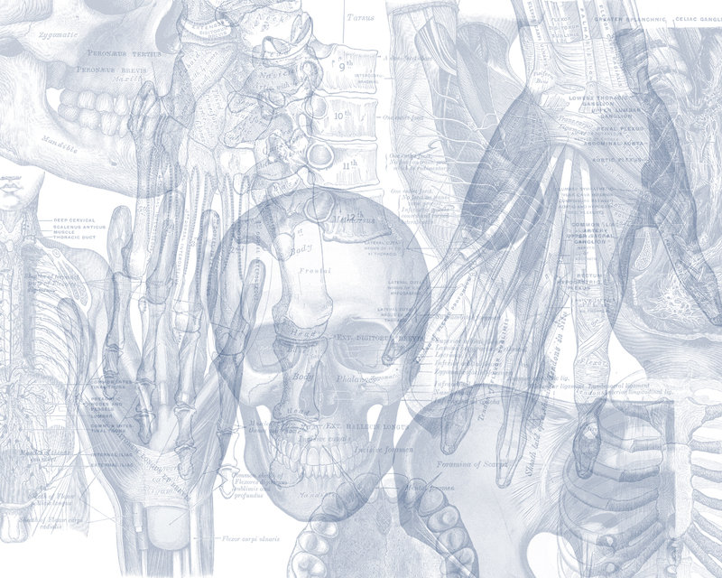
OSPE RESPIRATORY BLOCK
Color Code
Nerves
Arteries
Veins
Muscles
Lymphatics

Slide 2
Please note that these figures are not necessarily
those present in the exam
THANK YOU
PROF. AHMED FATHALLA IBRAHIM

Slide 3
MUSCLES INVOLVED IN RESPIRATION Action- Nerve supply
Intercostal Muscles
External Intercostal Muscle
Nerve supply: intercostal nerves
Action: rib elevators (inspiratory)
Internal Intercostal Muscle
Nerve supply: intercostal nerves
Action: rib depressors
Innermost Intercostal Muscle
Nerve supply: intercostal nerves
Action: rib depressors

Slide 4
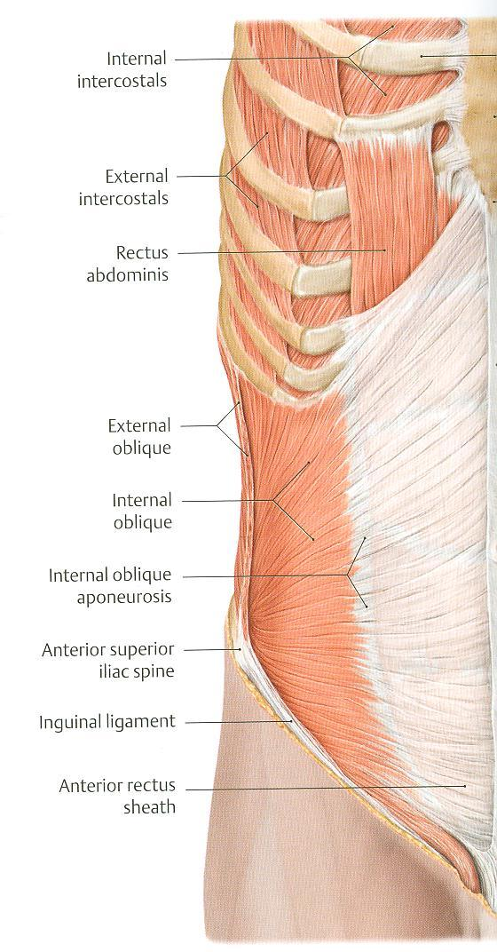
MUSCLES INVOLVED IN RESPIRATION Action- Nerve supply
Anterior Abdominal Wall Muscles
External Oblique Muscle &
Internal Oblique Muscle
Nerve supply:
lower intercostal nerves (T7 – T11),
subcostal nerve (T12), and
first lumbar nerve.
Action:
Compression of abdominal viscera to help in ascent of diaphragm (during forced expiration)

Slide 5
MUSCLES INVOLVED IN RESPIRATION Action- Nerve supply
Anterior Abdominal Wall Muscles
Transversus Abdominis
Nerve supply:
lower intercostal nerves (T7 – T11),
subcostal nerve (T12), and
first lumbar nerve.
Action:
Compression of abdominal viscera to help in ascent of diaphragm (during forced expiration)

Slide 6
DIAPHRAGM Action- Nerve supply
Diaphragm
Nerve supply:
Phrenic nerve (C3,4,5),
Action:
contraction (descent) of diaphragm increase vertical diameter of thoracic cavity essential for normal breathing.
Origin:
1) Costal: lower 6 costal cartilages
2) Vertebral: upper 3 lumbar vertebrae
(right & left crus + arcuate ligaments)
3) Sternal: xiphoid process of sternum
Insertion:
Central Tendon (lies at the level of xiphisternal joint , at 9th thoracic vertebra)
Major openings of diaphragm
The thoracic spinal levels at which the three major structures pass through the diaphragm can be remembered by the number of letters contained in each structure:
Vena Cava (8 letters) – Passes through the diaphragm at T8.
Oesophagus (10 letters) – Passes through the diaphragm at T10.
Aortic Hiatus (12 letters) – "Passes" through the diaphragm at T12
Mnemonic of major openings of diaphragm: I ate (8) 10 Eggs At 12.
(I 8= inferior vena cava pierce at T8,
10 Eggs= Esophagus pierces at T10 ,
At 12 = Aorta pierces at T12)

Slide 7
NASAL CAVITY
Soft palate
Hard palate

Slide 8
NASAL CAVITY

Slide 9
NASAL CAVITY, LARYNX, PHARYNX, TRACHEA
Frontal air sinus
Nasal septum
Sphenoidal air sinus
Hard palate
Opening of pharyngo-
tympanic tube
Epiglottis
Palatine tonsil
Trachea
N.B.: Site of drainage of
the sinuses – important
structures in the wall of
pharynx- blood sypply –
lymphatic drainage

Slide 10
NASAL CAVITY, LARYNX, PHARYNX, TRACHEA
Pharynx | Arterial supply | from branches of the following arteries: 1- Ascending pharyngeal 2- Ascending palatine 3- Facial 4- Maxillary 5- Lingual
 | Veins | drain into pharyngeal venous plexus, which drains into the internal jugular vein
 | Lymphatics | drain into the deep cervical lymph nodes either directly, or indirectly via the retropharyngeal or paratracheal lymph nodes
Larynx: Nerve Supply
Sensory | Above the vocal cords: | - Internal laryngeal nerve - branch of the superior laryngeal of the vagus nerve.
 | Below the vocal cords: | Recurrent laryngeal nerve of the vagus nerve
Motor | All intrinsic muscles supplied by the recurrent laryngeal nerve except the cricothyroid The cricothyroid is supplied by the external laryngeal nerve of superior laryngeal of vagus.

Slide 11
NASAL CAVITY, LARYNX, PHARYNX, TRACHEA
Pharynx | Structures in the lateral wall
Nasopharynx | Opening of auditory tube Tubal elevation Pharyngeal recess Salpingopharyngeal fold Pharyngeal Tonsil Tubal Tonsil
Oropharynx | Palatopharyngeal fold Palatoglossal fold Palatine Tonsil
Laryngopharynx | Piriform Fossa
Site of Drainage | Sinus
Spheno-ethmoidal recess | sphenoidal sinus
Superior meatus | posterior ethmoidal sinus
Middle meatus | middle ethmoidal, anterior ethmoidal , maxillary, and frontal sinuses
Inferior meatus | nasolacrimal duct.

Slide 12
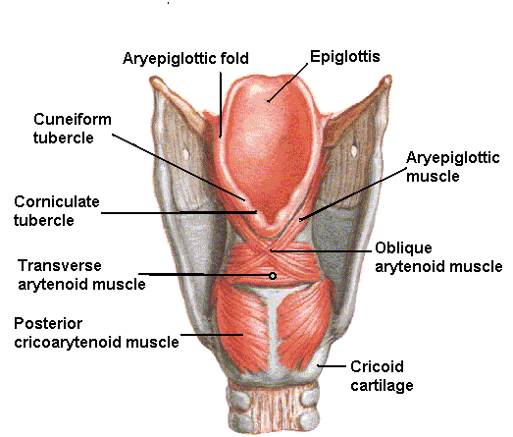
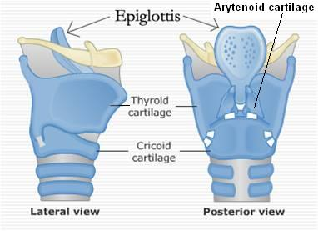
LARYNX, TRACHEA
-Level of beginning
and termination of larynx, trachea and pharynx
-Cartilages of larynx
Structure | Beginning | Termination
Pharynx | Base of skull | C6 vertebra
Larynx | Laryngeal inlet | Lower border of cricoid (C6)
Trachea | Lower border of cricoid (C6) | Sternal Angle (T4)
The cartilaginous skeleton is composed of 9 cartilages:
3 Single:
Thyroid 2. Cricoid 3. Epiglottis
3 Paired:
4. Arytenoid 5. Corniculate 6. Cuneiform
6
3
3
5
1
1
4
4
2
2

Slide 13
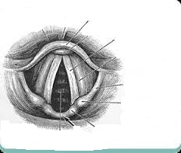
Identify the following labelled structures :
a ………………………….
b…………………………..
c……………………………..
d……………………………….
e……………………………….
a
b
c
Answer
epiglottis.
Vocal cord.
Aryepiglottic fold.
Cuniform cartilage.
Corniculate cartilage.
d
e

Slide 14
TRACHEA & BRONCHI

Slide 15
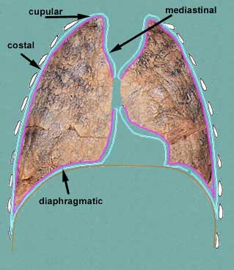
LUNG & PLEURA
Nerve Supply
Pleura | Visceral pleura |  | supplied by the autonomic fibers from the pulmonary plexus.
 | Parietal pleura | Costal pleura | segmentally supplied by the intercostal nerves.
 |  | Mediastinal pleura | phrenic nerves
 |  | Diaphragmatic pleura | central part by phrenic nerves, around the periphery by lower 6 intercostal nerves
Lungs |  |  | Pulmonary plexus at the root of lung….is formed of autonomic N.S. from sympathetic & parasympathetic fibers. 1- Sympathetic Fibers From: sympathetic trunk 2- Parasympathetic Fibers From: Vagus nerve
Nerve supply- Surface Anatomy
Cervical

Slide 16
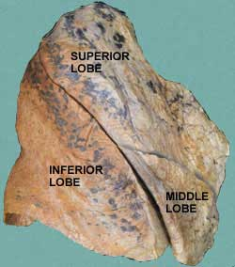
LUNG & PLEURA
Transverse (horizontal) fissure
Oblique fissure
Surface anatomy of fissures and cardiac notch

Slide 17
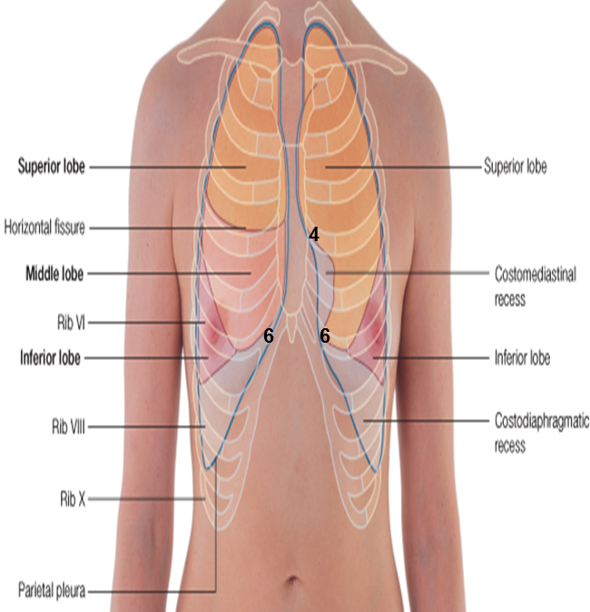
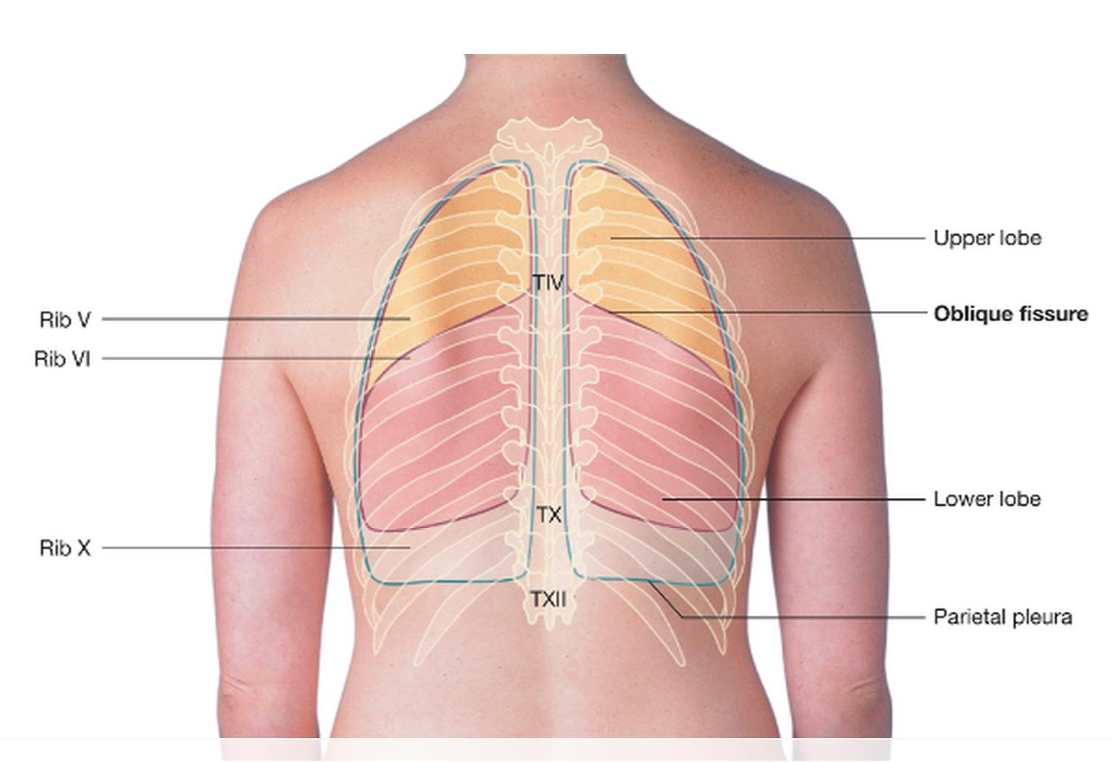
Surface Anatomy
435 SAQ
Describe the SUFACE ANATOMY OF PLEURA??
Apex: lies one inch above the medial 1/3 of the clavicle.
Right pleura: The anterior margin extends vertically from sterno-clavicular joint to 6th costal cartilage.
Left pleura: The anterior margin extends from sternoclavicular joint to the 4th costal cartilage, then deviates for about 1 inch to left at 6th costal cartilage to form cardiac notch
Inferior margin : passes around the chest wall, on the 8th rib in midclavicular line, 10th rib in mid-axillary line and finally reaching to the last thoracic spine (T12 spine).
Posterior margin : along the vertebral column from the apex to the inferior margin ( T12 spine).
Describe the SUFACE ANATOMY OF lung fissures??
Oblique fissure: Represented by a line extending from 3rd thoracic spine, obliquely ending at 6th costal cartilage.
Transverse fissure: Only in the right lung: represented by a line extending from 4th right costal cartilage to meet the oblique fissure.
Describe the SUFACE ANATOMY OF cardiac notch??
The anterior margin of left pleura extends from sternoclavicular joint to the 4th costal cartilage, then deviates for about 1 inch to left at 6th costal cartilage to form cardiac notch
Describe the SUFACE ANATOMY OF the lung??
Apex, anterior border and posterior border: correspond nearly to the lines of pleura but are slightly away from the median plane.
Inferior margin : as the pleura but more horizontally and finally reaching to the 10th thoracic spine.

Slide 18
RIGHT LUNG
SVC = Superior Vena Cava
IVC = Inferior Vena Cava
Phrenicnerve
S
V
C
Superior lobar bronchus
Transverse fissure
Azygos vein
Inferior lobar bronchus
Superior pulmonary
vein
Pulmonary artery
I
V
C
Inferior pulmonary
vein
Esophagus
Cardiac impression
Vagus nerve
Oblique fissure

Slide 19
LEFT LUNG
Common carotid artery
Phrenic nerve
Subclavian artery
Aortic arch
Pulmonary artery
Bronchus
Superior pulmonary
vein
Inferior
pulmonary vein
Cardiac impression
Pulmonary ligament
Area related to
diaphragm
Oblique fissure
Descending aorta
Vagus nerve
Lingula

Slide 20
MEDIASTINUM Contents

Slide 21
MEDIASTINUM Contents

Slide 22
MEDIASTINUM Contents
N.B.:
LEVEL OF T4
T4 is the level of:
Sternal angle
Second costal cartilage
1.Bifurcation of trachea
2. Bifurcation of pulmonary trunk
3. Beginning & termination of arch of aorta
Descending aorta

Slide 23
RADIOLOGY
Trachea
Clavicle
Aortic
knuckle
Scapula
Apex of heart
(left ventricle)
Cardiophrenic angle
Left dome
of diaphragm
Right dome
of diaphragm
Right atrium

Slide 24
RADIOLOGY
T
T: Trachea
B: Bronchus (primary)
B

Slide 25
RADIOLOGY
Barium swallow
Esophagus

Slide 26
Done by:
Mohammed Ghandour
Jawaher Abanumy
anatomyteam436@gmail.com
@anatomy436

