Slide 1


OSPE
"لا حول ولا قوة إلا بالله العلي العظيم" وتقال هذه الجملة إذا دهم الإنسان أمر عظيم لا يستطيعه ، أو يصعب عليه القيام به .
أول ثلاث سلايدات لمراجعة أساسيات المايكروبايلوجي

Slide 2
Introduction : Bacteria
How to differentiate between GRAM POSSITVE and GRAM NEGATIE by gram stain ?
By color:
Blue \ purple
Red \ pink
It could be coccus or bacillus
It could be coccus or bacillus
eg.
  Staphylococcus
  streptococcus
Let’s talk about them in the next slide

Slide 3
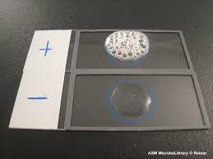
Introduction :
Gram positive cocci :
staphylococcus
In clusters
streptococcus
In chain or pairs
To differentiate between them we use catalase test
Bubbles :
(+ve) = staph
NO Bubbles:
(-ve) = strept
Streptococcus are divided into 2 : (when we culture them in blood agar)
Thanks to 435

Slide 4
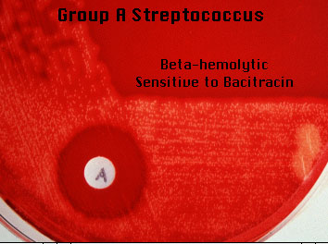
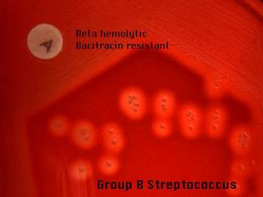
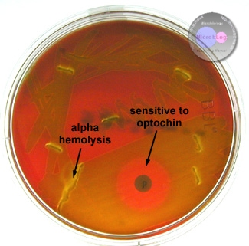
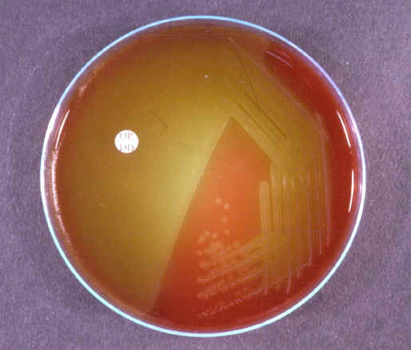
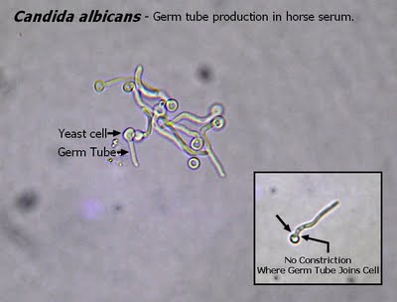
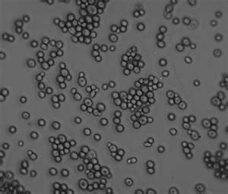
Different Test Used in Lab .
Introduction :
negative | Positive | Use | Test
Streptococcus | Staphylococcus | To differentiate between Staphylococcus & Streptococcus | CATALASE TEST
 |  | To differentiate between Streptococcus gp.A & any other group in beta haemolysis Streptococcus spec. | BACITRACIN SUSCEPTIBILITY
 |  | To differentiate between Streptococcus pnumoniae & other alpha haemolysis Streptococcus spec. | OPTOCHIN SUSCEPTIBILITY (optochin disk)
 |  | FOR IDENTIFICATION OF CANDIDA ALBICANS | GERM TUBE TEST *for fungas
S. pnumoniae

Slide 5
Out line:
Case 1: Pharyngitis – group A streptococcus
  Case 2 : Pneumonia - Streptococcus Pneumoniae.
Case 3: otitis media - Haemophilus influenzae
  Case 4: Diphtheria - Corynebacterium diphtheriae
  Case 5: Pulmonary TB
  Case 6: Candida albicans
  Case 7: Aspergillus niger

Slide 6
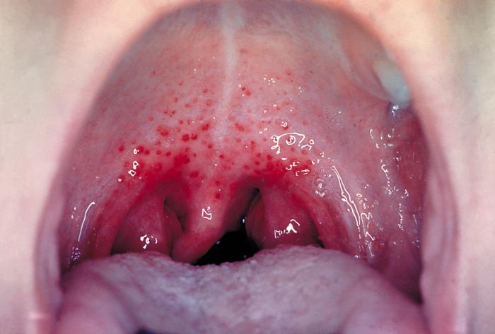
Case 1:
A 5 year boy was brought to KKUH, outpatient department complaining of fever and sore throat. He had regular vaccination history. On examination his temp. was 38.5°C, the tonsil area and pharynx were obviously inflamed with some foci of pus.
What is the differential diagnosis?*
  Acute Pharyngitis and\or Tonsillitis – virus infection
What investigation should be done?
  Throat swab.
  Catalase test.
  Culture of the throat swab on blood agar.هو الأدق لكن يحتاج وقت
  Rapid Antigen Detection Test (RADT). الأسرع لكن مو دائما يعطي النتيجة الصحيحة(false negative)**
  Bacitracin susceptibility test.
  Gram stain of the throat swab.(microscope). في حالة الثروت سواب غير مفيد بسبب وجود النورمل فلورا
*دامه قال (differential) فنذكر كل الممكن يسبب هذه الاعراض
**إذا سوينا الاختبار وطلع بوزيتف فهو قروب أي ستربت ونعالج وخلاص
أما إذا سويناها وطلعت النتيجة فولز فنظل مو متأكدين ونسوي الكلتشر عشان نتأكد هو قروب اي سترب او لا

Slide 7
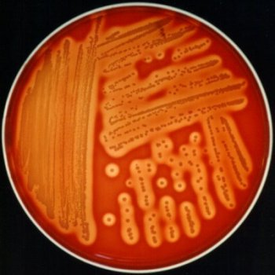
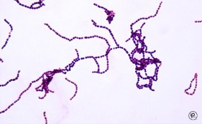

Case 1:
The tests showed :
RESULT | TEST
Beta haemolysis (colonies surrounded with clear zone of haemolysis) | CULTURE ON BLOOD AGAR
No bubbles → catalase negative | CATALASE TEST
gram positive cocci in chains | GRAM STAIN FROM CULTURE
Bacitracin Susceptible colonies | BACITRACIN SUSCEPTIBILITY TEST
CATALASE TEST
CULTURE ON BLOOD AGAR
*
*
GRAM STAIN FROM CULTURE
BACITRACIN
What is the likely identity of the organism?
  Beta haemolytic Group A Streptococcus. (streptococcus pyogenes)
What is the best antibiotic therapy for this child?
  Penicillin for 10 days. If allergic, use Erythromycin.
what complication may this child have after 6 weeks period If not treated ?
  ➔ Rheumatic fever.
  ➔ Acute glomerulonephritis.
كلا الاختبارين يعطوني نفس المعلومة اللي هي انه ستريبت
لكن الكاتليز أدق*

Slide 8
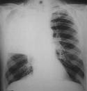
Case 2:
A 28 Year Old Female presented to the accident and emergency of KKUH with a sudden onset of fever, right sided chest pain and productive cough of purulent sputum. On examination her temperature was 39 °C. There were Rhonci and dullness on the right side of the chest X-ray showed massive consolidation on the right side of the chest.
What is the differential diagnosis?
  Streptococcus Pneumoniae, S.aureus, Haemophilus influenzae …. All cause Chest infection (Lobar pneumonia).
What investigation should be done?
  CBC.
  Gram stain from sputum .
  Culture of The sputum on blood agar.
  catalase test.
  Optochin susceptibility test.
  Antibiotic susceptibility test
The chest X- ray done showed massive consolidation on the right side of the chest.
What is the most likely organism?
  Streptococcus Pneumoniae.
What should have been the empirical therapy for this case and why?
  Ceftriaxone+ Vancomycin.
  -Because the organism may be Penicillin resistant.

Slide 9
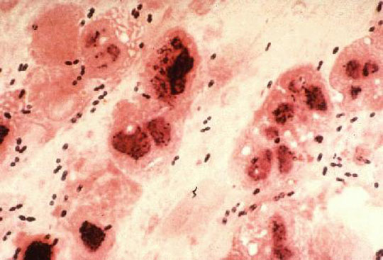
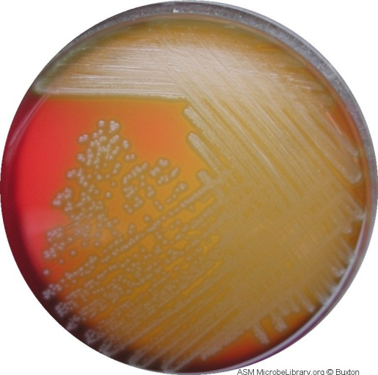
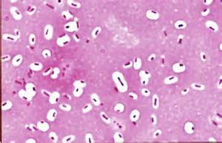
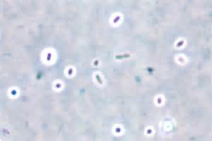
Sputum culture showed:
Alpha haemolysis on blood agar (colonies surrounded by partial haemolysis with greenish color).
MICROSCOPIC APEARANCE
 culture
Gram stain From sputum showed :
Gram positive diplococci (arranged in piers) + pus cells
Negative Stains showing capsule:
Capsule stain
India ink stain

Slide 10
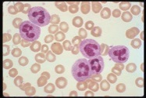
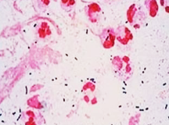
Lab. Tests Results(Summary)
 | Result | TEST
 | 45,000/ ml 90% of the cells were neutrophils | CBC
 | Alpha haemolysis | CULTURE ON BLOOD AGAR
 | No bubbles → catalase negative | CATALASE TEST
 | gram positive diplococci in pairs | GRAM STAIN
 | Optochin Susceptible colonies | Optochin SUSCEPTIBILITY TEST
Streptococcus pneumoniae (Pneumococcus)

Slide 11
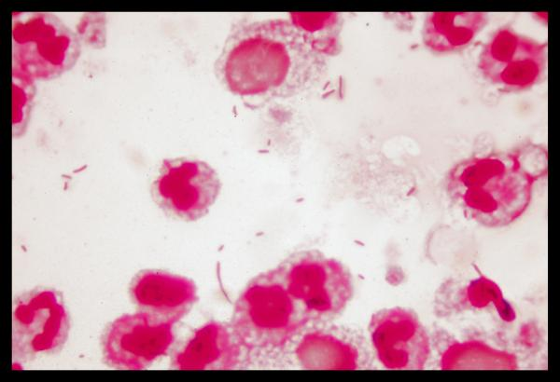
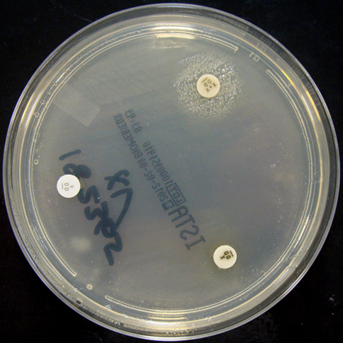
Case 3:
A 3-year-old girl is brought to your office by her mother because she has a fever and complains that her ear hurts. She has no significant medical history. Her temperature is 38.8°C, injected tympanic membranes.
  What is the differential diagnosis?*
    Haemophilus influenzae , S. arouse, Streptococcus Pneumoniae….(all cause otitis media)
What investigation should be done?
  Gram stain from ear discharge .
  Culture of The specimen on blood and mackonckey agar.
  Biochemical tests
  Antibiotic susceptibility test
*دامه قال (differential) فنذكر كل الممكن يسبب هذه الاعراض
The tests showed :
RESULT | TEST
gram negative coccobacilli | GRAM STAIN FROM EAR DISCHARGE
Haemophilus influenzae grow around the disc containing X and V factors | Nutrient agar with X and V factors:
GRAM STAIN
Nutrient agar with X and V factors
Haemophilus influenza تنمو فقط في التشوكلت آغار, لأنها تحتاج مكونات موجودة فيه فقط(اكس وفي)
Nutrient agar هذا اغار لا يحتوي شيء فقط نضع فيه الديسكز

Slide 12
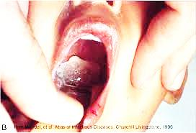
Case 4:
A 5 year-old boy attended to the emergency department complaining of sore throat , fever (38.5°C), and a noticed pharyngeal pseudomembrane
What is the differential diagnosis?
  Diphtheria, ……اذكروا أي شيء آخر ☺
What investigation should be done?
  Gram stain From culture.
  Throat swab culture on blood tellurite.
  ELEK’s test
What is the likely identity of the organism?
  Corynebacterium diphtheriae
What is the best antibiotic therapy for this child?
  Anti-toxin
  Penicillin , If allergic, use Erythromycin.
What complication may this child develop?
  Local complication (descent of pseudomembrane)
  Cardiac failure
  adrenal infraction

Slide 13
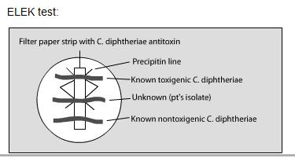
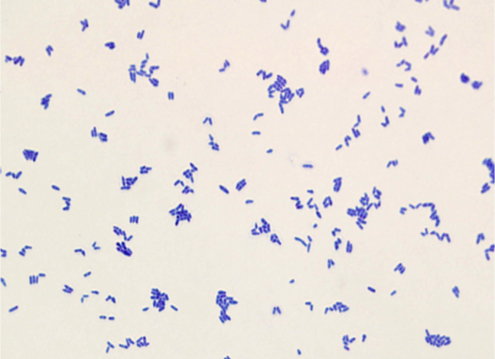
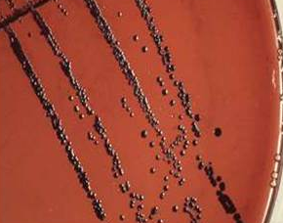
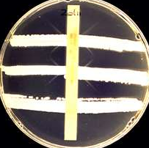
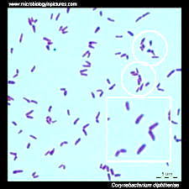
Throat swab culture on blood tellurite showed:
Black color colonies
MICROSCOPIC APEARANCE
 culture
 ELEK TEST
Gram stain From culture showed :
Gram positive bacilli (chains' litter appearance)
Toxin from culture of C. diphtheriae diffused and react with the diphtheria antitoxin defused from strip and produce precipitation lines → which demonstrate positive test (Diphtheria exotoxin production)
Corynebacterium diphtheriae

Slide 14
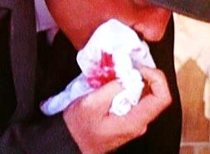
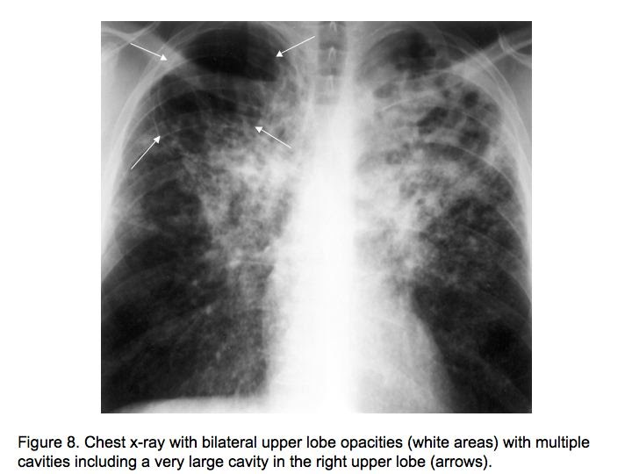
Case 5:
Abdul Karim is a 45 year old Saudi man who was admitted to KKUH because of 2-3 month history of loss of appetite, weight loss, and on and off fever with attacks of cough. On examination Abdul Karim looked weak with a temperature 38.6 °C, CVS and Respiratory system examination was unremarkable. two days before admission .he coughed blood (haemoptysis), Abdul karim is diabetic for the last 5 years. His father died of tuberculosis at the age of 45 yr
What is the differential diagnosis?
  Chronic Pulmonary infection ( TB, virus, fungal )
What investigation- tests should be done?
  X-ray
  Sputum Microscopy: Ziehl-Neelsen stain (Shows Acid Fast Bacilli)
  Culture: Growth on L.J medium (Selective for Mycobacteria )
What is the probable diagnosis?
  Pulmonary TB
How can the diagnosis be confirmed?
  Measurement of Interferon–Gamma (IFNγ).
  If the morphology on LJ media showed buff rough and tough colonies.
  If the growth occurred at 37°C and produced 5-10%CO 2.
The chest X- ray done showed multiple opacities and cavities.
The ESR was increased (85 m /hour).
The chest X- ray done showed multiple opacities and cavities

Slide 15
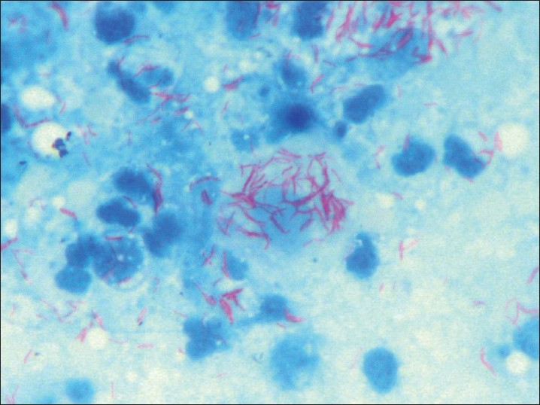
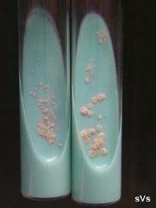
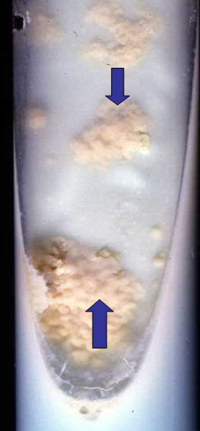
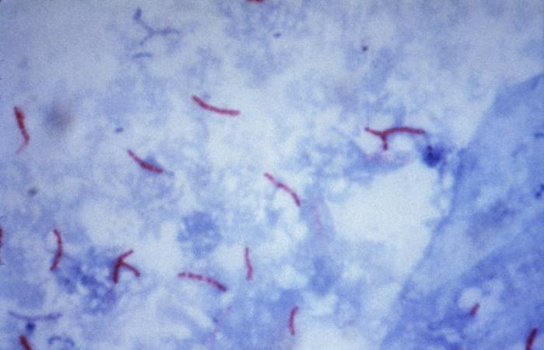
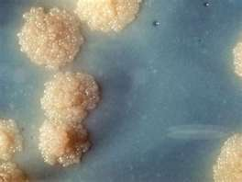
Sputum culture on Lowenstein–Jensen medium (selective for mycobacteria) showed: showing growth of Rough, Tough and Buff colonies
MICROSCOPIC APEARANCE
 culture
Ziel – Neelsen Stained Smear From Sputum Showing:
Acid – Fast Bacilli (AFB)

Slide 16
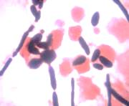
Case 6:
A 45-year old women who underwent bilateral lung transplant developed fever and respiratory failure 4 days post-operatively. She received immunosuppressive therapy. Gram stain of lung tissue biopsy shown below figure:
What is the differential diagnosis?
  Candida albicans
What investigation should be done?
  Gram stained of lung tissue.
  Culture from sputum on SDA.
  Germ tube test.
  chlamydospore test.
  Candida albicans

Slide 17
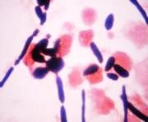
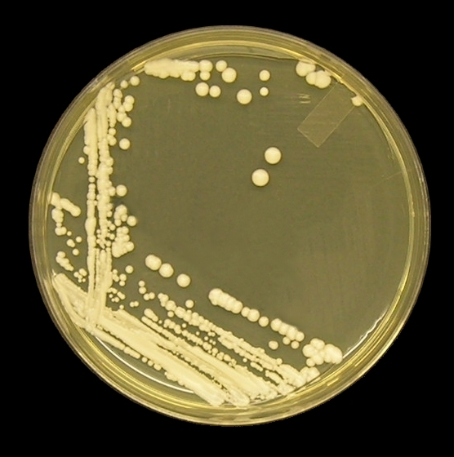
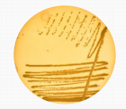
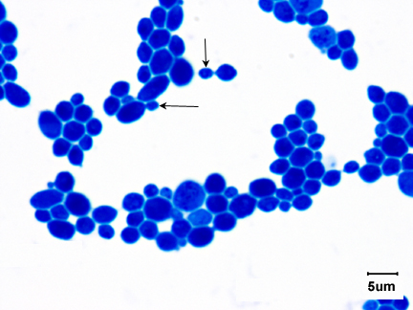
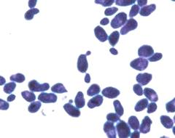
Culture from sputum on SDA (Sabouraud's Dextrose Aagar) showed:
Cream color colonies.
MICROSCOPIC APEARANCE
 culture
1- Gram stained of lung tissue showed :
Budding yeast cells & pseudohyphae.
2- Gram stain From culture showed :
Gram positive oval budding yeast cells.

Slide 18
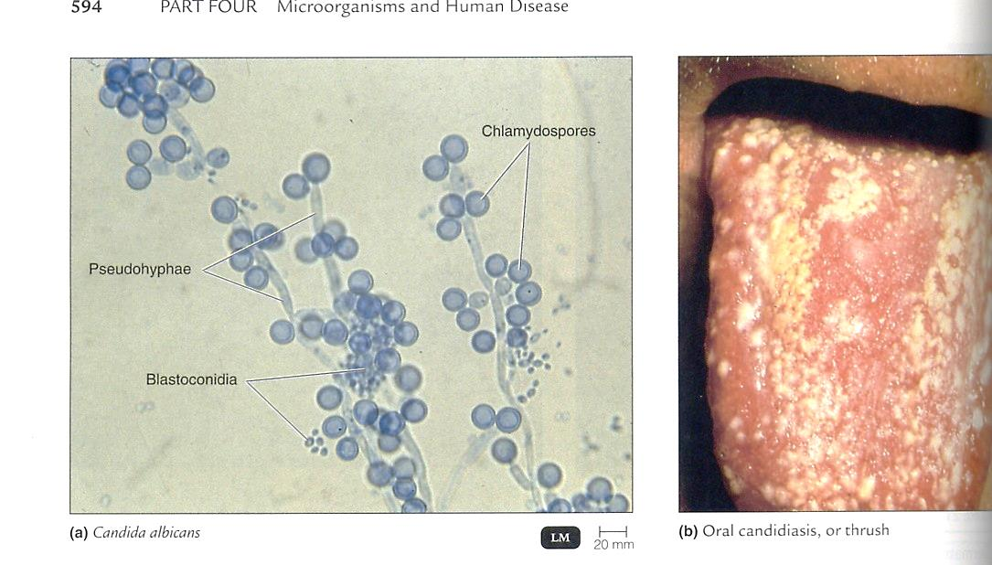
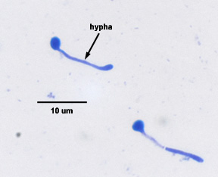
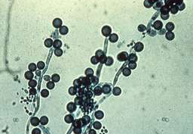
+Ve Test
CHLAMEDOSPORE TEST
 GERM TUBE TEST
CULTURE ON CORN MEAL AGAR
+Ve Test

Slide 19

Lab. Tests Results(Summary)
 | Result | TEST
 | Budding yeast cells & pseudohyphae. | Gram stained of lung tissue
 | Cream color colonies | CULTURE ON SDA
 | Chlamydospores, blastosconidia and pseudohyphae | CHLAMEDOSPORE TEST
 | Germination of tube | GERM TUBE TEST
Candida albicans

Slide 20
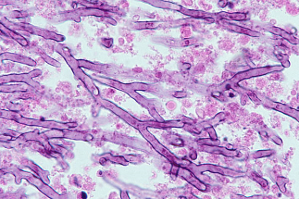
Case 7:
A 15-yaer old girl who recently diagnosed as acute leukemia developed prolonged granulocytopenia (less than 100/muL) and refractory fever for 14 days and pulmonary signs or symptoms of pneumonia. Lung biopsy showed the below figer:
What is the differential diagnosis?
    Aspergillus niger
What investigation should be done?
  Methenamine silver (GMS).
  H&E Stain.
  Culture from sputum on SDA.
  LPCB preparation from culture
  Aspergillus niger

Slide 21
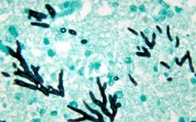
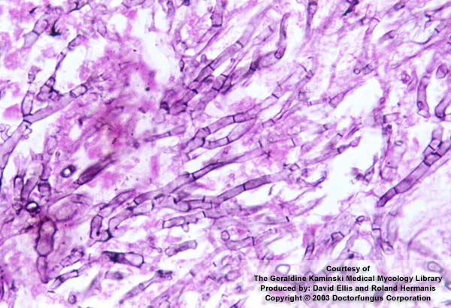
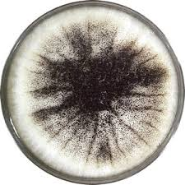
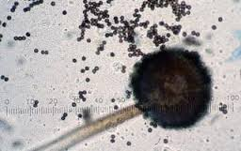
Lab. Tests Results(Summary)
Images | Result | TEST
 | Dichotomously branching fungal element | Methenamine silver (GMS) tissue stain of lung:
 | Dichotomously branching fungal element | H&E tissue Stain
 | Salt and pepper appearance | Culture from sputem on SDA :
 | Dark brown conidial heads and true hyphae | LPCB preparation from culture
Aspergillus niger

