Slide 1



Spirometry
Objectives :
Use a spirometer and determine lung volumes and capacities
Define and provide values for the various lung volumes and capacities .
Recognize the physiological and some pathological factors that modify lung volumes and capacities.
Physiology lab Team 436 – Respiratory block
This work include Boy’s + girl’s slides + girl’s handout
Team work : Leena Alwakeel – Hassan Alshammari – Ruba Ali

Slide 2
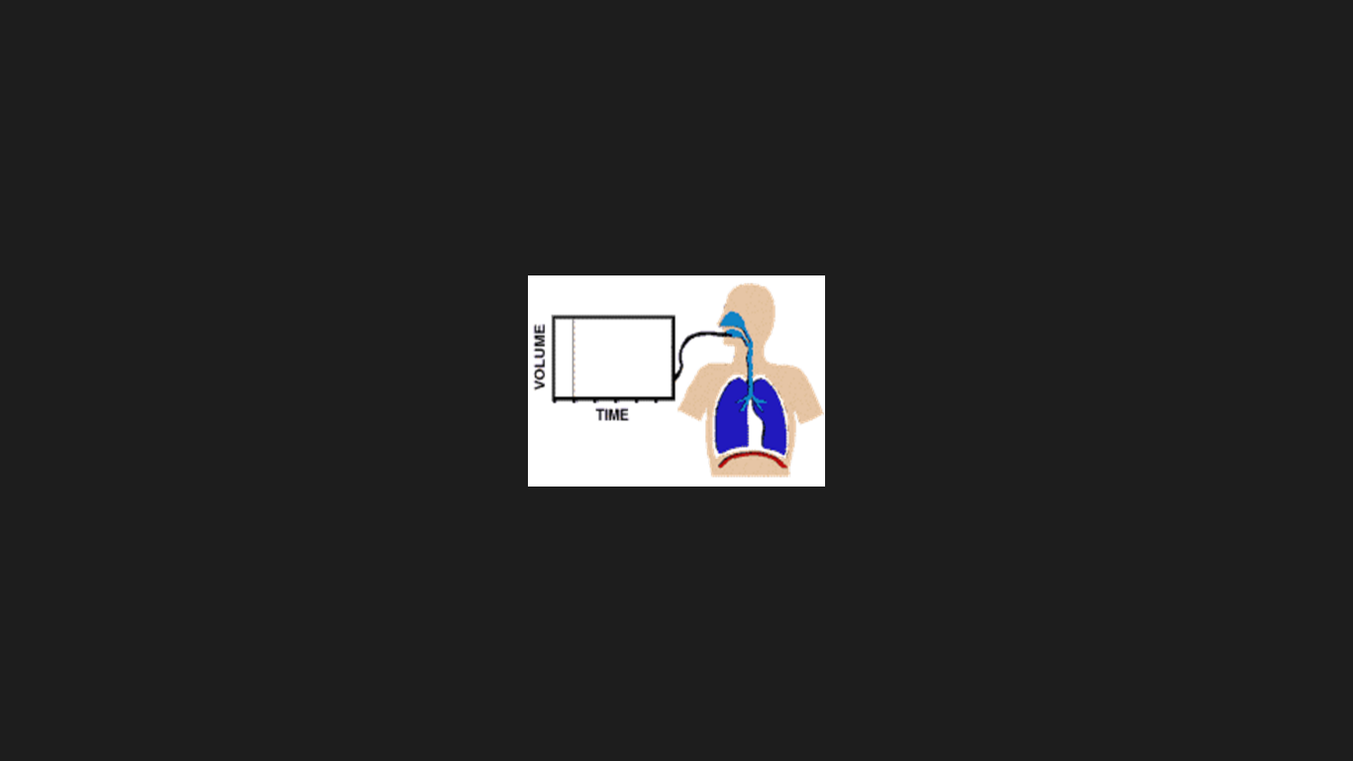
What is spirometry ?
It is a pulmonary function test that measures lung volumes and capacities.
Why a spirometry test ?
1
To determine the cause of shortness of breath
2
To rule out any kind of obstructive or restrictive disease
3
To diagnose and monitor lung problems
4
To monitor how well medications for lung problems are working

Slide 3
Simple Spirometer
Doctor’s note : Just understand it
- Drum inverted over a chamber of water with the drum counterbalanced by a weight.
- The drum contains air or Oxygen.
- A Tube connects the mouth with the gas Chamber.
- When one breathes in and out of the chamber, the drum rises and falls.
- An appropriate recording is made on a moving paper.
1- Insert sterilized mouthpiece
2- Close the nose with the nose clip
3-Take normal breath through the mouthpiece for a short time then take a deep inspiration to fill the lungs completely, then breathe normally for a short time. Do the same for expiration
4- Take a deep forceful inspiration and immediately expire forcibly and as completely as possible, then breathe normally.
5- The spirogram is recorded on a moving drum
Method of spirometer :

Slide 4
Air in the lungs is subdivided into :
Doctor’s note : Very important with numbers
(4 volumes and 4 capacities) :
4 volumes :
Tidal volume : (TV) The volume of air that inspired or expired during normal breathing it is normal value is = 500ml or 0.5L | Expiratory reserve volume: (ERV) The volume expelled by an active expiratory effort after passive expiration ( after the end of a normal tidal expiration) = 1.1L \ 1100ml
Inspiratory reserve volume : (IRV) The extra volume of air that can be inspired above the normal tidal volume = 3L \ 3000ml | Residual volume: (RV) The air left in the lungs after the most forceful expiration = 1.2L
4 Capacities :
Measured by : Helium dilution technique (can’t be measured by Spirometry )
Total lung Capacity:
TLC= VC+RV
The max volume to which the lungs can be expanded with the greatest possible inspiratory effort = 5.8L
Vital Capacity :
VC= IRV+TV+ERV
Maximum amount of air a person can expel after maximal inspiration = 4.6L \ 4600ml
Functional Residual Capacity :
FRC= ERV+RV
Amount of air that remains in the lungs at the end of normal expiration = 2.3L
The Inspiratory Capacity :
IC= TV+IRV
The volume of air that can be maximally inhaled after normal expiration . It is normal value is = 3.5L \ 3500ml
Measured by : Helium dilution technique
Physiological significance of RV & FRC :
Prevent lung collapsing , make breathing easier, maintain continuous gas exchange
Measured by : Helium dilution technique (contain RV)
Numbers could be asked by ml or L (1L= 1000ml)
Numbers are taking from female handout according to doctors’ note
Notes:
other definition of IC : it is the volume of air that can be maximally inhaled after normal expiration .

Slide 5
factors influencing lung volumes and capacities
Physiological factors
Pathological factors
Gender: female 20-25% less in all volumes & capacities.
Age: with age… ↑ RV, ↑ FRC while ↓ VC.
Obesity (weight): ↓ FRC, ↓ VC.
Height: ↑ VC.
Athletes: ↑ VC .
Pregnancy & Posture (Body position).
Vital capacity is decreased with :
↓lung volume:
E.g: surgical removal of lung tissues large tumors.
Restrictive lung disease: inability to fully expand the lungs. E.g: Pneumonia, pulmonary edema\fibrosis , broken ribs. ↑ elastic recoil of the lungs , ↓ VC, ↓ IRV, ↓ ERV, ↓ RV, ↓ TV , ↑ breathing frequency.
Obstructive lung disease E.g: Chronic bronchitis, asthma, emphysema and foreign body. ↓ elastic recoil of the alveoli , ↑ TLC, ↑ FRC, ↑ RV, ↑ TV , ↓ VC, ↓ ERV .
Loss of elastic recoil E.g: emphysema.
Chest wall deformities & respiratory muscle weakness.
لتسهيل الحفظ في الزيادة و النقص في ال volumes & capacities لازم أن يفهم السلايد الماضي.

Slide 6
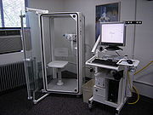
Dynamic spirometry
Objectives :
Understanding Forced expiratory volume curve (FEV).
Understanding Flow-volume curve (Loops).
Calculating : FVC, FEV1and FEV1% of FEV Curve.
Calculating : FVC, PEFR, PIFR and MEF50 of Loops Curve.
Physiology lab Team 436 – Respiratory block
This work include Boy’s + girl’s slides + girl’s handout
Team work : Leena Alwakeel – Hassan Alshammari – Ruba Ali

Slide 7
Type of spirometry
Static test (1st lecture)
Dynamic test
* It provides an objective measurement of lung function.
* It analyzes volume and velocity of expired air
Forced vital capacity :
the max volume of air that can be forcibly and rapidly exhaled following a max inspiration.
* Performed at forcible and max effort against time
* Measures the rate (with time) at which the lung changes volume during forced breathing
Relaxed Vital Capacity :
Max Volume of air expired during relaxed expiration after a maximal inspiration
Performed without regard to time
Requirements Of Dynamic spirometry:
Vitalograph (device).
Mouthpiece (disposable).
Nose clip
Procedure:
Make a tight seal around
the mouthpiece.
Ask subject to inhale
deeply.
In standing position , ask the subject to breath normally for 3 time then exhale as strong and as fast as possible.
Doctor’s note : Just understand it
Importance of Dynamic spirometry
1- Assess physical ﬁtness
2- Helps in the diagnosis of certain pulmonary diseases (obstructive & restrictive)
3- Follow disease progression

Slide 8
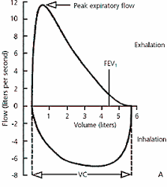
There are TWO type of curve in dynamic spirometry
Forced Expiratory volume Curve
Flow volume curve (slide 11)
FEV1 : Volume of air expelled in the 1st sec of forced expiration starting from full inspiration .
Function : measure of how quickly the lungs can be emptied.
Forced Vital Capacity (FVC) = Plateau (Horizontal curve line )
FVC : the volume of air expired with forceful effort after a maximum inspiration FEV1 % (FEV1 ratio) = (FEV1/FVC) * 100 : Fraction of the Vital capacity (VC) expired during the 1st sec of a forced expiration
Normal range : ( 70% - 80% )
Function : The ratio is useful index of airﬂow limitation
The subject takes :
    1- A maximal inspiration
    2- Then exhales as rapidly , as forcibly & as maximally as long as possible.
A plot of exhaled volume against time :
- The equation -

Slide 9
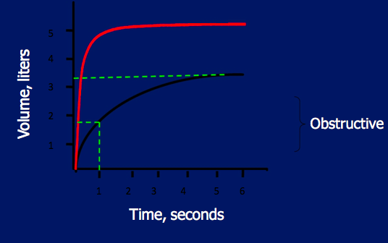
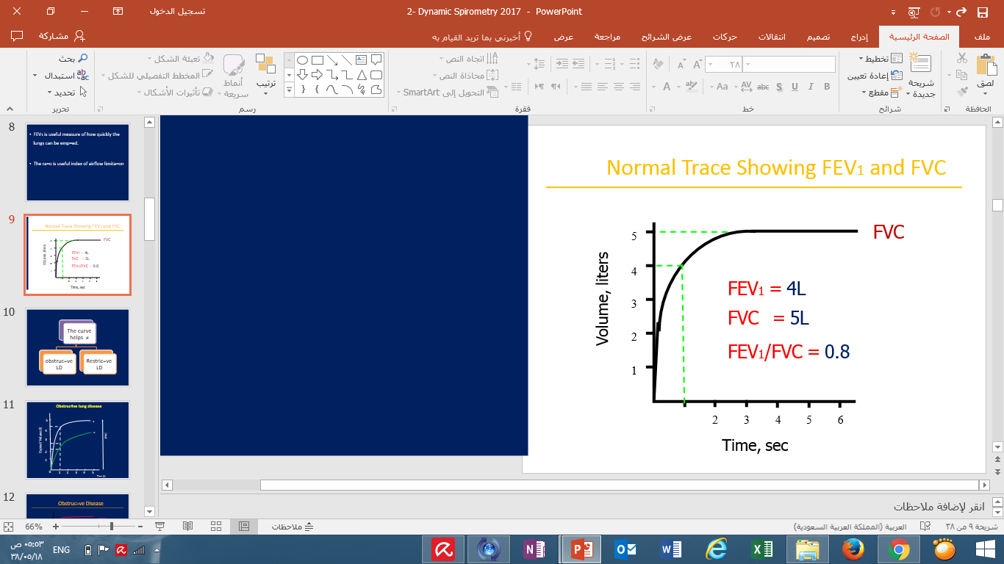
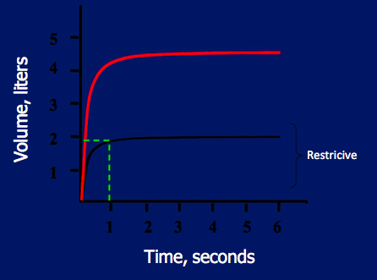
Forced Expiratory Curve
Doctor’s note : Very important
They will give you a curve and u should come up with FEV1 , FVC & FEV1 ratio then you will decide if it Obstructive or restrictive curve
Normal Trace
Normal
1- Obstructive LD
E.g : COPD
FEV1 = 1.8L
FVC = 3.2L
FEV1/FVC = 0.56
Duration or forceful expiration : >5 sec
Almost = 6sec
Duration or forceful expiration :
3-5 sec
FEV1 = ↓
FVC = ↓ or ↔
FEV1/FVC = ↓
↑ Airway resistance
Normal FEV1 ratio = (70-80)%
2- Restrictive LD
E.g : pulmonary fibrosis
How to get the information from the curve for diagnosis (obstructive , restrictive) :
FEV1 = draw a vertical line from the 1st sec (on x-axis) until it reaches the curve then draw a second horizontal line (from the end of the 11st line) toward Y- axis (the volume)= 4
FVC = we draw a horizontal line from the moment that the curve begin to be a plateau (horizontal ) = 5
FEV1/FVC = 4/5 X100 = 80% (normal)
Normal
FEV1 = 1.9L
FVC = 2.0L
FEV1/FVC = 0.95
Duration or forceful expiration : 3-5 sec
FEV1 = ↓
FVC = ↓ FEV1/FVC = ↑ or ↔
↓ Lung compliance
((( FVC in Restrictive lung disease is only decreased )))
LD = lung disease

Slide 10
Results Interpretation ( Extra example )
When we do this test on a patient Results of patient are reported as absolute values (liter) ,and as percentages of predicted values (normal value of person ) based on age, height, sex, ethnicity.
Example : patient has this readings (FEV1 = 3.16. , FVC = 3.97 ) .
Step1: calculate predicted value
Predicted value of FEV1 (3.16 / 4) * 100 = 79%
Predicted value of FVC (3.97 / 5) * 100 = 79%
So this patient is healthy
-----------------------------
Other example : patient has this readings ( FEV1= 1.8 , FVC =3.2 ).
Step1: calculate predicted value
Predicted value of FEV1 (1.8 / 4) * 100 = 45%
Predicted value of FVC (3.2 / 5) * 100 = 0.64%
Step2 : calculate FEV1/FVC
(1.8 / 3.2 ) * 100 = 56.25 %
So this patient has obstructive disease
دائما لما نحسب ال predicted value of FEV1 نقسم على 4
اما Predicted value of FVC نقسم على 5
If both predicted values are greater than 75 %, we conclude that the patient is healthy .
If one of the predicted values is lesser than 75 %, we should calculate FEV1/ FVC.
Remember :
If FEV1 % ( 70% - 80% ) à Normal
If FEV1 % ≥ 80% à Restrictive
If FEV1 % < 70 % à Obstructive
Numbers with this color are just an example cause it differ from person to another due to age , sex , etc…

Slide 11
Practice Questions
Dynamic Spirometry was done on 3 patients, the results were the following:
A. FEV1= 4L , FVC=5L FEV1/FVC = 80% (Normal) because ratio is within normal range 70% - 80%
B. FEV1=1.2L , FVC=3L FEV1/FVC = 40% (obstructive) because ratio is lower than 70%
C. FEV1= 2.7 L, FVC=3L FEV1/FVC = 90% (restrictive) because ratio is higher than 80%

Slide 12

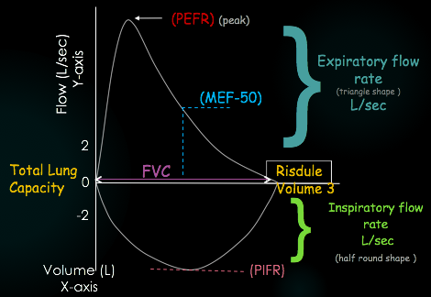
Flow Volume loop
Doctor’s note : Curve is Very important
They will give you a curve and u should come up with FVC , PEFR & PIFR then you will decide if it Obstructive = concave shape or restrictive = small shape curve ( on the next slides)
It is a process that measures expiration & inspiration ﬂow as a function of exhaled volume rather then against time.
Definition:
Method :
Just understand it
Curve :
Breathes normally (TV)
Exhales Fast
Rapid max inspiration
Max inspiration
PEFR : peak expiratory flow rate.
PIFR : peak inspiratory flow rate.
MEF50 : maximum expiratory flow at 50% of VC .
•PEFR : maximum expiratory ﬂow speed that achieved during forceful expiratory effort = 6 -12 L/sec (Y- axis). | •PIFR = max inspiratory ﬂow speed that achieved during forceful inspiratory eﬀort =6 L/sec (Y- axis).
MEF-50 : max expiratory ﬂow at 50% of VC = 4- 6 L ( Y- axis). | •FVC measured over the X-axis (Volume )
It is very important to know how to calculate FVC, PEFR, PIFR and MEF50
You have to know where is expiratory loop as well as inspiratory loop.

Slide 13
Example :How to get the information from flow-volume curve ?
Doctor’s note : Curve is Very important
They will give you a curve and u should come up with FVC , PEFR & PIFR then you will decide if it Obstructive = concave shape or restrictive = small shape curve ( on the next slides)
Expiratory loop
Inspiratory loop
From the curve above :
FVC : it is the value of x-axis that the expiratory loop falls. (~ 5.8 L )
PEFR: look at the peak of expiratory loop and draw horizontal line towards Y-axis. (~12 L/s )
PIFR: look at the peak of inspiratory loop and draw horizontal line towards Y-axis. (~ 7 L/s )
The numbers above are just an example.

Slide 14
Flow Volume Loop and Flow Limitation
Effort dependent
Happened in :
Inspiratory + 1st early ﬂow rates of the expiratory curve
(ﬂows generated near the TLC )
Harder (effort) forces the air out
→ will raise pleural pressure → The greater effort will result an air flow
Effort independent
Happened in :
1- At low lung Volume ,( as RV is approached)
2- certain pleural pressure (Pip) is reached
(it depends on the size of the bronchi)
Hard effort → Generates higher Pip (but no greater airﬂow because:
Positive Pip ( that tends to collapse the airway) exceeds the airway pressure (that tends to keep the airways open) → will lead to :
1- airways narrow
2- preventing any further increase in airﬂow despite greater eﬀort
The next slide contains doctor’s notes witch may help you to understand this slide.

Slide 15
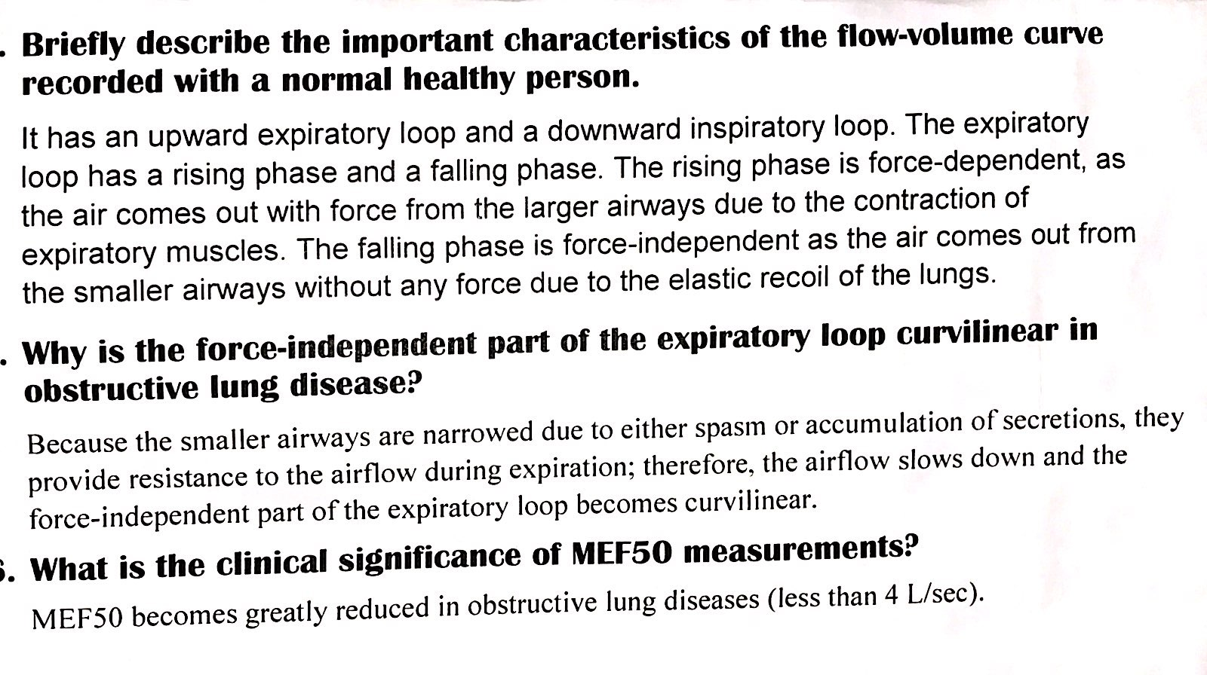
Doctor’s Notes ( explanation of flow-volume curve )
+ inspiratory loop

Slide 16
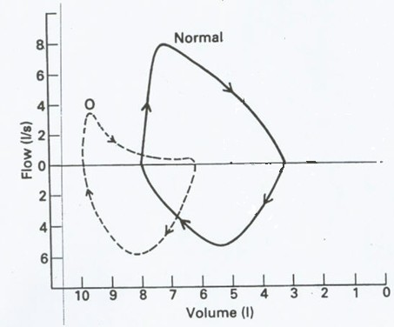
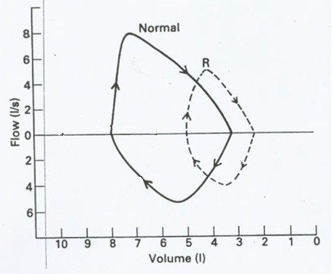
Obstructive & Restrictive Lung disease
Doctor’s note : Very important
 | OBSTRUCTIVE LD | RESTRICTIVE LD
PARAMETER | PEFR : ↓ | All ﬂow parameters :↓
 | MEF50 :↓
CURVE SHAPE | Inspiratory loop: Normal | Miniature loop (elliptical) (both inspiration & expiration )
 | affect eﬀort : independent curve: concave
CURVE

