Slide 1
Nose, Nasal Cavity, Paranasal Sinuses, and Pharynx
Color Code
Important
Doctors Notes
Notes/Extra explanation
Please view our Editing File before studying this lecture to check for any changes.

Slide 2
Objectives
At the end of the lecture, the students should be able to:
Describe the boundaries of the nasal cavity.
Describe the nasal conchae and meati.
Demonstrate the openings in each meatus.
Describe the paranasal sinuses and their functions
Describe the pharynx and its parts, and the related structures.

Slide 3
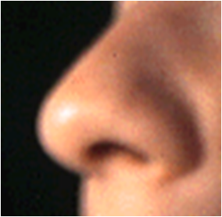
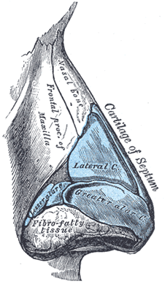
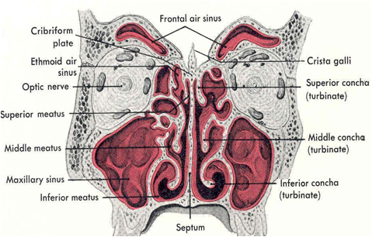
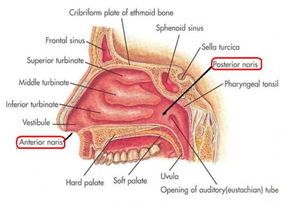
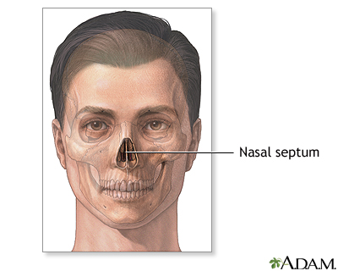
Nose
root
Bony skeleton
The external (anterior) nares or nostrils, lead to the nasal cavity.
Formed above by: Bony skeleton
Formed below by plates of
hyaline cartilage.
tip
Hyaline cartilage
ala
septum
external nares
Nasal Cavity
Extends from the external (anterior) nares to the posterior nares (choanae).
Divided into right & left halves by the nasal septum.
Each half has a:
Roof
Floor
Medial wall (septum)
Lateral wall
Extra

Slide 4
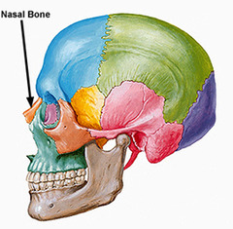
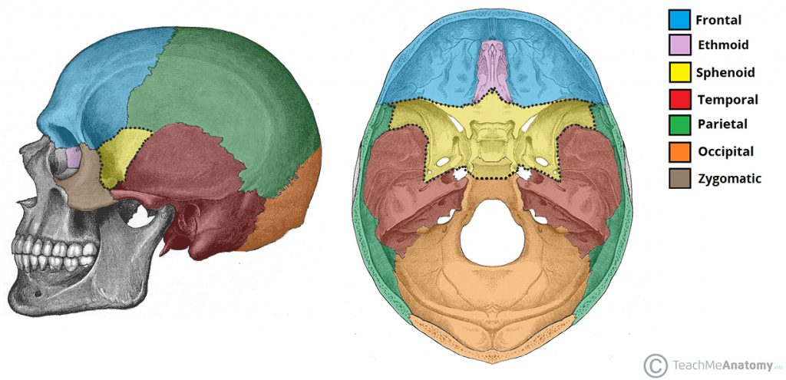
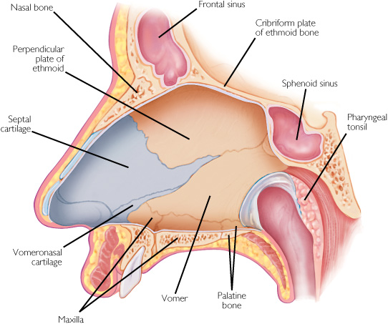
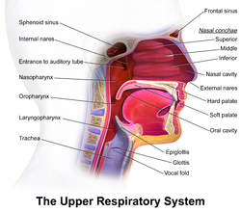
Nasal Cavity
1. Roof
Narrow & formed (from behind to forward) by:
1. Body of sphenoid.
2. Cribriform plate of ethmoid bone.
3. Frontal bone.
4. Nasal bone & cartilage
Extra
Extra
3
2
2. Floor
Separates it (nasal cavity) from the oral cavity.
Formed by the hard (bony) palate.
Note:
There are 2 palates: a soft palate and a hard palate.
4
1
Extra

Slide 5
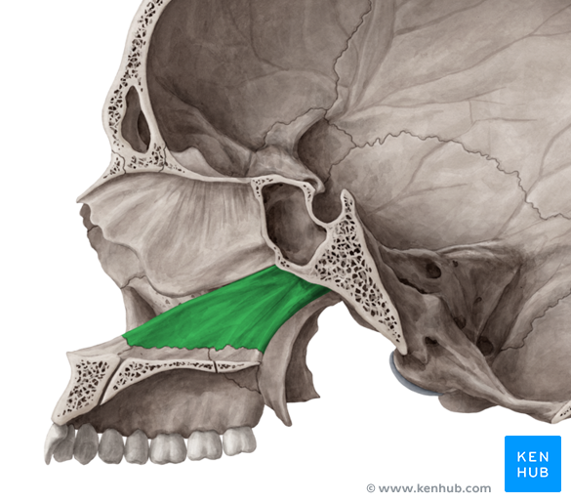
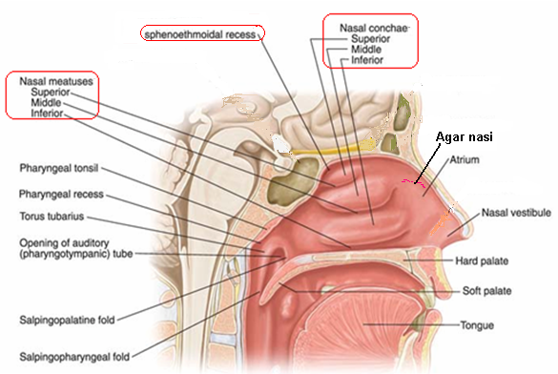
Nasal Cavity
Extra
3. Medial Wall (Nasal Septum)
Osteocartilaginous partition.
Formed by:
1. Perpendicular plate of ethmoid bone.
2. Vomer.
3. Septal cartilage.
Vomer
1
3
2
*Don’t get confused between the choanae (posterior nares) and the conchae!
4. Lateral Wall
Shows three horizontal bony projections, the superior, middle & inferior conchae*
The cavity below each concha is called a meatus and are named as superior, middle & inferior meatus corresponding to the conchae.
The small space above the superior concha and below the roof is the sphenoethmoidal recess.
The conchae increase the surface area of the nasal cavity.
The recess & meati receive the openings of the: Paranasal sinuses and Nasolacrimal duct. (will be discussed later)

Slide 6
Nasal Cavity
Nasal Mucosa
We have 2 type of nasal mucosa: olfactory and respiratory.
Olfactory: (relating to the sense of smell)
It is delicate and contains olfactory nerve cells (carries smell to the brain)
It is present in the upper part of nasal cavity in the roof, lateral wall and medial wall.
On the Lateral wall : It lines the upper surface of the superior concha and the sphenoethmoidal recess.
On the Medial wall: It lines the superior part of the nasal septum

Slide 7
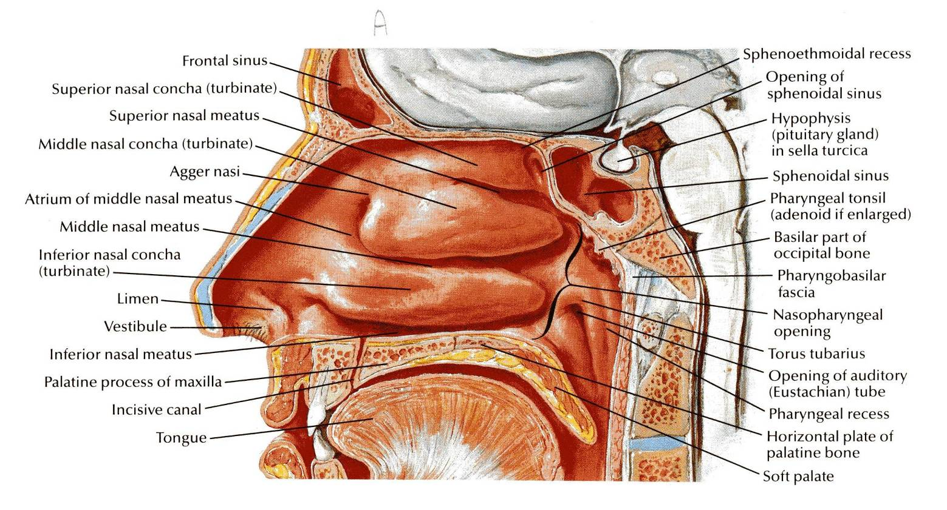
Respiratory mucosa (lining the rest of the nasal cavity)
Nasal Cavity
Nasal Mucosa
The inspired air is dirty , dry and cold. So, the respiratory mucosa will clean, moisten and warm the inspired air.
We have 2 type of nasal mucosa: olfactory and respiratory.
It is thick, ciliated ,highly vascular and contains mucous glands & goblet cells.
It lines the Lower part of the nasal cavity.
It functions to moisten, clean and warm the inspired air.
The air is moistened by the secretion of numerous serous glands.
It is cleaned by the removal of the dust particles by the ciliary action of the columnar ciliated epithelium that covers the mucosa.
The air is warmed by a submucous venous plexus.
Vestibule is lined by Skin.(the only part of the nasal cavity lined by skin not mucosa)

Slide 8
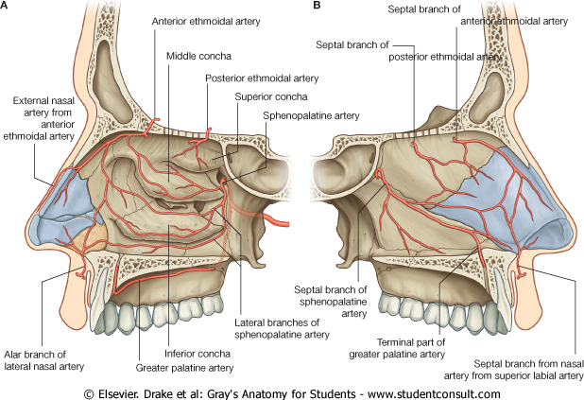
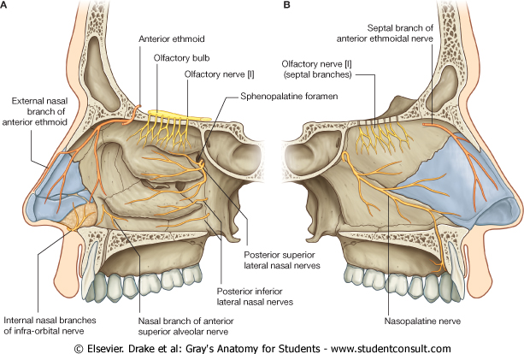
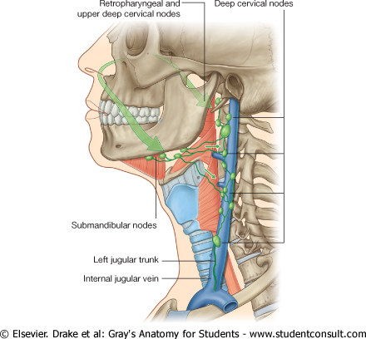
Nasal Cavity
Arterial Supply:
-Branches of the:
Maxillary: sphenopalatine artery
Facial: superior labial artery
Ophthalmic: ethmoidal arteries.
-The arteries make a rich anastomosis in the region of the vestibule, and anterior portion of the septum.
Venous Drainage:
Submucosal plexus by veins accompany the arteries which drain into the:
Facial vein
Ophthalmic vein
Spheno-palatine vein
Maxillary and facial arteries are branch of external carotid artery Opthalmic artery is branch of internal carotid artery.
Nerve supply:
-Olfactory mucosa supplied by olfactory nerves (speacial sensation).
-Nerves of general sensation are derived from:
Ophthalmic nerve
Maxillary nerve.
Anterior ethemoidal nerve.
Autonomic fibers: Nasal, nasopalatine and palatine branches of the ptergopalatine ganglion.
Branches from the trigeminal nerve
Lymphatic Drainage:
The lymphatics from the:
Vestibule drains into the submandibular lymph nodes.
Rest of the cavity drains into the upper deep cervical lymph nodes.

Slide 9
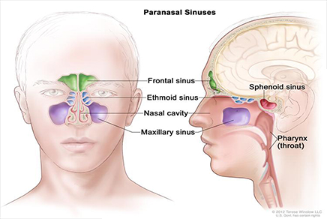
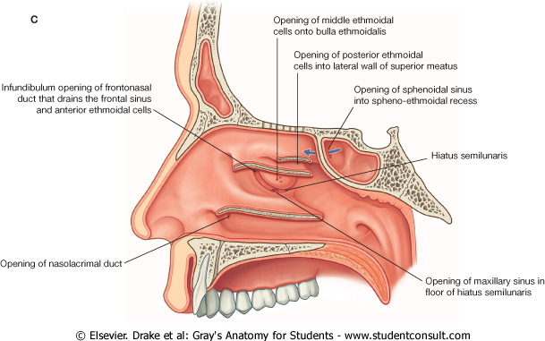
Paranasal Sinuses (الجيوب الأنفيه)
Air filled cavities located in the bones around the nasal cavity: (Ethmoid, Sphenoid, Frontal and Maxilla bones)*
Lined by respiratory mucosa which is continuous with the mucosa of the nasal cavity.
Drain into the nasal cavity (Sinuses drain into recess and meati of the nasal cavity).
Functions :
1- Lighten the weight of the skull.
2- Act as resonant chambers for speech.
3- Air conditioning: The respiratory mucosal lining helps in warming, cleaning and moistening the incoming air.
عشان كذا الاشخاص اللي عندهم التهاب او انسداد في الجيوب الأانفية
(sinusitis ) يتغير صوتهم
* The paranasal sinuses are:
Frontal sinus
Maxillary sinus
Spenoid sinus
Ethmoid sinus (divided into anterior, middle, and posterior)
Opening | Sinus
Spheno-ethmoidal recess | sphenoidal sinus
Superior meatus | posterior ethmoidal sinus
Middle meatus | middle ethmoidal, anterior ethmoidal , maxillary, and frontal sinuses
Inferior meatus | nasolacrimal duct. (carries tears from the lacrimal sac of the eye into the nasal cavity)

Slide 10
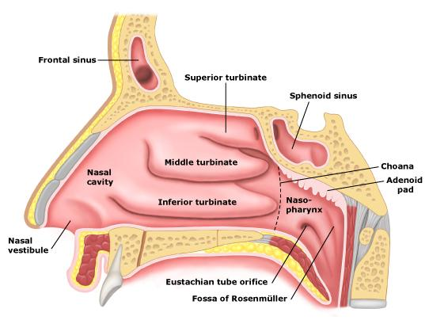
Pharynx
Nasal Cavity
Muscular tube lying behind the nose, oral cavity & larynx.
Extends from the base of the skull to level of the C6 vertebra, where it continuous with the esophagus .
The anterior wall is deficient and shows (from above to downward): 1- Posterior nasal apertures. (choaena) 2- Opening of the oral cavity. 3- Laryngeal inlet.
The muscles are arranged in circular and longitudinal layers.
Oral Cavity
Larynx
Explanation:
The pharynx is made up of muscles that cover/make up the posterior and lateral walls. But they do not cover the anterior wall that’s why it is deficient. Instead the anterior wall is open and connects with the structures listed above.
Extra

Slide 11
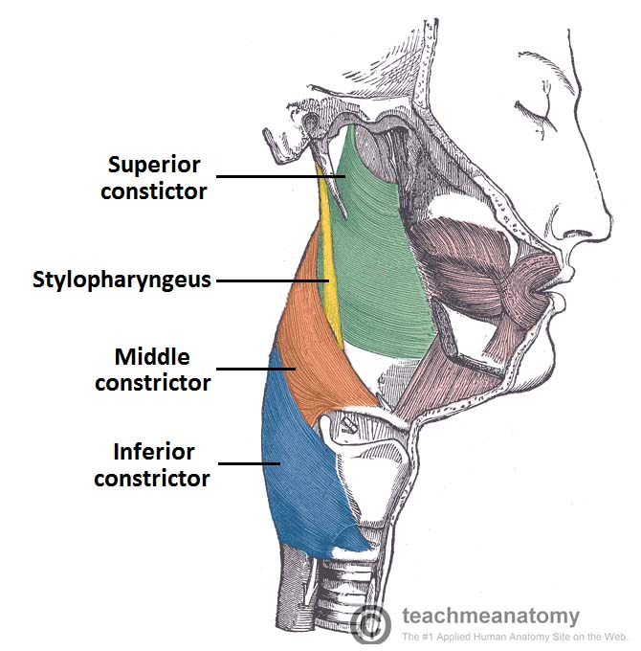
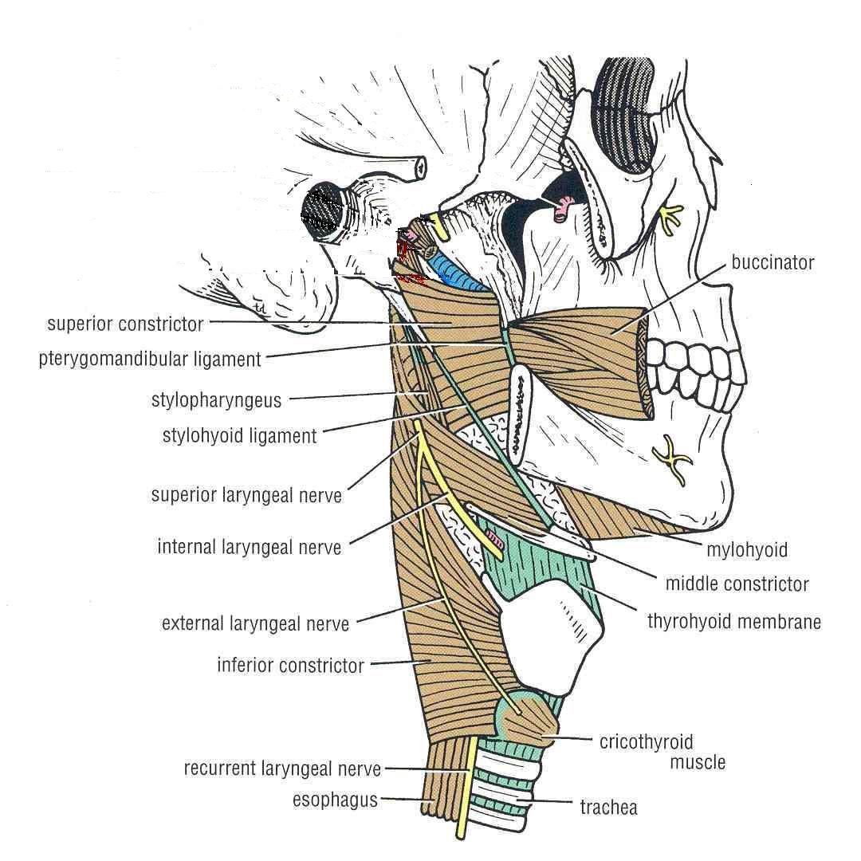
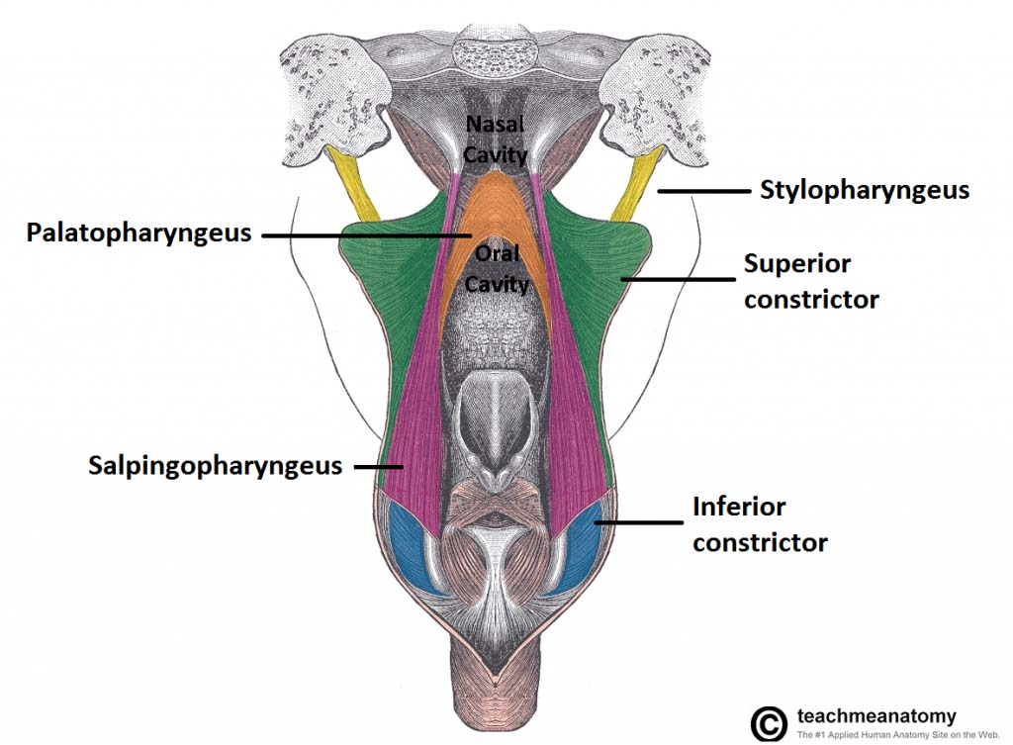
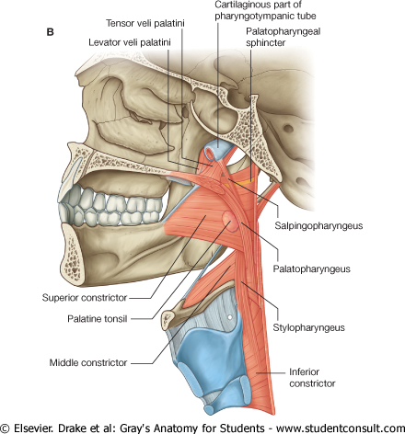
Muscles that form the walls of the Pharynx :
1- Circular (Constrictor) Muscles :
Three in number: (1) Superior constrictor (2) Middle constrictor (3) Inferior constrictor The three muscles overlap each other. Functions: - Propel the bolus of food down into the esophagus. (by contracting sequentially from superior to inferior to constrict the lumen) - lower fibers of the inferior constrictor (Cricopharyngeus) act
as a sphincter, preventing the entry of air into the esophagus
between the acts of swallowing.
2- Longitudinal Muscles :
Three in number: (1) Stylopharyngeus (2) Salpingopharyngeus (3) Palatopharyngeus.
Function: - Elevate the larynx & pharynx during swallowing
S
M
I
Extra
Extra

Slide 12
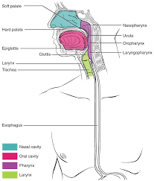
Pharynx
The pharynx is divided into three parts:
Nasopharynx.
Oropharynx.
Laryngopharynx.
داخل البلعوم ، البلع و التنفس ما يمكن أنهم يحصلون بنفس الوقت لهذا:
Nasopharynx & laryngopharynx are concerned with respiration
Oropharynx & laryngopharynx are concerned with swallowing
Divisions of pharynx
(البلعوم)

Slide 13
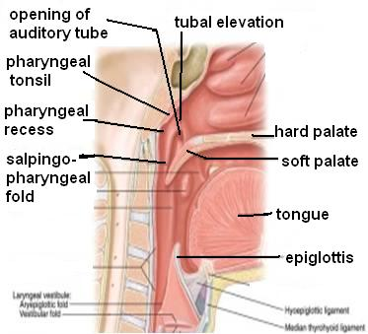
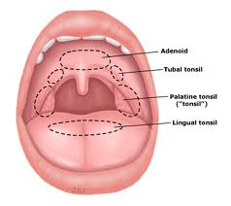
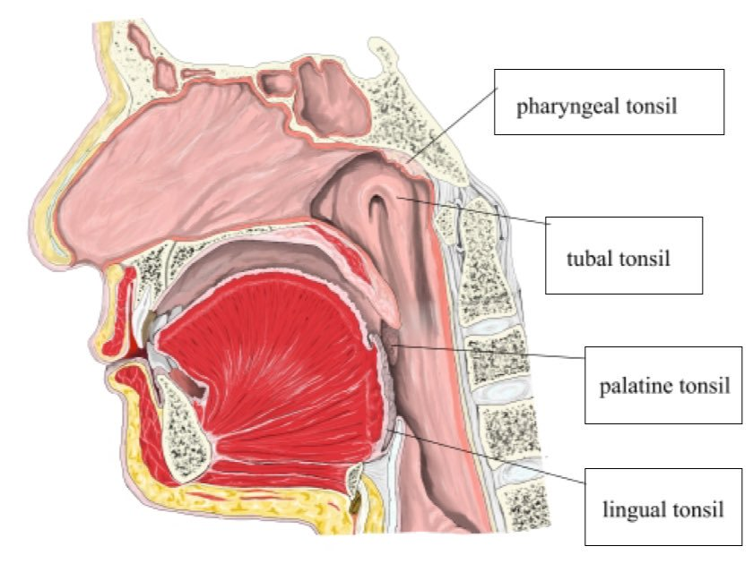
Pharynx Nasopharynx
Extends from the base of skull to the soft palate.
Communicates with the nasal cavity through posterior nasal apertures (choanae)
Pharyngeal tonsils (Adenoides *اللحمية) present in the submucosa covering the roof.
Lateral wall shows:
Opening of auditory tube**.
Tubal elevation (produced by posterior margin of the auditory tube).
Tubal tonsil.
Pharyngeal recess (الجزء الغائر)
Salpingopharyngeal fold (raised by salpingo-pharyngeus muscle).
*خطورة اللحمية لما تكون كبيرة عند بعض الأطفال أنها تسد choanae فما يقدر الطفل يتنفس
Auditory tube (comes from audio)**عبارة عن قناة تفتح على الأذن الوسطى ، وهي المسؤولة عن معادلة الضغط الجوي . تكون مقفلة دائما و تفتح لما يختلف الضغط (عشان كذا لما يختلف الضغط يبلع الواحد ريقه )

Slide 14
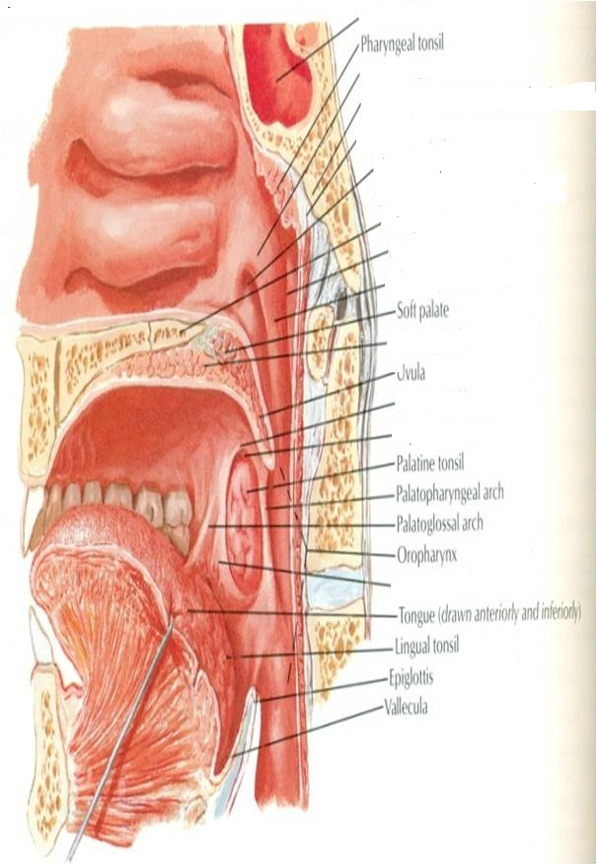
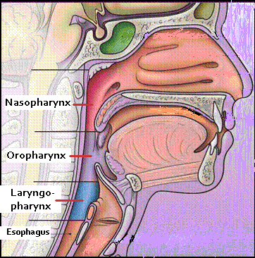
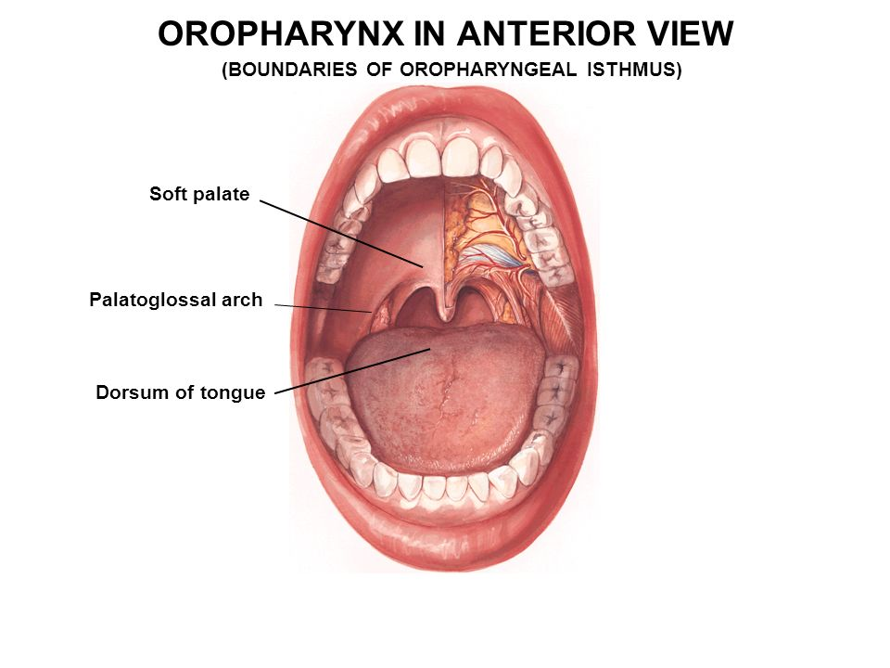
Pharynx Oropharynx
Lies behind the mouth cavity, communicates with the oral cavity through the oropharyngeal isthmus*
Extends from soft palate to upper border of epiglottis.
Lateral wall shows:
Palatopharyngeal fold or arch.
Palatoglossal fold (glossal=related to tongue)
Palatine tonsil اللوز located between them in a depression called the ‘tonsillar fossa’.
*isthmus: a narrow anatomical part or passage connecting two larger structures or cavities (in this case the oral cavity and the pharynx)
Palatoglossal fold
Extra
Extra
Palato-pharyngeal fold
Tonsillar fossa

Slide 15
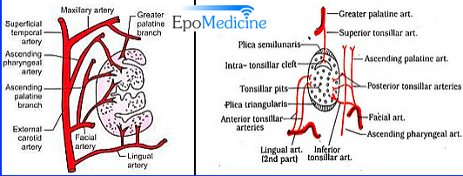
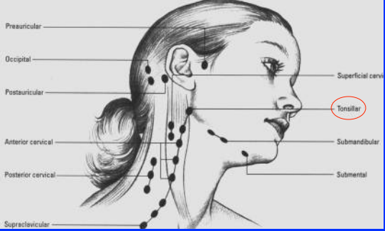
Pharynx Palatine Tonsil
Two masses
Formed of lymphoid tissue
located in the lateral wall of the oropharynx in the tonsillar fossa,
Each one is covered by:
mucous membrane
laterally by fibrous tissue (capsule).
It reaches the maximum size during childhood, after puberty it diminishes in size . لأن الانسان اذا كبر تقل مناعته
Arterial supply | tonsillar artery from the fascial, lingual, ascending pharyngeal and greater palatine.
Venous drainage | join external palatine, pharyngeal, and fascial veins
Lymphatic drainage | to the upper deep cervical (jugulodigastric node)

Slide 16
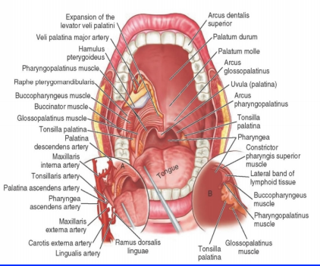
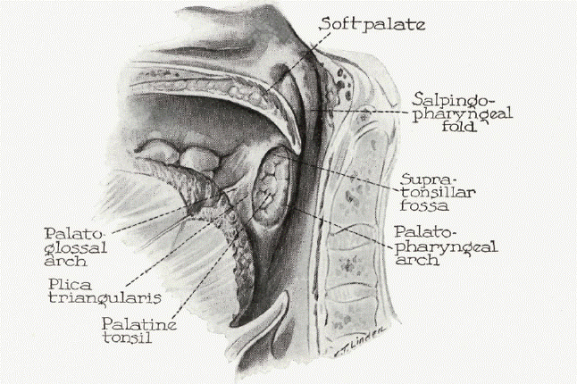
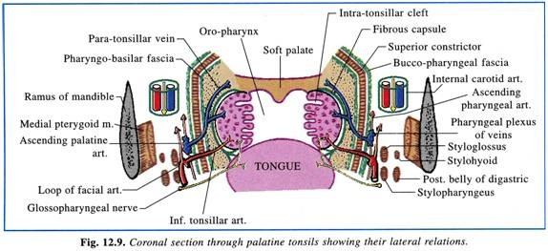
Pharynx Palatine Tonsil
Relations
Anteriorly | palatoglossal arch
Posteriorly | palatopharyngeal arch
Superiorly | soft palate
Inferiorly | posterior 1\3 of the tongue
Medially | cavity of the oropharynx
Laterally | (1) superior constrictor of the pharynx separated from it by loose connective tissue through which descends the (2) external palatine vein, (3) loop of the facial artery and , (4) the internal carotid artery which lies behind and lateral to the tonsils.
Extra
Extra

Slide 17
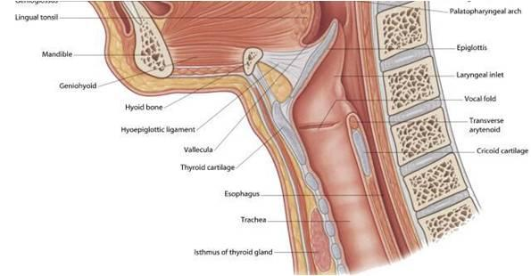
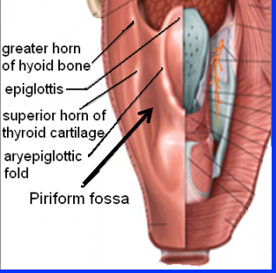
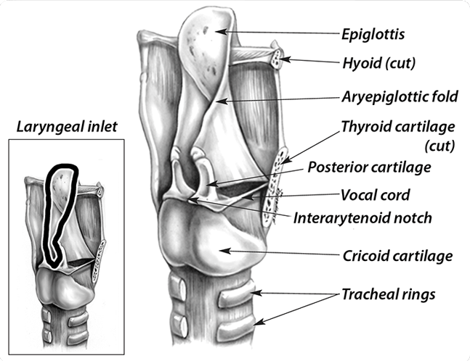
Pharynx Laryngopharynx
Lies behind the laryngeal inlet & the posterior surface of larynx
communicates with the larynx through the laryngeal inlet ( الفتحة الي تودي لللارنكس)
Extends from upper border of epiglottis to lower border of cricoid cartilage.
A small depression تجويفsituated on either side of the laryngeal inlet is called ‘Piriform Fossa’ it is a common site for the lodging of foreign bodies*.
Branches of internal laryngeal & recurrent laryngeal nerves lie deep to the mucous membrane of the fossa‘Piriform Fossa’ and are vulnerable to injury during removal of a foreign body.
*When you swallow fish bones this is were they usually get stuck. You should be careful when trying to remove them because they could injur the internal laryngeal & recurrent laryngeal nerves.
Extra

Slide 18
Pharynx
Nerve Supply | Sensory | Nasopharynx: Maxillary nerve Oropharynx: Glossopharyngeal nerve (cranial nerve number 9) Laryngopharynx: Vagus nerve (cranial nerve number 10)
 | Motor | All the muscles of pharynx are supplied by the pharyngeal plexus. Except the Stylopharyngeus is supplied by the glossopharyngeal nerve
Arterial supply | from branches of the following arteries: 1- Ascending pharyngeal 2- Ascending palatine 3- Facial 4- Maxillary 5- Lingual
Veins | drain into pharyngeal venous plexus, which drains into the internal jugular vein
Lymphatics | drain into the deep cervical lymph nodes either directly, or indirectly via the retropharyngeal or paratracheal lymph nodes

Slide 19
Summary
Upper Respiratory
Nasal cavity
Paranasal Sinuses
parts
Blood supply
Nerve supply
Lymphatics drainage
Spheno ethmoidal recess
sphenoidal sinus
left
right
Arterial
Branches of:
-maxillary
-facial
-ophthalmic arteries.
Venous
-facial,
-ophthalmic
-spheno-palatine veins.
1-Olfactory mucosa by olfactory nerve
2-General sensation: ophthalmic , maxillary, Anterior ethemoidal nerves, and Autonomic fibers.
Superior meatus
Middle meatus
Inferior meatus
posterior ethmoidal sinus
Middle ethmoidal,maxillary,
frontal &
the anterior ethmoidal sinuses
nasolacrimal duct.
1-submandibular lymph nodes
2- upper deep cervical lymph nodes
Boundaries of each half
Roof
Floor
Medial wall "nasal septum"
lateral wall
1- Nasal bone & cartilage
2- frontal bone
3- cribriform plate of ethmoid
4-body of spenoid
Hard bony plate (forms the roof of oral cavity)
1- septal cartilage
2-perpendicular plate of ethmoid
3-vomer
Conchae
1- superior concha
2-middle concha
3-inferior concha
Meati
1- sphenoethmoidal recess
2- superior meatus
3- middle meatus
4- inferior meatus

Slide 20
Summary
Upper Respiratory
Pharynx
Muscles of pharynx
parts
palatine tonsils
Nasopharynx
Oropharynx
Blood supply
Circular: Superior, Middle & Inferior constrictors
Laryngopharynx
Arterial tonsillar artery from the facial, lingual and greater palatine
Venous :join external palatine pharyngeal and fascial veins
Nerve supply
Blood supply
Lymphatics drainage
Longitudinal: Stylopharyngeus Salpingopharyngeus Palatopharyngeous
sensory:
•Nasopharynx: Maxillary nerve
•Oropharynx: Glossopharyngeal nerve •Laryngopharynx: Vagus nerve
Motor : All muscles by the pharyngeal plexus. Except Stylopharyngeus is by the glossopharyngeal nerve.
Arterial -Ascending pharyngeal
- Ascending palatine -Facial -Maxillary
- Lingual
Venous :​into pharyngeal venous plexus, which drains into the internal jugular vein
directly:deep cervical lymph nodes
indirectly : retropharyngeal or paratracheal lymph nodes.
Lymphatics drainage
​to the upper deep cervical (jugulodigastric node)

Slide 21
Summary
 | Begins | Ends | Communicates with | Tonsil | Structures
Nasopharynx | Base of skull | Soft palate | Nasal cavity Through posterior nasal apertures | Pharyngeal Tubal | Opening of auditory tube Tubal elevation Pharyngeal recess Salpingopharyngeal fold
Oropharynx | Soft palate | Upper border of epiglottis | Oral cavity Through oropharyngeal isthmus | Palatine | Palatopharyngeal fold Palatoglossal fold
Laryngopharynx | Upper border of epiglottis | Lower border of cricoid cartilage | Larynx Through laryngeal inlet | - | Piriform Fossa

Slide 22
Questions
4. What is the nerve supply of the olfactory mucosa :
A) maxillary nerve. B) olfactory nerve. C) facial nerve. D) vagus nerve.
Answer: B
5. Blood supply of nasal cavity includes branches of:
A) ophthalmic artery. B) maxillary artery. C) facial artery. D) all of the above
Answer: D
6. Which one of the following is not a function of paranasal sinuses :
A) elevate the larynx and pharynx. B) lighten the skull. C) air conditioning D) resonant chambers for speech.
Answer: A
7. The lymphatic drainage from vestibule into :
A) upper deep cervical lymph nodes.
B) submandibular lymph nodes
Answer: B
1. Which one of the following is a component of the roof of the nasal cavity :
A) Epiglottis. B) nasal septum. C) body of sphenoid. D)choanae.
Answer: C
2. The cavity below the conchae known as :
A) choanae. B) piriform fossa. C) notch. D) meatus.
Answer: D
3. Which one of the following is the feature of respiratory mucosa :
A) thick. B) highly vascularized. C) has goblet cells and mucous glands. D) all of the above
Answer: D

Slide 23
Questions
11. The uppermost portion of the pharynx is:
Oropharynx
Laryngopharynx
Nasopharynx
Answer: C
12. Which structure is present in the lateral wall of the oropharynx?
Pharyngeal recess
Auditory tube
Palatine tonsil
Tubal tonsil
Answer: C
13. Which of the following does NOT drain into the middle meatus?
Anterior ethmoidal sinus
Posterior ethmoidal sinus
Frontal sinus
Maxillary sinus
Answer: B
8. Which one of the following drains into the sphenoethmoidal recess?
Maxillary sinus
Anterior ethmoidal sinus
Posterior ethmoidal sinus
Sphenoidal sinus
Answer: D
9. Medial to the palatine tonsil is:
Palatopharyngeal arch
Cavity of the oropharynx
Palatoglossal arch
Soft palate
Answer: B
10. Which muscle prevents the entry of air into the esophagus while swallowing?
Superior constrictor muscle
Stylopharyngeus
Cricopharyngeus
Palatopharyngeus
Answer: C

Slide 24
Questions
14. The Palatoglossal fold acts as an anterior margin for which third of the pharynx?
Nasopharynx
Oropharynx
Laryngopharynx
Answer: B
15. Inferior portion of the pharynx; extends from the epiglottis to lower border of the cricoid cartilage:
Nasopharynx
Oropharynx
Laryngopharynx
Larynx
Answer: C
16. All muscles of the pharynx are supplied by pharyngeal plexus except:
Stylopharyngeus
Salpingopharyngeus
Palatopharyngeus
Superior constrictor muscle
Answer: A
17. In continuation of the previous question: which nerve is it supplied by?
Answer: glossopharyngeal nerve
18. A patient presented to the ER and was diagnosed with tonsilitis after examination of the palatine tonsil. Which lymph nodes would be enlarged in this case?
Answer: upper deep cervical lymph nodes
19. A little boy presented to the ER with a foreign body stuck in the piriform fossa. Which nerve(s) is/are vulnerable for injury?
Answer: internal laryngeal and recurrent laryngeal nerves

Slide 25
Leaders:
Nawaf AlKhudairy
Jawaher Abanumy
Members:
Alanoud Abuhaimed
Alanoud Alsaikhan
Ameera Niazi
Deena AlNowiser
Lama Alfawzan
Lara Alsaleem
Maha Alissa
Nada Aldakheel
Safa Al-Osaimi
Wejdan Alzaid
anatomyteam436@gmail.com
@anatomy436

