Slide 1
Muscles involved in Respiration
Color Code
Important
Doctors Notes
Notes/Extra explanation
Please view our Editing File before studying this lecture to check for any changes.

Slide 2
Objectives:
Describe the components of the thoracic cage and their articulations.
Describe in brief the respiratory movements.
List the muscles involved in inspiration and in expiration.
Describe the attachments of each muscle to the thoracic cage and its nerve supply.
Describe the origin, insertion, nerve supply of diaphragm.

Slide 3
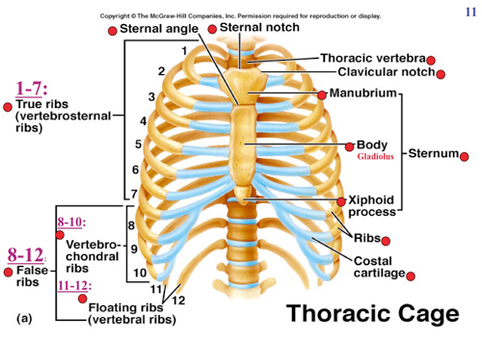
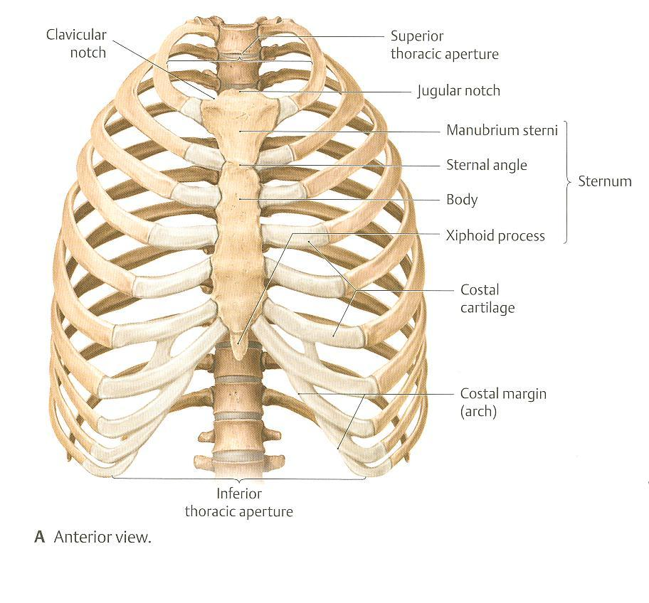
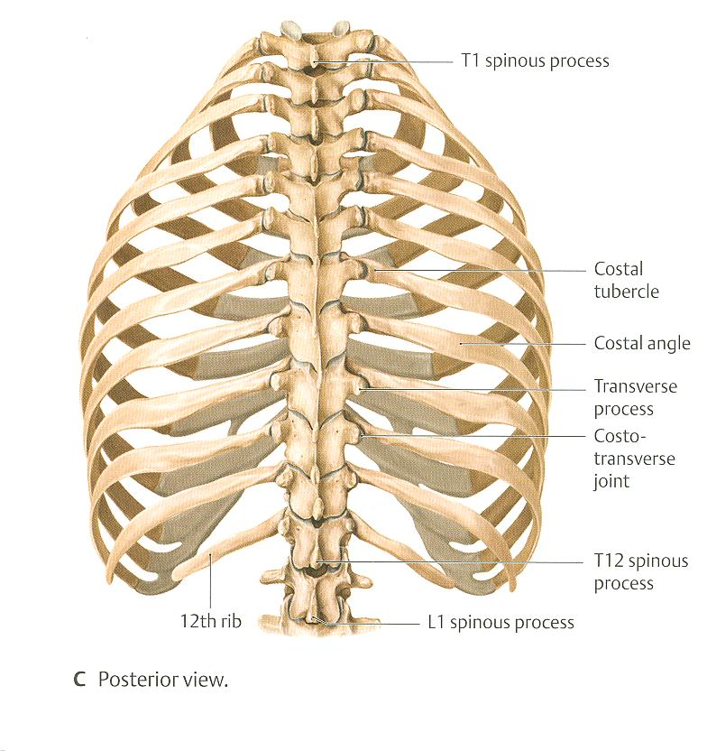
Thoracic Cage
Vertebra
Rib
Extra

Slide 4
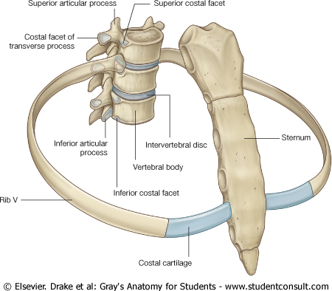
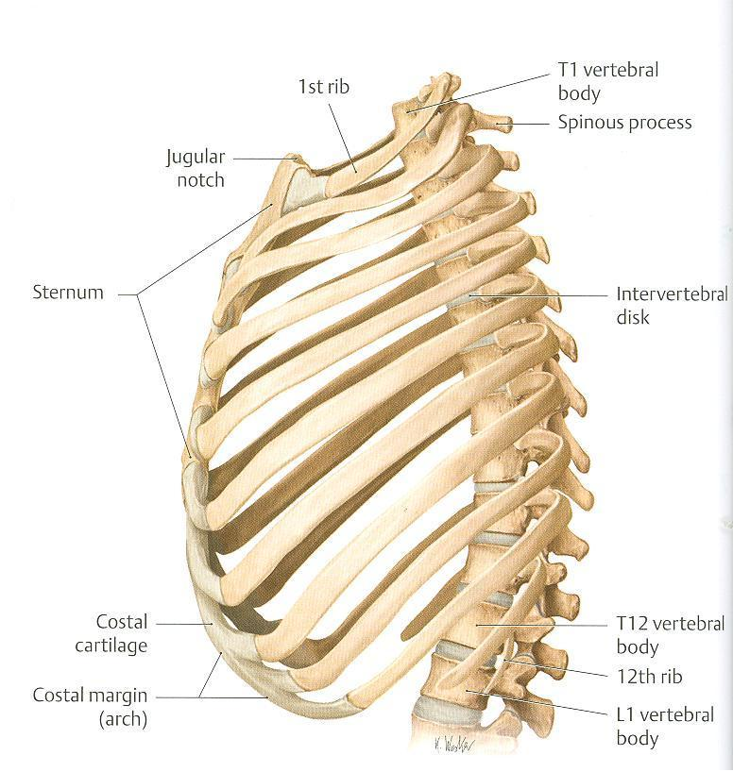
Thoracic Cage
Articulations
Costochondral (cartilaginous joint) is an articulation between the ribs and the costal cartilage .
Sternocostal (1st cartilage with manubrium by primary cartilaginous joint/ 2nd to 7th cartilages with sternum by synovial joint) is an articulation between the true ribs and the sternum.
Costovertebral (plane synovial joint) is an articulation between the thoracic vertebrae and the heads of ribs .
Conical ( مخروطي)in shape
Has 2 apertures (openings):
Superior (thoracic outlet): narrow, open, continuous with neck
Inferior: wide, closed by diaphragm
Formed of:
Sternum & costal cartilages: anteriorly
Twelve pairs of ribs: laterally
Twelve thoracic vertebrae: posteriorly
Costovertebral
Sternocostal
Sternocostal
Costovertebral
Costochondral
Costochondral

Slide 5
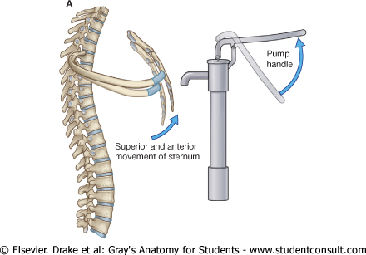
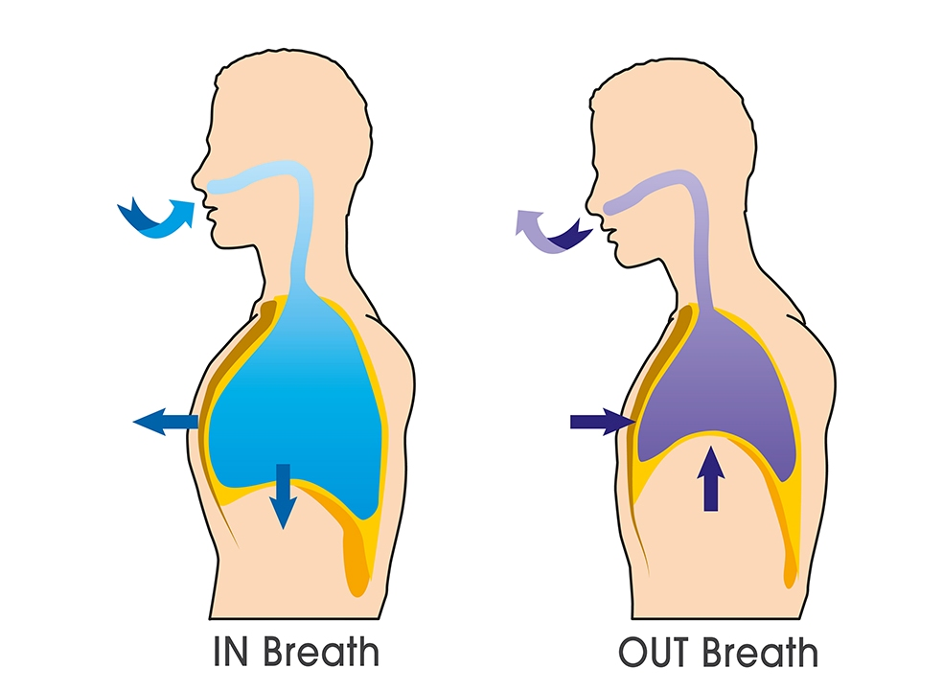
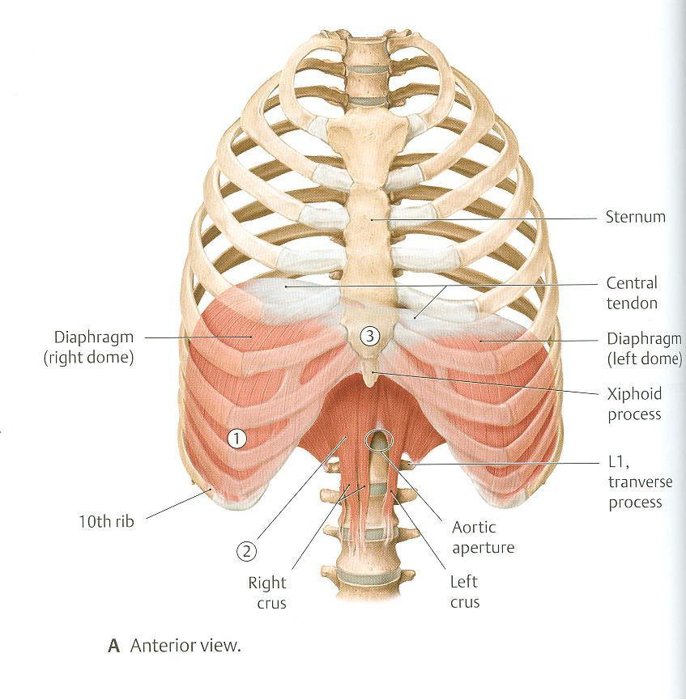
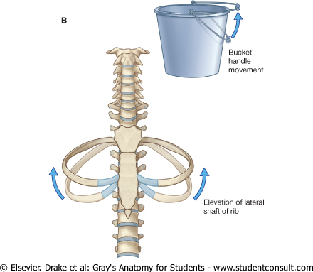
Thoracic Cage
Respiratory Movements
A- MOVEMENTS OF DIAPHRAGM
B- MOVEMENTS OF RIBS (In Normal Inspiration)
Inspiration:
Contraction (descent) of diaphragm
Increase of vertical diameter
of thoracic cavity
Extra picture
1-PUMP HANDLE MOVEMENT:
Elevation of ribs
Increase in antero-posterior diameter
of thoracic cavity
2-BUCKET HANDLE MOVEMENT:
Elevation of ribs
Increase in lateral (transverse) diameter
of thoracic cavity
Extra picture
Expiration:
Relaxation (ascent) of diaphragm
#Watch this helpful videos: (very short)
https://www.youtube.com/watch?v=V45Jywr4nhA
https://www.youtube.com/watch?v=_Ph9tlaUSfo

Slide 6
Inspiratory Muscles
Muscles used in rest and forced inspiration
Accessory muscles
(only during forced inspiration) :
Diaphragm : most important muscle in inspiration
Rib elevators: external intercostal muscles
Muscles attaching cervical vertebrae to first & second rib: scalene muscles
Muscles attaching thoracic cage to upper limb: pectoralis major
Note:
Why are the accessory muscles listed in anatomy different from the ones in physiology?
Because they are BOTH correct.
Grey’s Anatomy:
“Any muscles attaching to the ribs can potentially move one rib relative to another and therefore act as accessory respiratory muscles.”

Slide 7
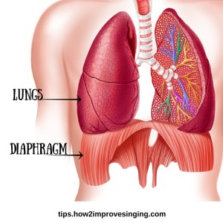
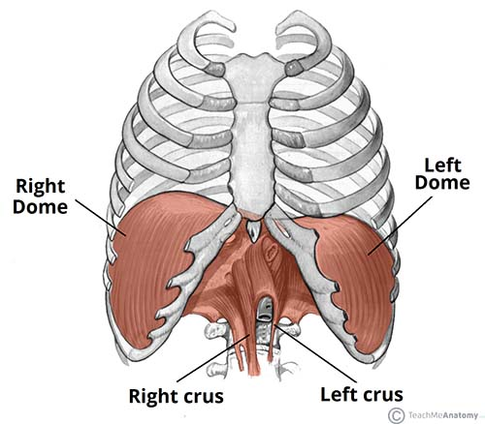
Inspiratory Muscles Diaphragm
A musculotendinous partition between thoracic & abdominal cavity .
Convex toward thoracic & concave toward abdominal cavity .
Attached to: sternum, costal cartilages, 12th rib & lumbar vertebrae.
Fibers converge to join the central tendon.
Nerve supply: phrenic nerve (C3,4,5), penetrates (تخترق) diaphragm & innervates it from abdominal surface .
Action: contraction (descent) of diaphragm increase vertical diameter of thoracic cavity essential for normal breathing .
Extra

Slide 8
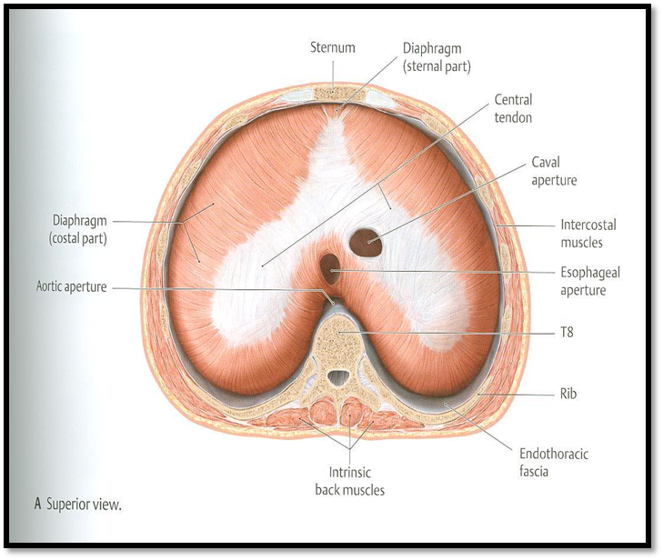
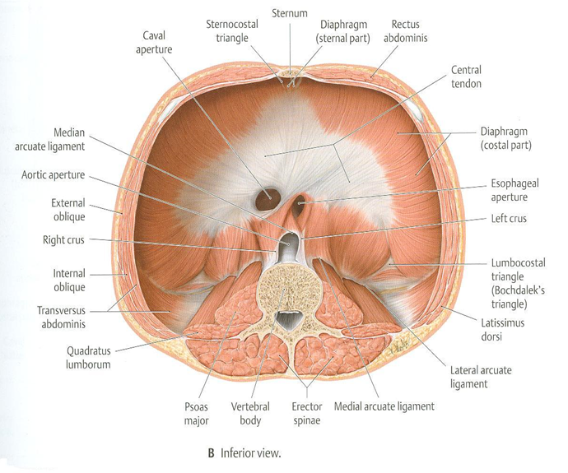
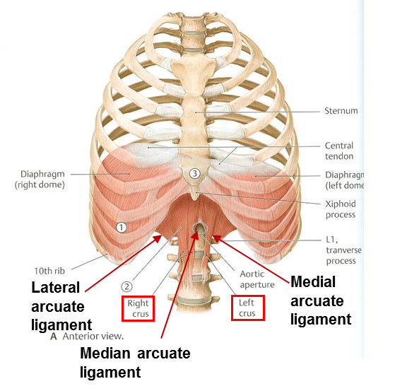
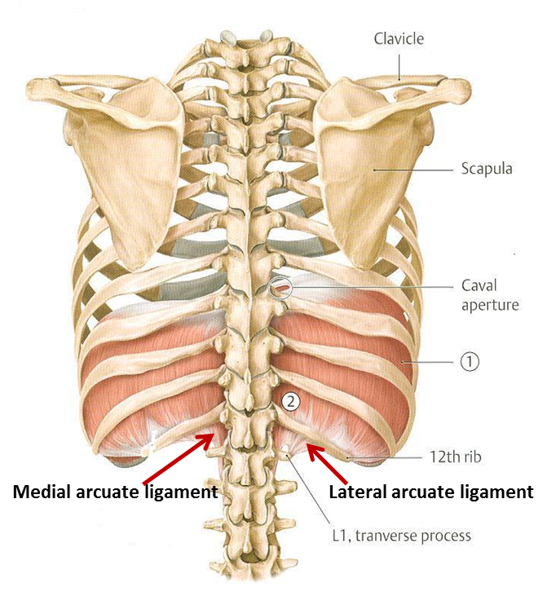
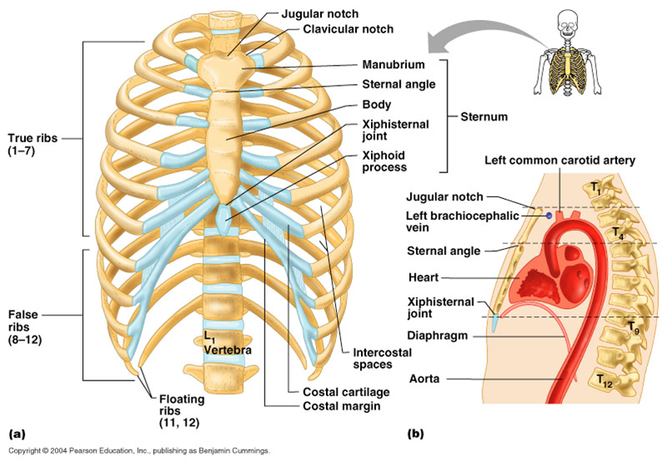
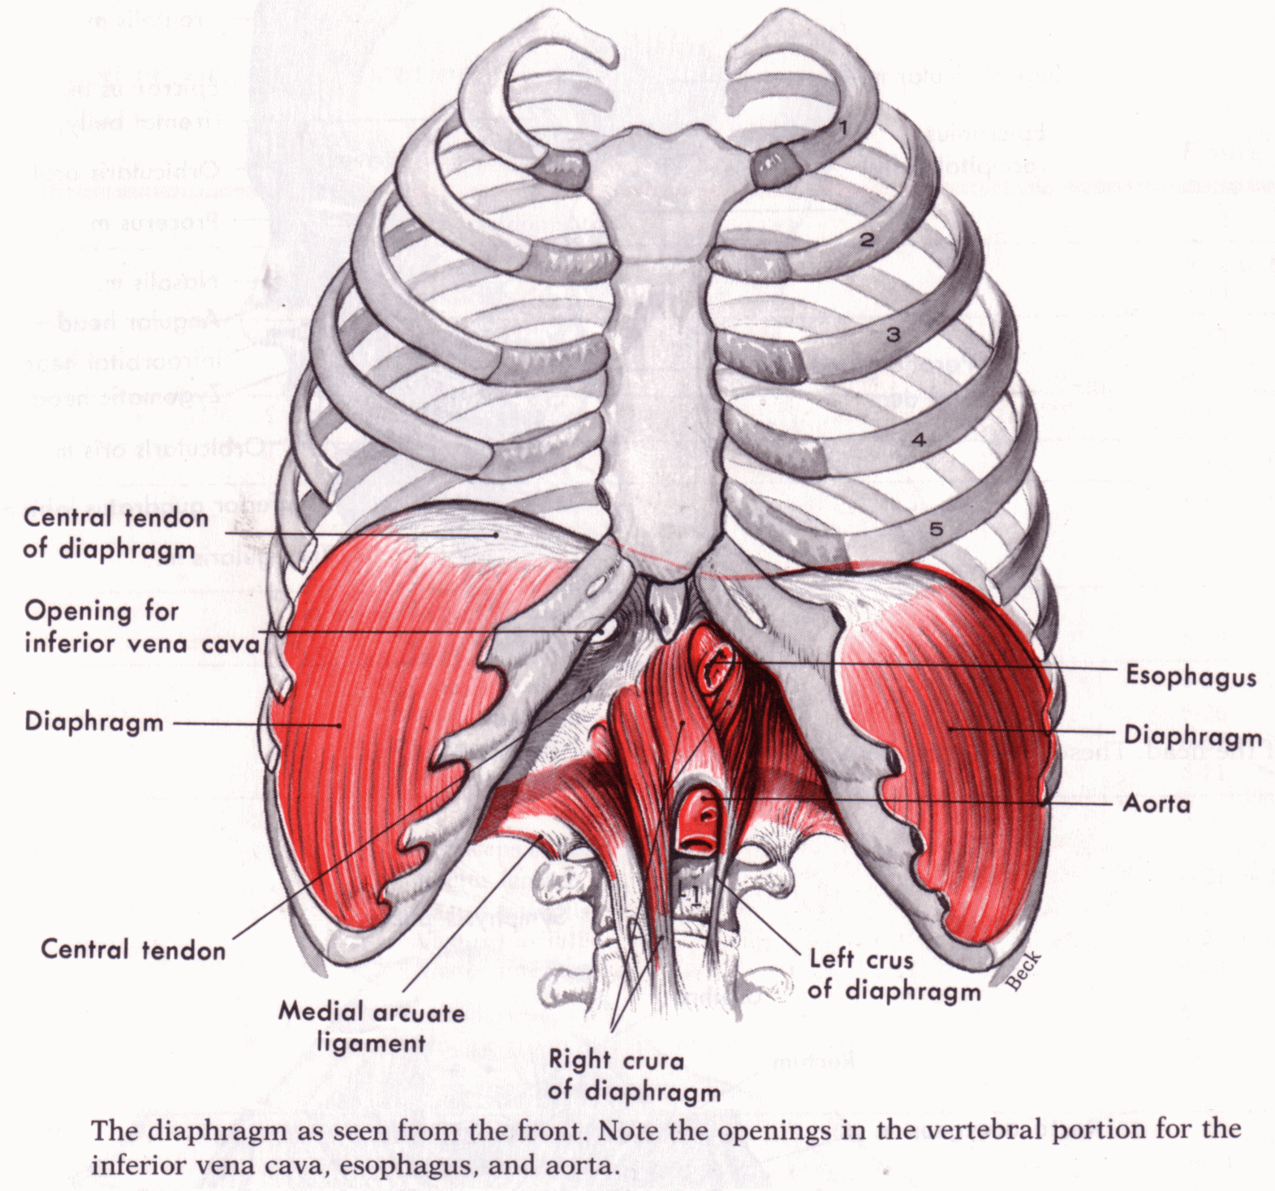
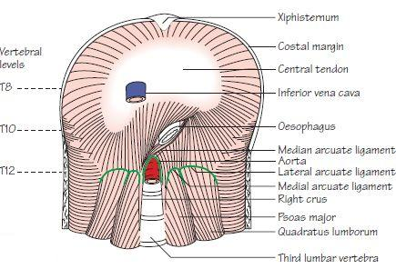
Inspiratory Muscles Diaphragm
Insertion Of Diaphragm
Origin Of Diaphragm
Central Tendon : Lies at the level of xiphisternal joint , at 9th thoracic vertebra
1) Costal: lower 6 costal cartilages
2) Vertebral: upper 3 lumbar vertebrae
(right & left crus + arcuate ligaments)
3) Sternal: xiphoid process of sternum
Extra
Extra

Slide 9
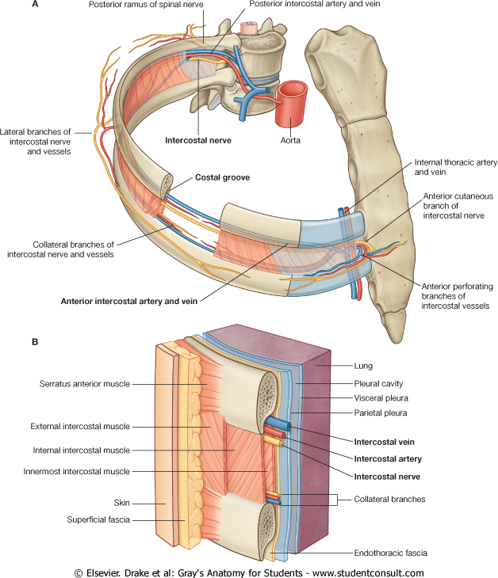
Inspiratory Muscles External Intercostal
Attachments: from lower border of rib above to upper border of rib below
Direction of fibers: downward & medially
Nerve supply: intercostal nerves
Action: rib elevators (inspiratory)

Slide 10
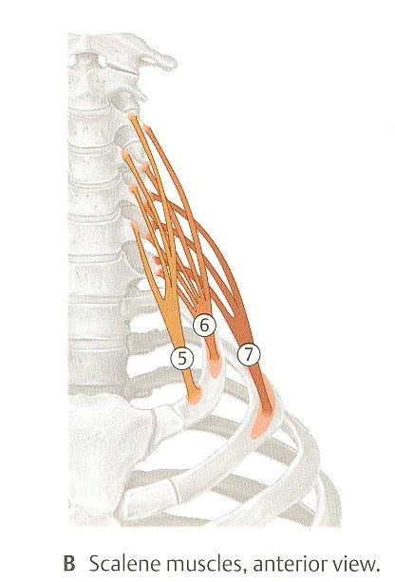
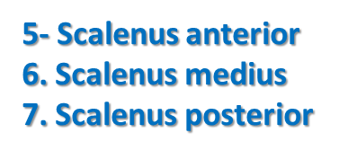
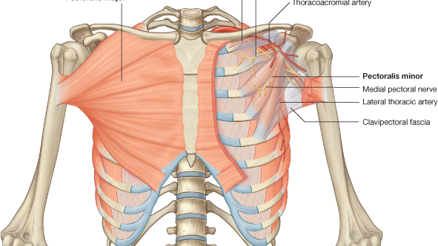
Scalene Muscles
Inspiratory Muscles Accessory Muscles (in forced inspiration)
Origin: cervical vertebrae
Insertion: 1st & 2nd ribs
Action: elevates 1st & 2nd ribs (inspiratory)
Pectoralis Major
Origin: sternum + costal cartilages
Insertion: humerus (Biciptal groove)
Action: increases antero-posterior diameter of thoracic cavity, when arm is fixed (inspiratory)

Slide 11
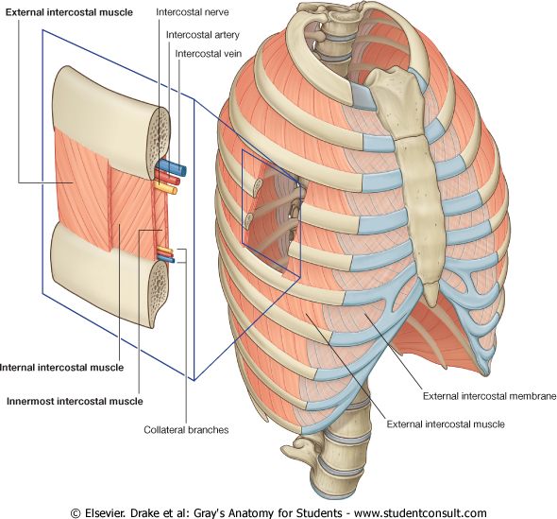
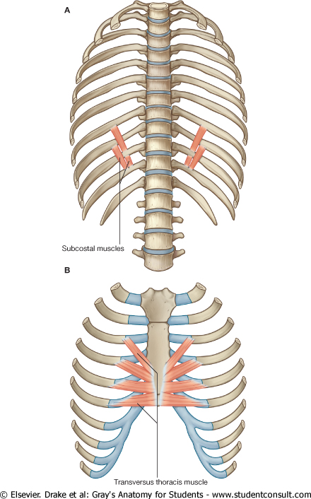
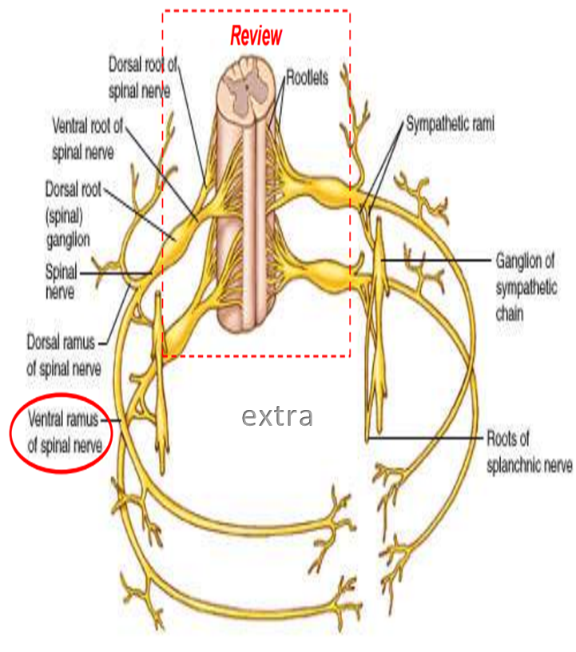
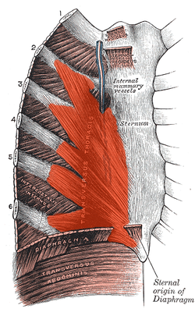
Expiratory Muscles
*Act only during forced expiration*
Rib depressors:
Internal intercostal
Innermost intercostal
Subcostals
Transversus thoracis
Nerve supply: intercostal nerves (ventral rami of T1-T11)
Anterior abdominal wall muscles:
FUNCTION: Compression of abdominal viscera to help in ascent of diaphragm
External oblique
Internal oblique
Transversus abdominis
Rectus abdominis
Direction: upward & medially
Intercostal vessles&nerve lie in intercostal space behind the internal intercostal muscle.

Slide 12
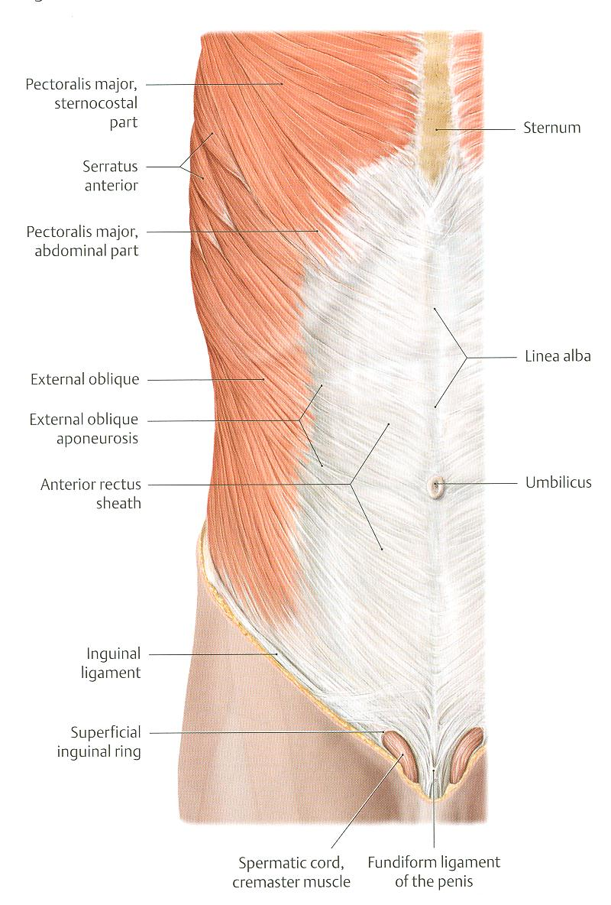
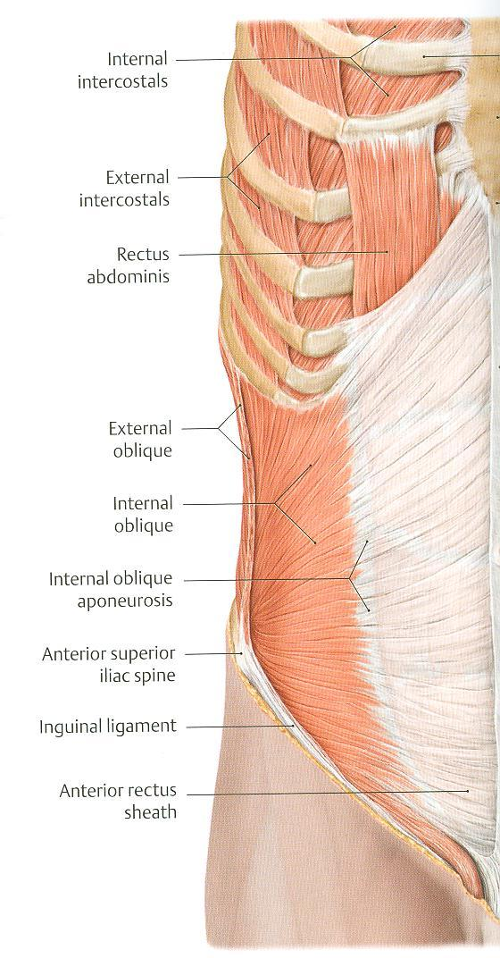
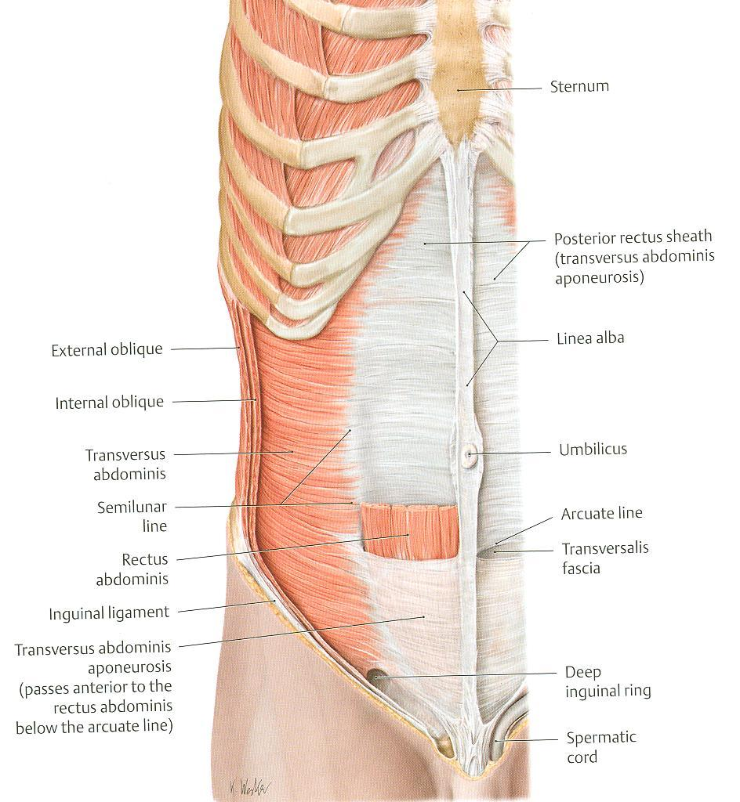
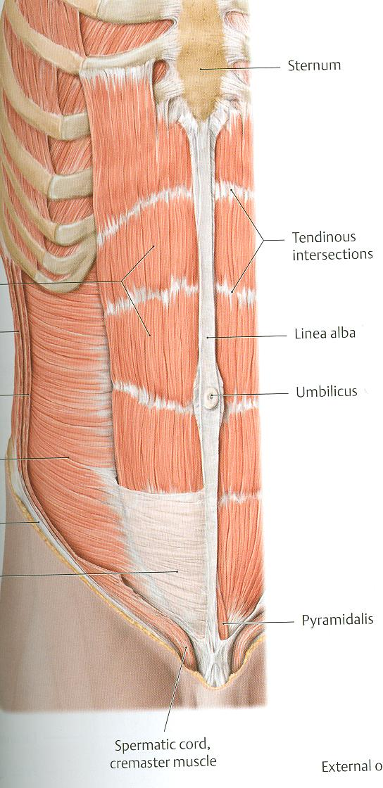
Expiratory Muscles
Anterior Abdominal Wall
The linea alba is a fibrous structure that runs down the midline of the abdomen in humans and other vertebrates. In humans linea alba runs from the xiphoid process to the pubic symphysis.
Linea alba
Rectus abdominis
External oblique (outer layer)
Direction: downward & medially
Internal oblique (middle layer)
Direction: upward & medially
Transversus abdominis (inner layer)
Direction : transverse
Rectus abdominis
Direction: vertical

Slide 13
Expiratory Muscles
Anterior Abdominal Wall
Is formed of 3 layers of muscles of fibers running in different directions (to increase strength of anterior abdominal wall)
The 3 muscles form a sheath in which a fourth muscles lies (rectus abdominis)
Muscles are attached to: sternum, costal cartilages and ribs + hip bones
The aponeurosis of the 3 muscles on both sides fuse in the midline to form linea alba.
Action (during forced expiration): Compression of abdominal viscera to help in ascent of diaphragm (during forced expiration)
Nerve supply: lower intercostal nerves (T7 – T11), subcostal nerve (T12) and first lumbar nerve
Note: there are no muscles directly in charge of regular/relaxed expiration. This is because expiration is a passive movement depending on the natural recoil of the lungs, and relaxation of the diaphragm

Slide 14
Summary
Inspiration: -Quiet(Active):1-Contraction (Descent) diaphragm
2-Elevation of ribs By external intercostal
-Forced(Active):Accessory muscles of inspiration: 1-Pectoralis major 2-Scalene muscles
Expiration:-Quiet(Passive): 1-Elastic recoil of lung
2-Relaxation of diaphragm & external intercostal
-Forced(Active):1-Contraction of anterior abdominal wall muscles
2- Depression of ribs (Rest of intercostal muscles +Subcostals and transversus thoracis)
The thoracic spinal levels at which the three major structures pass through the diaphragm can be remembered by the number of letters contained in each structure:
Vena Cava (8 letters) – Passes through the diaphragm at T8.
Oesophagus (10 letters) – Passes through the diaphragm at T10.
Aortic Hiatus (12 letters) – "Passes" through the diaphragm at T12
*THE RIGHT CRUS IS LARGER THAN THE LEFT BECAUSE OF THE POSITION OF THE LIVER.

Slide 15
MCQ
4. The phrenic nerve’s root value is?:
C4,C5,C6
C3,C4,C5
C5,C6,C7
C2,C3,C4
1. Which one of the following muscles is involved in expiration?
A. external intercostal
B. internal intercostal
C. transversus thoracis
D. Answers B AND C
5. The most important muscle in respiration ?
A. External intercostal
B. scalene muscle
C.Pectoralis major
D. Diaphragm
2. The expiratory muscles act only during:
A. Forced expiration.
B. Deep inspiration.
C. Deep expiration.
D. Normal expiration.
6. Which one of the following is an articulation between the cartilages of true ribs and the sternum ?
A- sternocostal
B- costochondral
C- costovertebral
D- sacroiliac
3. The diaphragm is supplied by which nerve:
A. Vagus
B. Phrenic
C. Intercostal nerves
D. Long thoracic
7. In the pump handle movement which of the following will increase?
A- transverse diameter
B- lateral diameter
C- antero-posterior diameter
D- antero-lateral diameter
ANSWERS:
1.D
2.A
3.B
4.B
5.D
6.A
7.C

Slide 16
SAQ
1-What is the action of pectoralis major in forced inspiration?
2-what will happen to the diaphragm during respiration?
3-Describe diaphragm’s shape?
4-What is the nerve supply of the anterior abdominal wall muscles?
ANSWERS:
1- increases antero-posterior diameter of thoracic cavity, when arm is fixed (inspiratory)
2- (1) Inspiration:
-Contraction (descent) of diaphragm.
-Increase of vertical diameter of thoracic cavity.
(2) Expiration:
-Relaxation (ascent) of diaphragm
3-Convex toward thoracic & concave toward abdominal cavity .
4-lower intercostal (T7-T11), subcostal (T12), and first Lumbar nerve.

Slide 17
Leaders:
Nawaf AlKhudairy
Jawaher Abanumy
Members:
Abdullah Jammah
Abdulmohsen alghannam
Abdulaziz ALMohammed
Mosaed Alnowaiser
Abdullah hashem
Khalid Al-dakheel
Abdulmohsen Alkhalaf
Abdulrahman Almalki
Essam Alshahrani
anatomyteam436@gmail.com
@anatomy436

