Slide 1
Larynx, Trachea, and Bronchi
Color Code
Important
Doctors Notes
Notes/Extra explanation
Please view our Editing File before studying this lecture to check for any changes.

Slide 2
Objectives
By the end of the lecture, you should be able to:
Describe the Extent, structure and functions of the larynx.
Describe the Extent, structure and functions of the trachea.
Describe the bronchi and branching of the bronchial tree.
Describe the functions of bronchi and their divisions.

Slide 3
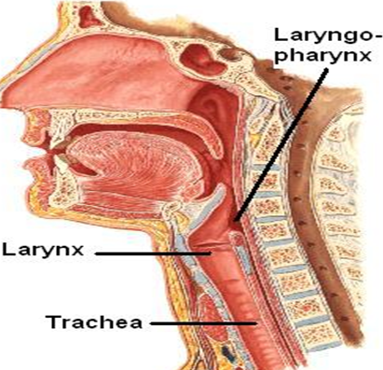
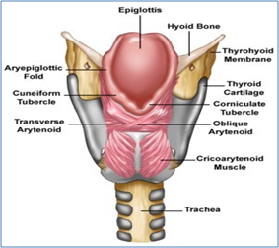
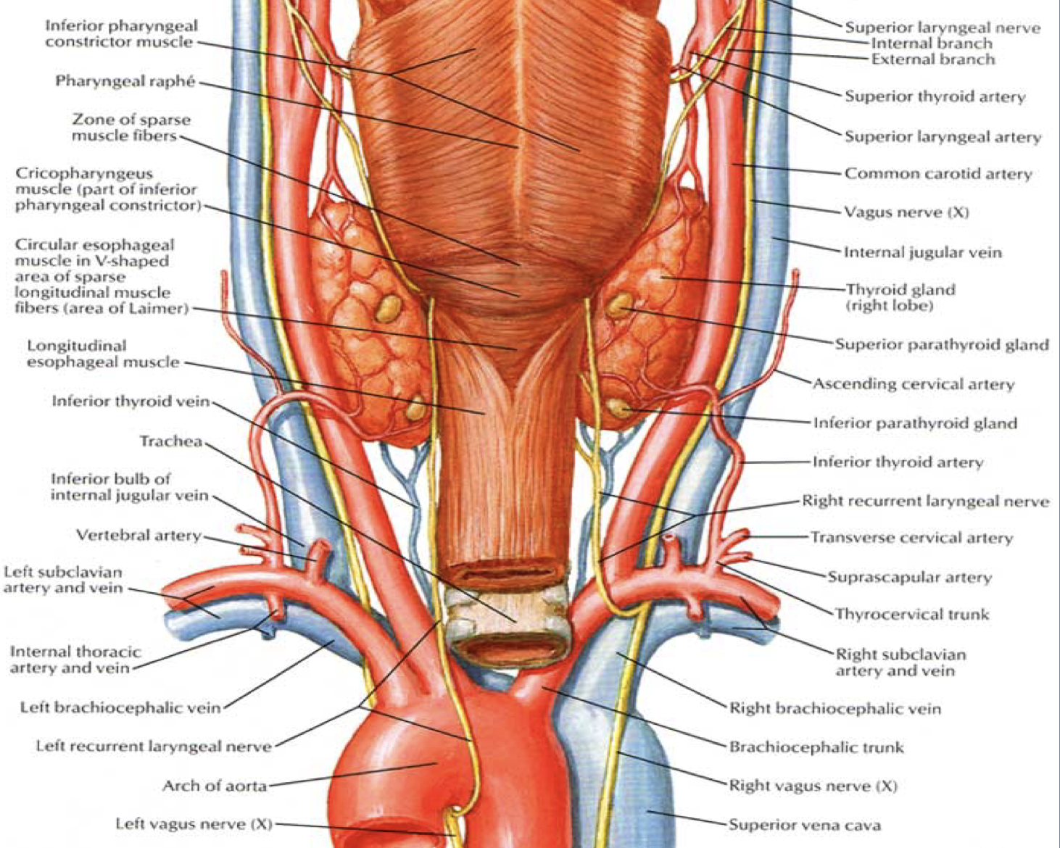
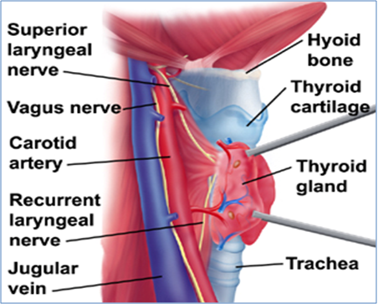
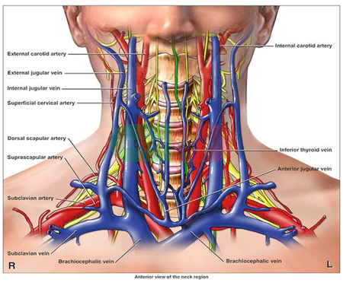
Larynx
NOTE: PHARYNX EXTENDS FROM C1 TO C6 WHILE LARYNX EXTENDS FROM C3 TO C6
*C6 AT THE LEVEL OF CRICOID CARTILAGE.
The larynx is the part of the respiratory tract which contains the vocal cords.
In adult it is a 2-inch-long tube.
It opens above into the laryngeal part of the pharynx.
Below, it is continuous with the trachea
The larynx has functions in:
Respiration (breathing).
Phonation (voice production).
Deglutition (swallowing).
The larynx is related to major critical structures in the neck.
Arteries
Veins
Nerves
Carotid arteries: (common, external and internal).
Thyroid arteries: (superior & inferior thyroid arteries).
Jugular veins, (external & internal)
Laryngeal nerves: (Superior laryngeal & recurrent laryngeal).
Vagus nerve.

Slide 4
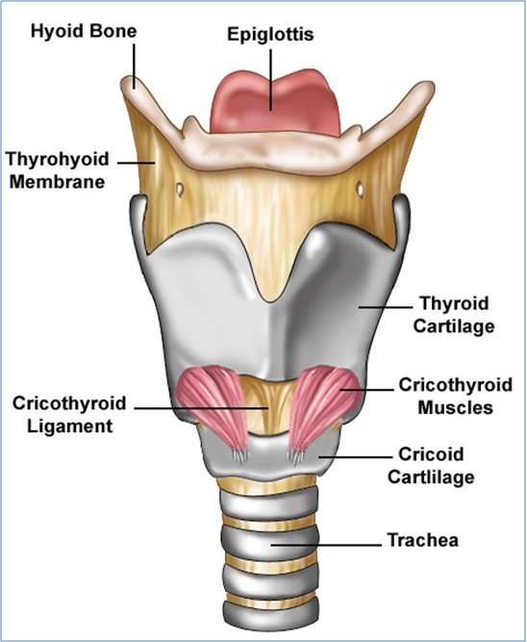
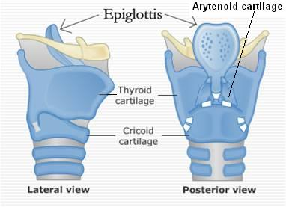
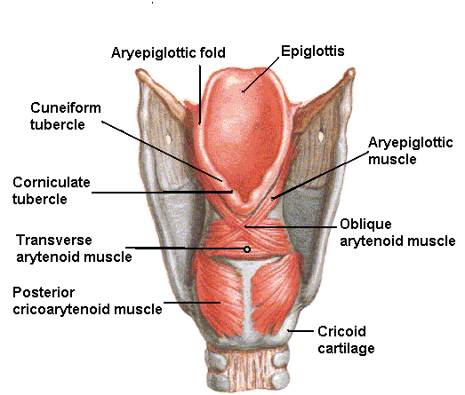
Larynx
1- Cartilaginous skeleton
The cartilaginous skeleton is composed of 9 cartilages:
3 Single:
Thyroid 2. Cricoid 3. Epiglottis
3 Paired:
4. Arytenoid 5. Corniculate 6. Cuneiform
All the cartilages, are hyaline except the epiglottis which is Elastic cartilage.
The cartilages are:
Connected by joints, membranes & ligaments.
Moved by muscles.
The larynx consists of four basic components:
1- Cartilaginous skeleton.
2- Membranes and ligaments.
3- Mucosal lining.
4- Muscles (Intrinsic & extrinsic muscles).
-Arytenoid lies in the back of larynx.
-Corniculate and Cuneiform are in the Aryepiglottic fold.
6
3
3
5
1
1
4
4
2
2

Slide 5
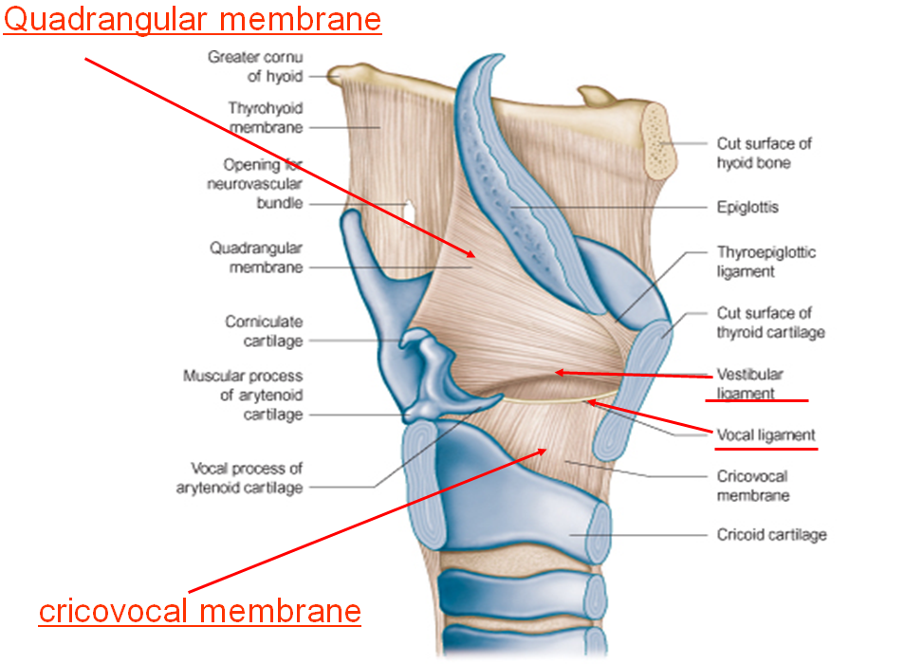
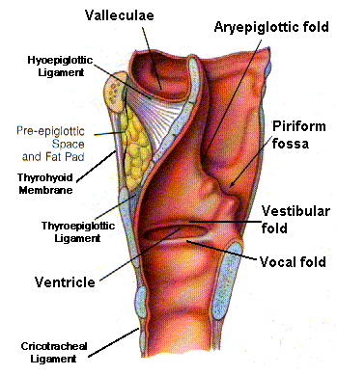
Larynx
2- Membranes & Ligaments
- Thyrohyoid membrane
Cricothyroid membrane
Cricotracheal membrane
Hyoepiglottic ligament
Thyroepiglottic ligament
The thyrohyoid membrane is thickened in the median plane to form median thyrohyoid ligament and on both sides to form lateral thyrohyoid ligaments.
- Quadrangular membrane or (aryepiglottic membrane) :
It extends between the arytenoid and epiglottis.
Its lower free margin forms the vestibular ligament which forms the vestibular fold (false vocal cord).
- Cricothyroid membrane (conus elasticus):
Its lower margin is attached to the upper border of cricoid cartilage.
Upper free margin forms Vocal ligament which forms the(true vocal cord)

Slide 6
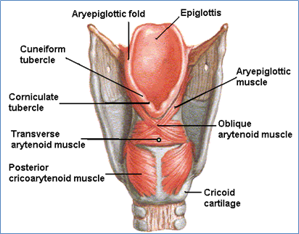
Larynx
Laryngeal Inlet
It is the upper opening of the larynx.
It faces upward and backward and opens into the laryngeal part of the pharynx (laryngopharynx).
Bounded by :
Anteriorly: by the upper margin of epiglottis (E)
Posteriorly & below by arytenoid cartilages (A)
Laterally by the Aryepiglottic folds (AEF)

Slide 7
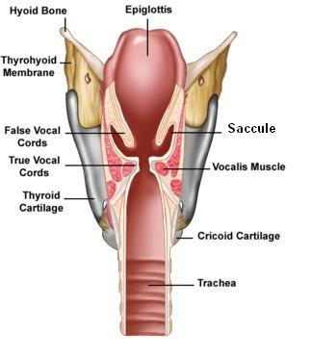
Larynx
Laryngeal Cavity
A
Rima vestibuli
Extends from laryngeal inlet to lower border of the cricoid cartilage
Narrow in the region of the vestibular folds (rima vestibuli)
Narrowest in the region of the vocal folds (rima glottidis)
Divided into three parts:
Supraglottic part or vestibule: it is the part above the vestibular folds.
Ventricle: it is the part between the vestibular folds & the vocal folds. The ventricle has an upward invagination called saccule which is rich in goblet cells.
Infraglottic part: the part below the vocal folds.
B
C
Rima glottidis
A
B
C

Slide 8
Larynx
3- Mucosal Lining
4- Muscles
Mucous Membrane
The cavity is lined with ciliated columnar epithelium except the surface of the vocal cords.
The surface of vocal folds, is covered with stratified squamous epithelium because of exposure to continuous trauma during phonation.
It contains many mucous glands, more numerous in the region of the saccule (for lubrication of vocal folds).
Laryngeal muscles are divided into 2 groups
Extrinsic muscles
Subdivided into 2 groups:
Intrinsic muscles
Subdivided into 2 groups:
Elevators of the larynx
Depressors of the larynx
Muscles controlling the laryngeal inlet
Muscles controlling the movements of the vocal cords

Slide 9
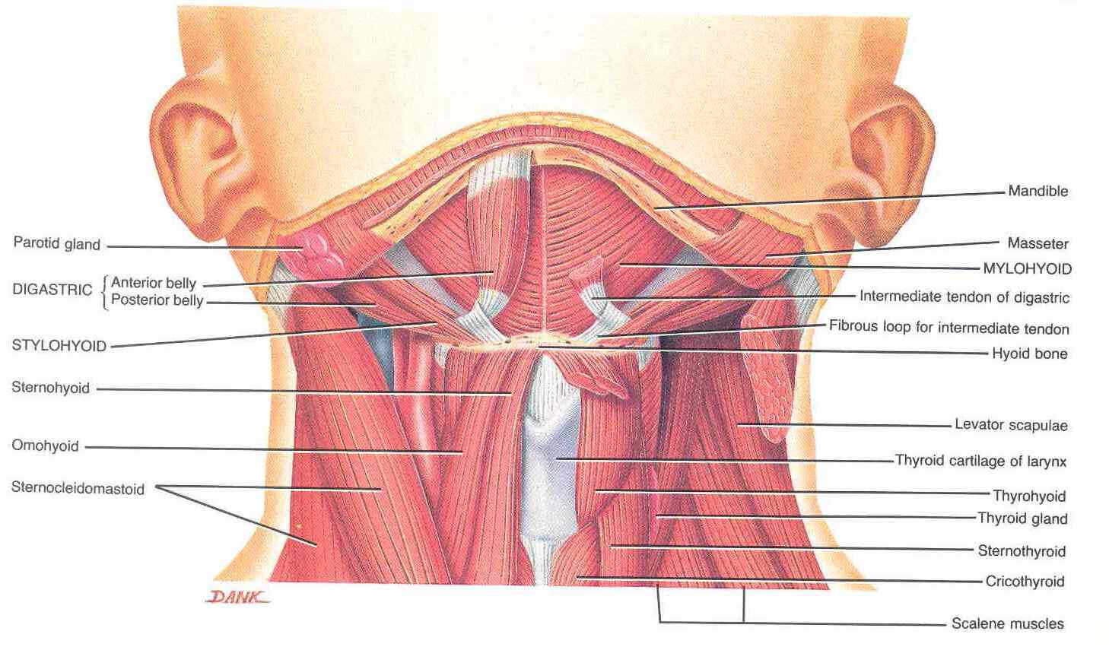
Larynx
4- Muscles (Extrinsic)
Elevators of the Larynx:
A- Suprahyoid muscles (MSGD)
Mylohyoid.
Stylohyoid.
Geniohyoid.
Digastric.
B- The longitudinal muscles of the pharynx
Stylopharyngeus.
Salpingopharyngeus.
Palatopharyngeus.
Depressors of the Larynx:
The Infrahyoid Muscles:
Sternohyoid.
Sternothyroid.
Omohyoid.

Slide 10
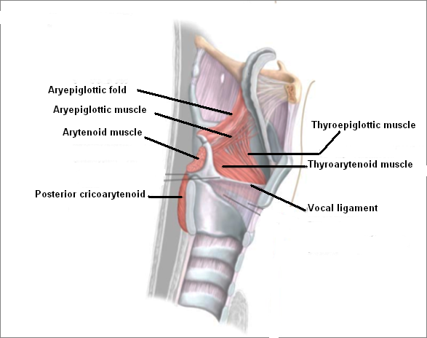
Larynx
4- Muscles (Intrinsic)
Muscles controlling the Laryngeal Inlet
Oblique arytenoid
Aryepiglottic muscle

Slide 11
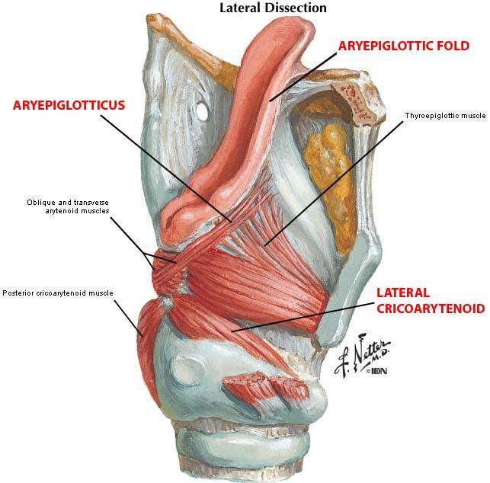
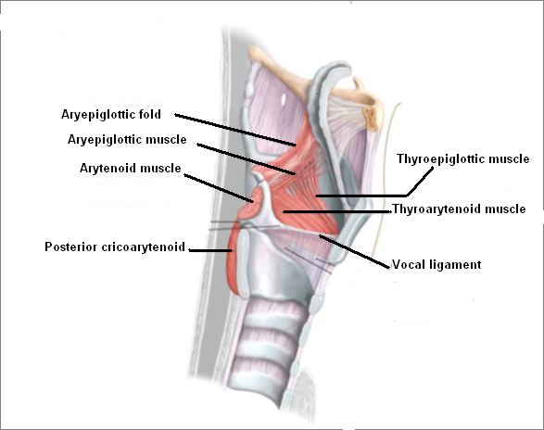
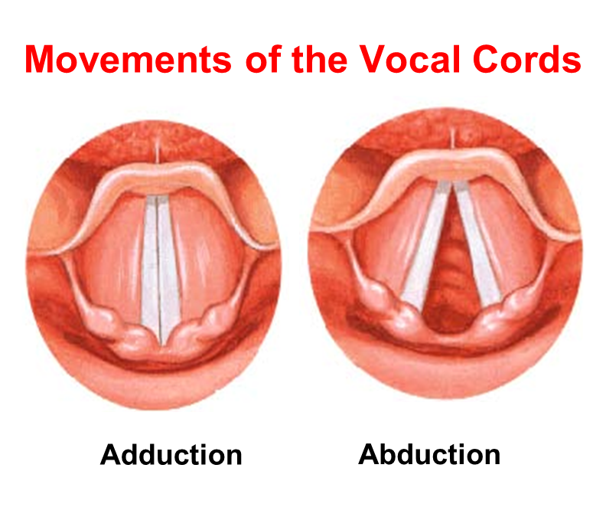
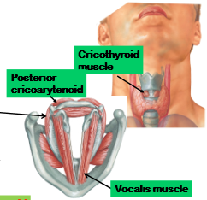
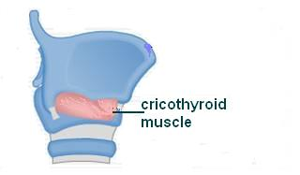
Larynx
4- Muscles (Intrinsic) Muscles controlling vocal cords:
LENGTH AND TENSION
ADDUCTION AND ABDUCTION
Thyroarytenoid (vocalis) muscle:
- Relax vocal cords
- Decrease both length and tension of vocal cords
2. Cricothyroid muscle:
- increase both length and tension of vocal cords
Remember: Cricothyroid is the only intrinsic muscle which found outside the larynx
1. Adductors (close rima glottis)
- Lateral cricoarytenoid.
- Transverse arytenoid.
2. Abductor (open rima glottis)
- Posterior cricoarytenoid
TRANSVERSE ARYTENOID
POSTERIOR CRICOARYTENOID

Slide 12
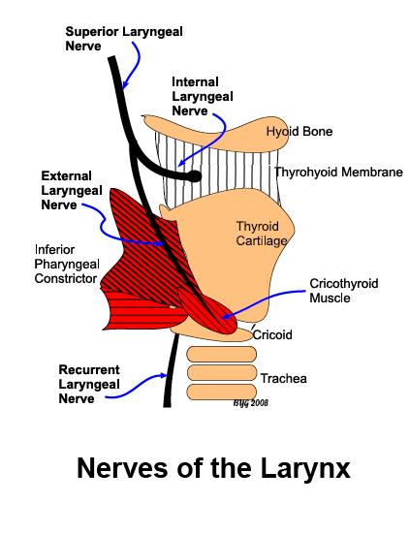
Larynx
Nerve Supply (very important):
Sensory:
Above the vocal cords:
- Internal laryngeal nerve
- branch of the superior laryngeal of the vagus nerve.
Below the vocal cords:
- Recurrent laryngeal nerve of the vagus nerve.
Motor:
All intrinsic muscles supplied by the recurrent laryngeal nerve except the cricothyroid
The cricothyroid* is supplied by the external laryngeal nerve of superior laryngeal of vagus.
Blood Supply And Lymphatics:
Arteries:
Upper half:
- Superior laryngeal artery
branch of superior thyroid artery
Lower half:
- Inferior laryngeal artery
- branch of inferior thyroid artery
Veins:
Accompany the corresponding arteries.
Lymphatics:
The lymph vessels drain into the deep cervical lymph nodes.
للحفظ : بما أن سالفة arteries معقدة شوي في اللارنكس لأن فيها نصف علوي و نصف سفلي نقدر نقول: لا ذا ! (laryngeal & thyroidal )
مهم
*للحفظ : cross the rule
NB. recurrent laryngeal nerve is both sensory and motor

Slide 13
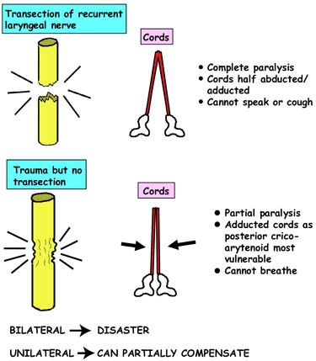
Semon’s Law indicates the different effect between damage (surgical trauma) and transection (قطع) of the recurrent laryngeal nerve due to surgery in region of the neck (e.g. thyroidectomy or parathyroidectomy).
SEMON’S LAW or
damage of the RECURRENT LARYNGEAL NERVE
Vocal cords lie in cadaveric position (نفس وضع الجثة )
Median or paramedian position and air cannot pass
Damage occurs to both sides of the nerve → patient may die
Damage occurs to one side only → can be repaired incompletely

Slide 14
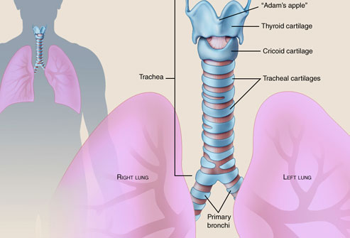
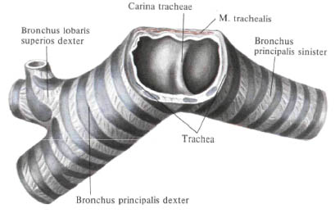
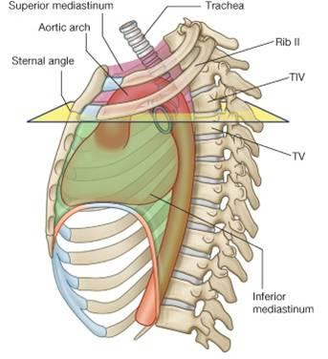
Trachea (windpipe)
Mobile متحركة ,fibro cartilaginous tube, 5 inches long*, and 1 inch in diameter.
Begins: In the neck below the cricoid cartilage of the larynx (at lower border of cricoid cartilage at (C6).
Ends: In the thorax at the level of sternal angle (lower border of T4), by dividing into right and left principal (main,primary) bronchi.
The ridge at the bifurcation from inside is called carina. زاوية الانقسام
It is the most sensitive part of the respiratory tract and is associated with the cough reflex.
*Note:
Trachea = 5 inches
Larynx = 2 inches
Extra (sternal angle)

Slide 15
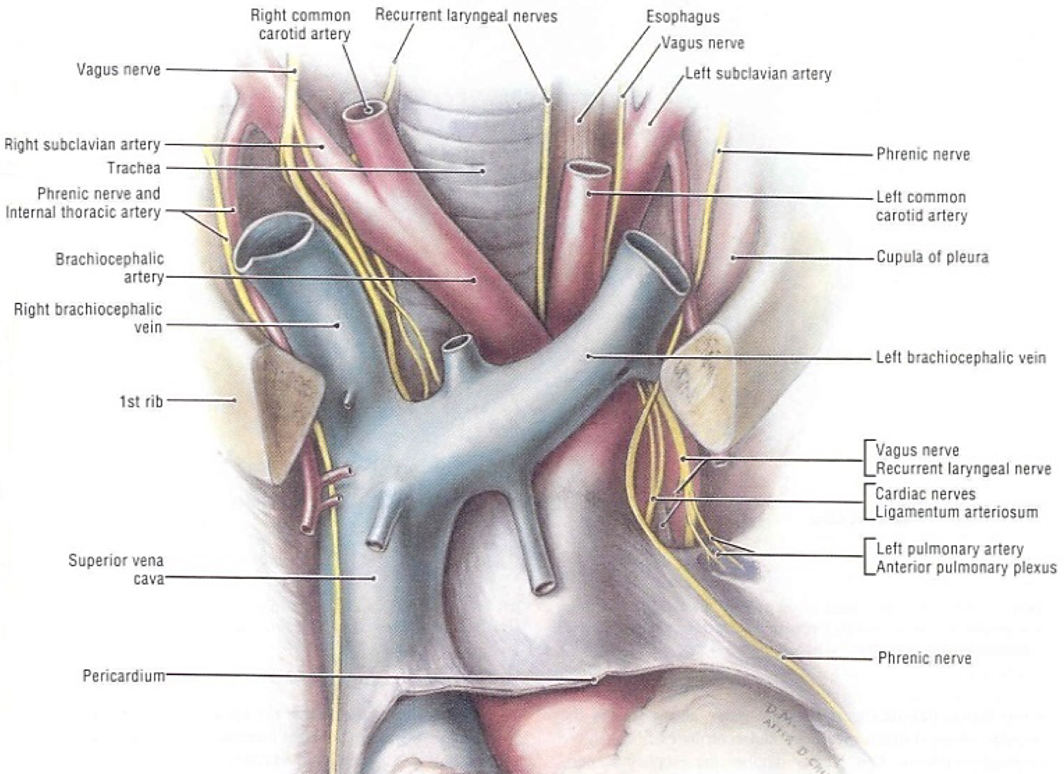
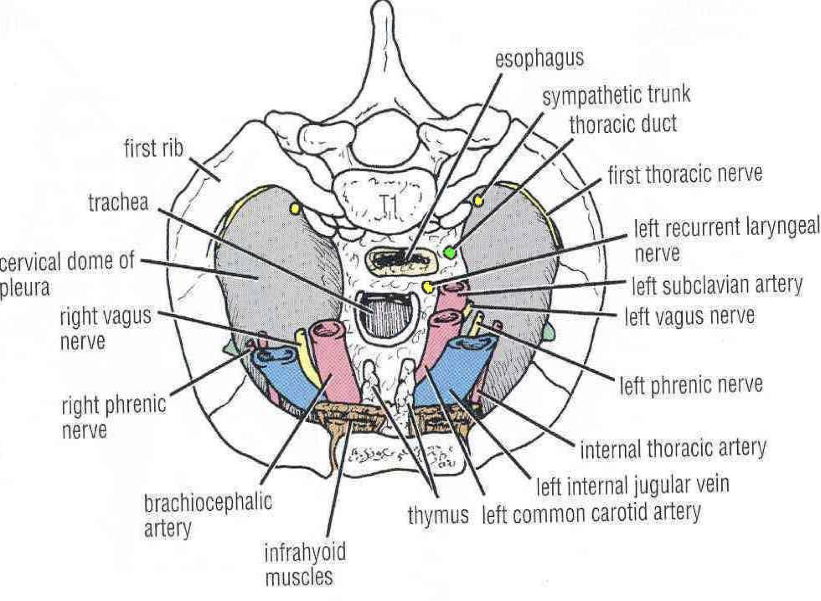
Anterior:
Sternum
Thymus,(remains of thymus gland).
Left brachiocephalic vein.
Arch of aorta.
Origin of: Brachiocephalic artery and left common carotid artery.
Left side:
Arch of aorta.
Left common Carotid artery
Left subclavian artery
Left vagus nerve
Left phrenic nerve
Pleura
Relations in the Superior Mediastinum
Right side:
Azygos vein
Right vagus nerve
Pleura
Posterior:
Esophagus
Left recurrent laryngeal nerve.

Slide 16
Trachea
Nerve Supply:
Branches of the vagus nerve and recurrent laryngeal nerve give sensory fibers to supply the mucous membrane
Branches from the Sympathetic trunks supply the trachealis muscle and the Blood vessels.
Blood Supply:
Arteries: Branches from the inferior thyroid and bronchial arteries (from descending thoracic aorta)
Veins: Drain to inferior thyroid veins.
Lymphatic Drainage:
Into the pretracheal and paratracheal lymph nodes.

Slide 17
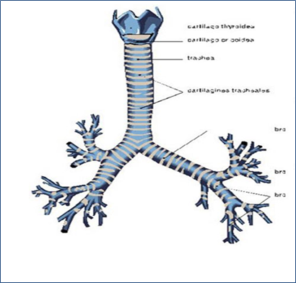
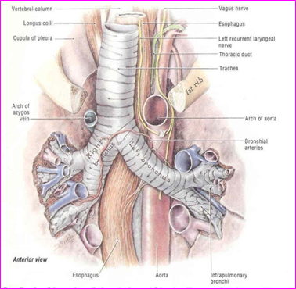
Right Principal Bronchus
About one inch long.
Wider, shorter and more vertical than the left.
Gives superior lobar bronchus before entering the hilum of the right lung.
On entering the hilum it divides into middle and inferior lobar bronchi.
Left Principal Bronchus
About two inches long.
Narrower, longer and more horizontal than the right.
Passes to the left below the aortic arch and in front of esophagus.
On entering the hilum of the left lung it divides into superior and inferior lobar bronchi.

Slide 18
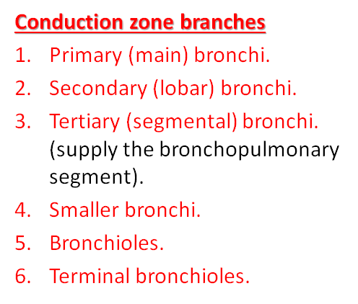
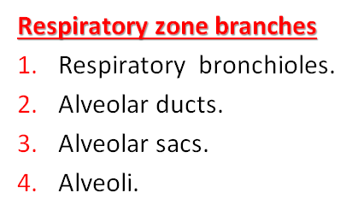
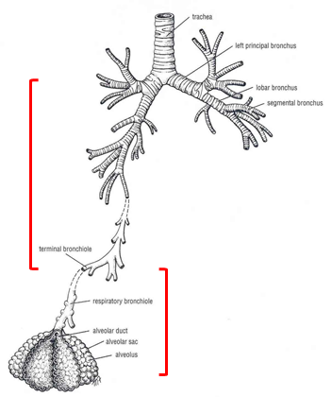
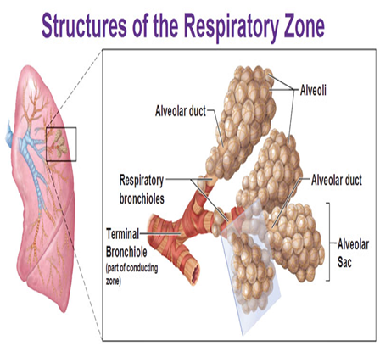
Bronchial Divisions (VERY IMPORTANT SLIDE)
Within the lung, each bronchus divides and redivides into number of branches that can be divided into two groups:

Slide 19
Questions
Which muscle is responsible for opening the rima glottidis?
a. Lateral cricoarytenoid
b. Posterior cricoarytenoid
c. Transverse arytenoid
d. Both a and c
Answer: B
All intrinsic muscles of the larynx are innervated by the recurrent laryngeal nerve except:
a. Thyroarytenoid
b. Cricothyroid
c. Lateral cricoarytenoid
d. Posterior cricoarytenoid
Answer: B
In continuation of the previous question: which nerve is it supplied by?
Answer: External laryngeal nerve of the superior laryngeal branch of the vagus nerve.
Which of the following muscles controls the laryngeal inlet?
a. Omohyoid b. Digastric
c. Palatopharyngeus d. Aryepiglottic muscle
Answer: D
Which of the following muscles relaxes and shortens the vocal cords?
a. Cricothyroid b. Oblique arytenoid
c. Thyroarytenoid d. Sternothyroid
Answer: C
The laryngeal muscle most responsible for stretching the vocal cords is the:
a. Cricothyroid b. Oblique arytenoid
c. Thyroarytenoid d. Sternothyroid
Answer: A

Slide 20
Recurrent laryngeal nerves are sensory to:
a. Laryngeal cavity below the level of vocal cords
b. Laryngopharynx
c. All intrinsic muscles of the larynx
d. Both a and c
Answer: A
According to Semon’s Law, the result of transection of the recurrent laryngeal nerve can cause:
a. Adducted cords b. Inability to breath
c. Inability to speak d. Partial paralysis
Answer: C
Following thyroid surgery, it was noted that a patient frequently aspirated fluid into her lungs. Upon examination it was determined that the area above the vocal fold of the larynx was numb. What nerve may have been injured?
a. External branch of the superior laryngeal nerve
b. Internal branch of the superior laryngeal nerve
c. Recurrent branch of vagus nerve
d. None of the above
Answer: B
The mucous membrane of the trachea is innervated by:
a. Recurrent laryngeal nerve
b. Internal laryngeal nerve
c. External laryngeal nerve
d. Sympathetic nerve fibers
Answer: A
What happens to the trachea, or windpipe, before it reaches the lungs?
a. It branches in two directions
b. It branches in three directions
c. It vibrates and creates a sound
d. It closes up so that no oxygen can escape
Answer: A
Which of the following statements is NOT true regarding the trachea?
a. Trachea rings are C-shaped
b. It splits into the right and left bronchi to supply air to the lungs
c. Opening to the trachea is covered by epiglottis
d. It lies posterior to the esophagus
Answer: D

Slide 21
17. Quadrangular membrane forms :
A) vocal ligament.
B) lateral thyrohyoid ligament.
C) median thyrohyoid ligament.
D) vestibular ligament.
Answer: D
18. Laryngeal Cavity Extends from laryngeal inlet to upper border of the cricoid cartilage A\ true. B\ false
Answer: B, correct is: until lower border of crocoid cartilage
19. Epithelium lining of vocal folds is :
A) ciliated columnar epithelium.
B) simple squamous epi.
C) stratified squamous epi.
D) simple cuboidal epi.
Answer: C
20. Extrinsic muscles of Larynx subdivide into:
A) Elevators & depressors B) Controlling laryngeal inlet & vocal cavity C) none of the above D) all of the above.
Answer: A
13. Bronchi branch into tubes of smaller diameter that are known as:
A) Microtrachea B) Bronchioles
C) Alveolar sacs D) Respiratory bronchioles
Answer: B
14. All the larynx cartilages are hyaline cartilage EXCEPT :
A) cricoid. B) epiglottis.
C) thyroid. D) Arytenoid
Answer: B
15. How long is the larynx :
A) 2cm. B) 2.5 inches. C) 2inches. D) 4cm
Answer: C
16. Laryngeal Inlet is bounded anteriorly by:
A) upper margin of epiglottis.
B) arytenoid cartilage.
C) Aryepiglottic folds.
D) all of themed
Answer: A

Slide 22
single
paired
*All cartilages are hyaline, except the epiglottis is Elastic cartilage
nerves
Veins
Arteries
cartilaginous skeleton
Superior laryngeal
Recurrent laryngeal
vagus nerve
Jugular veins:
1.external Jugular
2.internal Jugular
Carotid arteries: 1.external Carotid 2.internal Carotid
3. Common carotid
Thyroid arteries: 1.superior Thyroid 2.inferior Thyroid
1.Thyroid 2.Cricoid 3.Epiglottis
1.Arytenoid 2.Corniculate 3.Cuneiform
Relations
1-Thyrohyoid membrane
2-Cricothyroid membrane
3-Cricotracheal membrane
4-Hyoepiglottic ligament
5-Thyroepiglottic ligament
6-Quadrangular membrane
larynx
*function in respiration,Phonation
- deglutition
controlling the laryngeal inlet:
1-Oblique arytenoid
2-Aryepiglottic muscle
Membranes and ligaments
structures
Intrinsic muscles:
Muscles
controlling the movements of the vocal cords
1-decreasing Length & Tension of Vocal Cords
Thyroarytenoid
2- increasing Length & Tension of Vocal Cords: Cricothyroid.
-laryngeal cavity lined with ciliated columnar epithelium except The vocal folds surface with stratified squamous epithelium.
-contains mucous glands.
Extrinsic muscles:
Mucosal lining
Elevators
S:Mylohyoid, Stylohyoid Geniohyoid ,Digastric.
L:Stylopharyngeus, Salpingopharyngeus, Palatopharyngeus.
Depressors(The Infrahyoid Muscles):
Sternohyoid,
Sternothyroid,
Omohyoid.

Slide 23
Adductors :
Lateral cricoarytenoid
Transverse arytenoid
vocal cords
Veins
Arteries
movment
drain to inferior thyroid vein
branches from the inferior thyroid and bronchial arteries
Abductor
Posterior​ cricoarytenoid
Trachea
relations
Arteries
Lymphatics
nerves
Nerves
Upper half: ​Superior laryngeal artery
Lower half​: ​Inferior laryngeal arteyr
Into Pretracheal and paratracheal lymph nodes
1-Branches of the vagus nerve and recurrent laryngeal nerve give sensory fibers to supply mucus membrane
2-Branches of the sympathetic trunks supply the trachealis muscle and blood vessels
Sensory:
Above the vocal cords:
Internal laryngeal nerve
Below the vocal cords: ​Recurrent laryngeal nerve
Motor
- All intrinsic muscles, are ​supplied by the recurrent laryngeal nerve except the ​cricothyroid which is ​ supplied by the external laryngeal nerve ​of superior laryngeal of vagus
Bronchial Divisions
Lymphatics
drain into the deep cervical lymph nodes
Respiratory zone branches:
Respiratory bronchioles and below
Conduction zone branches:
Terminal bronchioles and above
Veins
Accompany the corresponding arteries

Slide 24
Leaders:
Nawaf AlKhudairy
Jawaher Abanumy
Members:
Alanoud Abuhaimed
Alanoud Alsaikhan
Ameera Niazi
Dania Alkelabi
Deena AlNowiser
Lama Alfawzan
Lara Alsaleem
Maha Alissa
Nada Aldakheel
Nourah Al Hogail
Wejdan Alzaid
anatomyteam436@gmail.com
@anatomy436

