Slide 1
Pleura and Lung
Color Code
Important
Doctors Notes
Notes/Extra explanation
Please view our Editing File before studying this lecture to check for any changes.

Slide 2
Objectives
By the end of the lecture, the student should be able to :
Describe the anatomy of the pleura:
subdivisions into parietal & visceral pleurae, nerve supply of each of them.
List the parts of parietal pleura and its recesses.
Describe the surface anatomy of both pleurae and lungs.
Describe the anatomy of lungs : shape, relations, nerve supply & blood supply.
Describe the difference between right & left lungs.
Describe the formation of bronchopulmonary segments and the main characteristics of each segment in the lung.

Slide 3
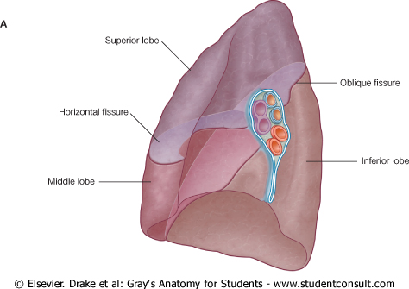
Pleura
Double-layered serous membrane enclosing the lung.
Has two layers:
Parietal layer, which lines the thoracic walls.
Visceral layer, which covers the surfaces of the lung.
The two layers continue with each other around the root of the lung, where it forms a loose cuff hanging down called the pulmonary ligament.
The space between the two layers, the pleural cavity, contains a thin film of pleural serous fluid ( 5-10 ml.)
When this fluid increases above normal it is called pleural effusion (will be discussed later).
Pulmonary ligament

Slide 4
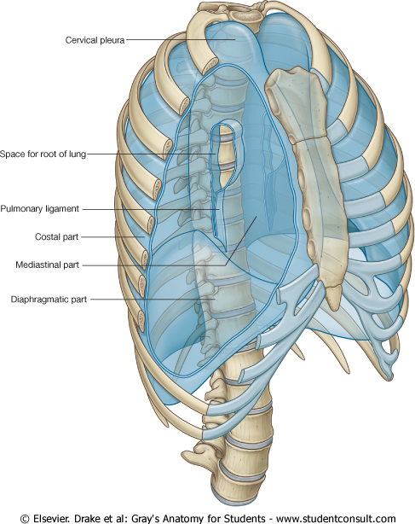
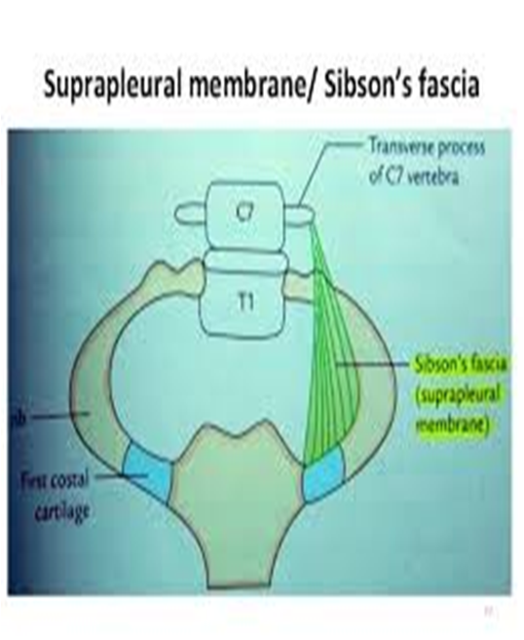
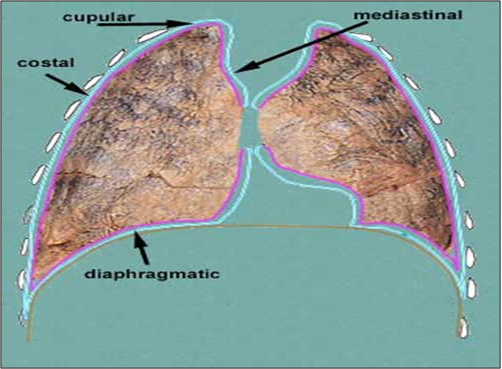
Parietal Pleura
1- Cervical Pleura:
Projects up into the root of the neck about
one inch above the medial1/3rd of clavicle.
It lines the under surface of the
suprapleural membrane.
2- Costal pleura:
It lines, the back of the:
Sternum,
Ribs & costal cartilages,
Intercostal spaces &
Sides of vertebral bodies
It is divided according to the region in which
it lies and the surfaces it covers, into:
1- Cervical (or cupular)
2- Costal
3- Mediastinal
4- Diaphragmatic
Cervical

Slide 5
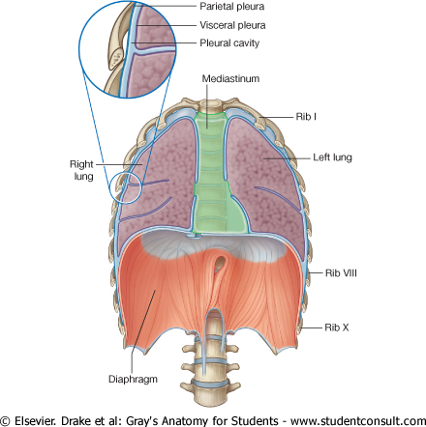
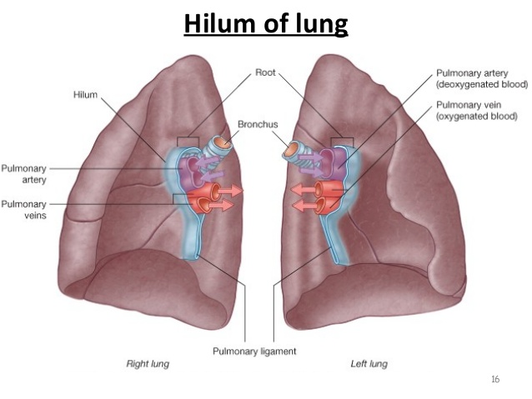
Parietal Pleura
3- Mediastinal pleura:
covers the mediastinum.
At the hilum, it is reflected on to the vessels and bronchi that enter the hilum of the lung, and continuous with the visceral pleura*.
4- Diaphragmatic pleura:
covers the thoracic (upper) surface of the diaphragm.
* The lung root is a collection of structures (vessels, nerves, lymphatics) that leave the lung and suspend it from the mediastinum. All these structures enter or leave the lung via the hilum – a wedge shaped area on its mediastinal surface. The parietal and visceral pleura meet and join around the hilum.
Extra

Slide 6
Pleural Recesses
Recess: a small, empty space or cavity
1- Costodiaphragmatic Recess:
Slit like space between costal and diaphragmatic pleurae, along the inferior border of the lung which enters through it in deep inspiration.
2- Costomediastinal Recess:
Slit like space between costal and mediastinal pleurae, along the anterior border of the lung which enters through it in deep inspiration.
These spaces allow the lung more room to expand during deep inspiration.

Slide 7
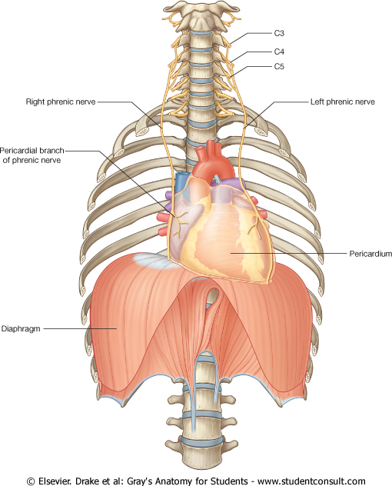
Pleura: Nerve Supply
Parietal pleura:
It is sensitive to pain, pressure, temperature, and touch.
It is supplied as follows:
Costal pleura is segmentally supplied by the intercostal nerves.
Mediastinal pleura is supplied by phrenic nerves.
Diaphragmatic pleura is supplied in the central part (over the diaphragmatic domes) by phrenic nerves, around the periphery by lower 6 intercostal nerves.
Visceral pleura:
sensitive to stretch only and is supplied by the autonomic fibers from the pulmonary plexus.

Slide 8
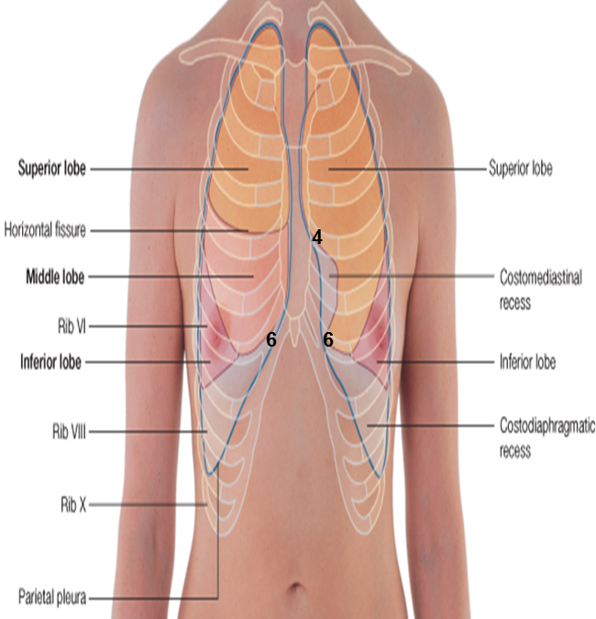
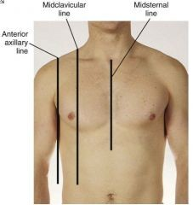
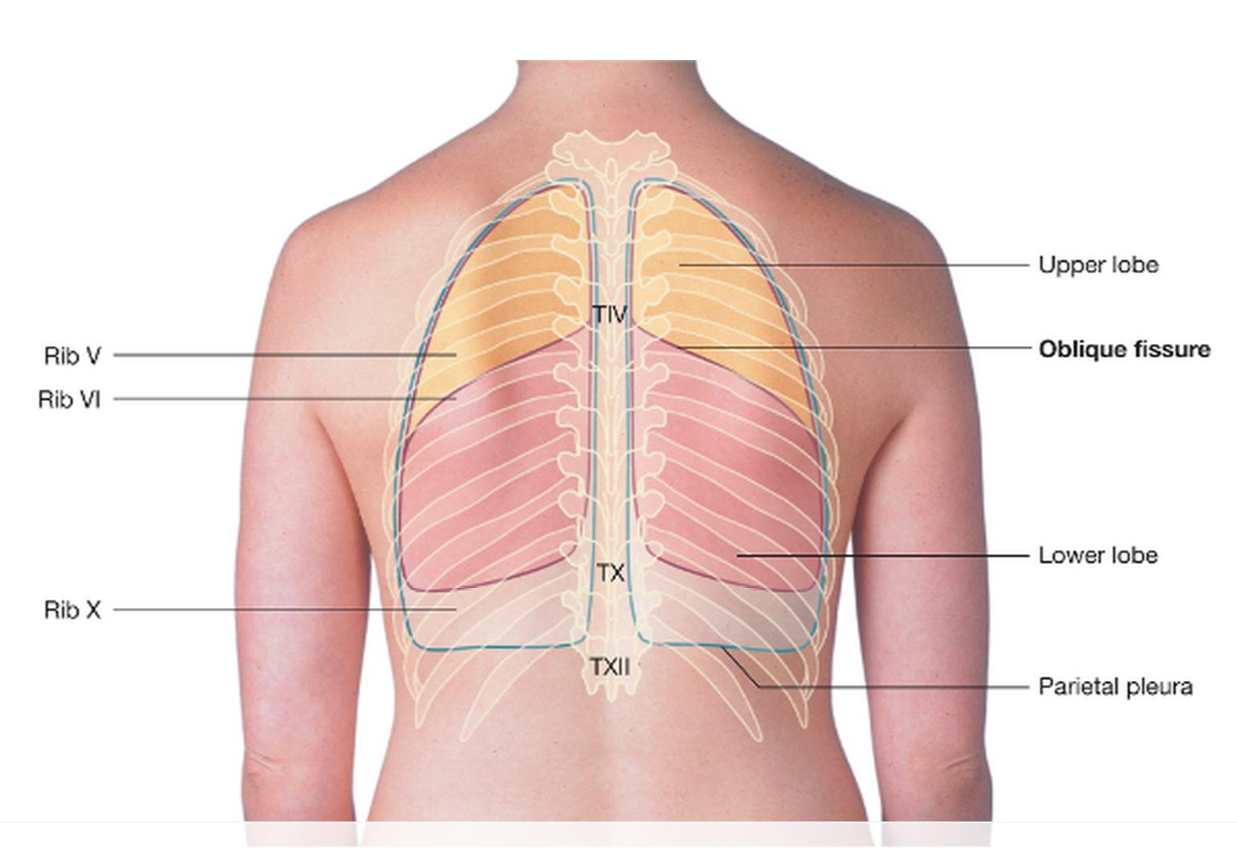
Surface Anatomy of the Pluera
Apex: lies one inch above the medial 1/3 of the clavicle.
The anterior margin:
-Right pleura: The anterior margin extends vertically from sterno-clavicular joint to 6th costal cartilage.
-Left pleura: The anterior margin extends from sternoclavicular joint to the 4th costal cartilage, then deviates for about 1 inch to left at 6th costal cartilage to form cardiac notch.
Inferior margin : passes around the chest wall, on the 8th rib in midclavicular line, 10th rib in mid-axillary line and inally reaching to the last thoracic spine (T12 spine).
Posterior margin : along the vertebral column from the apex to the inferior margin ( T12 spine).
Because the heart lies on the left side
The inferior margin of lung:
above in T10.
Extra
Extra

Slide 9
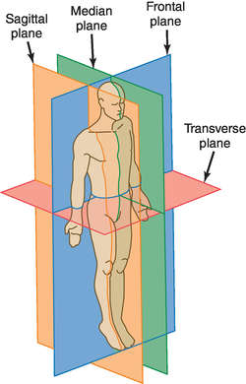
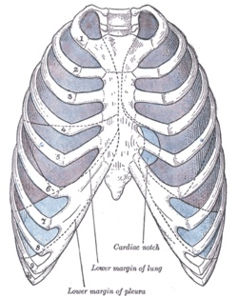
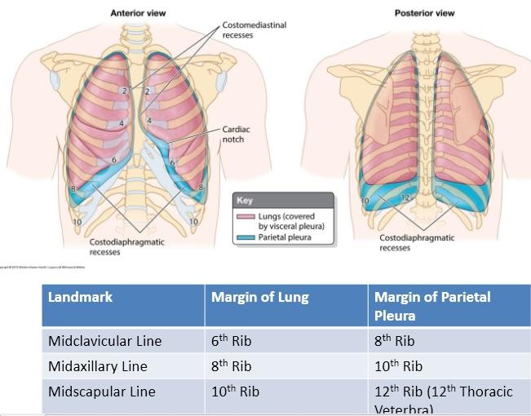
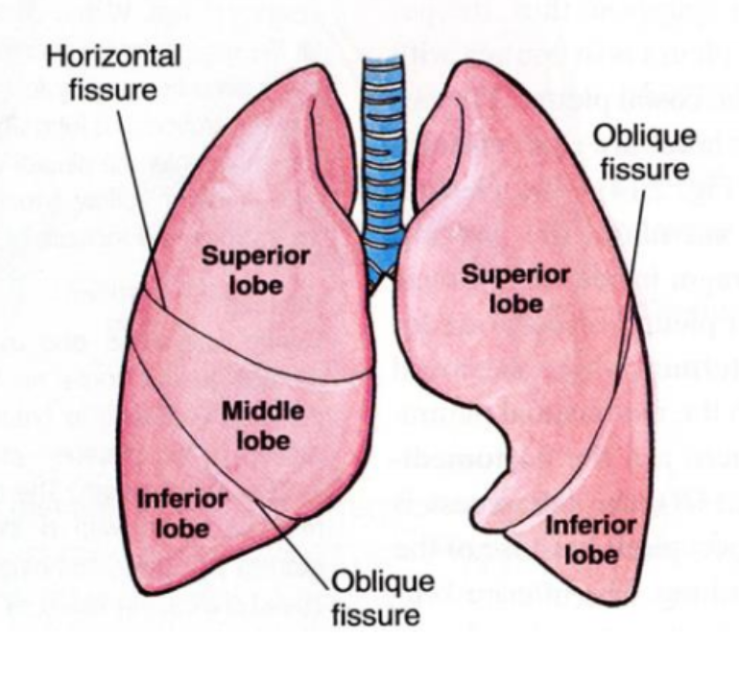
Surface Anatomy of the Lungs
Apex, anterior border and posterior border correspond nearly to the lines of pleura but are slightly away from the median plane.
Inferior margin : as the pleura but more horizontally and finally reaching to the 10th thoracic spine.
Oblique fissure: (both right and left lungs)
Represented by a line extending from 3rd thoracic spine, obliquely ending at 6th costal cartilage.
Transverse (or horizontal) fissure: Only in the right lung:
Represented by a line extending from 4th right costal cartilage to meet the oblique fissure.
Extra
Recall the planes of the body
(The inferior margin of pleura: T12.)
Right lung :
2 fissures & 3 lobes (superior,middle,inferior)
Left lung :
1 fissure & 2 lobes (superior and inferior)
Extra
Extra

Slide 10
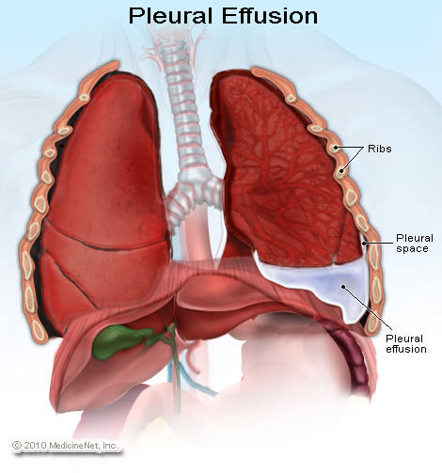
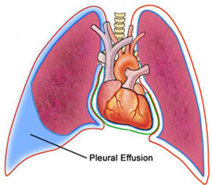
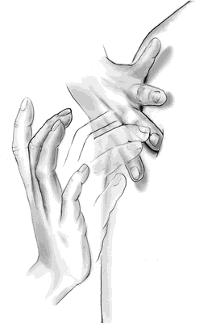
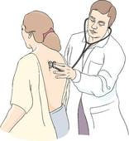
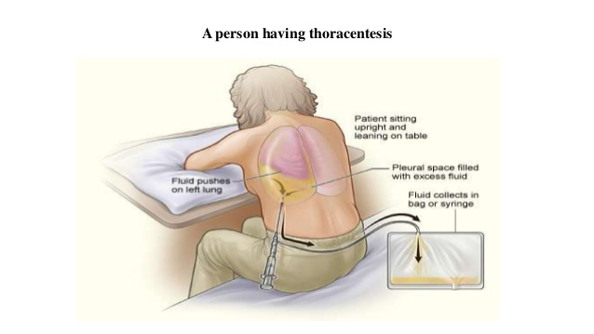
Pleural Effusion
It is an abnormal accumulation of pleural fluid about 300 ml, in the Costodiaphragmatic pleural recess , (normally 5-10 ml fluid)
Causes: inflammation, TB, congestive heart disease and malignancy.
The lung is compressed & the bronchi are narrowed.
Auscultation would reveal only faint & decreased breathing sounds over compressed or collapsed lung lobe.
Dullness on percussion over the effusion.
Percussion: (by the hand) the act or technique of tapping the surface of a body part to learn the condition of the parts beneath by the resulting sound.
Auscultation : is listening to the internal sounds of the body, usually using a stethoscope.
Extra information:
Treatment of pleural effusion is aspiration of the fluid (thoracentesis).
Extra
Extra
Extra

Slide 11
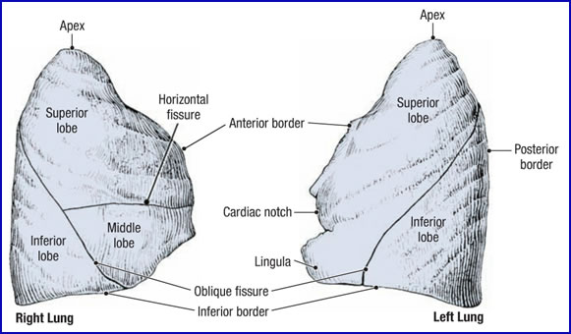
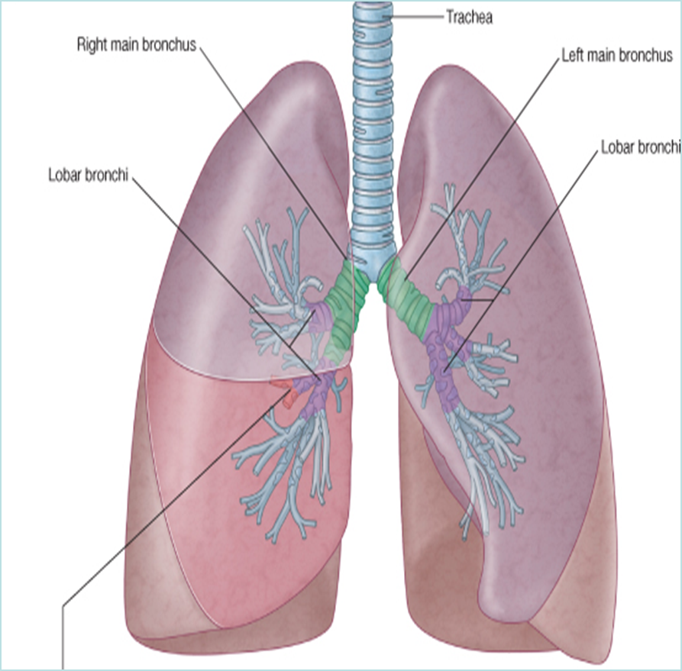
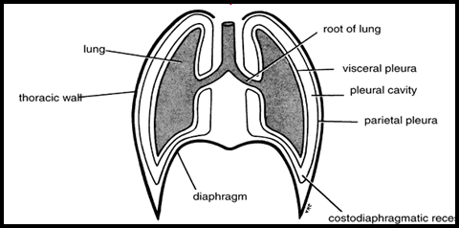
Lungs
Located in the thoracic cavity, one on each side of the mediastinum .
Each lung is:
Conical in shape.(شكل مخروط)
Covered by the visceral pleura.
Suspended free in its own pleural cavity.
Attached to the mediastinum only by its root.
Each lung has:
1-Apex and base: identify the top and bottom of the lung, respectively. 2-Costal surface: surrounded by the ribs from front & back. 3-Medial surface: Where the bronchi, blood vessels, and lymphatic vessels enter the lung at the hilum.
It is also related to the structures forming the mediastinum.

Slide 12
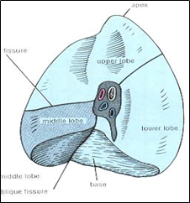
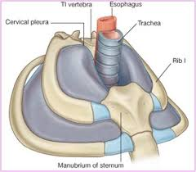
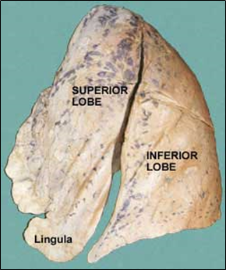
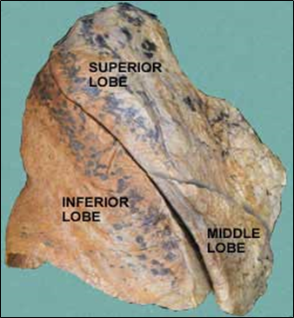
Lungs Apex and Base
Apex:
Projects into the root of the neck (1/2 an inch(1.27cm) above medial 1/3 of clavicle).
It is covered by cervical pleura.
It is grooved anteriorly by subclavian artery.
Base:
inferior or diaphragmatic surface is concave
and rests on the diaphragm

Slide 13
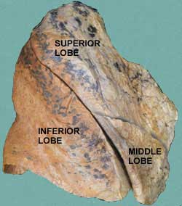
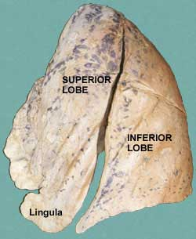
Lungs Borders
Anterior border :
Is sharp, thin and overlaps the heart.
Anterior border of left lung presents a cardiac notch at its lower end, has a thin projection called the lingula below the cardiac notch.
Posterior border :
is rounded, thick and lies beside the vertebral column.

Slide 14
Lungs Surfaces
Costal Surface:
Convex.
Covered by costal pleura which separates lung from: ribs, costal cartilages & intercostal muscles.
Mediastinal Surface:
It is divided into 2 parts:
Anterior (mediastinal) part:
Contains a hilum in the middle (it is a depression in which bronchi, vessels, & nerves forming the root of lung).
Posterior (vertebral) part:
It is related to:
Bodies of thoracic vertebrae,
Intervertebral discs,
Posterior intercostal vessels
Sympathetic trunk.
Lateral & medial surfaces of right lung

Slide 15
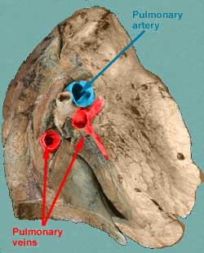
Right Lung Root (hilum)
Lungs
ليش هنا الشرايين هي اللي لونها أزرق و الأوردة العكس ؟
هنا الشرايين تحمل دم غير مؤكسد وعشان كذا يكون لونها أزرق مثل الأوردة ، وسميت شرايين لأنها تطلع من القلب مع أن الدم اللي فيها هو نفس نوع الدم اللي يكون داخل الأوردة (الخالي من الأكسجين)
(يعني تسميتها حسب المصدر هل هو القلب أو غيره ، مو حسب نوع الدم اللي يمشي فيها)
2 bronchi: (middle & inferior lobar bronchi)
Lies most posterior.
Pulmonary artery: is most superior
Pulmonary veins: are inferior and anterior.
Left Lung Root
(hilum)
ملاحظة: الدكتورة نبهت على أن هذي الصور تجي كثير في امتحان OSPE وقالت مهم تعرفون الفرق بين arteries & veins
One bronchus: lies posterior
Pulmonary artery: is most superior
Pulmonary veins: are inferior and anterior

Slide 16
**الصورة مو موجودة بالمحاضرة لكن الدكتورة ركزت على هذي الأجزاء أثناء المحاضرة
اعرفوا كل capillaryايش atriumاللي طالع منه أو داخل له

Slide 17
Lungs
Right lung
Larger & shorter than left lung.
Divided by 2 fissures (oblique & horizontal) into 3 lobes (upper, middle and lower lobes).
Right Lung
Left Lung
Divided by one oblique fissure into 2 lobes, Upper and lower.
There is No horizontal fissure.
It has a cardiac notch at lower part of its anterior border.
Left Lung

Slide 18
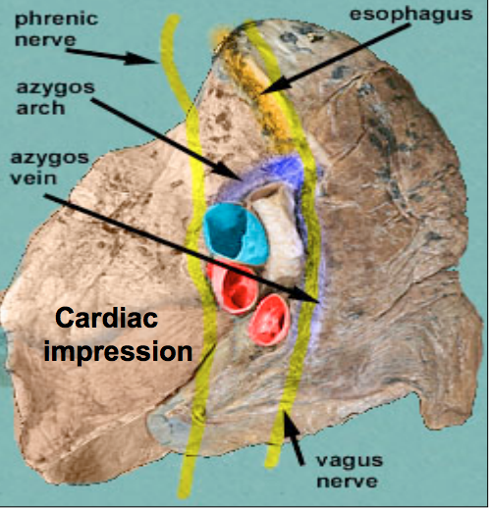
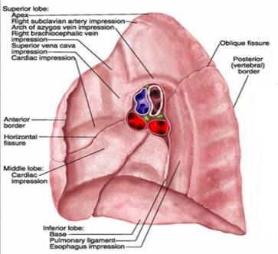
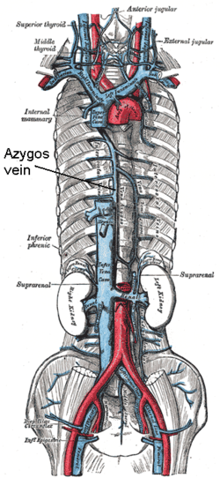
Lungs Mediastinal surface of right lung
On the mediastinal surface of the right lung, you find these structures:
Azygos vein and its arch (posterior and over the root of the lung).
Vagus nerve posterior to the root of the lung.
Esophagus posterior to the root.
Phrenic nerve anterior to the root of the lung.
Cardiac impression: related to right atrium.
Below hilum and in front of pulmonary ligament : groove for I.V.C. (inferior vena cava)
Anterior
Posterior
مبدئيا حنا نعرف ان الرئه شكلها زي حرف C
والمنطقه المجوفه تكون في مكان يسمى mediastinumراح ناخذ عنها محاضره منفصله فهي تكون كذا
( <3 )
الرئتين وبينهم القلب
Extra

Slide 19
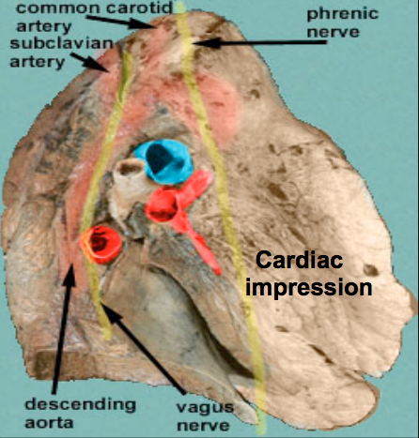
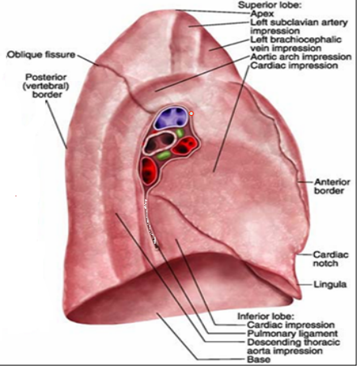
Lungs Mediastinal surface of left lung
On the mediastinal surface of the left lung, you will find these structures:
Descending aorta posterior to the root.
Vagus nerve posterior to the root of the lung
Arch of the aorta over the root of the lung
Groove for left common carotid and left subclavian arteries.
Phrenic nerve anterior to the root of the lung
Cardiac impression: related to left ventricle.
Note:
Cardiac impression:
Right lung = right atrium
Left lung = left ventricle

Slide 20
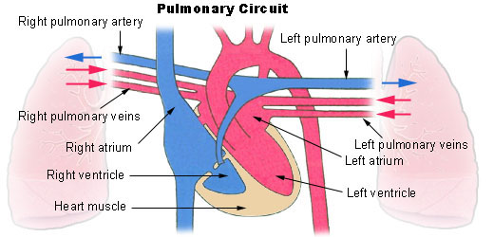
Lungs Blood and Nerve Supply
Bronchial arteries (From descending aorta)…. It supplies oxygenated blood to bronchi , lung tissue & visceral pleura.
Pulmonary artery which carries non-oxygenated blood from right ventricle to the lung alveoli.
Bronchial veins : drain into azygos & hemiazygos veins.
2 pulmonary veins : carry oxygenated blood from lung alveoli to the left atrium of the heart.
Pulmonary plexus at the root of lung….is formed of autonomic N.S. from sympathetic & parasympathetic fibers.
2- Parasympathetic Fibers
From: Vagus nerve
Action:
Broncho-constriction
vasodilatation
secretomotor to bronchial glands
1- Sympathetic Fibers
From: sympathetic trunk
Action:
broncho-dilatation
vasoconstriction.
Extra

Slide 21
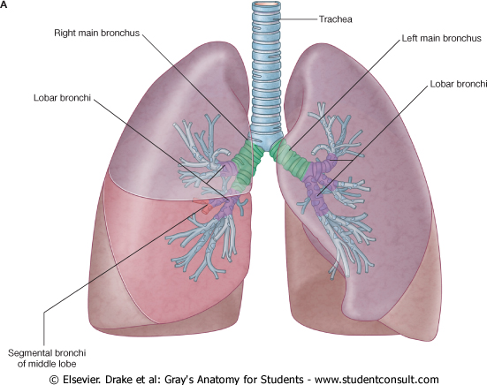
Lungs Bronchi
The trachea divides into 2 main bronchi:
Right main bronchus:
which divides before entering the hilum, it gives: superior lobar (secondary) bronchus. On entering hilum, it divides into middle & inferior lobar bronchi.
Left main bronchus:
On entering hilum, it divides into superior & inferior lobar bronchi.

Slide 22
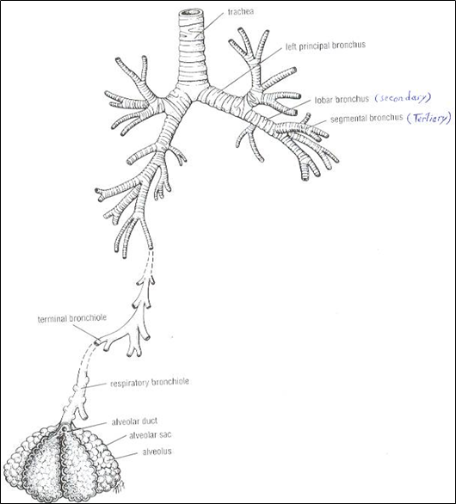
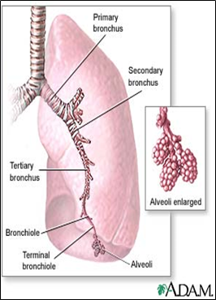
Lungs Bronchopulmonary segments
They are the anatomic, functional, and surgical units of the lungs.
Each lobar (secondary) bronchus gives segmental (tertiary) bronchi.
Each segmental bronchus divides repeatedly into bronchioles.
Bronchioles divide into terminal bronchioles, which show delicate outpouchings ‘the respiratory bronchioles’.

Slide 23
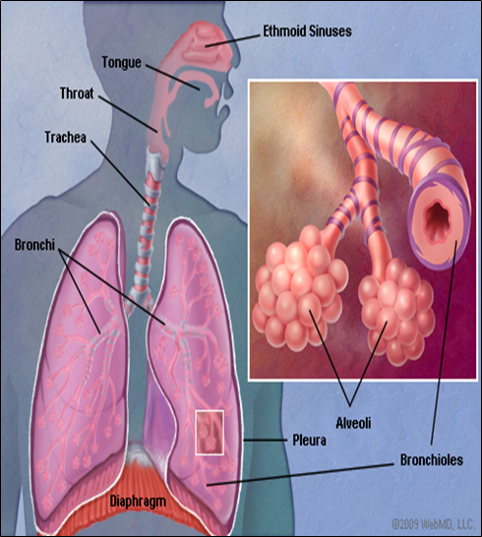
Lungs Bronchopulmonary segments
The respiratory bronchioles end by branching into alveolar ducts, which lead into alveolar sacs.
The alveolar sacs consist of several alveoli, each alveolus is surrounded by a network of blood capillaries for gas exchange.

Slide 24
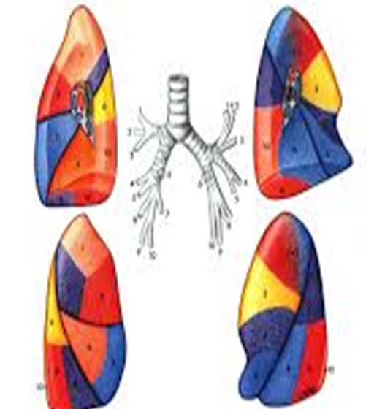
Lungs Bronchopulmonary segments
The pulmonary segments are arranged like a pizza. All the tips (apex) are directed toward the lung root
The main characteristics of a bronchopulmonary segment:
It is a subdivision of a lung lobe.
It is pyramidal shaped, its apex toward the lung root.
It is surrounded by connective tissue septa.
It has a segmental bronchus, a segmental artery, lymph vessels, and autonomic nerves.
The segmental vein lies in the inter- segmental C.T. septa between the segments.
A diseased segment can be removed surgically, because it is a structural unit.
This picture shows one segment and its content

Slide 25
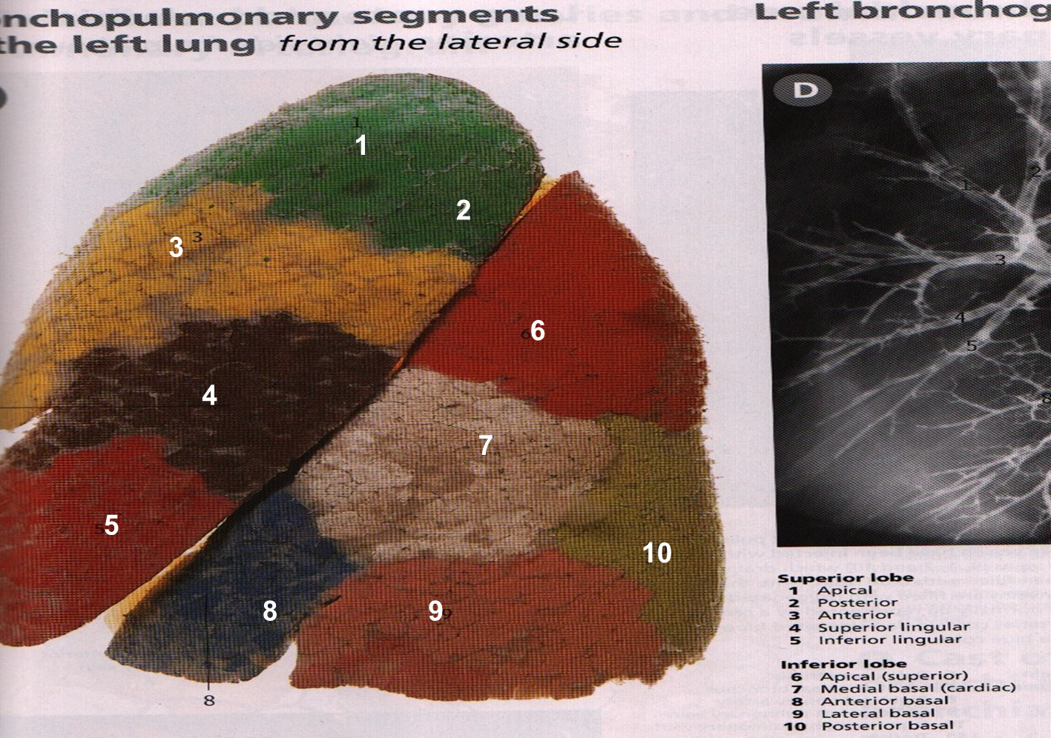
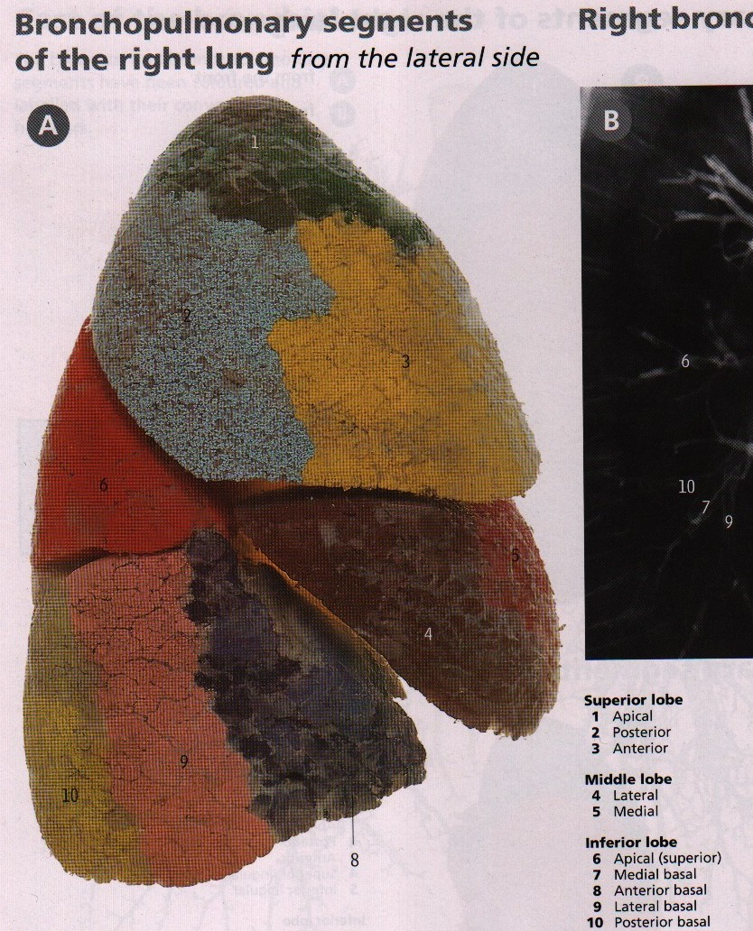
Lungs Bronchopulmonary segments
1
2
3
6
5
4
9
8
10

Slide 26
N.S: intercostal nerves.
Cervical
N.S :autonomic fibers from the pulmonary plexus.
Costomediastinal
;along the inferior border of the lung
Costal
Visceral layer
N.S:phrenic nerves
Pleural Recesses
Costodiaphragmatic:along the anterior border of the lung
Mediastinal
Parietal layer
N.S:-phrenic nerves.
-lower 6 intercostal nerves.
Diaphragmatic
V: Bronchial veins
-2 pulmonary veins
Found structures:
-Descending aorta
-Vagus nerve
-Arch of the aorta
-Groove for left common carotid and left subclavian arteries
Phrenic nerve
-Cardiac impression
Pleura
A:- Bronchial arteries
-Pulmonary artery
N.S:Pulmonary plexus
Left main bronchus
Bronchi
On entering hilum, it divides into superior & inferior lobar bronchi.
Pleura & Lung
Left lung
Lung
Mediastinal
Bronchopulmonary segments
features
alveoli
Each lobar
Right Lung
Divided by one oblique fissure into -2 lobes, Upper and lower
Right main bronchus
alveolar sacs
Mediastinal surface
features
which divides before entering the hilum, it gives: superior lobar (secondary) bronchus. On entering hilum, it divides into middle & inferior lobar bronchi.
segmental (tertiary) bronchi.
There is No horizontal fissure.
alveolar ducts
Found structures:
Azygos vein and its arch
Vagus nerve
Esophagus
Phrenic nerve
Cardiac impression
Inferior vena cava
It has a cardiac notch at lower part of its anterior border.
bronchioles
Divided by 2 fissures into 3 lobes (upper, middle and lower lobes).
terminal bronchioles
the respiratory bronchioles
Larger & shorter than left lung.

Slide 27
Questions
The bronchi in the right lung root lie:
a. Anteriorly b. Posteriorly
c. Superiorly d. Inferiorly
e. Both a and d
Answer: B
The pulmonary veins of the right lung root lie:
a. Anteriorly b. Posteriorly
c. Superiorly d. Inferiorly
e. Both a and d
Answer: E
The cardiac impression in the right lung is related to the:
a. Right atrium b. Right ventricle
c. Left ventricle d. Inferior vena cava
Answer: A
Which of the following statements is incorrect?
a. The pulmonary veins in the left lung root lie anteriorly and inferiorly
b. The pulmonary artery in the right lung root lies superiorly
c. The left lung root has two bronchi
d. The right lung root has two bronchi
Answer: C
Which feature is found only in the left lung?
a. Cardiac notch
b. Transverse fissure
c. Oblique fissure
d. Cardiac impression
Answer: A
Which of the following structures carries oxygenated blood from the lung alveoli to the left atrium of the heart?
a. Bronchial artery
b. Pulmonary artery
c. Pulmonary veins
d. Azygos vein
Answer: C
Which of the following vessels supplies the lungs themselves with oxygen?
a. Bronchial artery b. Bronchial vein
c. Pulmonary artery d. Pulmonary vein
Answer: A

Slide 28
Questions
The lungs and visceral pleura receives parasympathetic innervation from:
a. Cranial nerve IX b. Vagus nerve
c. Phrenic nerve d. Spinal nerve II
Answer: B
Which of the following is the first branching of the bronchial tree that has gas exchanging capabilities?
a. Alveolar sacs
b. Alveolar ducts
c. Terminal bronchioles
d. Respiratory bronchioles
Answer: D
10. The pleural cavity, contains a thin film of pleural serous fluid. what is the normal value: A) 5-10ml. B) 10-20ml. C) 50ml. D) 300ml.
Answer: A
11. Which one of the parietal pleura covers the thoracic (upper) surface of the diaphragm:
A) Cervical Pleura. B) Costal pleura.
C) Mediastinal pleura. D) Diaphragmatic pleura
Answer: D
12. Pleural Recesses are : A) Costodiaphragmatic. B) Costomediastinal.
C) none of them. D) all of them.
Answer: D
13. Mediastinal pleura is supplied by: A) laryngeal nerve. B) phrenic nerve.
C) intercostal nerves. D) vagus nerve
Answer: B
14. The anterior margin of the left pleura has : A) Cardiac notch. B) lingula.
C) none of them. D) all of them.
Answer: D
15. Cause of Pleural Effusion is : A) TB. B)infections. C) congestive heart disease.
D) all of them
Answer: D
16. The apex of the lungs is grooved anteriorly by : A) subclavian artery. B) Azygos vein.
C) phrenic nerve. D)Cardiac impression
Answer: A

Slide 29
Leaders:
Nawaf AlKhudairy
Jawaher Abanumy
Members:
Alanoud Abuhaimed
Alanoud Alsaikhan
Ameera Niazi
Deena AlNowiser
Lama Alfawzan
Lara Alsaleem
Maha Alissa
Nada Aldakheel
Nourah Al Hogail
Wejdan Alzaid
anatomyteam436@gmail.com
@anatomy436

