Slide 1
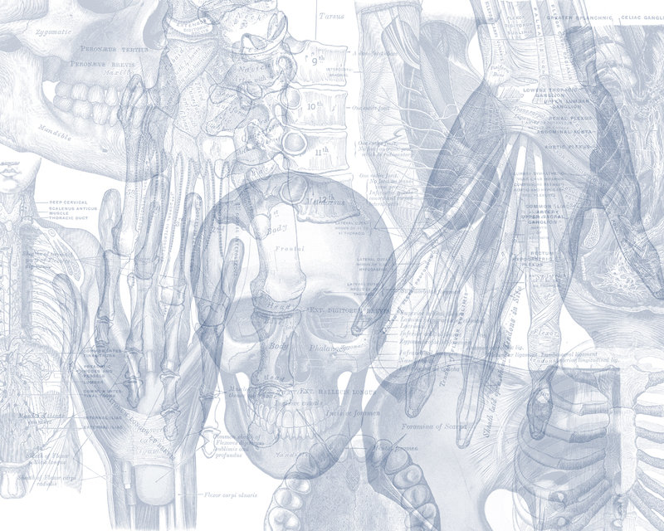
Radiological Anatomy Of The Chest
Color Code
Important
Doctors Notes
Notes/Extra explanation
Please view our Editing File before studying this lecture to check for any changes.

Slide 2
Objectives
By the end of the lecture you should be able to:
Identify the bones of the thoracic cage.
Identify superficial soft tissues.
Identify the trachea and lunge fields.
Describe the mediastinum and the cardiac shadows.
Describe brief knowledge about Bronchography.
Describe brief knowledge about Coronary Angiography

Slide 3
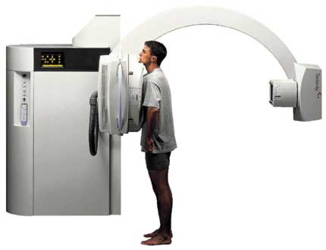
Radiography
Different views of the chest can be obtained by changing the orientation/relative position of the body and the direction of the x-ray beams.
The most common views are:
Posteroanterior (PA)
Anteroposterior (AP)
Lateral (L).
Decubitus
Extra
Extra

Slide 4
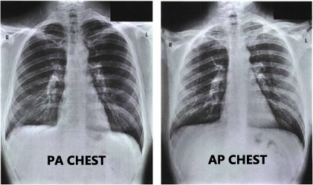
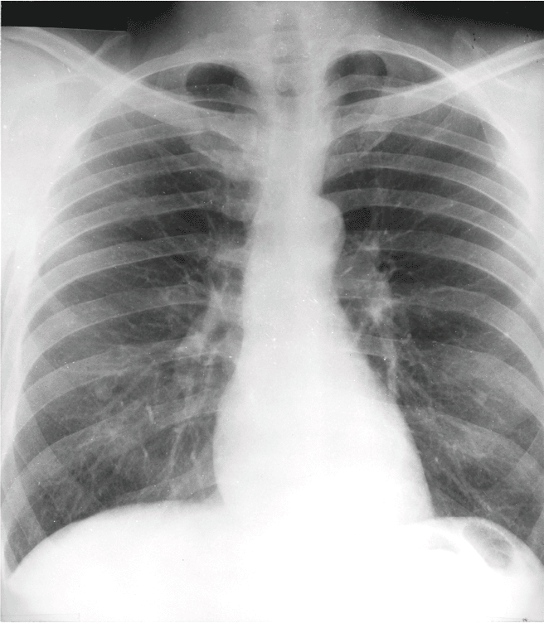
Only on the girls’ slides
Radiography
1. Posteroanterior (PA) view:
Most commonly used.
The x-rays enter through the posterior aspect of the chest, and exit out of the anterior aspect where they are detected by an x-ray film.
PA view gives a good assessment of the Cardiac Size.
It avoids magnification of the heart as the film is close to the anterior chest wall. (the patient stands directly in front of the sheet so that the beams fall directly without spreading and amplifying the picture)
How can we differentiate if the x-ray is PA or AP?
The PA is identified by the presence of the fundal gas bubble* and the absence of the scapulae in the lung fields**.
* The fundus is the only part of the stomach containing air instead of food.
** The scapulae are not completely absent. The medial borders are partially visible.
Extra:
Notice how the scapulae are unclear in PA as opposed to the AP.

Slide 5
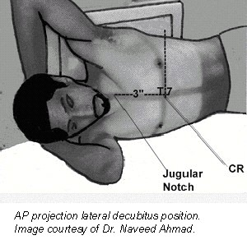
Only on the girls’ slides
Radiography
2. Anteroposterior (AP) view:
The x-rays enter through the anterior aspect and exit through the posterior aspect of the chest.
AP chest x-rays are done where it is difficult for the patient to obtain a normal chest x-ray, such as when the patient cannot get out of bed (we call these patients bed ridden).
3. Lateral view
Taken from the side.
Indicated only for further interpretation. (to see structures we can’t see in the PA/AP, for example: the right ventricle and left atrium).
4. Decubitus:
The patient is lying at the side.
Extra
Extra

Slide 6
Radiography Indications for chest X-ray
This slide is different in the girls’ and boys’ lectures
A chest x-ray may be used to diagnose and to plan the treatment and follow up for various conditions, including:
1- Disease/Fractures of chest bones including:
Ribs
Sternum
2-Lung disorders
Emphysema
3-Heart disorders
Vertebrae
Clavicle
Scapula
Pleural effusion
Tuberculosis
Lung cancer
Atelectasis
pneumonia
Congestive heart failure, which causes cardiomegaly (heart enlargement).
Indication: reasons or signs we should use a chest x-ray.
Follow up:لمتابعة المريض هل تحسن أم لا
Pneumonia: infection of the lung usually by a bacteria or a virus.
Emphysema: enlargement of air spaces with destruction of their walls.
Atelectasis: (known as collapse), it is loss of lung volume because of inadequate expansion of air spaces.
Pleural effusion: accumulation of fluid in the pleural cavity.
Asbestos: a mineral that was used as an insulator.
Silica: a compound found in sand.
4-Chest radiographs are also used to screen for job-related lung diseases in industries such as mining where workers are exposed to dust, example of diseases: Asbestosis, silicosis
5-Chest x-ray is also requested as pre-employment demand. (boys slide)

Slide 7
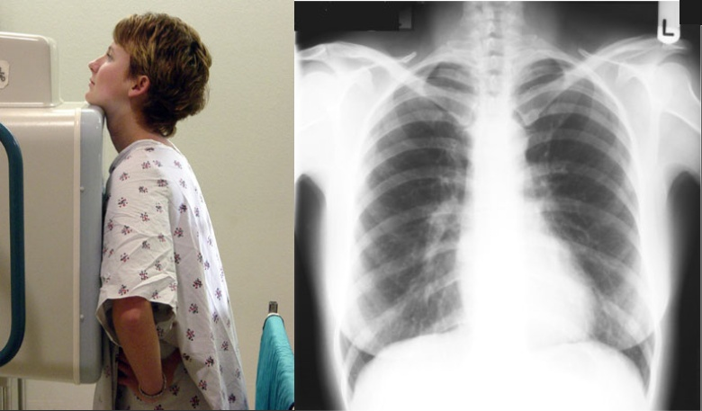
Posteroanterior Radiograph

Slide 8
Posteroanterior Radiograph
For Posteroanterior radiograph (PA), the following systems must be examined in order.
1. Superficial soft tissues;
The nipples in both sexes.
The breast shadow in female are seen superimposed on the lung fields.
2. Bones of thoracic cage.
3. Diaphragm.
4. Lungs and bronchi.
5. Heart and great vessels.

Slide 9
Posteroanterior Radiograph Bones of the thoracic cage:
This slide is different in the girls’ and boys’ lectures
Thoracic vertebrae:
The Thoracic Vertebrae are imperfectly seen.
The black parts resemble the trachea.
Clavicles:
seen clearly crossing the upper part of each lung field.
C
Anterior Ribs
Posterior Ribs
each Rib should be examined in order from above downward and compared to their fellows of the opposite side to check for any abnormality or fracture .
Medial border of the scapula:
may overlap the periphery of each lung field.
S
V
R
Costo-transverse joints
The joint between the transverse process and the head of the ribs.
Costal Cartilages:
are not usually seen, but if calcified, they will be visible.
Note: *LT* is the left side of the patient

Slide 10
Posteroanterior Radiograph Diaphragm
The diaphragm appears as a dome (or cupola) shaped shadow on each side.
The right dome is slightly higher than the left. If the left dome is at the same level or higher than the right dome that means there is fluid in the peritoneal or pleural cavity.
Beneath the right dome is the homogeneous, dense shadow of the liver.
Beneath the left dome a gas bubble mostly seen in the fundus of the stomach.
RD
LD
Gas bubble in the fundus of stomach
LD: Left Dome
RD: Right Dome

Slide 11
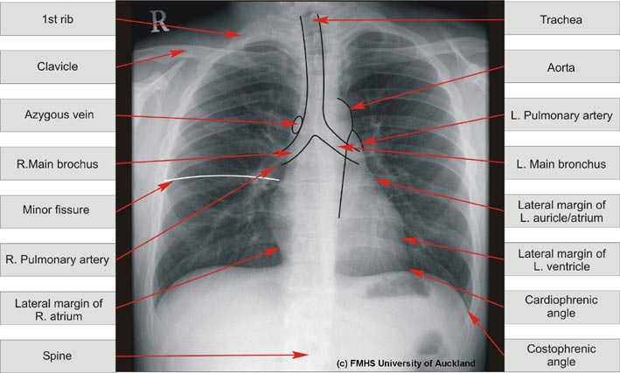
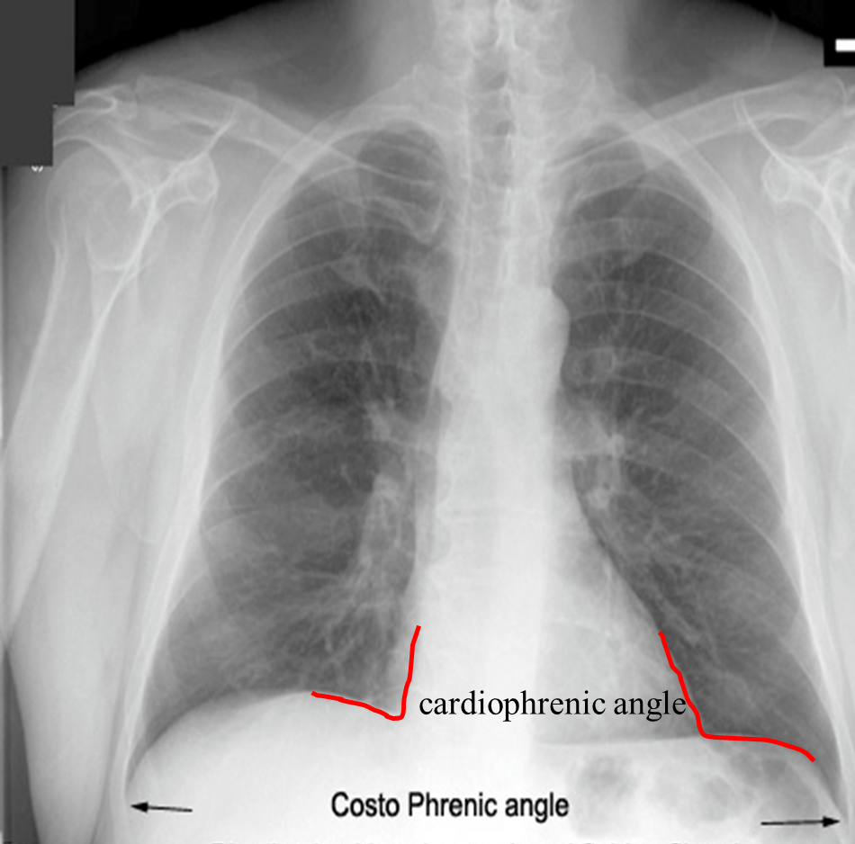
Posteroanterior Radiograph Diaphragm
This slide is different in the girls’ and boys’ lectures
Costo-diaphragmatic (costo-phrenic) Angles:
They are at the sites where the diaphragm meets the thoracic/lateral wall.
The angles become blunt or obscured in case of presence of pleural fluid or fibrosis. (normally they are acute.)
Notice the costophrenic angle, where the diaphragm meets the thoracic wall, the angle becomes blunt or obscured due to minimal pleural fluid (effusion) or fibrosis.
Also note the cardiophrenic angle where the diaphragm meet the heart.
Posterior-Anterior View

Slide 12
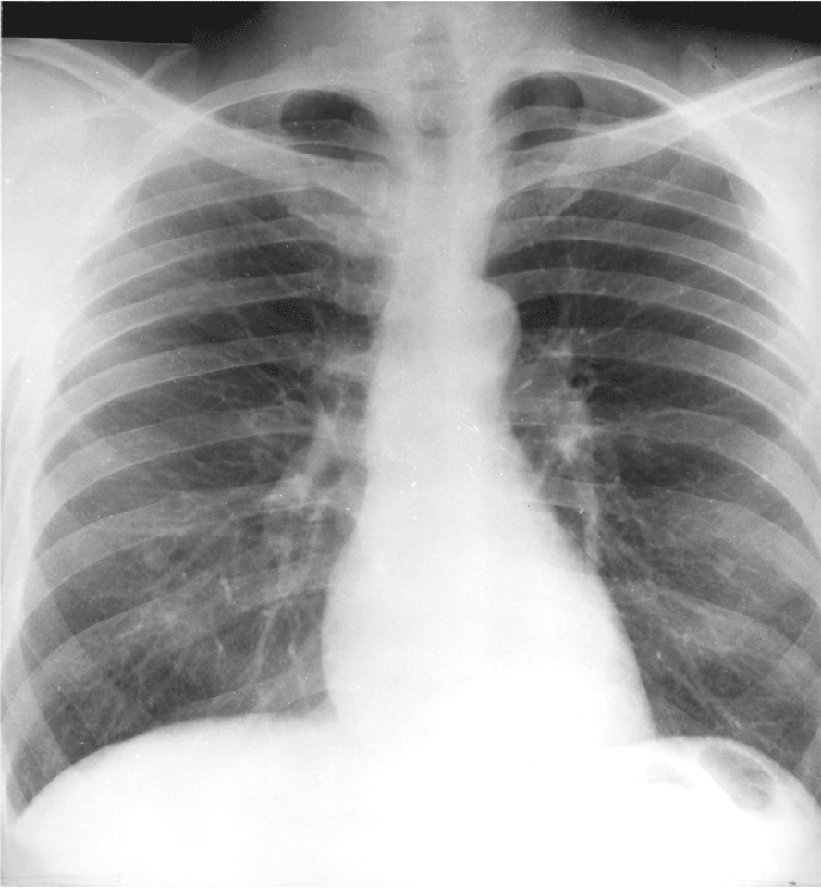
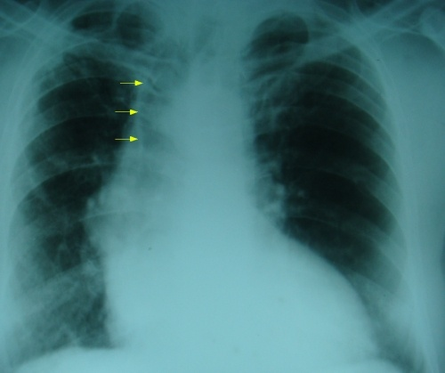
Posteroanterior radiograph Trachea
The radio-translucent, air-filled shadow of the trachea is seen in the midline of the neck as a dark area (because the trachea is a tube filled with air and air is black in x-rays).
This is superimposed by the lower cervical and upper thoracic vertebrae.
Tracheal Shift
Tracheal air column is seen shifted to right on X-ray chest PA view.
It indicates:
A loss of volume of the right upper lobe of the lung, either due to collapse or fibrosis.
OR
A massive pleural effusion on the left side.
(But in this x ray, no pleural effusion is seen on the left)
Meaning the diagnosis is more likely loss of volume due to collapse or fibrosis.
Only on the girls’ slides

Slide 13
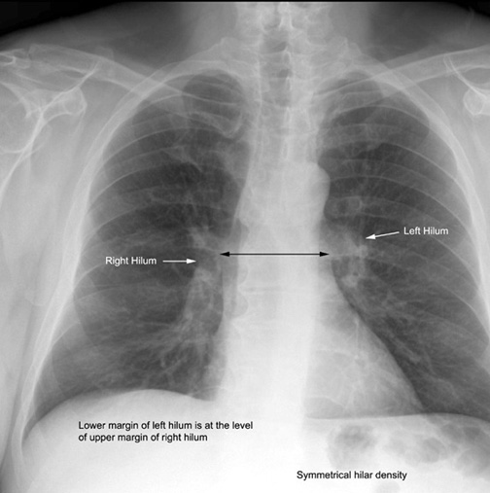
Posteroanterior radiograph Lungs
Lung roots/hilum:
Relatively dense shadows caused by the presence of:
Blood-filled pulmonary and bronchial vessels.
Large bronchi.
Lymph nodes.
Notice that the lower margin of left hilum is at the level of upper margin of right hilum.

Slide 14
Posteroanterior radiograph Lungs
The lung fields, by virtue of the air they contain, readily permit the passage of x-rays. For this reason, the lungs are more translucent on full inspiration than on expiration. (when the lung contains more air, like in deep inspiration, it appears more clear on the x-ray)
The pulmonary blood vessels are seen as a series of small, round, white shadows radiating from the lung root.
The large bronchi, also cast similar round shadows.
The smaller bronchi are not seen.
H
B
H
PV

Slide 15
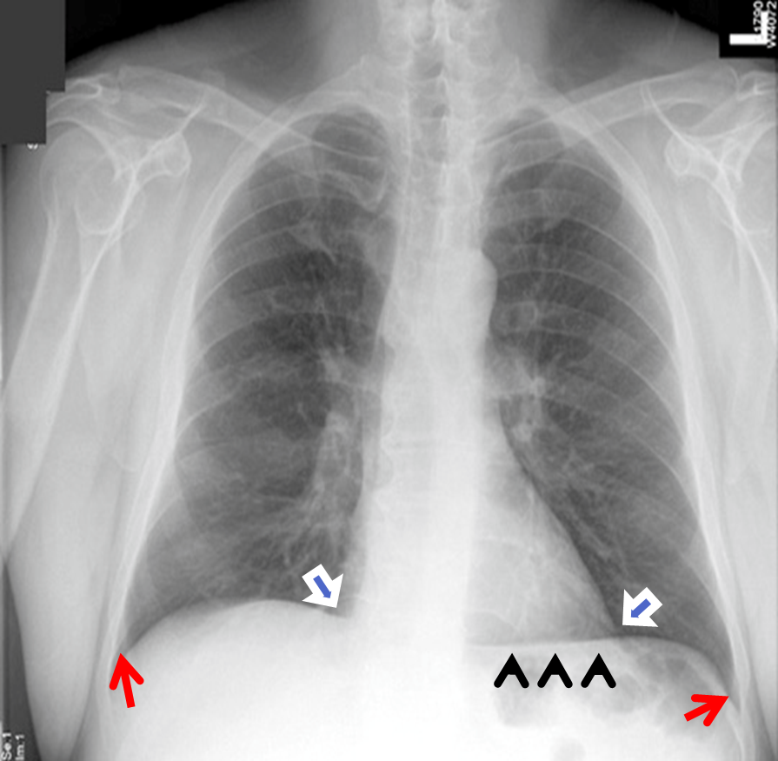
Posteroanterior Radiograph Mediastinum
Only on the girls’ slides
The shadow is produced by the various structures within the mediastinum, superimposed one on the other
Note the outline of the heart and great vessels.
The inferior border of the mediastinum: (lower border of the heart) blends with the diaphragm and liver shadow.
Note the cardiophrenic angles.

Slide 16
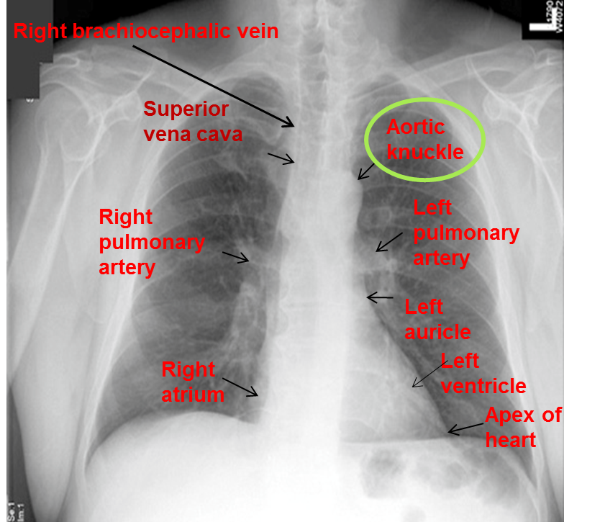
Posteroanterior Radiograph Mediastinum
The right border of the mediastinum from above downward consists of:
Right brachiocephalic vein
Superior vena cava
Right atrium 4. Inferior vena cava (sometimes)
The left border of mediastinum consists of:
Aortic knuckle, or knob (a prominence caused by the aortic arch).
Left margin of the Pulmonary trunk.
3. Left auricle. 4. Left ventricle.
5. Apex of heart.

Slide 17
Posteroanterior Radiograph Mediastinum
Only on the boys’ slides
Aortic knuckle, or
knob (aortic arch).
Pulmonary trunk.
Left auricle.
Left ventricle.
Right Brachiocephalic Vein
Superior vena cava
Right atrium.
Inferior vena cava.

Slide 18
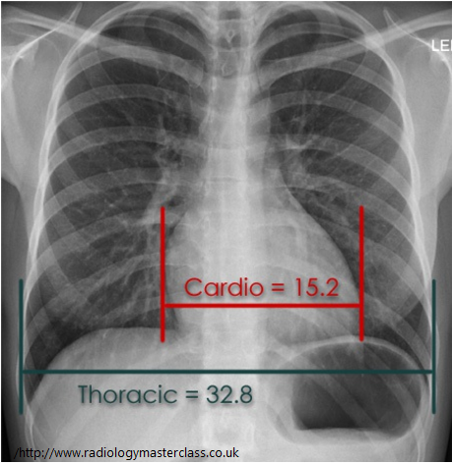
Posteroanterior Radiograph The heart
Transverse
Vertical
The Transverse Diameter of the heart should not exceed half the width of the thoracic cage.
For example if the width of the thoracic cage is 32 inches, the transverse diameter of the heart should be less than 16.
On deep inspiration, when the diaphragm descends, the vertical length of the heart increases and the transverse diameter is narrowed. As if you are pulling down the heart.
In infants, the heart is always wider and more globular in shape than in adults.
The vertical and horizontal diameters are almost equal so the heart appears globular.

Slide 19
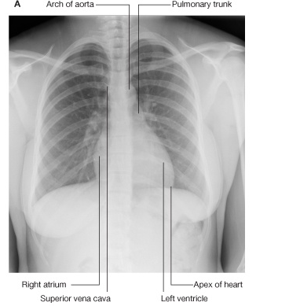
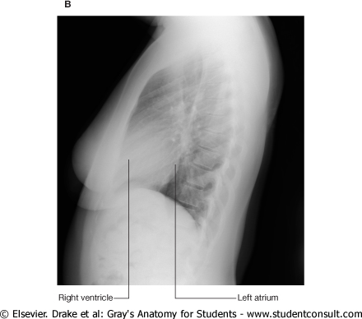
Posteroanterior radiograph The heart
Only on the girls’ slides
PA
LV
In the PA view you can see the aortic knuckle, apex of the heart, right atrium and left ventricle, but in order to see the right ventricle and left atrium you have to look at the LV.

Slide 20
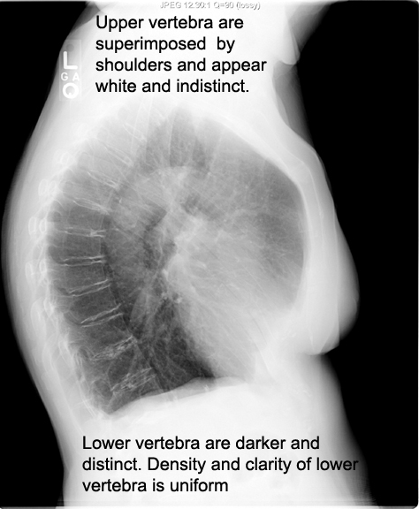
Lateral radiograph of the chest
Only on the girls’ slides
Aortic Arch
We also use the LV to asses the vertebral column.
Vertebral body
Pulmonary arch
Intervertebral disc

Slide 21
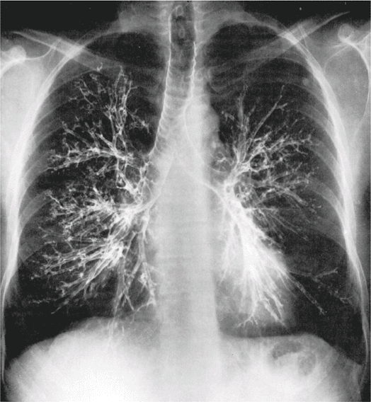
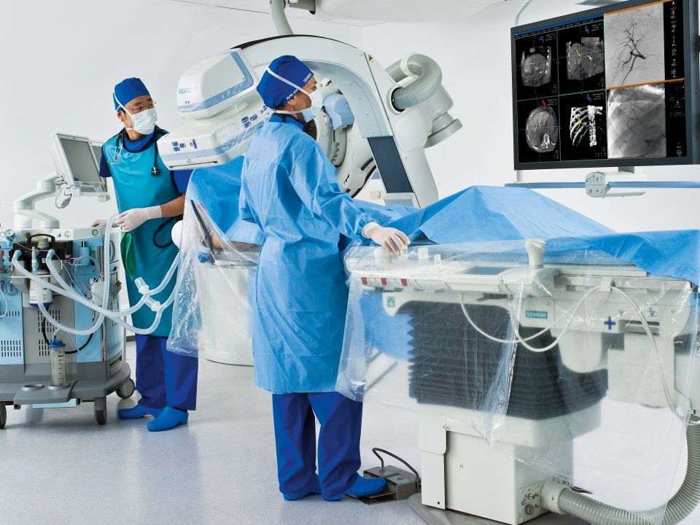
Bronchography
This slide is different in the girls’ and boys’ lectures
is a special study of the bronchial tree by means of the introduction of contrast media into a particular bronchus or bronchi, usually under fluoroscopic control.
The contrast media are nonirritating and sufficiently radio opaque to allow good visualization of the bronchi.
After the radiographic examination is completed, the patient is asked to cough and expectorate the contrast medium.
T
LB
RB
Fluoroscopy: A continuous X-ray beam is passed through the body part being examined. The beam is transmitted to a TV-like monitor so that the body part and its motion can be seen in detail.
Radio opaque: obstructing the passage of radiant energy, such as x-rays, the representative areas appearing light or white on the film.
Expectorate: to spit
T: Trachea
RB: Right Bronchus
LB: Left Bronchus
Extra

Slide 22
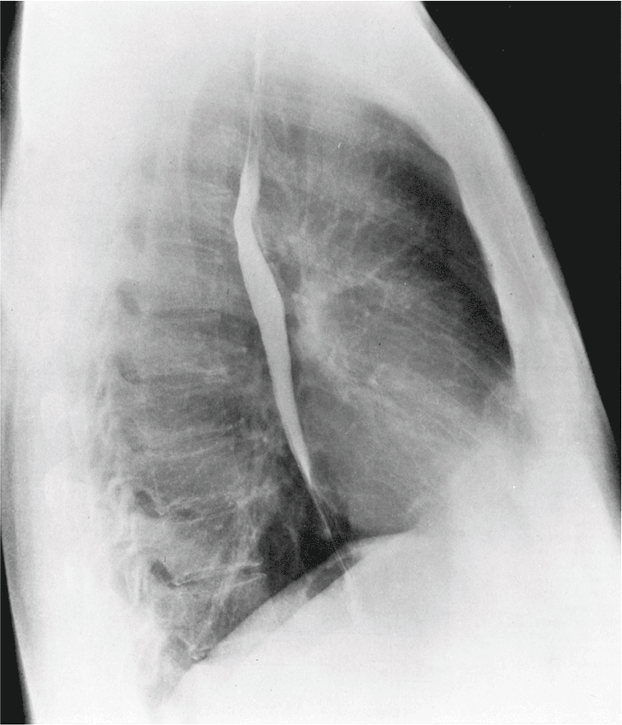
This slide is different in the girls’ and boys’ lectures
Contrast visualization of the esophagus
Contrast visualization of the esophagus by swallowing a contrast media, (barium swallow).
Identification of the aortic arch and left bronchus.
Identification of enlargement of left atrium. (When it enlarges it will press on the esophagus)
Other barium contrast studies for GIT:
Barium meal: stomach
Barium follow through: small intestine
Barium enema: large intestine
Esophagus
Left lateral radiograph of the chest of a normal adult man after a barium swallow.

Slide 23
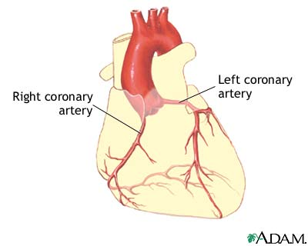
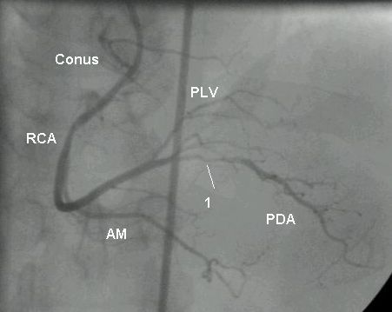
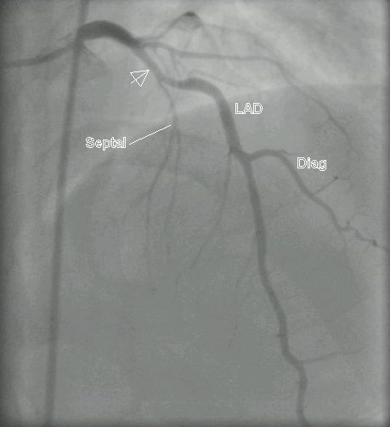
This slide is different in the girls’ and boys’ lectures
Coronary Angiography (or Coronary Angiogram)
is an X-ray with radio-opaque material contrast in the coronary arteries.
The coronary arteries are visualized by introduction of radio-opaque material into their lumen
Pathological narrowing or blockage of coronary artery can be identified.
Extra picture for understanding
Note: the coronary arteries supply the heart.
Right coronary
Left coronary

Slide 24
MCQs
Q1- A chest X-ray can be used to diagnose:
Fractures of the ribs
Pneumonia
Tuberculosis
All of the above
Answer: D
Q2- Which one of these bones is NOT seen in the Posteroanterior radiograph ?
Thoracic vertebrae
Clavicles
Posterior Ribs
Cervical vertebrae
Answer: D
Q3-Beneath the right dome is the homogeneous dense shadow of……?
The stomach
The liver
The kidney
The lungs
Answer: B
Q4-The most anterior structure of the left border of the mediastinum is?
Apex of the heart.
Left pulmonary artery.
Aortic knob.
Left ventricle.
Answer: C
Q5- Which structures forms the aortic knuckle?
Ascending aorta
Descending aorta
Aortic arch
Apex of the heart
Answer: C
Q6- Which of the following cannot be viewed in the PA view?
Left Ventricle
Right Ventricle
Superior Vena Cava
Inferior Vena Cava
Answer: B

Slide 25
Leaders:
Nawaf AlKhudairy
Jawaher Abanumy
Members:
Yazeed Alsuhaibani
Abdulmalek Alhadlaq
Hamad Alkhudairy
Talal Alhuqail
Abdullah jammah
Mohammed habib
Majed Alzain
Abdulhakeem Alonaiq
Abdulaziz Alsalman
Mohammed Alayed
Mohammed alkohail
Mohammed nuser
Khalid aldakheel
Abdulaziz almohammed
Abdulmohsen alghanam
Abdullah hashem
Mosaed alnowaiser
Abdulmohsen alkhalaf
anatomyteam436@gmail.com
@anatomy436

