Slide 1
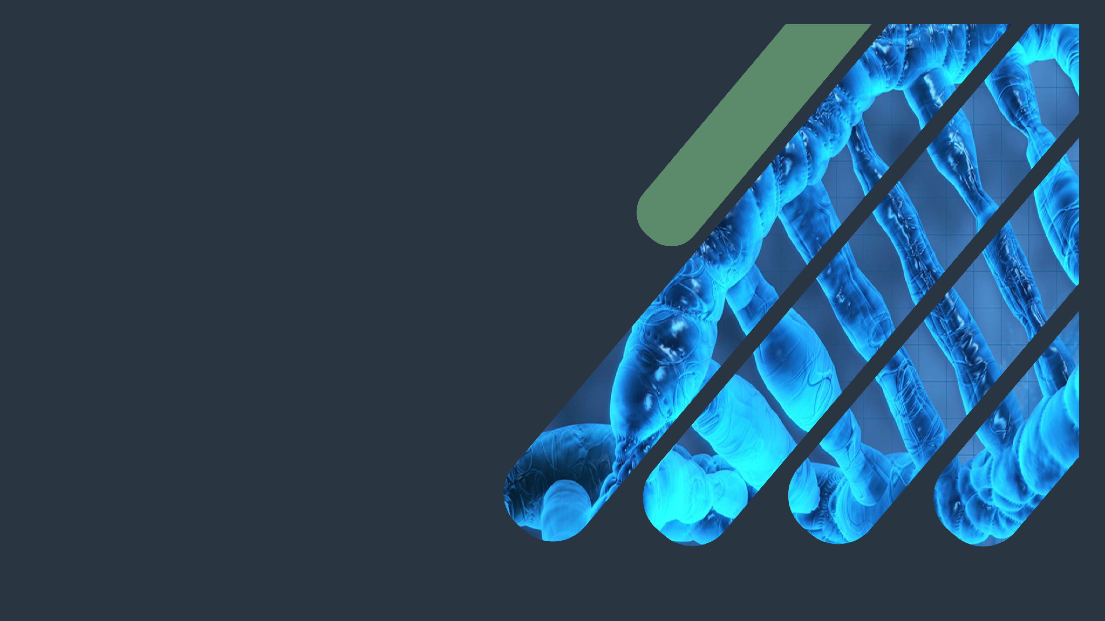
Biochemistry
Globular proteins
There is no elevator to success, you have to take the stairs !
Important.
Extra Information.
Doctors slides
436 Biochemistry team

Slide 2
Objectives:
describe the globular proteins using common examples like hemoglobin and myoglobin.
To study the structure and functions of globular proteins like:
Hemoglobin (a major globular protein)
Myoglobin, and
γ-globulins (immunoglobulins) .
To know the different types of hemoglobin and difference between normal and abnormal hemoglobin .
To understand the diseases associated with globular proteins .

Slide 3
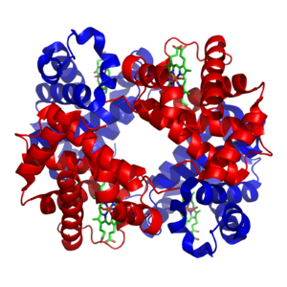
- Amino acid chains fold into shapes that resemble spheres are called globular proteins
Globular protein
- This type of folding increases solubility of proteins in water :
Polar groups on the protein’s surface
Hydrophobic groups in the interior
- Fibrous proteins are mainly insoluble structural proteins
They come from the side chain of amino acid
The sequence of the protein is what determine the structure and the structure is what determine the function of it
-Globular proteins have functional properties.
ex: they can work as enzymes
-Fibrous proteins are structural only.
What makes the protein soluble is the ability to interact with water

Slide 4
Globular proteins
Heme - proteins
Alph1, alpha2, Beta globulins
Gamma globulins (immunoglobulin's)
hemoglobin
Oxygen transport function, it’s present in the RBCs
myoglobin
Oxygen storage\ supply function in heat and muscle
Various functions
Immune function
Enzymes: catalysis of biochemical reactions.
hemoglobin and myoglobin are the two most abundant heme-proteins in humans.

Slide 5
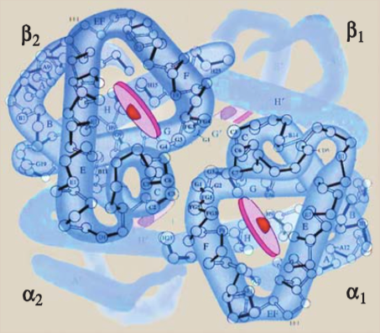
Hemoglobin
A major globular protein in humans
Composed of four polypeptide chains: (subunits)
Two α and two β chains
Contains two dimers of αβ subunits
Held together by non-covalent interactions
Each chain is a subunit with a heme group in the center that carries oxygen
A Hb molecule contains 4 heme groups and carries
4 molecules of O₂
- the bond within the dimer itself is very strong because it has covalent and Hydrophobic bonds .while, the bond between the 2 dimers is weaker because it has ionic and van der val bond .
- 1 hemoglobin > 4 heme group > 4 oxygen molecules.

Slide 6
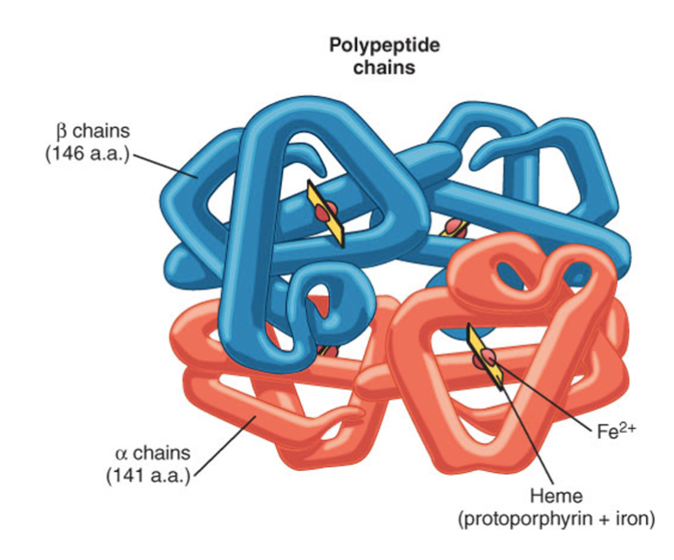
Hemoglobin Structure
Hemoglobin consist of heme group and chains ( alpha - beta - gamma - delta )
beta chain represented by one gene , while alpha represented by two
the heme is in a ring form and the ferrous iron is in the center
Iron binds with the Histidine residue in the globule chain and in the other side binds to O2

Slide 7
Types of hemoglobin
Normal : | Abnormal: not able to transport O2 due to the structure of it.
HbA (97%) It is the major hemoglobin | Carboxy – HB: (IMPORTANT NOTES) CO replaces O₂ and binds 220X tighter than O₂ (Smokers) it can produce toxic concentrations of carboxyhemoglobin in the blood for example increased levels of CO are found in the blood of tobacco smokers. CO toxicity appears to result from a combination of tissue hypoxia and direct CO- mediated damage at cellular level.
HbA2 (2%) | Met- HB: Contains oxidized Fe³⁺ (~2%) that cannot carry O₂
HbF (1%) fetal or neonates It is increased in hepatocellular carcinoma patients | Sulfur-HB: Forms due to high sulfur levels in blood (irreversible reaction) (increased in people who have been using sulfur containing drugs for a long period of time)
HbA1c

Slide 8
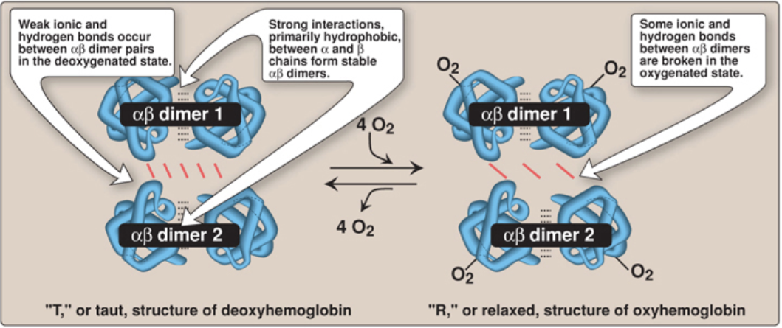
Hemoglobin A
( O2 binding to hemoglobin (
T form: The deoxy form of hemoglobin is called the "T, or taut (tense) form. In the T form, the two alpha beta dimers interact through a network of ionic bonds and hydrogen bonds that constrain the movement of the polypeptide chains.
The T conformation is the low-oxygen-affinity form of hemoglobin.
R form: The binding of o2 to hemoglobin causes the rupture of some of the polar bonds between the dimers, allowing movement. This leads to a structure called the “R” or relaxed form. The R conformation is the high-oxygen- affinity form of hemoglobin.

Slide 9
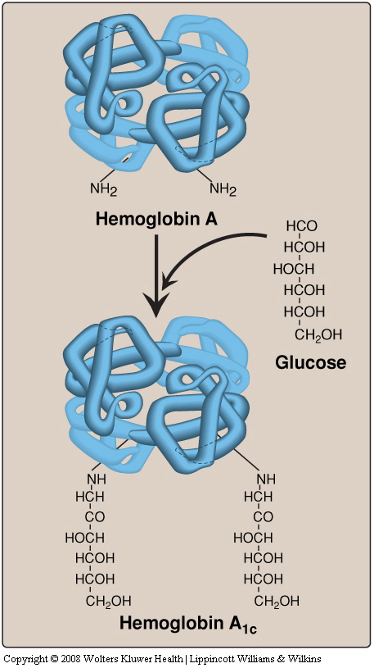
Types of normal hemoglobin
HbA1c is a marker for diabetes, and it is modified form of HbA2.
The most abundant form of glycosylated hemoglobin is HbA1c
Hb A1c identifies how long has the patient been maintaining his/her blood glucose level for a period of 2-3 months; therefore it’s a better marker for diagnosing and monitoring diabetic patients)
HbA_{1c}
HbA₂
Composed of two α and two δ globin chains
Appears before birth
HbA_{1c}
HbA undergoes non-enzymatic glycosylation, which depends on plasma glucose levels so we can get HbA_{1c}
It has glucose residues attached predominantly to the NH2 groups of the N-terminal valines of the β-globin chains
HbA_{1c} levels are high in patients with diabetes mellitus
Fetal hemoglobin (HbF)
Composed of two α and two γ globin chains
Constitutes ~2% of total Hb in an adult body.
Has higher affinity for O₂ than HbA
Which facilitates the transfer of
O₂ from the maternal circulation across the placenta to the RBCs of the fetus.
Major hemoglobin found in the fetus and newborn

Slide 10
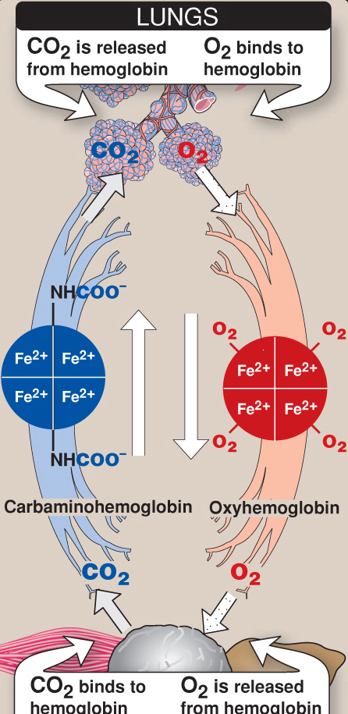
Hemoglobin function
Hemoglobin is found exclusively in red blood cells.
Extra information:
Hb’s main function is to transport O2 from the lungs to the capillaries of the tissues, and can carry 4 molecules of O2 .
Also Hb can transport H+ and CO2 from the tissues to the lungs.
And most of CO2 is hydrated and bicarboniated. And it’s produced in the RBCs
Carrying oxygen from the lungs to tissues.
Carries carbon dioxide from tissues back to the lungs.
Normal levels (g/dL):
Males: 14-16
Females: 13-15
oxygenated Hb called oxyhemoglobin
But Hb that has CO2 called carbaminohemoglobin

Slide 11
Hemoglobin in diseases
All are autosomal recessive
Hemoglobinopathies | Description
Sickle cell disease (HbS) | Caused by a single mutation in B-globin genea | Glutamic acid at position 6 in HbA is replaced by valine The mutant HbS contain B^{s} chains The shape of RBC’s are sickled Cause sickle cell anemia. It is caused by single point mutation
Hemoglobin C disease (HbC) |  | Glutamic acid at position 6 in HbA is replaced by lysine Cause a mild form of hemolytic anemia (no specific therapy is required)
Hemoglobinpathies
are genetic disorders of hemoglobin
are caused by:
*Synthesis of structurally abnormal Hb (qualitative)
*Synthesis of insufficient quantities of normal Hb (quantitive)
OR
A combination of both

Slide 12
Hemoglobin in diseases cont.
Hemoglobinopathies | Description
Methemoglobinemia | Caused by the oxidation of Hb to ferric Fe³⁺ state Methemoglobin cannot bind to O₂ Caused by certain drugs, reactive O₂ species, and NADH-cytochrome b5 reductase deficiency Chocolate cyanosis: the brownish-blue color of the skin and blood (IMPORTANT)
Thalassemia | Defective synthesis of either alpha or beta global chains due to gene mutation. Beta-thalassemia has higher risk than alpha-thalassemia because beta-thalassemia has only two copies of the gene while alpha-thalassemia has four copies. That's why beta-thalassemia need regular blood transfusion and cause severe anemia | Alpha-thalassemia: - Synthesis of alpha-globin chain is decreased or absent Cause mild to moderate hemolytic anemia.
 |  | Beta thalassemia: Synthesis of beta-globin chain is decreased or absent Cause severe anemia Need regular blood transfusion .

Slide 13
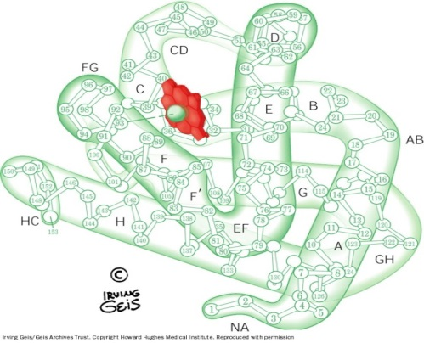
Myoglobin
A globular hemeprotein in heart and skeletal muscle
Single chain will bind to one Heme. So Myoglobin molecule will bind to one O₂
Acts as O₂ carrier that increases the rate of transport of O₂ within muscle cell.
Function | Structure
Stores and supplies oxygen to the heart and skeletal muscle only | Contains a single polypeptide chain forming a single subunit with eight a-helix structures
It gives red color to skeletal muscles | The interior of the subunit is composed of nonpolar amino acids
Supplies oxygen during aerobic exercise | The charged (polar) amino acids are located on the surface (forming hydrogen bond) while The heme group is present at the center of the molecule
Explanation: Forming the structure of myoglobin is stabilized by hydrophobic interaction.

Slide 14
Myoglobin in diseases
Myoglobinuria: Myoglobin is excreted in urine due to muscle damage (rhabdomyolysis it means the destruction of muscle cells)
May cause acute renal failure
Specific marker: Muscle injury
less Specific marker:
Heart attack
Myoglobin in the urine
The most common causes of myoglobinuria in adults are : trauma, alcohol and drugs.
IMPORTANT NOTE:
The cause of myoglobinuria is muscle damage and myoglobinuria may cause acute renal failure

Slide 15
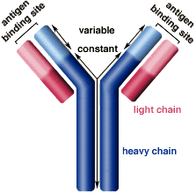
Immunoglobulins
Defensive proteins produced by the B-cells of the immune system
Y-shaped structure with 2 heavy and 2 light polypeptide chains
Neutralize bacteria and viruses
Types: IgA, IgD, IgE, IgG, IgM
Explanation: The antibodies bind with the antigen and makes immune complex which trigger the immune system and the macrophages start engulf this complex

Slide 16
Summary
Hemoglobin:
4 Chains
Transports O2 and CO2
Normal HB: 4 Types
-HbA –HbA2 –HbF –HbA1C
Abnormal HB: 3 Types
-Carboxy Hb –Met Hb –Sulf Hb
Hemoglobinopathies: 4 types
1- Sickle cell disease (HbS)
2- Hemoglobin C disease (HbC)
3- Methemoglobinemia
4- Thalassemia (alpha or beta)
Myoglobin:
1 Chain
Stores O2
Gives red color to skeletal muscles
Myoglobin disease:
Myoglobinuria
Immunoglobulins:
4 Chains
Neutralizes Bacteria
5 Types: Ig G, A, M, E, D

Slide 17
Quiz
SAQ
https://www.onlineexambuilder.com/globular-proteins-saq/exam-127554
MCQ’s
https://www.onlineexambuilder.com/globular-proteins/exam-127546
https://www.onlineexambuilder.com/globular-proteins/exam-128219
Helpful video
Hemoglobin Video: https://www.youtube.com/watch?v=89feCoBXRGE

Slide 18
TEAM
MEMBERS
1- Zinah Alkaaf
2- Ruba Barnawy
3- Reem Alserjany
4-Lama Altamimi
5- Reema Alshaea
6- Shatha Algeheb
7-Rana Barasain
8-Heba Alnasser
TEAM LEADERS
.Rania Alessa
.Mohammad
Almutlaq

Slide 19
Review the notes
https://www.youtube.com/watch?v=89feCoBXRGE
THANK YOU
PLEASE CONTACT US IF YOU HAVE ANY ISSUE
Lippincott's Illustrated Reviews: Biochemistry, 6th E
@436Biochemteam
Biochemistryteam436@gmail.com

