Slide 1
Biochemistry
Phospholipids of clinical significance
Nothing is ever wrong. We learn from every step we take. Whatever you did today was the way it was meant to be.
Be proud of you !
Important.
Extra Information.
Doctors slides
436 Biochemistry team

Slide 2
Objectives:
By the end of this lecture the students will be able to:
1-Identify the types and functions of phospholipids
2-Discuss the physiological importance of phospholipids
3-Understand the role of glycerphospholipids in lung surfactant and their clinical implications in respiratory distress syndrome (RDS)
4-Identify the classes and physiological functions of phospholipase enzymes

Slide 3
Overview
Types and functions of phospholipids
Glycerophospholipids : Types, functions and role in lung surfactant, cell signaling and protein anchoring
Respiratory distress syndrome (RDS)
Sphingophospholipids
Phospholipids in lipoprotein particles
Phospholipases: Types and functions

Slide 4
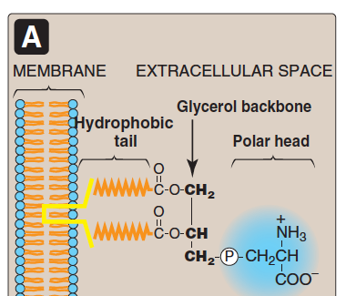
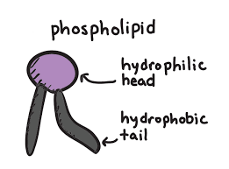
Phospholipids
Major lipids of cell membranes
CLASSIFICATIONs OF PHOSPHOLIPIDS:
Glycerophospholipids
When phosphate group attached to Diacylglycerol
Sphingophospholipids
When phosphate group attached to Sphingosine
Phospholipids are polar, ionic compounds that contain an alcohol group attached either to:
Diacylglycerol
Sphingosine
When the backbone of alcohol is diacylglycerol we call it glycerophospholipids, when it is sphingosine we call it sphingophospholipids
It’s an amino alcohol
Their hydrophobic (non-polar) portion of is attached to the membrane.
Their hydrophilic (polar) portion extends outward interacting with the aqueous environment.
Extra:
You know all of these information from the foundation block, aren’t you smart ?!
Hydrophilic
Amphipathic structure

Slide 5
Functions of phospholipids:
Membrane-bound phospholipids
Nonmembrane-bound phospholipids
Lung surfactant
Components of bile (as detergents to solubilize cholesterol)
Anchors to cell membranes
Reservoir for intracellular messengers (cell signaling)
Ex: kinase C Anchors; hold proteins and stabilize them
Holding or Attaching some proteins to membranes
works as a coat that surround cholesterol “lipid” to solubilize it and make it able to leave the body.+ helps in digestion of phospholipids
Team435/Detergents:
مثل مساحيق الغسيل عندما تقوم بتذويب البقع الدهنية ، فهنا يساعد على تذويب الليبدز من أجل أهداف معينة.

Slide 6
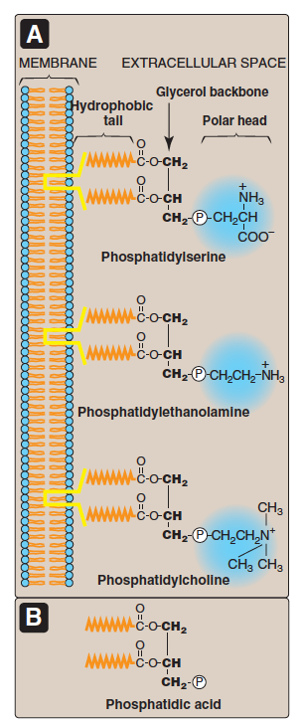
Glycerophospholipids:
Also called phosphoglycerides
A major class of phospholipids
Contain glycerol
Also contain phosphatidic acid (PA)
PA is the simplest phospholipid
الصورة من اليسار توضح تركيب الفوسفوليبيد والي شرحناه في السلايد رقم 2.
الصورة من ليمين توضح انواع الكحول الي راح تنضاف عليها وبناءً على النوع يتحدد اسم المركب ووظيفته, الشرح التفصيلي في السلايد القادمة.
The structure of phosphatidic acid: it’s a DAG with a phosphate group on carbon 3

Slide 7
Glycerophospholipids :
1-Phospholipids are derived from PA such as:
Serine + PA | Phosphatidylserine (PS) | Cell signaling Blood clotting
Ethanoliamine+PA | Phosphatidylethanolamine (PE) (cephalin) | It’s present in heart & brain
Choline + PA | Phosphatidylcholine (PC)(lecithin) | Lung surfactant
Inositol + PA | Phosphatidylinositol (PI) | Cell signaling
Glycerol + PA | Phosphatidylglycerol (PG) | Lung surfactant

Slide 8
Role of PC (phosphatidylcholine) in lung surfactant:
Alveolar cells of the lungs are lined by the extracellular fluid layer.
Alveolar cells (pneumocyte type2) secrete DPPC (a major lung surfactant)
Lung surfactant is a complex mixture of:
Lipids (90%) including Diplamitoylphosphatidylcholine (DPPC)*
Proteins (10%)
*(the major lipid in lung surfactant is phosphatidylcholine present in a different form)

Slide 9
Role of PC (phosphatidylcholine) in lung surfactant:
Role of PC in lungs surfactant:
Surfactant decrease the surface tension of the fluid layer
Reduced the pressure needed to re-inflate alveoli
Prevents alveolar collapse (atelectasis)*
*If the lung surfactant is not there the alveoli will collapse and not be able to re-inflate which leads to Respiratory distress syndrome.

Slide 10
Respiratory Distress Syndrome (RDS):
Respiratory distress syndrome (RDS) (also called new born respiratory distress syndrome)
In preterm infants due to deficiency of lung surfactant.
A major cause of neonatal death.
Preventation : glucocorticoids to mother to promote lung maturation.*
In adults due to damaged alveoli by infection or trauma.**

Slide 11
Dr.Sumbul and lippincot explanation about the RDS:
How to measure if the lung is having respiratory distress syndrome or not?
By measuring the ratio between Sphingomylein and Lecithin, if the ratio is 2 or more that means the person is healthy, if less that means the person is having respiratory distress syndrome.
*It is actually a preventive method, if there’s any complication in the mother or the baby leading to earlier delivery we give the mother glucocorticoids (by injection) which activates specific enzymes leading to earlier production of lung surfactants.
But the actual treatment is giving the early born child an intratracheal lung surfactants (either natural or synthetic)
**Can also happen to heavier chronic smokers because smoking causes inflammation which leads to accumulation of water in lungs.

Slide 12
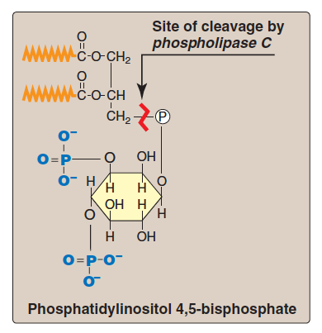
Role of PI (phosphatidylinositol)
In Cell signaling:
Plays an important role in intracellular signaling.
PI is a part of calcium-phosphatidyl inositol system.
PI is present in the membrane and it gets
phosphorylated at two positions, and it is the target
for phospholipase C enzyme.
Phospholipase C cleaves phosphatidylinositol 4,5-bisphosphate and give inositol triphosphate (IP3) soluble, and diacylglycerol (DAC)

Slide 13
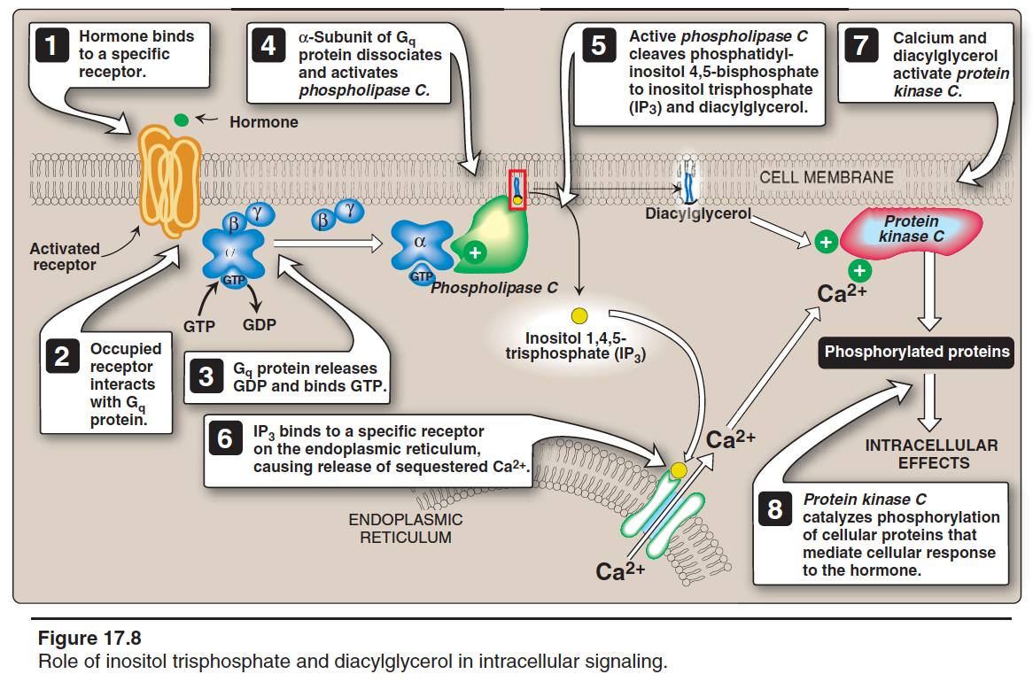

Slide 14
Hormone/neurotransmitter binds to G-protein coupled receptor.
2,3. Receptor Interaction
Receptor will Interact with G-protein Which will lead to replacing GDP with GTP.
4. Dissociation
α-subunit dissociates from β & γ subunits, and activates Phospholipase C.
5. Breaking Down
Phospholipase C break phosphatidylinositol 4-5trisphosphate into DAG + inositol 4-5 bisphosphate
6. Ca Releasing
ER stores Calcium Which released to the cytoplasm when IP3 binds. (IP3: Inositol 1,4,5 triphosphate)
7. Kinase C Activation
Calcium and DAG activate protein kinase C
8. Responding to Action
Protein kinase C catalyze protein phosphorylation. These proteins will give the response of the hormone or neurotransmitter.
e.g. “Antidiuretic hormone (ADH), Acetylecholine”
1. Binding

Slide 15
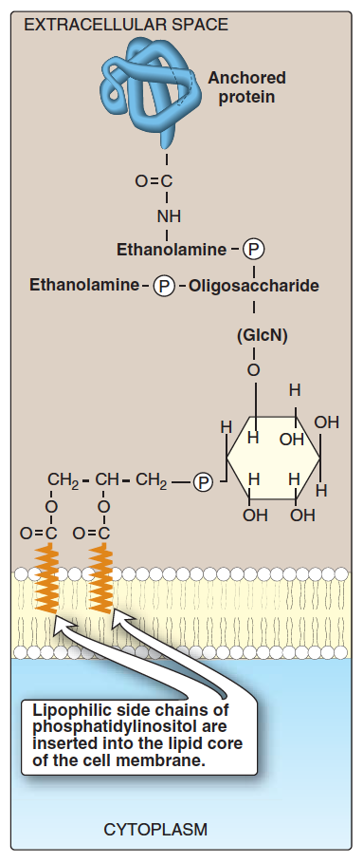
Role of Phosphatidylinositol (PI) in membrane protein anchoring
Anchoring (holds proteins there) of proteins to membranes is done through: carbohydrate-PI bridge.
Anchoring proteins can be cleaved by phospholipase C enzyme.
Examples of anchored proteins
Alkaline phosphatase
Acetylcholine esterase
(present on the surface of small intestine)
(present on postsynaptic membrane of neurons)
When anchoring proteins it needs the help of carbohydrates that makes a bridge between the protein and anchor

Slide 16
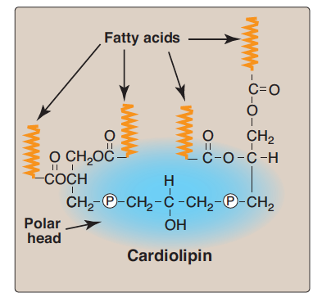
Some examples:
Cardiolipin
Two molecules of PA joined to an additional molecule of glycerol through PO4 groups
In the inner mitochondrial membrane
Function: maintenance of respiratory complexes of electron transport chain
Triggers macrophages and neutrophils to release free radicals to kill bacteria

Slide 17
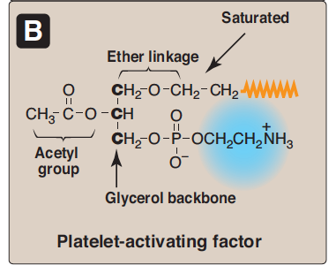
Some examples:
Platelet activating factor (PAF)
Binds to cell surface receptors
Triggers thrombotic and acute inflammatory reaction
PAF : triggers acute inflammatory reaction by activation of macrophages & neutrophils to produce free radical and cause tissue damage
Consist of: Ether linkage

Slide 18
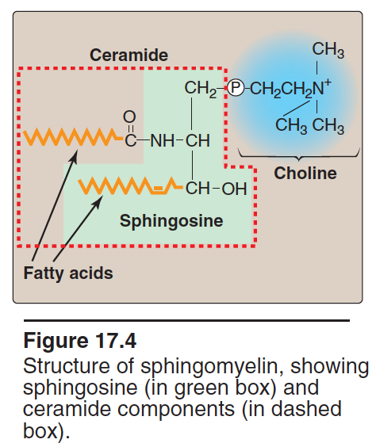
Sphingophospholipids*
*imp
Sphingophospholipids are a long-chain fatty acid attached to sphingosine.
Ex. Sphingomyelin. (the only significant sphingophospholipid in humans).
Sphingomyelin is an important component of myelin sheath that protects and insulates nerve fibers.
And increase the velocity of transmission of the signal
* if the backbone is sphingosine we call it Sphingophospholipids

Slide 19
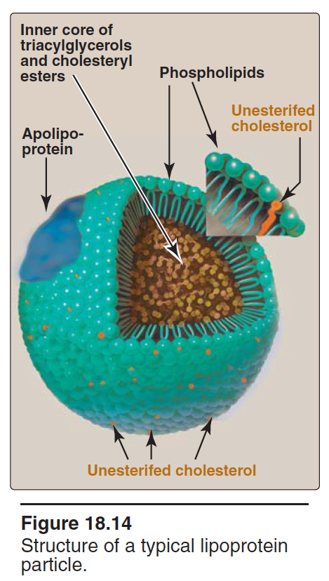
Phospholipids in lipoprotein* particles
Lipoproteins are composed of a neutral lipid core (containing triacylglycerol and cholesteryl esters) surrounded by a shell of amphipathic apolipoproteins, phospholipid, and unesterified (free) cholesterol. They main function is to keep lipids soluble as they transport them between tissues.:
Lipidبحمد الله تم دخول الـ
لللاسلام حيث غيرت اسمها الى ليبو بروتين ولبست العباءة المكونة من الفوسفوليبيد والكوليسترول لكي تمشي
بدون جذب انتباه اقرانها المشابهين لها (الهيدروفوبيك)
شكر للولوة الشيحة *
The outer core of lipoprotein particles is hydrophilic contains phospholipids and free cholesterol. This outer core allows transport of core lipids (hydrophobic) in aqueous plasma (hydrophilic).
*it has different types: Chylomicrons, high density lipoproteins (HDL), low density lipoproteins (LDL), very low density lipoproteins (VLDL).

Slide 20
When There is lipid being transported through blood as: triacylglycerol from diet, we use lipoprotein. The Inside (core) made up of lipids, the surface made up of phospholipid bi layer, The hydrophobic part interact with the lipid molecules and the hydrophilic part interact with aqueous environment. In addition to cholesterol and apolipoprotein.

Slide 21
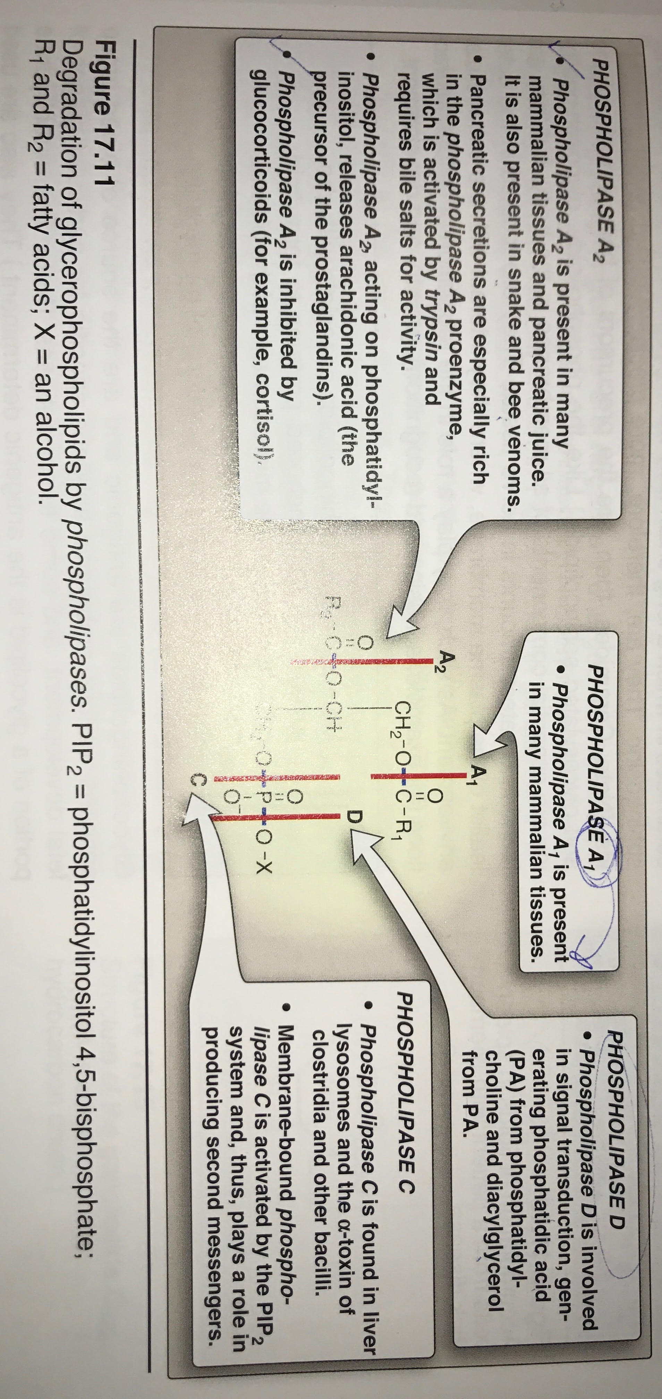
Phospholipase
* what are they ? group of enzymes that catalyse the cleavage of phospholipid.
*Where there are found? in all tissues including pancreatic juice
.
*Glycerolphospholipids are degradated by : phospholipase A1,A2,C,D
*sphingophospholipid are degraded by :
Sphingomyelinase
Sphingomyelinase is type of phosphodiesterase a Type C and D phospholipase
Types of phospholipase :
1-phospholipase A2 : present pancreatic juice , activated by trypsin by acting as proenzyme.
Inhibited by glucocorticoids.
2-phospholipase A1: found in many mammalian tissue .
3-Phospholipase D: mostly found in planets tissue.
4-phospholipase C : responsible for producing second messengers.

Slide 22
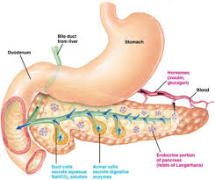
Functions of Phospholipase
digestion
Remodeling
Production of second messenger
Dissolving the cell membrane in infection
Pathogenic bacteria produce phospholipases to dissolve cell membranes and spread infection.
Change in the composition of the phospholipid.
Example: DDPC is produced remodeling.(consisting of two palmitic acids attached of a phosphatidylcholine head-group (Phospholipase cleaves the phosphatidylcholine ,and by the help of transferase enzyme it adds the palmitic acid)
In pancreatic juice, it helps in digestion of phospholipids “ by cleaving them”.

Slide 23
معلومات اثرائية:
Essentially all cells except mature erythrocytes can synthesize phospholipids, whereas triacetyle glycerol synthesis occurs essentially only in liver, adipose tissue, lactating mammary glands, and intestinal mucosal cells.
PC and PE are the most abundant phospholipids in most eukaryotic cells. The primary route of their synthesis uses choline and ethanolamine obtained either from the diet or from the turnover of the body’s phospholipids.
Sphingomylien, a sphingosine- based phospholipid is a major structural lipid in the membranes of nerve tissue.
Cardiolipin is antigenic and is recognized by antibodies raised against Treponima palidum, the bacterium that causes syphillis
(المرض الي جاء جورج اومالي في جريز اناتومي)

Slide 24
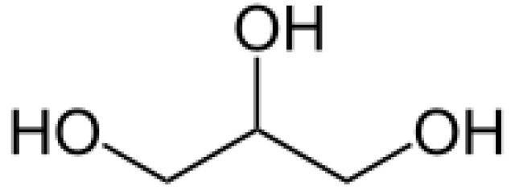
There are two classes of phospholipids
The first class it's backbone is made up of diacylglycerol
Glycerol structure
Monoacylglycerol is made by removing one OH from glycerol and adding fatty acid chain.
Diacylglycerol is made by removing two OH from carbon No. 1 and carbon No. 2 and then adding two fatty acid chains at these two positions.
If the back bone is made of diacylglycerol, then the phospholipid going to be called: glycerophospholipid or phosphoglycerides
When adding a phosphate group on diacylglycerol it becomes phosphatidic acid, which is the simplest phospholipid (phosphatidic acid)
Diacylglycerol is lipid
The fatty acid chains are hydrophobic
The phosphate group is the hydrophilic polar head
Thus become parent phospholipid
Then adding an alcohol group like: Serine, choline, ethanolamine. Then they become different phospholipid
If you add choline group on phospholipid it becomes: phosphatidylcholine
The second class (spgingophospholipid):
Backbone: sphingosine. It's an amino alcohol

Slide 25
SUMMARY OF PHOSPHOLIPIDS:
- They have a hydrophobic tail and hydrophilic head.
- They are membrane bound or non membrane bound.
- Lipoproteins contain phospholipids to allow transport of core lipids in aqueous plasma.
- Phospholipase Functions:
1- Degrades phospholipids. (each type has a different enzyme)
2- Remodeling phospholipids. 3- Produce second messengers.
4- Bacteria produces phospholipase to dissolve cell membranes and spread infection.
Phospholipids on the cell membrane are two types:
1- Glycerophospholipids:
They all contain phosphatic acid (PA) which is the simplest phospholipid.
Many types of phospholipids are derived from PA:
1- Cardiolipin
2- Platelet activating factor (PAF)
And two important examples are
1- Phosphatidylcholine (PC)(lecithin) and its role in lung surfactant and RDS.
2- Phosphatidylinositol (PI) and its role in cell signaling and membrane protein anchoring.
2- Sphingophospholipids:
Like sphingomyelin and its role in protecting nerve fibers

Slide 26
Quiz
SAQ
https://www.onlineexambuilder.com/phospholipid-compounds-saq/exam-130261
MCQ’s
https://www.onlineexambuilder.com/phospholipid-compounds/exam-130242
https://www.onlineexambuilder.com/phospholipids/exam-130270 **
Helpful video
Respiratory distress syndrome
https://www.youtube.com/watch?v=vO63j9m5grE
https://m.youtube.com/watch?v=cn6mMlKedwU

Slide 27
TEAM
MEMBERS
1-Talal Altokheem
1- Shatha Alghaihb
2-Bushra Quqandy
3- Heba Alnasser
4-Rana Barasain
5-Nourah Als’hali
6-Hifa Alwael
TEAM LEADERS
Rania Alessa
Mohammad almutlaq

Slide 28
Review the notes
https://m.youtube.com/watch?v=cn6mMlKedwU
THANK YOU
PLEASE CONTACT US IF YOU HAVE ANY ISSUE
Lippincott's Illustrated Reviews: Biochemistry, 6th E
@436Biochemteam
Biochemistryteam436@gmail.com

