Slide 1
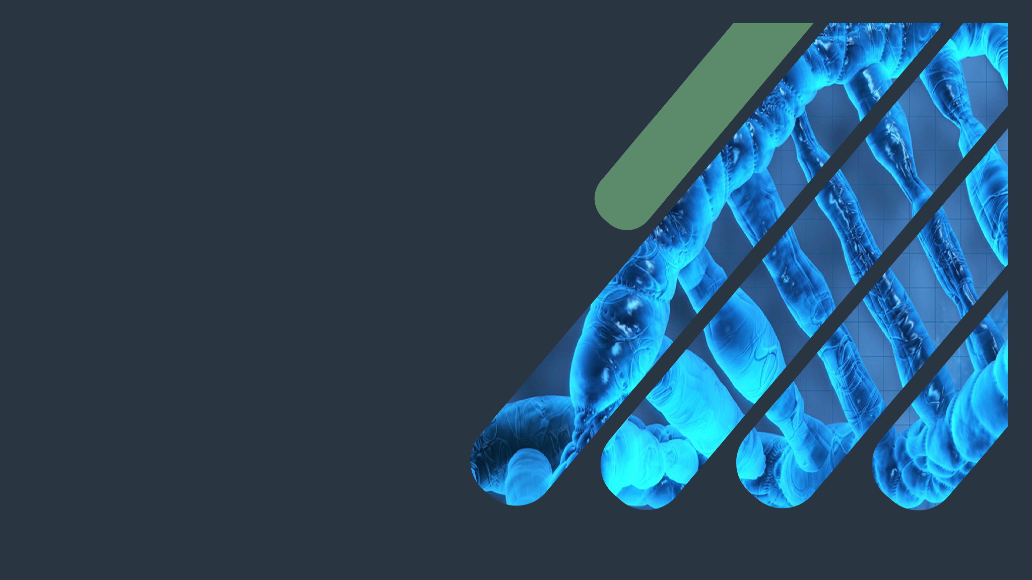
Biochemistry
Electron Transport Chain (Respiratory Chain)
Your patient is someone's mom\ someone’s wife \ someone’s best friend.
Please study hard ..
Important.
Extra Information.
Doctors slides

Slide 2
OBJECTIVES:
By the end of this lecture the students will be able to:
Understand how energy-rich molecules including glucose are metabolized by a series of oxidation-reduction reactions ultimately yielding CO2 and water.
Explain the process of electron transport chain that releases free energy, which is used for ATP synthesis and heat production.
Recognize the reactions of electron transport chain taking place in mitochondria that are coupled to oxidative phosphorylation.

Slide 3
Electron Transport Chain (ETC)
Recall:
1-The ETC happens after krebs cycle.
2-Most of the ATP is synthesized by this process.
3-Proteins transport the electrons.
4- Respiratory chain \ ETC \ cellular respiration are the same
Another difinition of ETC that Dr.Sumbul mentioned:
It’s a process which involves the transfer of electrons to create a proton gradient because it’s the proton gradient that is responsible of generation of ATP not the ETC directly
A system of electron transport that uses respiratory O₂ to finally produce ATP (energy)
Located in the inner mitochondrial membrane
Final common pathway of metabolism
Electrons from food metabolism are transported to O₂
Uses maximum amount of body’s oxygen
Which is the purpose of ETC
Everything is metabolized into simple molecules CO2\H2O
Such as: Carbohydrates, fat and protenis

Slide 4
Metabolic breakdown of energy yielding molecules
From
The Food
Reduced co-enzymes which are energy rich molecules, transfer their electrons to molecule and during this process they generate energy.
MITOCHONDRIA
Cristae increase the surface area
Excess energy generates heat
Electrons (e⁻) lose their free energy
Mt= mitochondrial

Slide 5
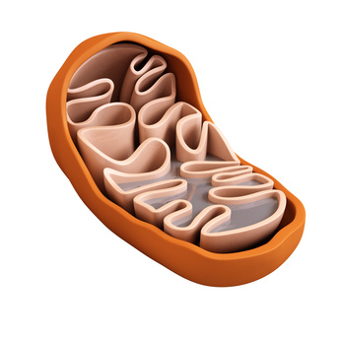
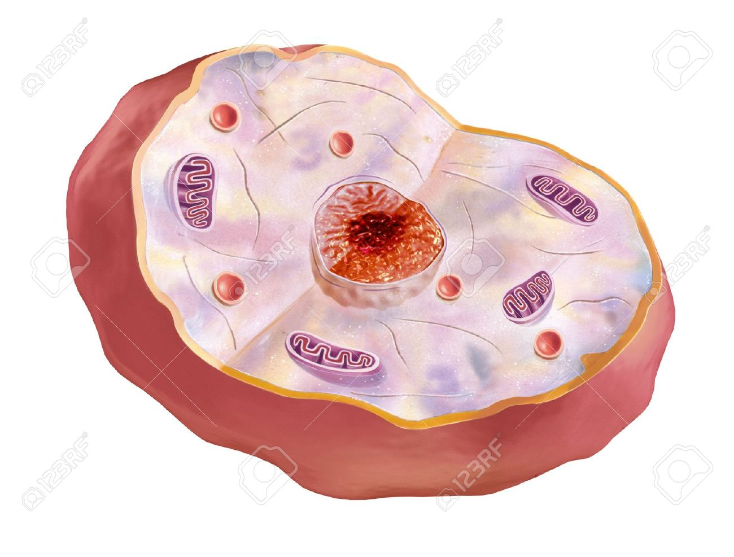
Mitochondrion
You remember all these information from the foundation block, aren’t you GENUIS ?!!
Inner membrane:
Impermeable to most ions, small and large molecules .folded to increase the surface area.
Cristae:
Increase surface area .
Matrix:
~TCA cycle enzymes.
~Fatty acid oxidation enzymes.
~MtDNA, mtRNA.
~Mitochondrial ribosomes.
*ATP synthesising structure
(ATP synthase) is found in the inner membrane.
Kk
5

Slide 6
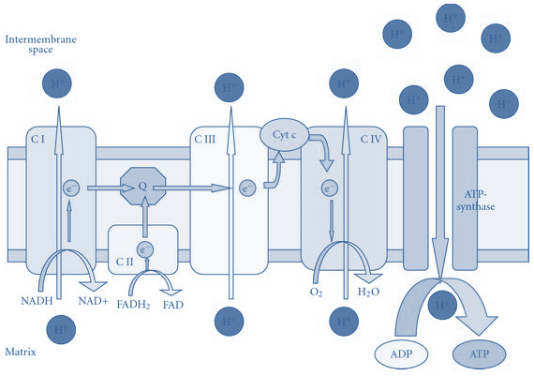
Components of ETC
All components are located in the inner mitochondrial membrane(IMM)
IMM contains 5 complexes: (protein complexes)
Complex I, II, III, IV. (part of ETC)
Complex V (ATP synthase: catalyzes ATP synthesis). Participates in oxidative phosphorylation it is not a part of ETC
Mobile electron carriers: they can move
CoQ.
Cytochrome C.

Slide 7
Organization of ETC
Each complex accepts (reduced) or donates (oxidized)
electrons to mobile carriers
Carriers
accept electrons from donors and then donate to the next carrier in chain
Electrons finally combine with oxygen and protons to form water
We pump the electron seminreniously from the inner mitochondria
Oxygen is required as a final acceptor (respiratory chain)
Remember:
Oxidation is losing H (electrons).
- Reduction is giving H (electrons).

Slide 8
Complex I - NADH Dehydrogenase: collects the pair of electrons from NADH and passes them to CoQ
Note : it is proton pump
Complex I I -Succinate dehydrogenase:
-It is also a part of the krebs cycle. -Transfers electrons to CoQ.
Note: it's not proton pump
COENZYME Q (COQ) :
Also called ubiquinone (because it is ubiquitous in biological system ) .
A non-protein member of the ETC (electron transport chain) it’s the only one which is non protein
Lipid soluble and mobile (moving)

Slide 9
Cytochromes
cytochrome is:
When cytochromes accept electron
Fe³⁺ (ferric) is converted to Fe²⁺ (ferrous)
Fe²⁺ is reoxidized to Fe³⁺ when it donates lost electrons to the next carrier
Remember .. ! In Cytochromes: Heme group = porphyrin ring + iron in Fe3+ (Ferric) In HB: Heme group = porphyrin ring + iron in Fe2+ (Ferrous)
protein
Which contains
Heme group
That composed of
porphyrin ring + iron in Fe³⁺ state
Complex III and IV
Complex III: Cytochrome bc1
Complex IV: Cytochrome a + a3
Electrons flow from:
CoQ → Complex III → Cyt. c → Complex IV

Slide 10
Site-specific inhibitors of ETC
They are compounds that prevent the passage of electrons by binding to a component of the chain, blocking the oxidation reduction reaction
The inhibitors are :
Rotenone | AntimycinA | Cyanide
اضافة الى
CN, CO , H2S and NaN3
ETC is coupled to proton transport for ATP synthesis
The energy of electron transfer is used to drive the protons out of the matrix (that will increase proton concentration between the membranes of mitochondria )
It is done by complexes I, III and IV (proton pumps)
This creates a proton gradient across the IMM to synthesize ATP. (the mitochondria uses the concentration gradient force of proton which will synthesis the ATP when the proton influx in ATP synthase)
Oxidative phosphorylation: production of free radicals

Slide 11
Transport of protons:
Simultaneously protons are pumped from the matrix to the inner part of the membrane so you have lots of hydrogenised in the IMM which has to come back inside.
Every proton enters will rotate F0 which will cause conformational change in F1 subunit.
So when 4 electrons come inside they lead to the production of 1 ATP molecule

Slide 12
Energetics of ATP synthesis :
• The energy required for phosphorylation of ADP to ATP = 7.3kcal/mol
• Energy produced from the transport of a pair of electrons from
NADH to O2 = 52.58 kcal
• No. of ATP molecules produced is 3 (NADH to O2)
• Excess energy is used for other reactions or released as heat
*Excess energy is used for other reactions or released as heat.
P:O ratio :
• ATP made per O atom reduced
–For NADH
• P:O = 3:1 ” 3 ATP are made per oxygen atom reduced”
–For FADH2
• P:O = 2:1 “2 ATP are made per oxygen atom reduced”
ATP synthase
ATP synthase (Complex V) synthesizes ATP
Consists of two domains:
F0 – membrane spanning domain
F1 – extramembranous domain
ندى اقوى من فهد عشان كذا تكون
اكثر منهATP

Slide 13
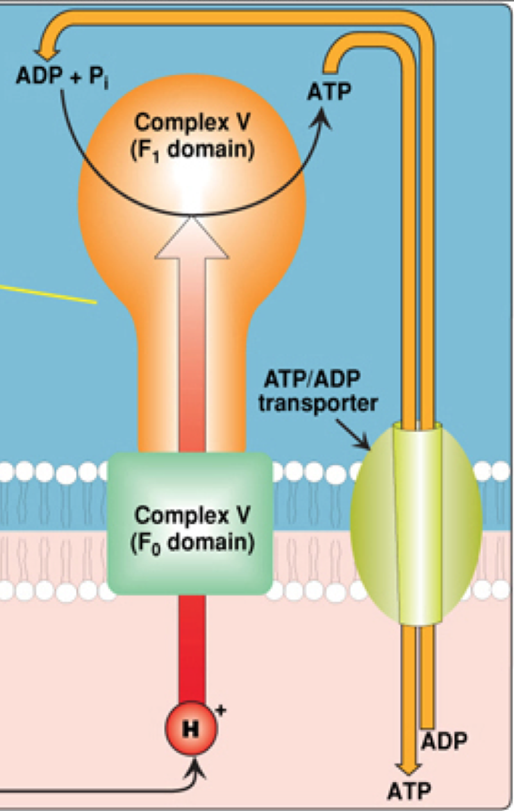
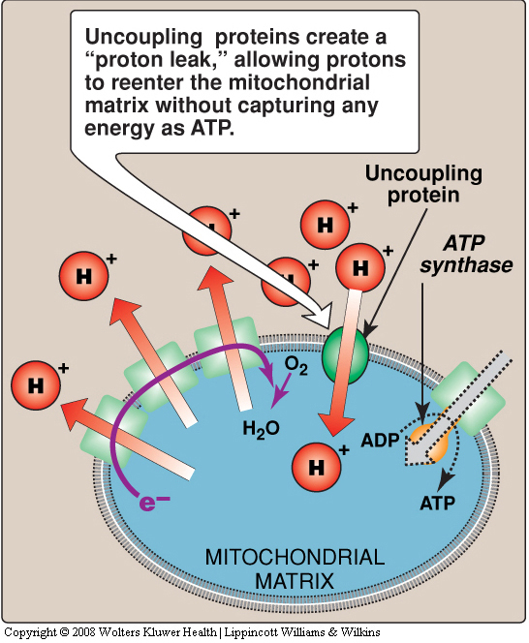
Inhibitors of ATP synthesis :
• Oligomycin : – Binds to F0 domain of ATP synthase and closes the
H+ channel • Uncoupling proteins (UCPs) :
– Create proton leaks (allow protons to reenter the matrix without ATP synthesis)
– Energy is released as heat (non-shivering thermogenesis)
Pottasium channel:
When it’s closed no proton comes back into the matrix so no twisting on F0 subunit and no conformational change in F1 so no ATP synthesis
Non shivering thermogenesis: is present in brown fat which’s present in animals and newborn babies and it looks brown because it has a lot of mitochondria
Oligomycin

Slide 14
Quick summary of the concept ☺
(Extra slide)
Organization of ETC
Components of ETC
Each complex accepts or donates electrons to mobile carriers
Carriers accept electrons from donors and then donate to the next carrier in chain
Electrons finally combine with oxygen and protons to form water
Oxygen is required as a final acceptor (respiratory chain)
All members/components are located in the inner mitochondrial membrane (IMM).
IMM contains 5 complexes:
Energy-rich molecules (like glucose are metabolized by a series of oxidation reactions ultimately yielding Co2 and water.
The intermediates of these reactions donate electrons to form energy-rich reduces forms (NADH and FADH2)
The reduced enzymes donate a pair of electrons to special set of electron carriers called “the electron transport chain”
1- Electron transport chain of the mitochondrion: it’s in the inner membrane of mitochondria
2- Components (with the exceptions of co-enzyme Q, which is a lipid-soluble quinone, all members of the chain are proteins)
3- organization of the electronic transport chain
Phosphorylation of ADP to ATP:
1- Proton Pump (done by complexes I, III and IV)
2- ATP synthase (Complex V)
1
Complex I, II, III, IV (part of ETC)
Complex V (ATP synthase: catalyzes ATP synthesis)
Mobile electron carriers
-Co-enzyme Q (CoQ) -Cytochrome c
2
3
4

Slide 15
Quiz
SAQ
https://www.onlineexambuilder.com/etc-saq/exam-131861
MCQ’s:
https://www.onlineexambuilder.com/electron-transport-chain/exam-131853
https://www.onlineexambuilder.com/etc-extra/exam-131862
Both are important ..
Helpful video
https://www.youtube.com/watch?v=xbJ0nbzt5Kw

Slide 16
TEAM
MEMBERS
مهند الزهراني
طلال الطخيم
فهد العتيبي
عبدالعزيز الصومالي
سعود الشنيفي
صالح التويجري
حمد الحسون
محمد العسيري
نورة الشبيب
TEAM LEADERS
محمد المطلق
رانيا العيسى

Slide 17
Review the notes
https://www.youtube.com/watch?v=xbJ0nbzt5Kw
THANK YOU
PLEASE CONTACT US IF YOU HAVE ANY ISSUE
Lippincott's Illustrated Reviews: Biochemistry, 6th E
@436Biochemteam
Biochemistryteam436@gmail.com

