Slide 1
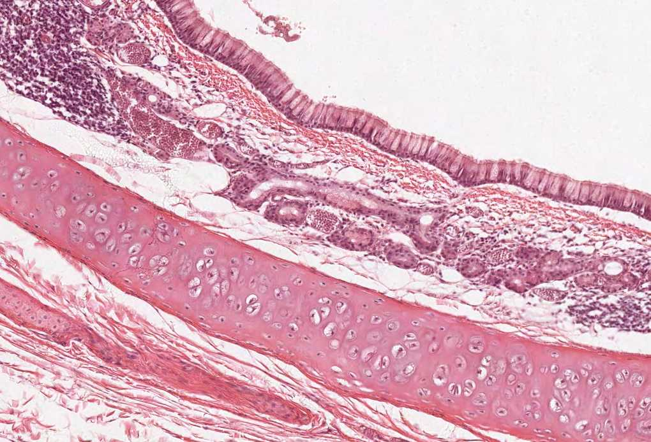

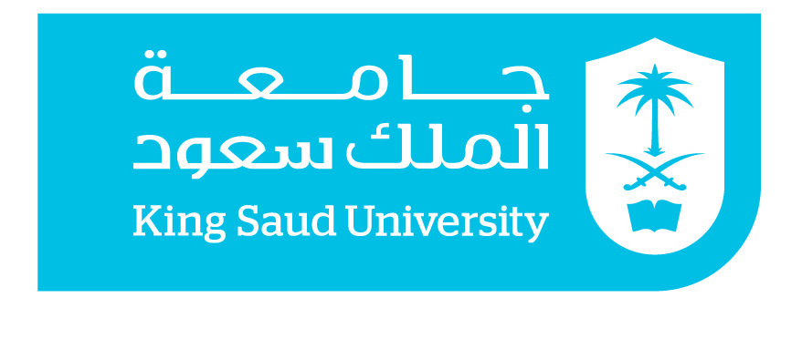
Histology of the Upper Respiratory Tract
(Nasal cavity, Paranasal sinuses and Larynx)
Color index:
Slides.. Important ..Notes ..Extra..

Slide 2
Objectives :
By the end of this lecture the student should be able to describe the microscopic structures of:
Vestibule of the nasal cavity.
Respiratory mucosa of the nasal cavity.
Nasal septum.
Olfactory mucosa of the nasal cavity.
Mucosa of the paranasal sinuses.
Larynx.

Slide 3
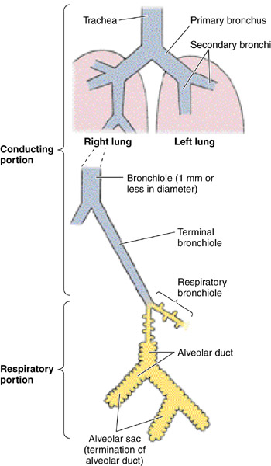
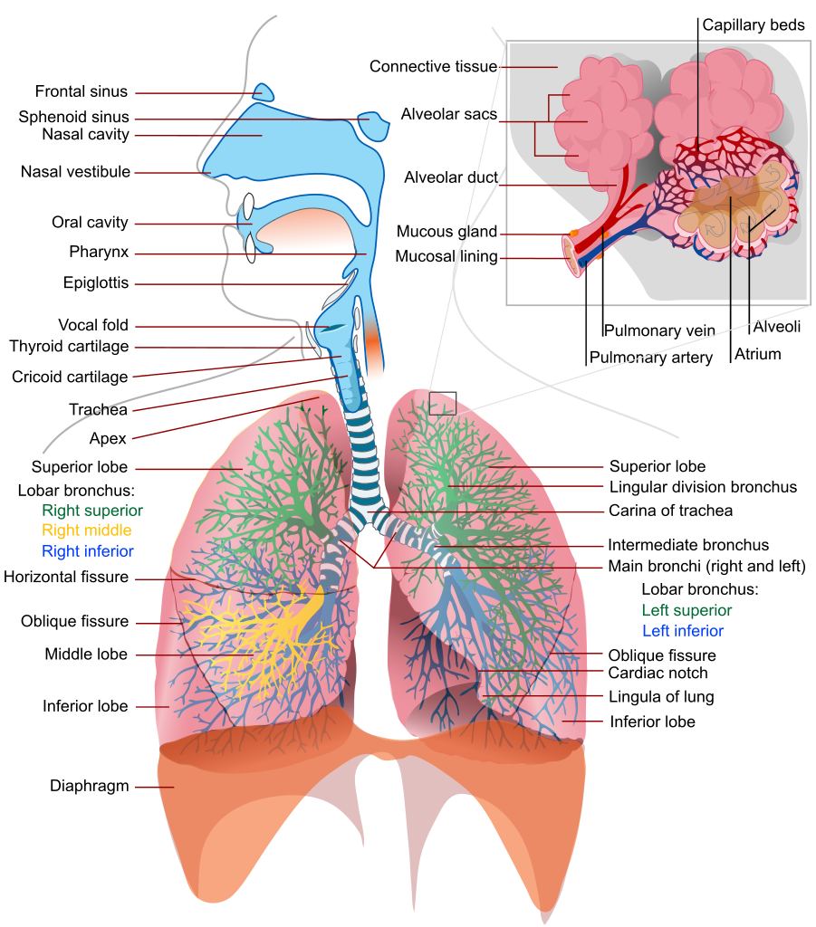
RESPIRATORY SYSTEM
A- Conducting portion :
Nasal cavity.
Nasopharynx.
Larynx.
Trachea.
Primary bronchi (extrapulmonary bronchi).
Intrapulmonary bronchi:
  - 2ry bronchi (lobar bronchi).
  - 3ry bronchi (segmental bronchi).
Primary bronchioles (preterminal bronchioles).
Terminal bronchioles.
B- Respiratory portion:
Respiratory bronchioles.
Alveolar ducts .
Alveolar sacs.
Pulmonary alveoli
Alveolar ducts are tiny ducts that connect the respiratory bronchioles to alveolar sacs

Slide 4
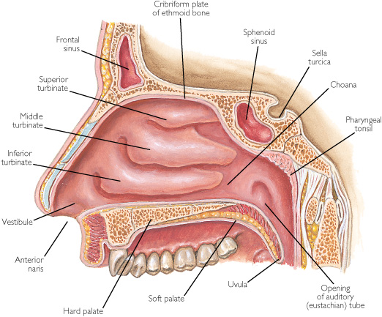
NASAL CAVITY
Anterior portion of N.C
Vestibule
Posterior portion of N.C
Respiratory region
Olfactory region
VESTIBULE OF N.C
is lined with thin skin.
1- Epidermis: (Keratinized stratified Squamous epithelium).
2- Dermis.
Lining
1- Vibrissae: stiff hairs.
2- Sebaceous glands. غدد دهنية
3- Sweat glands.
Contents
N.B. The nasal septum (made from cartilage + spongey bone) divides the nasal cavity into two halves (right and left).
Wall
1- Hyaline cartilage.
2- Cancellous (spongy) bone..
Olfactory region is found in the roof of the nasal cavity and the upper part of nasal septum and it is abundant in water secretory vesicles in order to dissolve the odor producing chemicals

Slide 5
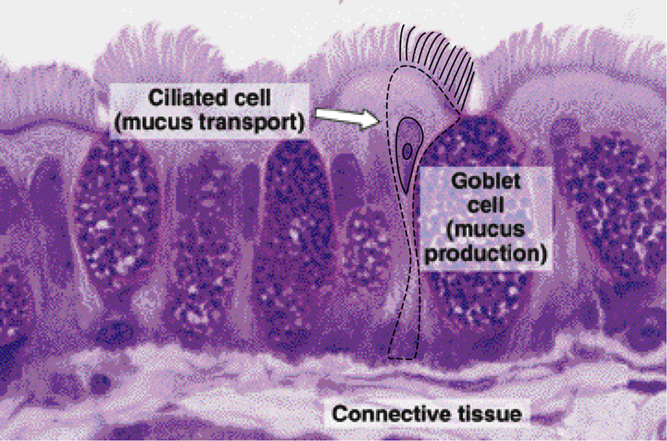
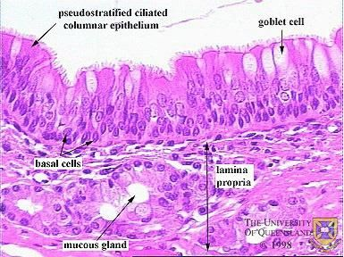
RESPIRATORY REGION (Area) OF NASAL CAVITY MUCOSA (mucous membrane)
The respiratory area of the nasal cavity is made up of two components:
Mucous membrane = epithelium + lamina propria (vascularized connective tissue layer)
A) Epithelium:
Pseudo-stratified ciliated columnar epithelium with goblet cells (Respiratory epithelium). begins in the posterior nasal cavity
Respiratory Epithelium
Is made of pseudo-stratified ciliated columnar epithelium with goblet cells.
This epithelium consists of multiple types of cells mainly : (all touch basement membrane)
  Ciliated columnar cells. Short and tall but only the ones that reach surface are ciliated
  Goblet cells .
  Basal cells (stem cells).
  DNES cells e.g. Serotonin
Functions :
it serves to moisten and protect the airways. It also functions as a barrier to potential pathogens and foreign particles, preventing infection and tissue injury by the action of mucociliary clearance.
B) Lamina propria ( Sub-epithelial C.T.):
  contains:
  1- Large arterial plexuses & venous sinuses (Highly vascularized C.T.)
  3- Many seromucous glands (acini). Watery secretions
  4- Abundant lymphoid elements:
    Including occasional lymphoid nodules , plasma cells & mast cells.

Slide 6
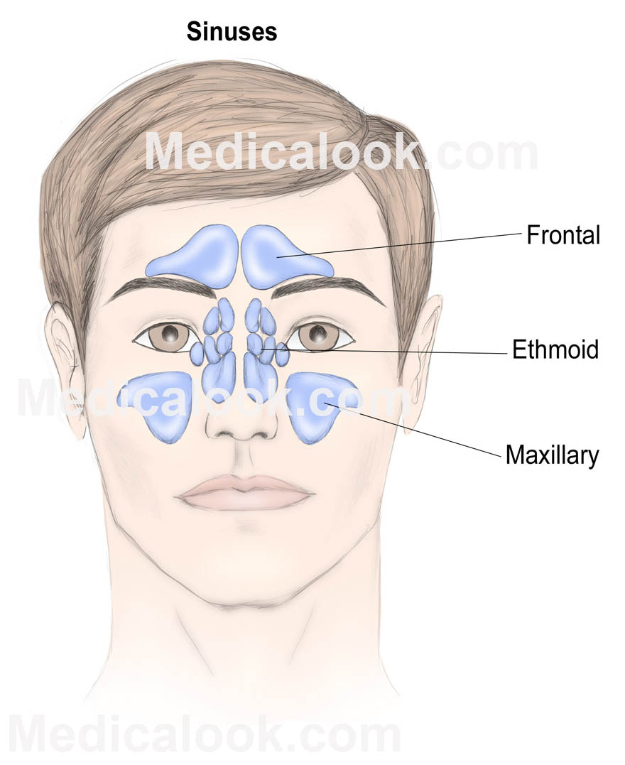
PARANASAL SINUSES
Lining:
  1- Respiratory epithelium . (Pseudo-stratified ciliated columnar epithelium with goblet cells )
  2- Lamina propria.
CLINICAL APPLICATION:
Sinusitis.
Sinusitis is characterized by inflammation of the lining of the paranasal sinuses. Because the nasal mucosa is simultaneously involved and because sinusitis rarely occurs without concurrent rhinitis, rhinosinusitis is now the preferred term for this condition.

Slide 7
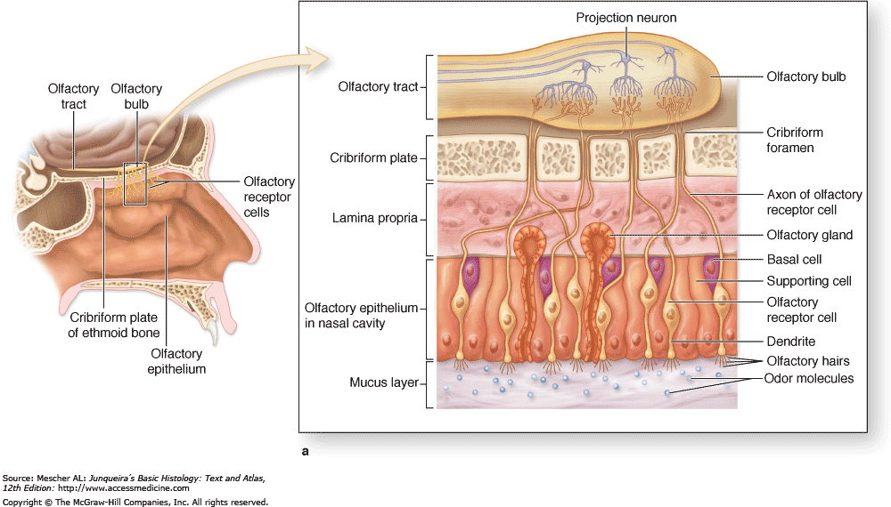
OLFACTORY region of nasal cavity
Olfactory Mucosa is made up of two components :
1)OLFACTORY EPITHELIUM:
  Pseudo-stratified columnar epithelium. (no goblet cells!)
  Olfactory cells (olfactory nerve cells)
  Sustentacular (supporting) cells.
  Basal cells: Pyramidal in shape, basal in position and act as stem cells. (neurons cannot divide due to lack of centrioles thus it needs stem cells for annual renewal)
2)LAMINA PROPRIA:
Highly vascular loose to dense C.T. Contains:
  Bowman’s glands (olfactory glands): serous acini.
  Bundles of unmyelinated nerve fibers.
  axons of olfactory nerve cells + Schwann-like cells (glial cells).
  Rich vascular plexus.
  Numerous lymphoid elements
pure serous , no mucus secretion
OLFACTORY CELLS
Are bipolar neurons
Dendrite has olfactory vesicle that has nonmotile cilia. Sterocilia
Axons are unmyelinated with Schwann-like cells.
Axons will collect in the lamina propria to form bundles of nerve fibers. Bundles will collect to form the olfactory nerve
SUSTENTACULAR (SUPPORTING) CELLS
are columnar cells.
Function:
Physical support and nourishment (metabolic) for olfactory cells.
Site of olfactory region:
1)Roof of nasal cavity.
2)Upper part of nasal septum.
3)over superior concha.

Slide 8
Larynx
-Mucosa (Mucous membrane) | Epithelium (2 types): |  | Lamina Propria
 | 1.Respiratory Epithelium (Pseudostratified Ciliated Columnar Epithelium With Goblet Cells). | 2.Non Keratinized Stratified Squamous Epithelium Found In: Vocal Folds (Cords) And Superior Surface Of epiglottis.
-Cartilages | Elastic cartilages e.g. Epiglottis |  | Hyaline cartilages e.g. Thyroid cartilage
-Extrinsic and intrinsic muscles | All Are Skeletal
-Ligaments
Vestibular Folds "Are Immovable" | Vocal Folds (Cords)
Epithelium: Respiratory epithelium | Epithelium : Non keratinized stratified squamous epithelium
Lamina propria: Loose C.T. With seromucous glands Lymphoid elements Adipose cells | Lamina propria : C.T. containing bundles of elastic fibers and skeletal muscle . NO Lymphoid nodules - NO Seromucous glands
There are 2 pairs of Shelf-like Mucosal Folds in larynx.

Slide 9
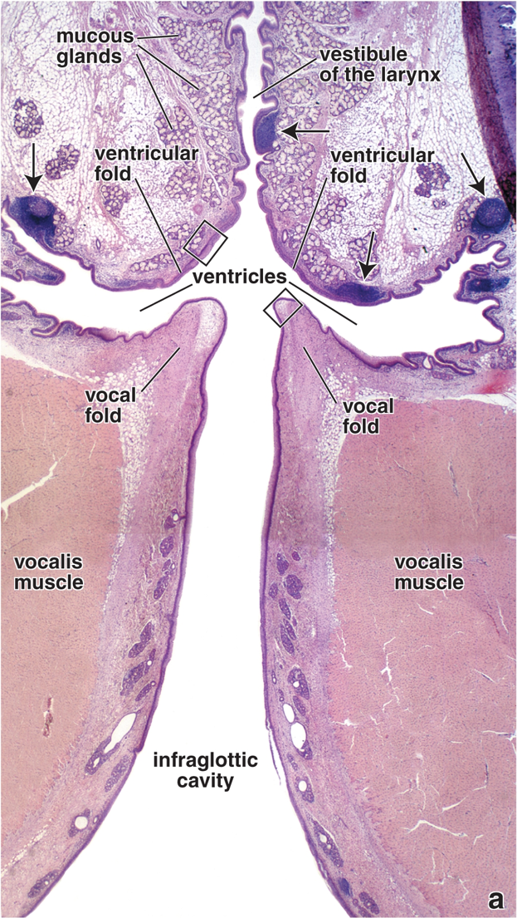
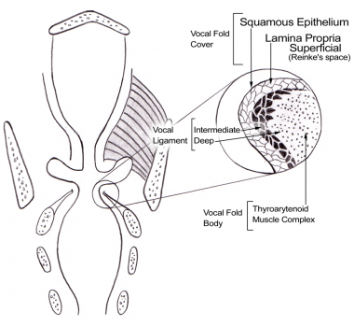
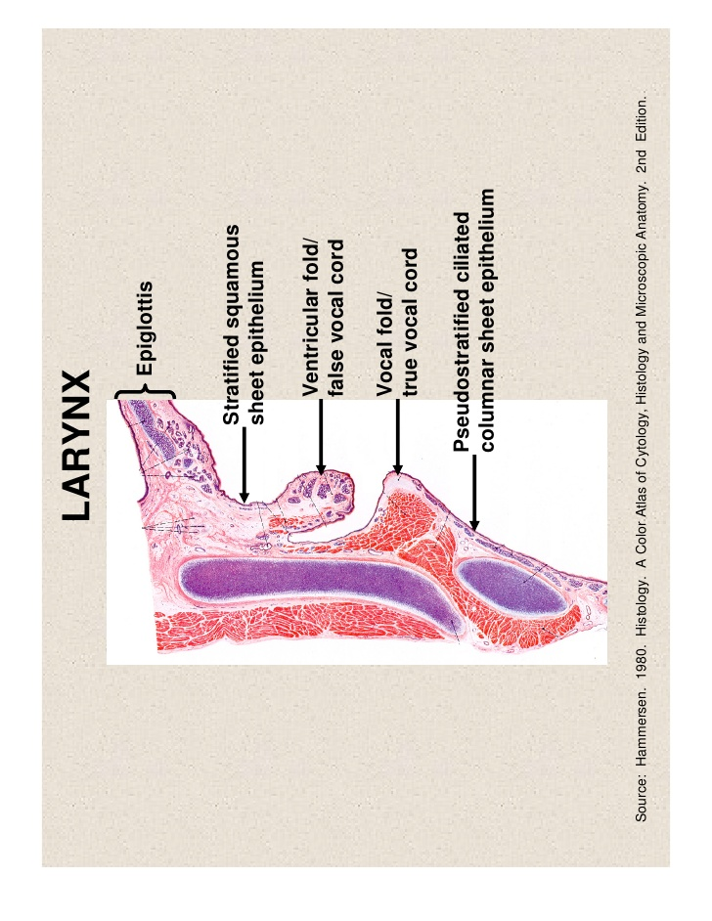
Pictures for further understanding

Slide 10
Still confused ? Please read this .
Ok so as you all should know by now the respiratory system is divided into 2 zones 1)Conducting 2) respiratory , each of them are composed of several organ or parts that serve their function . In this lecture we talked about the nasal cavity and larynx which are both part of the conducting zone , meaning that their function is to pass or transport air to the lungs acting as passages .
The nasal cavity
  the nasal cavity has 2 main functions smelling (olfactory) and as passage ways for cleaning and humidifying air (respiratory)so it is further divided to 2 regions 1) olfactory region 2) respiratory region . Both these are composed of different mucosa to serve their function , put in mind that all mucosa consists of two parts (epithelium + lamina propria).
  Both these regions exist in the posterior portion on nasal cavity (remember nasal cavity is primarily divided to anterior and posterior portions ) . Olfactory region is present in the upper part of posterior portion of the nasal cavity , while respiratory region is present in the back of this portion .
Olfactory region
  Epithelium : 4 types of cells ( no cilia but is has cilia like dendrites from olfactory cells) . No goblet cells .
  Lamina propria : doesn't have any mucus glands but it has bowman’s gland that secrete water like fluids.
Respiratory region
  Epithelium : multiple types of cells . Goblet cells are present . Special cells : DNES are present .
  Lamina propria : seromucous glands the secrete watery mucous .
  What are the difference between bowman’s gland and seromucous glands ?
  Bowman gland has water (serum) like secretion .
  Seromucos gland’s secretion is between water and mucous consistency ( thicker than bowman’s ) (not completely mucus nor completely watery )
Larynx
Why does the superior part of epiglottis (in contact with esophagus)have stratified epithelium and not pesudostratified ?
Imagine eating something hot and you accidently burn the first layer of epithelium ? If it were to be pseudostartifed (one layer ) than food will directly contact the vascular tissue beneath the epithelium causing you to bleed in seconds . That is why its is composed of stratified epithelium (multiple layers) so it can protect the vascular layer beneath
Same goes for the vocal cords incase of edema or swelling the vocal cords may contact the false cords causing friction which will damage the epithelium causing the person to bleed . That is why it is covered with stratified epithelium

Slide 11
Mind Map
Special thanks to Norah AlShabib

Slide 12
Links to help you !
Videos :
Nasal cavity and larynx :
https://www.youtube.com/watch?v=bkSZUHsG1No&t=57s
Full playlist for respiratory system :
https://www.youtube.com/watch?v=23_aHo4X2Vs&list=PLEf8wmJpS_1HmywDPF1Ve0zRhWfHCHCOy
FULL MIND MAP

Slide 13

MCQ :
6- The olfactory epithelium contain all of these except
A- sustentacular cell
B- basal cell
C- bowman’s gland
D- olfactory cell
7- Pyramidal in shape and act as stem cell
A- sustentacular cell
B- basal cell
C- goblet cell
D- olfactory cell
8- axons of olfactory nerve cells are unmyelinated
A- T B- F
9- vocal folds contain all of these except
A- elastic fibers
B- skeletal muscles
C- lymphoid nodules
D- lamina propria
1- Respiratory bronchioles are part of both respiratory and conducting portion
A- T B- F
2- The epithelium of the vocal cord is
A- Pseudo-stratified ciliated columnar epithelium with goblet cells
B- Pseudo-stratified non-ciliated columnar epithelium without goblet cells
C- Keratinized stratified Squamous epithelium
D- non- Keratinized stratified Squamous epithelium
3- Epiglottis made of
A- hyaline cartilage
B- elastic cartilage
C- fibrocartilage
4- Vestibule lined by respiratory epithelium
A- T B- F
5- The lining of paranasal sinuses is
A- respiratory epithelium
B- both Pseudo-stratified ciliated columnar epithelium with goblet cells
& skin
C- endothelium same as vessels
1- B
2- D
3- B
4- B
5- A
6- C
7- B
8- A
9- C

Slide 14


Thank you & good luck
- Histology team
Done by :
We’am Babaier
Rema Albarrak
Amal Al Qarni
Shahad Alanzan
Team leaders:
Reema Alotaibi
Faisal Alrabaii
Please if you need anything or even further explanation contact us on :
HistologyTeam436@gmail.com
@histology436

