Slide 1
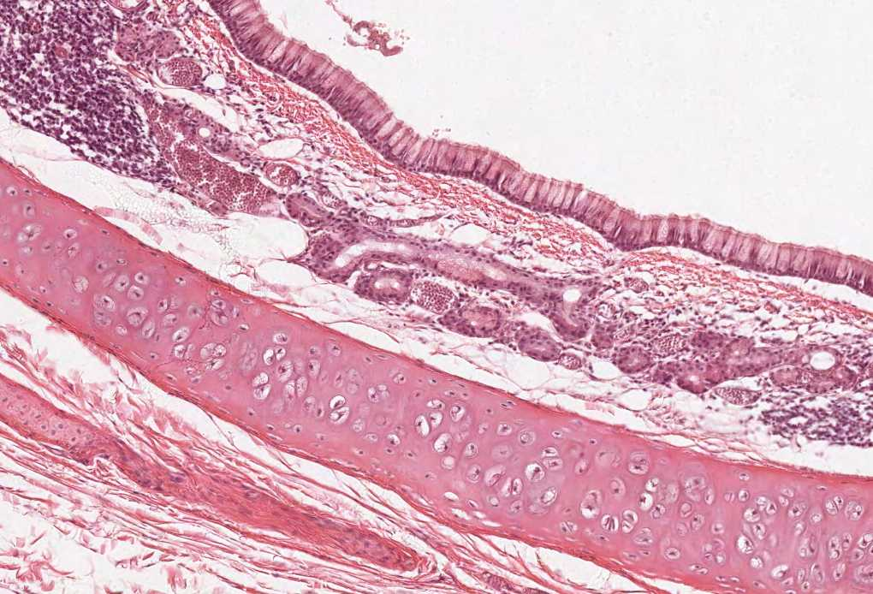



Histology of the Lower Respiratory Tract
(Trachea, Bronchi, Bronchioles) & the Lung
Color index:
Slides.. Important ..Notes ..Extra..

Slide 2
Objectives :
The microscopic structures of the wall of:
    Trachea.
    Primary or extrapulmonary bronchi.
    Intrapulmonary (secondary and tertiary) bronchi.
    Bronchioles
    The microscopic structures of :
    Interalveolar septum.
    Alveolar phagocytes.
    Pleura.

Slide 3
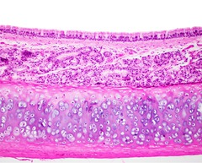
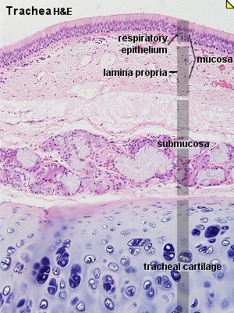
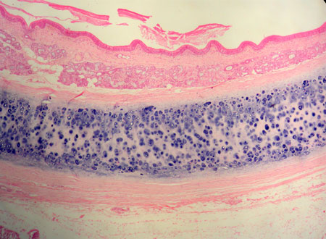
The wall of trachea is formed of
Mucosa
Submucosa
Adventitia*
Epithelium: Respiratory epithelium
Lamina Propria
Elastic Lamina ( membrane)
C.T
Numerous Mucous and seromucous glands
Lymphoid elements
(cells)
Fibroelastic C.T
C-shaped rings (12-16) of hyaline cartilage (incomplete)
Trachealis muscle (bundle of smooth muscle fibers ) connects the 2 ends of each C-shaped (incomplete) rings of cartilage
TRACHEA
* Adventitia is the outermost fibroblastic connective tissue+cartilage covering of an organ, vessel, or other structure
The mucosa (MAINLY) composed of 2 things :
epithelium
Lamina propria (connective tissue)
The trachea is highly humidified because not only does the mucosa has glands but also the submucosa leading to a high humidity
In the trachea the elastic fibers is so dense and form a membrane , this membrane separates the lamina propria form the submucosa.
Note : you MUST differentiate between the elastic cartilage and elastic fibers !

Slide 4
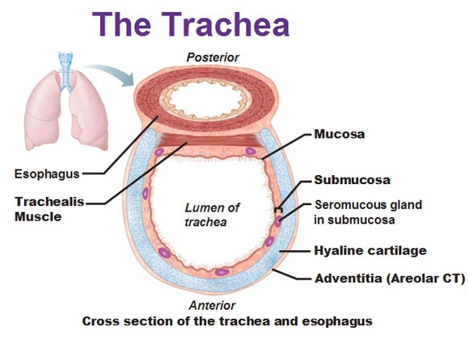
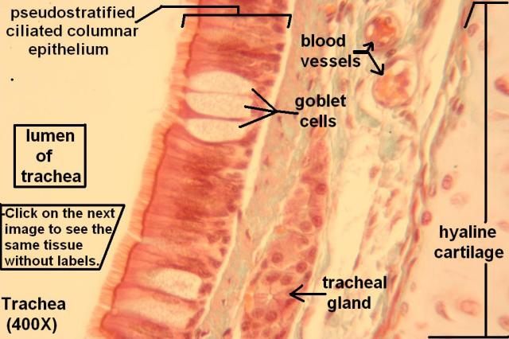
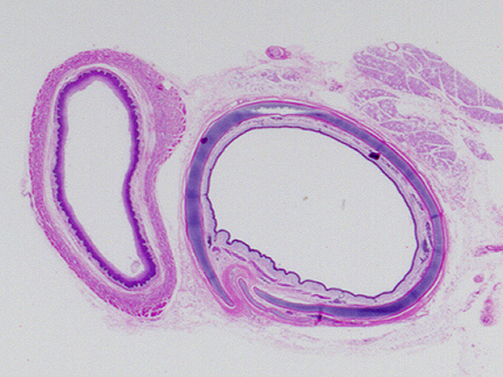
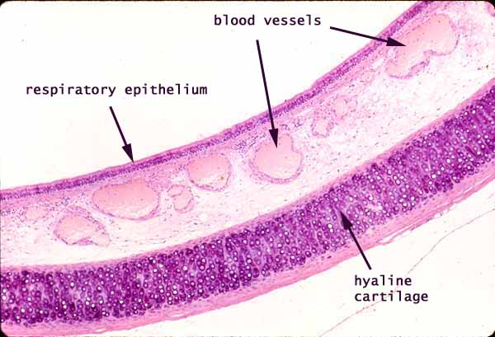
Pictures of the different layers of mucosa
As you can see here the trachealis muscle enclosed the c-shaped hayline cartilage
C-shaped cartilage
The elastic lamina is not visible because it needs a special stain

Slide 5
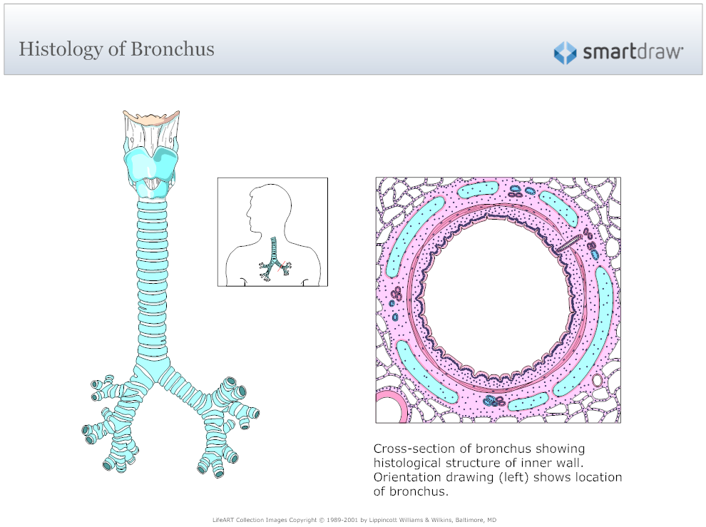
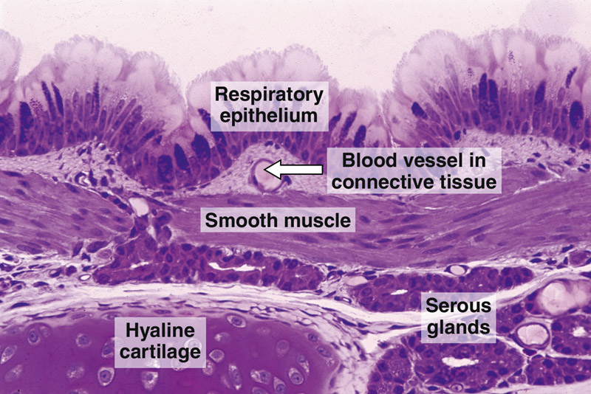
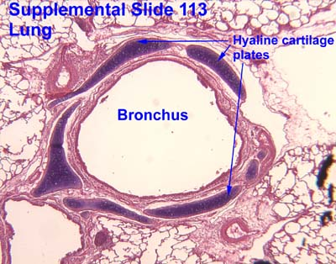
BRONCHI
1-EXTRAPULMONARY BRONCHUS(1ry BRONCHUS):
Generally have the same histological appearance as the trachea.
2-INTRAPULMONARY BRONCHI(2ry & 3ry BRONCHI):
1-Mucosa:
2-Muscle coat (complete)not like trachea:
Sub-mucosa:
Adventitia:
2 Layers:
A- Epithelium:
Respiratory epithelium
(pseudo-stratified Ciliated columnar
Epithelium with goblet cell).
B- Lamina propria.
(It’s narrow so it doesn’t contain
1- glands 2- lymphoid follicles.)
N.B. No elastic lamina.
Two distinct layers of smooth muscle fibers spirally arranged in opposite direction
(2 spiral shape crisscrossing layers one is clockwise and the other is anti-clockwise).
Note : all muscle after larynx are smooth muscles
ليش هذا الجزء من التفرع بدأ يصير فيه عضلات ؟ عشان الرئه تمدد ف يقوم تتمدد معها الشعب الهوائية
C.T. contains:
A- Seromucous glands.
B- Lymphoid elements.
Contents:
A- Loose C.T.
B- Irregular plates of hyaline cartilage (complete layer) hallmark .
C- Solitary lymphoid nodules.

Slide 6
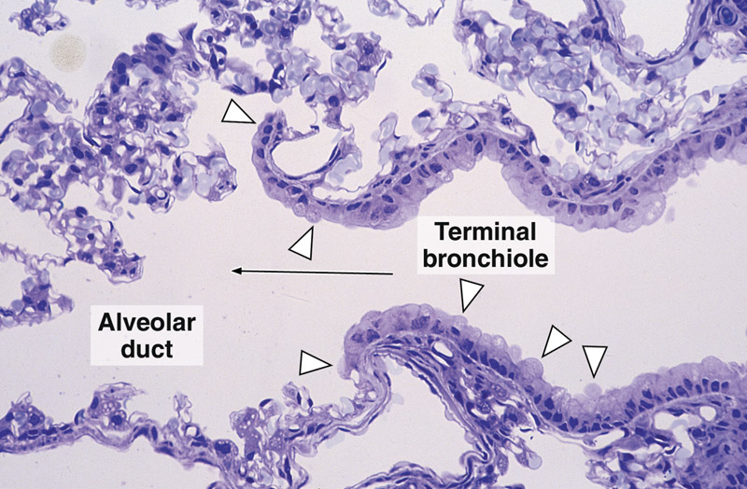
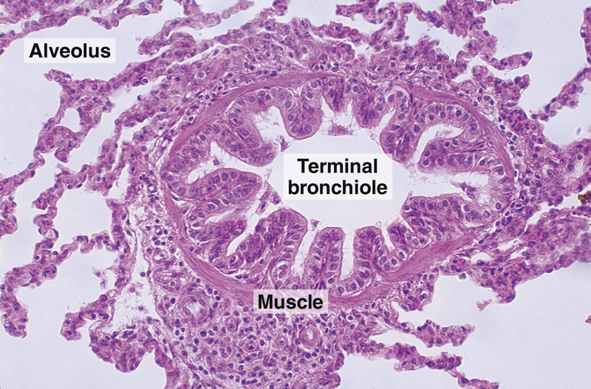
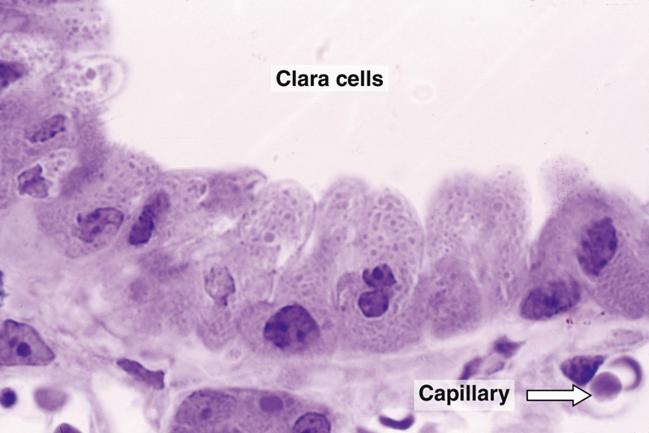
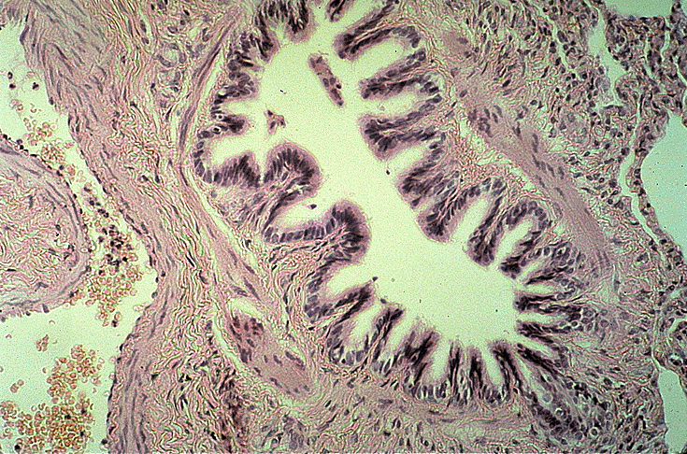
BRONCHIOLES (DOESN’T CONTAIN CARTILAGE)
Preterminal Bronchioles(1ry):
Respiratory Bronchioles(3ry):
Terminal Bronchioles(2ry):
less than 1mm in diameter.
Mucosa: (has longitudinal folds )
  A- Epithelium:
  Simple ciliated Columnar
  Epithelium with occasional goblet cells.
  (The doctor said usually you will not
  find goblet cells )
  B- Lamina propria :
  C.T. rich in elastic fibers.
  (although it’s rich in elastic fiber but
  there’s no membrane)
Muscle coat:
  2 helically arranged smooth muscle layers.
Adventitia:
  C.T.
  No cartilage at all, No
  seromucous glands, No lymph
  nodules.
Similar structure to terminal bronchioles, but:
their walls are interrupted by the presence of few pulmonary alveoli.
Why is the mucosa folded ? To give larger surface area for dilatation.
less than 0.5mm in diameter.
Similar structure to preterminal bronchioles,
but:
Epithelium:
Simple cuboidal partially ciliated epithelium
With Clara cells ( With NO goblet cells).
CLARA CELLS:
Structure:
columnar cells (non ciliated).
Function:
1- Degrade toxins in inhaled air. (immune cell like function)
2- Divide to regenerate the bronchiolar epithelium.
3- Produce surfactant-like material.
Location:
Terminal bronchioles and respiratory bronchioles.
*Important notes :
The Terminal Bronchioles are the last part of the conduction zone .
The Respiratory Bronchioles are the first part of the respiratory zone.
The main difference between the bronchioles and the bronchus is the absent of:
1- Cartilages 2- Seromucous glands 3- Lymph nodules
4- Goblet cells 5- Sub-mucosa

Slide 7
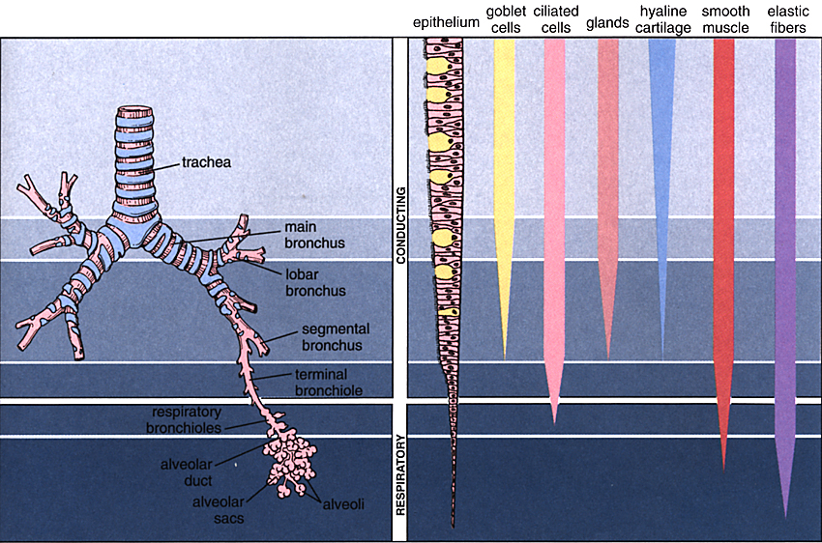
هنا يوضح لك كيف انه كل ما تعمقت و كلما زاد تفرع الشعب الهوائية تنقص عندك التراكيب و الاشياء الداخلة في تكوينها
EXTRA
Note-team435-: Special features of everyone of them: Pretermenal > Goblet cells
Terminal > NO goblet cells , Rispiratory > Alveoli
Bronchioles
Terminal bronchiole = end of conducting portion + end of goblet cells, Goblet cells are replaced by Clara cells

Slide 8
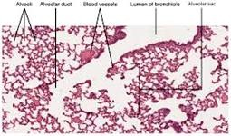
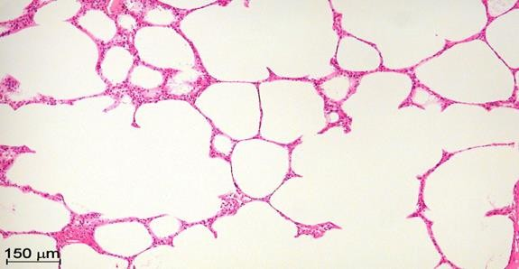
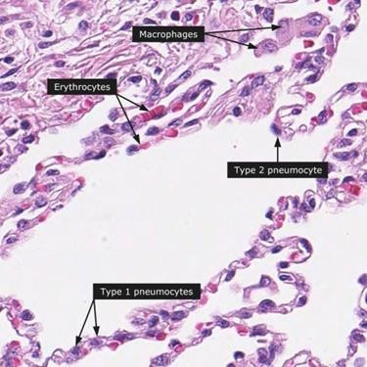
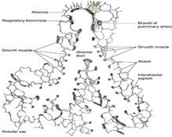
ALVEOLAR DUCTS
INTERALVEOLAR SEPTA
Definition:
The region between 2 adjacent alveoli.
the alveoli are like rooms and the septas are like the walls in between
PULMONARY ALVEOLI
The wall of alveolar ducts consist almost of pulmonary alveoli.
Definition:
They are small out-pouching of respiratory bronchioles, alveolar ducts & alveolar sacs.
Components:
Alveolar Epithelium:
lines both sides of interalveolar septum.
Interstitium.
PULMONARY ALVEOLI
Alveolar epithelium.
Interalveolar septa.
Alveolar phagocytes (Lung macrophages).
N.B. Alveolar duct → ends by: atrium →
communicates with: 2-3 alveolar sacs

Slide 9
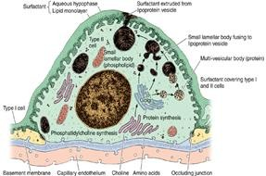
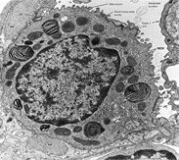

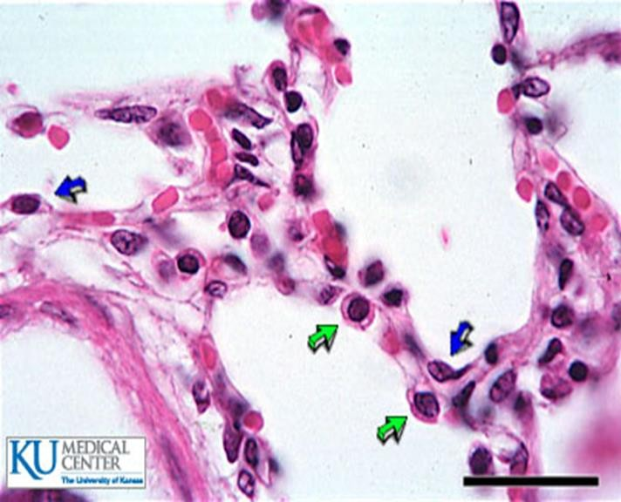
ALVEOLAR EPITHELIUM
Alveolar epithelium consist of two major cells :
Type I Pneumocytes
Type II Pneumocytes
Type I Pneumocytes
Type II Pneumocytes
Lining:
line 95% of the alveolar surface.
Line 5% of the alveolar surfaces.
Count:
less numerous than type II pneumocytes.
Are more numerous than type I pneumocytes.
simple squamous epithelium.
Are cuboidal or rounded cells, With Foamy cytoplasm.
Nucleus: central & rounded.
- The cytoplasm contains membrane- bound Lamellar bodies
(contain pulmonary surfactant).
The number of type I pneumocyte in alveolar epithelium is less then type 2 but its lining surface is greater , why ?
Simply because the epithelium of pneumocyte type 1 is SIMPLE SAQUAMOUS and since it’s SQUAMOUS it can fill the space with less number of cells ☺ .
L/M:
Exchange of gases.
1- Synthesis & secretion of pulmonary surfactant.
2- Renewal of alveolar epithelial cells )STEM CELL( :
Type II cells can divide to regenerate both type I & type II pneumocytes.
Function:

Slide 10
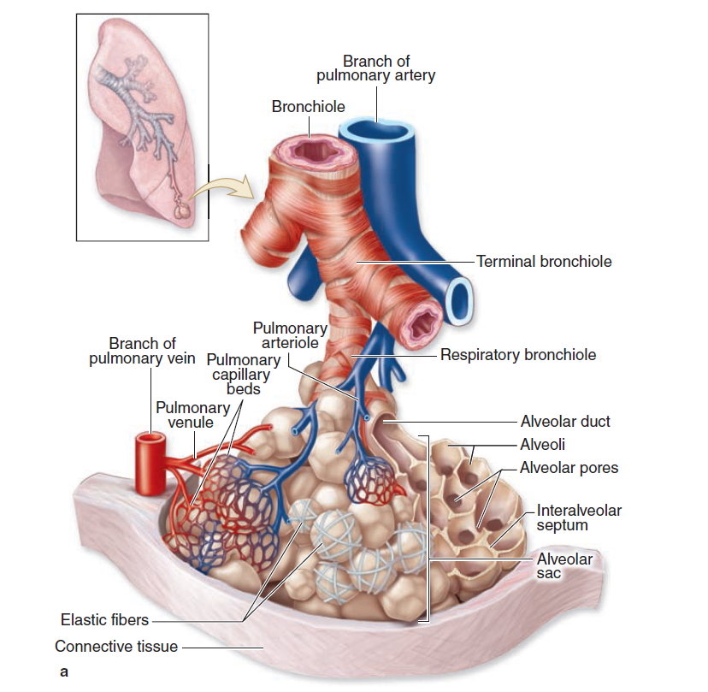
Interstitium of interalveolar septa
* Interstitium of interalveolar septa
Continuous Pulmonary Capillaries.
Interstitial C.T.
C.T. Fibers:
elastic fibers
type III collagen (reticular fibers).
C.T. Cells:
Fibroblasts
Macrophages
(Alveolar macrophage)
Mast cells
Lymphocytes

Slide 11
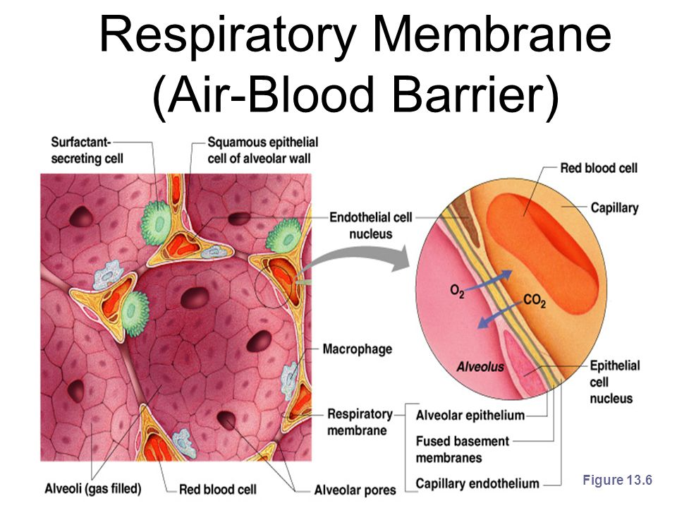
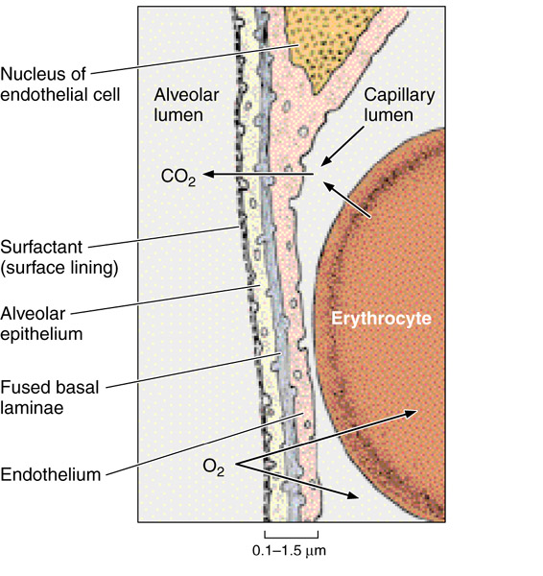
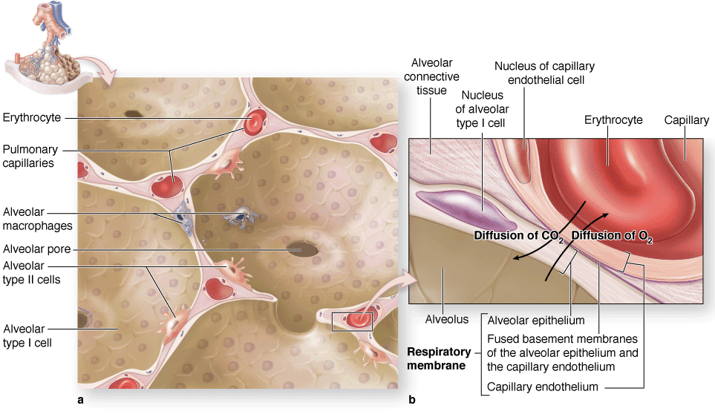
BLOOD-GAS BARRIER
(BLOOD-AIR BARRIER)
Alveolar phagocytes
(Alveolar Macrophages) (Dust Cells)
Definition: It is the region of the interalveolar septum that is traversed by O2 & CO2 .
Components:
1- Thin layer of surfactant. (from pneumocyte type II )
2- Type I pneumocyte . (Exchange of gases)
3- Fused basal laminae of type I pneumocytes &
endothelial cells of the pulmonary capillary.
4- Endothelial cells of the pulmonary capillary.
* The wall of blood capillaries is continues .
Sites:
1- In the lumen of pulmonary alveoli.
2- In the interstitium of interalveolar septa.
Function:
Phagocytose particulate matter (e.g. dust) & bacteria in the lumen of pulmonary alveoli and in the interstitium of interalveolar septa.
When the O2 molecules diffuse to the capillaries it they pass the following structures respectively :
surfactant ( surface lining )
Alveolar epithelium
Fuesed basel lamnie (base)
Endothelium

Slide 12
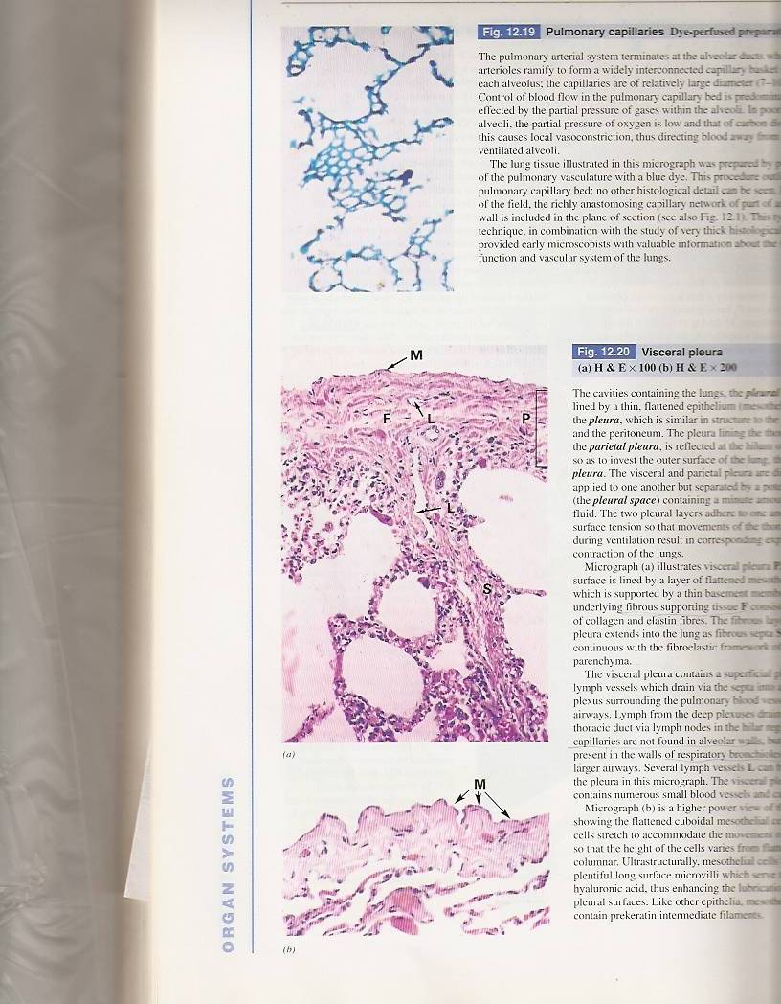
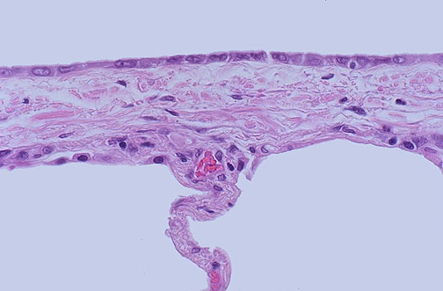
Pleura
Is formed of two layers:
1- Parietal and visceral.
2- It is formed of simple squamous mesothelium .
( Mesothelium is the epithelium of serous membranes e.g. Pleura )
3- The two layers are separated by serous fluid .
Visceral Layer :
has sub-epithelium loose C.T that extends into the lung tissue .

Slide 13
Mind Map
Thanks to our dear fellow student Norah Alshabib for sharing!
FULL MIND MAP

Slide 14
Conducting Portion Comparison
 | Trachea | Extra -pulmonary bronchi ( 1ry Bronchus ) | Intrapulmonary bronchi (2ry &3ry Bronchi) | Preterminal Bronchioles | Terminal Bronchioles
Mucosa | 1 - Respiratory epithelium 2- Lamina propria 3- Elastic Lamina |  | 1 - Respiratory Epithelium 2 - Lamina propria (No elastic lamina) | 1- Simple ciliated epithelium with occasional goblet cells 2- Lamina propria ( C.T. is rich in elsatic fibers) | Simple cuboidal partially ciliated epithelium With Clara cells (NO goblet cells). Lamina propria
Submucosa | 1 - C.T. 2 - Numerous mucous & seromuscous glands 3 - Lymphoid elements |  | C.T. contains: A- Seromucous glands B - Lymphoid elements | here there’s no submucosa , why ? Simply because the elastic fibres do not form a elastic lamina ( membrane ) and therefore ,there’ll be no submucosal layer .
Adventitia | 1 - Fibroelastic C.T. 2 - C -shaped rings of hayaline cartilage (incomplete rings of cartilage) |  | A-Loose C.T. Irregular plates of hyaline cartilage (complete layer). Solitary lymphoid nodules | No cartilage No seromucous glands No lymph nodes
Muscle coat | Only trachealis muscle to compete the C-shaped rings |  | (complete) | ---------------------------------------------------------------

Slide 15
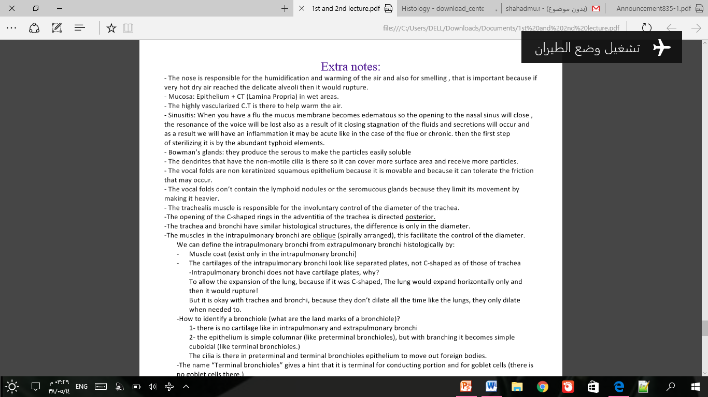
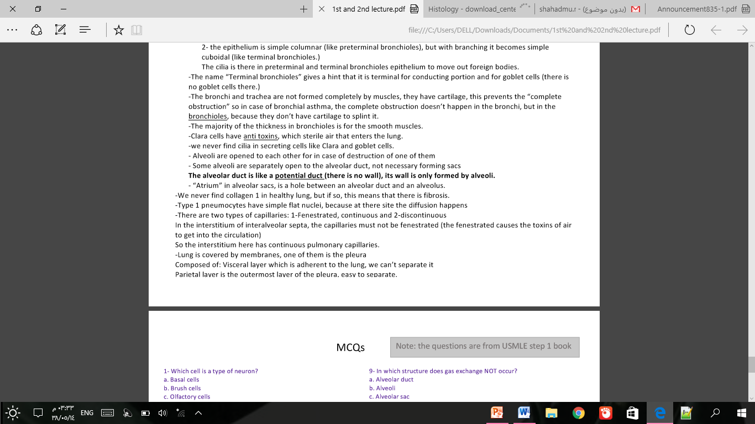
EXTRA NOTE –team435-
For the 1st & 2nd lectures

Slide 16
Links to help you !
Videos :
We recommend watching this 5min video:
https://www.youtube.com/watch?v=UDIgNteqVag
Full playlist for respiratory system :
https://www.youtube.com/watch?v=23_aHo4X2Vs&list=PLEf8wmJpS_1HmywDPF1Ve0zRhWfHCHCOy

Slide 17

MCQ :
1- which one of the following has an elastic lamina?
A-trachea
B-Intrapulmonay bronchi
C-preterminal bronchioles
D- Terminal bronchioles
2- the incomplete ring of hyaline cartilage in trachea completed by :
A-Trachealis muscle
B-Tendon
C- ligament
D-elastic cartilage
3- type of muscle coat found in intrapulmonary bronchus is :
A-cardiac muscle
B-smooth muscle
C- skeletal
D- All of them
4 -The preterminal bronchioles have no …
A-Mucosa ,cartilage and seromucous glands
B-lymph nodes, smooth muscle and cartilage
C-cartilage,seromucous gland and lymph nodes
5- which one of the following has clara cells?
A-trachea
B-extrapulmonary bronchi
C-terminal bronchioles
D-alveolar sacs
6- what is the type of epithelium found in both type I and II pneumocytes ?
A-simple columnar – simple squamous
B pseudo stratified columnar - simple squamous
C-Stratified squamous - simple cuboidal
D-simple squamous – simple cuboidal
7- which one of the following is responsible for the secretion and synthesis of pulmonary surfactant ?
A-type I pneumocytes
B-type II pneumocytes
C- alveolar ducts
D-trachea
1-A
2-A
3-B
4-C
5-C
6-D
7-B

Slide 18


Thank you & good luck
- Histology team
Done by :
Ahmed Badahdah
Mutasem Alhasani
Omar Turkistani
Nawaf Aldarweesh
Mohammed Khojah
Shahad Alanzan
Team leaders:
Reema Alotaibi
Faisal Alrabaii
Please if you need anything or even further explanation contact us on :
HistologyTeam436@gmail.com
@histology436

