Slide 1
Lecture :
Tuberculosis
important
Extra notes
Doctors notes
"لا حول ولا قوة إلا بالله العلي العظيم" وتقال هذه الجملة إذا دهم الإنسان أمر عظيم لا يستطيعه ، أو يصعب عليه القيام به .

Slide 2
Objectives:
Recognize that tuberculosis as a chronic disease mainly affecting the respiratory system.
Know the epidemiology of tuberculosis world wide and in the kingdom of Saudi Arabia
Understand the methods of transmission of tuberculosis and the people at risk.
Know the causative agents , their characteristic .classification and methods of detection. and staining methods .
Understand the pathogenesis of tuberculosis.
Differentiate between primary and secondary tuberculosis and the clinical features of each.
Understand the method of tuberculin skin test and result interpretation ..
Know the laboratory and radiological diagnostic methods.
Know the chemotherapeutic agents and other methods of management .
Describe the methods of prevention and control of tuberculosis.

Slide 3
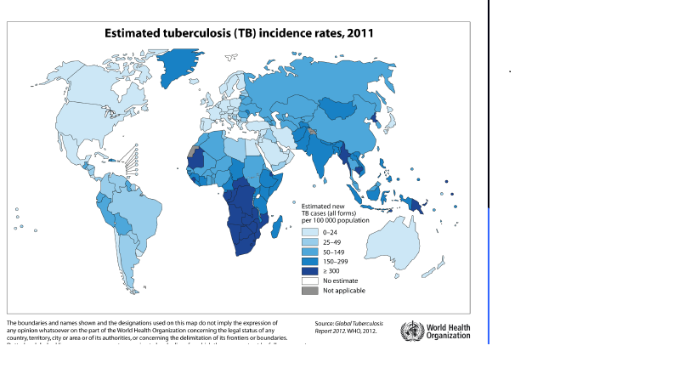
Introduction:
Tuberculosis (TB) is an ancient, chronic disease that affects humans lungs but also, other organs might be affected in one third of cases. If it is properly treated, Tuberculosis can be curable, on the other hand, it is fatal if untreated in most cases. So is a major cause of death worldwide. TB is typically caused by a Mycobacterium Tuberculosis complex* .
Epidemiology :
•Mycobacterium TB is especial Because: -need especial Stain = Ziehl-Neelsen , not gram stain -need esp Media = Lowenstein Jensen Media (very important) -don't grow fast
-can affect any part of body
TB affects 1/3 of human race ( 2 billions) as a latent dormant tuberculosis.
It affects all age groups who are subject to get the infection.
Incidence: a world wide disease , more common in developing countries.
The WHO* estimated 8.9 million new cases in 2004 & 2 - 4 million death.
in KSA: 1- 32-64 cases /100,000 (only in male’s slides)
2- 0-24 cases /100,000 population ( 2011 Data) (only in female’s slides)
in USA : 5.2 cases/100,000 (only in male’s slides)
in South Ease Africa : 290 cases /10,000 due to coupling with HIV infection. (only in male’s slides)
*كومبلكس: لأنها تحتوي على عدة مايكوبكتريا كلها تسبب السل -الإصابة بالبكتيريا لا تعني بالضرورة الإصابة بالمرض نفسه * World Health Organization

Slide 4
Epidemiology (transmission):
The closer people to the TB patient احتمالية اصابتهم أكبر من البعاد 10% of the exposed people become affected (symptomatic) while the rest may get the virus (but Asymptomatic
Transmission mainly through :
1- inhalation of airborne (ينقل بالجو)droplet nuclei ( < 5 μm) in pulmonary diseases case
2- rarely through GIT & skin
Reservoir: patients with open TB.
Age: young children & adults ( all age groups )
People at risk : -lab technicians, workers in mines, doctors ,nurses.
-HIV pts., diabetics , end stage renal failure, contacts with index case. (اللي عندهم ضعف في المناعة)
Characteristics of the Genus Mycobacteria :
Slim, rod shaped, non­-motile, not forming spores.
*Cannot be stained by Gram stain; Why? مهم
-Mycobacteria contain high concentration of Mycolic acid and other lipids in its cell wall that resist staining. It covers the peptidoglycan so the stain cannot reach it.
*It is called Acid­-alcohol fast bacilli (AFB) Why?
-Because it resists decolorization with up to 3 % HCL and/or 5 % ethanol.
Mycobacterium species appear tiny red bacilli, acid fast bacilli Stained by Zieh-Neelsen ( Z-N ) and Auramine staining
* That mean we can’t call them gram(+) or(-) we call them:Acid­-alcohol fast bacilli *احنا ممكن نصبغها بقرام بس مارح نستفيد لن تكون واضحة ابدا ويمكن تفهم خطأ فأفضل ما نستخدمها

Slide 5
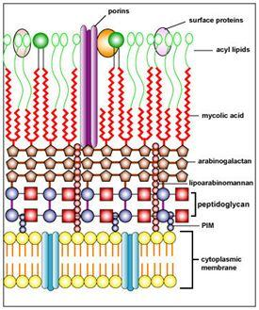
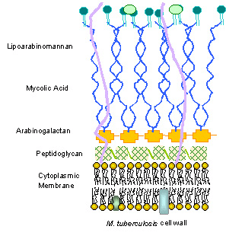
Mycobacteria contain high concentration of Mycolic acid and other lipids in its cell wall that resist staining. It covers the peptidoglycan so the stain cannot reach it.

Slide 6
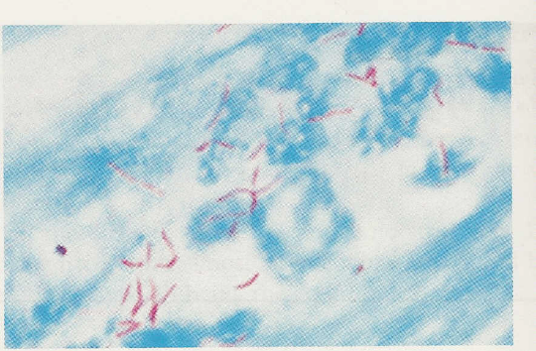
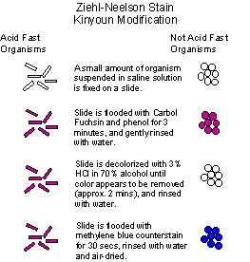
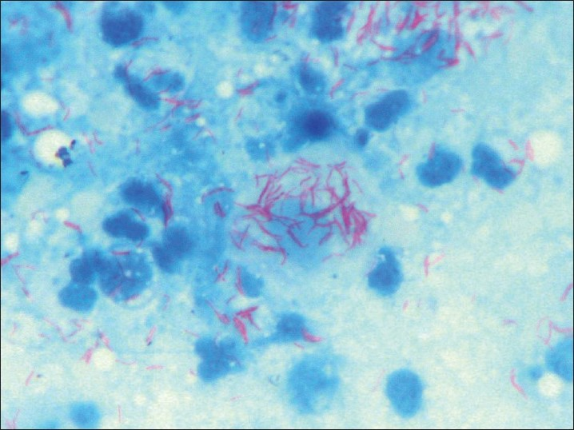
Just for your information :
*Mycobacterium species appear tiny red bacilli (AFB) by Z-N stain.
Z-N stained smear showing AFB
Not every AFB +ve mycobacterium But every mycobacterium is AFB +v
^blue background with Red bacteria = AFB +ve
دام الخلفية زرقاء فاحنا استخدمنا
AFB

Slide 7
Characteristics of Mycobacteria (cont.):
Acid Fast Bacilli (AFB) or mycobacteria :
Strict aerobe . بما انها أصلا تنمو في الرئة !
Multiply intracellularly. وهذا سبب بقاءها في الماكروفيجز لمدة طويلة وما يدري عنها الاميون سستم
Slowly growing (2­-8 weeks).
Causes delayed hypersensitivity reaction of immune response .
Mycobacterium tuberculosis complex :
There’re many Mycobacteria, but Mycobacterium tuberculosis are the most important since they cause TB. And they are:
1- Mycobacterium Tuberculosis (Human type. )
2- Mycobacterium Bovis (Bovine* type.) 3- Mycobacterium Africanum. 4- *BCG (Bacillus Calmette­ Guéri(اسم شخص)) strains. بكتيريا تسبب السل بس مضعفة فيستخدمونها كتطعيمه ضد السل، يعطونها ثاني يوم بعد الولادة وهي اللي تبقى علامتها:)
All are called Mycobacterium Tuberculosis Complex and cause Tuberculosis (TB).
*it is a vaccine used against TB but sometime can TB infection *=بقري Bovine

Slide 8
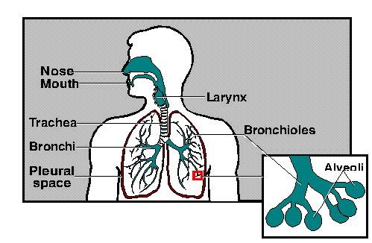
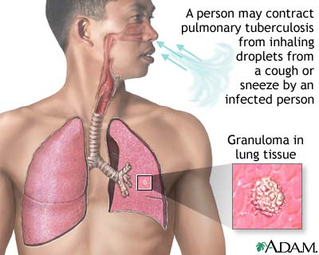
Pathogenesis of Tuberculosis :
Mycobacteria is acquired by airborne droplet that reaches the alveolar macrophages, and is able to survive their* ( main virulence factor).
This starts cell mediated immune response, which controls the multiplication of the organism but does not kill it.
There will be Granuloma formation .
The organism lives in dormant** state ( latent tuberculosis infection)
Patient show evidence of delayed cell mediated immunity ( CMI ), and this disease results due to destructive effect of CMI (immune response).
This Disease develop slowly and chronic.
Clinically, the disease is divided into
1-Primary TB (asymptomatic)
2-Secondary TB (symptomatic)
* من الخواص المميزة لهذه الباكتيريا **سبات Many things can cause granuloma! That’s why we need more test

Slide 9
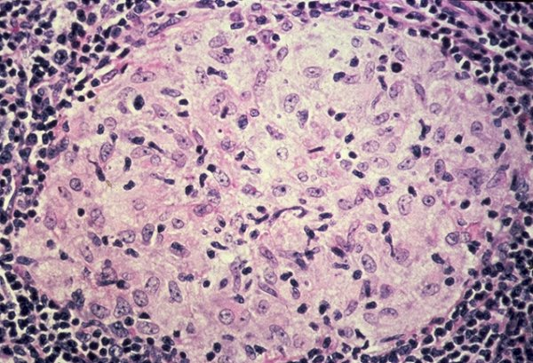
1-Primary Tuberculosis
(Occurs in patients not previously infected ) :
Inhalation of bacilli ➝ Phagocytosis ➝ lymph nodes calcify to produce GHON focus.
*GHON focus or “Primary Complex” occurs at the periphery of the mid zone of the lung.
Infection handled by host response.
In some people disseminate or remain viable for long period.تنتشر أو تبقى قابلة للحياة لفترة طويلة
Microscopy of the lesion shows Granuloma.
Clinically, primary TB is usually asymptomatic, or shows minor illness.لكنه لا يعدي اشخاص آخرين
Pathogenesis
Non-pulmonary TB:
may spreads from pulmonary infections to other organs eg.:
TB of lymph nodes (cervical, mesenteric).
TB meningitis
TB bone & joint
TB of the genitourinary system.
­ TB miliary (Blood and other organs.)
­ TB of soft tissue (cold abscess): lacks inflammation with Caseation
Other site beside the lung
Caseation: due to delayed hypersensitivity reaction. Contains many bacilli ,enzymes, O2,N2 intermediates, necrotic center of granuloma with cheesy material.
*it is complex of nodule in lung tissue and lymph nodes, caseous necrosis ,calcium deposit in fatty area of necrosis and it visible on x-ray

Slide 10
2- Secondary TB (reactivation): occurs sometimes at lifetime
Occurs later in life
Lung more common site
Secondary TB may be localized or spread to other organs
Immunocompromised patients.
Lesion localized in*apices (NOTE: in primary TB the GOHN focus occurs at periphery of the mid zone of the lung.)
Infectious & symptomatic يبدأ يصير معدي
Microscopy: many bacilli, large area of caseous necrosis ➝ cavity (open TB) with granuloma and caseation.
Clinically: fever, cough, hemoptysis ,weight loss & weakness.
^symptoms depends on the organ affected.
Source of secondary TB :
-Endogenous (re-activation of an old TB)
or
Exogenous (re-infection in a previously sensitized patient who has previous infection with the organism).
*because in the apices there is more oxygen

Slide 11
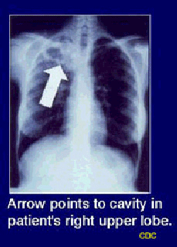
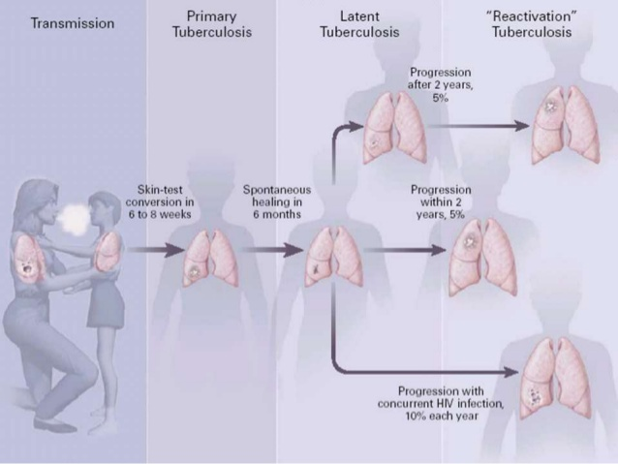
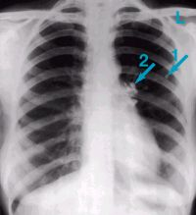
Secondary TB
لما نشوف اشعة اكس فيها كافيتيشن أول شيء نسويه ... عزل
Primary TB
Stages of Tuberculosis
GHON focus

Slide 12
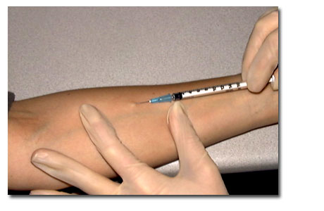
Immunology of Tuberculosis
Type of Immunity against TB: Cell-mediated immunity associated with delayed hypersensitivity reaction.
Detected by tuberculin skin test.
Tuberculin Skin Test:
Tuberculin test* takes 2-10 weeks to react to tuberculin and becomes positive.
Uses purified protein derivative (PPD).
Activity expressed by Tuberculin unit.
Activates synthesized lymphocytes to produce CMI which appear as skin induration(تيبس).
May not distinguish between active and past infection except in an individual with recent contact with infected case.
Low level activity induced by environmental mycobacteria, previous vaccination.يعني ممكن التست يكون بوزيتف لكن المرض غير موجود ، شلون ؟ بسبب انه طعم من قبل او مايكو بكتيريا أخرى سببت التفاعل . بس طبعاً درجة انه بوزيتف قليلة
*This test may be +ve even if you dont have TB because other mycobacterium Interact or (تكون المايكوبيكتيريوم بيوبركلوزز موجودة بس ما سببت المرض)

Slide 13
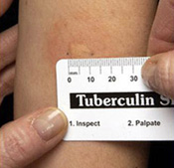
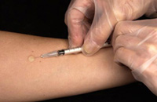
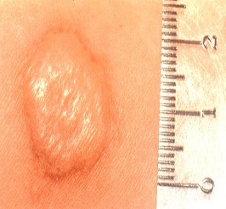
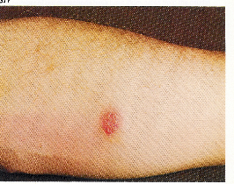
Methods of Tuberculin Skin Test:
Intradermal inoculation of 0.1 ml of PPD, 5TU. (TU= Tuberculin unit)
Read after 48-72hrs.
Methods of tuberculin skin test : 1- Mantoux test. 2- Heaf test (screening).معد يستخدم☺
Positive Tuberculin Skin Test: | Negative Tuberculin Skin Test: No induration, due to:
A) > 5mm induration. positive in: - Recent contact with active TB. - HIV or high risk for HIV - Chest X-ray consistent with healed TB. | - Previous infection. - Pre-hypersensitivity stage. - Lost TB sensitivity with loss of antigen. - AIDS patients are not anergic and not susceptible to infection.
B) > 10mm induration. positive in: IV drugs user, HIV seronegative patient. Medical conditions: diabetes, malignancy. Residents & employees at high risk Patients from countries with high incidence. Children less than 4 years old. Children exposed to adult high risk group. Mycobacteriology lab personnel.
C) >15 mm indurati.on. positive in: Any person, including those with no risk factors for TB.
- إذا حقناه وجت النتيجة تيبس بمقدار 15 مم أو أكثر فنقول أن النتيجة بوزيتف مهما كان هذا الشخص وانه مصاب بالسل
- لكن لو كانت النتيجة بعد الحقن تيبس بمقدار 10مم أو أكثر(بس أقل من15) فهي بوزيتف في احد من المذكورين في الجدول
- ونفس الشيء اذا كانت النتيجة 5مم أو أكثر(بس اقل من 10) نقول ان النتيجة للتست بوزيتف عند الأشخاص المذكورين في الجدول

Slide 14
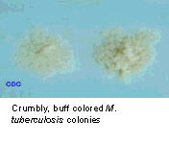
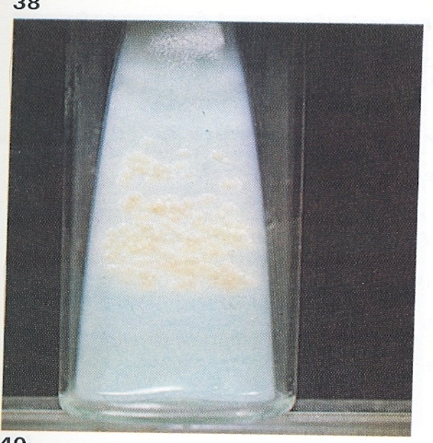
Laboratory Diagnosis of TB:
Important
1- Specimens(العينات): Samples should be repeated.
TB Pulmonary: 3 early morning sputum samples or (induced cough), or bronchial lavage, or gastric washing (in infants) in 3 consecutive days.
TB Meningitis: Cerebrospinal fluid ( CSF)
TB of the genitourinary system: 3 early morning urine
TB bone & joint :Bone, joint aspirate
TB of lymph nodes: Lymph nodes, pus or tissues, NOT swab (via aspiration) .
*repeat the sample if all -ve = get the patient out of isolation
2- Direct microscopy of specimen: Z-N or Auramine stain.
3- Culture: the gold standard test for identification and sensitivity.
The Media: Lowenstein-Jensen media (L J) مهم
This Media contains: eggs, asparagin, malachite green and glycerol or pyruvate .
Colonies appear in L J media after 2-8 weeks as: Eugenic, raised, buff, adherent.
Growth is enhanced by glycerol (MTB) or by pyruvate (M.bovis).
-ليه الصباح؟ لان الميوكس يكون متراكم بسبب عدم الكحة وقت النوم
*(when the tests done above are negative but the doctor still suspect that the patient has TB)
AFB smear (30% sensitive) Then culture (80% sensitive)

Slide 15
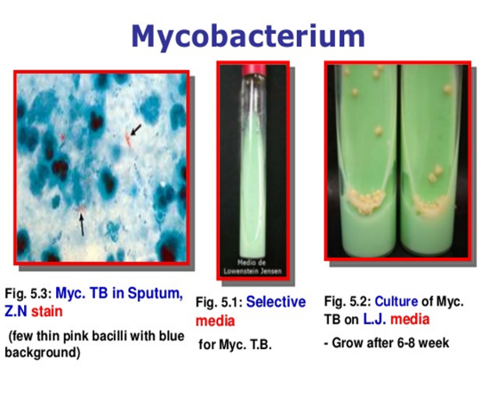
Laboratory Diagnosis of TB:
4- Other media PLUS LJ media that may be used:
fluid media ( middle brook) (Liquid=to grow faster) (where as JL is solid)
MGIT (mycobacteria growth indicator test)
Automated methods: Bactec MGIT.
Interferon –gamma release assay: positive in latent TB, (Measurement of interferon –gamma ( IF-γ) secreted from sensitized lymphocytes challenged by the same mycobacterial proteins in a patient previously exposed to disease, will produce interferon gamma. Has a specific significance than tuberculin skin test)
Molecular method : eg.
1- ProbTech ;detects nucleic acid directly from respiratory samples.
2- Xpert MTB/RIF detect nucleic acid and resistance to rifampicin .
3- PCR (polymerase chain reaction) : molecular test directly from specimen (CSF). Only in male slides

Slide 16
Identification of TB:
Morphology: grows at 37C + 5 - 10 % CO2
*Biochemical tests: Niacin production & Nitrate test.
Sensitivity testing: to detect susceptibility / resistance to ant-TB drugs
Guinea pig inoculation: rarely done.
*to differentiate between Mycobacterium subtypes; using the z-n stain they all look the same but using this technique help us in differentiation as MT release Niacin & Nitrate
Management of a TB case:
Isolation for 10-14 days: لما نشوف اشعة اكس فيها كافيتيشن أول شيء نسويه ... عزل
For smear positive cases: > 1000 organisms/ml of sputum is considered infectious.
Triple regimen of therapy. Why?
To prevent resistant mutants.
To cover strains located at different sites of the lung.
To prevent relapse.
Treatment must be guided by sensitivity testing.

Slide 17
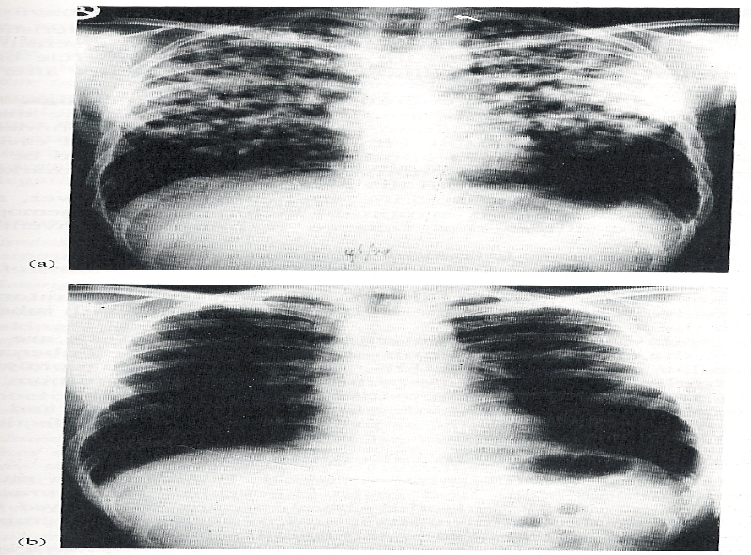
Treatment:
مهم
First Line Treatment: | Second Line Treatment:
- Isoniazide (INH) - Rifampicin (RIF) - Ethmbutol (E) - Pyrazinamide (P) -Streptomycin (S) INH + RIF + P (or E)+ S for 2 months then continue with INH+RIF for 4-6 months. Multidrug resistant TB is resistant to INH & RIF. - Directly Observed Therapy (DOT). (in non-compliance)اننا نروح للمريض في بيته ونعطيه الدواء ☺ | Used if the bacteria was resistant to first line drugs. More toxic than the first line drugs. - PASA (Para-Amino Salicylic acid) - Ethionamide - Cycloserine - Kanamycin - Fluroquiolones
Tuberculosis: (a) Chest X-ray of a patient with tuberculosis bronchopneumonia.
(b) Chest X-ray of the same patient 10 months after antituberculous therapy.

Slide 18
Prevention of TB:
- Tuberculin testing of herds.للناس اللي حول الشخص المصاب
- Slaughter (ذبح)of infected animals.
- Pasteurization of milk to prevent bovine TB.
- Recognition of new cases.
- Prophylaxis with INH of contacts.
- Follow up cases.
- Immunization with BCG to all new borne.

Slide 19
GOOD LUCK!
MICROBIOLOGY TEAM:
Waleed Aljamal (leader)
Ibraheem Aldeeri
Shrooq Alsomali and Ghadah Almazrou (leaders)
Rema Albarrak
Shatha Alghaihab
Rana Barasain
Ohoud Abdullah
lama Altamimi
The Editing File
We are waiting for your feedback
@microbio436
436microbiologyteam@gmail.com

