Slide 1
Lecture :
Upper Respiratory Tract Infection
(URTI)
important
Extra notes
Doctors notes
"لا حول ولا قوة إلا بالله العلي العظيم" وتقال هذه الجملة إذا دهم الإنسان أمر عظيم لا
يستطيعه ، أو يصعب عليه القيام به.

Slide 2
Objectives:
To learn the epidemiology and various clinical presentation of URT
To identify the common etiological agents causing these syndromes
To study the laboratory diagnosis of these syndromes
To determine the antibiotic of choice for treatment

Slide 3
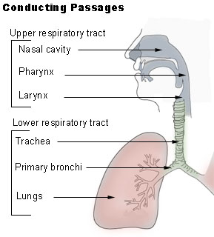
Overview of the lecture :
1- Pharyngitis
2- Diphtheria
3- Epiglottitis
4- Pertussis السعال الديكي
5- Acute otitis media
6- Sinusitis (acute – chronic)
7- Deep neck infection -read only
8- Other infections -read only

Slide 4
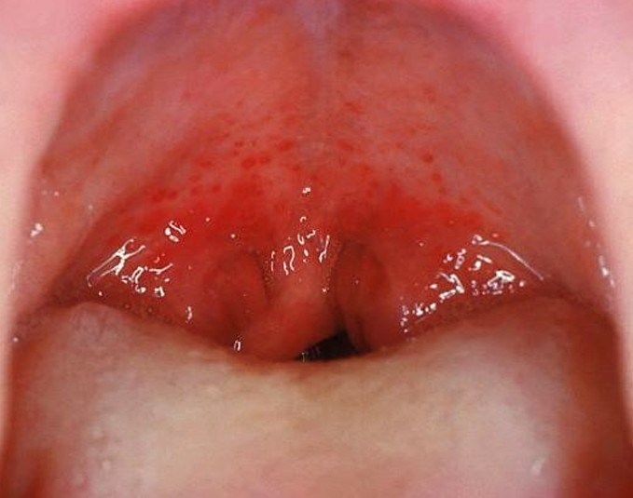
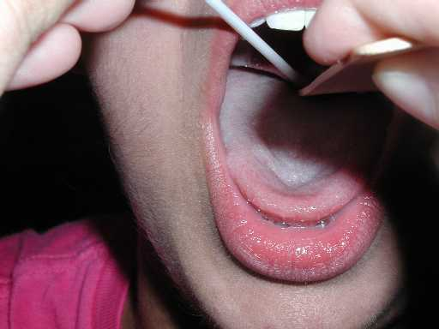
Pharyngitis:
Common in children (5-15)
Epidemiology
Occurs in late fall¹,winter and early spring
Erythema ²
Edema
Exudate³ (sometimes)
Signs & symptoms
Remember 4 E’s
Enlargement >1 cm and tender of lymph node
Fever 38.4 to 39.4ºC or even 40ºC.
+ Sore throat
No signs and symptoms of viral infections
¹: فصل الخريف
²: redness
³: Mass of cells and fluid that has seeped out of blood vessels or an organ which is filled with protients, especially in inflammation

Slide 5
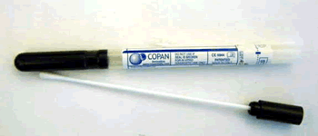
Pharyngitis:
swap is taken Nasopharyngeal
Viral infection (most common)
Respiratory viruses : Enterovirus, HSV, EBV, HIV
Etiology
Group A strept (also called pyrogen!)
Antistreptolysin O (ASO) ⁵
Group A streptococcus, diagnose by
Culture
Bacterial infection
Neisseria gonorrhoeae
Rapid Bacterial antigen detection.
Anaerobic bacteria (Causes Lemierre's syndrome⁴)
When it’s a bacteria infection : (fever + sore throat BUT NO runny nose (no upper symptoms)
​ Corynebacterium diphtheria (normal flora)
swap taken from throat except Corynebacterium diphtheriae from Nasopharyngeal!!! مهم
children more susceptible because they have large lymph nodes
⁴.: ​ A complication of a bacterial sore throat.
⁵: ​ A test that measures antibodies against streptolysin O.

Slide 6
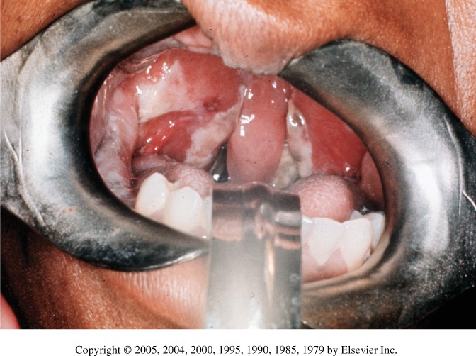
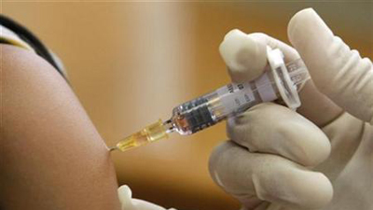
Diphtheria
*في آخر المحاضرة يوجد تشبيه لتسهيل حفظ المرض
common cause of ​death​ on ​non-vaccinated​ children​ 1-­5 years.
Epidemiology
Toxin mediated disease¹.
Rapid progression
Pathogenesis
Tightly adhering grey membrane in the throat²
difficulty breathing and swelling and cause suffocation and death ومن هنا جاءت التسمية ..مرض الخانقة
Etiology
Corynebacterium diphtheriae
Tinsdale medium ³
Diagnosis
ELIK’s ​Test⁴ for confirmation
Penicillin
Treatment
​Erythromycin if the child is allergic to Penicillin
¹: The bacteria will produce toxins move from throat and affect other organs usually heart and the peripheral nerves and sometimes the adrenal glands
²:symptoms : sore throat, difficulty in breathing, swallowing ,drooling ((سيلان of saliva.
The membrane can get bigger until it obstructs the airway causing suffocation(اختناق), death
³:Tinsdale Agar used to identify C. diphtheria
⁴:Test for ​toxigenicity​ of ​C. diphtheria

Slide 7
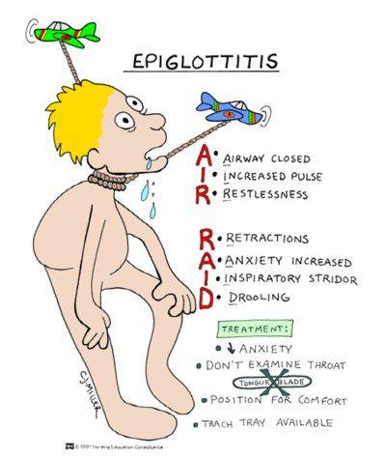
Epiglottitis:
Epidemiology | Affects young unimmunized children
Signs and symptoms | Usually presented with three D’s: 1-Dysphagia (difficulty or discomfort in swallowing) 2-Drooling (dropping saliva uncontrollably from the mouth) 3-distress (anxiety)
Etiology | Bacteria | Fungal | Viral
 | Haemophilus influenza Type b Streptococcus pneumoniae Staphylococcus aureus Beta hemolytic streptococcus | Candida
Treatment | Crftriaxone
normal can't see with X-ray
X-Ray = thumb sign مهم
Don't try examine airway by opening mouth --> suffocation and death! Instead diagnose with X-ray
throat swap
patient will be leaning forward, open mouth, difficulty swelling
Type B is encapsulated so it can invade the blood, we also used the capsule to develop the the vaccine against this bacteria.

Slide 8
Pertussis (whopping coughالسعال الديكي ):
Etiology :
Caused by Bordetella pertussis (gram –ve)
Pathogenesis:
the bacteria attaches to the cilia of the respiratory epithelium, then produce (pertussis toxin) that will cause inflammation to the respiratory tract and interferes with the pulmonary secretions, it also produce Filamentous hemagglutinin (FHA) and Pertacin (PRN), these products responsible for the clinical features.
Causes leukocytosis with lymphocyte predominance (it is the only bacterial infection that causes lymphocytosis in this lectuere)
Clinical Course
Incubation period 1 to 3 wks
Catarrhal Stage 1-2 weeks
Paroxysmal Stage 1-6 weeks
Convalescent Stage 3-6 weeks
Diagnosis:
nasopharyngeal swabs (NB), the swab is cultured in a special media called
Charcoal-horse blood T media (regan-lowe) – bordetella selectve media (bordet-gengou)
Treatment :
Erythromycin
Prevention :
By vaccination
*Hemagglutinin :Large, filamentous protein that gives attachment factor for adherence to host ciliated epithelial cells.
*pertactin: highly immunogenic virulence factor of Bordetella pertussis.
Children = cyanosis because they have small trachea and increased mucus
Adult = chronic cough
Thanks for 435 team

Slide 9
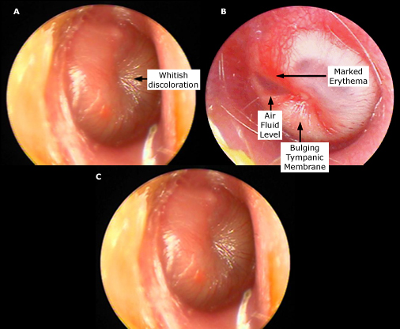
Acute otitis media:
Secondary bacterial infection
Etiology | Streptococcus pneumoniae. Haemophilus influenzae. Group A streptococcus (GAS ) Staphylococcus aureus.(S.aureus) Moraxella catarrhalis. | Viral and Fungal too.
Diagnosis | Tympanocentesis (Drainage of fluid from the middle ear)
Treatment | Amoxicillin o r AMC (Amoxicillin + clavulanate). If mastoiditis (Inflammation of the mastoid process ), treat for 2 weeks.
It’s caused by the stagnant accumulation of contaminated fluid coming from the Nasopharynx into the
middle ear causing the infection and inflammation of the middle ear. In the sever cases the middle ear can rupture and cause the fluid or pus to come out.

Slide 10
Bacterial sinusitis:
usually self limiting
 | Acute sinusitis | Chronic sinusitis
 | Children
Etiology viral | 13% of cases
Etiology (Bacterial ) | S.pneumonia H.infuenza M.catarrhalis | S.pneumonia H.infuenza M.Catarrhalis Oral anaerobes
Signs and symptoms |  | Mimic allergic rhinitis. Less local symptoms
Diagnosis | Mainly clinical diagnosis Aspiration in case Immunocompramized , treatment failure Diagnosis X-rays CT/MRI Periorbital cellulitis R/O sinusitis by CT/MRI Post-septal involvement treat as meningitis. | Obtain odontogenic (1)X-rays if maxillary sinus (2). Dx Image less useful than acute (changes persist after Treatment and to R/O tumor)
treatment | Quinolones or Ceftriaxone For 1-2 weeks. | Quinolones or Ceftriaxone (For 2-4 weeks)
⁽¹⁾ Tooth or the closely surrounding tissues.
⁽²⁾ The maxillary sinus is one of the four paranasal sinuses, which are sinuses located near the nose.

Slide 11
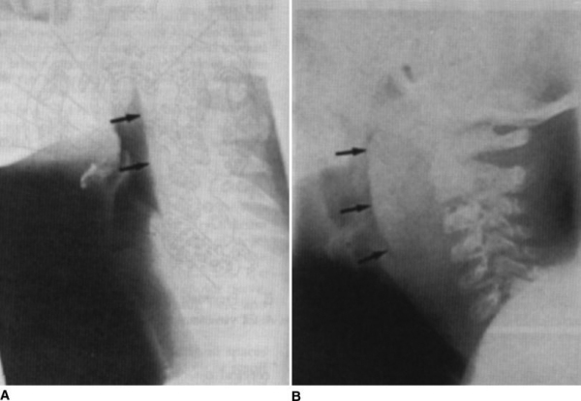
Deep neck space infections: (Usually a complication of another infection and is very rare nowadays)
Lateral pharyngeal, retropharyngeal or prevertebral space.
Patients are toxic ​with unilateral posterior pharyngeal soft tissue mass on oral exam.
Neck stiffness with retropharyngeal space infection/abscess.
Retropharyngeal (danger space) infection may extend to mediastinum and present a mediastinitis.
Prognosis is poor if surgical drainage has not been done.
Etiololgy :
Usually the pathogens that cause Deep Neck Space infections are Streptococci and Anaerobes.
Treatment:
Meropenem or Piperacillin or Clindamycin for 2 weeks (All of these antibiotics cover Anaerobes).
You can read this slide

Slide 12
Other infections:
Lemierre's Syndrome:
It is a complication of a peritonsillar abscess (It generally involves a pus-filled pocket that forms near one of your tonsils) ​or a post­dental infection.
Clinical Presentation: ­ Sore Throat, ­ Fever, ­ Shock.
The presenting symptoms are due to IJV (Internal jugular vein) *thrombophlebitis which leads to multiple septic emboli in the lung (a blood clot, fat globule, gas bubble or foreign material in the bloodstream that is caused by bacteria).
It is caused by Fusobacterium Necrophorum
Treatment is the same as Deep Neck Space infection. ­Meropenem or Piperacillin or Clindamycin for 2 weeks, If the patient does not respond to the treatment, venotomy ​must be done.
(This can go the the internal jugular vein and cause an infection and will create a thrombosis that will ultimately end up in the lung causing the pulmonary embolism. It’s diagnosed by X-­ray)
You can read this slide
*thrombophlebitis : Inflammation of the wall of a vein with associated thrombosis)

Slide 13
Name | diagnose | Etiology |  |  | Treatment
Pharyngitis | 1.Antistreptolysin O (ASO) 2.Culture 3.Rapid Bacterial antigen detection. | Viral (most common): 1-Enterovirus 2-HSV 3-EBV 4-HIV | Bacterial: 1.Group A streptococcus 2.Neisseria gonorrhoeae 3.Anaerobic bacteria 4.Corynebacterium diphtheria |  | -
Diphtheria | 1-Tinsdale medium 2-ELIK’s ​Test | Corynebacterium diphtheriae |  |  | -Penicillin -Erythromycin
Epiglottitis | - | Bacteria: 1.H. influenza Type b 2.S. pneumoniae 3.S. aureus 4.Beta hemolytic streptococcus | Fungal: Candida | Viral | Crftriaxone
Pertussis | nasopharyngeal swabs -Charcoal-horse blood T media -bordetella selectve media | Bordetella pertussis |  |  | Erythromycin
Acute otitis media | Tympano centesis | Bacteria S. pneumoniae. H. influenzae. Group A streptococcus (GAS ) S.aureus Moraxella catarrhalis. | Viral and Fungal. |  | -Amoxicillin -AMC (Amoxicillin + clavulanate).
Acute sinusitis | -Aspiration (Immunocompramized) -radiological | Bacteria: 1- S.pneumonia 2- H.infuenza 3- M.Catarrhalis | Viral 13% of cases |  | Quinolones or Ceftriaxone
Chronic sinusitis | -odontogenic -X-rays (maxillary sinus) | 1- S.pneumonia 2- H.infuenza 3- M.Catarrhalis 4- Oral anaerobes

Slide 14
SAQ:
An unvaccinated child with cough who seems to be gasping for a breath and makes a whooping sound. After taking a swab and under the microscope we found gram negative bacilli. We did the culture in blood agar and it was negative for that. Later with further investigation we found that the patient has Leukocytosis especially the lymphocytes.
Q1: What is the most likely diagnose in this case ?
Pertussis (Whooping cough)
Q2: What is the most likely bacteria can cause that ?
Bordetella pertussis
Q3: List three virulence factors does this bacteria have :
Pertussis toxin
Filamentous hemagglutinin
Pertactin
Q4: Is there any culture media or agar you suggest it to confirm your diagnose ?
Bordet Gengou agar.
Q5: From where do you think the swab was taken ?
Nasopharyngeal.
Q6: Which antibiotic can be used as a treatment or even prophylaxis in this case ?
Erythromycin
Q7:This infection can be prevented by vaccine such as DPT. What are the other infections/disease can be prevented with the same vaccin ?
D for Diphtheria
P for Pertussis
T for tetanus

Slide 15
SAQ:
A 5 year-old suddenly complains of sore throat, malaise, and low grade fever. Examination reveals a white\grey thick coating of the tonsils, uvula, and palate. It cause sudden bleeding when we tried to scrape this coating.
Q1: What is the most likely diagnose in this case ?
Diphtheria
Q2: What is the most likely bacteria can cause that ?
Corynebacterium diphtheriae
Q3: Which agar can help us to identify this organism ?
Tinsdale agar
Q4: Is there any test for toxigenicity can be used in this case ?
ELIK’s Test.
Q5:How can be treatment ?
Anti-toxin
Penicillin
Erythromycin “ if there is allergy from penicillin”
دُف ثيريا (ثيريا لعبة لأطفال يلعبون بالشارع دايما) يلعبون فيها الأطفال اللي من سنة إلى 5 سنين, ولأنهم يلعبون بالشارع فبيكونون معرضين ل توكسيك ميدياتيد ديزيزز , فأنا كطبيب بعالجهم بالبنيسيلين لكنهم متعبين لأن ممكن يكونوا حساسين فبعطيهم ايريثرومايسين وبعطيهم بدائل ألعاب أحسن من دُف ثيريا بعلمهم ( يلعبوا تنس مع الكس ). وشكراً عاتكة على التشبيه المميز
ELIK’s ​Test
Tinsdale medium
MCQs:
https://www.onlineexambuilder.com/micro-uri/exam-131908

Slide 16
GOOD LUCK!
MICROBIOLOGY TEAM:
Waleed Aljamal (leader)
Ibraheem Aldeeri
Ibrahim Fetyani
Abdulaziz almohammed
Abdulmalik alghannam
Omar albabtain
Turki maddi
Mohammad alkahil
Meshal Eiaidi
Khalid Alhusainan
Khalid Alshehri
Nasir Aldosarie
Shrooq Alsomali and Ghadah Almazrou (leaders)
Rawan Alqahtani
Dorah Alhamdi
The Editing File
We are waiting for your feedback
@microbio436
436microbiologyteam@gmail.com

