Slide 1
Lecture :
Community Acquired Pneumoniae
important
Extra notes
Doctors notes
"لا حول ولا قوة إلا بالله العلي العظيم" وتقال هذه الجملة إذا دهم الإنسان أمر عظيم لا يستطيعه ، أو يصعب عليه القيام به .

Slide 2
Introduction to Pneumonia:
Definition: it ​is an infection of the pulmonary parenchyma (the alveoli ) that causes inflammation, consolidation and exudation. Can be : Acute (fulminant) or chronic
Histologically:
Epidemiology:
Common in winter
Overall the rate of CAP 5-6 cases per 1000 persons per year
Mortality 23%
Pneumonia are high especially in old people
Almost 1 million annual episodes of CAP in adults > 65 yrs in the US
 | (1) | (2) | (3)
Histological spectrum | Fibrinopurulent alveolar exudate​is (Pus exudate that contains a large amount of fibrin) | Mononuclear interstitial infiltrates​in | Granulomas and cavitation​seen
Happen in | acute bacterial pneumonias. | viral and other atypical pneumonias | chronic pneumonias (happen in some TB cases)

Slide 3
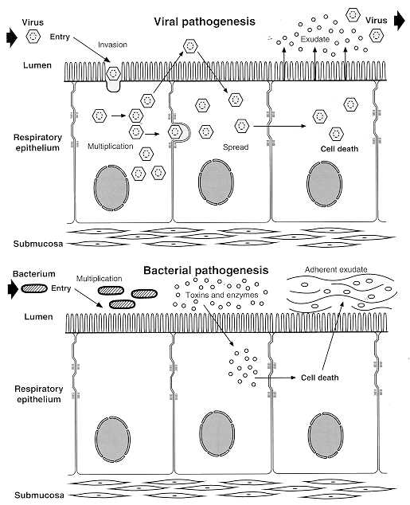
Pathogenesis
Two factors involved in the formation of pneumonia
pathogens
host defenses.

Slide 5
Pathophysiology :
Inhalation or aspiration of pulmonary pathogenic organisms into a lung segment or lobe.
Result from Secondary bacteraemia from a distant source, such as Escherichia coli urinary tract infection and/or bacteraemia (Less common)
Aspiration of Oropharyngeal contents (multiple pathogens).

Slide 6
Risk factors:
Age < 2 yrs , > 65 yrs (extreme ages)
alcoholism ,smoking
Asthma and COPD
Aspiration
Dementia (A chronic mental disorder marked by memory loss, personality changes, and impaired reasoning)
prior influenza
Immunosuppression ,HIV
Institutionalization (The process of committing someone to a facility like prisons and mental hospitals)
Travelling and staying in hotels: Legionella bacteria (بكتيريا المكيفات المركزية. تعيش في وحدات التكييف خصو ًصا في الفنادق وغرف العناية المركزة.) (waterborne transmission)
pets, occupational exposures- birds C- psittaci = (Chlamydophila psittaci)
Chronic lung & heart (S.pneumoniae)
Classification of pneumonia : according to
1
3
Etiology (pathogen)
2
Clinical (Acquired enviroment)
Anatomy

Slide 7
1- Pathogens:
4- Others | 3- Viral pneumonia common cause of pneumonia in children less than 5 years | 2- Fungal pneumonia | 1- Bacteria (dominant)
 |  |  | Atypical pneumonia | Typical pneumonia
 |  |  |  | Anaerobic | Gram - | Gram +
1)Parasites2)Protozoa 3)Chemical 4)Allergy | ­1)Respiratory syncytial V. 2)Influenza V. ­ 3)Adenoviruses. ­ 4)Human metapneumovirus. ­ 5)SARS and MERS CoV. ­ 6)Cytomegalovirus. 7)Herpes simplex virus. | ­1)Candida. ­ 2)Aspergillosis.­ 3)Pneumocystis jiroveci ​(carinii), It causes PCP. | 1)Legionnaies pneumonia(Legionella) 2)Mycoplasma pneumoniae (most common) 3)Chlamydiophila pneumoniae 4)Chlamydophila Psittaci ​ 5)Rickettsias. ­ 6)Francisella tularensis (tularemia) |  | 1)Klebsiella pneumoniae 2)Hemophils influenzae 3)Moraxella catarrhal 4)Escherichia coli | 1)Streptococcus pneumoniae (most common Typical pneumonia) 2)Staphylococcus aureus 3) Group A hemolytic streptococci
1)Streptococcus pneumoniae, H.influenzae and Moraxella: have cell wall therefore are gram stained and respond to Penicillin
and B-lactam
2)Mycoplasma pneumoniae, Legionella and chlamydia: doesn’t have cell wall (resistant to drugs that work on cell wall E.g (penicillin and B-lactam)
Parasites and protozoa infections are rare
Immunocompromised patients are more likely to develop fungal + viral pneumonia

Slide 8
2- Anatomical pneumonia:
1-Lobar pneumonia
Lobular
2-Bronchopneumonia
Entire Lobe
3-Interstitial pneumonia

Slide 9
CAP and bioterrorism agents
Bacillus anthracis (anthrax)
Yersinia pestis (plague)
Francisella tularensis (tularemia)
Coxialla . burnetii (Q fever)
Level three agents

Slide 10
3- Classification by acquired environment:
Community Acquired Pneumonia (CAP)
Hospital Acquired Pneumonia (HAP)
Nursing Home Acquired Pneumonia (NHAP)
ImmunoCompromised Host Pneumonia (ICAP)
Outpatient | Inpatient Non-ICU | ICU
Streptococcus pneumoniae Mycoplasma / Chlamydophila H. influenzae, Staph aureus Respiratory viruses | Streptococcus pneumoniae Mycoplasma / Chlamydophila H. influenzae, Staph aureus Legionella Respiratory viruses | Streptococcus pneumoniae Staph aureus, Legionella Gram neg bacilli (Enterobacteriaceae, and Pseudomonas aeruginosa) H. influenzae

Slide 11
Community Acquired Pneumonia (CAP):
Definition: Pneumonia acquired outside of hospitals or extended-care facilities for >14 days before the onset of symptoms.
Streptococcus pneumoniae (most common)
Haemophilus influenzae
mycoplasma pneumoniae
Chlamydia pneumoniae
Moraxella catarrhalis
Staph.aureus
Commonly caused by Streptococcus pneumoniae , and drug resistant streptococcus pneumoniae (DRSP) is a major concern on this aspect.

Slide 12
Important
What is the difference between typical and atypical community-acquired pneumonia?
 | Typical | Atypical
Etiology | S.Pneumoniae (Lobar Pneumoniae) H.influenza Moraxella catarrhal | Mycoplasma pneumonia chlamydophila pneumoniae Legionella TB Viral, Influenza and Adenovirus or fungal
Clinical presentation | Sudden onset of fever, chill, productive cough, shortness of breath and chest pain. Rusty Sputum. | Gradual onset headache, sore throat and body ache
Gram stain | Useful | Useless (no cell wall)
Radiography | Lobar infiltrate Condolidation | Dramatic changes: patchy or interstitial No Consolidation
Treatment with penicillin | Sensitive | Resistant, treated with Macroides
Diagnosis | History & physical examination X-ray examination Laboratory : CBC- leukocytosis Sputum Gram stain- 15% Blood culture- 5-14% Pleural effusion culture | Serology test X-ray liver enzyme high

Slide 13
Drug Resistant Strep Pneumoniae:
Not
Important
40% of U.S. Strep pneumo CAP has some antibiotic resistance:
PCN, cephalosporins, macrolides, tetracyclines, clinda, bactrim, quinolones.
All MDR strains are sensitive to vancomycin or linezolid; most are sensitive to respiratory quinolones.
β-lactam resistance – Not for meningitis (CSF drug levels).
PCN is effective against pneumococcal.
Pneumonia at concentrations that would fail for meningitis or otitis media.
For Pneumonia, pneumococcal resistance to β-lactams is relative and can usually be overcome by increasing β-lactam doses (not for meningitis!)
 | PCN Minimum Inhibitory Concentration (MIC) mcg/mL to Streptococcus Pneumonmoniae:
 | Susceptible | Intermediate | Resistant
2011CAP Guidelines | MIC <2 | 4 | MIC > 0.12
Meningitis | MIC <0.06 | --- | MIC >0.12
 | PCN Minimum Inhibitory Concentration (MIC) mcg/mL to Streptococcus Pneumonmoniae:
 | Susceptible | Intermediate | Resistant
2008 | MIC ≤ 2 | MIC = 4 | MIC > 8
2007 CAP Guidelines | MIC <2 | --- | MIC > 2
Meningitis | MIC <0.06 | --- | MIC >0.12
Boys slides
Girls slides
Pneumococcal CAP: Be cautious if using PCN if MIC >4. Avoid using PCN if MIC >8.
Remember that if MIC <1, pneumococcus is PCN-sensitive in sputum or blood (but need MIC <0.06 for PCN-sensitivity in CSF).

Slide 14
Atypical Pneumonia
Organisms that cause Atypical Pneumonia:
Chlamydia pneumonia
Mycoplasma pneumonia
Legionella spp
Psittacosis – Parrots (Caused by birds droplets) مرض الطيور
Coxiella burnettii (Q fever) مرض الماعز
Viral (Influenza, Adenovirus)
AIDS
PCP
TB (M. intracellular)
About Atypical Pneumonia:
Approximately 15% of all CAP(Community-Acquired Pneumonia)
Not detectable on gram stain
Won’t grow on standard media
Often extra-pulmonary manifestations:
Mycoplasma: otitis, non-exudative pharyngitis, watery diarrhea, erythema multiform, increased cold agglutinin titer
Chlamydophilla: laryngitis
Most don’t have a bacterial cell wall→ Don’t respond to β-lactams
Therapy: macrolides, tetracycline, quinolones (intracellular penetration, interfere with bacterial protein synthesis)

Slide 15
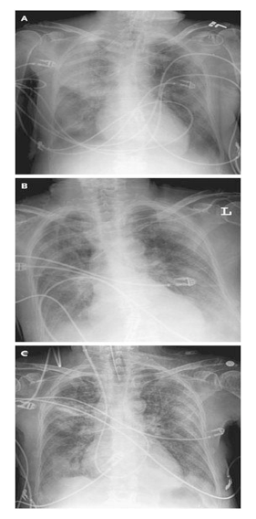
Mycoplasma pneumonia:
● Eaton agent (1944).
● No cell wall.
● Common.
● Rare in children and older than 65 years.
● People younger than 40.
● Crowded places like schools, homeless
shelters, prisons.
● Usually mild and responds well to antibiotics.
● Can be very serious.
● May be associated with a skin rash,
hemolysis, myocarditis or pancreatitis.
Mycoplasma pneumonia x-ray
Mortility Rate 1.4%
- Detection through serum antibodies
- Low mortality rate

Slide 16
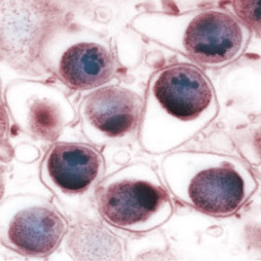
Chlamydia Pneumonia:
Chlamydophila pneumoniae is a species of Chlamydophila, and it’s Obligate intracellular organism
50% of adults sero-positive
Mild disease
Sub clinical infections common
5-10% of community acquired pneumonia
This atypical bacterium commonly causes pharyngitis, bronchitis, coronary artery disease and atypical pneumonia in addition to several other possible diseases.
Chlamydophila pneumoniae
وجه الشبه بين مايكوبلازم و الكالميديا: عدم وجود الجدار الخلوي، لا يصيب كبار السن والأطفال، لا يسبب حالات خطيرة (غالبًا).
وجه الاختلاف بين الاثنين (مهم جدًا): المايكوبلازما تسبب طفح جلدي وأمراض في القلب والبنكرياس، بالإضافة لأماكن العدوى.

Slide 17
Important
Psittacosis:
-Chlamydophila psittaci
-Exposure to birds
-Bird owners, pet shop employees, vets
Parrots, pigeons and poultry (الدواجن).
-Birds often asymptomatic (because it is normal flora for them).
1st: Tetracycline
Alt: Macrolide
Q Fever:
Coxiella burnetti
Exposure to farm animals mainly sheep ماعز
1st: Tetracycline, 2nd: Macrolide

Slide 18
Legionella pneumophila:
Symptoms :
-Insidious onset -Mild URTI (upper resp tract infection) to severe pneumonia -Headache -Malaise -Fever -Dry cough -Arthralgia (pain in a joint)/ myalgia(pain in a muscle)
Signs :
-Minimal Few crackles
-Rhonchi (rattling sound of the lung خشخشة)
-Low grade fever
Legionnaire's disease.
Serious outbreaks linked to exposure to cooling towers
ICU admissions.
Hyponatremia common (<130mMol) (low sodium)
Bradycardia
WBC < 15,000
Abnormal LFTs (liver function test)
Raised CPK (creatine phosphokinase)
Acute Renal failure
Positive urinary antigen

Slide 19
Cont…
Diagnosis:
-CBC
Mild elevation WBC
-U&Es
-Low serum Na (Legionella)
-Deranged LFTs = Increase Liver enzymes
↑ ALT (Alanine transaminase enzyme)
↑ Alkaline phosphatase
-Culture on special media BCYE
(لكن عمليا ما يسوونه لانه يطول اكثر من اللازم)
-Cold agglutinins (Mycoplasma)
-Serology
-DNA detection
Differential diagnosis :(ما ركز عليها)
-Pulmonary tuberculosis
-Lung cancer
-Acute lung abescess
-Pulmonary embolism
-Noninfectious pulmonary infiltration
Treatment:
Macrolide (Erythromycin)
Rifampicin
Quinolones
Tetracycline
Treat for 10-14 days
(21 in immunosuppressed)

Slide 20
Importance of history taking in patient with community-Acquired pneumonia:
History
Solid organ transplant | Any pathogen Bacterial , viral, fungal,or parasitic
HIV | Pneumocystis jeroveci
Travel to some area in USA | Endemic Mycosis
Exposure to air-conditioning, cooling towers, hot tub, hotel stay, grocery sore mist machine | Legionella pneumophilla
Exposure to Turkeys, chickens, ducks or parrots | Chlamydia psittaci
Exposure to contaminated bat caves | Histoplasma capsulatum
Exposure tosheep, goat or cattle | Coxiella burnetii
Exposure to rabbits | Francisella tularensis
Occupation | Mycobacterium tuberculosis, HIV
Evaluate the severity & degree of pneumonia:
Is the patient will require hospital admission?
patient characteristics
comorbid illness
physical examinations
basic laboratory findings

Slide 21
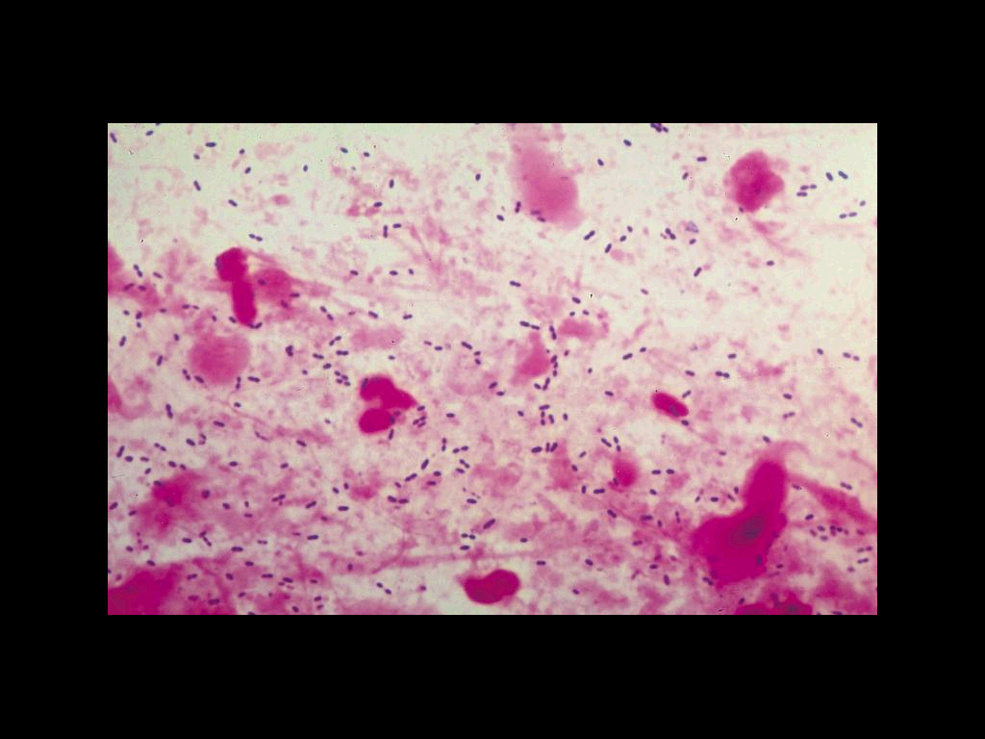
Diagnosis:
-no culture -urine test is used
Sputum Gram stain- 15%
Sputum culture
Bronchoscopic specimens
Blood culture 6-10%
NP swab for respiratory viruses
Legionella urine antigen
Serology for M.pneumoniae, C.pneumoniae
Cold agglutination M.pneumoniae
More Invasive procedure in sick patient
Physical examination:
Respiratory signs on consolidation
Other systems
Chest x-ray examination
Laboratory:
CBC- leukocytosis
Electrolytes (↓Na in legionella)
Urea, creatinine, LFT
Only in girls slides

Slide 22
Management:
Girls slides
Outpatient or inpatient (hypotension, confusion and oxygenation) and age
Previous treatment in the past 3 months
Resistance patterns in the community
Boys slides
Outpatient, healthy patient with no exposure to antibiotics in the last 3 months
Outpatient, patient with co-morbidity or exposure to antibiotics in the last 3 months
Inpatient : Not ICU
Inpatient : ICU
Antibiotic Treatment:
Macrolide: Azithromycin, Clarithromycin
Doxycycline
Beta Lactam :Amoxicillin/clavulinic acid, Cefuroxime
Respiratory Flouroquinolone:Gatifloxacin, Levofloxacin or Moxifloxacin
Antipeudomonas Beta lactam: Cetazidime
Antipneumococcal Beta lactam: Cefotaxime

Slide 23
 |  | Macrolides | Doxycycline | Levofloxacin | B-lactam And Macrolide | B-lactam And Levofloxacin
Outpatient, healthy patient with no exposure to antibiotics in the last 3 months | S pneumoniaes, M pneumoniae, Viral
Outpatient, patient with comorbidity or exposure to antibiotics in the last 3 months | S pneumoniaes, M pneumoniae, C. pneumoniae, H influenzae M.catarrhalis anaerobes S aureus
Inpatient : Not ICU (not important) | Same as above +legionella
Inpatient : ICU (not important) | Same as above + Pseudomonas
Summery:
Macrolides and Levofloxacin = are effective for both Typical and Atypical
B-lactam only work on Typical therefore need to be combined with Macrolides
in the exam they may ask about the antibiotic that covers the typical and nontypical bacteria (important)

Slide 24
The diagnostic standard of severe pneumonia: not important
(It means : the problems that a severe pneumonia patient will have)
1-Altered mental status
2-Pa02<60mmHg. PaO2/FiO2<300, needing MV
3-Respiratory rate>30/min
4-Blood pressure<90/60mmHg
5-Chest X-ray shows that bilateral infiltration, multilobar infiltration and the infiltrations enlarge more than 50% within 48h.
6-Renal function: (Under <20ml/h) and (Under<80ml/4h)

Slide 25
Notes:
Not
Important
Normal respiratory rate is 12-16
-PaO2/FiO2 ratio. The ratio of partial pressure arterial oxygen and fraction of inspired oxygen, sometimes called the Carrico index, is a comparison between the oxygen level in the blood and the oxygen concentration that is breathed.
Complications:
1-Death 10% , 40% (ICU) within 5 days
2-Mainly old age with sever pneumonia
3-Respiratory and cardiac failure
4-Empyema 10%
prevention
By giving Vaccination :
Influenza
S.pneumoniae
Prevention of Aspiration by:
Head Position
Teeth cleaning

Slide 26
Community Acquired Pneumonia not common in young
Young have twice Pneumonia within 3 months is an immunocomprmised and suspect HIV
Young travelled also suspect HIV
Anthrax and Coxiella (Q fever- ماعز) cause Pneumonia.
Anthrax is a deadly disease
Liganella come from hot water, hospital fountain, aircoditioning
Have High fever, don’t respond to Penicillin and effect old and immunocomprmised patient
Good sputum have: Macrophages, WBC, Columnar ciliated epithelial cells (No Squamous cells)
Mycoplasma and chlamydia : we don’t do culture , we do PCR and serology (because it require living cell wich takes time patient would be already dead)

Slide 27
MCQs:
1-The most common organism that causes Atypical pneumonia ?
A- Klebsiella pneumonia
B- Legionella
C- Mycoplasmal pneumonia
D- Ricketsias
2-Patient came with productive cough , shortness of breath and chill , which organism could cause these symptoms ?
A- Legionnaires pneumonia
B- adenovirus
C- M. tuberculosis
D- H. infleunza
3-What possible drug you could prescribed for a patient who has Mycoplasma pneumoniae ?
A- Penicillin G
B-Erythromycin
C- ceftriaxone
D- cephalexin
1- C
2- D
3-B

Slide 28
SAQ:
1-A patient have been admitted to the ICU suffer from fever. what is the most common micro-organism causing this?
2- what will you do to confirm the diagnosis?
3-How will you treat this condition?
4- Sara had a flu tow days ago, now she suffers from diarrhea, otitis, and erythema. what is the diagnosis?
5- List the possible causative agents and the micro-organisms for the diagnosis above?
1- legionella pneumophila
2- CBC, Mild elevation WBC, U&Es, Low serum Na, Deranged LFTs, ↑ ALT (Alanine transaminase enzyme), ↑ Alkaline phosphatase, Culture on special media BCYE, Cold agglutinins (Mycoplasma), Serology DNA detection
3- Macrolide (Erythromycin), Rifampicin, Quinolones, Tetracycline, Treat for 10-14 days (21 in immunosuppressed)
4-Atypical pneumonia
5- Chlamydia pneumonia, Mycoplasma pneumonia, Legionella spp, Psittacosis, Coxiella burnettii

Slide 29
GOOD LUCK!
MICROBIOLOGY TEAM:
Waleed Aljamal (leader)
Ibraheem Aldeeri
Ibrahim Fetyani
Abdulaziz almohammed
Abdulmalik alghannam
Omar albabtain
Turki maddi
Mohammad alkahil
Meshal Eiaidi
Khalid Alhusainan
Khalid Alshehri
Nasir Aldosarie
Shrooq Alsomali and Ghadah Almazrou (leaders)
Leena Alwakeel
Lama Altamimi
The Editing File
We are waiting for your feedback
@microbio436
436microbiologyteam@gmail.com

