Slide 1
Lecture :
Health Care Associated Pneumonia
important
Extra notes
Doctors notes
"لا حول ولا قوة إلا بالله العلي العظيم" وتقال هذه الجملة إذا دهم الإنسان أمر عظيم لا يستطيعه ، أو يصعب عليه القيام به .

Slide 2
Objectives:
Name the different causative bacterial agents .
Classify and describe types of VAP.
Recognize the ways by which VAP is prevented.
Describe the different chemotherapeutic anti microbial agents used for the treatment of health care associated pneumonia.
Evaluate response to treatment and recognize reasons for failure of treatment.
Define the terms, pneumonia, community acquired pneumonia, health care associated pneumonia
( HCAP) and ventilator associated pneumonia (VAP).
Describe the pathogenesis of the health care associated pneumonia (hospital associated pneumonia ) and VAP.
Classify HCAP according to the time of onset .

Slide 3
Health care associated Pneumonia:
Pneumonia
Definition : Infection of the pulmonary Parenchyma
It can be
Community acquired pneumonia
Health care associated pneumonia (Nosocomial pneumonia)
acquired in the community, by community acquired organism
eg. Streptococcus pneumoniae
usually susceptible (sensitive) to antibiotic.
acquired 48-72 hours (2-3days) after admission to health care institutions. Pneumonia that is caused by organisms in hospital which are usually resistant to antibiotics
eg. Pseudomonas aeruginosa
Mainly caused by susceptible organisms like:
1- S.Pneumonial which is susceptible to penicillin.
2- H.influenza which is susceptible to ampicillin
Hospital acquired pneumonia (HAP)
Ventilator associated pneumonia (VAP)
in patients with assisted respiration for a period of 48 hours

Slide 4
Nosocomial pneumonia:
Definition:
is defined as hospital associated pneumonia (HAP) or health care associated pneumonia (HCAP).
Occurring at least 48-72 hours after admission and not incubating at the time of hospitalization.
Introduction:
Nosocomial pneumonia is the 2nd most common hospital-acquired infections after urinary tract infection. Accounting for 31 % of all nosocomial infections
Nosocomial pneumonia is the leading cause of death from hospital-acquired infections.
The incidence of nosocomial pneumonia is highest in ICU patients (intensive care unit) وحدة العناية المركزة (الفائقة).
The incidence of nosocomial pneumonia in ventilated patients is 10-fold higher than non-ventilated patients
The reported crude mortality for HAP is 30% to greater than 70%.
Nosocomial: a disease originating in a hospital. مرض ينتقل عن طريق بيئة المستشفى

Slide 5
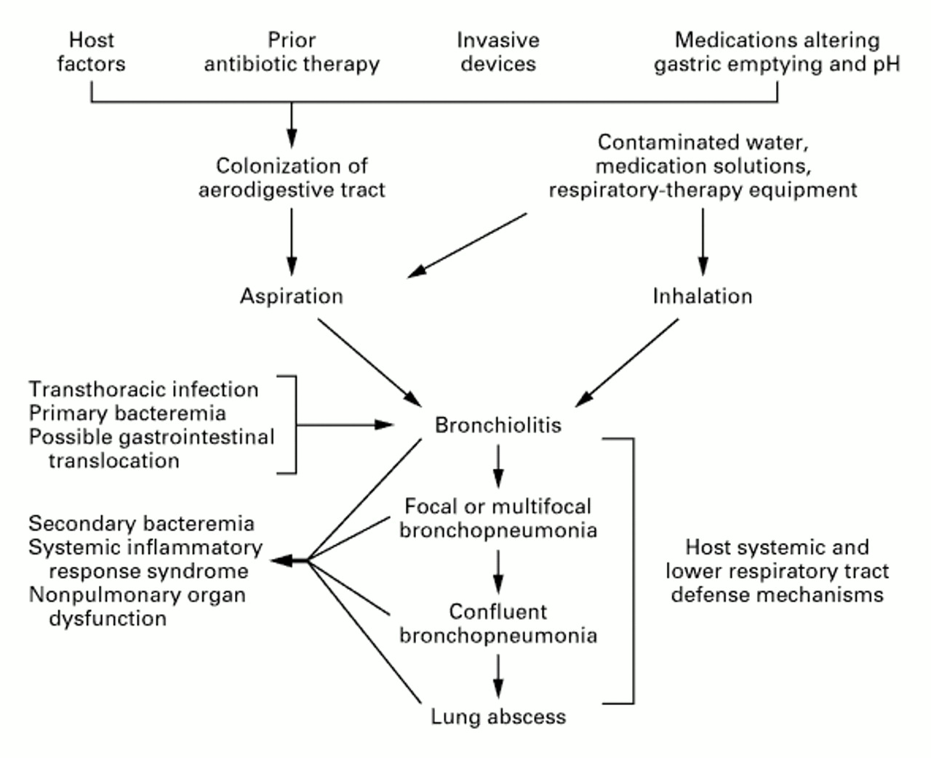
Pathogenesis¹:
One of the following three conditions at least² is required for pneumonia to occur:
1) Significant impairment (weakness) of the host defenses³.
2) Introduction of a sufficient-size inoculum⁴ that overwhelms the host's lower respiratory tract defenses* indirectly .
3) Introduction of highly virulent organisms directly into the lower respiratory tract , which is common in microaspiration⁵ of oropharyngeal secretions⁶ that are colonized with pathogenic bacteria. ⁷
Important, most ventilated patients are given broad spectrum antibiotics that can cause resistance
1 ICU patients are surrounded by many tubes which contain large number of inoculum “organisms” which invade in his respiratory tract.
2 The gold standard for any bacterial infection is culture.
3 The patient has diabetes, taking steroids, chemotherapy, or other diseases .
4The infective agent which may be vaccinated or introduced to the body.
5 Inhalation of foreign materials into the lower airways.
6 Secretions gathering while the patient is lying down on ventilation .
7 Normal nose and throat flora are very dangerous in sterile sites of the body like the deep lungs.
You don’t have to memorize the picture
*So they can’t cough up the bacteria and secretions
Thanks To 435 Team

Slide 6
Classification of HAP: The classification of nosocomial pneumonia is based on its onset duration
Early-onset nosocomial pneumonia:
-Occurs during the first 4 days of admission.
-Usually is due to :
S. pneumonia
MSSA (Methicillin sensitive S.aureus )
H. Influenza
anaerobes.
Late-onset nosocomial pneumonia:
-occurs more than 4 days of admission.
-More commonly by :
Gram negative organisms, especially: P. aeruginosa, Acinetobacter, Enterobacteriaceae (Klebsiella, Enterobacter, Serratia)
MRSA (Methicillin resistant S.aureus) .
Important!

Slide 7
Causative Agents
Enteric Gram negative bacilli (Enterobacteriacae):
are isolated most frequently particularly in patients with late-onset disease and in patients with serious underlying disease often already on broad-spectrum antibiotics.4
Prior use of broad-spectrum antibiotics and an immunocompromised state make resistant Gram-negative organisms more likely.
P. aeruginosa and Acinetobacter:
are common causes of late-onset pneumonia, particularly in ventilated patients.
S. aureus :
is isolated in about 20~40% of cases and is particularly common in :
1. Ventilated patients after head trauma, neurosurgery, and wound infection
2. In patients who had received prior antibiotics or
Prolonged care in ICU
MRSA(methicillin resistant S.aureus):
is seen more commonly in patients who:
Received corticosteroids
Undergone mechanical ventilation >5 days
Presented with chronic lung disease
Had prior antibiotics therapy
Anaerobes : (not a common cause to pneumonia)
are common in patients predisposed to aspiration .
Ventilator associated pneumonia (VAP ) with anaerobes occurred more often with oropharyngeal intubation than nasopharyngeal intubation

Slide 8
VENTILATOR ACQUAIRED PNEUMONIA:
Definition: Nosocomial pneumonia that has developed in patient who is receiving mechanical ventilation. يعني تنفس او تهوية ميكانيكية
Classification:
Early-onset: within 48-72 hours after tracheal intubation, which complicates the intubation process
Late-onset: after 72 hours. التراكيال انتيوبايشن هو لما يحطون انبوب من الفم او الانف الى القصبة الهوائية (التراكيا) لاي سبب كان, ممكن للتنفس او ايصال دواء او منع اختناق او غيرها
Pathogenesis:
Requires 2 important processes:
1. Bacterial colonization of the aerodigestive tract. الايرودايجستف تراكت يقصد فيه الجهاز التنفسي و الجزء العلوي من الجهاز الهضمي
(Lips, mouth, tongue , nose ,throat , vocal cords , part of the esophagus and windpipe)
2. Aspiration of contaminated secretion into the
Lower airway سوائل الجهاز الهضمي تنزل على التراكيا و تحت فتسبب مشاكل .
Prevents mechanical clearance by cough and the mucociliary escalator.
Signs and symptoms Of having VAP :
1- need a lot of oxygen
2- fever
3-leukocytosis
4-increase secretion

Slide 9
PREVENTION:
The oral regimen النظام او الخطة(topical Gentamicin, Colistin, Vancomycin cream given every 6h for 3 weeks) treating oropharyngeal colonization could prevent VAP.
Non-pharmacologic strategies:
-Effective hand washing and use of -protective gowns and gloves.
-Semi recumbent positioning هي وضعية انه ينسدح و يرفع التورسو 45 درجة.
-Avoidance of large gastric volume كمية السوائل في المعدة
-Oral (non-nasal) intubation
-Continuous subglottic suctioning يشفطون السوائل عشان ما تنزل
-Humidification with heat and moisture exchanger
-Posture changeتعديل وضعية الجسم
Pharmacologic strategies:
-Stress-ulcer prophylaxis
-Combination antibiotic therapy
-Prophylactic antibiotic therapy
-Chlorhexidine oral rinse (disinfectant).
-Prophylactic treatment of neutropenic patients.(neutrophil count is less than normal)
-Vaccines

Slide 10
Treatment of HAP and VAP:
Most initial therapy is empiric (based on expectations) because no pathogen is identified or results are not yet available when antimicrobial decisions are made in most patient .
First, we will treat with a broad spectrum antibiotic regimen to cover all likely bacterial pathogens
the regimen should subsequently be narrowed into a more specific antibiotic according to the bacteria shown in the culture’s result.
The pathogen is influenced by coexisting illnesses, prior treatment, and the length of hospitalization.
The frequency of ICU acquired Pseudomonas Aeruginosa carriage, colonization or infection is 23.4% at 7 days and 57.8% at 14 days.
The mortality can be reduced with early appropriate empiric therapy (Form 30% with appropriate therapy to more than 90% with inappropriate therapy.)

Slide 11
“Guidelines by American Thoracic Society has divided HAP patients into three groups, each with a set of probable pathogens”
Read
Only
For mild to moderate HAP:
Monotherapy has been shown to be effective.
For severe HAP with resistant organisms:
Combination therapy probably should be instituted until culture result are available.
For patients with Staph. Aureus infection:
Agents against this organism are necessary, including Vancomycin if MRSA is suspected. Linezolid is comparable with Vancomycin, nevertheless, one of the main advantages of Linezolid is that it does not cause nephrotoxicity.
For patients with Pseudomonas Aeruginosa infection:
Combination of antipseudomonal drugs is controversial.
1) Traditional approach:
Antipseudomonal Beta-lactam + Aminoglycoside.
Synergy but potential nephrotoxicity.
Synergy : working together to enhance the effectiveness
2) Another approach:
Antipseudomonal Beta-lactam + Fluoroquinolone.
No benefit of synergy but reduces the concern of nephrotoxicity, and quinolone
gets into the lungs at higher concentrations.
When we think about treatment we should always select drugs that cover Pseudomonas Aeruginosa and MRSA

Slide 12
Important slide
For Pseudomonas we have to use 2 drugs from
2 different families
B-lactam
Ceftazidime
Pipracillin
For Straphycoccus Aurues
Aminoglycoside
Tobramycin
Gentamycin
Amikacin
MSSA
MRSA
Cefazplin
(1st generation)
Clyndamycin
Cloxacillin
Vancomycin
Or Linazolid
Fluoroquinolone
Ciprofloxacin
levothoxacin
Carbapenum
Meropenum
Lmipenum

Slide 13
Response to therapy:
Read Only
If no clinical response is noted or deterioration occurs, we need to consider the following:
Infectious Causes | Non-infectious events
Resistant pathogen Unusual pathogen Superinfection Extra-pulmonary Infection Lung abscess | Heart: Congestive heart failure (CHF). Lung: Fibro-proliferative acute respiratory distress syndrome (ARDS) Pulmonary embolism. Atelectasis.

Slide 14
SAQ:
Ahmed and Khaled were both admitted to the hospital after a car accident ,both of them were ventilated in the ICU . After one day Ahmed acquired pneumonia and after six days Khaled acquired pneumonia.
Q1: What organisms most likely caused Ahmed to develop pneumonia ?
Q2:What organisms most likely caused Khaled to develop pneumonia?
Q3: As a doctor how would you try to prevent pneumonia in ventilated patients?
Q4: What ANTIBIOTICS will you use to treat Ahmed and Khaled?
ANS
1)s.Pneumoniae , MSSA, H.Influenza, anaerobes
2) Gram negative organisms , P.aeruginose , acinetobacter , enterobacteriaceae , MRSA
3) By applying topical gentamycin , colistin ,vancomysin cream (given every 6 hours for 3 weeks)
4) Vancomycin , linezolid

Slide 15
GOOD LUCK!
MICROBIOLOGY TEAM:
Waleed Aljamal (leader)
Ibraheem Aldeeri
Ibrahim Fetyani
Abdulaziz almohammed
Abdulmalik alghannam
Omar albabtain
Turki maddi
Mohammad alkahil
Meshal Eiaidi
Khalid Alhusainan
Khalid Alshehri
Nasir Aldosarie
Shrooq Alsomali and Ghadah Almazrou (leaders)
Amal Alshaibi
Nouf Aloqaili
The Editing File
We are waiting for your feedback
@microbio436
436microbiologyteam@gmail.com

