Slide 1



Lecture :
Respiratory Fungal Infection
important
Extra notes
Doctors notes
"لا حول ولا قوة إلا بالله العلي العظيم" وتقال هذه الجملة إذا دهم الإنسان أمر عظيم لا يستطيعه ، أو يصعب عليه القيام به .

Slide 2
Objectives:
Respiratory System
Rout of infection?
Oral Cavity, any role?
Respiratory fungal infections are less common than viral and bacterial infections.
Have significant difficulties in diagnosis and treatment.

Slide 3
Respiratory fungal infection - Etiology
YEAST (Opportunistic) | Mould fungi (Opportunistic) | Dimorphic fungi (Primary infections) Common in travel
Candidiasis (Candida) | Aspergillosis (Aspergillus species) | Histoplasma capsulatum
Cryptococcosis (Cryptococcus neoformans, C. gattii) | Zygomycosis (y, e.g. Rhizopus, Mucor) | Blastomyces dermatitidis
 | Other mould | Paracoccidioides brasiliensis
 |  | Coccidioides immitis

Slide 4
Primary Systemic Mycoses
  Infections of the respiratory system that occur by Inhalation.
  Dissemination seen in immunocompromised hosts.
  Common in North America and to a lesser extent in South America. Not common in other parts of the World.
  Etiologies are dimorphic fungi:
    In nature found in soil of restricted habitats.
    Primary pathogens, dimorphic fungi
    They are highly infectious
  They include:
    Histoplasmosis,
    Blastomycosis,
    Coccidioidomycosis,
    Paracoccidioidomycosis

Slide 5
Aspergillosis
Aspergillosis is a spectrum of diseases of humans and animals caused by members of the genus Aspergillus
of mould fungi (Opportunistic).
These include :
  (1) Mycotoxicosis (such alpha toxin which produced by Aspergillus)
  (2) Allergy
  (3) Colonization (without invasion and extension ) in preformed cavities
  (4) Invasive disease of lungs
  (5) Systemic and disseminated disease.
Aetiological Agents:
  Aspergillus species, common species are:
  A. fumigatus, (Glabellar)
  A. flavus, (Regional)
  A. niger,
  A. terreus
  A. nidulans.
Common airborne Fungi
Aspergillus niger
Aspergillus fumigatus

Slide 6
CLASSIFICATION OF ASPERGILLOSIS:
Risk factors :
Airways/nasal exposure to airborne Aspergillus
Invasive aspergillosis Chronic aspergillosis Aspergilloma of lung Maxillary (sinus) aspergilloma Allergic: Allergic bronchopulmonary (ABPA) Allergic Aspergillus sinusitis Persistence without disease colonisation of the airways or nose/sinuses
  Bone marrow/ organ transplantation
  AIDS
  Diabetes
  others
  Cancer: Leukemia, lymphoma,.. Etc

Slide 7
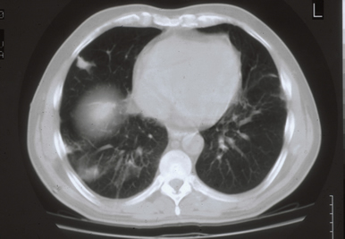
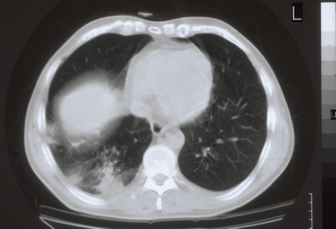
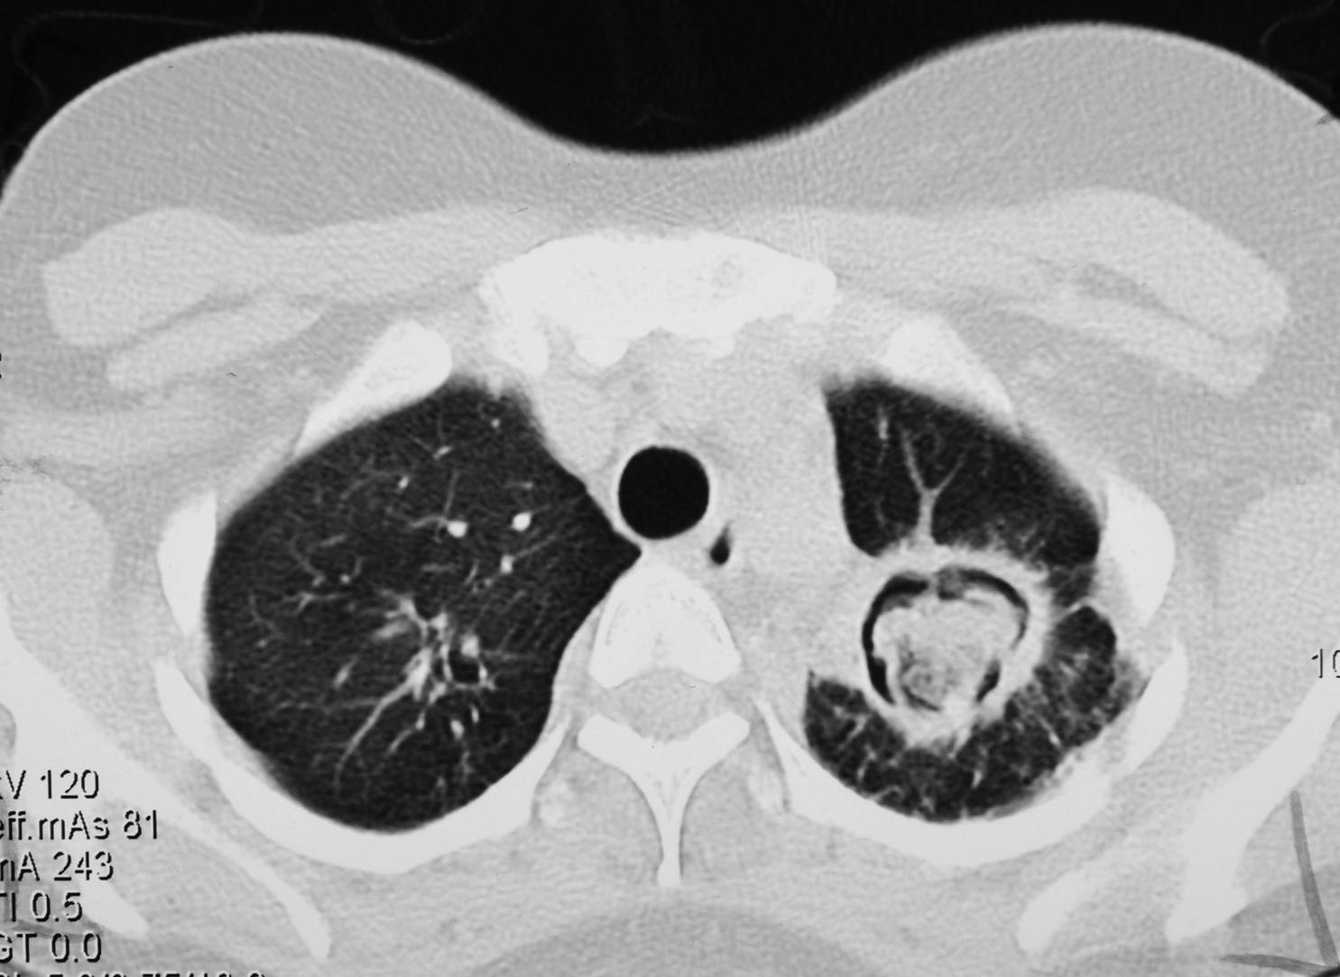
Aspergillosis:
Chronic Aspergillosis (Colonizing aspergillosis)
(Aspergilloma OR Aspergillus fungus ball) (Fungus Ball is a mass or clumping of hyphae +mucous + fibrin + cellular debris) usually inside cavity.
    Signs include: Cough, hemoptysis, variable fever
    Radiology will show mass in the lung , radiolucent (air) crescent
Invasive pulmonary Aspergillosis
    Signs: Cough , hemoptysis, fever, Leukocytosis
    Radiology will show lesions with halo sign
مهم
Simple (single) aspergilloma
Invasive pulmonary aspergillosis
Note the Air crescent
Note the Halo sign

Slide 8
Allergic bronchopulmonary (ABPA)
Also:
Symptoms of Asthma
Bronchial obstruction
Fever, malaise
Eosinophilia
Wheezing +/-
  Skin test reactivity to Aspergillus
  Serum antibodies to Aspergillus
  Serum IgE > 1000 ng/ml
  Pulmonary infiltrates

Slide 9
Fungal sinusitis
Clinical :
Nasal polyps – and other symptoms of sinusitis
In immunocompromised, Could disseminate to → eye → craneum (Rhinocerebral)
The most common cause in KSA is Aspergillus flavus
In addition to Aspergillus, there are other fungi that can cause fungal sinusitis
Aspergillus sinusitis has the same spectrum of Aspergillus disease in the lung
Diagnosis
  Clinical and Radiology
  Histology
  Culture
  Precipitating antibodies useful in diagnosis
  Measurement of IgE level,
  RAST test*
Treatment :
  depends on the type and severity of the disease and the immunological status of the patient
* A radioallergosorbent test is a blood test using radioimmunoassay test to detect specific IgE antibodies, to determine the substances a subject is allergic to.

Slide 10
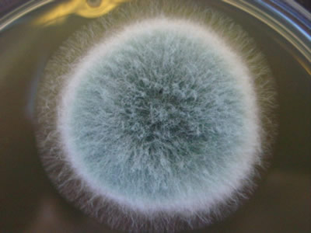
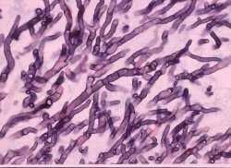
Diagnosis of Aspergillosis
Specimen:
  Respiratory specimens: Sputum, BronchoAlveolar Lavage (BAL), Lung biopsy,
  Other samples:
  Blood, etc.
Lab. Investigations:
  Direct Microscopy:
  Giemsa Stain, Grecott methenamine silver stain (GMS)
  Will show fungal septate hyphae
  Culture on SDA (Sabouraud Dextrose Agar is selective media)
  Serology:
    Test for Antibody
    ELISA test for galactomannan Antigen
  PCR: Detection of Aspergillus DNA in clinical samples
Cultures of Aspergillus
Choice of antifungal for aspergillosis:
Usually we need surgery also
Voriconazole
Alternative therapy:
  Amphotericin B, Itraconazole, Caspofungin
Smear: Septate fungal hyphae. Aspergillosis

Slide 11
Zygomycosis:
Pulmonary Zygomycosis:
Pulmonary zygomycosis
Rhinocerebral zygomycosis
Risk factors
  Transplant patients
  Malignancy
  AIDS
  Diabetic ketoacidosis
  Many others
Acute infection
Consolidation , nodules, cavitation, pleural effusion, hemoptysis
Infection may extend to chest wall, diaphragm, pericardium.
  Pulmonary infractions and hemorrhage
  Rapid evolving clinical course
Early recognition and intervention are critical
Etiology:
  Zygomycetes , Non-septate hyphae
    e.g. Rhizopus,
Note :
Aspergillosis –septate hyphae
p.Zygomycosis – non-septate hyphae

Slide 12
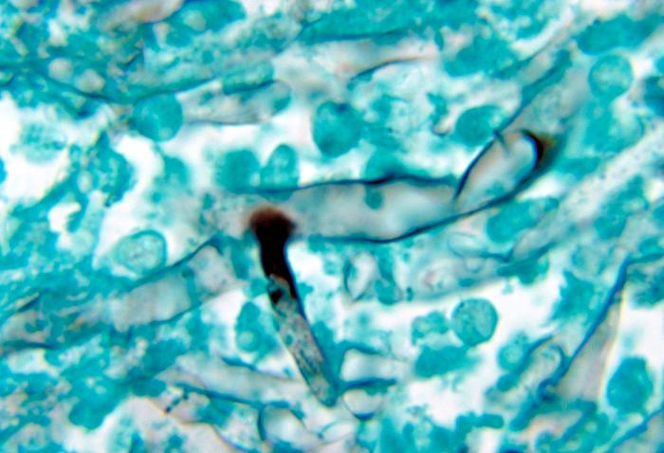
Diagnosis:
Specimen:
  Respiratory specimens: Sputum, BAL, Lung biopsy,
  Other samples
Lab. Investigations:
  Direct Microscopy:
    Giemsa, Grecott methenamine silver stain (GMS)
      Will show broad non- septate fungal hyphae
  Culture on SDA (no cycloheximide)because it may inhibit the growing of this fungi
Serology: Not available
Treatment:
  Amphotericin B
  Surgery

Slide 13
Pneumocystosis (PCP):
Pneumocystis pneumonia (PCP)
Opportunistic fungal pneumonia
It is interstitial pneumonia of the alveolar area that effect immunocompromised hosts.
Affect compromised host
Especially common in AIDS patients.
Etiology: Pneumocystis jiroveci
Previously thought to be a protozoan parasite, but later it has been proven to be a fungus
Does not grow in laboratory media e.g. SDA ( only we can use silver \ IF stain which is more sensitive)
Naturally found in rodents (rats), other animals (goats, horses), Humans may contract it during childhood
Important slide

Slide 14
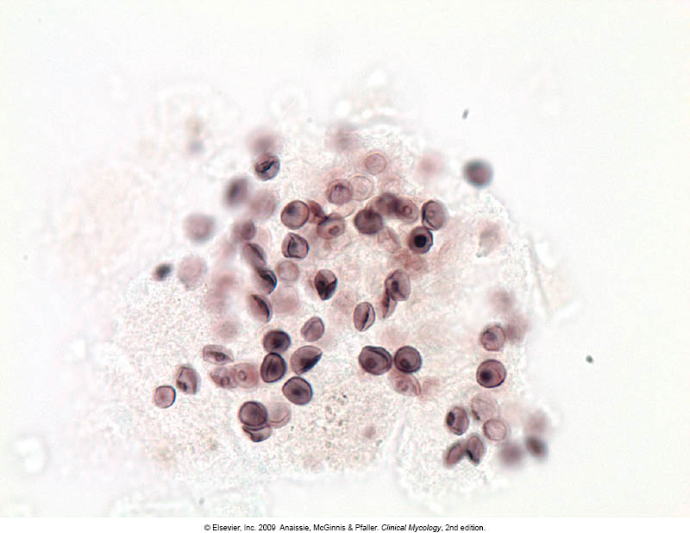
Pneumocystosis:
Laboratory Diagnosis:
Patient specimen: Bronchoscopic specimens (B.A.L.), Sputum (not very good), Lung biopsy tissue.
Histological sections or smears stained by GMS stain.
  Immunuofluorescence (better sensitivity)
  If positive will see cysts of hat-shape, cup shape, crescent.
Treatment:
Trimethoprim – sulfamethoxazole (the two drugs are combined and known as co-trimoxazole)
Dapsone
Important slide

Slide 15
Pulmonary Candidiasis
Candida causing Pneumonia but Not Common.
Has Primary and Secondary
Secondary Dissimination of blood
Diagnose: don’t depend on Sputum
Treatment: Fluconazole
Voticonazole if resistant to fluconazole

Slide 16
summary:
Opportunistic |  | Primary infections
Yeast | Mould Fungi | Dimorphic fungi
Candidiasis (candida, and other yeast) | Aspergillosis (Aspergillus species) | Histoplasma capsulatum
 |  | Blastomyces dermatitidis
 | Zygomycosis (Zygomycetes eg. Rhizopus, mucor)
Cryptococcosis (Cryptococcus neoformans, C. gatti) |  | Paracoccidiodes brasiliensis
 | Other mould
 |  | Coccidioides immitis
Etiology
Respiratory Fungal Infections
(1) Primary Systemic Mycoses
(Inhalation)
Primary pathogens
Highly infectious
Etiology: Dimorphic fungi:
Histoplasmosis
Blastomycosis
Coccidioidomycosis
Paracoccidioidomycosis
(3) Zygomycosis
Rhinocerebral zygomycosis
Pulmonary zygomycosis (Acute)
Etiology:
Zygomycetes (rhizopus)
Diagnosis:
Specimen (sputum, BAL, biopsy)
Lab (direct microscopy: GMS and Giemsa stain = broad non-septate fungal hyphae)
(culture = SDA)
(serology= not available)
Treatment:
Amphotericin B
Surgery
(4) Pneumocystosis (PCP)
Opportunistic fungal pneumonia
Etiology:
Pneumocystis jiroveci
Diagnosis:
Specimen (sputum, BAL, biopsy)
Histology (GMS stain)
Immunofluorescence
Treatment:
Trimethoprim –Sulfamethoxazole
Dapsone
Classification
(2) Aspergillosis
(next slide)

Slide 17
summary:
(2) Aspergillosis
Etiology: (Aspergillus species)
A. fumigatus
A. flavus
A. niger
A. terreus
A. nidulans
Diagnosis:
Specimen (Sputum, BAL, biopsy, blood, etc)
Lab (direct microscopy: GMS and Giemsa stain = septate hyphae) fungal
(culture = SDA)
(Serology = test for antibody, ELISA)
(PCR = detection of aspergillus DNA in clinical sample)
Treatment:
Voriconazole
Alternative: Amphotericin B, Itraconazole, Caspofungin
Invasive aspergillosis
Signs: cough, hemoptysis, fever, leukocytosis. Radiology: Lesions with halo signs
Allergic
Allergic aspergillus sinusitis Allergic bronchopulmonary Aspergillosis (ABPA): Symptoms of asthma, bronchial obstruction, fever, malaise, eosinophilia, wheezing +/-
Chronic aspergillosis (colonizing apergillosis)
Aspergilloma of lung Maxillary (sinus) aspergilloma Signs: cough, hemoptysis, variable fever Radiology: mass in the lung, radiolucent crescent
Fungal Sinusitis
Signs: nasal polyps and other symptoms of sinusitis Most common cause: Aspergillus flavus Diagnosis: clinical and radiology, histology, culture, RAST, IgE levels Treatment: Varies according to severity and type of the disease and the immunological status of the patient
Persistence without disease colonization of the airways or nose/sinuses

Slide 18

GOOD LUCK!
MICROBIOLOGY TEAM:
Waleed Aljamal (leader)
Ibraheem Aldeeri
Ibrahim Fetyani
Abdulaziz almohammed
Abdulmalik alghannam
Omar albabtain
Turki maddi
Mohammad alkahil
Meshal Eiaidi
Khalid Alhusainan
Khalid Alshehri
Nasir Aldosarie
Shrooq Alsomali and Ghadah Almazrou (leaders)
Reem Alshathri
Ruba Barnawi
Jawaher Abanumy
Ouhod Abdullah
Rawan alqahtani
The Editing File
We are waiting for your feedback
@microbio436
436microbiologyteam@gmail.com

