Slide 1
lecture:
Viral Infections of the Respiratory System
important
Extra notes
Doctors notes
"لا حول ولا قوة إلا بالله العلي العظيم" وتقال هذه الجملة إذا دهم الإنسان أمر عظيم لا يستطيعه ، أو يصعب عليه القيام به .

Slide 2
Objectives:
Introduction to respiratory viral infections
Characteristics of respiratory viruses (Orthomyxoviridae, Paramyxoviridae)
Mode of transmission
Clinical features
Lab diagnosis
Treatment & prevention

Slide 3
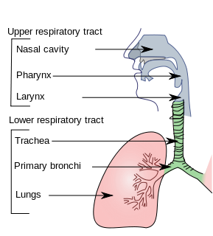
Viral infection of respiratory tract
They are the commonest of human infection and cause large amount of morbidity and loss of time at work “sick leave”
Are common in both children and adults
Mostly caused by viruses
Mostly are mild and confined to the upper respiratory tract
Mostly are self-limiting disease(no need for treatment)
Upper respiratory tract infection may spread to other organ causing more severe infection and death
Clinical manifestation :
Common cold “rhinitis”
Pharyngitis
Tonsillitis
Sinusitis
Otitis media
Croup “ acute laryngotracheobronchitis “
Acute bronchitis
Acute bronchiolitis
Viral pneumonia

Slide 4
للإطلاع :)

Slide 5
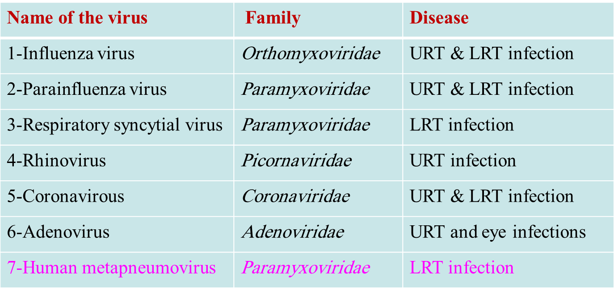
Common respiratory viruses:
سندرس كل واحد بالتفصيل في هذه المحاضرة والتي تليها
URT- infection includes : rhinitis “ common cold”, tosillitis , pharyngitis
LRT- infection includes : croup, bronchitis, bronchiolitis, pneumonia

Slide 6
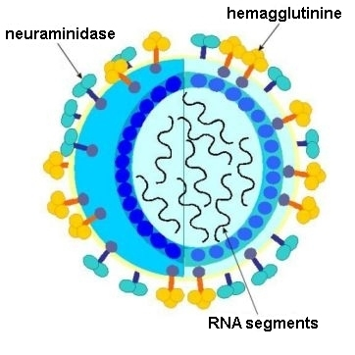
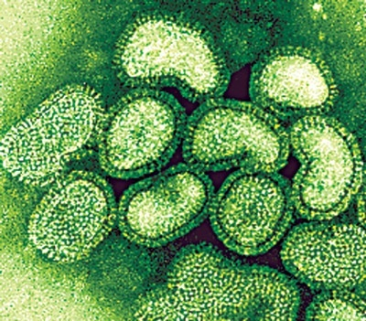
Influenza virus :
Family: Orthomyxoviridae.
Features: | Envelope contain 2 projecting glycoprotein spikes:
-Genome: 8 Segmented (it is the only segmented virus in this 2 lectures) (-ve)polarity ssRNA. (-ve polarity = the virus RNA will transcription to mRNA then translation to protein ) -Highly susceptible to mutation and rearrangements within the infected host | Heamagglutinin “H” Function: attachment to the cell surface receptor Antibody for HA is responsible for immunity 16 haemogglutinin antigenic type H1-H16 Human associated antigenic type are H1, H2, H3 | Neuroamindase “N” Functin :An enzyme respnsible for release of the progeny viral particles from the infected cell 9 neuroaminidase antigenic type N1-N9 Human associated N antigenic type are N1, N2
Divided into subtypes
-based on the haemagglutinine and neuraminidase proteins. -The currently circulating strains are: H1N1 & H3N2.

Slide 7
Types of Influenza Viruses
pandemic
epidemic
Influenza A
Influenza B
Influenza C
Out
break
Infect human and animals.
cause epidemic and pandemic
cause epizootic in animals
Antigenic drift -< minor change in the genetic material
antigenic shift -< major change in the genetic material
Infect human
Cause outbreaks
Antigenic drift only
Infect human only
Cause mild illness

Slide 8
Influenza virus :
Pathogenesis: The virus infects the epithelial cells of the nose, throat,
bronchi and occasionally the lungs.
Transmission: inhalation of infectious aerosol droplets.
Incubation period: 1 - 4 days
prognosis: usually self limiting disease
Symptoms: fever - Cough - Malaise - Headache - chills - sore throat - generalized pain

Slide 9
Influenza virus :
Complication of Influenza:
Lab diagnosis:
routine testing by Direct detection of Influenza A or B virus from sputum, nasopharyngeal swab, aspirate (NPA) or respiratory secretion by direct immunoflourecent assay (IFA). (detect the antigen)
Other detection methods not common: Cell culture, PCR.
Primary Influenza Pneumonia.
2ndbacterial-pneuomonia
Reye’s syndrome [fatty degeneration of CNS and Liver (Aspirin)]
Treatment:
1: Amantadine is effective against influenza A virus only.
2: Rimantadine, Oseltamivir (Tamiflu) or Zanamivir (Relenza) are effective against both influenza A & B viruses and can be used as treatment and prophylaxis.

Slide 10
Influenza virus :
Prevention:
Influenza vaccine: Two types of vaccines available:
1- The flu shot vaccine: Inactivated (killed vaccine).
Given to people older than 6-months, including healthy people and those with chronic medical conditions. injection
2- The nasal spray flue vaccine (Flu mist): Live attenuated vaccine.
Approved for use in healthy people between 5-49 years of age. Nasal spray
Both vaccines contain two strains of the current circulating influenza A virus and the current circulating strain of influenza B virus. ( 2 A + 1 B)
Vaccine should be given in October or November, before the influenza season begins.

Slide 11
Avian flu
Viral etiology: Avian influenza type A virus (H5N1).
Family: Typical orthomyxovirus.
Epidemiology: Wild birds are the natural reservoir for the virus. They shed the virus in saliva, nasal secretion and feces.
All domestic poultry are susceptible to infection.
They become infected, when they eat food contaminated with secretion or excretion from infected bird.
Avian influenza viruses do not usually infect human.
High risk group includes those who working in poultry farms and those who are in close contact with poultry.
Symptoms in human:
-Ranges from typical flu to severe acute respiratory disease.
-Diarrhea, abdominal pain and bleeding from the nose have been reported.
Treatment:
-Should be initiated within 48 hours.
-Oseltamivir and Zanamivir are used.
Lab diagnosis:
-PCR, detection of the viral RNA in throat swap.

Slide 12
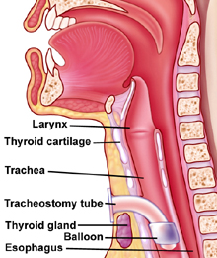
2- Parainfluenza Virus
Family: Paramyxoviridae.
Structural features: Enveloped virus with - polarity ssRNA genome, with 5 serotypes.
Transmission: Inhalation of infectious aerosol droplets mainly in winter.
Clinical syndrome:
Croup or acute laryngotracheobronchitis. PIV Type-I, II affect mainly in infants and young children. Fever, harsh cough, difficult inspiration can lead to airway obstruction which may require hospitalization and tracheostomy.
Bronchiolitis and Pneumonia: PIV Type-III in young children.
Lab diagnosis: routine testing by Direct detection of the virus from sputum, nasopharyngeal swab, aspirate (NPA) or respiratory secretion by direct immunoflourecent assay (IFA).
Other detection methods: tissue culture, PCR.
Treatment and prevention: Supportive treatment, No specific treatment or vaccine available.

Slide 13
3- Respiratory Syncytial Virus (RSV) + Human metapneumovirus
Family: Paramyxoviridae.
Structural features: Enveloped virus with - polarity ssRNA genome.
Transmission: Inhalation of infectious aerosols mainly in winter.
Clinical syndromes:
Bronchiolitis: Life-threatening disease in infant especially under 6 month of life with respiratory distress and cyanosis can be fatal and can lead to chronic lung disease in later life.
Pneumonia: can also be fatal in infant.
Lab diagnosis: routine testing by Direct detection of the virus from sputum, nasopharyngeal swab, aspirate (NPA) or respiratory secretion by direct immunofluorescent assay (IFA).
Other detection methods: Isolated of virus by cell culture from N.P.A with multinucleated giant cell or syncytia as cytopathic effect (C.P.E); PCR.
Treatment and prevention: Ribavirin administered by inhalation for infants with severe condition.
Vaccine: No vaccine available, but passive immunization immunoglobulin can be given for infected premature infants.
For Human metapneumovirus there is no diagnosis EXEPT PSR

Slide 14
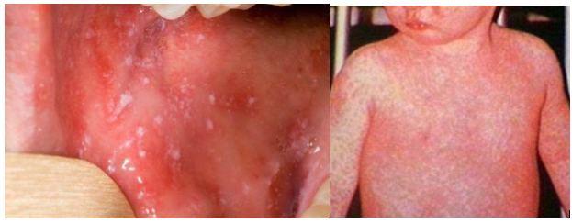
4- Measles Virus Transmission - Epidemiology – pathogenesis - Clinical features – Complication - Lab diagnosis - Treatment and prevention
Measles Virus
Family: Paramyxovidae.
Structural features: Enveloped virus with ss-RNA genome.
infects human only.
Transmission
Inhalation of infectious aerosol droplets.
Epidemiology
Measles virus infects human only. Most cases in preschool children, very infectious cases mainly in winter and spring.
pathogenesis
Virus infects first epithetical cells of respiratory tract then virus spread to the blood causing vireamia .The virus reaches the lymphoid tissue where it replicates further and widely disseminated to the skin with maculopopular rash.

Slide 15
4- Measles Virus Transmission - Epidemiology – pathogenesis - Clinical features – Complication - Lab diagnosis - Treatment and prevention
Clinical features:
-I.P.: 7- 14 days.
-Prodromal symptom: Fever, cough, conjunctivitis and running nose
-Koplik’s spot: Small red papules with white central dots appear mostly in buccal mucosa
-Rash: Maculopapular rash first on face trunk then extremities. The rash is red, become confluent, last 4 or 5 days, then disappears leaving brownish discoloration of the skin and final desquamation
-Recovery complete in normal children with life long immunity.

Slide 16
4- Measles Virus Transmission - Epidemiology – pathogenesis - Clinical features – Complication - Lab diagnosis - Treatment and prevention
Complication:
1- Encephalitis :Acute or Subacute sclerosing panencephalitis (SSPE)
2- Giant cell pneumonia: rare in immunocompromised children due to direct invasion of measles virus to the lung tissue.
Lab diagnosis:
Serology by detection of IgM Ab (it’s a mark for acute infection) using ELISA , and in case of SSPE detection of measles antibodies in CSF or detection of viral NA using PCR.
Treatment and prevention:
No specific treatment, Prevention by giving the live attenuated vaccine (MMR) for Measles, Mumps and Rubella (given to all children 15 month and booster dose at school entry. Give excellent long last protection.

Slide 17
5- Mumps Virus Transmission –Epidemiology – pathogenesis - Clinical Features – Complications - Lab diagnosis - Treatment and prevention
Mumps Virus
is an acute benign viral Parotitis*.
Family: Paramyxoviridae.
Structural features: Enveloped virus with ss-RNA genome. The viral envelope is covered with two glycoprotein spikes, hemagglutinine and neuraminidase
disease of children (5-15 years), but also can be seen in young adult with more complicated feature.
Transmission
Inhalation of infectious aerosol droplets during sneezing and coughing, direct contact with saliva.
Epidemiology
Mumps virus infects human only.
pathogenesis
Infection started in the epithelial cells of upper respiratory tract, then virus spread by viremia to parotid gland mainly and to other organs as: testes, ovaries, pancreas and CNS.
Highly infectious, peak in winter.
Long incubation period 18-21 days
*Parotitis (painful inflammation and swelling of salivary gland mainly parotid glands)

Slide 18
5- Mumps Virus Transmission –Epidemiology – pathogenesis - Clinical Features – Complications - Lab diagnosis - Treatment and prevention
Clinical Features:
-Classic mumps starts with moderate fever, malaise, pain on chewing or swallowing, particularly acidic liquids.
Complications
Aseptic meningitis. Encephalitis. Pancreatitis. Thyroiditis.
Lab diagnosis:
Serology by detection of IgMAb using ELISA, cell culture and isolation of the virus from saliva or detection of viral NA using PCR.
-Sudden onset of fever and painful swelling of parotid gland.
-Self-limiting disease resolve within one week.
-Solid and long life immunity developed
after puberty:
Orchitis : inflammation of one or both testicles. usually unilateral, rarely leads to sterility bilateral can lead to sterility
Oophoritis, inflammation of ovaries
No specific antiviral treatment
Treatment and prevention:
MMR:Live attenuated vaccine for Measles, Mumps and Rubella given to all children 15 month and booster dose at school entry. Give excellent long last protection.
During Infection
After Recovery

Slide 19
GOOD LUCK!
MICROBIOLOGY TEAM:
Waleed Aljamal (leader)
Ibraheem Aldeeri
Ibrahim Fetyani
Abdulaziz almohammed
Abdulmalik alghannam
Omar albabtain
Turki maddi
Mohammad alkahil
Meshal Eiaidi
Khalid Alhusainan
Khalid Alshehri
Nasir Aldosarie
Shrooq Alsomali and Ghadah Almazrou (leaders)
Reem alshathri
Wateen alhomoud
Jawaher abanumy
The Editing File
We are waiting for your feedback
@microbio436
436microbiologyteam@gmail.com

