Slide 1
Lecture :
MERS-CoV & other viruses
important
Extra notes
Doctors notes
"لا حول ولا قوة إلا بالله العلي العظيم" وتقال هذه الجملة إذا دهم الإنسان أمر عظيم لا يستطيعه ، أو يصعب عليه القيام به .

Slide 2
Objectives:
Characteristics of MERS-CoV, Rhinovirus, Coxsackieviruses Picronaviruses, Adenovirus, Epstein – Barr virus & other.
Mode of transmission
Clinical features
Lab diagnosis
Treatment & prevention

Slide 3
1- Introduction
Severe forms of Coronavirus
Structural features: Enveloped virus with (+ve) polarity ss-RNA genome.
Transmission: Inhalation of infectious aerosol droplets.
Family: Coronaviridae.
The 2nd cause of common cold.
It causes zoonotic disease*
Ex:
SARS-CoV
MERS-CoV
*(the virus is capable of infecting humans and animals including birds, camels and others).
NOTE:
(-ve) polarity : we said in the previous lecture it is mean that the RNA of the virus will transcription to mRNA then translation to protein
But (+ve) polarity : the RNA of the virus will act as a mRNA so it’s going to translation directly (NO transcription)
\ الكورونا تسبب الكومن كولد لكن لأنها تصيب الحيوانات والإنسان ممكن يحصل لها طفرات وتسبب أمراض خطيرة
راينو فايروس المسبب الأول للكومن كولد يليه الكورونافيروس

Slide 4
SARS-CoV
Severe Acute Respiratory Syndrome (SARS)
In winter of 2002, a new respiratory disease known as (SARS) emerged in China after a new mutation of coronavirus.
The disease spread worldwide due to travelling.
The animal reservoir may be cats or rats أنتقل منهم للإنسان وصار خطير
SARS starts with high fever followed by cough with difficulty in breathing (atypical pneumonia).
Associated with high mortality due to respiratory failure.

Slide 5
MERS-CoV general info. – Epidemiology – Transmission – risk group - Clinical Features – Complications - Lab diagnosis – Treatment - Prevention
Middle East Respiratory Syndrome coronavirus (MERS-CoV)
is viral respiratory illness first reported in Saudi Arabia in 2012. It is caused by a coronavirus.
Epidemiology:
-So far, all the cases have been linked to countries in and near the Arabian Peninsula.
-Highly infectious, peak in winter.
-Incubation period 2-14 days.
Transmission:
-This virus spread from ill people to others through close contact.
-There is no evidence of sustained spreading in community settings.
-Evidence also suggested that the virus can be acquired from direct close contact with animals.
Risk group:
-Individuals with weakened immune systems
-People with pre-existing medical conditions (or comorbidities) such as diabetes, cancer, and chronic lung, heart, and kidney disease.
Less severity than SARS

Slide 6
MERS-CoV general info. – Epidemiology – Transmission – risk group -Clinical Features – Complications - Lab diagnosis – Treatment - Prevention
Clinical Features:
They had fever, cough, and shortness of breath.
Some people also had gastrointestinal symptoms including diarrhea and nausea/vomiting.
Some infected people had mild symptoms (such as cold-like symptoms) or no symptoms at all and they recovered completely.
Most people with comorbidities developed severe acute respiratory illness.
Complications:
- Severe complications include pneumonia and kidney failure. About 30% of people with MERS-Co died.

Slide 7
MERS-CoV general info. – Epidemiology – Transmission - Clinical Features – Complications - Lab diagnosis – Treatment - Prevention
Lab diagnosis:
Detection of the viral nucleic acid (NA) by PCR.
Other methods: Isolation of the virus from NPA by cell culture.
Treatment:
No specific antiviral treatment. For severe cases, current treatment includes care to support vital organ functions.
Prevention:
People are advised to protect themselves from respiratory illnesses by taking everyday preventive actions:
-Wash your hands often with soap and water for 20 seconds, and use an alcohol-based hand sanitizer.
-Cover your nose and mouth with a tissue when you cough or sneeze, then throw the tissue in the trash.
-Avoid touching your eyes, nose and mouth with unwashed hands.
-Avoid personal contact, such as kissing, or sharing cups or eating utensils, with sick people.
-Clean and disinfect frequently touched surfaces such as toys and doorknobs.

Slide 9
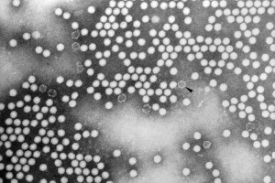
2- Rhinovirus
Family: Picornaviridae.
Structural features:
Non-enveloped virus with (+ve) polarity ssRNA genome, more than 100 serotypes available.
Transmission:
Inhalation of infectious aerosol droplets.
Clinical symptoms:
The 1st cause of common cold. The main symptoms of common cold are sneezing, clear watery nasal discharge with mild sore throat, and cough.
Lab diagnosis:
routine testing by detection of the viral NA from NPA using PCR.
Treatment and prevention:
Usually self-limiting disease, no specific treatment, and no vaccine available.
من أصغر الفيروسات

Slide 10
3- Coxsackieviruses & other Picronaviruses
Family: Picornaviridae.
Structural features:
-Non-enveloped virus with (+ve) polarity ssRNA genome
-Coxsackieviruses group A & B, Echovirus, Enteroviruses.
Transmission:
-Inhalation of infectious aerosol droplets.
Clinical symptoms:
-Coxsackieviruses commonly cause herpangina and pharyngitis
-Echovirus & other Enteroviruses cause respiratory symptoms
Lab diagnosis:
-routine testing by detection of the viral NA from NPA using PCR.
Treatment and prevention:
-Usually self-limiting disease, no specific treatment, and no vaccine available.

Slide 11
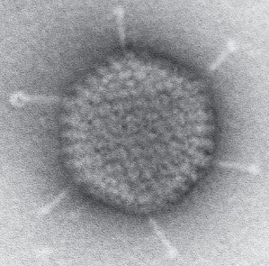
4- Adenovirus
Family: Adenoviridae.
Structural features: Non-enveloped virus with ds-DNA genome.
Pathogenesis: Adenovirus infects epithelial cell lining respiratory tract, conjunctiva, urinary tract, gastrointestinal tract and genital tract.
Clinical syndrome:
Phrayngitis and tonsilitis.
Pharyngioconjunctivitis
Conjunctivitis.
Pneumonia: in preschool children.
Gastroenteritis.
Acute hemorrhagic cystitis.
UTI (Cervicitis and urethritis).
Lab diagnosis: routine testing by Direct detection of the Ag from NPA by direct IFA (immunoflourecent assay ).
Other detection methods: tissue culture, PCR.
Treatment and prevention: No specific treatment or vaccine.

Slide 12
5- Epstein – Barr Virus (EBV)
Family:
Herpesviridae
Structure:
-Enveloped , icosahedral dsDNA virus
-It is lymphotropic (means likes the lymphoid tissues)
-It has oncogenic properties:
-Burkitt’s lymphoma
-Nasopharyngeal carcinoma
- B-cell lymphoma
Epidemiology
Distribution: worldwide (Mainly in teenagers & young adults)
Transmission:
Saliva [kissing disease] - Blood [rarely]
Age: Socio-economic status: SE
Low SE class --- <early childhood
High SE class ---- <adolescence
Clinical Features:
Immunocompetent host: Asymptomatic - Infectious mononucleosis [or glandular fever]
IP = 4-7 weeks
Fever, sore throat, tonsillitis, pharyngitis, malaise, hepatosplenomegaly & abnormal LFT, hepatitis.

Slide 13
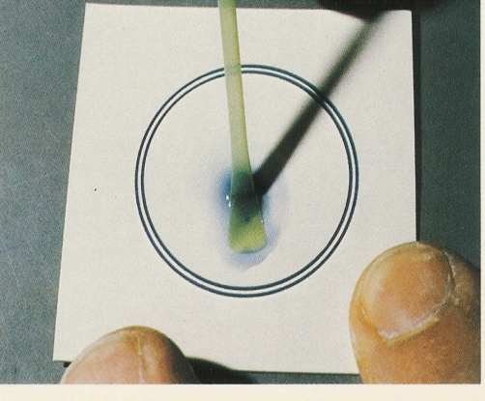
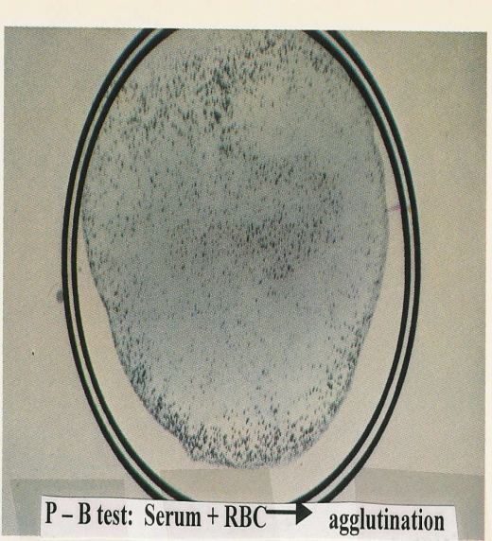
5- Epstein – Barr Virus (EBV)
Complications:
(acute air way obstruction, splenic rupture, CNS infection)
Immunocompromised host: Lymphoproliferative disease ( LD), Oral hairy leukoplakia (OHL)
Diagnosis:
1-Hematology:
WBC ↑ , lymphocytosis (Atypical lymphocytes)
2-Serology tests:
Non-specific AB test: Heterophile Anti-bodies +ve , Paul-Bunnell or monospot test
EBV-specific AB test: Detection of IgM Anti-bodies to EBV capsid antigen by ELISA
Treatment and Prevention:
There is no treatment for Infectious mononucleosis, No vaccine

Slide 14
GOOD LUCK!
MICROBIOLOGY TEAM:
Waleed Aljamal (leader)
Ibraheem Aldeeri
Ibrahim Fetyani
Abdulaziz almohammed
Abdulmalik alghannam
Omar albabtain
Turki maddi
Mohammad alkahil
Meshal Eiaidi
Khalid Alhusainan
Khalid Alshehri
Nasir Aldosarie
Shrooq Alsomali and Ghadah Almazrou (leaders)
Reema albarrak
Aseel nasser
The Editing File
We are waiting for your feedback
@microbio436
436microbiologyteam@gmail.com

