Slide 1
Lecture : TB
SUMMARY + QUIZ + helpful videos
"لا حول ولا قوة إلا بالله العلي العظيم" وتقال هذه الجملة إذا دهم الإنسان أمر عظيم لا يستطيعه ، أو يصعب عليه القيام به .

Slide 6
MCQs:
All of the following are characteristics of Primary TB except:
a-Non-pulmonary b. Lesions of Granuloma c.Symptomatic
Mycobacterium tuberculosis complex is:
a-Contact transmission b. Airborne transmission
In the molecular method the Xpert is used to detect:
a- the nucleic acid b- RIF resistance c-INH resistance d- both a&b
Secondary TB can’t spread to other organs unlike primary TB
a-T b-F
A mother is in direct contact with her TB infected son, which of the following antibiotics should be given to her as a prophylaxis?
a-INH b-RIF c-ethambutol d-streptomycin
Interferon –gamma release assay is negative in latent TB:
a-T b-F
the protocol done to all new born:
a- BCG vaccine b-INH prophylaxis c- slaughtering d-all of the above
1- C
2- B
3- D
4- B
5- A
6- B
7- A

Slide 7
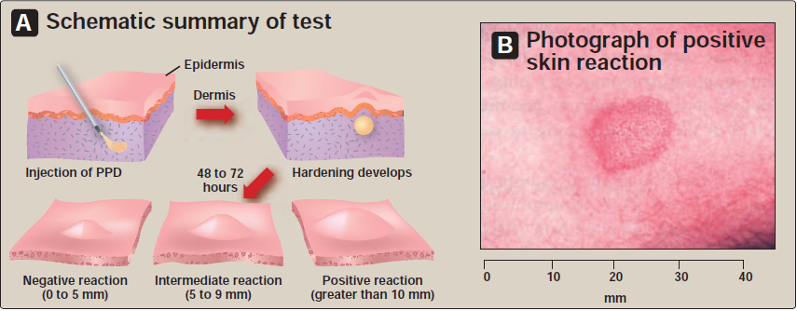
SAQ:
What is the cell morphology of the bacterium shown (panel B)?
What are the fi brotic lesions seen on the chest x-ray (panel A) called?
A 60-year-old male with depressed cell-mediated immunity presents with fever, chills, and weight loss. Acid-fast staining of sputum samples resembled that shown (panel B). What is the most likely etiology and infection?
A
B
4-The test and reaction shown is intended to monitor and document exposure to what pathogen?
5-What is the recommended treatment for a person who suffers from the disease caused by this pathogen?

Slide 8
SAQ – The answers :
The bacteria are acid-fast, long, slender rods.
The fibrotic lesions are Ghon complexes .
The patient most likely has tuberculosis caused by Mycobacterium tuberculosis .
4-This test is for Mycobacterium tuberculosis .
5-The patient would get concomitant treatment with four antimicrobials: isoniazid, rifampin, pyrazinamide or ethambutol and streptomycin.
THE SAQs are from Lippincott reviews flash cards microbiology and if you want a pdf copy inform us ☺
+ شكرا منيرة الضفيان على المعلومة
Finally , helpful videos:
1-The pathogenesis of TB: 2-the diagnosis:
https://youtu.be/S0Kak0qQFgM https://youtu.be/faqhDcrWfHQ

Slide 9
GOOD LUCK!
The Team members :
Aseel Badukhon
Ohoud Abdullah
Lama Altamimi
The Editing File
We are waiting for your feedback
@microbio436
436microbiologyteam@gmail.com

