Slide 1
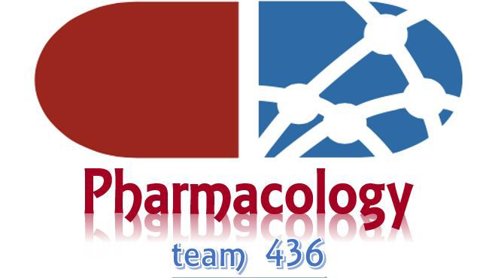

ANTICHOLINERGIC DRUGS
Objectives:
Identify the classification of anticholinergic drugs
Describe pharmacokinetics and dynamics of muscarinic antagonists
Identify the effects of atropine on the major organ systems.
list the clinical uses of muscarinic antagonists.
know adverse effects & contraindications of anticholinergic drugs.
Identify at least one anti-muscarinic agent for each of the following special uses: mydriasis, cyclopedia, peptic ulcer & parkinsonism.
Sleeping more may take away 10% of your day, but if you are 50% more efficient while awake, Who cares?!

Slide 2

Recall cholinergic (Parasympathetic) system
Cholinergic receptors
Types | Nicotinic | Muscarinic
features | Found centrally. Almost always excitatory. acetylcholine is the main neurotransmitter with high affinity to nicotine. Ion-channel linked receptor. | Found peripherally. Can be excitatory and inhibitory. Acetylcholine is the main neurotransmitter. G-protein coupled receptor.
Location and subclasses | Skeletal muscles Autonomic ganglia Adrenal medulla CNS | M1: CNS. M2: Heart. M3: internal organs. M4 and M5: CNS for memory and attention.
Don’t forget:
Activation of M1 causes:
  CNS excitation.
  Increase Gastric acid secretion.
Activation of M2 causes bradycardia.
Activation of M3 causes:
  Increase secretions of glands.
  Smooth muscle contraction.
  Vasodilation.
Remember:
Odd numbers (1,3,5) are excitatory.
Even numbers (2,4) are inhibitory.

Slide 3
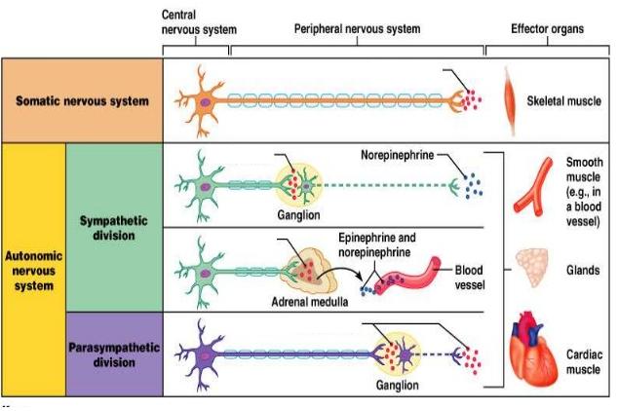
Anticholinergic Drugs
Anti-muscarinics
anti-nicotinics
Ganglionic Blockers
Neuromuscular blockers
*
**
**
**
***
* neuromuscular blockers.
** ganglionic blockers.
*** site of action of antimuscarinic drug.

Slide 4
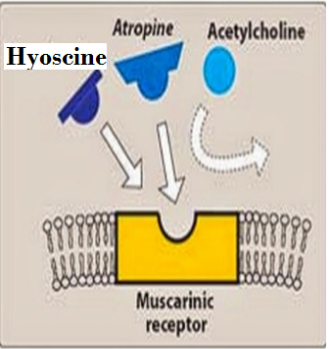
Antimuscarinic Drugs
Source
  Natural: atropine, hyoscine.
  Semisynthetic :Homatropine
  synthetic: Tropicamaide, Benztropine, Pirenzepine, Ipratropium, Glycopyrrolate, Oxybutynin, Darifenacin
Structure
  Tertiary amines ( lipid soluble ): atropine, hyoscine.
  Quaternary ammonium ( water soluble): Glycopyrrolate.
Antimuscarinic drugs classified according to:
Glycopyrrolate = glucose = soluble in water
Selectivity
  Non-selective: Atropine, Hyoscine, Ipratropium.
  Selective: Pirenzepine (M1), Darifenacin (M3)
نقدر نقرأ اسم الدرق “داري فين الأكل “يعني تعرف وين الاكل اكيد بال GIT or UT ونوع الريسبتور هناك M3 وممكن أتذكره من عدد كلمات الجملة “داري فين الأكل”
Darifenacin
نقدر نقرأ أول مقطع باسم الدرق (Piren) باريني يعني نافسني ، واخر مقطع (pine) باين يعني واضح، فتصير الجملة باريني ,باين بأصير الأول (M1)
Pirenzepine =Gastrozepin
Mechanism of action:
Competitively block muscarinic receptors.
Salivary, bronchial, and sweat glands are the most sensitive . Smooth muscles and heart muscles are intermediate. Gastric glands and muscles are the least sensitive.

Slide 5
Pharmacokinetics:
-Natural Alkaloids:
Atropine (Hyoscyamine)
Hyoscine (scopolamine): better BBB Penetration, while passage of atropine is restricted
عشان نتذكر هالمعلومة كأننا نأشر ونقول هيو Hyo السكين scine ، والسكين حاد ويخترق Penetration أي شيء.
Lipid soluble.
Good oral absorption.
Good distribution.
Cross blood brain barrier (have CNS actions).
Rapidly absorbed from the GIT.
When applied to the eyes they penetrate the cornea.
50% of atropine is metabolized in the liver and excreted unchanged in urine.
Atropine has t_{1/2} of 3–4 h
Hyoscine is more completely metabolized and has better BBB penetration.

Slide 6
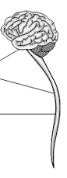
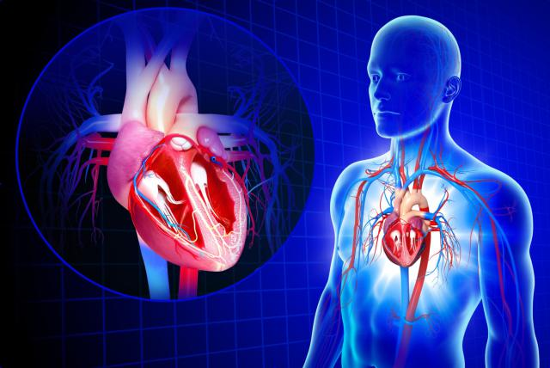
Pharmacodynamics effects
of muscarinic drugs
1) CNS | Atropine: Clinical dose: initial stimulation followed by depression (sedative effect). High dose: cortical excitation, restlessness, disorientation, hallucinations, delirium followed by respiratory depression, coma. Hyoscine: sedative effect (more) Antiemetic effect of motion sickness (block vomiting center if they cross BBB). Benzotropine: Antiparkinsonian effect (block basal ganglia).
2) CVS | Atropine - Causes initial bradycardia followed by tachycardia due to blockade of M2-receptors on SA node. - Higher AV conduction (+ve dromotropic effect) (tachycardia) * AV = Atrioventricular - Does not influence Blood Pressure. - Decrease (blunt) Vasodilatation induced by cholinergic agonists . Doesn’t reach vasoconstriction. # Atropine does not influence the blood pressure because it doesn't have any effect on the blood vessels. It only block (blunt) the effect of vasodilation induced by cholinergic agonist. -Toxic dose: Cutaneous vasodilatation→ atropine flush. Face appears red
3) Eye | - Passive mydriasis (no miosis) due to paralysis (relaxation) of circular muscle - Cycloplegia (loss of near vision accommodation) due to paralysis of ciliary muscle. - Loss of light reflex. - Increase I.O.P > # glaucoma. (contraindication) - Lower Lacrimal secretion → sandy eye (dryness)

Slide 7
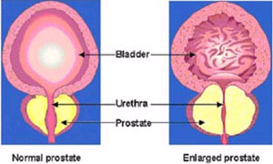
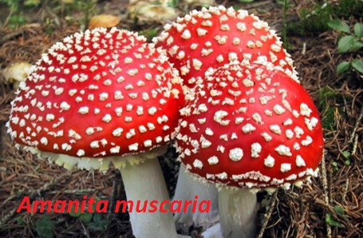
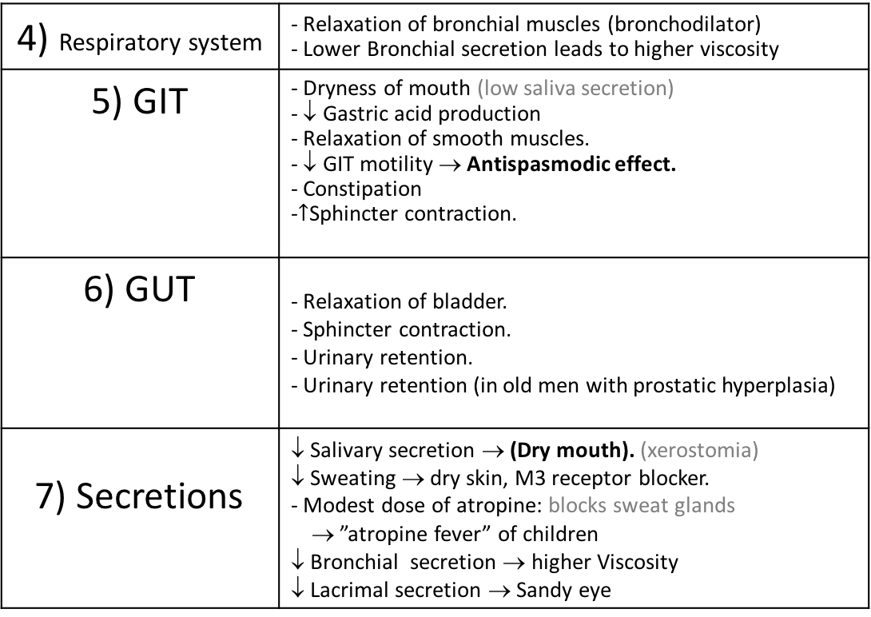
Pharmacodynamics effects
of muscarinic drugs
4) Respiratory system | - Relaxation of bronchial muscles (bronchodilator) - Lower Bronchial secretion leads to higher viscosity
5) GIT | - Dryness of mouth (low saliva secretion) - ↓ Gastric acid production - Relaxation of smooth muscles. - ↓ GIT motility → Antispasmodic effect. - Constipation -$↑$Sphincter contraction.
6) GUT | - Relaxation of bladder. - Sphincter contraction. - Urinary retention. - Urinary retention (in old men with prostatic hyperplasia)
7) Secretions | ↓ Salivary secretion → (Dry mouth). (xerostomia) ↓ Sweating → dry skin, M3 receptor blocker. - Modest dose of atropine: blocks sweat glands → ”atropine fever” of children ↓ Bronchial secretion → higher Viscosity ↓ Lacrimal secretion → Sandy eye
Clinical Uses of anti-muscarinic drugs
Cardiovascular effects:
Sinus bradycardia.
Cholinergic poisoning
Cholinesterase inhibitors “insecticides”.
Mushroom poisoning it has high constriction of muscarinie.
Pain of myocardial infarction → depression of SA, AV node.
Hyperhydrosis

Slide 8
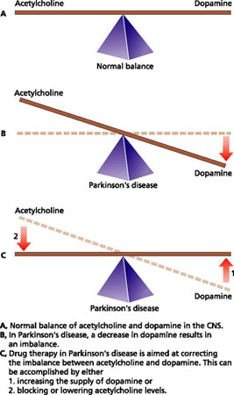
Clinical Uses of anti-muscarinic drugs
Uses | organ | Drugs
Pre-anesthetic medication, Antispasmodic. Atropine with diphenoxylate used for treatment of Traveler's diarrhea with opioid. | CNS | Atropine
Pre-anesthetic medication, Motion sickness, antispasmodic. | CNS | Hyoscine
* Parkinson's disease- (benztropine -lipid soluble to cross brain barrier) | CNS | Benztropine Benzhexol
Ophthalmoscopic examination of retina. We can’t use atropine because it has long duration effect | Eye | Homatropine Tropicamide
asthma, COPD, by inhalation because ipratropium is not selective so, to limit the effect we give it by inhalation pre-operative medications when anesthetic→ increase secretion & laryngospasm. ((Hyoscine for amnesia)) | Respiratory system | Ipratropium
Peptic ulcer | Stomach | Pirenzepine
Urinary incontinence, Urinary urgency caused by minor inflammatory bladder disorders | UT | Oxybutynin Darifenacin (selective)
Antispasmodics in hypermotility, Biliary and renal colics. Irritable bowel syndrome (cause diarrhea and increase mortality) Colonic diverticular disease | GIT | Glycopyyrolate (water soluble) Hyoscine butyl bromide (solid) dicyclomine
Glyco=Glucose which is found in the food in the (GIT)
Glycopyyrolate
It is known also as Gastrozepin, and as its name suggest its related to decrease the gastric acid in stomach.
Pirenzepine
*CNS:

Slide 9
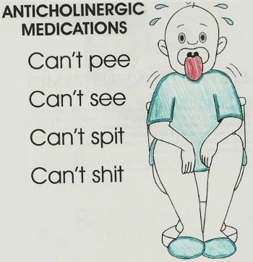
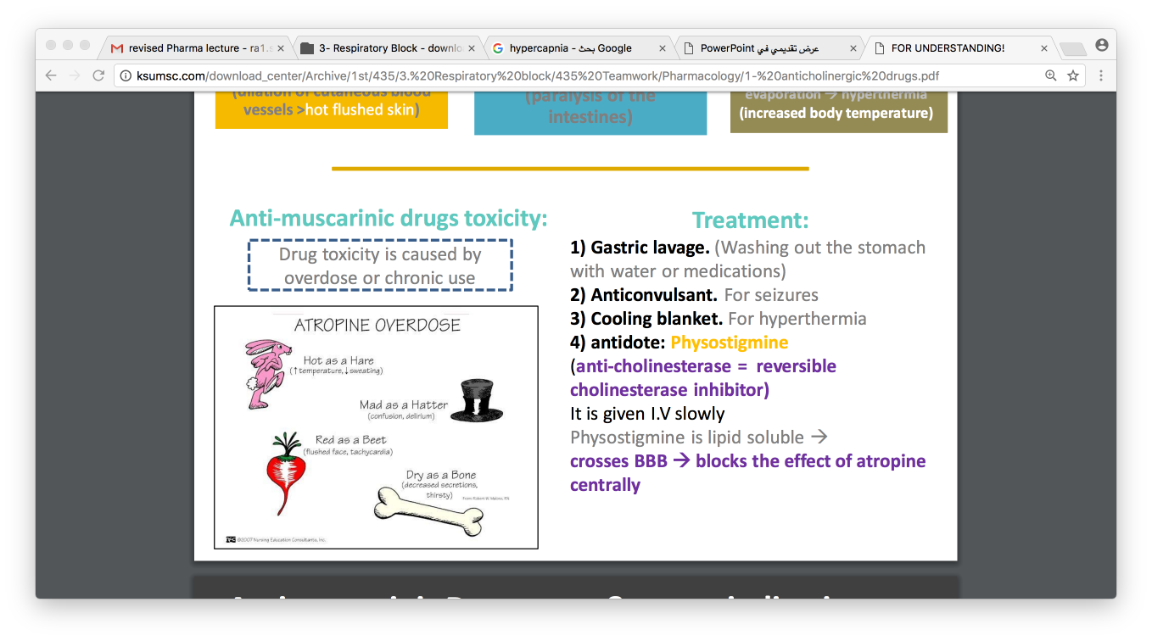
اللي فيهم شلل رعاشي Parkinson's disease صعبة يسوقون سيارة، والسيارة تحتاج بينزينBenz
Benztropine
الرئة Respiratory system كأنها بالونة ما ينفع ندخل جواتها إبرة Ipra وإلا بتنفقع .
Ipratropium
أول مقطع باسم الدرق (Dari) يذكرني ب”إدرار البول” يعني يستخدم ل (Genitourinary tract)
Darifenacin
نقدر نقرأ أسم الدرق كذا ،اوخص(oxy)عنده بيوتيفل beautiful=(buty)حمام , يعني يستخدم ل (Genitourinary tract)
Oxybutynin
  Oxybutynin and Darifenacin are used for Urinary urgency, urinary incontinence
لما نحتاج الحمام ويكون فيه أحد جوا يستخدمه نقول له اطلع exit=(oxy) يله دوري (dari)
نستخدم هالدرق كقطرة عند فحص العيون فنقدر نقرا اسم الدرق كذا يله القطرة (trop)=drop جت (camide)=came
Tropicamide
أول مقطع بالكلمة يذكرني بكلمة “ھم” اللي يحسون فیه من يفقد بصره وفعلا أي مرض بالعین فیه كربة وهم ونتذكر يعقوب علیه السلام لما ابیضت عیناه من الحزن والھم، فأتذكر ان هالدرق يستخدم عند دكتور العيون بفحص الشبكية.
Homatropine
Tropicamide and homatropine are used for Ophthalmoscopic examination of retina
بعد الاختبار عند طبيب العيون رجعت البيت (hom) وما قدرت اشوف حتى التراب (trop)
Adverse Effects:
Mydriasis, blurred vision
Tachycardia
Constipation, urinary retention
↑ Body temperature (hyperthermia)
Confusion, agitation, delirium
Dry mouth (even in therapeutic dose) , hot flushed skin
Contra-indications:
Glaucoma (angle closure glaucoma)
Tachycardia secondary to thyrotoxicosis ( toxicity of thyroid gland increase production of thyroid gland patients are very thin and very active) or cardiac insufficiency
Old patients with prostate hypertrophy.
Paralytic ileus
Constipation
Children in case of atropine.
Non selective M blocker → ulcer

Slide 10
SAQ
A 39 male works as farmer in rural area is brought to the emergency room with Organophosphate toxicity while using pesticide. The patient has received atropine as an antidote.
Q1: what is the mechanism of action of atropine to neutralize the toxicity?
It acts as anti-muscarinic drug so it blocks the muscarinic receptor.
Q2: Which subtype of muscarinic receptor does this drug act on?
Atropine is non selective anti-muscarinic drug so it may act on all subtype (M1/M2/M3/M4/M5).
Q3: Atropine is lipid soluble drug so it has CNS action. Is there any other drugs has better blood brain barrier penetration than atropine?
Yes , Hyoscine has better BBB penetration.
Q4: Atropine has CNS action so in toxic dose it may lead to?
cortical excitation, restlessness, disorientation, hallucinations, and delirium followed by respiratory depression and coma.
Q5: What are the pharmacological actions of atropine at eyes level?
1\ loss of near vision (cycloplegia) due to to paralysis of ciliary muscle
2\ Passive myadriasis due to paralysis of circular muscle
3\ Loss of light reflex 4\increase intra-ocular pressure 5\ decrease lacrimal secretion
Q6:What are the pharmacological actions of atropine at GIT level?
1\Dryness of mouth 2\ decrease Gastric acid production
3\ Relaxation of smooth muscles. 4\ decrease GIT motility
5\ increase Sphincter contractions
Q7: List 4 contraindication for this drug?
1\ Glaucoma 2\ Paralytic ileus
3\ Constipation 4\Children in case of atropine
Zoom in to chick your answers

Slide 11
QUIZ

