Slide 1
Anaphylactic shock
Objectives:
• Perceive the differences between anaphylactic shock and other types of shock.
• Recognize its nature, causes & characteristics.
• Specify its diagnostic features.
• Identify its standard emergency management protocol.
• Justify the mechanism of action and method of administration of each of the different used drugs to limit its morbid outcomes.
Rise up, start fresh, see the opportunity in each day.

Slide 2
Anaphylaxis
Is a sudden, severe hypersensitivity reaction affecting the whole body (generalized or systemic) in response to allergen.
Symptoms
Mucosal swelling
Difficulty breathing
Blood pressure (hypotension)
Rash
ANAPHYLACTIC SHOCK
A life-threatening allergic reaction that causes shock (hypoperfusion) and airway swelling. “Anaphylactic shock” is a term that specifically refers to an episode of anaphylaxis.
Generalized circulatory derangement causing multiple organ HYPOPERFUSION [Inadequate oxygen delivery to meet metabolic demands ] &
strong sympathetic activation.
If the shock is intense or sustained enough, it will lead to irreversible derangements sets then to permanent functional deficit or death.
SHOCK
Adrenoceptors:
Alpha1:vasoconstriction.
Beta1:restore heart function(heart muscles contraction).
Beta2:bronchodilation.

Slide 3
Types of shock
Caused by | Type
• Hemorrhage • fluid loss (plasma, ECF) e.g. Excessive vomiting | Hypovolemic
Inability to contract & pump. E.g.: • myocardial infarction | Cardiogenic
Extra-cardiac obstruction: • Pulmonary embolism. • Cardiac Tamponade. | Obstructive
Decreased Peripheral* Resistance vasodilation hypotension. As in: septic shock, Neurogenic shock, anaphylactic shock. | Distributive
*Peripheral resistance is the resistance of the arteries to blood flow. As the arteries constrict, the resistance increases and as they dilate, resistance decreases.
Peripheral resistance is determined by three factors:
Autonomic activity: sympathetic activity constricts peripheral arteries.
Pharmacologic agents: vasoconstrictor drugs increase resistance while vasodilator drugs decrease it.
Blood viscosity: increased viscosity increases resistance.
What we need for normal blood pressure :
Good cardiac output
Good vessels walls constriction
If the patient is taking B2 blockers salbutamol won’t work so antimuscarinics like ipratropium is the drug of choice.

Slide 4
ANAPHYLACTIC SHOCK
Immunologic Anaphylaxis
(known as ANAPHYLAXIS)
It belongs to type I
hypersensitivity reaction (IgE)
Occurs after exposure to foreign substances [antigen] such as food, insect or animal venom, drugs, blood products.
The immune system will then develop
antibodies for this antigen and it will remain in the body for a while.
After a 2nd exposure to the same antigen in previously sensitized persons (antigenspecific ige are present), IgE binds with mast
cell causing its degranulation.
Non-Immunologic Anaphylaxis (ANAPHYLACTOID) Directly act on mast cells Not IgE-mediated Exogenous substances directly degranulate mast cells. E.g. Radiocontrast dye, Opiates “analgesics”, Depolarizing drugs, Dextrans “antithrombotics”.
An anaphylactoid reaction can occur following a single, first-time exposure to certain agents in non-sensitized patients.
NO need for second exposure
Because anaphylactic and anaphylactoid reactions produce the same clinical manifestations and are treated exactly the same way, we use the term anaphylaxis to refer to both conditions.

Slide 5
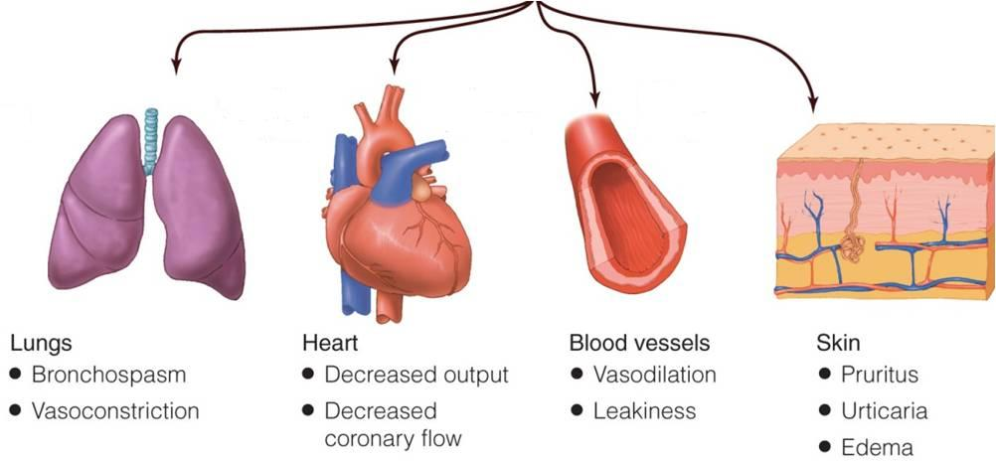
The degranulation of the mast cells will release histamine, Leukotrienes and other inflammatory substances and will lead to:
Adrenaline
salbutamol
Adrenaline
Adrenaline
Adrenaline
Corticosteroids
H1antagonist(antihistamine)
3.
4.
47%
Circulatory Collapse
Hypo-perfusion
1.
33%
88%
Shortness of breath
Remember when there is to much vasodilatation the body has to compensate by causing tachycardia as a reflex
2.
characters of anaphylactic shock:
Rapidly developing [ 5/30 min.can be hours ].
Severe, life-threatening.
Multisystem involvement.
Mortality: due to respiratory (70%) or cardiovascular (25%).
Mucous Swelling
Rhinitis 16%
Angioedema 88%
Airway 56%
GIT 30%
ANAPHYLACTIC
SHOCK
When the diagnosis is made
Call ambulance
START EMERGENCY TREATMENT
Respiratory support
Open airway-
O2 inhalation-
Circulatory support : Lay down and raise legs up\fluid replacement
Adrenaline IM by auto injector or Syringe

Slide 6
ANAPHYLACTIC SHOCK THERAPY PROTOCOL
RESCUE
1st Line
To compensate for vasodilation BC vasodilation means you need more blood
2nd Line
In skin
The doctor said we won’t be asked about doses.

Slide 7
ANAPHYLACTIC SHOCK THERAPY PROTOCOL
Adjuvant to 2nd line:
bronchodilator
H blocker
glucagon
inhalator
parental
Aminophyline
Salbutamol, Ipratropium
H₁ blocker
H₂ blocker
Phenaramine
Ranitidine
Cimetidine
For patients taking beta-blocker.
Objective of therapy:
To support the respiratory & circulatory deficits
To halt (to stop) the existing (the excessive) hyper-reaction
To prevent further hyper-reaction of immune system (Biphasic phenomenon ): 2nd release of mediators without re-exposure to antigen (in up to 20% ) Clinically evident 3-4h after the initial manifestations clear

Slide 8
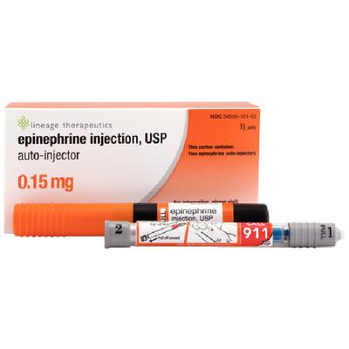
1st line
Adrenaline
Mechanism of action | A nonselective Adrenergic agonist [α₁, α₂, β₁, β₂ ]
Action | As an adrenergic agonist: Reverses peripheral vasodilation  maintains Blood Pressure & directs blood flow to major organs edema  reverse hives* ,swelling around face & lips & angioedema** in nasopharynex & larynx As a β-adrenergic agonist: β₂ effect: Dilates bronchial airways + histamine & leukotriene release from mast cells β₁ effect:  force of myocardial contraction PHYSIOLOGICAL ANTAGONIST: Attenuates the severity of IgE-mediated allergic reactions Indication: drug of choice * allergic skin reaction causing localized redness, swelling, and itching (see more http://medical-dictionary.thefreedictionary.com/hives) ** a localized edematous reaction of the deep dermis or subcutaneous or submucosal tissues appearing as giant wheals (see more http://medical-dictionary.thefreedictionary.com/angioedema)
Contraindications | Not given more than 40 years cardiac patient Rare in a setting of anaphylaxsis
Adverse effect | Dysrrhythmias
Administration | Intamascular (IM), due to:
Repeat every 5-10 min as needed Patients observed for 4-6 hours. Why ? Fear of biphasic anaphylaxsis |  | If hypotension persist  start dopamine
Caution | For patients taking β-blockers because they either: Refractory (not response); as it may antagonize β effects of adrenaline Rebound hypertension: [ unopposed a effect], specially when adrenaline is repeated يعني بيجي الأدرينالين مكان مستقبلات الألفا ويسبب ارتفاع ضغط
Easily accessible (Auto-injectors Kits: Disposable (use for once) , prefilled devices  automatically administer a single dose of epinephrine in emergency)
Greater margin of safety, so no dysrrhythmias as with IV
No need to wait for IV line, if IV present it given by physician under monitoring

Slide 9
 | corticosteroids | H₁ blockers | H₂ blockers | Salbutamol |  | Aminophylline | glucagon
Mechanism of action | through immediate GCs actions on Membrane-bound receptors  modulating levels of 2nd messengers  (within seconds or minutes) which means Non-genomic action | Though mast cells have already de-granulated (e.g. phenaramine) | (anti-ulcer drugs, used for epigastric pain) | β₂-adrenergic agonist | Anticholinergic |  | Has both positive inotropic & chronotropic effects on heart  increase cardiac cyclic AMP  an effect entirely independent of adrenergic that is why effective in spite of β−adrenergic blockade. Efficacy of acting on bronchi less than in heart (no evident bronchodilation)
Action | Reverse hypotension and bronchoconstriction, so it will decrease the releasing of inflammatory mediators (anti-chemotactic & mast cell stabilizing effects). Decrease mucosal swelling and skin reaction May help to limit biphasic reactions by decrease allergic mediators | help to counter act histamine-mediated vasodilation & bronchoconstriction. May help to limit biphasic reactions by decrease histamine release | The significance of H₂ blockers is not established (e.g. Ranitidine & cimetidine) | 1- Short acting, rapid relief onset relax bronchial smooth muscle and may decrease mediator release from mast cells and basophils. 2- Inhibit airway microvascular leakage. | Decrease secretion Less rapid in action | treatment of anaphylaxis when inhaled Broncho-dilators are not effective & bronchospasm is persistent | patients with refractory hypotension Drug of choice for severe anaphylaxis in patients taking β-blockers.
Contraindications | Not given more than 40 years cardiac patient Rare in a setting of anaphylaxis |  | No cimetidine in elderly, renal/hepatic failure, or if on β-blockers |  |  | Given in hospital setting as levels of drug should be Therapeutically Monitored because it has narrow therapeutic index
Adverse effect | Dysrrhythmias |  | associated with serious adverse drug interactions |  | Inhalational longer duration of action
Administration | slowly intravenously or intramuscularly | Ranitidine 50 mg IV |  | Inhalational |  |  | 1 mg IV q 5 min until hypotension resolves
Ipratropium

Slide 10
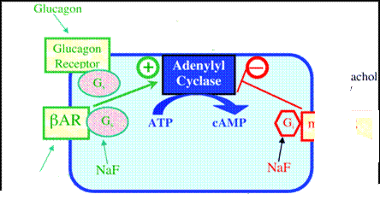
More explanation
Non-genomic action
Genomic action
هنا يدخل الدوا ويرتبط بالمستقبلات اللي على الغشاء البلازمي ويعطي تأثير سريع
genomic action is slow may take hours to days
هنا يدخل الدوا ويرتبط بمستقبل جوا الخلية، هذا المستقبل بيدخل جوا وبيأثر بتكوين البروتين بعدين يطلع التأثير، يأخذ وقت طويل عشان يعطي تأثيره
DNA
لو كان المريض يأخذ ماراح يصير عندي بالتالي مافيه ، عشان أسوي استخدم قلوكاجون اللي بيأثر على مستقبلات خاصه فيه تحفز وبالتالي تزيد وبيصير عندي
contraction
contraction
cAMP
β-blockers
Glucagon
contraction
cAMP
G_{S}
G_{s}
G_{s}
M₂ & M₃
-
Sympathomimetics
Ipratropium

Slide 11
SAQ
A 12-year-old boy is brought to the emergency department after being stung by a bee. He had been well until he was stung on his right forearm, while playing in the yard. He initially complained of localized pain and swelling. Fifteen minutes later, he began to complain of shortness of breath. His parents observed him to be wheezing, very weak and dizzy. His parents brought him immediately to the local emergency department. His medical history shows that he has allergy.
Q1: what is the most likely diagnose in this case ?
Anaphylactic shock.
Q2: What is the drug of choice in this case ?
Adrenaline.
Q3: What is the best route of administration for this drug ?
Intra-muscular (IM).
although we can use IV line but should be given by physician under monitoring.
Q4: What is the mechanism of its action ?
It is Sympathomimetic drug, so it mimics the effect of Sympathetic system by working as Adrenergic agonist .
It is nonselective agonist which act on [α1, α2, β1, β2, β3 ], some of its action:
1\ In blood vessel, act as α agonist which cause vasoconstriction.
2\ In heart, act as β1 agonist which lead to increase the force of myocardial contraction.
3\ In bronchi & bronchioles, act as β2 agonist which cause bronchodilator and decrease histamine & leukotriene release from mast cells .
After 3-4 hours, he may develop what we called Biphasic Phenomenon.
Q5:What do we mean by Biphasic Phenomenon?
It is a second episode of anaphylaxis with 2nd release of mediators without re-exposure to antigen.
Q6: List some drugs we can use it to prevent Biphasic Phenomenon ?
2nd line anaphylaxix’s drugs. Such as 1\ Glucocorticoids : Hydrocortisone
2 \ First generation H1 blocker : Chlorophenamine
Q7: Later, we can give him some bronchodilators as Adjuvant 2nd
line therapy, list some of them?
Salbutamol as β2 Agonist.
Ipratropium as Anti-muscarinic.
Aminophylline as Methyl-xanthine.
Zoom in to see the answers

Slide 12
QUIZ

