Slide 1
Adrenergic agonists
Objectives:
على قدر الهدف يكون الانطلاق.

Slide 2
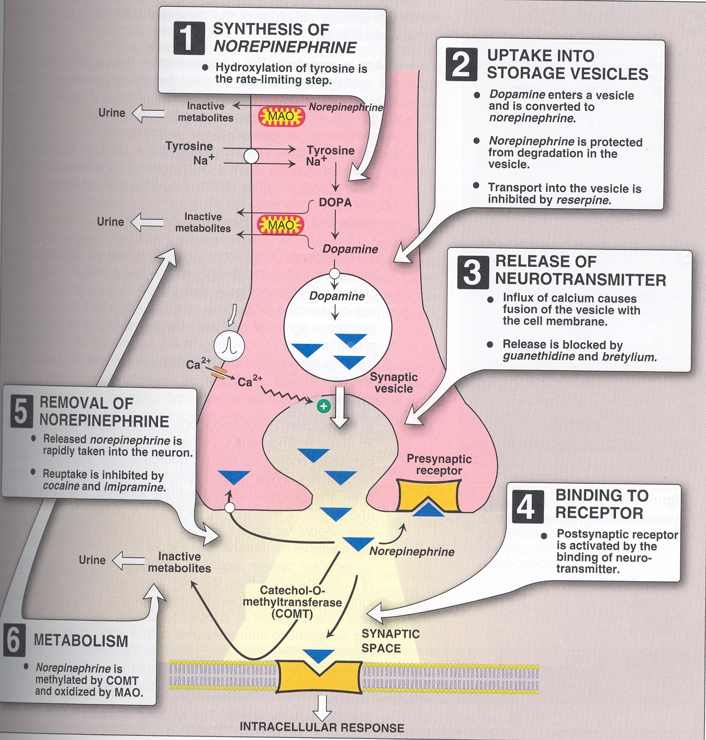
Adrenergic transmission
Adrenergic transmission
Synthesis of norepinephrine
2) Storage of norepinephrine
3) Release of norepinephrine
4) Binding to post synaptic receptors
5) Ending of action by
Neuronal reuptake into neuron
Monoamine oxidase (MAO) in neuronal mitochondria
Catechol -O-methyl transferase (COMT) in synaptic space

Slide 3
Adrenergic receptors
In general we can say
1 → excitatory
2 → inhibitory
α-adrenoceptors |  | β-adrenoceptors
α₁ | α₂ | β₁ | β₂ |  | β₃
postsynaptic | Presynaptic | postsynaptic | postsynaptic | Presynaptic | postsynaptic
Present in smooth muscles. | - | mainly in heart | mainly in smooth muscles | - | adipose tissue
excitatory in function except in GIT | Inhibition of NE (Negative feedback) | excitatory in function | inhibitory in function present | release of NE (Positive feedback)
Vasoconstriction of skin & peripheral blood vessels →↑peripheral resistance → hypertension Relaxation of GIT muscles ↑Glycogenolysis Contraction of: 1- radial muscle of eye → mydriasis 2-pregnant uterus. عشان كذا ما ينفع استخدم أي درق يشتغل على هذا الريسبتور للمرأة المتوقع اجهاضها . 3- sphincter in GIT + urinary bladder |  | ↑ heart rate: + chronotropic effect, Tachycardia ↑ force of contraction : + inotropic effect ↑ conduction velocity : +dromotropic effect ↑ blood pressure ↑ renin release | Relaxation of: 1- skeletal & coronary blood vessels (vasodilatation). 2-bronchial smooth muscles 3- GIT muscles (constipation). 4-Urinary bladder 5-Uterus Delay premature labor ↑blood glucos level(hyperglycemia) ↑ glucagon release from pancreas ↑ liver & muscle glycogenolysis Tremor of skeletal muscles | عكس الفا١ هنا يفضل استخدامه للمرأة المتوقع اجهاضها لانه يسوي ريلاكسيشن. | ↑ lipolysis →↑ free fatty acids
قلبي هو بيتك الأول والأخير
هذا بيتك الثاني ارتاح inhibitory =relaxation
α₂ = (a t)wo
β2 = (P t)wo
The 2nd baby is coming. = β₂
راح )أ(جهض طفلي الأول ؟ = α₁

Slide 4
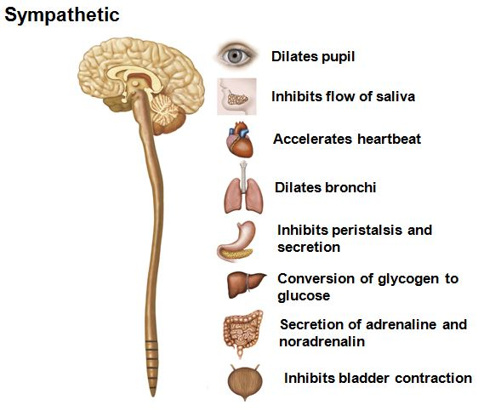
Sympathetic actions
Constipation
Relaxation of the uterus.
↑ conversion of glycogen to glucose ( hyperglycemia)

Slide 5
Classification of sympathomimetics
Action
Direct acting:
Indirect acting:
Chemistry
Catecholamines:
Non-catecholamines:
Spectrum of action
Non-selective adrenergic agonist:
Inhibit noradrenaline uptake: Cocaine - Anti depressants
Mixed “dual acting”:
Increase noradrenaline release from pre-sympathatic adrenergic nerve endings -: Amphetamine – tyramine.
Direct stimulation of adrenergic receptors -: Adrenaline - Noradrenaline - Isoprenaline - Phenylephrine - Dopamine - Salbutamol - Methoxamine - Naphazoline - Clonidine – dobutamine
Direct and indirect stimulation of adrenergic receptors -: Ephedrine - Pseudo-ephedrine
-have catechol rings - Water soluble - Not effective orally - Poor penetration into CNS - Inactinated by COMT and MAO in GIT - Sort half life: Adrenaline - Noradrenaline – Dopamine - Isoprenaline
Adrenaline (a1, a2, B1, B2, B3)
-Noradrenaline (a1, a2 B1)
-Isoprenaline (B1, B2, B3)
-Dopamine (a1, B1, D1)
selective agonist:
Phenylephrine (a1)
- a-methyldopa – clonidine (a2)
-Dobutamine (B1)
-Salbutamol , terbutaline, ritoderine (B2)
Lack catechol rings - Lipid soluble - effective orally - cross well BBB - Not inactivated by COMT in GUT wall - Long half life: - Ephedrine – Amphetamine - Phenylephrine
Amphetamine increase NA مافيه زيادة من نورا
ادري نورا از دوبا Adre Nora is Dopa
نورا وقفت عند قلبي β₁
Isomers of peta receptor
Do it But be Amine والأمانة والضمير محلها القلبβ₁

Slide 6
Adrenaline
non-selective agonist (a1, a2, B1, B2).
Natural, catecholamine.
Fast onset of action.
Short duration of action. “cause inactivated by COMT and MAO in GIT”
Not effective orally. “inactivated by intestinal enzymes”
Given by inhalation, SC or IV , topically.
Pharmacological actions:
Heart | β₁ | Inotropic / Chronotropic / Dromotropic
Blood Pressure | α1 , β1 | Increase systolic
 | β₂ | Decrease diastolic
Blood vessele | α₁ | Vasoconstriction Of BV in skin and peripheral
 | β₂ | Vasodilation of BV of skeletal muscle and coronaries
Eye | α₁ | Mydriasis (not effect on accommodation)
Lung | β₂ | Bronchodilation
GIT | α₁ | Contract sphincter
 | β₂ | Decrease motility
bladder | α₁ | Contract sphincter
 | β₂ | Relaxation of detrusor muscle
Pregnant uterus | β₂ | Relaxation tocolytic
Metabolism:
a2 | B2 | B3 | CNS ( little )
- insulin | Glucagon liver glycogenolysis skeletal muscle glycolysis | - Adipose lipolysis | Headache Tremors restlessness
uses
Locally | Hemostatic “Control bleeding” Such as | Nasal pack in epistaxis
 |  | In dental practice
 | Combined with local anesthetic to .. | Absorption of local anesthetic
 |  | Duration of action
 |  | Side effect of local anesthetic
 |  | Bleeding from incision
Systemically | In acute asthma “given by inhalation, SC “ | β_{2 →} bronchodilation α1 → mucosal edema
 | Anaphylactic shock “hypersensitivity reactions” | Is the drug of choice given SC Is the physiological antagonist of histamine BP and bronchodilation
 | Cardiac arrest | Given IV

Slide 7
Adverse effects:
Adrenaline
Tachycardia / Palpation / Arrhythmias / Angina pains
Headache / Weakness Tremors / Anxiety / Restlessness
Hypertension → Cerebral hemorrhage and pulmonary edema
Coldness of extremities → Tissue necrosis and gangrene if extravasation.
Nasal stuffiness: rebound congestion if used as decongestant
Contraindication
Hypertyhroidism
Close angle glaucoma “ciliary relaxation , filtration angle” → IOP
Cardiovascular disease such as :
Coronary heart disease (CHD)
Ischemic heart disease (angina)
Arrhythmia
Myocardial infarction
Hypertension
Peripheral arterial disease

Slide 8
Norepinephrine ( Noradrenaline)
Feature : | Uses :
Non selective agonist “mainly in a adrenoreceptors a1, a2, week action on B2” Catecholamine Sever vasoconstriction (a1) Increase force of contraction but decrease HR Reflex bradycardia Given only by IV not I.M or S.C → necrosis | In hypotensive state “ in septic shock if fluid replacement and inotropics fail” As a local haemostatic with local anesthetic
Isoprenaline
Features: | Pharmacological actions: |  | Uses | Contraindication
Non selective B agonist “B1 B2 B3” Synthetic, Direct acting Catecholamine Longer effect “no reuptake, no destruction by MAO” | β₁ | - Inotropic - Chronotropic - Increase cardiac output | Mainly in cardiac arrest “parenteral” Rarely in acute attacks of asthma “ inhalation” | Hyperthyroidism Coronary heart disease
 | β₂ | - Vasodilation of blood vessels of skeletal muscles and coronaries - Bronchodilation - Relaxation of uterus - hyperglycemia
 | β₃ | lipolysis
Dopamine
Features: | Natural CNS neurotransmitter Direct acting, catecholamine Given parenterally via infusion
Doses: | Low: “D1” | Vasodilation of: Muscarinic Coronary Renal blood vessel → Improves blood flow to viscera “has diuretic action” | On heart → “ inotropic, chronotropic effects “ On Blood pressure → ”according to dose” First : decrease in BP due D1 effect . Then : increase in BP due to β₁ Followed by α1 effect
 | Intermediate: ” β₁ ” | + inotropic +chronotropic
 | High: “α1 ” | Vasoconstriction
Uses : | - Cardiogenic shock ”IV infusion” : - Can be given in acute heart failure “but better dobutamine” Septic Hypovolemia Cardiogenic Increase BP and CO (B1) “without causing renal impairment D1”

Slide 9
Dobutamine (selective B1)
Features: | Synthetic catecholamine. Metabolized by COMT Short duration, given by intravenous infusion Selective β₁–receptor agonist. Positive inotropic effect, increases cardiac output, with little increase in heart rate.
Uses: | short term management of cardiac decompensation after cardiac surgery, in acute myocardial infarction (AMI) & heart failure.
Phenylephrine (selective α1)
Features: | A synthetic non catecholamine, direct acting Not inactivated by COMT, longer duration of action Vasoconstriction ,↑ increased both systolic & diastolic blood pressure, hypertension, reflex bradycardia.
Uses: | Nasal decongestant topically, nasal drops in allergic rhinitis, cold Vasopressor agent: hypotension & terminate atrial tachycardia (reflex bradycardia). Local Haemostatic with local anesthesia Mydriatic: In ophthalmic solutions to facilitate eye examination.
Adverse effects: | Hypertension
other | Midodrine peaks in 20 min, duration 30 min, used in hypotensive states

Slide 10
Selective β₂ agonists
Salbutamol | Ritodrine | Terbutaline
selective β2 agonists, non catecholamines orally or by inhalation or injection. Produces bronchodilation Used for acute attack of asthma & COPD. | Selective β2 agonist, non catecholamines. orally or by injection Is a tocolytic drug (relaxation of uterus). Used orally and injection to treat premature labor. | Bronchodilator Tocolytic
Ritodrine = Tocolytic = Beta Two
Clonidine (selective α2)
Features: | synthetic, imidazoline Given orally or as patch. Is a presynaptic α₂ agonist.
Pharmacological action | Acts centrally (a2 ) at nucleus tractus solitaries to  sympathetic outflow to heart & vessels. Inhibit sympathetic vasomotor centers
Uses: | Used as antihypertensive in essential hypertension to lower BP.
Brimonidine
is an imidazoline  α₂ agonist used in glaucoma
ADRENERGIC STIMULANTS Indirect & DUAL acting sympathomimetics
Indirect acting | Amphetamine (α & β) | Synthetic non-catecholamine. given orally, longer duration Excreted mostly unchanged ( by acidification of urine) Acts indirectly, it depletes vesicles from stored NE  tachyphylaxsis has CNS stimulant effects; mental alertness, wakefulness, concentration & self-confidence followed by depression & fatigue on continued use  euphoria  causes its abuse  Weight   appetite  increase energy expenditure No more used therapeutically  induces psychic & physical dependence and psychosis.
DUAL Acting | Ephedrine (α & β) | Plant alkaloid, synthetic, non-catecholamine, dual acting direct action on receptors  down regulation of receptors indirect by releasing NE from adrenergic endings  depletes stores Tachyphylaxsis Orally, not destroyed by enzymes  prolonged action has CNS stimulant effects (less than amphetamine) No more therapeutically used  but is abused by athletes and prohibited during games.
 | Pseudoephedrine | Dual acting < CNS & pressor effects compared to ephedrine. Used as nasal & ocular decongestant & in flu remedies

Slide 11
SUMMARY
Agents specifically indicated for hypotension
Midodrine, Phenylephrine, Norepinephrine, Phenylpropanolamine
Agents specifically indicated for cardiogenic shockAHF
Dobutamine, Dopamine, Epinephrine
Agents specifically indicated for shock (Dopamine, Norepinephrine)
Agents specifically indicated for cardiac arrest
(Epinephrine, Norepinephrine, Dobutamine)
Agents specifically indicated for bronchial asthma
Salbutamol, Salmeterol, Formoterol, Terbutaline, Isoprenaline
Agents specifically indicated for premature labour
Ritodrine, Terbutaline
Agents specifically indicated for nasal decongestion
Pseudoephedrine, Naphazoline, Oxymetazoline, Phenylephrine, Xylometazoline
Agents specifically abused in sports  Ephedrine, Amphetamine

Slide 12
SAQ
A 47 years old patient with asthma came to the emergency room with difficulties in breathing, after checking his heart beats it turned out he has tachycardia.
Which drugs could be prescribed to him that will slow his heart and reduce the vasoconstriction in his lung?
Adrenaline and Noradrenaline
Which receptors do that drugs effect ?
Adrenaline (α1, α2 , β1 , β2, β3)
Nor adrenaline (α1, α2 , β1)
What's the traits of that drug that you can conclude if you know its a catecholamine?
have catechol ring water soluble (polar) Not effective orally.
Poor penetration into CNS.
inactivated by COMT & MAO in GIT.
short half-life.
What's the best route of administration for his case ?
I.V
what are 3 adverse effect that is expected to see in this patient after giving him the drug ?
Tachycardia.
Hypertension.
weakness.

Slide 13
QUIZ

