Slide 1
Treatment of respiratory tract infection
Objectives:
At the end of lecture , the students should be able to understand the following:
The types of respiratory tract infections The antibiotics that are commonly used to treat respiratory tract infections and their side effects.
Understand the mechanism of action, pharmacokinetics of individual drugs.
It always seems impossible until its done.
-Nelson Mandela.

Slide 2
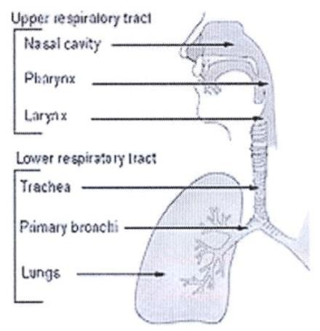
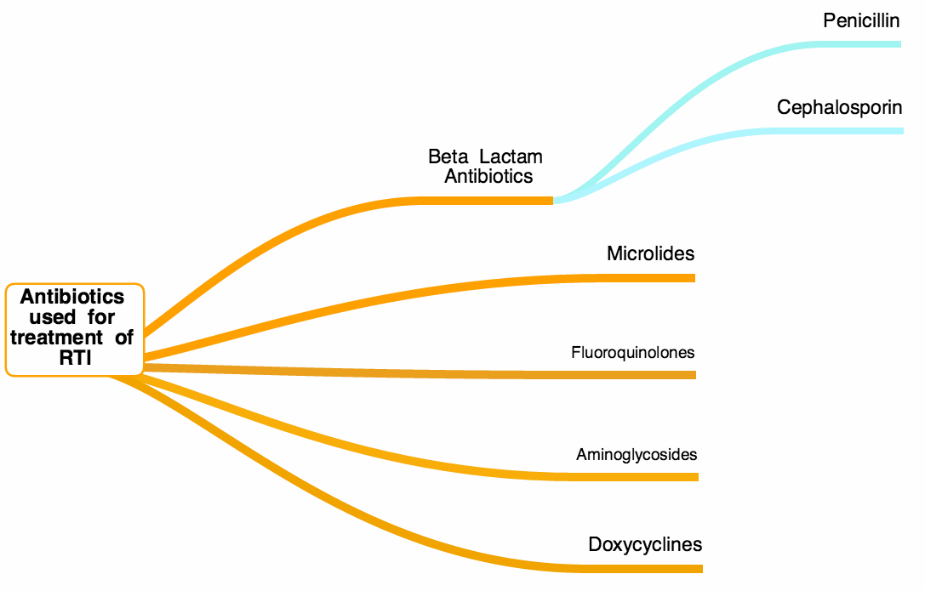
Thnaks435
Classification & antibiotics for respiratory tract infections
Caused by
Viruses
Should NOT be treated with antibiotics
Treatment: rest and plenty of fluids, OTC cold, pain relievers.
OTC: over-the-counter cold medicines
Upper respiratory tract
infections (URTI’s)
70%
Respiratory tract infections
Caused by
Bacteria
- URTI’s bacteria are mainly group A Streptococcus & H. Influenzae
- Treatment: Antibiotics; depending on: 1-Type of bacteria 2-Sensitivity test
30%
- Bronchitis is an inflammation of major
bronchi& trachea
- It could be Acute, Chronic, or acute exacerbation of chronic bronchitis
Bronchitis
Lower respiratory tract infections (LRTI’s)*
- Causes: virus, or bacteria: (H.Influenzae, S.pneumonia, M.catarralis)
- Pneumonia is a serious infection of bronchioles & alveoli. It can be:
1- Community acquired (CAP)
2- Hospital acquired (HAP)
NOTES:
*Upper respiratory tract infections are most common due to exposure to external environment.
Lower respiratory tract infections are costly & more difficult to treat.
*The air we breath will go to trachea then bronchi and finally to the alveoli then the circulation. The lower respiratory infections are the most dangerous because it will be in place that hard for antibiotics to reach and could lead to death.
Most common routes of administration of antibiotics:
Oral for URTI’s
IV Injection for LRTI’s (possible hospital admission)
Pneumonia
S.pneumonia (66%),
H.influenza (20%),
M.catarrhalis (20%)
**
Won’t be discussed in this lecture
*more dangerous-difficult to treat –lead to death **تحتوي على حلقة البيتا لاكتام

Slide 3
Penicillin (β-lactam)
Broad- spectrum Penicillins
(Act on both gram +ve & gram-ve microorganisms)
Amoxicillin - Clavulanic
Ampicillin - Sulbactam
Piperacillin - Tazobactam
الدرق الاخر(اللي بالأحمر) وظيفته فقط حماية حلقة البيتا لاكتام(اللي في الصورة لان بعض البكتيريا تهاجم هذي الحلقة و تبطل مفعول المضاد) و ليس له أي علاقة بالبكتيريا
Mechanism | Inhibits bacterial cell wall synthesis through inhibition of peptidoglycan layer of the cell wall. Penicillin inhibits transpeptidase enzyme which is a bacterial enzyme that cross-links peptidoglycan chains to form rigid cell walls. Bactericidal (kills bacteria) all act one gram +ve and –ve.
Pharmaco-kinetics | Given orally or parenterally Not metabolized in human, thus excreted mostly unchanged in urine. Relatively lipid insoluble. Doesn’t cross placental barrier nor BBB, but yet used in meningitis because inflamed meninges are more permeable to the penicillins. (inflammation = # permeability) Half-life=30-60 min ( increased in renal failure). Probenecid slows their elimination and prolonged their half life.
Adverse effects | Hypersensitivity reactions. Most serious ADR! Penicillins could cause Anaphylactic shock, so it is important to do skin test before prescribing the drug Convulsions (due to increased concentration in plasma, either after high IV dose or in renal failure) Nephritis Diarrhea (اغلب المضادات تسبب الاسهال لأنها تقتل النورمال فلورا ) Superinfections (superinfection is a second infection superimposed on an earlier one, mostly due to healthy normal flora eradication by antibiotics)
Therapeutic uses | Upper respiratory tract infections used in treatment of Acute otitis media especially those produced by Group A streptococci, which is gram positive (beta-hemolytic). Lower respiratory tract infections

Slide 4
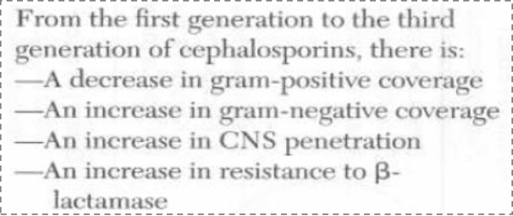
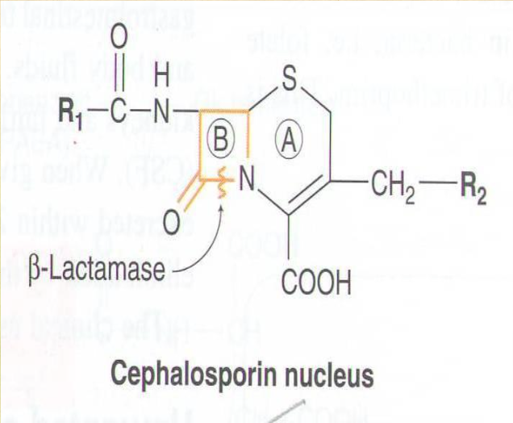
Cephalosporins
Mechanism of Action | Inhibit bacterial cell wall synthesis → Bactericidal
Generation | 1st | 2nd | 3rd
Drugs | Cephalexin | Cefuroxime axetil, Cefaclor | Ceftriaxone, Cefotaxime, Cefixime
Route | Orally | Orally (well absorbed) | I.V.
Spectrum | Gram +ve | Mainly Gram -ve (β-Lactamase –producing Bacteria) | (wide selection of Gram -ve Bacilli (no effect on Gram +ve)
Uses | Upper Respiratory Tract Infections (URTI) (Post-operative) | Upper and Lower Respiratory Tract Infections | Effective in treating Pneumonia (Emergency) Meningitis ( due to CNS Penetration)
Pharmacokinetics | Relatively lipid insoluble → do not penetrate cells or the CNS. Except 3rd generation Mostly excreted unchanged by the kidney(glomerular & tubular secretion) Half-life 30-90 min; except ceftriaxone 4-7 hr Probenecid ↑ half life (slows elimination)
ADRs | Hypersensitivity reactions If allergic to Penicillin → don’t give cephalosporins (cross reactivity) Thrombophlebitis* Superinfections* Diarrhea
Glossary
Thrombophlebitis: Inflammation of veins
Superinfections: an infection that develops during drug treatment for another infection, caused by a different microorganism that is resistant to the treatment used for the first infection

Slide 5
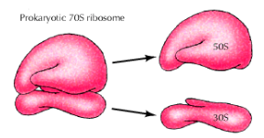
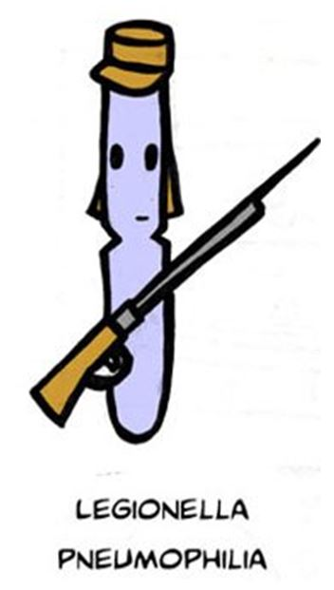
Macrolides
 |  | Erythromycin
 |  | Azithromycin | Clarithromycin
Mechanism of Action |  | Inhibit protein synthesis by binding to 50 S subunit of the bacterial ribosomes →Bacteriostatic At high doses: Bactericidal
Spectrum |  | Gram -ve | Gram +ve
Route |  | Stable at gastric acidity → Orally
Drug Interaction |  | No effect on cytochrome P-450 | Inhibit cytochrome P-450 → increase duration & toxicity of co-administered drugs
Pharamacokinetics | Metabolism | Undergo some hepatic metabolism (inactive metabolite) | Metabolized to active metabolite
 | Excretion | Biliary route is the major route of elimination 0-15% excreted unchanged in the urine
 | Half-life | 3 days | 6-8 hours
Dose |  | Once daily | Twice daily
Uses |  | Chlamydial pneumonia Legionella pneumonia
ADRs |  | GI disturbance Hypersensitivity reactions
Notes |  | Hepatic metabolism → not given to patients with Liver failure. Vomiting may require re-dosage of Azithromycin

Slide 6
Fluoroquinolones
Gatifloxacin | Moxifloxacin | Ciprofloxacin | Drug
given once-daily |  | Given twice-daily | Dose
Effective against gram-ve and gram +ve. Has high activity against pseudomonas species. |  | Mainly effective against gram –ve. Has high activity against pseudomonas species. | Spectrum
inhibits DNA gyrase enzyme, which is an enzyme involved in DNA supercoiling. |  |  | Mechanism of action
Given orally or parentally. Concentrates in many tissues (kidney, prostate, lung, bones and joints). Excreted mainly trough the kidney. Has long half life. |  |  | Pharmacokinetics
Acute exacerbation of chronic obstructive pulmonary disease. Community acquired pneumonia. Legionella pneumonia. |  |  | Clinical uses
Nausea, vomiting and diarrhea. CNS effects (confusion, insomnia, headache and anxiety). Damage of growing cartilage (arthropathy). Phototoxicity. Avoid excessive sunlight |  |  | Adverse effects
Not recommended for patients under 18 years. Pregnancy. Breast feeding women. |  |  | Contraindications

