Slide 1
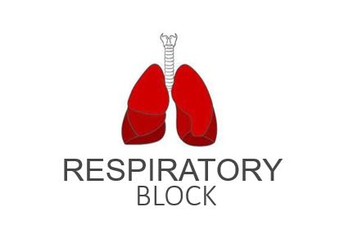
Effects of Low and High Gas Pressure on the Body
Red: very important.
Green: Doctor’s notes.
Pink: formulas.
Yellow: numbers.
Gray: notes and explanation.
Physiology Team 436 – Respiratory Block Lecture 10
Lecture: If work is intended for initial studying.
Review: If work is intended for revision.

Slide 2
Objectives
Describe the effects of exposure to low and high barometric pressures on the body.
Describe the body acclimatization to low barometric pressure.
Define decompression sickness and explain how it can be avoided.
Understand the effects of high nitrogen pressure, and nitrogen narcosis.

Slide 3
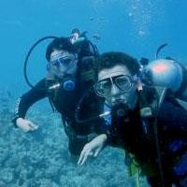
Effect of Increased Barometric Pressure (Deep Sea Diving)
When humans descend below the sea, the pressure around them INCREASES.
To prevent the lungs from collapsing, air must be supplied at high pressure
This exposes the blood in the lungs to extremely high alveolar gas pressure (Hyperbarism)*.
Under certain limits these high pressures cause tremendous alterations in the physiology of the body (i.e. nitrogen narcosis).
* Exposure to high pressure means more O₂ comes in, so there will be an increase in P_{o2}

Slide 4
Cont.
The surrounding pressure increases by
1 atmosphere every 10 meters (33 feet) of depth in sea water (1atm=760mmHg).
Therefore at a depth of 31 meters (100 feet) in the ocean the diver is exposed to a pressure of
4 atmospheres.
Therefore, a person 33 feet beneath the ocean surface is exposed to 2 atmospheres pressure,
1 atmosphere of pressure caused by the weight of the air above the water and the second atmosphere by the weight of the water itself.
How we got the numbers:
You add 1atm every 10 meters below sea level:
31 meters /10 meters =3
3*1atm(in water) + 1atm(above water) = 4atm
* It has amount an of O₂ which will give the diver the same PO₂ at the depth he is going to (يعني بيعطي ضغط نفس الضغط اللي بيجيه لو نزل للعمق اللي يبغاه، بيصير فيه توازن بالتالي ما يصير شي للرئة)
At 66 feet, the pressure is 3 atmospheres, and so forth..
These problems confront SCUBA (Self Contained Under Water Breathing Apparatus)*

Slide 5
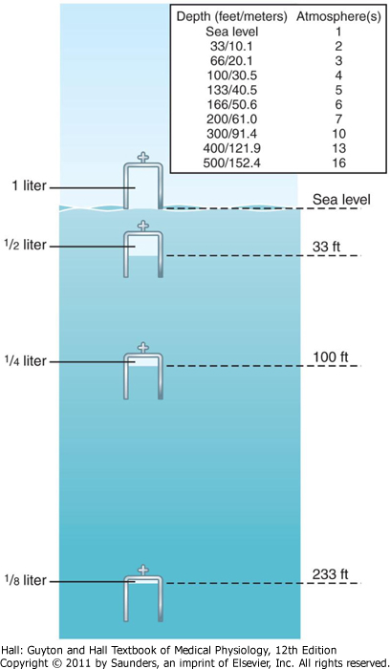
Effect of Increased Barometric Pressure (Deep Sea Diving)
Effect of depth on the volume of the gases – Boyle’s Law:
Effect of depth on the density of gases:
Nitrogen effect at high nitrogen pressure:
Compression of gases to smaller and smaller volumes.
1L (sea level)→1/2 L at 33 feet and so on.
Increase in density of gas and hence increased work of breathing.
Has 2 principle effects:
* Nitrogen narcosis (anesthetic effect).
* Decompression sickness. Results in nitrogen dissolved in the tissues in a liquid form.
Volume to which a given quantity of gas is compressed is inversely proportional to the pressure.
This is a principle of physics called Boyle’s law, which is extremely important in diving physiology because increased pressure can collapse the air chambers of the diver’s body, especially the lungs, and often causes serious damage.
Increase air resistance in the airway like swallowing jelly instead of water
زيادة كمية الضغط بتؤدي إلى تقارب جزيئات وبالتالي بتقل المساحة بين الجزيئات، هذا التقارب يخلي الغاز كثيف جدًا وشبيه بالسوائل
كل ما ننزل ٣٣ قدم الضغط بيزيد واحد وينقص حجم الهواء الي جوا الكاس ب ١/٢

Slide 6
Nitrogen Narcosis
Nitrogen like most other anesthetic gases, dissolves freely in the fats of the body, Including the membranes and other lipid structures of the neurons.
This leads to alteration of the electrical conductance of the membranes, and therefore reduces their excitability and subsequent narcosis develops.
At 120 feet: The diver exhibits cheerful behavior and loses his cares.
At 150-200 feet: There is a feeling of euphoria يكون فرحان جدًا كأنه ماخذ مخدر and drowsinessدوخه and impaired performance.
At higher pressure: Loss of coordination and finally coma might develop.
When neurons become less excitable = anesthesia effect.
Nitrogen is a very soluble gas so when it enters through the capillaries it becomes a liquid form in the body with toxic effect
Here nitrogen is shown to have similar effects to alcohol consumption.
About 4/5 of the air is nitrogen. At sea-level pressure, the nitrogen has no significant effect on bodily functions but at high pressures it can cause varying degrees of narcosis.
Nitrogen narcosis has characteristics similar to those of alcohol intoxication.
ONLY IN MALES’ SLIDES

Slide 7
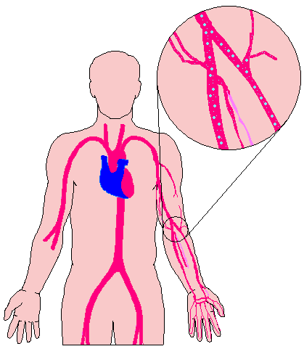
Decompression Sickness (Cassion’s Disease)
It is a syndrome caused by a decrease in the ambient (surrounding) pressure which occur in animals and men when the tissues of the body contain an excess of physically inert (does not undergo chemical reactions) gas.
وبين كل ارتفاع أخليه شوي ما أرفعه عشان أقدر أخلي النيتروجين يطلع من جسمه بسهوله)، الطريقة الصحيحة هي إني أرفعه بشوي شوي،
Upon Ascent
Inert gas comes out of physical solution forming a gaseous phase (bubbles), leading to symptoms and signs.
Upon Descent
The high partial pressure of nitrogen (encountered when breathing compressed air at depth) forces this poorly soluble gas into solution in body tissue particularly in fat (it has a high N₂ solubility).
During slow ascent (decompression is fast) N₂ is slowly removed from the tissues since the partial pressure there is higher than that in the arterial blood and alveolar gas. (To avoid getting Cassion’s disease)
During fast ascent (decompression is rapid) bubbles of gaseous nitrogen are released in tissues and blood, causing the symptoms of decompression sickness (The Bends Or Caisson disease) Happens when the diver gets out of the water fast.

Slide 8
Decompression Sickness (Cassion’s Disease) (The Bends)
ONLY IN MALES’ SLIDES
Breathes air under high pressure for a long time -> nitrogen dissolved in the body fluids increases.
And because nitrogen is not metabolized by the body, it remains dissolved in all the body tissues until the nitrogen pressure in the lungs is decreased back to some lower level, however, this removal often takes hours to occur and is the source of multiple problems collectively called decompression sickness.
If the diver suddenly comes back to the surface of the sea, nitrogen bubbles can develop in the body fluids either intracellularly or extracellularly -> decompression sickness.
Due to decompression, gases can escape from the dissolved state and form actual bubbles; in both tissues and blood where they plug many small blood vessels. The bubbles may not appear for many minutes to hours because sometimes the gases can remain dissolved in the "supersaturated" state for hours before bubbling.

Slide 9
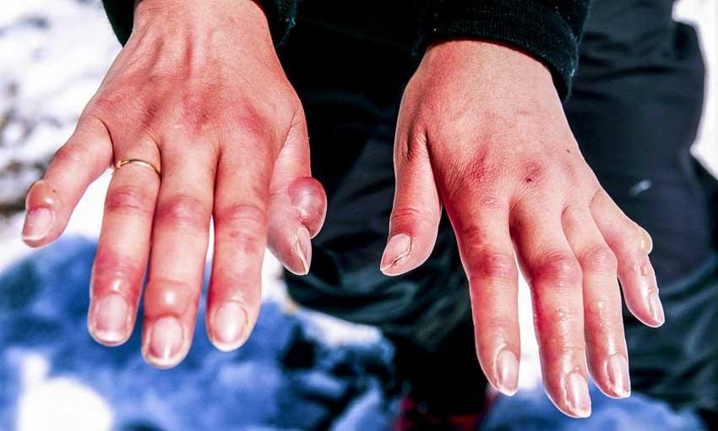
Symptoms & Signs of Decompression Sickness (DS)
The mildest form of DS is
Fatigue or drowsiness after decompression.
Local skin itch.
Other severe symptoms may occur e.g.:
Bubbles in the tissues cause severe pain particularly around the joints (counts for the term bend).
Neurological symptoms include paresthesia (numbness and tingling تنميل( , itching, paralysis, and inner ear disturbances.
Thoracic pains: Dyspnea (shortness of breath), substernal pain, cyanosis and cough.
Bubbles in coronary arteries may cause myocardial damage (because the bubble will close the blood vessel).
Decompressing sickness shock: capillaries become permeable to plasma and hypovolemia (decrease in blood volume) rapidly develop.
Edema may be prominent, shock is usually complicated by pulmonary edema.

Slide 10
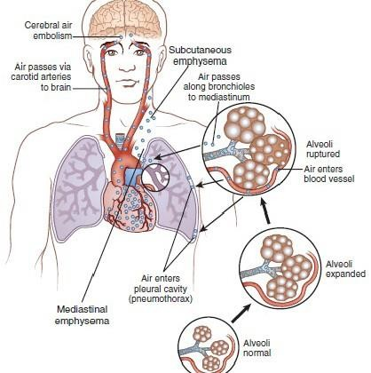
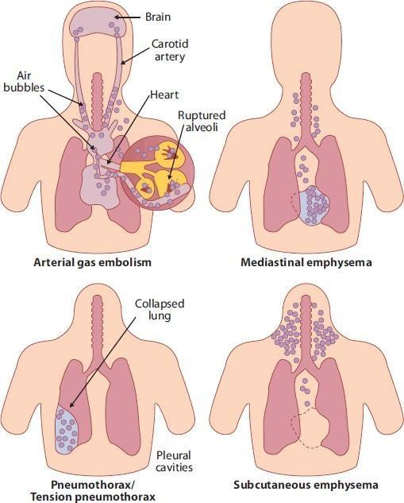

Slide 11
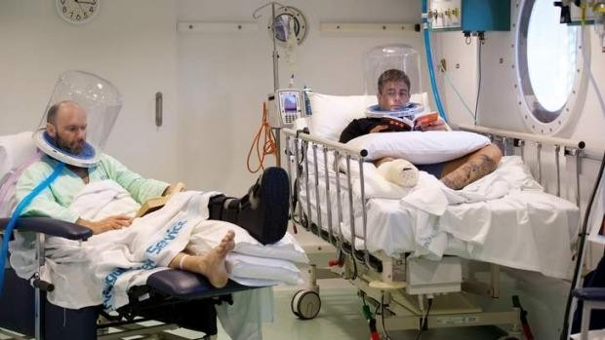
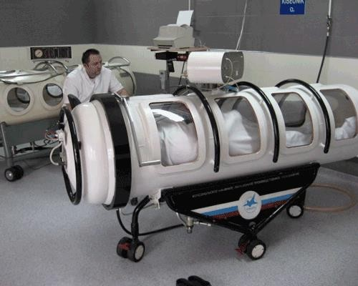
Treatment of Decompression Symptoms
1- Rapid recompression in a pressure chamber followed by slower decompression.
(Thus simulating what would have happened if the diver was decompressed slowly)
This reduces the volume of the bubbles and forces them back into solution.
In very deep dives, the risk of decompression sickness can be reduced if a helium-O₂ mixture is breathed during the dive.
Put the diver into a pressurized tank to lower the pressure gradually back to normal atmospheric pressure, by using this time schedule:
10 minutes at 50 feet depth
17 minutes at 40 feet depth
19 minutes at 30 feet depth
50 minutes at 20 feet depth
84 minutes at 10 feet depth
ONLY IN MALES’ SLIDES

Slide 12
Cont.
2- Helium is more desirable than nitrogen in deep dives because it has:
1/4-1/5 the narcotic effect of nitrogen on CNS.
1/7 the molecular weight of nitrogen.
Low density leading to decreased airway resistance of diver.
High diffusion through tissues (so it easily diffuses from capillary to alveoli and leaves the body).
Helium is about 1/2 as soluble as nitrogen in body fluids. This reduces the quantity of bubbles that can form in tissues when the diver is decompressed after diving (avoiding decompression sickness).

Slide 13
High Altitude (Low Pressure)
ONLY IN MALES’ SLIDES

Slide 14
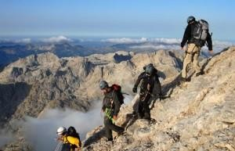
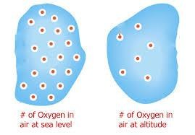
Effects of Low Oxygen Pressure on the Body (Aviation-Ascend to High Altitude)
At the sea level the barometric pressure (another term for atmospheric pressure) is 760 mmHg
At 10,000 feet is 523 mmHg
At 50,000 feet 87 mmHg.
This decrease in barometric pressure is the basic cause of all the problems of hypoxia in high altitude physiology.

Slide 15
Alveolar PO2 at Different Altitudes
As the barometric pressure decreases, the oxygen partial pressure decreases proportionally, leaving less than 21% of the total barometric pressure.
At high altitudes, carbon dioxide is continuously excreted from the pulmonary blood into the alveoli. Also, water vaporizes into the inspired air from the respiratory surfaces.
These two gases dilute the oxygen in the alveoli, thus reducing the oxygen concentration, therefore, hypoxia develops.
At sea level PO2= 159 mmHg
At 20,000 feet PO2= 40 mmHg
At 50,000 feet PO2= only18 mmHg
(CO2 + water vapor dilutes o2 → hypoxia.)

Slide 16
Effects of Acute Hypoxia
At 12000 feet
Drowsiness
Above 18000 feet
All the effects at 12000 and
1. Twitching
2. Convulsions (contraction of big muscles)
Above 23000 feet
Coma (the un-acclimatized person)
Lassitude ارهاق
Mental and muscle fatigue
Headache sometimes
Occasionally nausea
Euphoria (happiness) sometimes
Shortly followed by death
عشان كذا لمن يبغى شخص يطلع مرتفعات لازم يدرب نفسه على التسلق بارتفاع قليل بعدين ارتفاع أكثر فأكثر وهكذا، عشان يتعود جسمه
One of the most important effects of hypoxia is decreased mental proficiency, which decreases judgment, memory, and performance of discrete motor movements.

Slide 17
Acclimatization to Low PO2
A person remaining at high altitudes for days, weeks or years becomes more and more acclimatized to low PO2. Acclimatization is important to prevent or have fewer deleterious effects on the body so it becomes possible for the person to work harder without hypoxic effects or to ascend to a higher altitude.
Principle means of acclimatization:
Increase in pulmonary ventilation.
Increased red blood cells. (if there is decrease in O₂ the kidney will respond by producing Erythropoietin which will go to the bone marrow and synthesize RBCs + Hb, so more O₂ will be carried on Hb and more O₂ will be transferred to the tissue).
Increased diffusing capacity of the lungs.
Increased vascularity of the tissues.
Increased ability of the cells to utilize oxygen despite the low PO2.

Slide 18
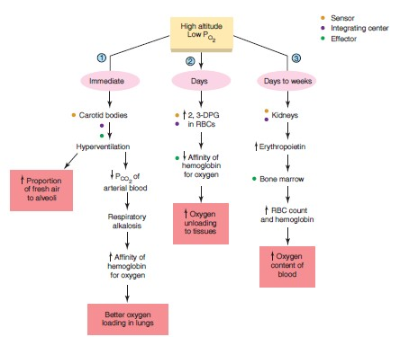
*This picture is important!
لأني طلعت CO₂ كثير

Slide 19
Link to Editing File (Please be sure to check this file frequently for any edits or updates on all of our lectures.)
Quiz
https://www.onlineexambuilder.com/lecture-10/exam-129895
References:
Girls’ and boys’ slides.
Guyton and Hall Textbook of Medical Physiology (Thirteenth Edition.)

Slide 20
Thank you!
اعمل لترسم بسمة، اعمل لتمسح دمعة، اعمل و أنت تعلم أن الله لا يضيع أجر من أحسن عملا.
The Physiology 436 Team:
Female Members:
Amal Alshaibi
Allulu Alsulayhem
Najd Altheeb
Ghada Alhadlaq
Heba Alnasser
Team Leaders:
Qaiss Almuhaideb
Lulwah Alshiha
Contact us:
Physiology436@gmail.com
@Physiology436

