Slide 1
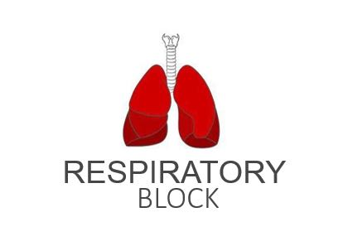
Mechanics of Pulmonary Ventilation
Red: very important.
Green: Doctor’s notes.
Pink: formulas.
Yellow: numbers.
Gray: notes and explanation.
Physiology Team 436 – Respiratory Block Lecture 2
Lecture: If work is intended for initial studying.
Review: If work is intended for revision.

Slide 2
Objectives
List the muscles of respiration and describe their roles during inspiration and expiration.
Identify and understand the importance of the following pressures in respiration: atmospheric, alveolar, intrapleural , and transpulmonary.
Explain why intrapleural pressure is always subatmospheric under normal conditions, and the significance of the thin layer of the intrapleural fluid surrounding the lung.
Define lung compliance and list the determinants of compliance.

Slide 3
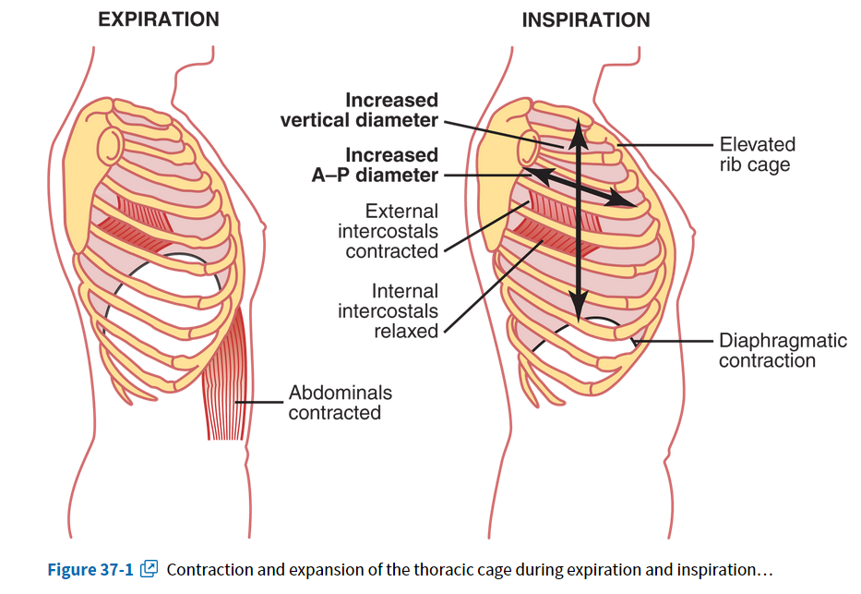
Muscles That Cause Lung Expansion and Contraction
ONLY IN MALES’ SLIDES
Lungs are expanded and contracted during breathing:
 | Expansion of the lungs (in inspiration ) | Contraction of the lungs (in expiration)
Diaphragm | Downward movement of the diaphragm will lengthen the chest cavity (vertically). | Upward movement of the diaphragm will shorten the chest cavity (vertically).
Ribs | By elevation of the ribs, the anteroposterior diameter of chest cavity will increase. | By depression of the ribs will decrease the anteroposterior diameter.
•Allows the air to move By the pressures.
•Changes the pressures By the muscles.

Slide 4
Elevation of the ribs will lead to two things:
Increasing anteroposterior diameter of chest cavity. (b)
Increasing horizontal diameter of the chest cavity. (a)
The chest has three diameters:
Vertical diameter.
Transverse diameter.
Anteroposterior diameter.

Slide 5
Respiratory Muscles

Slide 6
Respiratory Muscles
Respiratory Muscles
Inspiratory Muscles
Expiratory Muscles
(work only during forced expiration-muscles that depress the rib cage)
During resting inspiration
During forced inspiration
During forced expiration
Contraction of:
1-Diaphragm
2-external intercostals
Contraction of:
1-Accessory muscles of inspiration (the sternomastoid, anterior serratus, scalene muscles)
2-Muscles of resting inspiration.
Contraction of:
1-Abdominal muscles
2-internal intercostals.
Relaxation of :
1-diaphragm
2-external intercostal muscle
The diaphragm will increase the longitudinal diameter.
The external intercostals will increase the transverse diameter and pull the ribs outward.
Accessory muscles will increase the anteroposterior diameter and elevates the sternum and clavicle.

Slide 7
Respiratory Muscles
Inspiration and expiration could be either resting or forced.
Resting and forced (deep) inspiration is active. It requires muscle contraction and consumes energy.
Resting expiration is passive while forced (deep) expiration is active. (forced expiration - muscles depress the rib cage)
There are no muscles for resting expiration, It is a passive process that depends on the recoil tendency of the lung.
Recoil tendency: (elastic-like) lung will collapse when left alone without intervention of outside forces, chest size will be less, but alveoli will not collapse completely due to little amount of air left behind after expiration. (Only resting expiration uses NO muscles)

Slide 8
Deep Forceful Breathing
Deep (forced) Inspiration or Inhalation:
During deep forceful inhalation accessory muscles of inspiration participate to increase size of thoracic cavity:
1. Sternocleidomastoid: elevates sternum.
2. Scalenes: elevate first two ribs.
3. Pectoralis minor: elevate 3rd, 4th, and 5th ribs.
Pectoralis major is also involved (and plays a larger role than pectoralis minor based on anatomy lectures).
Deep (forced) Expiration:
Expiration during forceful breathing is active process.
Muscles of exhalation increase pressure in abdomen and thorax
1. Abdominal muscles
2. Intercostal muscles: Internal intercostal muscle - Innermost intercostal muscle - Subcostal muscle - Transversus thoracis muscle.

Slide 9
Pressures in the Lungs
Ventilation has two steps, the first one is the movement of the air from the atmosphere to the lungs.
Air moves only from areas of high pressure to areas of low pressure.
During inspiration, the pressure in the respiratory passages is less than the atmospheric pressure.
Contraction of inspiratory muscles will increase the volume of the chest which will decrease the pressure in the respiratory passages.
There are 12 cycles per minute (respiratory rate) consisting of inhalation then expiration then pause.
During pause the pressure inside is equal to the pressure outside, meaning there is no movement of air.
Inward movement of air will fill the space, which will return the pressure back to the atmospheric pressure and stop inspiration.
When inspiration stops, recoil will happen which will decrease the volume, so the pressure will increase and the air will move outward. We will have expiration.

Slide 10
Pressures in the Lungs
Our reference is the atmospheric pressure 760 mm HG. (To make it easier we will refer to it as 0).
If we have a pressure less than the atmospheric pressure we will refer to it as (–) the difference between the two pressures.
If we have a pressure higher than the atmospheric pressure we will refer to it as (+) the difference between the two pressures.
For your understanding:
P_{atm} = 760 mmHg
If P₁ = 759 P₂ = 758 P₃ = 761
759 – 760 = -1
758 – 760 = -2
761 – 760 = +1
And so on..

Slide 11
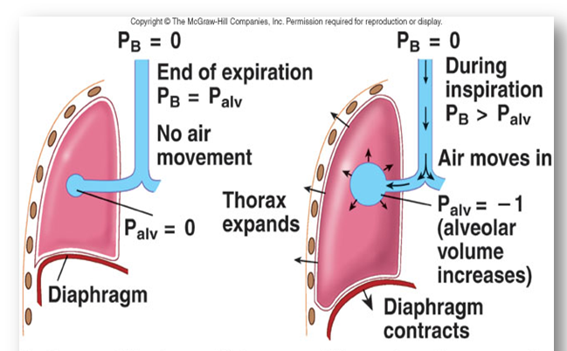
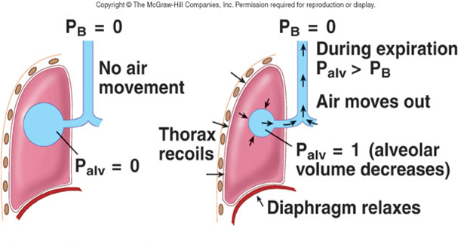
Air will flow from a region of high pressure to one of low pressure
“the bigger the difference, the faster the flow”
شرح مهم:
1: في نهاية الزفير (relaxed diaphragm) , الضغط داخل ال alveoli يساوي للضغط خارج الجسم فبالتالي الهواء ما ينتقل .
2: خلال الشهيق (diaphragm contraction) , حجم الرئة زاد فحسب قانون بويل الضغط داخل ال alveoli يقل فبالتالي الهواء ينتقل من الخارج الى داخل الرئتين.
3: في نهاية الشهيق الضغط داخل ال alveoli راح يتساوى مع الضغط خارج الجسم بسبب ان ال alveoli صارت ممتلئة بالهواء .
4: خلال الزفير (diaphragm relaxation) ,حجم الرئة يصغر بحسب قانون بويل الضغط داخل ال alveoli اكبر من الضغط خارج الجسم فبالتالي الهواء راح ينتقل الى خارج الجسم.
1
2
قانونين مهمين في الفيزياء:
الأول ان الغازات تنتقل من مناطق الضغط المرتفع الا مناطق الضغط المنخفض و الثاني هو قانون بويل: كلما زاد الحجم قل الضغط والعكس .
3
4
PB= atmospheric pressure. Palv= alveolar pressure.

Slide 12
Pressure Changes in the Lungs During Breathing
1- Intra-alveolar (intrapulmonary pressure):
Intra-alveolar pressure is the pressure inside the alveoli (in the respiratory zone).
Between breaths (end of expiration) = zero pressure.
The pressure inside the alveoli between breaths is zero.
During inspiration = (-1 mmHg). Air (tidal volume) flows from outside to inside the lungs.
The pressure becomes -1 mmHg due to the increase of the volume of lungs (diaphragm contracts). Which will cause air to flow inside. The volume of the air is 500ml and is known as the tidal volume.
At the end of inspiration = zero. Air flow stops.
Air flow stops because at this stage the pressure outside is equal to the pressure inside. So there will be no movement of air.
During expiration = (+1 mmHg). Air flows out of the Lungs.
The pressure becomes +1 mmHg due to the decrease of the volume of the lungs (diaphragm relaxes). Which will cause air to flow outside.
*As volume increases→ Pressure decreases (and vice versa).

Slide 13
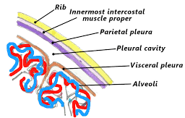
Pressure Changes in the Lungs During Breathing Cont.
2-Intrapleural pressure (IPP):
Pressure in the pleural space is negative with respect to atmospheric pressure at the end of normal expiration( -5cmH₂O). During the pause.
cmH2O is less than mmHG. IPP is approximately -3 mmHG
It has absolutely no relation to the atmospheric pressure because the pleural cavity is sealed.
Why is the Intrapleural pressure negative?
1- The lung's elastic tissue causes it to recoil*, while that of the chest wall causes it to expand. Because of these two opposing forces, the pressure in the pleural cavity becomes negative.
2- The pleural space is a potential space**, empty due to continuous suction of fluids by lymphatic vessels.
More negativity around lung pulls it outside with a suction like motion and the lungs always love to recoil and this force (negativity) opposes the lung’s recoiling force.
At all times: the chest is trying to inflate and the lung is trying to collapse.
(By negative we mean in comparison to atmospheric pressure.)
ليش سالب:
١- تخيلوا الرئة زي الكورة المطاطية حقت الأطفال؛ اذا ضغطنا الكورة بترجع زي ما كانت. الرئة زي كذا، قوة recoilبتضغط الرئة وقوة جدار الصدر بتوسع الرئة. وجود قوتين متعاكسة بيخلي IPPسالب.
٢- أوعية اللمفية تسحب السائل الي موجود داخل pleura وهذا السحب يخلي الضغط سالب
Extra picture: for understanding the pleural space
*(Recoil is the tendency of the lung to return to its original shape after expanding) - **(Potential space is two surface membranes separated by a small amount of fluid)

Slide 14
Pressure Changes in the Lungs During Breathing Cont.
Malignancies, heart failure, obstruction of lymphatics or inflammation of pleura and production of more pleural fluid will cause accumulation of pleural fluid (pleural effusion) which is very dangerous and requires immediate suction of fluid because it erases the negativity. No negativity means no opposing force so the lung will collapse.
A layer of pleura (a very thin membrane) covers the lung (this layer is called visceral pleura) and another layer covers the inside of the ribs (parietal pleura), these two layers move together to make the movement of the lung non-painful. Between the two layers there is a very thin lubricant fluid film. The space between the two layers is called the pleural space (pleural cavity).
Pleural effusion (Inflammation) reduces the negativity and therefore eliminates the effect of opposing forces (as there is no opposing force of negativity) and the lung collapses. In order to fix this, the fluid must be drained in order to have empty space once again.

Slide 15
Values of Intrapleural Pressure (IPP)
Intrapleural pressure is (-5) cm H2O during resting position between breaths, and it becomes more negative (-7.5) cm H2O during resting inspiration.
During “Forced ventilation”:
Forced Inspiration : -20 to -40 cmH2O
Forced Expiration : +30 cmH2O
اذا انكسر واحد من الضلوع ممكن انه يدخل في الرئة ويخلي intrapleural pressure صفر

Slide 16
Pressure Changes in the Lungs During Breathing Cont.
3-Transpulmonary Pressure (TPp) (Extending Pressure)
Called Extending pressure : because it is the pressure that keeps the lungs inflated or extended, so the lungs never collapse.
It is also called recoil pressure: because it is equal to the recoil force of the lungs. So when the pressure = the force, the recoiling will not happen, so no lung collapse. مساوية لها بالمقدار و مضادة لها بالإتجاه
• The difference between the alveolar pressure (Palv) and the pleural pressure(Ppl).
TPp = Palv-Ppl
• It is a measurement of the elastic forces in the lungs that tend to collapse the lungs (the recoil pressure).
It prevents lung collapse.
The bigger the volume of the lung the higher its tendency to recoil.
For example, the more you fill a balloon with air (more volume) the faster the air will come out once you let go; (the higher its tendency to go back to its original size).
Recoil tendency is directly proportional to lung size.
Example of transpulmonary pressure calculation during inspiration: -1 + 7.5 = 6.5
1) - ضغط السائل + مساحة القفص الصدري.
2 (- ضغط السائل + مساحة الهواء
3 (- ضغط السائل عند كل عملية استنشاق.

Slide 17
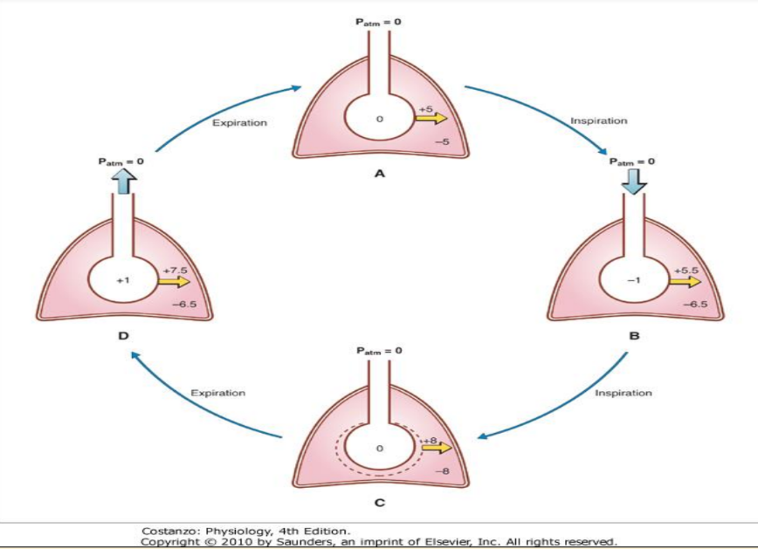
Pressure and Volume Relationships in a Single Respiratory Cycle
ONLY IN MALES’ SLIDES
A: during rest-: Intrapleural pressure is -5cmH2O while the Intra-alveolar pressure is 0mmHg.
B:during inspiration- the intra-alveolar pressure becomes -1mmHg, then the air enters the alveoli ,while the Intrapleural pressure becomes -6.5cm H2O(more negative).
الحجاب الحاجز يشد فيزود حجم الصدر وبحسب قانون بويل الضغط لازم يقل. عشان كذا intra alveolar pressure & intrapleural pressure ينقصون
C:at the end of inspiration-: Air flow stops since the Intra-alveolar pressure= the Atmospheric pressure(0). While the intrapleural pressure becomes -8cm H2O (more negative).
D:during expiration-: the intra-alveolar pressure becomes +1mmHg, then the air exits alveoli into the atmosphere while the Intrapleural pressure becomes -6.5cmH2O (it isincreased).
الحجاب الحاجز ينرخي فينقص حجم الصدر وبحسب قانون بويل الضغط لازم يزيد. عشان كذا intra alveolar pressure & intrapleural pressure يزيدون

Slide 18
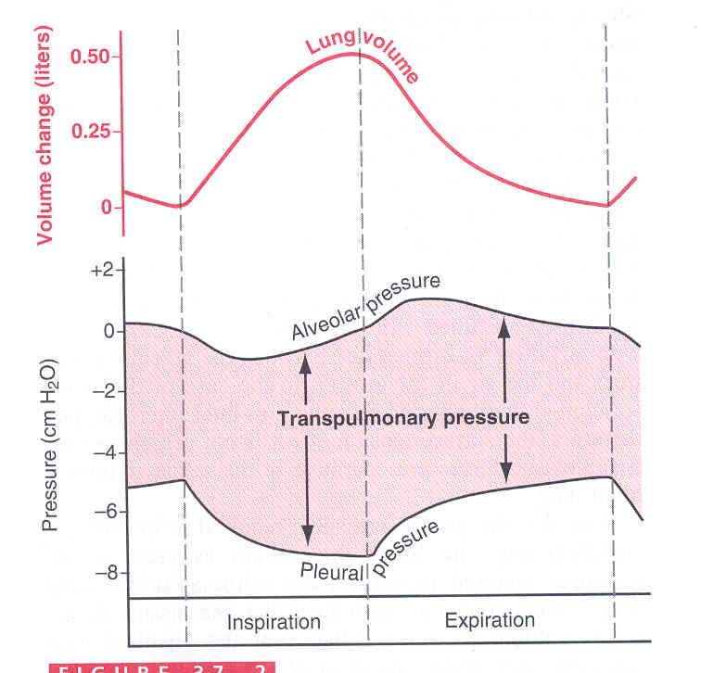
Vo (Compliance of the Lung) in a Single Respiratory Cycle
Compliance (resilience) of the Lungs (قابلية المطاطية) : ability of lungs to expand under pressure
E.g. two rubber bands, thin and thick. The thin rubber band easily stretched, and is very distensible (stretchable) and compliant. The thick rubber band difficult to stretch and is less distensible and less compliant.
Increased TTp = increased lung volume.
Decreased TTP = decreased lung volume.
الرئة نفس المطاط؛ اذا كان المطاط نحيف (less elastic tissue) تكون قابلية المطاطية عالية. أما اذا كان المطاط سميك ( more elastic tissue) تكون قابلية المطاطية أقل ولكن recoil أعلى.
The greater the amount of elastic tissue, the greater the recoil force and the lower the compliance.

Slide 19
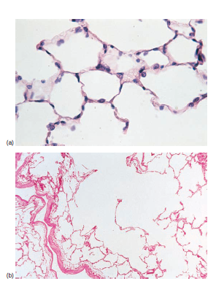
Cont. Compliance of the Lung
It is defined as the ratio of the change in the lung volume produced per unit change in the distending pressure (Transpulmonary pressure).
The extent to which the lungs expand for each unit increase in the transpulmonary pressure.
CL (Compliance of Lung) = Volume change (∆ V) Transpulmonary pressure change (∆ P)
CL = (∆ V) (∆ P)
For both lungs in adult = 200 ml of air /cm H20 if the lung is free not surrounded by the chest.
For lungs and thorax together = 110 ml/cm H20. نقص لأن مطاطية الثوراكس قليلة
Is reduced in pulmonary fibrosis, pulmonary edema, diseases of the chest wall ( kyphosis, scoliosis), paralysis of respiratory muscles.
Emphysema (COPD chronic obstructive pulmonary disease) increases (increase -> it is an exception) the compliance of the lungs because it destroys the alveolar septal tissue rich with elastic fibers that normally opposes lung expansion.
Emphysema is common in chronic smokers (because they are susceptible to infections). After a bacterial infection, Trypsin ingests the proteins in the wall and breaks down the septa (respiratory membrane) so they lose elastic fibers and we have less number of alveoli but they are larger in size due to merging of alveoli when their walls break down.
The alveoli is inflated but less in number, meaning we have less number of alveoli so we will have less septa (respiratory membrane) so there will be less space for gas exchange.
في حالة الامفيسيما، الالفيولايي تدمر (rich in elastic fibers)، بدون هذه الفايبرز تزداد قابلية المطاطية.

Slide 20
pulmonary ventilation
Inspiratory muscles
Respiratory muscles
Pressure
changes in the
lungs during
breathing:
1-Intra-alveolar
(intrapulmonary
pressure).
Expiratory muscles
3-Transpulmonary
pressure (TPp).
2-Intrapleural
pressure (IPP).
LUNG COMPLIANCE
Mind Map
FORCED :Accessory muscles
RESTING : External intercostal + Diaphragm
FORCED :Internal intercostalis+abdominal muscles
CL= (Δ V) / (Δ P)
Notes:
Intraalveolar pressure is measured in cmHg
Intrapleural pressure is measured in cmH2O
Compliance is measured in ml/cmH2O

Slide 21
Link to Editing File (Please be sure to check this file frequently for any edits or updates on all of our lectures.)
Quiz
https://www.onlineexambuilder.com/mechanics-of-pulmonary-ventilation/exam-127878
References:
Girls’ and boys’ slides.
Guyton and Hall Textbook of Medical Physiology (Thirteenth Edition.)

Slide 22
Thank you!
اعمل لترسم بسمة، اعمل لتمسح دمعة، اعمل و أنت تعلم أن الله لا يضيع أجر من أحسن عملا.
The Physiology 436 Team:
Female Members:
Laila Mathkour
Alaa Alaqeel
Aseel Alsulimani
Shrooq Alsomali
Sondos Alhawamedah
Wateen Alhamoud
Elham Alami
Male Members:
Hassan Alshammari
Team Leaders:
Qaiss Almuhaideb
Lulwah Alshiha
Contact us:
Physiology436@gmail.com
@Physiology436

