Slide 1
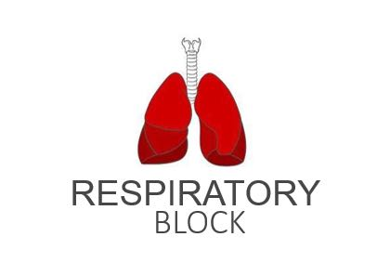
Respiratory Ventilation
Red: very important.
Green: Doctor’s notes.
Pink: formulas.
Yellow: numbers.
Gray: notes and explanation.
Physiology Team 436 – Respiratory Block Lecture 3
Lecture: If work is intended for initial studying.
Review: If work is intended for revision.

Slide 2
Objectives
Define the various lung volumes and capacities and provide values for each.
Define ventilation rate, their typical values and their measurement alveolar.
Describe FEV₁ and its role in differentiating obstructive and restrictive lung diseases
Describe the types of dead space and State a volume for the anatomical dead space.
Define the term minute ventilation and state a typical value.
Distinguish minute ventilation from alveolar ventilation.

Slide 3
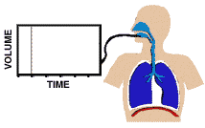
PULMONARY / LUNG VOLUMES AND CAPACITIES
ONLY IN MALES’ SLIDES
Animation

Slide 4
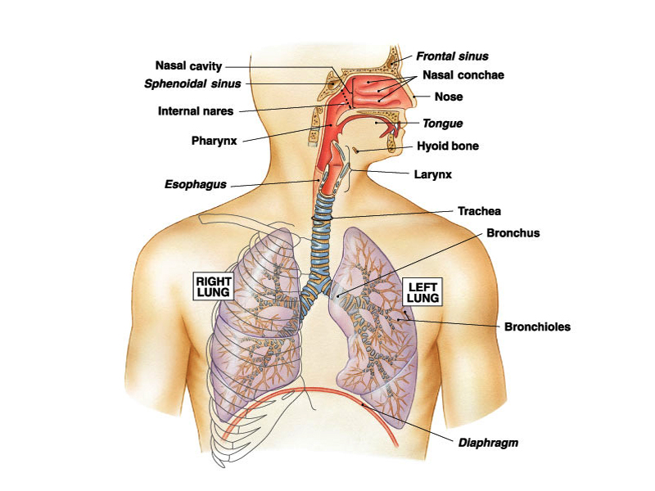
ONLY IN MALES’ SLIDES
RESPIRATORY SYSTEM
Upper Respiratory Tract:
1. Nose.
2. Pharynx and associated structures.
Lower Respiratory Tract:
1. Larynx.
2. Trachea.
3. Bronchi.
4. Lungs.

Slide 5
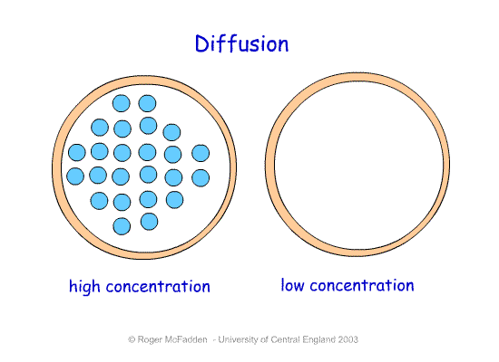
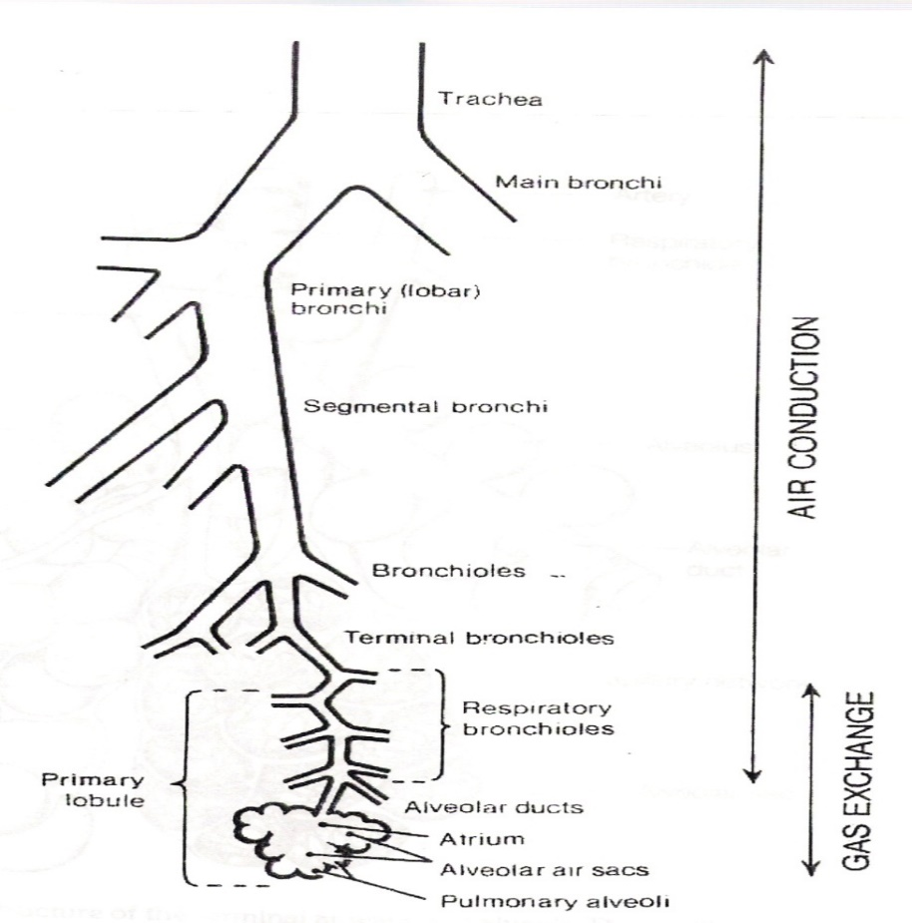
ONLY IN MALES’ SLIDES
Zones of the Respiratory Tract
Tidal volume (500 ml) = Conductive zone (150 ml) + Respiratory zone (350 ml)
Conduction Zone
= 150 ml
Gas diffuses in (respiratory zone) from higher concentration (higher pressure) to lower concentration (lower pressure).
Respiratory Zone= 350 ml

Slide 6
Cont.
Zones of respiratory Tract
Conduction Zone
Nose
Bronchi
Respiratory Zone (diffusion site)
Alveolar Duct
Pharynx
Alveolar Sac
Alveoli
Atrium
Larynx
Trachea
Bronchioles
Terminal bronchioles
Respiratory Bronchioles

Slide 7
Cont.
Tidal volume 500 = 150 (Conduction Zone) + 350 (Respiratory Zone)
Tidal Volume (Vt): Normal amount of air we inspire and expire.
The conducting zone: Structures form a continuous passageway for air to move in and out of the lungs.
Respiratory zone:
-Is found deep inside these thin-walled structures; allows inhaled oxygen (O2) to diffuse into the lung capillaries in exchange for carbon dioxide (CO2).
It occupies the space distal to the terminal bronchioles start from the respiratory bronchioles down to the alveolar sacs.
Where gas exchange takes place.
Two thirds of the tidal volume is lost here.
Volume ≅ 350ml/min

Slide 8
Dead Space
ONLY IN MALES’ SLIDES
Parts of the respiratory tract not participating in gas exchange:
Anatomical Dead Space:
- Tracheo-bronchial tree (the air-conducting system) down to respiratory bronchioles.
Normally 2ml/kg or 150ml in an adult, roughly a third of the tidal volume is lost here.
No gas exchange
Alveolar Dead Space:
Non-perfused alveoli perfused: supply (an organ or tissue) with a fluid by circulating it through blood vessels or other natural channels.
Physiologic Dead Space:
Anatomical Dead Space+ Alveolar Dead Space
No diffusion in “Anatomical Dead Space” is normal
No diffusion in “Alveolar Dead Space” (nonfunctioning alveoli) is pathological due to edema or fibrosis
Extra: dead space is the volume of air which is inhaled that does not take part in the gas exchange, either because it (1) remains in the conducting airways, or (2) reaches alveoli that are not perfused or poorly perfused. In other words, not all the air in each breath is available for the exchange of oxygen and carbon dioxide.
Diffusion occurs only in alveoli. If there is no diffusion in alveoli, it is due to pathological reasons.

Slide 9
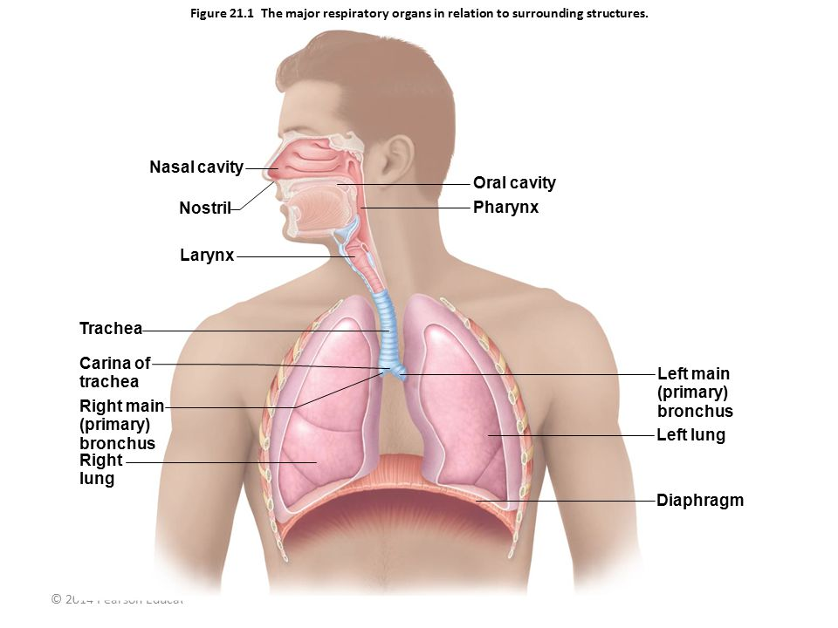
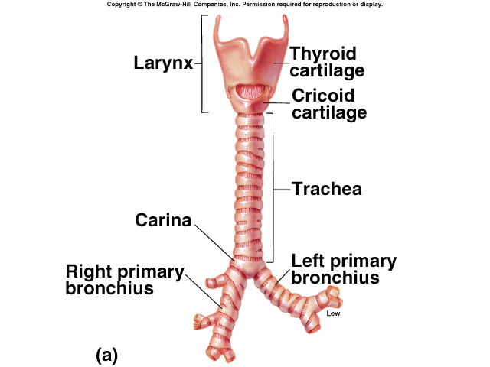
Pollution and Disease Pattern
ONLY IN MALES’ SLIDES
The larynx and carina are very sensitive to dust particles. Terminal bronchioles and even the alveoli are also sensitive to chemicals such as sulfur dioxide or chlorine gas. Air expelled at velocities ranging from 75 to 100 miles / hour [Guyton] 965 Km (600 miles / hour) [Ganong]
Dust particles with an aerodynamic diameter of: 10 μm = nose and pharynx. 2-10 μm = tracheo-bronchial tree 0.1-2 μm within the alveoli. Particles smaller then 0.1 μm remain in the air stream and are exhaled.

Slide 10
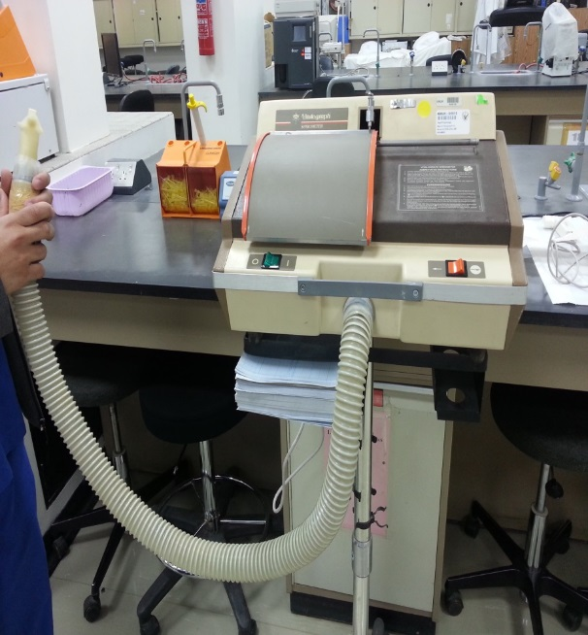
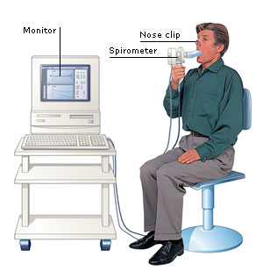
Spirometers
Spirometer:
An apparatus for measuring the volume of air inspired and expired by the lungs. A spirometer measures ventilation, the movement of air into and out of the lungs.
(More in lecture #4)
Important Note:
Spirometers are NOT used for measuring the: 1. Residual Volume, 2. Functional Residual Capacity, and 3. Total Lung Volume (Capacity not volume according to Guyton).
The Residual Volume is the only volume that cannot be measured by the spirometer

Slide 11
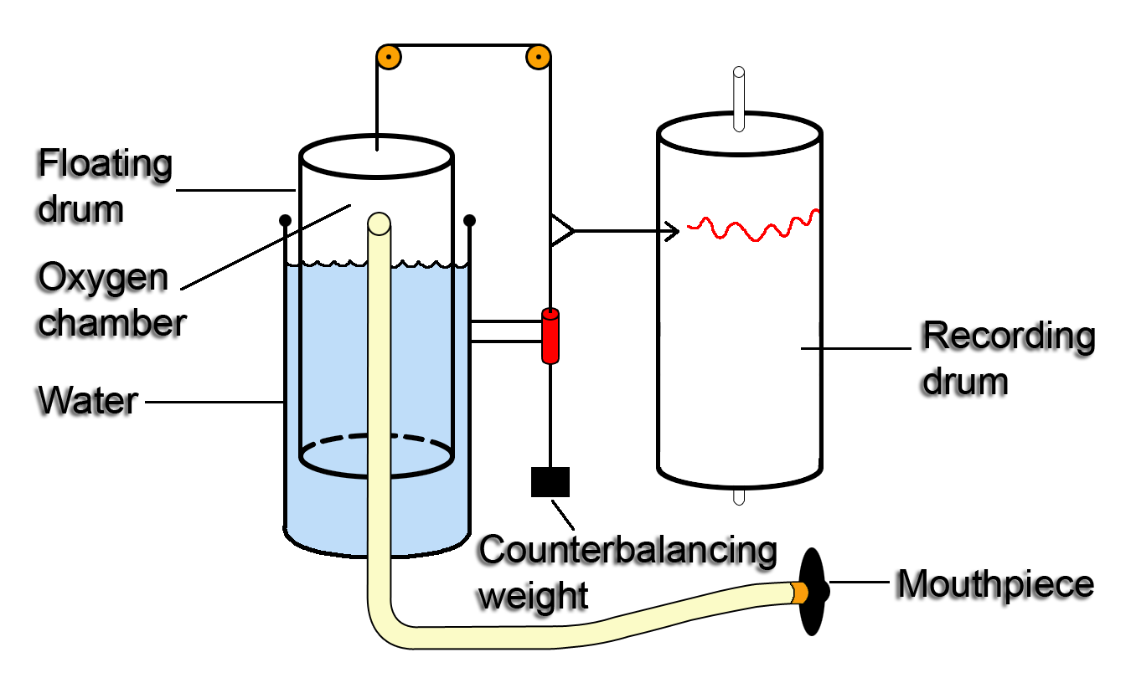
Spirometer
ONLY IN FEMALES’ SLIDES
Again: we use the spirometer to measure the lung volume and lung capacity, Except:
Residual volume.
Functional residual capacity (FRC)
Total lung volume (capacity).
The floating drum contains either oxygen or normal air.
Counterbalancing weight contains a pen that will move to draw when the patient breath in or out.

Slide 12
Physiological Conditions and Pulmonary Volumes and Capacities
مهم السلايد
Age: Pulmonary capacities/Vol keep on increasing until the age of 35 then begins to decrease after the age 35.
Gender: All lung volumes and capacities are about 20 to 25% less in women than in men.
Height: Height increase, increases pulmonary Vol/Cap.
Weight: Weight increase (obesity), decreases pulmonary Vol/Cap.
Ethnic group (race (عرق
Exercise: Increases pulmonary Vol/Cap . All lung volumes and capacities are greater in athletic persons than in small and asthenic persons.
Posture: Pulmonary Vol/Cap while standing is higher than while sitting.
Pregnancy: Decreases pulmonary Vol/Cap.
Diurnal variation, seasonal, climate.
Customary activity.
Geographical location.
Health: If the patient is normal or has lung diseases.
Asthenia: physical weakness or lack of energy.

Slide 13
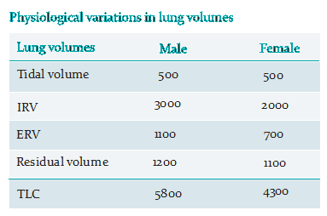
Pulmonary Volumes and Capacities
Lung Volumes
Tidal volume: [VT]
Inspiratory reserve volume [IRV]
Expiratory reserve volume [ERV]
Residual volume [RV]
Lung Capacities
Vital Capacity [FVC]
Inspiratory capacity (IC)
Functional Residual Capacity [FRC]
Total lung capacity [TLC]
Capacity equals the sum of 2 or more volumes.
الجدول مطلوب

Slide 14
Pulmonary Volumes (by using spirometer)
Tidal volume: [VT] Volume of air inspired or expired in each normal breath; value = 500 ml or 0.5 L in young adult man.
Inspiratory reserve volume [IRV]: It is the extra volume of air, that can be inspired forcefully, beyond the normal tidal volume value= 3000 ml or 3 L.
Volume of air inspired by maximal inspiratory effort after normal tidal inspiration. (سعة الرئة)
Expiratory reserve volume [ERV]: It is the extra volume of air that can be expired forcefully beyond the normal tidal volume. Value = 1100 ml or 1.1 L
Volume of air expired by maximal expiratory effort after normal tidal expiration.
Forcefully: with applying force.
Beyond: after.
Residual = متبقي
Residual volume [RV]: It is the volume of air still remaining in the lungs after a forceful expiration.
Value= 1200 ml.
This volume keeps the lung from collapsing .سبحان الله

Slide 15
Pulmonary Capacities
Functional Residual Capacity [FRC]
This is the amount (volume)of air that remains in the lungs at the end (after)of normal expiration.
FRC = the expiratory reserve volume ERV 1100 ml + the residual volume: RV 1200 ml = 2300 milliliters.
Notice the difference between the FRC & RV , that FRC amount of RESIDUAL air in lungs in NORMAL expiration BUT RV in FORCEFUL expiration.
The person is asked to inspire as deeply as possible and then to breathe out as hard and as fast as he/she can. The expiration is continued until he/she expired all the air out and thus forced vital capacity is obtained. During this process the volume of air expired in the first second is collected and is known as FEV1.
Forced Vital Capacity [FVC]
The maximum amount of air that a person can expel forcefully from the lungs after taking a deep inspiration. Or it is the volume of air expired by a maximal expiratory effort after maximal inspiration.
The vital capacity is the sum of the
= ( tidal volume + inspiratory reserve volume + expiratory reserve volume ) = 500 + 3000 + 1100= 4600 ml
Simply: It is the maximum amount of expiration that the person can do until an obligatory (uncontrolled) stoppage of the expiration.
Note: That based on the FVC the electronic spirometer calculate the different volumes and then diagnose the disease.
The capacity comprises of more than one volume.
All lung capacities and volumes in females are 20% - 25% less than in males.
Inspiratory Capacity
The volume of air inspired by a maximal inspiratory effort after normal expiration = 3500ml = inspiratory reserve volume + tidal volume.

Slide 16
Cont. Pulmonary Capacities
Total Lung Capacity [TLC]:
This is the maximum volume to which the lungs can be expanded with the greatest possible inspiratory effort. Or it is the maximum volume of air that can be accommodated in the lungs.
It is the sum of all pulmonary volumes.
(Tidal volume + Inspiratory + Expiratory reserved volume + Residual volume ) or (vital capacity + residual volume)
= 500 + 3000 + 1100 + 1200 = 5800 ml
Minute Respiratory Volume
The volume of air breathed in or out of the lungs each minute = respiratory rate x tidal volume = 12 X 500ml = 6000ml/min or 6 L/min.
Forced Expiratory Volume in one second (FEV₁):
This is the volume of air expelled during the first second of a forced expulsion after a maximum inspiration.
This is a very useful volume to test for the diagnosis of obstructive lung diseases, such as: emphysema and asthma in which FEV₁ is significantly reduced.
It is 80%-90% of the vital capacity. FEV₁ = 3680 ml.
Forced Expiratory Ratio (FEV₁/FVC): (Normally it is about 80% in the first sec.)
The forced expiratory ratio is a sensitive index in differentiating obstructive from restrictive pulmonary disease (when vital capacity is abnormal). It is decreased in obstructive lung disease
e.g: bronchial asthma, emphysema and is normal or increased in restrictive lung diseas e.g: interstitial pulmonary fibrosis .

Slide 17
Minute Respiratory Volume could rise to almost 200 L/min or more than 30 times normal , if the Respiratory Rate (RR) rises from 12 to 40, Tidal Volume (VT) rises from 500ml to 4600 ml (RR x VT = 4600* x 40 = 184000 ml = 184 L almost 200 L) in young adult man (under stress/excitation).
*4600 is just an example

Slide 18
Note
REMEMBER ALL THESE 3 PARAMETERS HAVE CLINICAL SIGNIFICANCE:
*Forced Vital Capacity [FVC].
*Forced expiratory volume in one second (FEV1).
*Forced expiratory ratio.

Slide 19
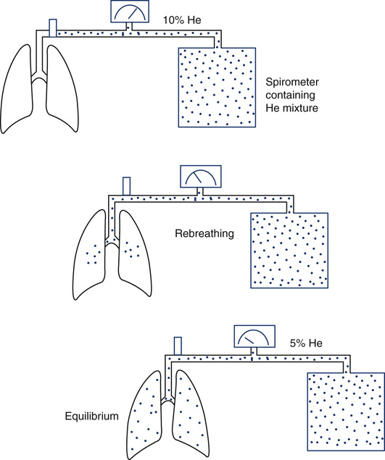
Closed Circuit Helium Dilution Method
ONLY IN FEMALES’ SLIDES
Used to measure the residual volume.
The patient breathes a known volume of air by a spirometer that contains a known concentration of helium. With each breathe the helium will be diluted with the air.
The equation is applied when a sample is drawn with constant concentration.
We use Closed circuit Helium Dilution to determine FRC, RV, and TLC.
C1xV1 = C2xV2
C1: concentration of Hi in spirometry
V1: volume of air in the spirometry.
C2: Final concentration of helium
V2 :Volume of spirometry+ FRC
FRC = ( Ci He (C1) - 1) x Vi Spi (V1)
Cf He (C2)
Ci \ i= initial
Cf \ f= final
FRC: Functional Residual Capacity

Slide 20
Note
شرح للشريحة السابقة
If we calculate the FRC we can also calculate the residual volume and the total lung capacity:
Simply:
FRC= ( C1 - 1 ) X (V1)
C2
RV= (FRC) – (expiratory reserve volume)
TLC= (vital capacity) + (RV)
المعادلات من سلايد 14-15
-يعني نستعمل الاف ار سي عشان نطلع ال الار في , ونستعمل الار في عشان نطلع التوتال لنق كابيسيتي.

Slide 21
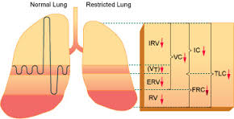
Obstructive and Restrictive Diseases
ONLY IN MALES’ SLIDES
Obstructive disease causes airway obstruction leading to decrease in airflow into and out of the lungs
and trapping of air inside the lung
(that is why RV, FRC TLC are increased)
Restrictive disease restrict expansion of lungs causing decrease in lung volume
(notice the decrease in amount of air according to all parameters)

Slide 22
Difference Between Obstructive and Restrictive Disease
الخط المنقط هو الطبيعي
In Obstruction:
-Prolongation in time, due to increased airway resistance.
In Restrictive:
-Decreased total lung volume of air, due to the accumulation between alveoli (ex. Fibrosis).
In Mixed:
-Both obstructive & restrictive occur at the same time.

Slide 23
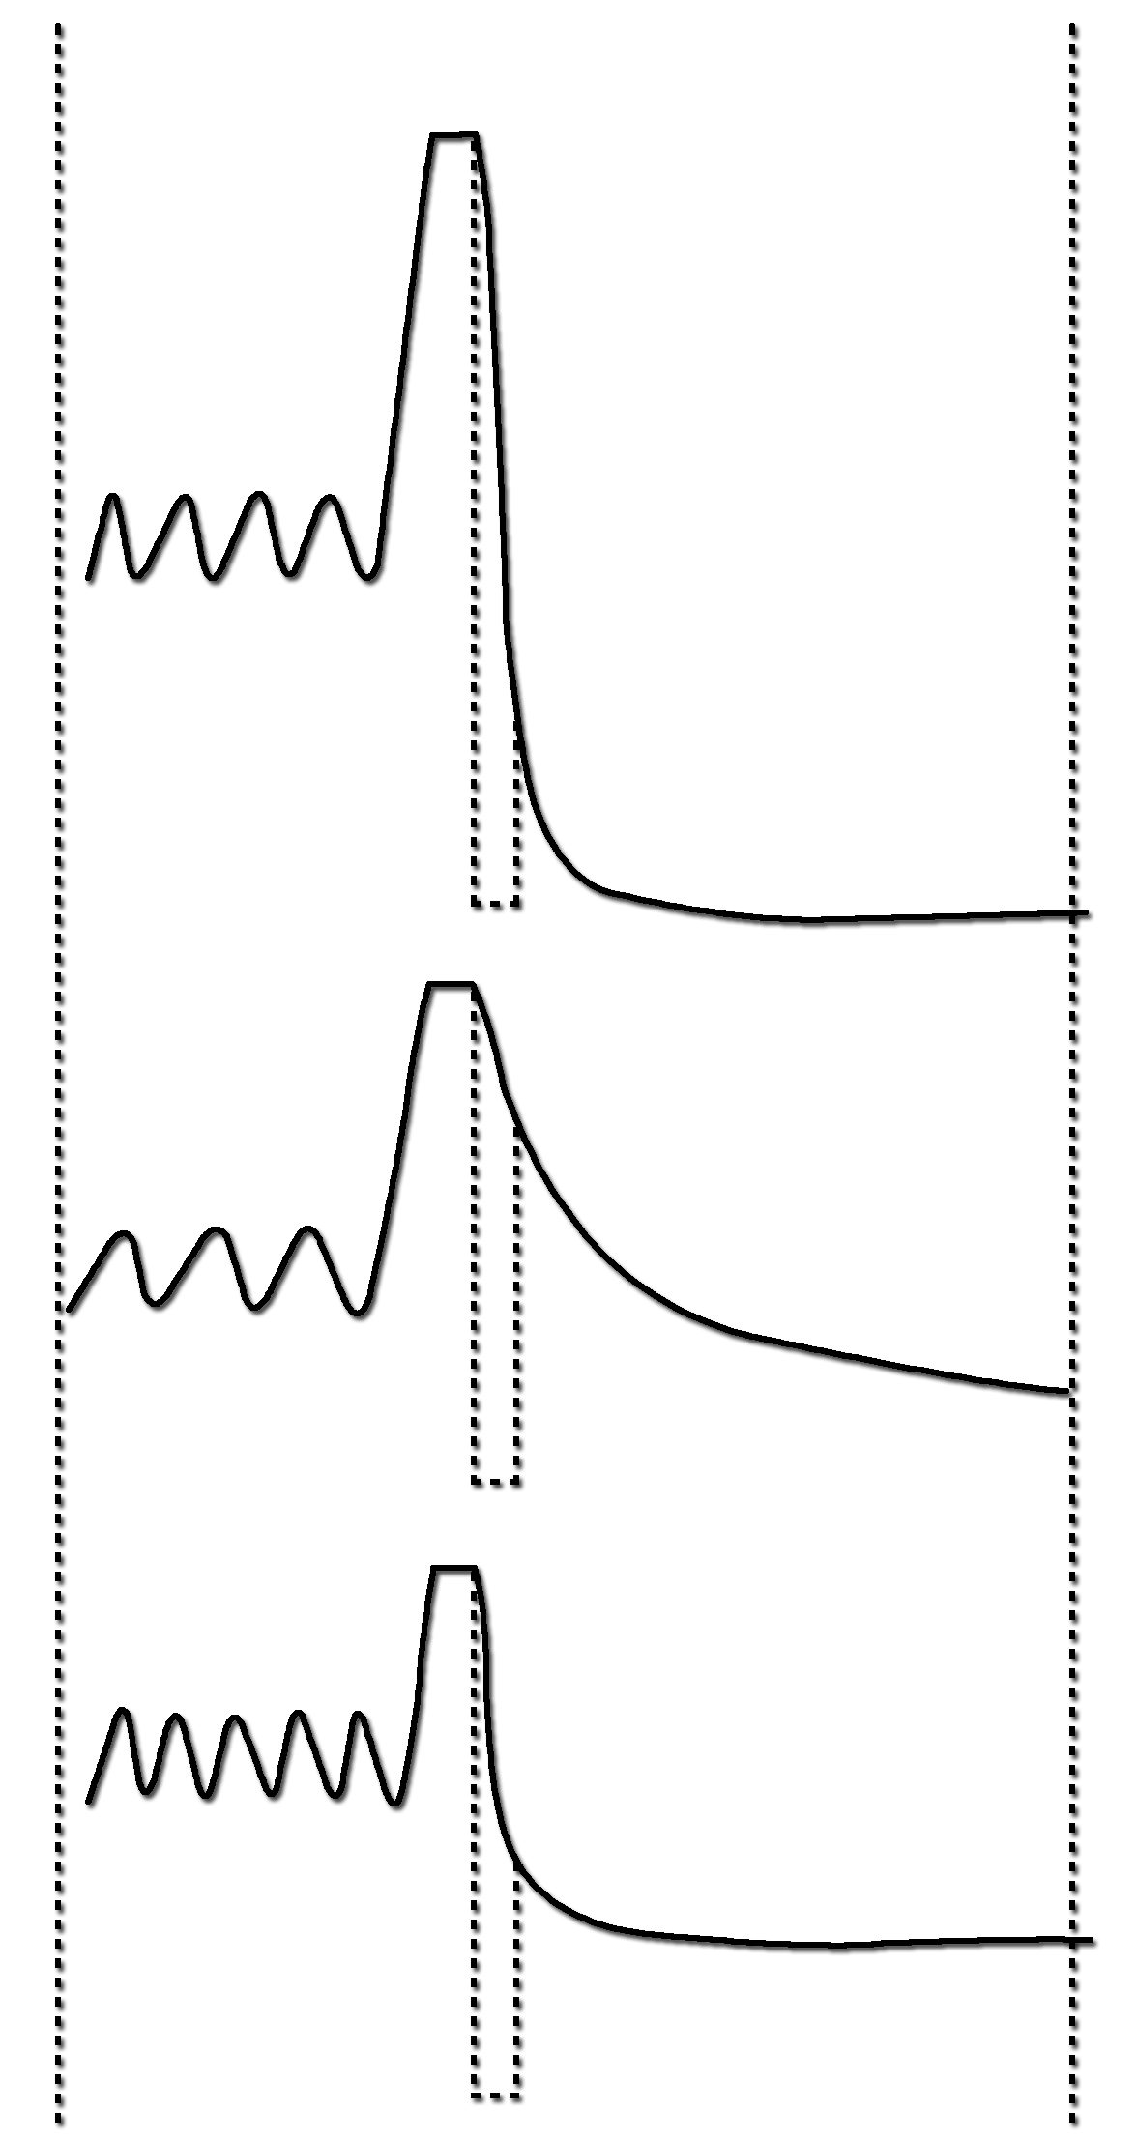
TIDAL
BREATHING
FORCED
EXPIRATION
ONLY IN FEMALES’ SLIDES
NORMAL
FEV₁ = 3.0L
FVC = 4.2L
FEV₁/FVC = 72%
FEV₁
OBSTRUCTIVE
FEV₁ = 0.9L
FVC = 2.3L
FEV₁/FVC = 40%
FEV₁
Obstructive lungs have problems with expiration.
RESTRICTIVE
FEV₁ =1.8L
FVC = 2.3L
FEV₁/FVC = 78%
FEV₁
Mini curve.
1 SECOND
- فرقوا بين أشكال الكيرف وقارنوه مع النورمال كيرف

Slide 24
Lung Volumes And Capacities (Spirogram)
Functional residual capacity =
Residual volume (RV) + Expiratory reserve volume (ERV)
Inspiratory capacity =
Tidal volume (VT) + Inspiratory reserve volume (IRV)
Vital capacity =
Expiratory reserve volume(ERV) + Inspiratory reserve volume (IRV)+
Tidal volume (VT)
Total lung capacity =
ERV +IRV + VT + RV
Spirogram: is the drawing of the spirometry. It is used for ease in describing the events of pulmonary ventilation, the air in the lungs has been subdivided in this diagram into four volumes and four capacities.

Slide 25
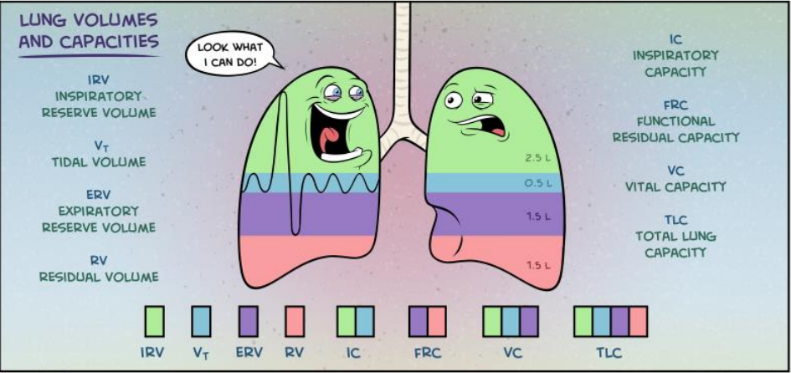
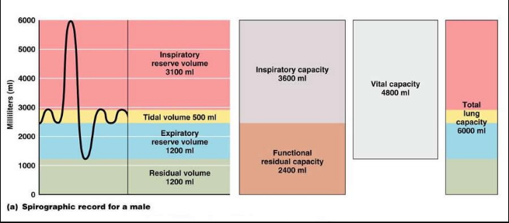
Summary Lung Volumes And Capacities

Slide 26
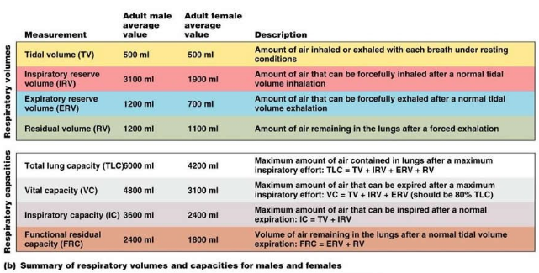
Cont.

Slide 27
Minute Ventilation Rate and Volume
Respiratory rate: Number of breaths taken per minute.
Minute ventilation: Total amount of air moved into and out of respiratory system per minute.
Minute respiratory volume: MRV: The total amount (volume) of new air that moves into the respiratory passages in each minute is called the minute respiratory volume.
Minute respiratory volume (MRV)= tidal volume x respiratory rate.
Rate of Alveolar Ventilation:
Alveolar ventilation = respiratory rate X (Tidal volume – air in dead space)
Alveolar ventilation per minute is the total volume of new air entering the alveoli and other adjacent gas exchange areas (respiratory zone) each minute. (Because 1/3 is lost in conductive zone.)

Slide 28
Note
Rate of Alveolar Ventilation:
Normal tidal volume of 500 milliliters
Normal dead space of 150 milliliters
Respiratory rate of 12-18 breaths per minute
What is the MRV and the rate of Alveolar ventilation for a patient with a respiratory rate of 12 breaths per minute?
MRV (tidal volume x respiratory rate)
= 500 x 12 = 6000 L/minutes
(it could rise to 200 L/min or more than 30 times normal if RR = 40 , TV = 4600 ml in young adults man)
Alveolar ventilation (Va) = (respiratory rate x (Tidal volume – air in dead space) )
=12 x (500 –150)= 4200 ml/min = 4.2 L
UNITS MUST BE IN LITERS!

Slide 29
Link to Editing File (Please be sure to check this file frequently for any edits or updates on all of our lectures.)
Quiz
https://www.onlineexambuilder.com/respiratory-ventilation/exam-128128
References:
Girls’ and boys’ slides.
Guyton and Hall Textbook of Medical Physiology (Thirteenth Edition.)

Slide 30
Thank you!
اعمل لترسم بسمة، اعمل لتمسح دمعة، اعمل و أنت تعلم أن الله لا يضيع أجر من أحسن عملا.
The Physiology 436 Team:
Female Members:
Shroog Alsomali
Alaa Alaqeel
Aseel Alsulaimani
Laila Mathkour
Sondos Alhawamdeh
Elham Alami
Wateen Alhamoud
Male Members:
Waleed Alaskah
Omar Babteen
Fouad Fathi
Ali Alsubaie
Team Leaders:
Qaiss Almuhaideb
Lulwah Alshiha
Contact us:
Physiology436@gmail.com
@Physiology436

