Slide 1
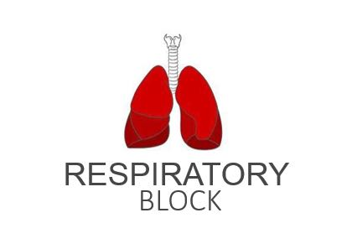
Lung Function in Health and Disease
Red: very important.
Green: Doctor’s notes.
Pink: formulas.
Yellow: numbers.
Gray: notes and explanation.
Physiology Team 436 – Respiratory Block Lecture 4
Lecture: If work is intended for initial studying.
Review: If work is intended for revision.

Slide 2
STUDY SMART
ملاحظة مهمة:
الفرق بين سلايدات العيال والبنات كبير جدا. ركزوا على المشترك بينهم أهم شي.

Slide 3
Types of Lung Function Tests
ONLY IN FEMALES’ SLIDES
Spirometry
It is the measurement of the speed and the amount of air that can be exhaled and inhaled. There are two types: 1. Static (for lung volumes) and
Body Plethysmography test:
Cardiopulmonary “Exercise” Stress Testing
Used for evaluation of dyspnea that is out of proportion to findings on static pulmonary function tests (to differentiate between cardiac and chest problems)
Diffusing Capacity of Lung for Carbon Monoxide
The patient is required to sit in an airtight chamber that resembles a small telephone booth. Inside the chamber is an affixed spirometer, which is used to determine the flow properties of the patient.
To evaluate the presence of possible parenchymal lung disease
Pulse Oximetry
The principle is measurement of O2 saturation by spectrophotometry
2. dynamic (for FEV1 and flow rate)
A diagnosis tool to assess airway responsiveness to "sensitizing" substances as opposed to nonspecific stimuli such as pharmacological agents (i.e. histamine, methacholine), cold air and exercise. Subjects are exposed to a suspected occupational agent in a controlled way under close supervision in a hospital laboratory. The specific inhalation challenges has been considered as the gold standard in confirming the diagnosis of occupational asthma.
Specific Inhalation Challenge (SIC)

Slide 4
Physiological Conditions Affecting Lung Functions
Age: In newborns it is decreased because their lungs are not fully developed, and in old age it also decreases. (Reaches its peak at the age of 35, then it starts on decreasing.)
Gender: In females it is 20%-25% less than males because females have greater body fat mass unlike males; who have greater muscle body mass.
Height: Increased height will result in longer chest cavity thus it increases lung volume.
Weight: Excessive fat in the abdomen will put pressure on the diaphragm so it will limit the lung function.
Ethnic group
الاختلافات العرقية يعني مثلا غالبا الافريقين والاوربيين يكونون طوال وبنيتهم الجسدية كبيرة والاسيويين بنتيهم صغيرة
Pregnancy: Enlarged uterus will also put pressure on the diaphragm.
Posture
Diurnal, seasonal, or climate variation
Customary activity
Geographical location
Greater in large and athletic people than in small and asthenic people.

Slide 5
Spirometry
Spirometry is a method to record volume movement of air into and out of the lungs.
1. Widely used. 2. Effort dependent (If the patient was not compliant (coughing or moving) the test will not be precise) basic lung function test.
Spirometry is a simple most commonly used test to:
1- Assess the lung performance.
2- Measure the physiological parameters: Lung volumes, Capacities, Flow rate.
3- Differentiate between the obstructive and restrictive lung conditions.
4- Play a critical role in the diagnosis, differentiation and management of respiratory diseases.نعطي المريض دواء وبعد فترة نعيد له الاختبار اذا تحسن معناته الدواء فعال إذا لا نغير العلاج

Slide 6
Overview; Indications of Spirometry
How does it benefit diagnosing?
Indications of spirometry
Clinical features (symptoms and signs) & lab tests
Occupation (pre-employment)
Certain diseases
Pre-operative
Asses therapeutic intervention
يعني متى نستخدم هذا الاختبار

Slide 7
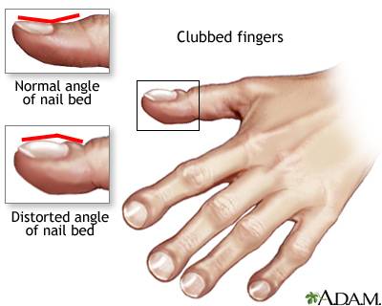
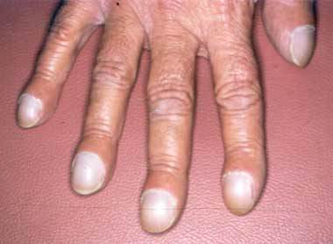
Indications of Spirometry
Based on clinical features / abnormal lab tests (the doctor suggests spirometry examination according to):
Diminished chest expansion (When you ask the patient to take deep breathe, it be limited movement)
-Hyperinflation (تضخم) نشاهده بأشعة اكس
-Diminished breath sounds صوت التنفس يكون محدود (بسبب بلموري اديما أو سوائل في التشست أو نومونيا) نحس بالصوت هذا لما نختبر بأصابعنا “percussion”
Prolongation of expiratory phase & crackles (Who have fluid in the chest)
1.
Symptoms
Dyspnea ضيق التنفس
Chest pain
4.
Abnormal Chest X Ray.
2. Signs
3.
Arterial Blood Gas Analysis
Cyanosis, ازرقاق للثة وأطراف الأصابع
Diminished breath sounds
Hypoxemia (low O2 in blood)
Hypercapnia (high CO2 in blood)
Cough
Sputum (لعاب-بلغم) production
Or phlegm production
Hyperinflation
Diminished chest expansion
Chest deformity (like: kyphosis)
Clubbing
*see in picture
Prolongation of expiratory phase & crackles
^= Low Ph (acid)
NOTE:
In Acute chest pain avoid spirometry because it requires deep inspiration & deep expiration. deep respiration exaggerates (worsens) the problem
Symptoms are what the patient says, signs are what the doctor notices.

Slide 8
Cont.
Occupational Settings:
Pre employment (spirometry must be a pre-employment test).
Periodic lung function examination for workers exposed to toxic substances including dust and fumes in industrial sectors such as:
Cement / Asbestoses
Welding / Wood / Steel
Flour / Coal mine / Oil
الناس الي يشتغلون في المصانع أو المناجم أو.... لازم نسويلهم الاختبار بشكل دوري
ONLY IN MALES’ SLIDES
To detect respiratory disease in patients presenting with symptoms of breathlessness, and to distinguish respiratory from cardiac disease. إذا جاك مريض فيه ألم في الصدر وصعوبة تنفس ووو... ونبغى نعرف إذا المشكلة في القلب أو الجهاز التنفسي نسوي هذا الاختبار
To diagnose or manage asthma (which is an obstructive disease).
To diagnose and differentiate between obstructive and restrictive lung diseases.

Slide 9
Cont.
Describe the course of diseases affecting PFT*s: نتابع تطور تحسن وتدهور بعض الأمراض
Neuromuscular diseases: Gillian Barre Syndrome, Myasthenia gravis
Pulmonary diseases: Obstructive airway diseases, Interstitial lung diseases
Adverse reactions: Drugs with known pulmonary toxicity [Pulmonary fibrosis]
Monitoring indications (to assess the therapeutic interventions):
(To measure the response to treatment of conditions which spirometry is used in the detection of e.g. COPD, etc..)
Bronchodilator therapy
Steroid treatment for asthma
Used on Chronic obstructive lung disease (like emphysema) and Interstitial (restrictive) lung disease
نشوف إذا نفع العلاج أو لا ؟
نعطي المريض دواء ولما ينتهي الكورس نعيد له الاختبار اذا تحسن معناته الدواء فعال إذا لا نغير العلاج
بعض التعقيدات اللي تصير بعد العمليات الجراحية تكون بسبب يتعلق بالتخدير , وحتى الشخص الصحي يعاني بعد العملية من ألم في الصدر , فالأشخاص اللي يعانون أصلاً من مشاكل في الرئة ممكن هالشيء يؤدي عندهم للوفاة, وعشان كذا دائماً دكتور التخدير يشوف المريض ويعاينه ويفحصه قبل العملية
Pre operative indications (to conduct pre-operative risk assessment before anesthesia):
To determine the suitability of patients for anesthesia during and after anesthesia (because anesthesia may cause chest complications after surgery).
To assess the risk for surgical procedures known to affect lung function.
*PFT= Pulmonary Function Test

Slide 10
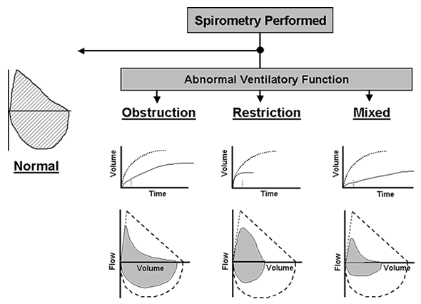
Result classification:
Assessment of Spirometry:
inspiration
Flow Volume Curve
expiration
In obstructive pattern: FVC, FEV1 and ratio decreases
In restrictive pattern FVC FEV1 decrease and ratio increases or normal
Combination of both
Normal
Obstructive
Restrictive
Combined (obstructive and restrictive)
Loop Volume Curve
Respiration is against resistant; curve is concave
يشبه الطبيعي لكن صغير
جامع الاثنين (صغير ومقعر)

Slide 11
Maintaining Accuracy
ONLY IN FEMALES’ SLIDES
The most common reasons for inaccurate results:
Inadequate or incomplete inhalation.
Additional breath taken during the test.
Lips not sealed around the mouth piece.
Slow start to forced exhalation.
Some exhalation through the nose(without nose clip).
Coughing.
الأخصائيين يتعبون مرة مع بعض المرضى خصوصاً كبار السن والأطفال لأنهم ما يتبعون التعليمات بشكل صحيح فيضطرون يعيدون كم مرة لعلهم يحصلون على نتيجة دقيقة.

Slide 12
Smoking and Spirometry
Effects of smoking on lung function:
Non-Smoker: In normal healthy non-smoker subject after the age of 30-35 the expected decline in lung function parameter [FEV1] is 25–30 ml/ year
Smokers: The average rate of decline of lung function in smokers as measured by Forced Expiratory Volume in 1 sec [FEV1] is 60-70 ml / year
In healthy person the curve goes down slowly in comparison with smoker.

Slide 13
Diagnosis of COPD
All of these indicate the use of Spirometry to diagnose COPD:
(When you see them -> use a spirometer to diagnose COPD)
Symptoms
Septum
Cough
Risk Factors
Occupation
Indoor/outdoor pollution
Dyspnea
Tobacco

Slide 14
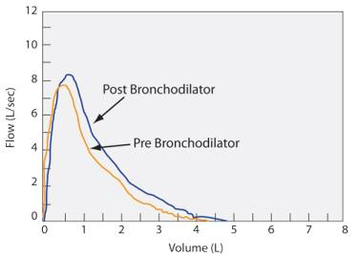
Spirometry in Respiratory Diseases
ONLY IN MALES’ SLIDES
طريقة الاختبار:
الاختبار يتسوى مرتين المرة الأولى قبل ما نعطيه موسع الشعب الهوائيه .
نسميه Pre Bronchodilator
والمرة الثانية بعد ما نعطيه موسع الشعب الهوائية , نسميه Post Bronchodilator
في الصورة تحسنت القراءات بين Pre and Post هذا يعنى انه الانسان هذا كان عنده ضيق في الشعب الهوائيه ويوم عطيناه الموسع توسعت شعبه الهوائيه . أما اذا ما صار في تحسن يعني انه الانسان سليم (شعبه الهوائيه طبيعية) فالموسع مب مأثر عليه

Slide 15
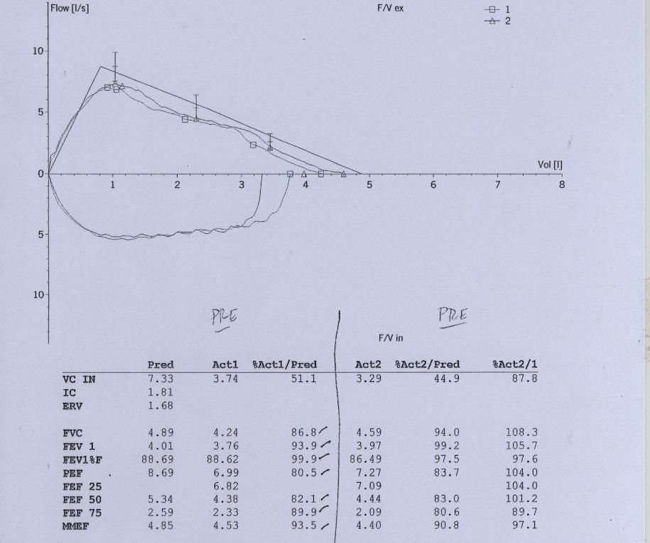
Spirometry in Respiratory Diseases
ONLY IN MALES’ SLIDES
مب جاي عليه أسئلة
Firstly, we enter age, height, weight and ethnicity to electronic spirometer → a graph will appear (spirogram)
Three values will appear on spirogram
Predicted, Actual, and Percentage
We look at the percentage for diagnosis:
Percentage 80 = normal
Percentage 70-80 = mild problem
Percentage 60-70 = moderate problem
Less than 60 = severe problem
Loop volume curve pre-bronchodilator
Predicted
Actual
Percentage
All values are above 80 = normal
Patient is normal so no need for bronchodilator challenge

Slide 16
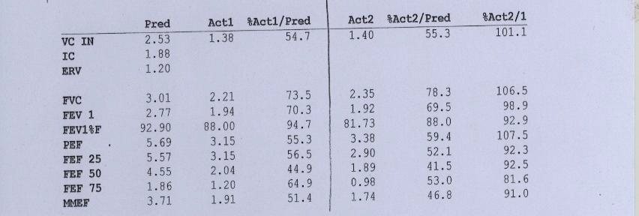
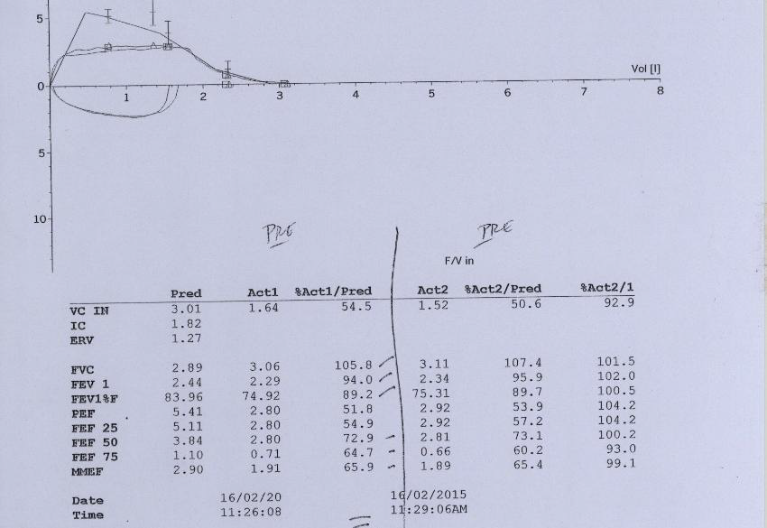
Other Examples of Spirograms
ONLY IN MALES’ SLIDES
مب جاي عليه أسئلة

Slide 17
Cont.
ONLY IN MALES’ SLIDES
SPIROMETRY& HbA1c
Any trauma (road car accident / surgery…) can cause obstruction of the airway
Extrathoracic obstruction:
obstruction in upper parts of respiratory tract
Intrathoracic airway obstruction: obstruction in lower parts of respiratory tract.
Increase in mean HbA1c is associated with decrease in lung function parameters FVC & FEV1

Slide 18
“بعض” من دراسات الدكتور
ONLY IN MALES’ SLIDES
Spirometry and Diabetes Mellitus
Spirometry and Cement Industry
Type 1 and type 2 diabetic patients showed a significant reduction in the:
Forced Vital Capacity [FVC]
Forced Expiratory Volume in one Second [FEV1]
Peak Expiratory Flow [PEF]
Forced Expiratory Flow [FEF25-75%]
Additionally, Stratification of results by years of disease showed a dose-response effect on lung function.
Lung Function Parameters
FVC
FEV1
FEF 25-75 % and
PEF were significantly decreased in cement mill workers compared to their matched controls
Spirometry and Welding Industry
Spirometry and Oil Spill
Lung Function Parameters:
FVC
FEV1
PEF were significantly impaired in welding workers compared to their matched controls
E.g. heavy manual labor or fire fighting.
Lung Function Parameters FVC, FEV₁, and FEF 25-75% were impaired in subjects exposed to crude oil spill in sea water

Slide 19
ONLY IN MALES’ SLIDES
TAKE HOME MESSAGES
The incidence of respiratory diseases has been increased, hence the importance of lung function test cannot be ignored.
Respiratory assessment through Spirometry may be mandatory at all the levels of respiratory care / clinical settings.
As we cannot treat the patient with high blood pressure without knowing the blood pressure; Similarly, we cannot treat the patients with respiratory problems without knowing the lung function test [Spirometry].

Slide 20
Link to Editing File (Please be sure to check this file frequently for any edits or updates on all of our lectures.)
Quiz + Videos
https://www.onlineexambuilder.com/lung-function-in-health-and-disease/exam-128572
Video of (Spirometry)
Duration: (6)mins
Video of (Obstructive Vs Restrictive Lung Diseases)
Duration: (2)mins
Video of (COPD)
Duration: (4)mins
References:
Girls’ and boys’ slides.
Guyton and Hall Textbook of Medical Physiology (Thirteenth Edition.)

Slide 21
Thank you!
اعمل لترسم بسمة، اعمل لتمسح دمعة، اعمل و أنت تعلم أن الله لا يضيع أجر من أحسن عملا.
The Physiology 436 Team:
Female Members:
Sumaya AlGhamdi
Ghadah Almazrou
Nouf Aloqaili
Nora Alsahli
Munirah aldofyan
Team Leaders:
Qaiss Almuhaideb
Lulwah Alshiha
Contact us:
Physiology436@gmail.com
@Physiology436

