Slide 1
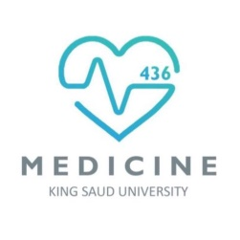
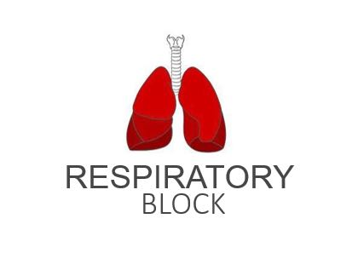
Effects of Exercise on Respiration
We recommend that you study lecture 6 (Gas Transfer) prior to studying this lecture. Good Luck!
Red: very important.
Green: Doctor’s notes.
Pink: formulas.
Yellow: numbers.
Gray: notes and explanation.
Physiology Team 436 – Respiratory Block Lecture 5
Lecture: If work is intended for initial studying.
Review: If work is intended for revision.

Slide 2
Objectives
Describe the effects of moderate and severe exercise on oxygen consumption, and ventilation volumes.
Describe the effects of exercise on arterial PO2, PCO2 and H+ ions.
Define the diffusing capacity of the respiratory membrane, and its typical values at rest, and explain its changes in exercise.
Explain causes of hyperventilation in exercise.

Slide 3
The Respiratory System and Exercise
ONLY IN MALES’ SLIDES
Energy Systems
During exercise muscles need more O2 and more CO2 must be removed from working muscles
As a result we increase
Oxygen used during exercise can increase up to 20 times a person’s normal oxygen uptake = 250 ml/min
Anaerobic systems
Aerobic systems
Uses fatty acids, glucose or amino acids
X + O2 →CO2 + H2O+Urea
X = glucose fatty acids or amino acids
I. Phosphocreatine → Creatine + PO3
II. Glycogen →Lactic acid
1- Breathing rate
2- Depth of breathing increases up to our vital capacity
3- Blood flow through the lungs
4- Oxygen intake and consumption
ATP→ADP + AMP
= Forced breathing
Up to vital capacity:
يعني كمية الهواء اللي يدخل أثناء التمرين ، بتكون مساوية للفايتل كبستي في حالة الريست
Video of (Energy Systems )
Duration: (4)mins

Slide 4
The Phosphagen Energy System
ONLY IN MALES’ SLIDES
Relation between exercise duration & energy source:
The combined amounts of cell ATP and cell phosphocreatine
These (ATP & phosphocreatine) together can provide maximal muscle power for 8 to 10 seconds, almost enough for a 100-meter run.
Thus, the energy from the phosphagen system is used for maximal short bursts of muscle power.
Aerobic system ↓
Unlimited time (as long as nutrients last)
Phosphagen system ↓
8 to 10 seconds
Glycogen–lactic acid system ↓
1.3 to 1.6 minutes

Slide 5
Brief Explanation of the Upcoming Slides
The stimulation of the respiratory system during exercises is MAINLY by neurogenic mechanism, the blood gases (PO2 + PCO2 levels) do not have to be disturbed to stimulate the hyperventilation, it get stimulated before the blood gases get disturbed so we can maintain within normal levels.
In other words; the blood gases and partial pressures during exercises are normal but we hyperventilate to maintain the normality.
Hyperventilation to prevent disturbance of gases under normal conditions rather than fixing after damage and disturbance occur. (when impulses are sent to muscles to contract impulses are also sent to the respiratory system to hyperventilate as well) to maintain normality not to correct abnormality.
هذا يعني ان جسم الإنسان لا ينتظر أن يختل اتزان الغازات حتى يبدأ التعويض بل يبدأ مع بدأ التمارين مباشرةً
Hyperventilation means increase in both breathing rate and depth.
Body heat increases during exercise due to metabolism.

Slide 6
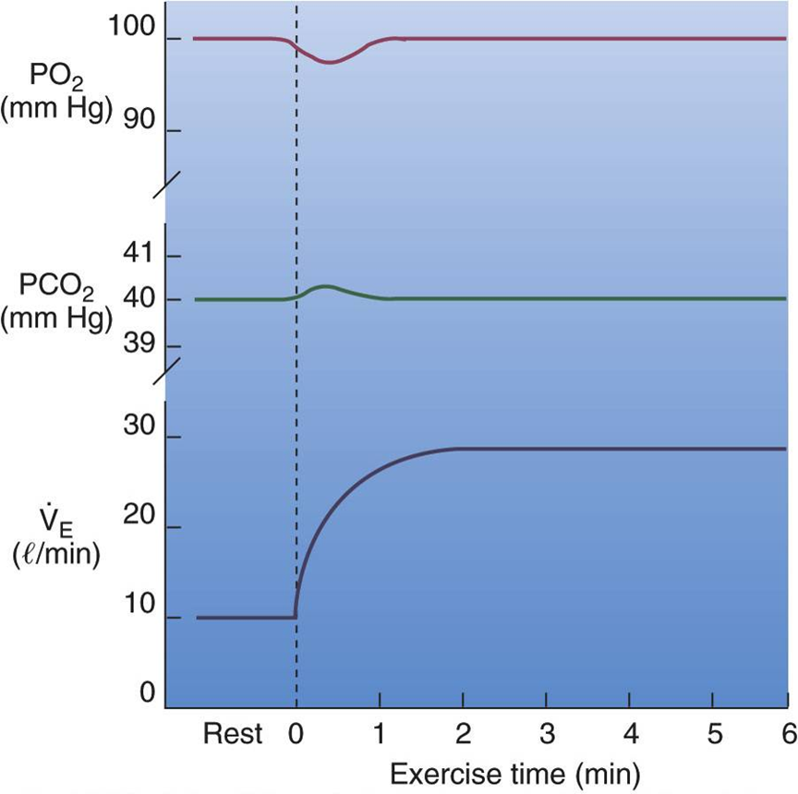
Effect of Exercise on the Respiratory System
ONLY IN MALES’ SLIDES
During exercise the respiration is stimulated by neurogenic mechanisms and in this situation the blood gases do not have to become abnormal.
Arterial tensions of PCO2 and PO2 are relatively unchanged during submaximal exercise.
but arterial PO2 decreases & PCO2 increases slight in transition from rest to steady state exercise.
Explanation:
Arterial tension is the partial pressure of any gas in the artery.
نعرف انه حسب قانون دالتون للضغوط الجزئية ، واللي ينص على أن الضغط الكلي لمخلوط غازات يساوي مجموع الضغوط الجزئية للغازات المكونة للمخلوط ، فاللي نقصده هنا الضغط الجزيئي لواحد من مجموعة الغازات جوا الشريان ما يتغير في حالة التمارين متوسطة الجهد . إن شاء الله فهمتوا ☺
Partial pressure: one part of the atmospheric pressure. i.e. oxygen only (21% of 760)
(atmospheric pressure composition: 21% oxygen - 80% nitrogen along with traces of water and other insignificant gases)

Slide 7
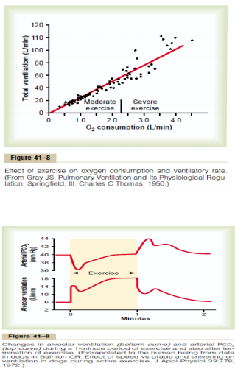
Effect of Exercise on the Respiratory System & Regulation of Respiration During Exercise
In exhausting “strenuous” exercise O2 consumption and CO2 formation increase 20 times more than normal but alveolar ventilation increases almost exactly in step with the increased levels of metabolism.
Therefore the arterial PO2, PCO2, PH all remain almost exactly normal.
الحين كلنا متفقين ان الكونسمبشن للأوكسجين وثاني أكسيد الكربون لازم يزيد مع التمرين ،، بس حسب السلايد اللي قبل هذي قلنا ان الضغوط حقتهم ما تتغير حتى لو كان فيه تمرين ليش ☹ ؟؟
السبب وراء تساوي الضغط في حالتي الراحة والتمرين ان زيادة الكونسمبشن في شيء قاعد يعادلها من الجهة الثانية وهو زيادة ال
alveolar ventilation
يعني الدم قاعد يتأكسد في الشعيرات الدموية بشكل أسرع من الطبيعي
فالاكسجين يستهلك ويعوض في نفس الوقت
-استهلاك الاكسجين ومعدل الفنتليشن يزيدون مع بعض
-كلما زاد الاحتياج يزيد التوفير.
Exercise -> hyperventilation -> increase rate and depth of breathing to vital capacity to increase oxygen intake as we need more oxygen.

Slide 8
What Causes Intense Ventilation During Exercise?
ONLY IN FEMALES’ SLIDES
The brain, on transmitting motor impulses to the exercising muscles, transmits at the same time collateral impulses into the brain stem to excite the respiratory center. مركز التنفس موجود في جذع الدماغ
A large share of the total increase in ventilation begins immediately on initiation of the exercise, before any blood chemicals have had time to change.
It is likely that most of the increase in respiration results from neurogenic signals transmitted directly into the brain stem respiratory center at the same time that signals go to the body muscles to cause muscle contraction.

Slide 9
What cause intense ventilation during exercise?
Neural signals from the motor areas of the brain to the respiratory center.وهو السبب الأقوى
The joint proprioceptors لما تتحرك المفاصل ترسل إشارات لمركز التنفس بالمستقبلات حقتها (بروبريوريسبتر)
Body temperature (hypothalamus).
Possibility that the neurogenic factor for control of ventilation during exercise is a learned response.
During maximal effort:
Pulmonary ventilation at maximal exercise 100-110 L/min
Maximal breathing capacity 150-170L/min
Maximal breathing capacity is about 50 % greater than the actual pulmonary ventilation during maximal exercise to giving athletes extra ventilation E.g.:
Exercise at high altitudes. (Because oxygen is less in high altitudes, so hyperventilation is triggered to compensate for it)
Exercise under very hot conditions.
Abnormalities in the respiratory system
Exercises which provide athletes with extra ventilation.
(Causes of hyperventilation).
زيادة الحرارة :
خلال التمرين، العضلات تنقبض كثير، فتحتاج لطاقة كثير، و وهذه الطاقة تجي (كمنتج نهائي) من تفاعلات كيميائية (هوائية-لاهوائية)، وأيضا من المنتجات النهائية لهذه ا لتفاعلات هي الحرارة , فكل ما زادت هذه التفاعلات تعطينا حرارة أكثر زي ما تعطينا طاقة للحركة *ونشوفها في الأطفال اذا جتهم حرارة يصيرون يلهثون .

Slide 10
Interrelation Between Chemical Factors and Nervous Factors in the Control of Respiration During Exercise
ONLY IN FEMALES’ SLIDES
Direct nervous signal stimulate the respiratory center almost the proper amount to supply the extra oxygen required for exercise and to blow off extra carbon dioxide.
Occasionally, the nervous respiratory control signals are either too strong or too weak.
Then chemical factors play a significant role in bringing about the final adjustment of respiration required to keep the O2, Co2, and H+ ion concentrations of the body fluids as nearly normal as possible.تكون المستقبلات على البلود فسل
بحيث اذا تغيرت تراكيز الغازات ترسل إشارات لتزيد معدل التنفس
The chemical factors (the partial pressure of the gas levels) tune and adjust the hyperventilation stimulated by the neurogenic mechanisms because they’re not that accurate. But these Factors ARE NOT the driving force of the hyperventilation.

Slide 11
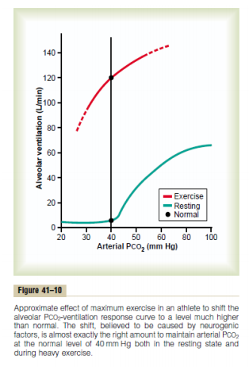
The Neurogenic Factor for Control of Ventilation During Exercise is a Learned Response (Conditioned Reflex)
ONLY IN FEMALES’ SLIDES
The ventilatory response during exercise, is at least partly a learned response.
That is, with repeated periods of exercise, the brain becomes progressively more able to provide the proper signals required to keep the blood PCO2 at its normal level.
The cerebral cortex is involved in this learning, because experiments that block only the cortex also block the learned response.
Learned Response:
من الأمثلة عليه لما نصير نروح يومياً لنادي في وقت محدد وجاء يوم ما رحنا! جسمنا يحدث فيه تغيرات يحسب انه هذا وقت الرياضة واننا الأن في النادي☺
if your brain knows you will exercise (e.g. when you enter a gym you always go to) it starts sending imp to muscles to contract before even beginning.

Slide 12
Example: using the stairs needs alveolar ventilation from 4-6 so the body provides 8 to wash out the CO2 so the range keeps fluctuating and sometimes provides more than needed which may disturb blood gas levels then it goes back to normal with fluctuation to release less CO2.
We tune this by blood gases working on chemoreceptors.
Motor cortex sends impulses to the respiratory center and skeletal muscle at the same time
When it is contracted it will send impulses to the respiratory center
ONLY IN FEMALES’ SLIDES

Slide 13
ONLY IN FEMALES’ SLIDES

Slide 14
Diffusion Capacity of the Respiratory Membrane
This means each one (mmHg) gives 21ml/min of diffusion capacity, so for example if we have 11 mmHg of O2 How much ml/min will diffuse through membrane ?
11 x 21 = 230
So 230 ml of O2 will diffuse in a minute
- إذا عند مستوى سطح البحر الفرق بيكون
104-40=64 mmHg
فحلو يكون الفرق يعطينا أكثر من حاجتنا .وهو أهم شيء ان الفرق يكون يعطينا المقدار اللي نحتاجه أو أكثر
Changes occur on oxygen diffusing capacity during exercise it will become =
65ml/min/mmHg
This is due to increased number of open pulmonary capillaries which were dormant (inactive), thereby increasing the surface area for gas exchange.
In addition to increased alveolar ventilation.
زي ما قلنا السلايد اللي قبل ان سرعة الترشيح تزيد بين ال
Alveoli &
Capillaries
طيب وشو اللي قاعد يترشح؟
أوكسجين وثاني أكسيد الكربون فطبيعي يزيد
diffusing capacity
لهذي الغازات
Is the volume of gas that diffuses through the membrane each minute for a pressure difference of 1mmHg.
Diffusing capacity for oxygen at rest =21ml/min/mmHg
Even if the oxygen pressure difference across the respiratory membrane is 11mmHg
11x21= 230ml oxygen diffusing through the membrane each minute.
During rest tissues consume 250 ml O2 per min.
^ليش ضربنا ب 11 ؟ عشان نعرف كم أقل شيء نحتاجه عشان يتوفر لي الكمية المطلوبة من الاكسجين (250) , فلو قل عنه تصير مشكلة
Notes:
From 434 Team

Slide 15
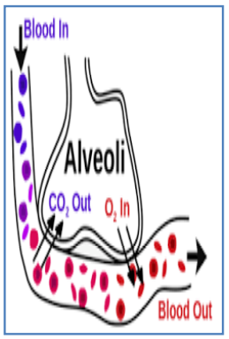
Diffusing capacity for carbon dioxide
ONLY IN MALES’ SLIDES
During rest tissues consume 250 ml O2 per min, CO2 diffuses 20 times greater than oxygen due to greater diffusion coefficient which is 20 times that for oxygen.
Diffusion capacity for carbon dioxide =400ml/min/mmHg.
During exercise = 1200 to 1300ml/min/mmHg.
Remember:
Oxygen-Diffusing Capacity of Athletes
The differences between diffusing capacity at resting and the state of maximal exercise make blood flow through many of the pulmonary capillaries and provide greater surface area through which oxygen can diffuse into the pulmonary capillary of blood.
More pulmonary capillaries → more surface area → more diffusion
Remember:
diffusion coefficient = S / √MW
- CO2 more soluble than O2 ,so it diffuses more.
It diffuses 20 times greater than Oxygen. Why ?
Because its easily diffusible because it has less partial pressure difference and higher molecular weight.
Note:
Diffusion coefficient depends more on water-solubility rather than molecular weight.
Diffusion capacity: is directly proportional to are of diffusion and inversely proportional to distance of diffusion.
More soluble in water therefor more diffusible because it is more soluble in tissue water

Slide 16
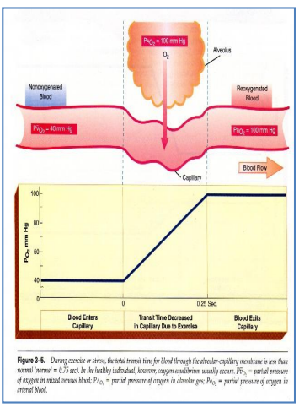
Oxygen Diffusing Capacity Cont.
During exercise the oxygen requirement increases 20 times, and cardiac output increases and so the time blood remains in the pulmonary capillaries becomes less than half normal despite the fact that additional capillaries open up.
But the blood is almost completely saturated with oxygen when it leaves the pulmonary capillaries.
معنى الكلام: أثناء التمرين، استهلاك الاكسجين يزيد ٢٠ ضعف، والكاردياك اوتبت يزيد(الدم قاعد يضخ بسرعة)، فالوقت الي يقعد فيه الدم في الأوعية الرئوية ينقص بالرغم من هذا تركيز الاكسجين في الدم عالي. ليش التركيز عالي دام الوقت نقص؟
Reasons for this are as follow:
1. The diffusing capacity for oxygen increases almost three folds during exercise, this results mainly from increasing numbers of capillaries participating in the diffusion and a more V/Q ratio all over the lung.
(It is the ratio of alveolar ventilation to pulmonary blood flow (cardiac output) per minute).
2. At rest the blood normally stays in the lung capillaries about three times as long as necessary to cause full oxygenation. Therefore, even with shortened time of exposure in exercise, the blood is still fully oxygenated or nearly so.
السبب في انه تركيز الاكسجين عالي:
١- ديفيوشن حق الاكسجين يزيد في الرياضة (يوصل ٦٥)، فينتقل اكسجين اكثر من الرئة إلى الدم
٢- في كيو راشيو يزيد ( في محاضرة بتشرح معناه)
٣- انه الدم في الحالة الطبيعية بيقعد في الاوعية الرئوية ثلاث اضعاف الوقت الي يحتاجه عشان يتأكسج ( فهو اصلا مو محتاج كل هذا الوقت , فلو نقص الوقت تركيز الاكسجين ما رح يقل )

Slide 17
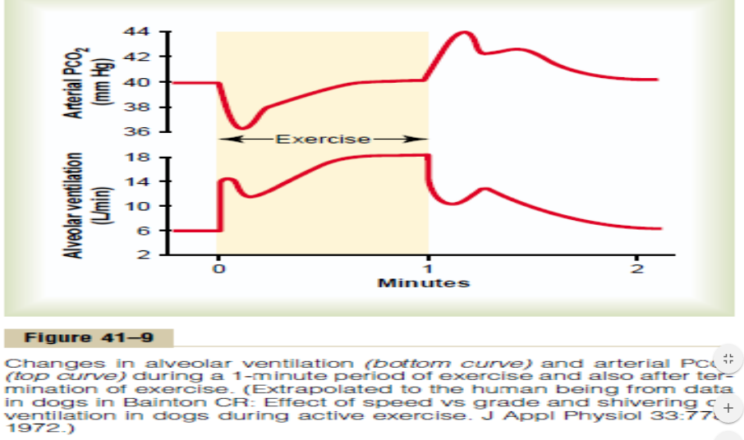
Relation Between O2 Consumption and Total Pulmonary Ventilation at Different Levels of Exercise
There is a linear relationship between both oxygen consumption (Vo2 Max) and total pulmonary ventilation increase about 20-folds between the resting state and maximal intensity of exercise in the well-trained athlete.

Slide 18
Pulmonary Ventilation and Maximal Breathing Capacity(MBC)
ONLY IN MALES’ SLIDES
Effects of Exercise on Arterial PO2, PCO2 and H+ Ions.
During maximal effort:
• Pulmonary ventilation (minute ventilation) at maximal exercise 100-110L/min
• Maximal breathing capacity 150-170L/min
Maximal breathing capacity is about 50 % greater (70% in some references) than the actual pulmonary ventilation during maximal effort (i.e. exercise).
Many studies have since reported that the lactate threshold (LT) is strongly correlated with ventilatory anaerobic threshold (VAT). The term VAT actually refers to the onset of exercise induced hyperventilation during effort. This increase in is a homeostatic response to deal with the consequences of the excess lactate production which can dissociate to release H+ ions from lactic acid into the blood stream. The H+ ions are buffered by bicarbonate and release CO2. This buffering of lactic acid results in extra CO2 production over that produced by aerobic metabolism and increases the arterial CO2 partial pressure (PaCO2). The increase in PaCO2 stimulates excess ventilation that follows on from the lactate threshold.
Thank you team 435 for the graph!
Respiratory minute volume: air that moves into all of the respiratory passages per minute
Alveolar ventilation per minute: air that reaches the respiratory unit only per minute.

Slide 19
Oxygen Consumption and Pulmonary Ventilation in Exercise
Normal oxygen consumption for a young man at rest is about 250 ml/min.
However, under maximal conditions, this can be increased to approximately the following average levels:
Untrained average male 3600 ml/min
Athletically trained average male 4000 ml/min
Male marathon runner 5100 ml/min

Slide 20
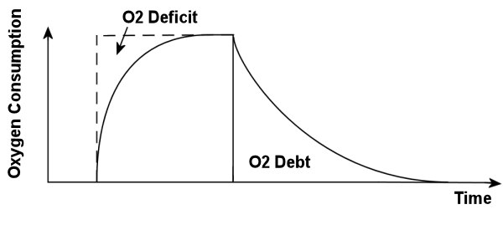
Oxygen Debt
ONLY IN MALES’ SLIDES
Oxygen debt is the extra consumption of oxygen after completion of strenuous exercise (about 11.5 liters).
You will develop oxygen debt after about 5 minutes or more of constant exercise. This is the point when the exercise becomes anaerobic (without the use of oxygen) and which has to be paid back. If the exercise is just aerobic (with oxygen) there will be no oxygen debt.
Example: when you have a short intense burst of exercise such as sprinting you generate energy for this anaerobically or without oxygen. When you stop exercising you are still breathing heavily. This is your body taking in extra oxygen to 'repay' the oxygen debt.

Slide 21
Summary (Numbers)
Diffusing capacity for oxygen at rest → 21ml/min/mmHg
diffusing capacity of oxygen during exercise →65ml/min/mmHg
Diffusion capacity for carbon dioxide at rest → 400ml/min/mmHg.
Diffusion capacity for carbon dioxide during exercise →1200 to 1300ml/min/mmHg.
Oxygen consumption (Vo2) at rest → 250 ml/min
Untrained average male → 3600 ml/min
Athletically trained average male → 4000 ml/min
Male marathon runner → 5100 ml/min
O2 consumption and CO2 formation and pulmonary ventilation (minute ventilation) increase 20 folds during strenuous (exhausting) exercise
Pulmonary ventilation (minute ventilation) at rest → 12 L/min
Pulmonary ventilation (minute ventilation) at maximal exercise →100-110L/min
Maximal breathing capacity → 150-170L/min
Phosphagen system → 8 to 10 seconds
Glycogen–lactic acid system →1.3 to 1.6 minutes
Aerobic → unlimited
Oxygen debt → (about 11.5 liters).

Slide 22
Link to Editing File (Please be sure to check this file frequently for any edits or updates on all of our lectures.)
Quiz
https://www.onlineexambuilder.com/effects-of-exercise-on-the-respiratory-system./exam-128832
References:
Girls’ and boys’ slides.
Guyton and Hall Textbook of Medical Physiology (Thirteenth Edition.)

Slide 23
Thank you!
اعمل لترسم بسمة، اعمل لتمسح دمعة، اعمل و أنت تعلم أن الله لا يضيع أجر من أحسن عملا.
The Physiology 436 Team:
Female Members:
Ghadah almazrou
Sumaya Alghamdi
Nouf Aloqaili
Nora Alsahli
Lama Alfouzan
Munirah aldofyan
Male Members:
Mohammad Almutlaq
Faisal Alfawaz
Fahad Alfayez
Ali Alsubaei
Team Leaders:
Qaiss Almuhaideb
Lulwah Alshiha
Contact us:
Physiology436@gmail.com
@Physiology436

