Slide 1
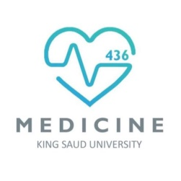
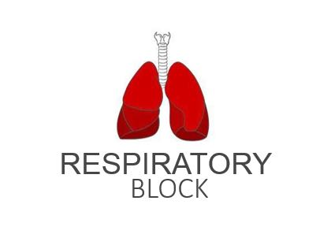
Gas Transfer (Diffusion of O2 and CO2)
Red: very important.
Green: Doctor’s notes.
Pink: formulas.
Yellow: numbers.
Gray: notes and explanation.
Physiology Team 436 – Respiratory Block Lecture 6
Lecture: If work is intended for initial studying.
Review: If work is intended for revision.

Slide 2
Objectives
Define partial pressure of a gas.
Understand that the pressure exerted by each gas in a mixture of gases is dependent on the pressure exerted by the other gases (Dalton's Law)
Understand that gases in a liquid diffuse from higher partial pressure to lower partial pressure (Henry’s Law)
Describe the factors that determine the concentration of a gas in a liquid.
Describe the components of the alveolar-capillary membrane (i.e., what does a molecule of gas pass through).
Knew the various factors determining gas transfer: - Surface area, thickness, partial pressure difference, and diffusion coefficient of gas
State the partial pressures of oxygen and carbon dioxide in the atmosphere, alveolar gas, at the end of the pulmonary capillary, in systemic capillaries, and at the beginning of a pulmonary capillary.

Slide 3
Gas Exchange Through the Respiratory Membrane
- Gas exchange happens between alveolus and capillaries that surround it.
- Both the alveoli and capillaries have to be patent (open) and functioning for gas exchange to occur.
- If one of them was not patent (collapsed), diffusion will not happen.

Slide 4
Cont.
Pulmonary vein
Pulmonary vein
Where external respiration happens
Systemic vein
Systemic artery

Slide 5
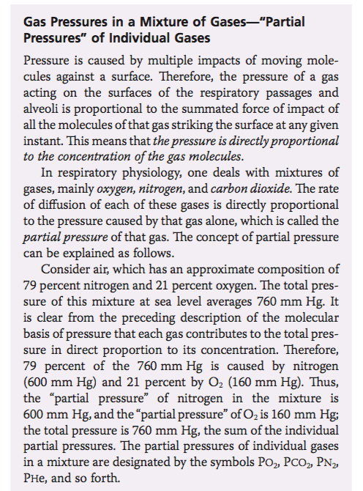
Partial Pressure of Gases (in a Mixture)
ONLY IN FEMALES’ SLIDES
It is caused by: the constant kinetic movement of gas molecules against the surface.
The 3 main gases (mixture) in respiratory physiology:
O₂ , N₂, and CO₂.
The rate of diffusion of each of these gases: is directly proportional with the partial pressure of the gas.
Pressure of gases dissolved in water and tissue:
The pressure of gases dissolved in fluid is similar to their pressure in the gaseous phase and
They exert their own individual partial pressure.

Slide 6
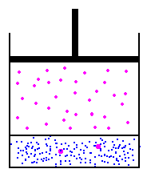
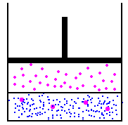
ONLY IN FEMALES’ SLIDES
Laws in Gas Exchange & Transfer
Dalton's Law of Partial Pressures
Henry's Law
(of Solubility)
Ptotal = P1 + P2 + P3 + . .
It state that:
If the temperature stays constant , increasing the pressure will increase the amount of dissolved gas
Because: Gases in a liquid diffuse from higher partial pressure to lower partial pressure.
solubility (concentration) is directly proportional to the gas partial pressure.
States that:
The total pressure exerted by a mixture of gases is the sum of partial pressure of each individual gas present.
Low pressure equilibrium
Low concentration
Double the pressure equilibrium
Double the concentration
Video of (Partial Pressure)
Duration: (6:12) mins
Video of (Henry’s Law) Duration: (8:38)mins

Slide 7
Factors that Affect the Diffusion Rate of Gas Through the Respiratory Membrane
ONLY IN FEMALES’ SLIDES
D = α ΔP x A x S
d x √MW
D: diffusion rate
P: Partial pressure differences (direct)
A: Surface area for gas exchange (direct)
S: Solubility of gas (direct)
d: diffusion distance (thickness) (inversely)
MW: Molecular weight (inversely)
The diffusion rate of specific gases:
Diffusion coefficient for the transfer of each gas through the respiratory membrane depends:
Directly on its solubility (S) through the membrane
Inversely on the square root of its molecular weight (MW).
CO₂ diffuses 20 times as rapidly as O₂.
Factor that may also affect gas diffusion: (male slides)
Diffusion of coefficient of gas (directly )
علاقة ال D طردية مع أي شيء في البسط و عكسية مع أي شيء في المقام.
Direct : Directly proportion (increase → increase ) , Inversely proportion (increase → decrease) and vice versa.

Slide 8
Factors That Affect the Diffusion Rate of Gas Through the Respiratory Membrane
P: Partial Pressure Differences:
The difference in gas pressure between the two sides of the membrane (between the alveoli and the capillary blood).
This difference dictates the direction of diffusion:
For Oxygen: the pressure of the gas in the alveoli is greater than the pressure of the gas in the blood, so the gas will diffuse from the alveoli into the blood. (from high to low)
PO2 in alveoli = 104, In blood = 40
For CO2: the pressure of the gas in the blood is greater than the pressure in the alveoli, net diffusion from the blood into the alveoli occurs.
PCO2 in blood = 45, In alveoli = 40.
A: Surface Area of the Membrane:
Average surface area is 70 m^{2.} in normal adult.
Removal of an entire lung decreases the surface area to half normal.
In emphysema (usually due to heavy smoking) with dissolution (loss) of the alveolar walls → decrease surface area to 5-folds.
D: Diffusion Distance (the Thickness of the Respiratory Membrane):
Membrane thickness is almost 0.5 μm (very thin) and presents little obstacle to diffusion.
If the membrane thickens, diffusion will take more time + gas exchange is inhibited (inversely proportional) like during exercise.
Higher thickness like in edema, infection, or fluid effusion → lower rate of diffusion.
The thickness of the respiratory membrane is inversely proportional to the rate of diffusion through the membrane.

Slide 9
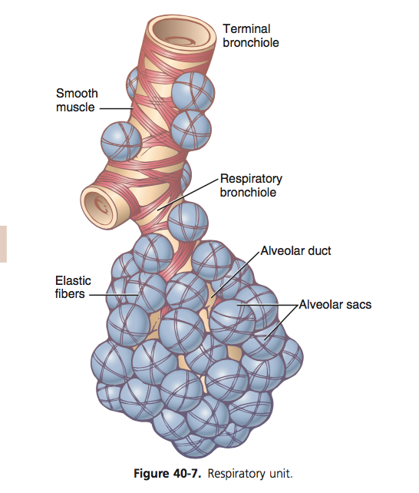
Respiratory Unit
ONLY IN MALES’ SLIDES
Also called: respiratory lobule.
Composed of: a respiratory bronchiole, alveolar ducts, atria, and alveoli.
Number of alveoli in 2 lungs: about 300 million alveoli in the two lungs.
Alveoli diameter: an average of 0.2 millimeters.
Respiratory membrane thickness: in some areas it is as little as 0.2 micrometer, on average it is 0.6 micrometers.
Total quantity of blood in the capillaries of the lungs: is (60 to 140 milliliters).

Slide 10
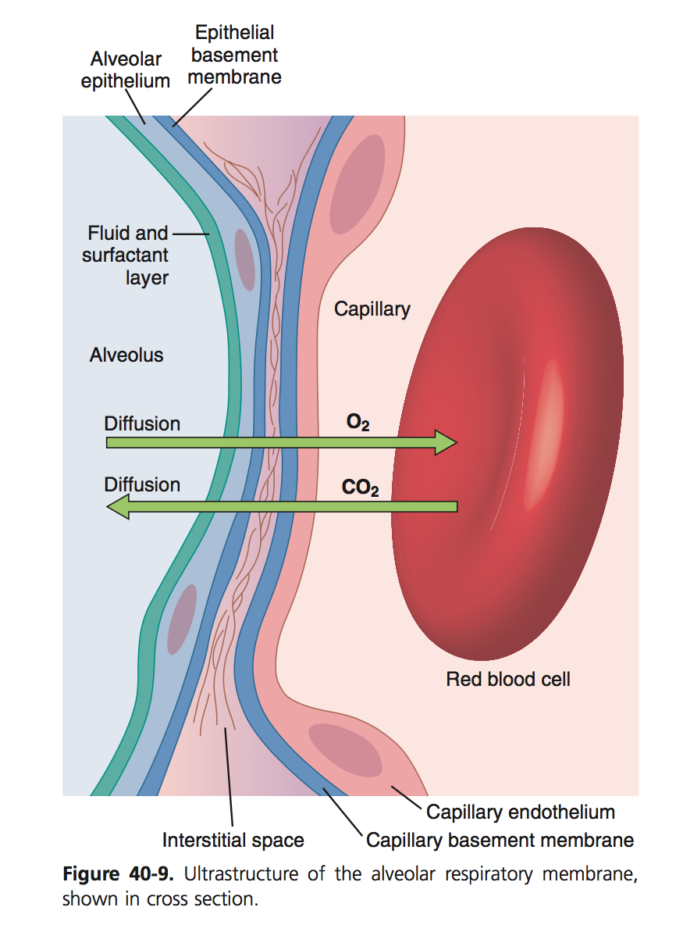
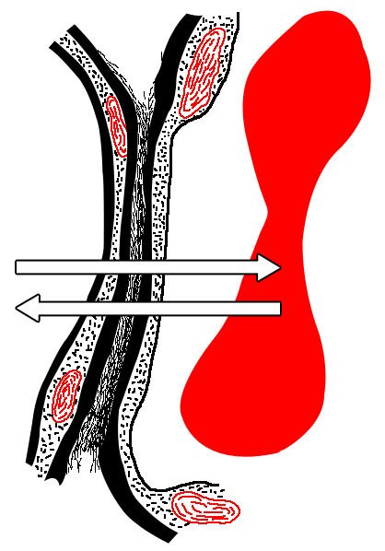
Layers of Respiratory Membrane (Alveolus) From Inside Out
3- Epithelial basement membrane
4- Interstitial space
5- Capillary basement membrane
Clearer picture:
6- Capillary endothelium
2- Alveolar epithelium
Red blood cell
1- Fluid and surfactant layer
A layer of fluid lining the alveolus
The alveolar epithelium
An epithelial basement membrane
Interstitial space
Capillary basement membrane
The capillary endothelial membrane
Alveolus
Capillary
Diffusion
O2
Diffusion
CO2
Because of their partial pressures O2 and CO2 have opposite diffusion directions as we have mentioned previously.

Slide 11
ONLY IN FEMALES’ SLIDES
Partial Pressures of Respiratory Gases as They Enter and Leave the Lungs (at Sea Level)
 | N₂ | O₂ | CO₂ | H₂O
Atmospheric Air (mmHg) | 597.0 (78.62%) | 159.0 (20.84%) | 0.3 (0.04%) | 3.7 (0.50%)
Humidified Air (mmHg) = conductive zone or anatomical dead space. | 563.4 (74.09%) | 149.3 (19.67%) | 0.3 (0.04%) | 47.0 (6.20%) Because it is humidified
Alveolar Air (mmHg) = respiratory zone. | 569.0 (74.9%) | 104.0 (13.6%) | 40.0 (5.3%) | 47.0 (6.2%)
Expired Air (mmHg) | 566.0 (74.5%) | 120.0 (15.7%) | 27.0 (3.6%) | 47.0 (6.2%)
O2 concentration in the atmosphere is 21%
PO2 in atmosphere = 760mmHg x 21% =160 mmHg.
This mixes with “old” air already present in alveolus to arrive at PO2 of 104 mmHg in alveoli. (drop)
CO2 concentration in the atmosphere is 0.04%
PCO2 in atmosphere = 760mmHg x 0.04% = 0.3 mmHg
This mixes with high CO2 levels from residual volume in the alveoli to arrive at PCO2 of 40 mmHg in the alveoli. (Increase)

Slide 12
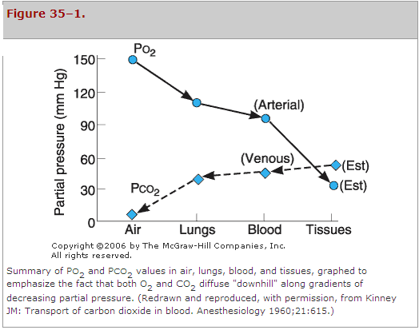
Composition of Alveolar Air and its Relation to Atmospheric Air
Further explanation of the previous schedule:
Alveolar air is partially replaced by atmospheric air with each breath.
O2 is constantly absorbed from the alveolar air. (reason of decrease)
CO2 constantly diffuses from the pulmonary blood into the alveoli. (reason of increase)
Once the dry atmospheric air enters the respiratory passage, it is humidified before it reaches the alveoli.
(as we studied in the function of conduction zone, or the function or respiratory mucosa)

Slide 13
PO2 and PCO2 in Various Potions of Normal Expired Air
PO2:
1. Diffusion from atmosphere into alveolus.
2. Diffusion from alveolus into pulmonary blood:
In Alveolus = 104
In venous (pulmonary) blood = 40
Pressure difference of O2 between alveoli and blood is : 014-40 = 64mmHg
3. Diffusion from Capillaries into interstitial fluid:
In arterial (end)blood = 95
In interstitial = 40
4. Diffusion from interstitial fluid into cells:
In interstitial = 40
Inside cell = 20 (females’ slides) 23 (males’ slides).
Atmosphere
PCO2:
1. Diffusion from cell into interstitial fluid:
Inside cell = 46
In interstitial = 45
2. Diffusion from interstitial fluid into capillaries:
In interstitial = 45
In venous blood = 40
3.Diffusion pulmonary into alveoli:
In pulmonary blood = 45
In Alveolus = 40
4. Diffusion from alveolus into Atmosphere
Pulmonary artery
Pulmonary vein
Systemic artery
Systemic vein
Both happen in opposite directions.

Slide 14
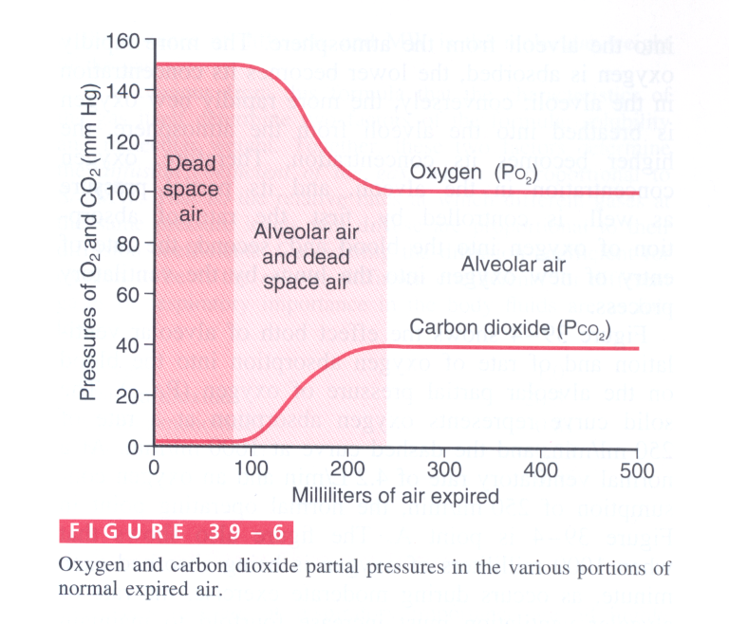
Cont.
Video of (Gas Diffusion)
Duration: (12)mins

Slide 15
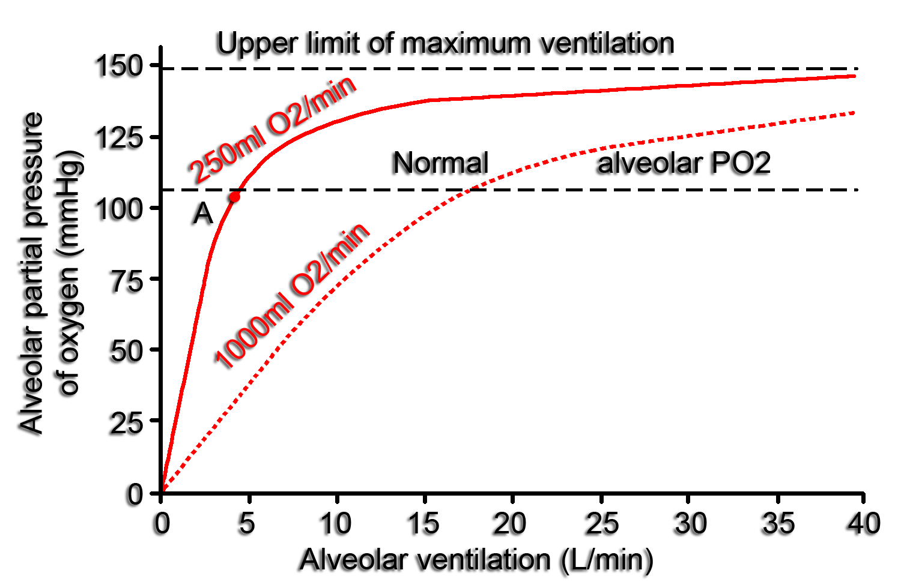
O2 Concentrations in the Alveoli
ONLY IN FEMALES’ SLIDES
At resting condition: 250 ml of oxygen enters the pulmonary capillaries per minute (normal rate), as shown in the solid curve.
At normal ventilation rate: 4.2 L/min.
Alveolar PO2 is at point A at 104 mmHg
During exercise: 1000 ml of oxygen is absorbed by the pulmonary capillaries/min, as represented by the dotted curve.
The alveolar (pulmonary) ventilation rate must increase 4 times (folds) to maintain the alveolar PO2 (partial pressure) at the normal value of 104 mmHg.

Slide 16
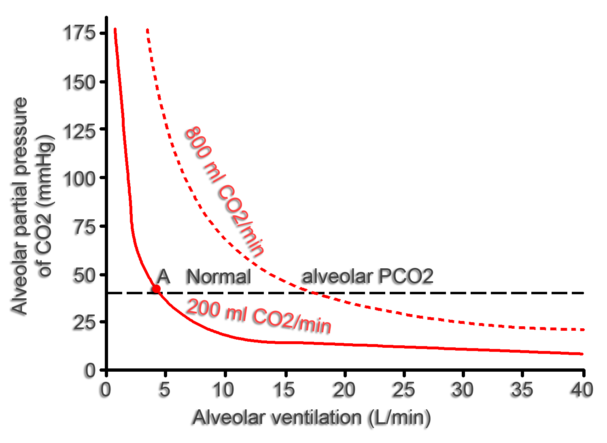
CO2 Concentrations in the Alveoli
ONLY IN FEMALES’ SLIDES
At resting condition: 200ml of CO2 is excreted per minute (normal rate), as shown in the solid curve.
At normal ventilation rate: 4.2 L/min.
The operating point for Alveolar PCO₂ is at point A at 40mmHg.
During exercise: 800 ml of CO2 is excreted per minute, as represented by the dotted curve (Also 4 folds).
Alveolar PCO₂ increases directly in proportion to the rate of CO₂ excretion.
Alveolar PCO₂ decreases in inverse proportion to alveolar ventilation.

Slide 17
Link to Editing File (Please be sure to check this file frequently for any edits or updates on all of our lectures.)
Quiz
https://www.onlineexambuilder.com/gas-exchange-and-gas-transfer/exam-128880
References:
Girls’ and boys’ slides.
Guyton and Hall Textbook of Medical Physiology (Thirteenth Edition.)

Slide 18
Thank you!
اعمل لترسم بسمة، اعمل لتمسح دمعة، اعمل و أنت تعلم أن الله لا يضيع أجر من أحسن عملا.
The Physiology 436 Team:
Female Members:
Rana Barasain
Reema Alotaibi
Leena Alwakeel
Haifa Alshaalan
Male Members:
Mohammed Alayed
Fares alnafeesah
Team Leaders:
Qaiss Almuhaideb
Lulwah Alshiha
Contact us:
Physiology436@gmail.com
@Physiology436

