Slide 1
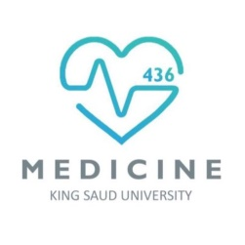
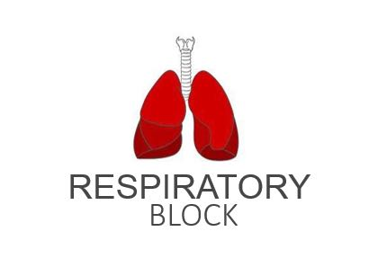
Oxygen and Carbon Dioxide Transport
Red: very important.
Green: Doctor’s notes.
Pink: formulas.
Yellow: numbers.
Gray: notes and explanation.
Physiology Team 436 – Respiratory Block Lecture 7
Lecture: If work is intended for initial studying.
Review: If work is intended for revision.

Slide 2
Objectives
Understand the forms of oxygen transport in the blood, the importance of each.
Differentiate between O2 capacity, O2 content and O2 saturation.
Describe (Oxygen- hemoglobin dissociation curve)
Define the P50 and its significance.
How DPG, temperature, H+ ions and PCO2 affect affinity of O for hemoglobin and the physiological importance of these effects.
Describe the three forms of carbon dioxide that are transported in the blood, and the chloride shift.

Slide 3
Transport of O2
The main function of blood: Transporting respiratory gases between the lungs and body (tissues).
Transport of O2
97 % in Hb
from the lungs to the tissues
3% dissolved in plasma
Hb + Oxygen = Oxyhaemoglobin
Binding:
O2 binds loosely and reversibly to Haem portion on hemoglobin.
Haem part:
The haem part of the Hb contains 4 atoms of iron → able to combine with a molecule of oxygen.
Result:
Hemoglobin can carry 4 molecules of O2 or 8 atoms of O2: Hb + 4O₂ → Hb(O₂)₄
Chemical combination
Physical combination

Slide 4
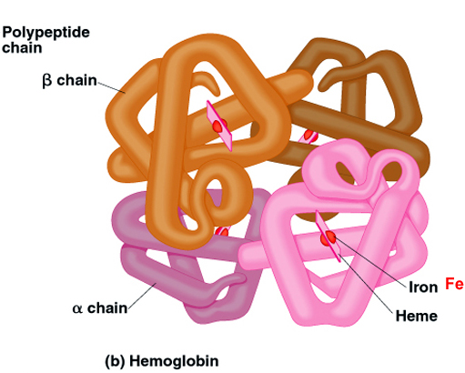
Binding to Hemoglobin
ONLY IN FEMALES’ SLIDES
The amount of O₂ carried in the blood in oxyhaemoglobin depends on the amount of Hb present in the blood.
The normal amount of Hb in young adults:
14-16 gm/dl of the blood.
Each gram of Hb can bind with: 1.34 ml of O₂.
Thus, if a person’s Hb is 16 gm/dl of blood his blood can carry: 16 x 1.34 = 21.44 ml of O₂/dl
هذا يفسر ليش يصير الاختناق وقت الحرايق , أول اكسيد الكربون ( CO) يرتبط بال Hb بكمية عالية فبالتالي يمنع o2 من الأرتباط بال Hb .

Slide 5
Transport of O2 in the Dissolved State
Oxygen combines with Hb is determined by: PO₂
If the PO2 is high: oxygen binds with Hb
Result: greater Hb saturation
Example: pulmonary capillaries
At normal arterial PO2 of 95 mmHg, about 0.29 ml of oxygen is dissolved in each 100ml of blood.
If the PO2 is low: oxygen is released from Hb
Result: lesser Hb saturation
Example: tissue capillaries
When the PO2 of the blood falls to 40 mmHg in tissue capillaries, only 0.12 of oxygen remains dissolved. Therefore 0.17 ml of oxygen is normally transported in the dissolved state to the tissues per each 100 ml of blood
Anemia is reduction of hemoglobin; with anemia, there is shortness of breath.

Slide 6
O2 Capacity, Content and Saturation
ONLY IN FEMALES’ SLIDES
O2 Content: amount of O2 in blood (ml O2/100 ml blood)
O2-binding capacity: maximum amount of O2 bound to hemoglobin (ml O2/100 ml blood) measured at 100% saturation.
Percent saturation: percentage ( % ) of heme groups bound to O2
Percentage of Saturation of Hb = $\frac{\text{oxygen} \text{content}}{\text{oxygen} \text{capacity}}$ x 100
Dissolved O2: unbound O2 in blood (ml O2/100 ml blood)
The definitions are important to understand the curve.

Slide 7
Transport of Oxygen in Arterial Blood
ONLY IN FEMALES’ SLIDES
Blood is 100% saturated with O2: each gram of Hb carry 1.34 ml O2.
So →O2 content = 15g Hb x 1.34 O2 = 20 ml.
Blood is only 97% saturated with O2: contain 19.4 ml O2/100 ml blood
Amount of oxygen released from the hemoglobin to the tissues is: 5ml O2/100ml blood
So →O2 content in venous blood =19.4 - 5= 14.4 ml
During strenuous (hard) exercise: the oxygen uptake by the tissue increases 3 folds
So 5x3 = 15 ml O2 /100 ml blood
So→ O2 content in venous blood =19.4 -15 = 4.4 ml O2/100ml blood.
At rest: tissues (our bodies) consume 250 ml O2/min and produce 200 ml CO2
Both arterial blood and venous blood contain oxygen, but arterial blood is more oxygenated than venous blood.

Slide 8
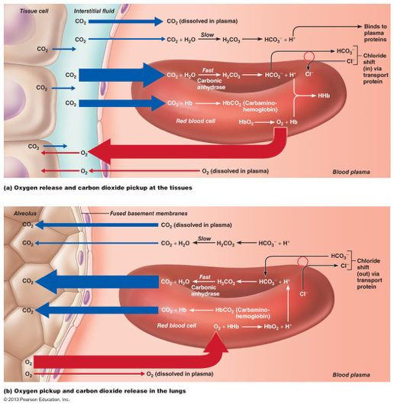
Transport of Carbon Dioxide in the Blood
CO₂ is produced in large amounts in the body
CO2 + globin part = carbaminohemoglobin
Remember: O2 + Haem part = Oxyhaemoglobin
CO₂ in normal resting conditions:
4ml of CO₂/100 ml of deoxygenated blood
CO₂ is carried in the blood in three forms:
70% of CO₂ is transported in bicarbonate form.
23% combines with the globin part of Hb to form carbamino-haemoglobin.
7% is dissolved in plasma
Venous blood is not literally deoxygenated it only carries less oxygen than arterial blood and that is why we refer to is as deoxygenated blood

Slide 9
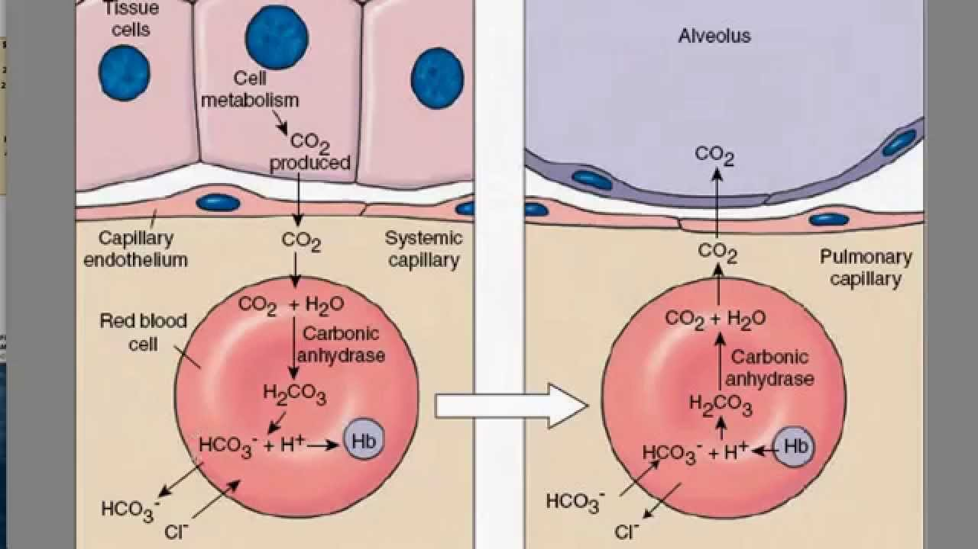
ONLY IN MALES’ SLIDES
1- CO2 Transport (Bicarbonate) and Chloride Shift
شرح السلايد السابق
Tissue Capillaries
Pulmonary Capillaries
Carbonic Anhydrase
1
HCO3 (bicarbonate)+ H+
H2CO3
1
Co2 + water (in RBC) H2CO3 (carbonic acid)
H2CO3 HCO3 (bicarbonate)+ H+
H ion + hemoglobin hydrogenhemoglobin
2
H2CO3
Carbonic Anhydrase
Co2 + water
2
Dissociates
Bicarbonate enters RBC, Cl gets out to maintain negative charge of cell.
3
Bicarbonate Shift Phenomena:
Bicarbonate gets out of RBCs, and Cl enters to maintain negative charge of cell.
If chloride does not enter the cell will shrink
9

Slide 10
2- Transport of CO₂ Combined with Hb (Displacement of O2)
CO (Carbon Monoxide) binding:
Co2 combines with Hb at the same point on the Hb molecule as does oxygen.
It binds with Hb about 250 times as much as O2 (affinity of Hb to CO is 250 times of that to O2).
It causes left shift of the O2-Hb curve (discussed later)
3- Transport of CO2 Dissolved in Plasma (7%)
PCO₂ of venous blood is: 45 mm Hg (Higher because it is carrying it back to the lungs be exhaled out)
PCO₂ of arterial blood is: 40 mmHg
The amount of CO₂ dissolved in the blood at 45 mmHg is 2.7 ml/dl (2.7%)
The amount of CO₂ dissolved at 40 mmHg is about 2.4 ml
The difference between 2.7 and 2.4 is only 0.3 ml
About 0.3 ml CO₂ / 100 ml of blood in the form of dissolved CO₂
dl = 100 ml

Slide 11
The Haldane Effect
ONLY IN FEMALES’ SLIDES
When oxygen binds with hemoglobin, carbon dioxide is released to increase CO2 transport.
Binding of Hb with O2 at the lung causes the Hb to become a stronger acid, and this in turn displaces CO2 from the blood and into the alveoli.
Change in blood acidity during CO2 transport:
Arterial blood has a pH of 7.41, and the pH of venous blood (which has higher PCO2) falls to 7.37 (i.e. change of 0.04 units takes place).
The pH decreases because of the carbonic acid formed when CO2 enters the blood.
R = $\frac{\text{Rate} \text{of} \text{CO}\text{2 }\text{output}}{\text{Rate} \text{of} \text{O}\text{2 }\text{uptake}}$
Normally (person with normal diet) it is 4/5 (200\250) = 82% =0.825
When Carbohydrate diet is used , R = 1 (every 1O2 consumed 1CO2 produced)
When only fats are used, R=0.7
Respiratory Exchange Ratio (Respiratory Quotient)

Slide 12
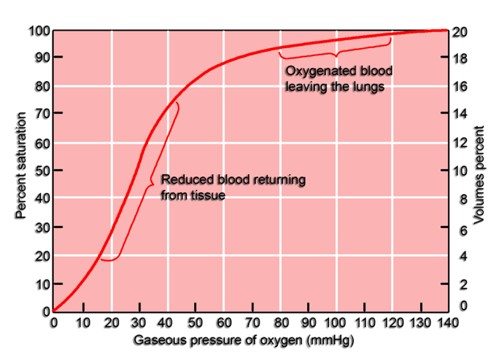
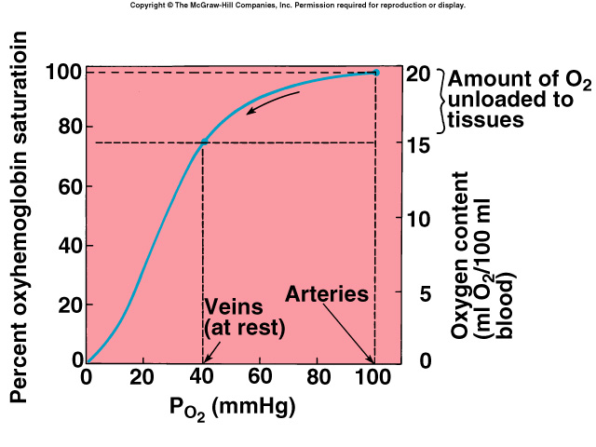
Oxygen-hemoglobin Dissociation Curve
Very Important
Curve Shape: is S - shaped or sigmoid (not linear)
Represent: relationship between the percent O₂ saturation of Hb and the partial pressure of O_{2 (PO2)}
This curve is called the oxyhemoglobin saturation curve.
Relation: shows progressive increase in the percentage saturation of the Hb with the increase in the PO2 in the blood.
Higher PO2 results in greater Hb saturation.
 | Arterial Blood | Venous Blood (returning from the tissues )
PO2 | 95 mmHg | 40 mmHg
Saturation of Hb with O2 | 97%. | 75%.

Slide 13
Shift of Oxygen-Hemoglobin Dissociation Curve
Shifted to the Left
Shifted to the Right
Means:
Hb affinity for oxygen is increased.
or
Loading or attachment of oxygen to Hb increased.
Means:
O2 is dissociated or released (unloaded) to the tissues from Hb.
Definitions/Other Explanations:
Rt shift means the oxygen is unloaded to the tissues from Hb
Lt shift means loading or attachment of oxygen to Hb.

Slide 14
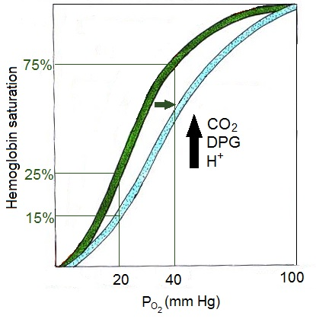
Factors Shifting Oxygen-hemoglobin Dissociation Curve to the Right/Left (Affecting Affinity of HB for O2)
Factors shifting to the Right
Factors shifting to the Left
Decreasing affinity
Increased PCO2 (Bohr effect)
Increased hydrogen ions ( PH )
Increased temperature
Increased 2, 3 DPG 2,3 diphosphoglycerate:
Synthesized in RBCs from the glycolytic pathway
Facilitate the oxygen release
Binds tightly to reduced Hb
Exercise increases all of them
Increasing affinity
Decreased CO2 (Bohr effect)
Decreased hydrogen ions ( PH )
Decreased temperature
Decreased 2,3 DPG
Fetal haemoglobin (coming next)
Anemia and hypoxemia :
2,3 DPG increases the RBCs in case of these diseases (anemia and hypoxia) → thus serves as an important adaptive response in maintaining tissue oxygenation.

Slide 15
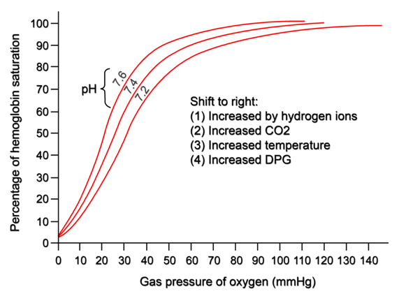
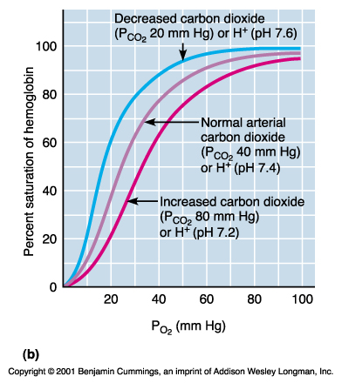
Right and Left Shifts (Bohr Effect)
Effect of CO2 and H ions on the curve (Bohr effect):
(Increased delivery of O2 to the tissues when CO2 and H ions shift the oxygen-hemoglobin dissociation curve)
At Lungs:
Movement of CO2 from blood to alveoli (where it will be exhaled out of the body) will decrease blood CO2 & H+ → shifting the curve to left.
Increased O2 affinity of Hb allowing more O2 transportation into the tissues.
At Tissues:
Increase CO2 & H+ in blood leads to → shifting the curve to Right.
Decreased O2 affinity of Hb allowing more O2 transportation to the tissues.
الكلام في هذا السلايد ما يشرح الصور

Slide 16
Shift of Dissociation Curve During Exercise
ONLY IN FEMALES’ SLIDES
Fetal Hb: has a P50 of 20 mmHg in comparison to 27 mmHg of adult Hb.
Utilization Coefficient: the percentage of the blood that gives up its oxygen as it passes through the tissue capillaries.
Utilization Coefficient
Normally at rest = 5 ml/20 m, which = 25% .
During exercise = 15 ml/20 ml, which = 75 % - 85%
P50: is the partial pressure of O2 at which 50% of Hb is saturated with O2.
↑ P50 means right shift ( lower affinity for O2 )
↓ P50 means left shift ( higher affinity for O2 )
= $\frac{\text{O}\text{2 }\text{delivered} \text{to} \text{the} \text{tissues}}{\text{O}\text{2 }\text{content} \text{of} \text{arterial} \text{blood}}$

Slide 17
Link to Editing File (Please be sure to check this file frequently for any edits or updates on all of our lectures.)
Quiz
https://www.onlineexambuilder.com/lecture-7/exam-129877
References:
Girls’ and boys’ slides.
Guyton and Hall Textbook of Medical Physiology (Thirteenth Edition.)

Slide 18
Thank you!
اعمل لترسم بسمة، اعمل لتمسح دمعة، اعمل و أنت تعلم أن الله لا يضيع أجر من أحسن عملا.
The Physiology 436 Team:
Female Members:
Deena AlNowiser
Jawaher Abanumy
Hayfaa alshaalan
Leena Alwakeel
Male Members:
Hassan Alshammari
Team Leaders:
Qaiss Almuhaideb
Lulwah Alshiha
Contact us:
Physiology436@gmail.com
@Physiology436

