Slide 1
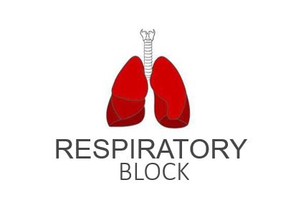
Control of Breathing
Red: very important.
Green: Doctor’s notes.
Pink: formulas.
Yellow: numbers.
Gray: notes and explanation.
Physiology Team 436 – Respiratory Block Lecture 8
Lecture: If work is intended for initial studying.
Review: If work is intended for revision.

Slide 2
Objectives
By the end of this lecture you should be able to:
Understand the role of the medulla oblongata in determining the basic pattern of respiratory activity.
List some factors that can modify the basic breathing pattern e.g.
A- The Hering-Breuer reflexes
B- The proprioceptor reflexes
C- The protective reflexes, like the irritant, and the J-receptors.
Understand the respiratory consequences of changing PO2 , PCO2 , and PH.
Describe the locations and roles of the peripheral and central chemoreceptors.
Compare and contrast metabolic and respiratory acidosis and metabolic and respiratory alkalosis

Slide 3
Controls of Rate and Depth of Respiration
Arterial PO2
When PO2 is VERY low (Hypoxia), ventilation increases.
Arterial PCO2
The most important regulator of ventilation is PCO2, small increases in PCO2, greatly increases ventilation.
Changes in PCO2 stimulate the respiratory center immediately. Unlike Po2 because the accumulation of CO2 is very dangerous for the body.
Arterial pH
As hydrogen ions increase (acidosis), alveolar ventilation increases.
“pHاذا زادت ايونات الهيدروجين يقل ال”

Slide 4
Respiratory Centers
Medullary Respiratory Center
Inspiratory area (Dorsal Respiratory Group) DRG
Expiratory area (Ventral Respiratory Group) VRG
Pontine Respiratory Center
Pneumotaxic area (in pons)
Apneustic area (in pons)
Generally located in the medulla oblongata and the pons of the brainstem.
Determines basic rhythm of breathing.
Causes contraction of diaphragm and external intercostals.
It will stimulate the phrenic nerve which supplies the diaphragm.
Inactive during normal quiet breathing.
Activated by inspiratory area during forceful breathing.
Causes contraction of internal intercostals and abdominal muscles.
Inhibits inspiratory area of medulla to stop inhalation.
Breathing is more rapid when pneumotaxic area is active.
Stimulates inspiratory area of medulla to prolong inhalation.
The medullary respiratory center stimulates basic inspiration for about 2 seconds and then basic expiration for about 3 seconds (5sec/ breath = 12breaths/min).
Pontine Respiratory center is the transition between inhalation and exhalation it is controlled by pneumotaxic and apneustic areas.

Slide 5
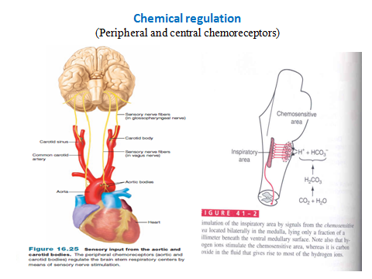
Respiratory Centers Cont.
Chemoreceptors
Central
Peripheral
Carotid bodies
Aortic bodies
Thoracic arteries
Abdominal arteries
Most of the chemoreceptors are in the carotid bodies. However, a few are also in the aortic bodies, and very few are located elsewhere in association with other arteries of the thoracic and abdominal regions.
1- Excess CO₂, H⁺ in the blood mainly acts directly →Central
2- Others in arteries of the thoracic and abdominal regions →Peripheral
If we compare the peripheral and the central: if there is an increase in P_{CO2} the peripheral is faster but weaker (e.g. increase ventilation 2 times within seconds), the central is slower but more powerful (e.g. increase the ventilation 4 times within minutes).
ONLY IN MALES’ SLIDES

Slide 6
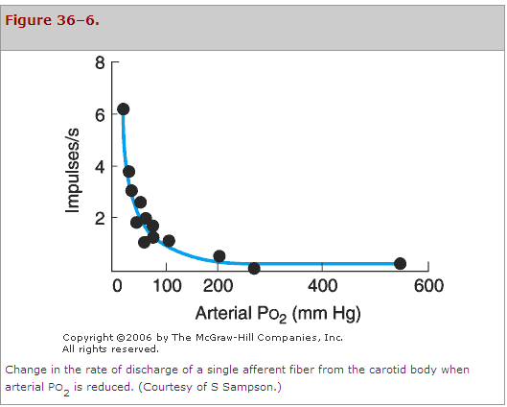
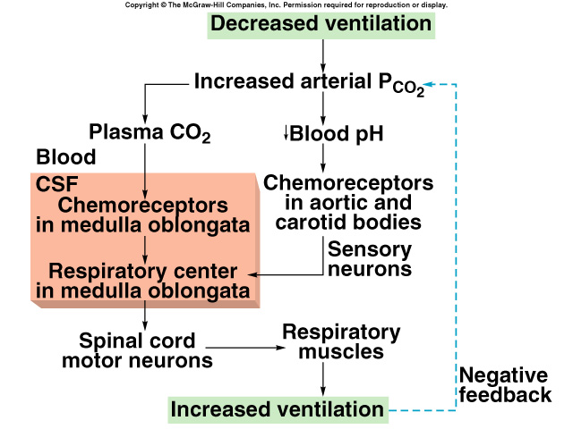
Chemoreceptor Control of Breathing
Due to increase the H⁺, and as it has a charge it is polar so it cannot cross BBB and acts on the chemoreceptors in medulla oblongata.
Decrease in the P_{O2} (hypoxia) will stimulate the respiratory center. Therefore, increasing the impulses.
Increase in the P_{O2} will not stimulate the respiratory center. Therefore, impulses will stop.
If the person has acidosis due to metabolic problem only the 2nd pathway will be stimulated, but if he has a problem which leads to an increase in P_{co2} the two pathways will be stimulated, so the effect will be more than if the problem were only in the pH.

Slide 7
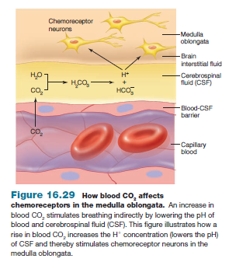
Effect of Blood CO2 Level on Central Chemoreceptors
An increase in blood CO₂ stimulates breathing indirectly by lowering the pH of blood and cerebrospinal fluid (CSF). This figure illustrates how a rise in blood CO₂ increases H⁺ concentration of CSF and thereby stimulates chemoreceptor neurons in the medulla oblongata.
Summary
The effect on central chemoreceptors:
1- increase the H⁺ itself in CSF the hydrogen will stimulate the chemoreceptors ➝ direct effect.
2- increase CO₂ in the blood which diffuse to CSF and increase H⁺ which will stimulate the chemoreceptors ➝ indirect effect (the CO₂ does not effect it directly).

Slide 8
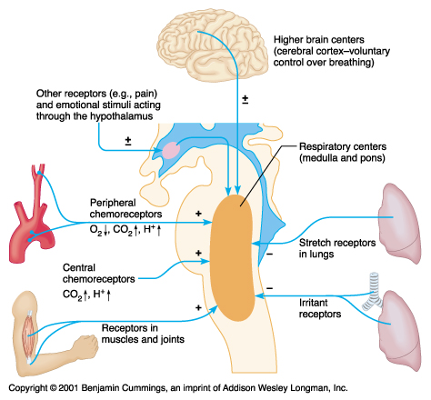
Factors Influencing Respiration
Central chemoreceptors are affected by CO₂ and H⁺
Peripheral chemoreceptors are affected by CO₂, H⁺ and O₂
Central chemoreceptors are NOT affected by O₂
Not for a long period, because there will be accumulation of CO₂ (in case of hypoventilation) or loss CO₂ in high amount (in case of hyperventilation)

Slide 9
Cont. (Factors Affecting Respiratory Centers)
Effect of irritant receptors in the airways:
The epithelium of trachea, bronchi, and bronchioles is supplied by irritant receptors that are stimulated by irritants (i.e. dust) that enter the respiratory airways causing coughing, sneezing, and bronchoconstriction in bronchial asthma and emphysema.
Function of lung J receptors:
Few receptors in the wall of the alveoli in juxta position (placed close together) to the pulmonary capillaries. They are stimulated especially when pulmonary capillaries become engorged (cause to swell with blood, water, or another fluid) by blood or when pulmonary edema occurs i.e. in congestive heart failure (CHF), their excitation cause the person a feeling of dyspnea.

Slide 10
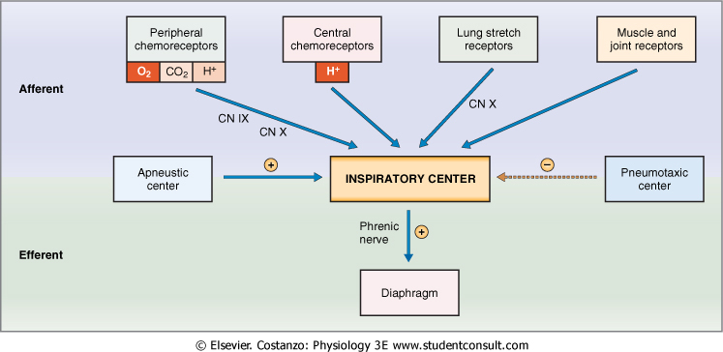
Cont. (Factors Affecting Respiration)

Slide 11
Hering-Breuer Inflation Reflex
When the lung becomes overstretched (tidal volume is 1L or more –recall normal value: 500ml or 0.5L-), stretch receptors located in the wall of bronchi and bronchioles transmit signals through vagus nerve to DRG producing an effect similar to pneumotaxic center stimulation:
Switches off inspiratory signals and thus stops further inspiration.
This reflex also increases the rate of respiration as does the pneumotaxic center.
Extra information from Guyton:
In humans the Hering-Breuer reflex is probably inactivated until the tidal volume increases to more than three times the normal (>1.5 liters per breath). Therefore this reflex appears to be mainly a protective mechanism for preventing excess lung inflation rather than an important ingredient in normal control of ventilation.

Slide 12
ONLY IN FEMALES’ SLIDES
Respiratory Acidosis*
Respiratory Alkalosis*
Metabolic Acidosis*
Metabolic Alkalosis*
Hypoventilation.
Accumulation of CO₂ in the tissues.
P_{CO2} increases.
pH decreases.
Acidity increases.
Hyperventilation.
Excessive loss of CO₂.
P_{CO2} decreases
(35 mmHg).
pH increases.
Acidity decreases.
Ingestion, infusion, or production of fixed acid.
Decreased renal excretion of
hydrogen ions.
Loss of bicarbonate or other bases from the extracellular compartment.
Excessive loss of fixed acids from the body.
Ingestion, infusion, or excessive renal reabsorption of bases such as bicarbonate.
pH increases.
Acidosis* means an increase in Acidity or a Decrease in pH of the blood.
Alkalosis* means a decrease in Acidity or an Increase in pH of the blood.
The respiratory system can compensate for metabolic acidosis or alkalosis by altering alveolar ventilation.
If the patient has ACIDOSIS the respiratory system will respond by HYPERVENTILATION, if he has ALKALOSIS the response will be HYPOVENTILATION.

Slide 13
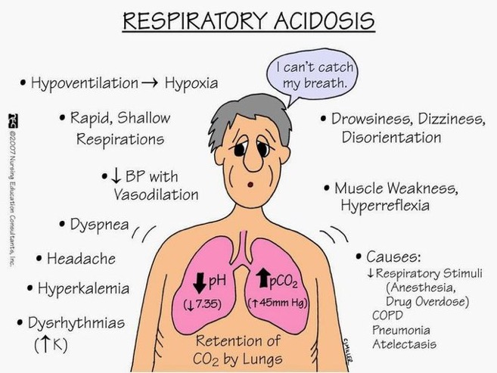
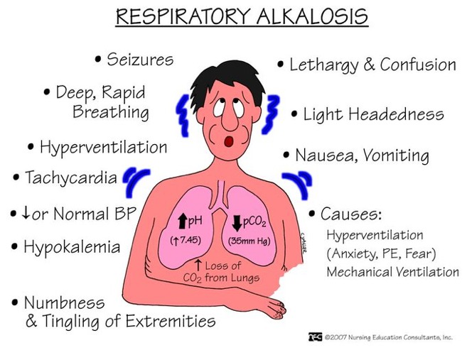
Cont. (Extra Images: to help you remember)

Slide 14
Link to Editing File (Please be sure to check this file frequently for any edits or updates on all of our lectures.)
Quiz
https://www.onlineexambuilder.com/lecture-8/exam-129878
References:
Girls’ and boys’ slides.
Guyton and Hall Textbook of Medical Physiology (Thirteenth Edition.)

Slide 15
Thank you!
اعمل لترسم بسمة، اعمل لتمسح دمعة، اعمل و أنت تعلم أن الله لا يضيع أجر من أحسن عملا.
The Physiology 436 Team:
Female Members:
Allulu Alsulayhem
Najd Altheeb
Ghada Alhadlaq
Ghada Alskait
Heba Alnasser
Male Members:
Faisal Alfawaz
Faris Alnafeesah
Omar albabteen
Team Leaders:
Qaiss Almuhaideb
Lulwah Alshiha
Contact us:
Physiology436@gmail.com
@Physiology436

