Slide 1
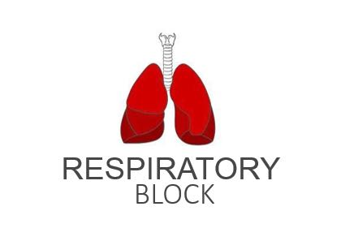
Hypoxia and Cyanosis
Red: very important.
Green: Doctor’s notes.
Pink: formulas.
Yellow: numbers.
Gray: notes and explanation.
Physiology Team 436 – Respiratory Block Lecture 9
Lecture: If work is intended for initial studying.
Review: If work is intended for revision.

Slide 2
Objectives
Define hypoxia and list its various physiological and pathological causes.
Define hypo and hyper-ventilation in terms of arterial PCO2 and PO2.
Define cyanosis and its clinical presentation
Define ventilation/perfusion (V͎/Q) ratio and its normal values.

Slide 3
Hypoxia
Hypoxia is defined as an inadequate supply (deficiency) of oxygen to the body tissues. It can be classified in the following types:
Definition | Type
Lack of oxygenation of blood in the lungs | Hypoxic hypoxia (arterial hypoxia)
Decreased oxygen carrying capacity of the blood due to decreased hemoglobin level | Anemic hypoxia
Decreased rate of blood flow throughout the body or a part of the body | Stagnant hypoxia (Hypokinetic or Ischemic hypoxia)
The tissue are unable to use oxygen even though plenty of oxygen is available | Histotoxic hypoxia

Slide 4
Hypoxic Hypoxia (Arterial Hypoxia)
It is defined as a lack of oxygenation of blood in the lungs which leads to a low PO2 in arterial blood (reduced arterial PO2). Since less amounts of Hb are converted into oxy-Hb . The tissues are supplied with blood deficient in oxygen. Hypoxic hypoxia can occur in the following conditions:
High altitude
Emphysema
Fluid in the lungs (pulmonary edema)
Obstruction in the respiratory passages
Other Causes: (explained in next slides)
Alveolar hypoventilation
Diffusion abnormalities
Right to left shunt
V/Q mismatch

Slide 5
Cont.
ONLY IN MALES’ SLIDES
1- Alveolar hypoventilation
E.g.
3- Diffusion abnormalities
Impaired diffusion from alveolar to pulmonary capillary blood can lead to arterial hypoxia. It is seen in conditions like alveolar-capillary block.
Reduced PO2 in inspired air (high altitude)
Increased airway resistance
Reduced lung compliance
Paralysis of respiratory muscles (like in M.G)
Depressed respiratory center
2- Ventilation-perfusion imbalance (including increased physiological dead space and physiological shunt)
If ventilation and blood flow are mismatched in various parts of the lung, impairment of both oxygen and carbon dioxide diffusion results. Ventilation perfusion imbalance may be caused by uneven ventilation (e.g. obstructive lung conditions), or uneven perfusion (e.g. consolidation of the lung).

Slide 6
Cont.
ONLY IN MALES’ SLIDES
Physiological shunt: Also called venous admixture, blood entering the arterial system without passing through ventilated areas of lung causing PO2 to be less than alveolar.
4- Right to left shunt
Blood passes from the systemic venous system without going through the gas exchanging part of the lungs. This type of hypoxia can be differentiated clinically from other types by giving the subject 100% oxygen to breathe. Hypoxia because of the shunt will not be abolished while in other types PO2 in the arterial system will improve considerably.

Slide 7
Anemic Hypoxia
In this condition the PO2 and %Hb-O2 are normal.
This condition is characterized by decreased oxygen carrying capacity of the blood due to decreased hemoglobin level or abnormal type of Hb which is unable to carry oxygen.
Causes:
Anemia
Abnormal Hb (e.g met hemoglobin, carboxyhemoglobin)
Anemic hypoxia is seen in hemorrhagic anemia (decreased RBC -quantity or quality-):
Failure of hemoglobin to carry its normal concentration of oxygen, as in carbon monoxide (CO) poisoning.
Altered hemoglobin formation e.g. methaemoglobin, sulphaemoglobin, and carboxyhaemoglobin.

Slide 8
Stagnant Hypoxia and Histiotoxic Hypoxia
Reduced blood flow through the body or part of the body (tissue)
so more and more oxygen is extracted from the blood, and due to slow circulation less oxygen is carried by the blood at the lung, leading to hypoxia.
This is caused by inhibition of the tissues’ use of oxygen even though plenty of oxygen is available due to inhibition of the oxidative enzyme activity in respiration electron transport chain.
Stagnant hypoxia
It may be caused by congestive heart failure, circulatory shock and arteriosclerosis.
Histotoxic hypoxia
The best example is cyanide poisoning, where tissue cytochrome oxidases are knocked out (blocked) and tissue is unable to utilize oxygen.
General slowing of circulation (heart failure and shock)
Local slowing: vasoconstriction, cold, arterial wall spasm.

Slide 9
Hypoxia and Clinical Features
ONLY IN MALES’ SLIDES
General signs and symptoms of hypoxia:
Cyanosis, Tachy-cardia and Tachypnea (abnormally rapid breathing).
Signs and symptoms of hypoxia:
Hypoxia’s clinical features depend on (the degree of hypoxia):
How fast & how severely partial pressure of O₂ is decreased.
Hypoxia can be classified according to its clinical features to 3 types:
Fulminant hypoxia:
This occurs very rapidly &suddenly. Its symptoms : Unconsciousness occurs in 15-20 seconds and brain tissue death occurs in 4-5 minutes.
Acute hypoxia:
In acute hypoxia body reflexes are slowed, symptoms : there may be slurred (unclear) speech, unconsciousness, coma and death may occur.
Chronic hypoxia:
The symptoms : fatigue, difficulty in breathing, and shortness of breath can occur.

Slide 10
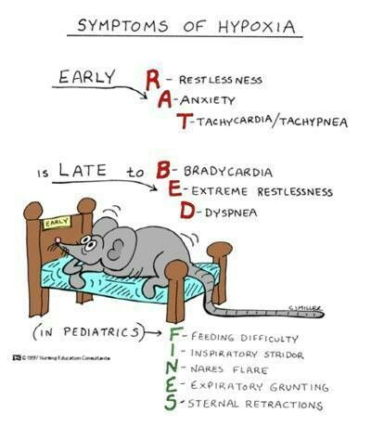
Effects of Hypoxia on the Body
Impairment of judgment (principally depressed mental activity).
Inability to perform complex calculations.
Headache, nausea, irritability, dyspnea, increased heart rate.
Reduction in muscle working capacity.
Coma and death may result (if severe enough).

Slide 11
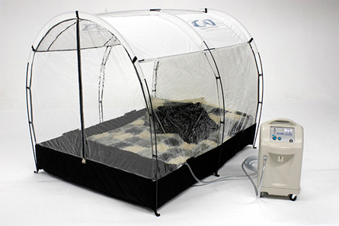
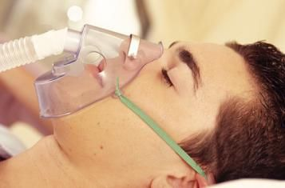
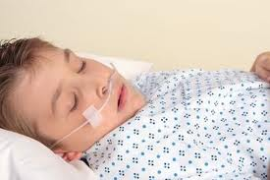
Treatment of Hypoxia
ONLY IN FEMALES’ SLIDES
(Treatment of hypoxia depends on the cause.)
Hypoxia is treated by giving oxygen therapy in a tent or high oxygen tension mask.
This is useful in hypoxic hypoxia, but of less value in other types of hypoxia.
Histiotoxic hypoxia will not benefit from O2 therapy.

Slide 12
Hypercapnea
ONLY IN FEMALES’ SLIDES
Excess of CO2 in body fluids.
It usually occurs with hypoxia*.
PCO2 increases above 52 mmHg and therefore it decreases the pH.
Features of hypercapnea:
Peripheral vasodilatation (you feel the pulse easily).
Sweating.
Warm extremities and bounding pulse (strong pounding or racing of the heart).
Muscle twitching.
Headache, drowsiness and coma
Papilledema ( swelling of optic disc) (in chronic hypoxia cases)
*Hypercapnia usually occurs in association with hypoxia only when hypoxia is caused by hypoventilation of circulatory deficiency.

Slide 13
Cyanosis
Definition: The term cyanosis means blueness of the skin and mucus membrane due to excessive amount for more than 5 g/dl of reduced (deoxygenated) hemoglobin in blood (skin blood vessels especially in the capillaries).
Cyanosis appears whenever the arterial blood contains more than 5 grams of deoxygenated hemoglobin in each 100 milliliters of blood.
This deoxygenated hemoglobin has an intense dark blue-purple color that is transmitted through the skin. (This is the cause of the blue skin color for people with cyanosis).
ONLY IN MALES’ SLIDES

Slide 14
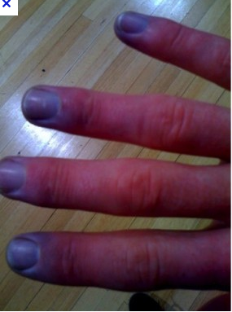
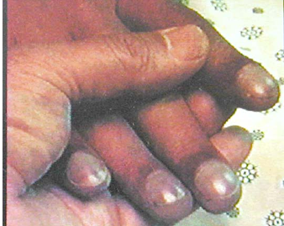
Cyanosis
ONLY IN MALES’ SLIDES
A person with anemia never becomes cyanotic because there is not enough hemoglobin for 5 grams to be deoxygenated in 100 milliliters of arterial blood.
(Anemia → Less blood cells → Less hemoglobin to be deoxygenated → Cyanosis cannot be achieved due to the lack of hemoglobin and red blood cells).
While In a person with excess red blood cells in the case of polycythemia, has a great excess of available hemoglobin that can become deoxygenated leads frequently to cyanosis.
(Polycythemia → More blood cells → More hemoglobin to be deoxygenated → Cyanosis can be achieved due to the excess hemoglobin and red blood cells.)

Slide 15
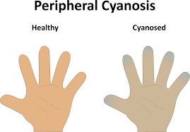
Causes of Cyanosis
ONLY IN MALES’ SLIDES
Inadequate oxygenation of blood in the lungs:
High altitude.
Obstruction of respiratory passages.
Pneumoconiosis*.
Emphysema.
CO-poisoning.
Presence of an aerated shunt between vessels:
Coaractation** of aorta.
Fallot’s tetralogy***.
Other Causes:
Moderate cold.
Diminished blood flow to tissues.
*a disease of the lungs due to inhalation of dust, characterized by inflammation, coughing, and fibrosis.
**Coarctation of the Aorta (CoA) A narrowing of the major artery (the aorta) that carries blood to the body. This narrowing affects blood flow where the arteries branch out to carry blood along separate vessels to the upper and lower parts of the body. CoA can cause high blood pressure or heart damage.
***Tetralogy of Fallot (TOF) is a congenital heart defect that is present at birth causing a number of heart-related abnormalities that disrupt blood flow.

Slide 16
Types of Cyanosis
ONLY IN MALES’ SLIDES
Cyanosis
Local cyanosis:
This is seen during decreased blood flow through a part of the body as in Raynaud’s disease. In this disease, circulation through the upper limb is impaired, it causes local cyanosis.
Generalized cyanosis:
Generalized impairment of circulation as in the case of heart failure leads to generalized cyanosis. It also occurs in hypoxic hypoxia.

Slide 17
Ventilation-Perfusion Ratio (V/Q)
Ventilation-Perfusion Ratio (VA/Q): This is the ratio of alveolar ventilation to the pulmonary blood flow per minute.
Ventilation-perfusion ratio is expressed as VA/Q
When VA (alveolar ventilation) is normal for a given alveolus and Q (blood flow) is also normal for the alveolus, the ventilation-perfusion ratio (VA/Q) is also said to be normal.
Ventilation - Perfusion Ratio (V/Q): The alveolar ventilation at rest is about (4.2 L/minute)
Calculated as: Alveolar ventilation = respiration rate x (tidal volume – dead space air)
The pulmonary blood flow is equal to right ventricular output per minute (5 L/min). Hence ventilation perfusion ratio is (V/Q) = 4.2/ 5= 0.84

Slide 18
Ventilation-Perfusion Ratio (V/Q)
Ventilation-perfusion ratio (V/Q)
Ventilation (V) Alveolar
Minute ventilation = 4 to 6 L
Perfusion (Q) Normal cardiac output = 5 L
Normal ventilation / perfusion ratio
(average)(V/Q ratio) = 0.8 to 1.2
At the apex V/Q ratio = 3
(moderate degree of physiologic dead space)
At the base V/Q ratio = 0.6
(represent a physiologic shunt).
*So the apex is more ventilated (gravity pulls it down) than perfused and the base is more perfused than ventilated.
*During exercise the V/Q ratio becomes more homogenous among different parts of the lung (because of hyperventilation).
Ventilation and perfusion must be matched at the alveolar capillary level.

Slide 19
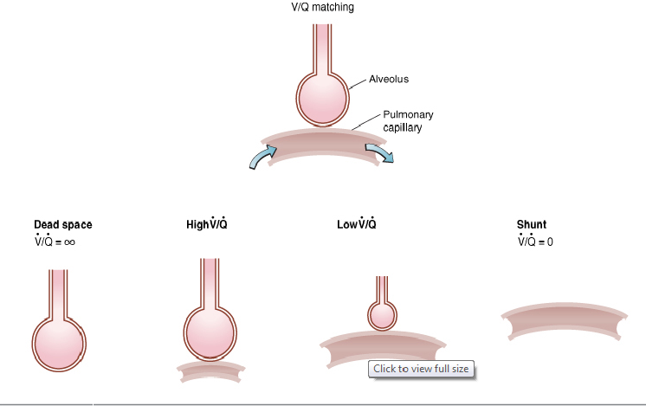
Decrease in Ventilation-Perfusion Ratio (V/Q)
ONLY IN MALES’ SLIDES
A decrease in V/Q ratio is produced by either decreasing ventilation or increasing blood flow.
DECREASED VENTILATION
Bringing in less oxygen to meet metabolic need
Blowing out less CO2 from the lungs
INCREASED PERFUSION
More blood cells are coming to remove O2 from alveolus
They deliver more CO2 than exhaled

Slide 20
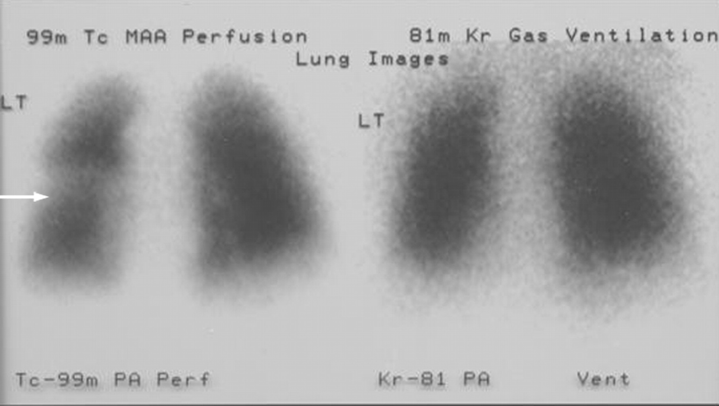
ONLY IN MALES’ SLIDES
Increase in Ventilation-Perfusion Ratio (V/Q)
Either caused by increased ventilation or decreased perfusion.
INCREASED VENTILATION
Bringing in more oxygen to the alveoli
Blowing out more CO2 from the lungs
DECREASED PERFUSION
Blood takes away less oxygen
Delivers less CO2
Ventilation- Perfusion Lung Scan

Slide 21
Ventilation-Perfusion Ratio (V/Q)
The ratio is variable from apex to base of the lung
As lung is centered vertically around the heart, part of the lung is superior to the heart, and part is inferior
High (V/Q) ratio of the apex leads to an increase in alveolar and arterial oxygen levels while decreasing the carbon dioxide. The blood leaving the apex of each lung in a standing person is estimated to have a PaO2 of 130 mm Hg and a PaCO2 of 28 mm Hg.
The normal value means on average lungs are over-perfused but under-ventilated at rest.
The main function of this ratio is to determine the state of oxygenation in the body.
Any mismatch in the ratio can result in hypoxia.
During exercise: Less difference in pulmonary blood flow between basal and apical portions of the lungs occurs. This makes ventilation more closely matching perfusion of the lungs.
ONLY IN MALES’ SLIDES

Slide 22
Abnormalities of the V/Q Ratio
ONLY IN FEMALES’ SLIDES
When the V/Q ratio is less than normal this is called physiologic shunt (a certain fraction of the venous blood is passing through the pulmonary capillaries without being oxygenated i.e. shunted blood).
When V/Q is more than normal this is called Physiologic dead space (when the ventilation of some of the alveoli is great but the alveolar blood flow is low, ventilation of these alveoli is wasted).
In Chronic Obstructive Lung disease COPD because of bronchial obstruction in some areas and destruction of the alveolar septa in other areas with patent alveoli those people have some areas of the lung exhibit serious physiologic shunt and in other areas serious physiologic dead space.
COPD is the most prevalent cause of pulmonary disability today, lung effectiveness as a gas exchange organ may decrease to 10%.

Slide 23
Pulmonary Blood Flow (Extra Slide From Guyton)
Important so you could understand the next slide.
The capillaries in the alveolar walls are distended by the blood pressure inside them but simultaneously they are compressed by the alveolar air pressure on their outsides.
Therefore anytime the lung alveolar air pressure becomes greater than the capillary blood pressure (((the capillaries are closed))).
Blood pressure in the apex is decreased but increased in the base duo to gravity.

Slide 24
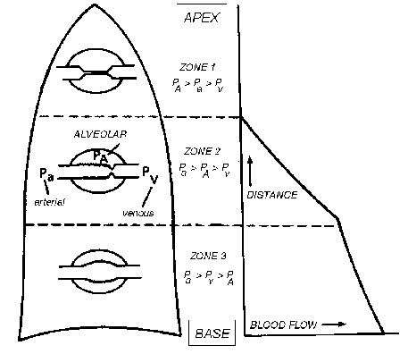
Regional Blood Flow Distribution
ONLY IN MALES’ SLIDES
Zone 1
alveolar air pressure > arterial and venous pressures
Vessels are collapsed and flow is close to zero
Zone 2
venous pressure < alveolar air pressure < arterial pressure
vessels partially collapsed and flow is low
Zone 3
alveolar air pressure < arterial and venous pressure
vessels open for full length and flow highest

Slide 25
Composition of Alveolar Air (Extra Slide From Guyton)
In alveoli the partial pressure of CO2 is increased and O2 is decreased in relation to atmospheric pressure due to:
Alveolar air is only partially replaced by atmospheric air.
As air moves into the alveoli, water vapor (which dilutes all other gases) and carbon dioxide (from pulmonary blood) are added.
Oxygen is constantly being absorbed into the pulmonary blood from alveolar air.
Since the apex is over ventilated it has higher oxygen concentration and lesser carbon dioxide concentration.
Partial pressure of O2 in atmosphere is 159 mmHg
Partial pressure of Co2 in atmosphere is 0.3 mmHg

Slide 26
Link to Editing File (Please be sure to check this file frequently for any edits or updates on all of our lectures.)
Quiz
https://www.onlineexambuilder.com/lecture-9/exam-129881
References:
Girls’ and boys’ slides.
Guyton and Hall Textbook of Medical Physiology (Thirteenth Edition.)

Slide 27
Thank you!
اعمل لترسم بسمة، اعمل لتمسح دمعة، اعمل و أنت تعلم أن الله لا يضيع أجر من أحسن عملا.
The Physiology 436 Team:
Female Members:
Amal Alshaibi
Najd Altheeb
Ghada Alskait
Ruba Barnawi
Male Members:
Mohammed Alayed
Foaad Fathi
Faisal Alfawaz
Fahad Alfayez
Ali alsubaie
Mohammad almutlaq
Team Leaders:
Qaiss Almuhaideb
Lulwah Alshiha
Contact us:
Physiology436@gmail.com
@Physiology436

