Slide 1
Lipoprotein Metabolism
Cardiovascular System Block

Slide 2
Objectives
By the end of this lecture, the First Year students will be able to:
Define and list the types, structure and composition of lipoproteins
Understand various functions of lipoprotein particles
Compare the functions of lipoprotein particles and their implications in disease
Understand the metabolism of chylomicrons, VLDL and LDL particles
List the diseases due to imbalance in the metabolism of lipoproteins

Slide 3
Overview
Lipoprotein types and composition
Apolipoproteins
Chylomicrons
VLDL particles and their metabolism
Lipoprotein lipase
VLDL diseases

Slide 4
Lipoproteins
Lipids are hydrophobic molecules
Transported in plasma as lipoproteins particles
Plasma lipoproteins are spherical macromolecular complexes of:
Lipids and
Specific proteins (apolipoproteins)
Lipoproteins keep lipid contents soluble while transporting them to and from the tissues

Slide 5
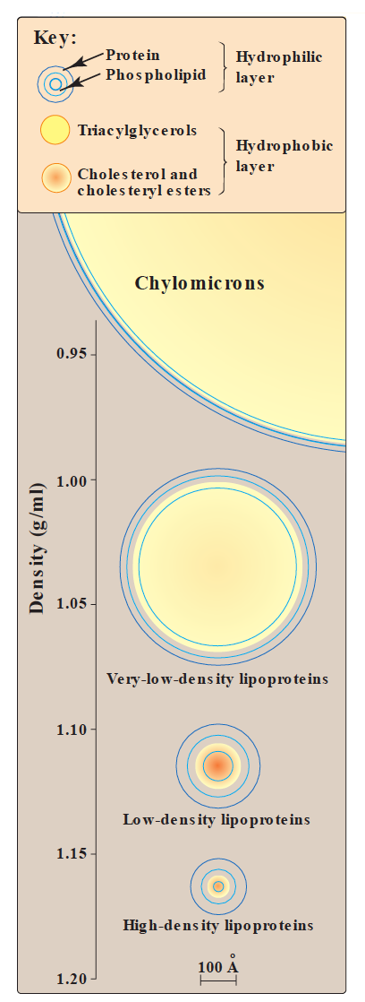
Types of lipoproteins
Chylomicrons (lowest density, largest)
VLDL (very low density lipoproteins)
LDL (low density lipoproteins)
HDL (high density lipoproteins)
Lipoproteins differ in:
Lipid and protein composition
Size
Density
Site of origin

Slide 6
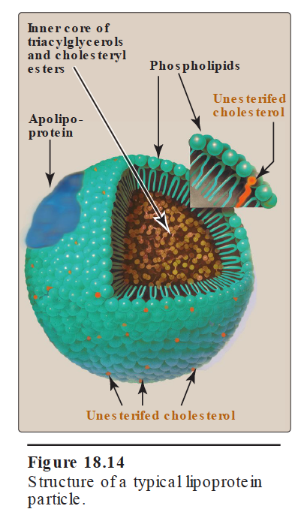
Compositions of lipoproteins
Neutral lipid core (hydrophobic):
Triacylglycerols (TAGs)
Cholesteryl esters
Hydrophilic shell:
Amphipathic apolipoproteins
Phospholipids
Free cholesterol

Slide 7
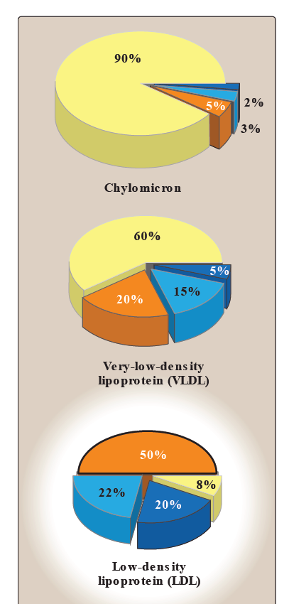
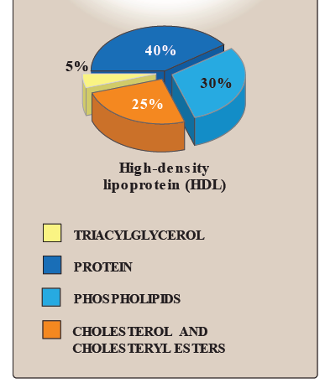
TAGs are mainly transported by:
Chylomicrons
VLDL
Cholesterol mainly transported by:
LDL
HDL

Slide 8
Apolipoproteins
Types:
Apo A
Apo B48 and Apo B 100
Apo C-I, C-II, C-III
Apo E
Functions:
Provide structure to lipoprotein particles
Provide recognition sites for cell-surface receptors
Activators or coenzymes for the enzymes involved in lipoprotein metabolism

Slide 9
Chylomicrons
Assembled in the intestinal mucosal cells
Transport to peripheral tissue:
Dietary TAGs (90%)
Cholesterol
Fat-soluble vitamins
Cholesteryl esters
The milky appearance of plasma after a meal is due to chylomicrons

Slide 10
VLDL
Produced and secreted by the liver
Composed of:
Mainly endogenous TAGs (60%)
Some cholesterol (free and esterified)
Carry these lipids from the liver to peripheral tissues

Slide 11
VLDL
Peripheral tissue degrade TAGs by lipoprotein lipase enzyme
Imbalance in hepatic TAG synthesis and secretion of VLDL can lead to:
Obesity
Type 2 diabetes mellitus

Slide 12
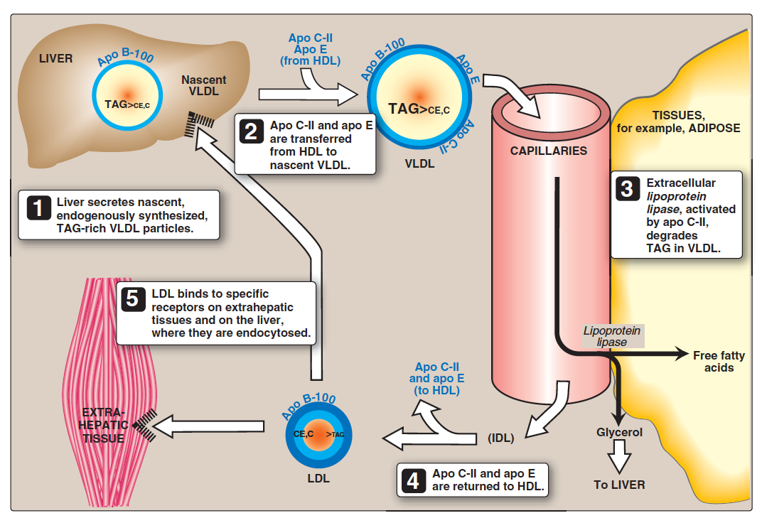
VLDL metabolism

Slide 13
VLDL metabolism
1. Release from the liver
As nascent particles containing:
TAGs and cholesterol
Apo B-100
Obtain apo C-II and apo E from circulating HDL particles
Apo C-II is required for activation of LPL

Slide 14
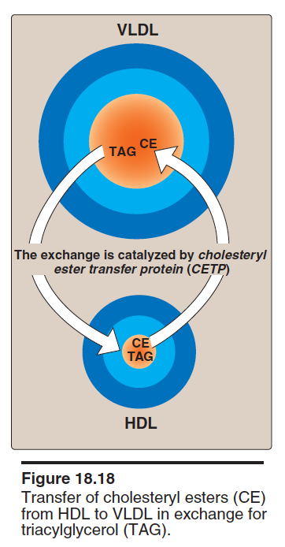
VLDL metabolism
2. Modification in the circulation
TAGs in VLDL are degraded by lipoprotein lipase (LPL)
VLDL becomes smaller and denser
Surface components (apo C and E) are returned to HDL
VLDL transfers TAGs to HDL in exchange for cholesteryl esters
This exchange is catalyzed by cholesteryl ester transfer protein (CETP)

Slide 15
VLDL metabolism
3. Conversion to LDL
After modifications, VLDL is converted to:
LDL
IDL (taken up by liver cells thru apo E)
VLDL remnants
Apo E exists in three isoforms:
Apo E-2 (Poorly binds to receptors)
Apo E-3
Apo E-4

Slide 16
Lipoprotein lipase (LPL)
Extracellular enzyme that degrades lipids
Anchored by heparin sulfate to the capillary walls of most tissues
Manly present in adipose tissue, cardiac and skeletal muscle
Requires ApoC-II for activation
Degrades TAGs into free fatty acids and glycerol
Insulin stimulates LPL synthesis
Deficiency of LPL or apo C-II causes:
Type 1 hyperlipoproteinemia (familial LPL deficiency)

Slide 17
VLDL diseases
Hypolipoproteinemia
Abetalipoproteinemia is due to inability to load apo B with lipids
Few VLDLs and chylomicrons are formed
TAGs accumulate in liver and intestine

Slide 18
VLDL diseases
Steatohepatitis
(Fatty liver disease)
Imbalance between:
TAG synthesis in the liver and
Secretion from the liver
Leads to accumulation of TAGs in the liver (fatty liver)

Slide 19
VLDL diseases
Type I hyperlipoproteinemia
A rare, autosomal recessive disease
Due to familial deficiency of LPL or its coenzyme (Apo C-II)
Causes excessive accumulation of chylomicrons in plasma (≥1000 mg/dl) (hyperchylomicronemia)
High fasting plasma TAGs are observed in these patients

Slide 20
VLDL diseases
Type III hyperlipoproteinemia
Also called familial dysbetalipoproteinemia, or broad beta disease
Individuals homozygous for apo E-2 are deficient in clearing:
Chylomicron remnants and
IDL from the circulation
Leads to hypercholesterolemia and premature atherosclerosis

Slide 21
Take home message
Lipoproteins are important for transportation of lipids to and from liver and peripheral tissues
Different types of lipoproteins perform different functions in the body
Imbalance in the metabolism of lipoproteins leads to accumulation of lipids in the tissues and circulation increasing the risk for atherosclerosis and coronary heart disease

Slide 22
References
Lippincott’s Biochemistry. 6th Edition, Chapter 18, pp. 226-232. Lippincott Williams & Wilkins, New York, USA.

