Slide 1
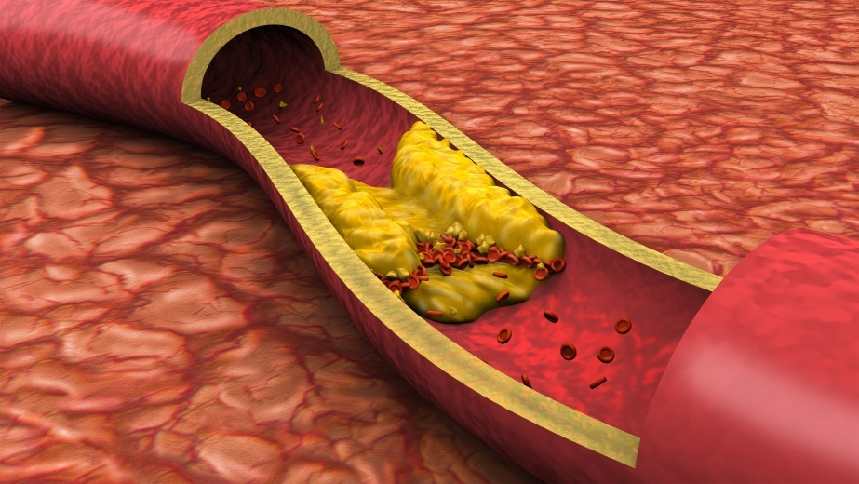
ATHEROSCLEROSIS Sufia Husain. Pathology. KSU. Riyadh. March 2017

Slide 2
Objectives for Atherosclerosis, ischemic heart diseases (angina and myocardial infarction) 2 lectures
Understand the pathogenesis and clinical consequences of atherosclerosis.
Be able to discuss pathology and complications of ischemic heart diseases with special emphasis on myocardial infarction.
Know how lifestyle modifications can reduce the risk of ischemic heart diseases.
Key principles to be discussed:
Risk factors of atherosclerosis.
Pathogenesis of the fibro lipid atherosclerotic plaque.
Clinical complications of atherosclerosis.
Commonest sites for the clinically significant coronary atherosclerosis.
Macroscopic and microscopic changes in myocardial infarction.
Biochemical markers of myocardial infarction.
Complications of myocardial infarction: immediate and late.

Slide 3
Normal Blood Vessels
Large (elastic) arteries
aorta, common carotid, iliac
lots of elastic fibers
Medium (muscular) arteries
coronary, renal arteries
mostly smooth muscle cells
Small arteries/arterioles
all smooth muscle cells
blood pressure controlled here
Capillaries
diameter of RBC
thin walls, slow flow
great for exchanging oxygen, nutrients
Venules/veins
large diameter, thin walls
compressible, penetrable by tumor
Have valves
Lymphatics
drain excess interstitial fluid
pass through nodes

Slide 4
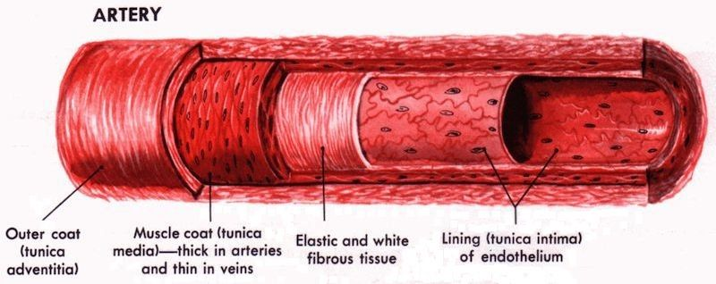
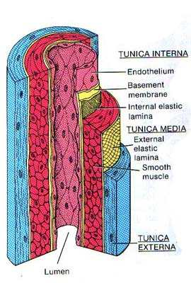
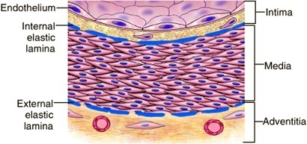
Artery
www.full-health.com
www.mananatomy.com

Slide 5
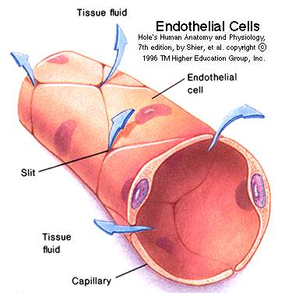
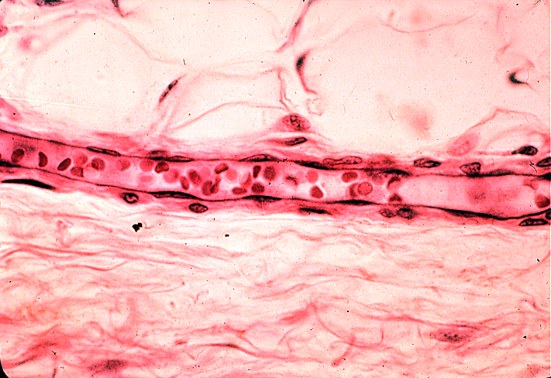
ENDOTHELIAL CELLS
The endothelium is a single cell thick lining of endothelial cells and it is the inner lining of the entire cardiovascular system (arteries, veins and capillaries) and the lymphatic system.
It is in direct contact with the blood/lymph and the cells circulating in it.
A normal structure and function of endothelium is essential for the maintenance of vessel wall homeostasis and normal circulatory function.
www.udel.edu

Slide 6
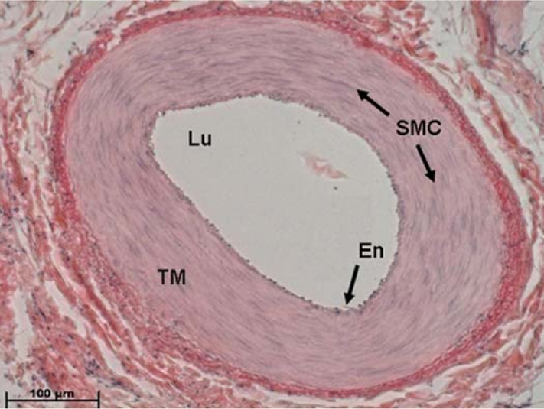
Smooth muscle cells (SMC)
SMCs are present in the media of blood vessels
SMCs are responsible for vasoconstriction and vasodilation of blood vessel.
Any vascular injury or dysfunction stimulates SMCs. On stimulation they:
They migrate from the media to the intima.
In the intima they lose the capacity to contract and gain the capacity to divide. So they multiply/proliferate as intimal SMCs.
They synthesize collagen, elastin etc and deposit extracellular matrix (ECM).

Slide 7
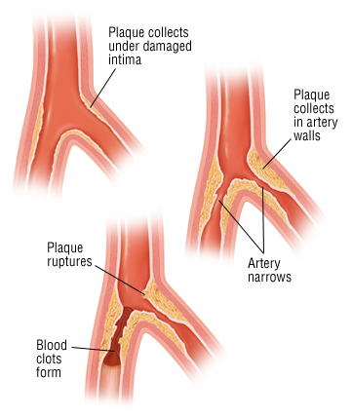
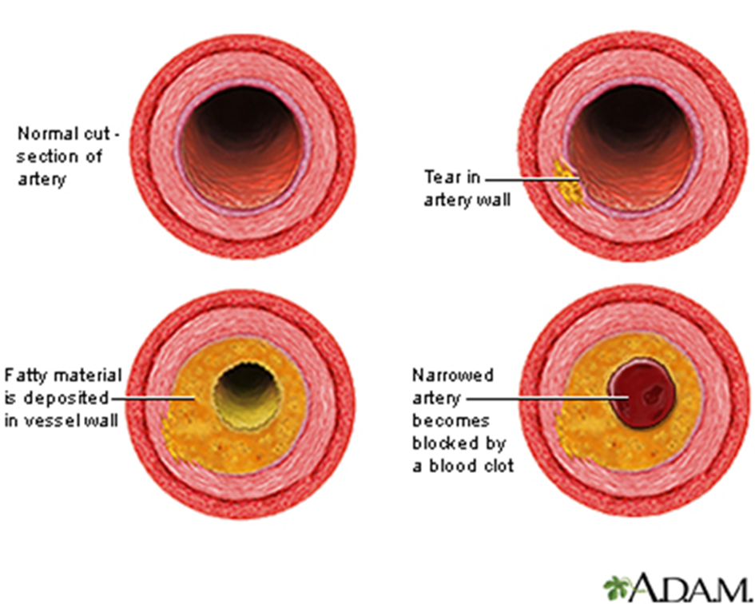
Atherosclerosis (AS)
Atherosclerosis is characterized by intimal lesions called atheromas (also known as atheromatous plaque or fibrofatty plaque), which protrude into and obstruct vascular lumens and weaken the underlying media.
They may lead to serious complications like Coronary artery disease (angina & MI) and Carotid atherosclerotic disease (stroke)
The most comonly involved vessels are the abdominal aorta then coronary arteries, the popliteal arteries, the internal carotid arteries, and the vessels of the circle of Willis.

Slide 8
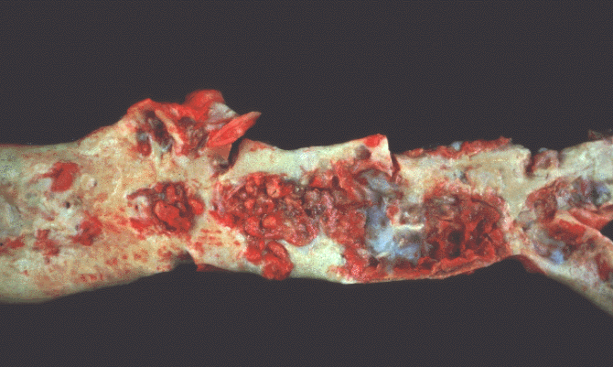
Gross morphology of atheroma/atheromatous plaque
The key processes in AS is intimal thickening and lipid accumulation.
The atheromatous plaques impinge on the lumen of the artery. They vary in size.
Atheromatous plaques usually involve only a partial circumference of the arterial wall ("eccentric" lesions) and are patchy and variable along the vessel length.
www.med.uottawa.ca

Slide 9
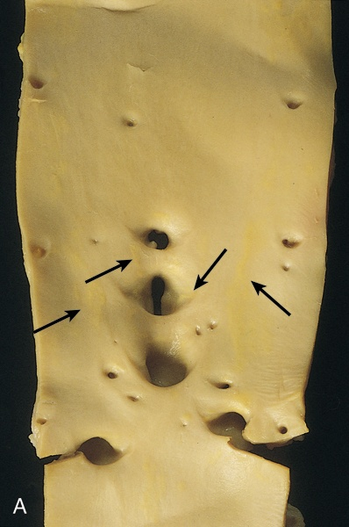
Aorta with fatty streaks ( arrows).
Fatty streaks are the earliest lesion of atherosclerosis they are a collection of lipid laden foam cells in the intima.
They do not cause any disturbance in blood flow.
Fatty streaks begin as multiple yellow, flat spots less than 1 mm in diameter that coalesce into elongated streaks, 1 cm long or longer. They contain T lymphocytes and extracellular lipid in smaller amounts than in plaques.
Photomicrograph of fatty streak in an experimental hypercholesterolemic rabbit, demonstrating intimal macrophage-derived foam cells ( arrow).

Slide 10
Atherosclerosis: Microscopic morphology
An atheroma consists of a raised focal lesion in the intima, with a soft, yellow, grumous/granular core of lipid (mainly cholesterol and cholesterol esters), covered by a firm, white fibrous cap. Atherosclerotic plaques have three principal components:
Cells: SMCs, macrophages, lymphocytes and foam cell
Extracellular matrix: including collagen, elastic fibers, and proteoglycans
Lipid: Typical atheromas contain relatively abundant lipid both intracellular and extracellular lipid .
NOTE: Foam cells are large, lipid-laden macrophages derived from blood monocytes, but SMCs can also imbibe lipid to become foam cells.

Slide 11
Atherosclerosis: microscopic morphology
Typically, the superficial fibrous cap is composed of SMCs and extracellular matrix. With some macrophages and T lymphocytes.
Below the fibrous cap is a necrotic core, containing a lipid deposits (primarily cholesterol and cholesterol esters), cholesterol clefts, debris from dead cells, foam cells, fibrin.

Slide 12
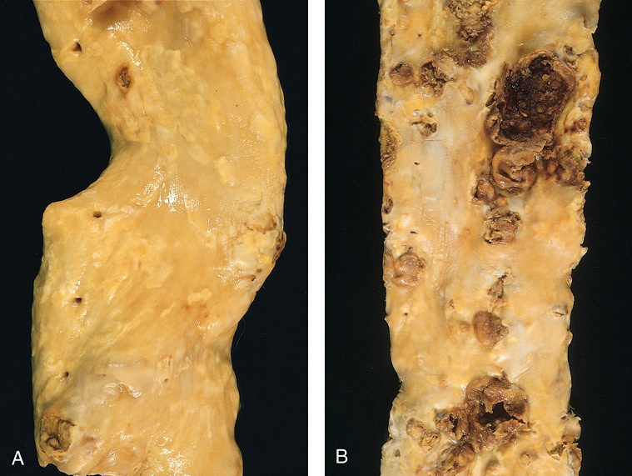
Gross views of atherosclerosis in the aorta.
A. Mild atherosclerosis composed of fibrous plaques, one of which is denoted by the arrow.
B. Severe disease with diffuse and complicated lesions.

Slide 13
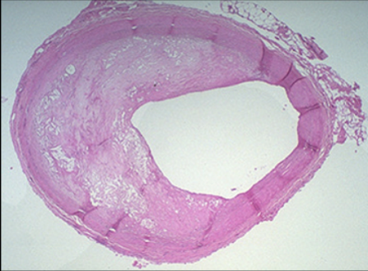
Overall architecture demonstrating an eccentric lesion with a fibrous cap and a central lipid core with typical cholesterol clefts. The lumen is moderately narrowed.
http://sphweb.bumc.bu.edu/otlt/MPH-Modules/PH/PH709_Heart/PH709_Heart3.html

Slide 14
PATHOLOGICAL COMPLICATIONS OF AS
The advanced lesion of atherosclerosis is at risk for the following:
Focal rupture, ulceration, or erosion of the luminal surface of atheromatous plaques which may induce thrombus formation OR the plaque may discharge debris into the bloodstream, producing microemboli composed of plaque lipid (cholesterol emboli or atheroemboli).
Hemorrhage into a plaque due to rupture of the overlying fibrous cap or the capillaries in the plaque. The hematoma may expand the plaque or induce plaque rupture
Superimposed thrombosis, which usually occurs on top of plaques with rupture, ulceration, erosion, or hemorrhage. It is the most feared complication. The thrombus can lead to partial or complete occlusion of the lumen. The thrombus can also embolize.
Weakening of the blood vessel wall with aneurysmal dilation. Atheroma can induce atrophy of the underlying media, causing weakness, aneurysm and potential rupture.
Calcifications: Atheromas often undergo calcification.

Slide 15
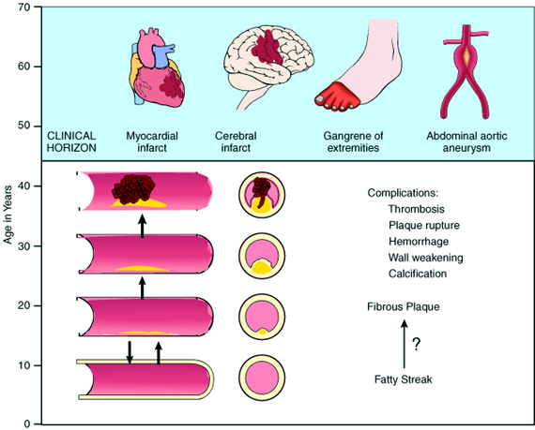
Natural history of atherosclerosis
Slide 12.5
Notes:
Natural history of atherosclerosis. Plaques usually develop slowly and insidiously over many years, beginning in childhood or shortly thereafter. As described in the text, they may progress from a fatty streak to a fibrous plaque and then to a complicated plaque that is likely to lead to clinical effects.

Slide 16
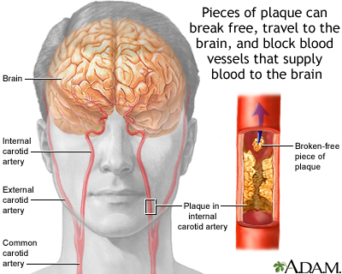
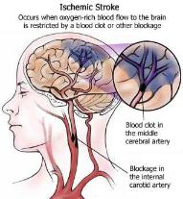
Stroke/ cerebrovascular accident
healthcaredir.com -

Slide 17
cardiologydoc.wordpress.com

Slide 18
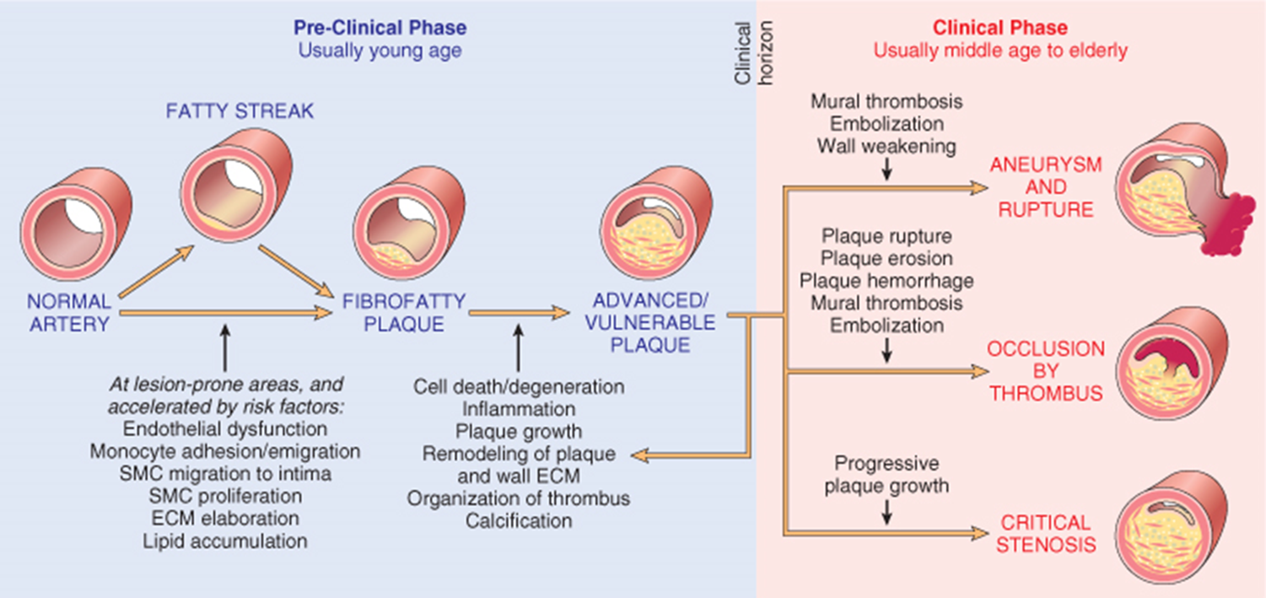
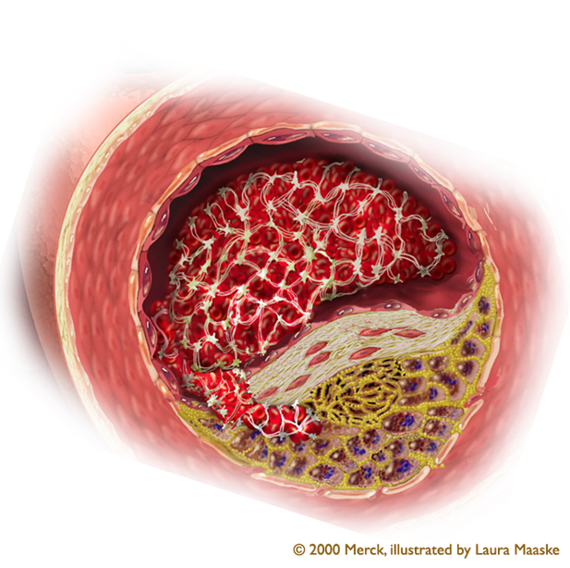

Slide 19
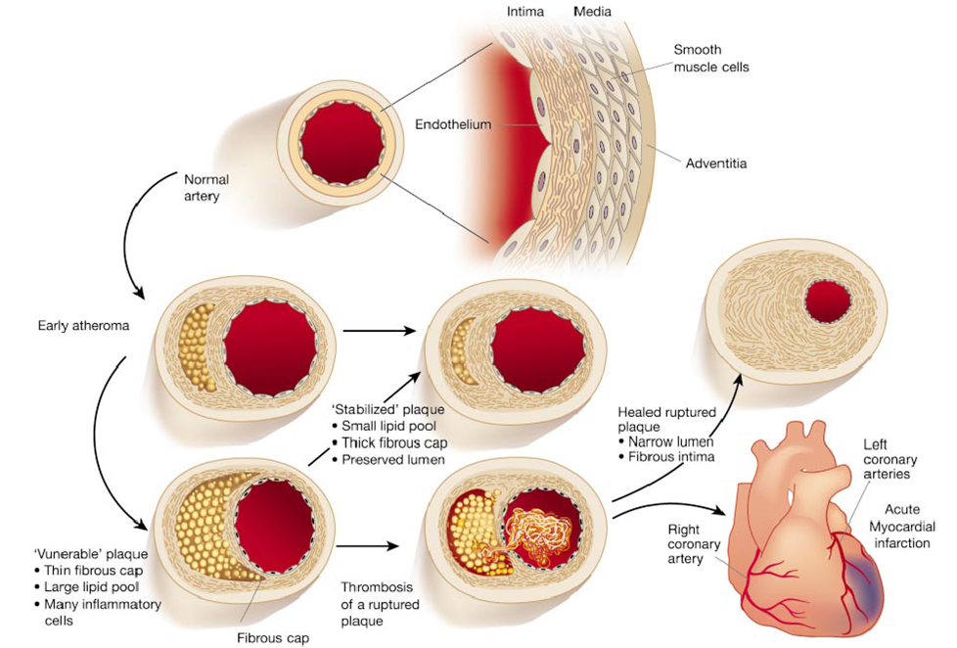
Illustration from from Libby P: Inflammation in Atherosclerosis. Nature 202;420:868

Slide 20
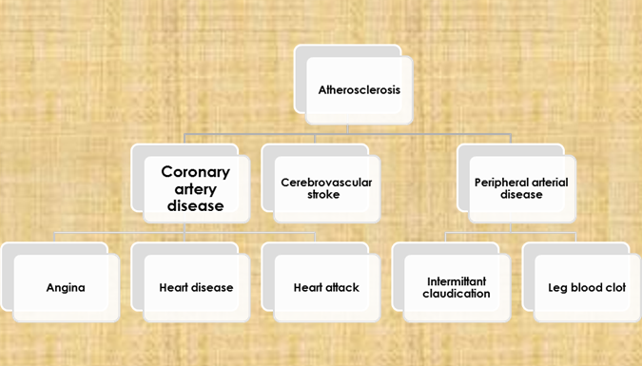

Slide 21
Risk Factors for Atherosclerosis
MINOR/ UNCERTAIN RISK FACTORS
Obesity
Physical inactivity
Stress ("type A" personality)
Postmenopausal estrogen deficiency
High carbohydrate intake
Alcohol
Lipoprotein Lp(a)
Hardened (trans)unsaturated fat intake
Chlamydia pneumoniae
MAJOR RISK FACTORS
NON-MODIFIABLE FACTORS
1. Increasing age
2. Male gender
3. Family history
4. Genetic abnormalities
POTENTIALLY MODIFIABLE FACTORS
1. Hyperlipidemia
2. Hypertension
3. Cigarette smoking
4. Diabetes

Slide 22
IMPORTANCE OF TYPES OF LIPOPROTEINS IN HYPERLIPIDEMIA
Low-density lipoproteins (LDLs): It is “bad cholesterol”. High LDL in the blood promotes AS and therefore heart disease.
Very-low-density lipoproteins (VLDLs): is also considered to be a type of bad cholesterol and it promote atherosclerosis
Chylomicrons also promote atherosclerosis.
High-density lipoproteins (HDLs): is known as “good” cholesterol. High levels of HDL protects against heart attack. Low levels of HDL also increase the risk of heart disease. HDLs help to reverse the effects of high cholesterol.

Slide 23
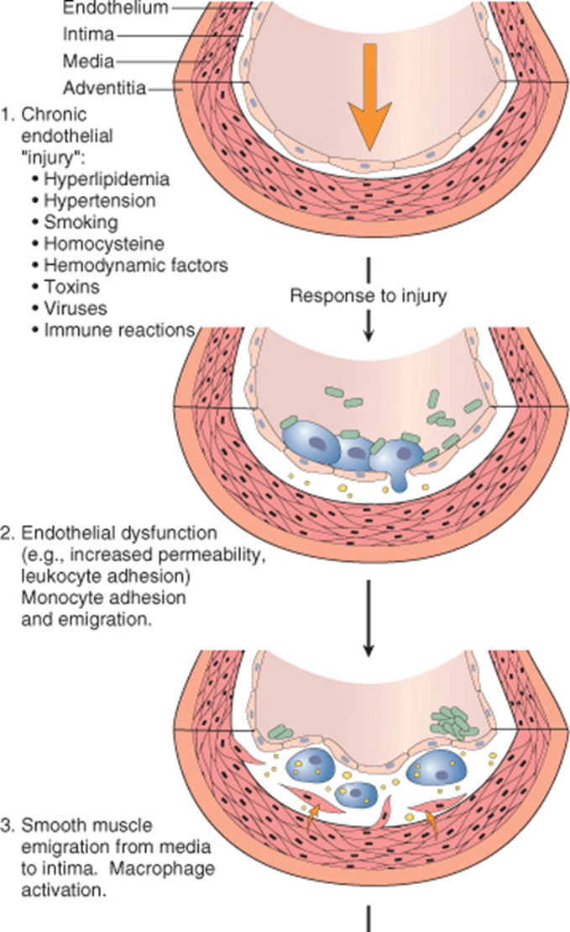
PATHOGENESIS: the hypothesis is that AS is a response to injury
The steps are as follows:
Accumulation of lipoproteins (mainly LDL with its high cholesterol content) in the vessel wall
Subtle Chronic endothelial injury
Increased permeability, leukocyte adhesion, and thrombotic potential.
Adhesion of blood monocytes and leukocytes to the endothelium, followed by migration of monocytes into the intima and transformation into macrophages and foam cells
Adhesion of platelets

Slide 24
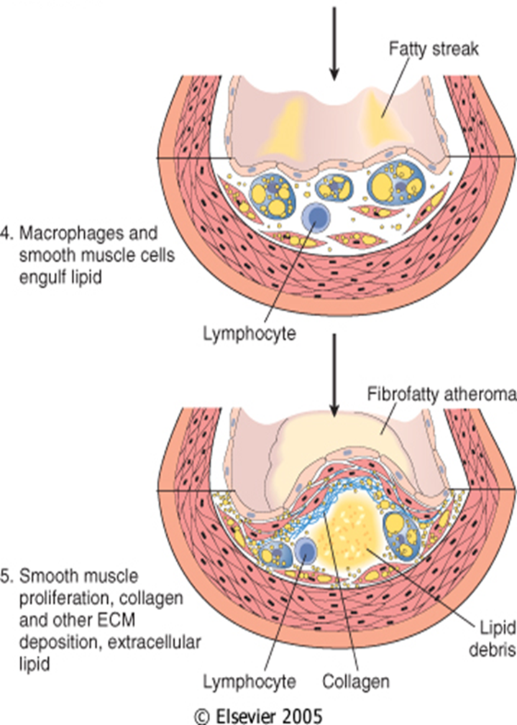
PATHOGENESIS:
Release of factors from activated platelets, macrophages, or vascular cells that cause migration of SMCs from media into the intima.
Proliferation of smooth muscle cells in the intima, and production of extracellular matrix(e.g. collagen & proteoglycans).
Enhanced accumulation of intracellular (macrophages and SMCs) and extracellularly lipids.

Slide 25
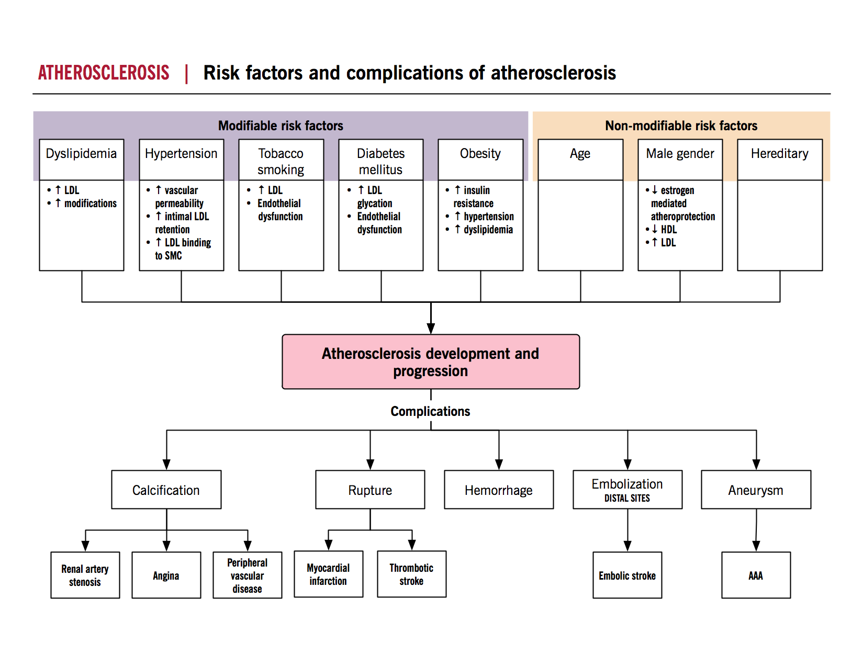
SUMMARY
http://www.pathophys.org/

Slide 26
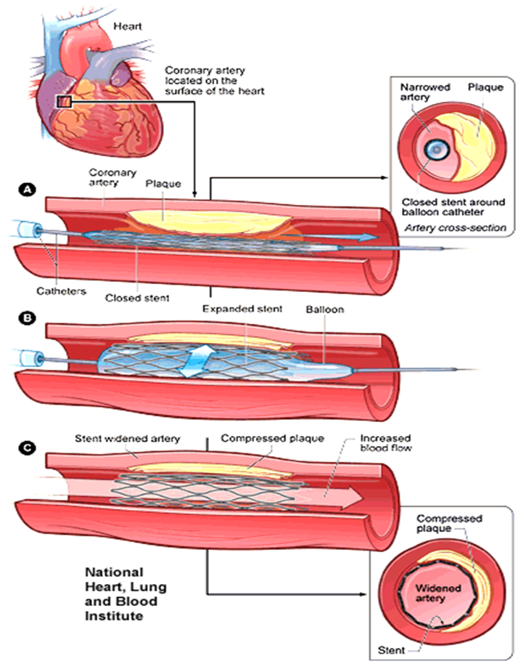
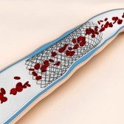
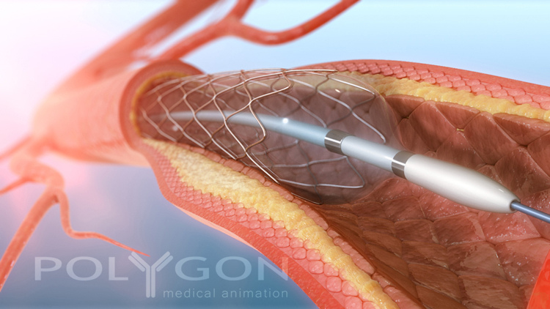
Angioplasty
www.flickr.com

