Slide 1

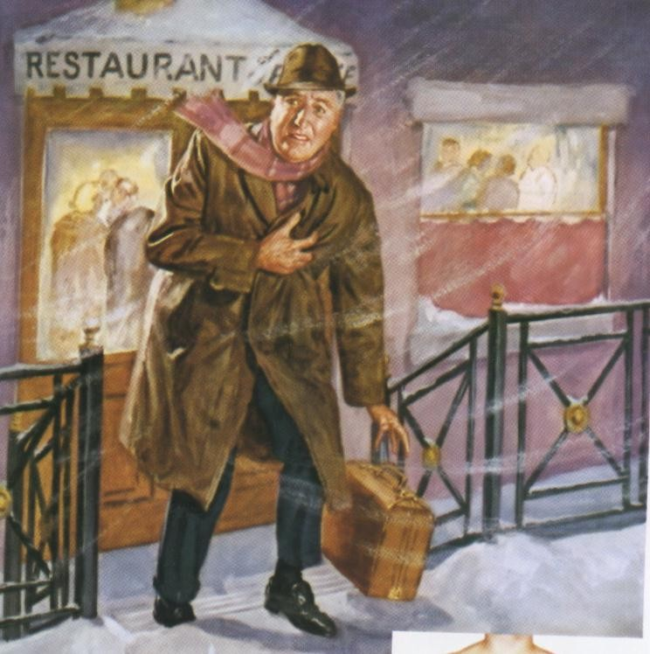



Antianginal Drugs
Learning outcomes
Recognize variables contributing to a balanced
myocardial supply versus demand
Expand on the drugs used to alleviate acute anginal attacks versus those meant for prophylaxis & improvement of survival
Detail the pharmacology of nitrates, other vasodilators, and other drugs used as antianginal therapy

Slide 2

Minicase
Helmi, a 62-year-old male smoker with type 2 diabetes mellitus and hypertension presents with a 4-month history of exertional chest pain. Physical examination shows a blood pressure of 152/90 mm Hg but is otherwise unremarkable. The ECG is normal, and laboratory tests show a fasting blood glucose value of 110 mg/dL, glycosylated hemoglobin 6.0%, creatinine
1.1 mg/dL, total cholesterol 160, LDL 120, HDL 38, and triglycerides 147 mg/dL. He exercises for 8 minutes, experiences chest pain, and is found to have a 2-mm ST-segment depression at the end of exercise.

Slide 3



Minicase
What life style modifications
should Helmi carry out?

Slide 4


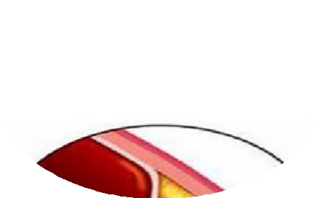
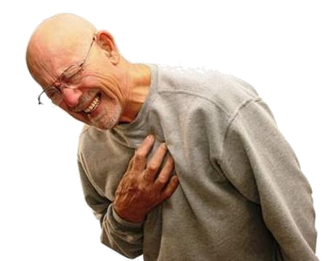
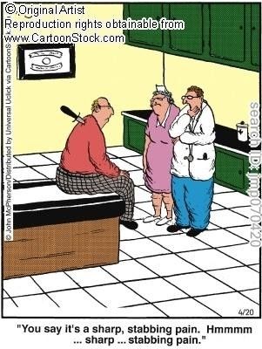
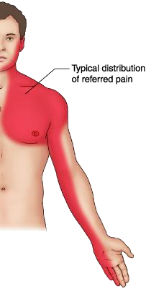


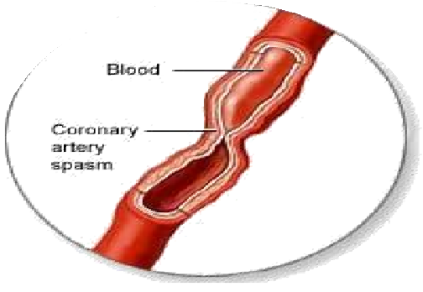
Which signs or symptoms of helmi
suggest diagnosis of angina pectoris?
A c_{P}li_{a}n_{i}i_{n}ca_{is}l s_{c}y_{a}n_{u}d_{s}r_{e}o_{d}m_{e}e_{it}o_{h}f_{er}ch_{b}e_{y}s_{o}t_{b}p_{s}a_{t}i_{r}n_{uc}(v_{ti}a_{o}r_{n}ying in
severity) due to ischemia of heart muscle
Pain is due to (accumulation of metabolites K⁺, PGs, Kinins, Adenosine….) secondary to the ischemia
Or spasm

Slide 5

Minicase
What is the possible underlying
cause of Helmi’s exertional pain?

Slide 6

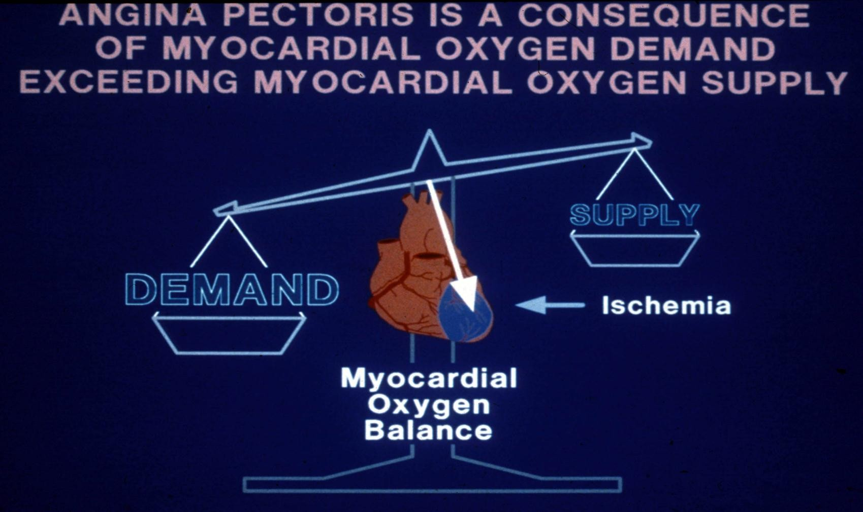
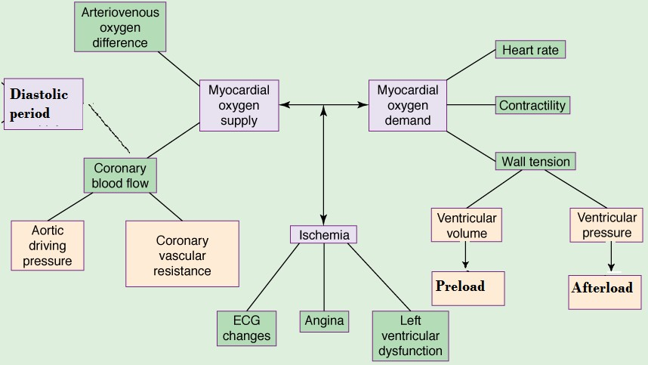
What is Basic mechanism of angia pectoris?
What are the determinants of oxygen demand and supply?

Slide 7


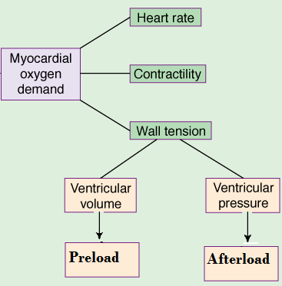









Myocardial oxygen
demand is determined by:-
Myocardial oxygen
demand is diminished by:-
Reducing contractility Reducing heart rate Reducing the preload Reducing the afterload

Slide 8
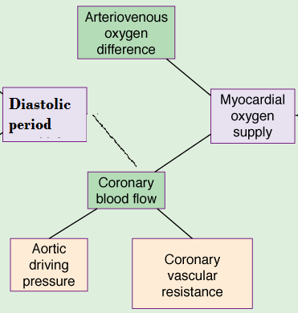

Myocardial oxygen
supply is determined by:-
Myocardial oxygen
supply is enhanced by:-
Reducing coronary vascular
resistance
Prolonging diastolic period Reducing external compression Dilating collateral vessels

Slide 9

Minicase
What triggers the onset of
symtoms in helmi?
What factors worsen the
symptoms in case of Helmi?
What is the possible underlying cause of angina in Helmi?

Slide 10
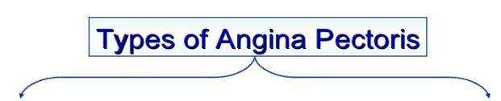
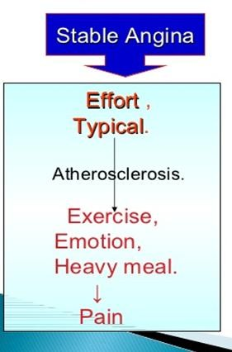
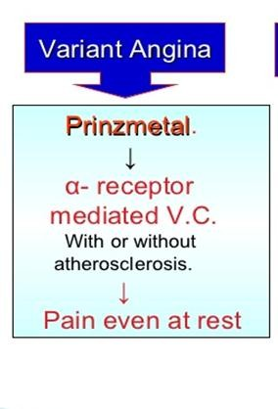
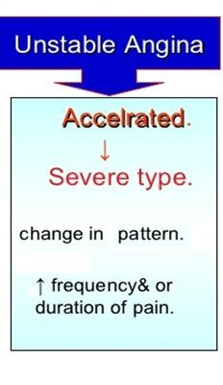

Slide 11

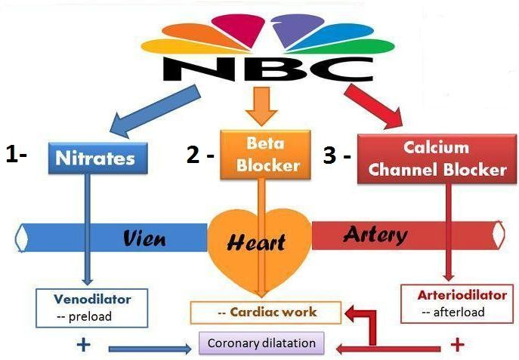
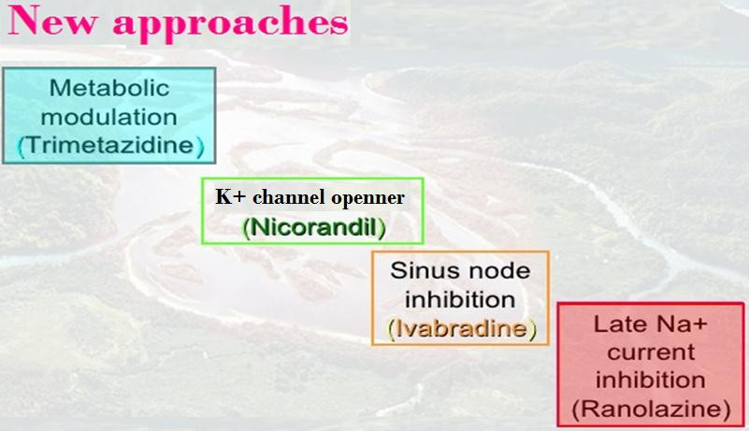
Treatment of angia pectors
1-Agents that improve symptoms & ischemia

Slide 12
Treatment of angia pectors
2-Agents that improve prognosis Aspirin / Other antiplatelets Statins
ACE Inhibitors
β-AD blockers

Slide 13


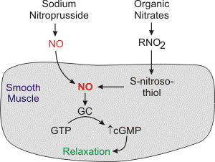


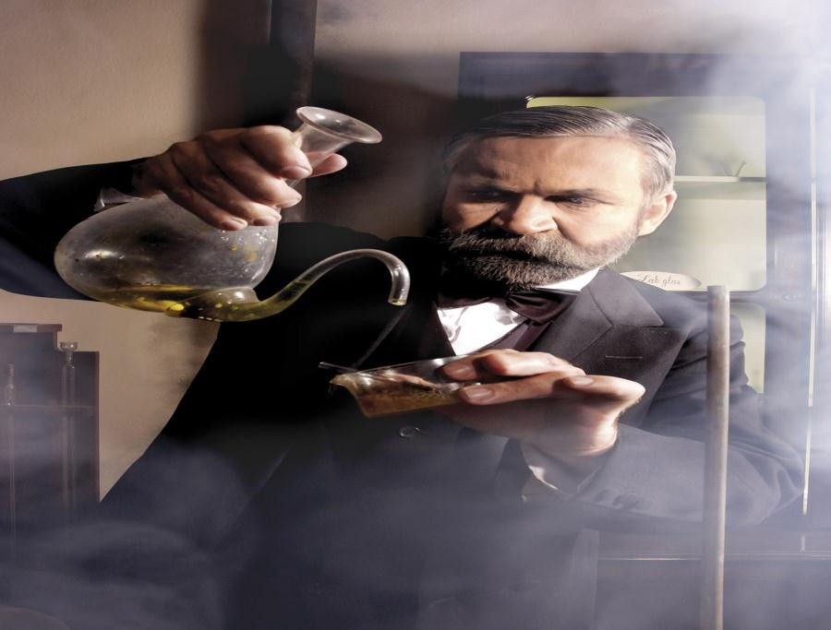
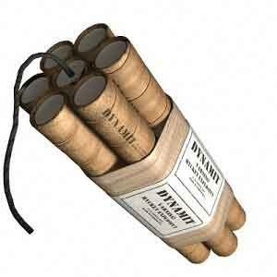

Organic nitrates
Mechanism of action
Long acting
Isosorbide mononitate
Short acting
Nitroglycerine
c oxide binds to guanyl
cular smooth muscle c
P activates PKG to pro
cyclase in
o form cGMP.
Nitri
vas
ate
ell t
cGM
duce relaxation

Slide 14


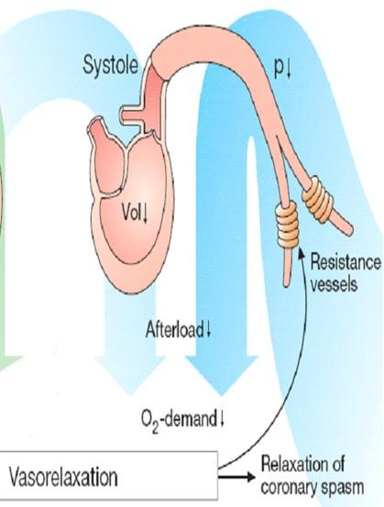
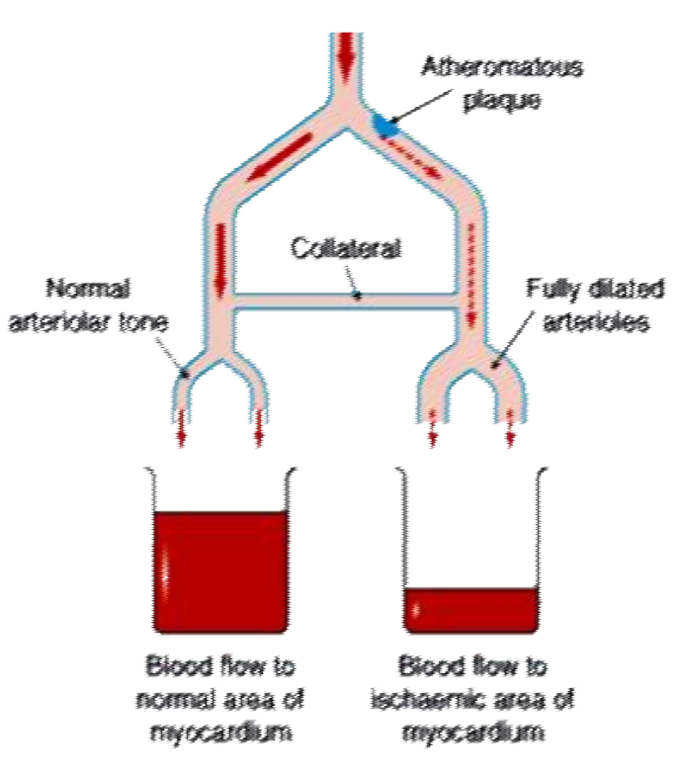
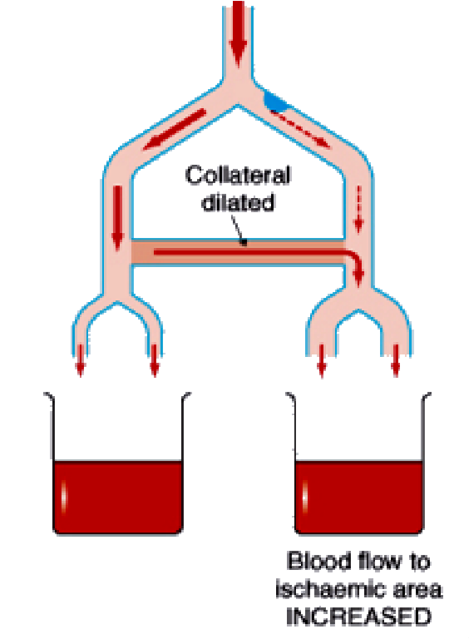
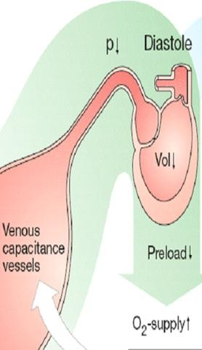

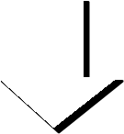




Hemodynamic effects of nitrates
S_{V}h_{e}un_{n}t_{o}i_{u}n_{s}g _{v}o_{a}f_{so}f_{d}lo_{il}w_{at}f_{a}r_{t}o_{io}m_{n} normal area to ischemic
area by dilating collateral ves
^{sels} With Nitrates
ion perfusion
Coron_{P}a_{r}r_{e}y_{lo}v_{a}a_{d}sodilatat
Myocardial
Arterial vasodilatation
Afterload

Slide 15











Think-pair-share
ftatch the effects of nitrates in treatment of angina with their results
Effects
1-↓Ventricular volume
Results
2-Reflex ↑ in contractility
A-↓ O2 demand
3-↓Arterial pressure
B-↑ O2 demand
4-↑Collateral flow
C-Relief of coronary
artery spasm
5-Reflex tachycardia
6-↓Left ventricular diastolic pressure
D-Improved perfusion to
ischemic myocardium
7-↓Diastolic perfusion time
due to tachycardia
E-Improve subendocardial
perfusion
8-Vasodilation of epicardial coronary arteries
F-↓ myocardial perfusion

Slide 16
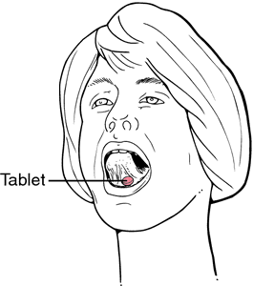



pharmacokinetics
NOirtarol igsloyscorirnbeid[Ge TdNin]itrate & mononitrate ^{Ve}S^{r}ig^{y}n^{w}if^{e}ic^{ll}aªn^{b}t^{s}fiºr^{r}s^{b}t^{e}p^{d}as&s¹m⁰⁰e%tab^{b}o^{io}liªs^{v}m^{ai}o^{la}c^{b}c^{i}u^{li}r^{t}s^{y} in
the liver (10-20%) bioavailability
The dinitrate undergoes denitration to two
_{mo}G_{n}iv_{o}e_{n}n_{itr}s_{a}u_{t}b_{e}l_{s}ingu_{b}a_{o}l_{th}or_{p}v_{o}i_{s}a_{s}t_{e}ra_{s}n_{s}s_{a}d_{n}e_{t}r_{ia}m_{n}a_{g}l_{i}p_{n}a_{a}t_{l}c_{a}h_{c},_{t}o_{iv}r_{it}p_{y}arenteral
(t_{1/2} 1-3 hours)
Further denitrated metabolites conjugate to glucuronic acid
in liver. Excreted in urine.

Slide 17

Indications
IN STABLE ANGINA;
AINcuVAteRsIAymNTptAomNGrIeNliAefsusbulbinlignugaulaGl GTNTN
IPNreUvNeSntTiAonB;LEPeArNsiGstINanAt proIVphGyTlaNxis  Isosorbide mono or dinitrate _{He}P_{a}r_{r}e_{t} v_{F}e_{a}n_{il}t_{u}io_{re}n; Situational prophylaxis  sublingual GTN
Refractory AHF  IV GTN
CHF  Isosorbide mononitrate + hydralazine
[ if contraindication to ACE Is]
AMI IV GTN

Slide 18
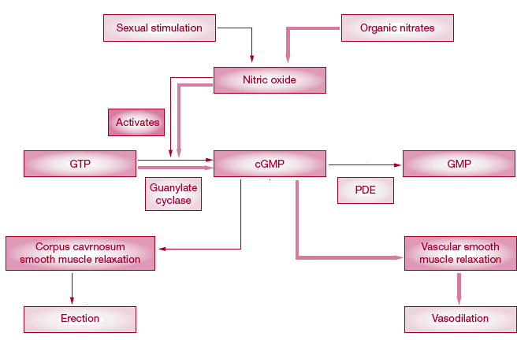

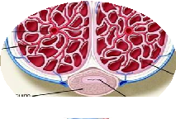
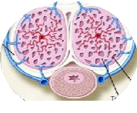
contraindications
Concomitant administration of PDE₅ Inhibitors
Known sensi nic nitrates
Glaucoma; nitrates  aqueous humour formation
tivity to orga
ncrease intr
d trauma or c
orrhage , I
acranial press
Hea erebral haem
Uncorrected hypovolemia
ure.
Sildenafil + nitrates Severe hypotension & death

Slide 19
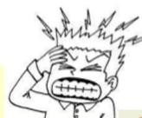

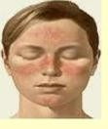

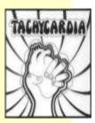

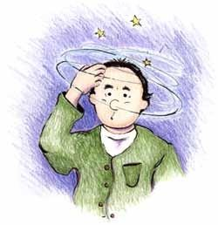

Adverse drug reactions
Throbing headache
Flushing in blush area
Tachycardia  palpitation
Postural hypotension, dizziness  syncope Rarely methemoglobinema

Slide 20
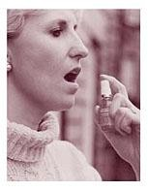
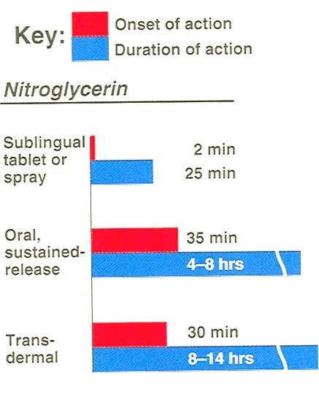
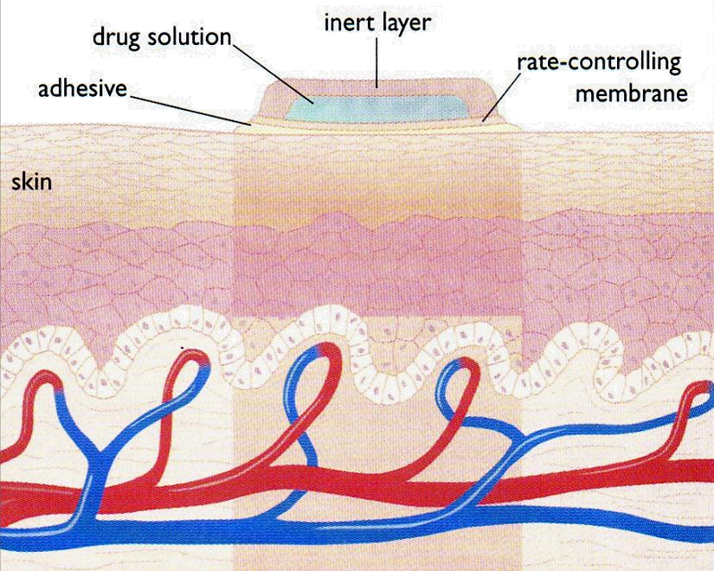

Preparations
Nitroglycerine Sublingual t Transderma
ablets or spray
l patch
Oral or bucal sustained release
I.V. Preparations

Slide 21

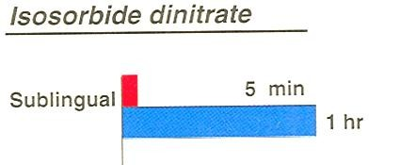
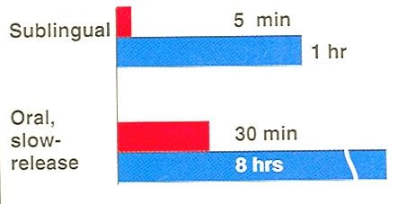

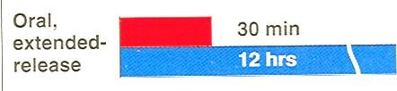
Preparations
Isosorbide dinitrate
▪Dinitrate Sublingual tablets
▪Dinitrate Oral sustained release
▪Infusion Preparations
ral sustained release
▪Mononitrate O

Slide 22

Nitrates tolerance
Loss of vasodilator response of nitrates on use of long- acting preparations (oral, transdermal) or continuous intravenous infusions, for more than a few hours without interruption.
Mechanism
1-Compensatory neurohormonal counter-regulation 2-Depletion of free-SH groups

Slide 23


Minicase
If Helmi was prescribed nitrates & tolerance developed to its effect, how to overcome tolerance to nitrates?
Nitrate tolerance can be overcome by:
Smaller doses at increasing intervals (Nitrate free
periods twice a day).
Giving drugs that maintain tissue SH group e.g.
Captopril.

Slide 24



Task- selection of a P-drug

