Slide 1





Antianginal Drugs
Learning outcomes
Recognize variables contributing to a balanced myocardial supply versus demand
Expand on the drugs used to alleviate acute anginal attacks versus those meant for prophylaxis & improvement of survival
Detail the pharmacology of nitrates, other vasodilators, and other drugs used as antianginal therapy

Slide 2








Calcium channel blockers
Classification Selectivity
Dihydropyridines:-
Nifedipine , Nicardipine, Amlodepine
Nifedipine ,
Vascular smooth muscle
Cardi_{V}om_{era}y_{p}o_{a}c_{m}yt_{i}e_{l} s
Interm_{Di}e_{lt}d_{i}i_{a}a_{z}t_{e}e_{m}
P^{V}he^{e}n^{ra}y^{p}laªl^{m}ky^{i}l^{l}amines:-
B^{D}e^{i}n^{lt}z^{i}tªh^{z}ia^{em}zepines:-

Slide 3

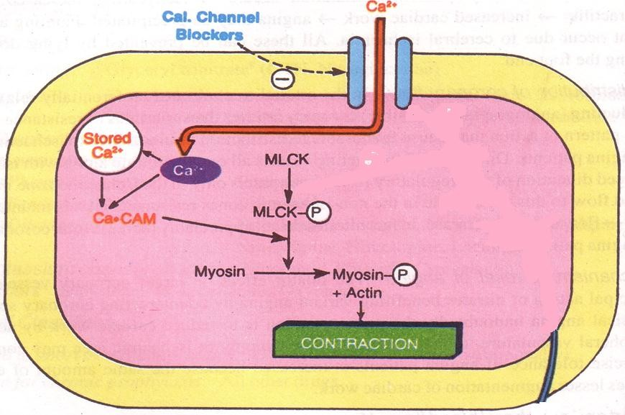
Mechanism of Action
Binding of calcium channel blockers [CCBs] to the L-type
Ca channels  their frequency of opening
in response to depolarization
entry of Ca   Ca release from internal stores 
No Stimulus-Contraction Coupling  RELAXATION

Slide 4


Antianginal Action
◉ Cardiomyocyte Contraction  cardiac work through their –ve inotropic & chronotropic action (verapamil & diltiazem)  myocardial oxygen demand
VSMC Contraction   After load  cardiac work 
myocardial oxygen demand
Coronary dilatation  myocardial oxygen supply

Slide 5






Therapeutic Uses
IN_{Sh}V_{o}A_{r}R_{t}IA_{a}N_{ct}T_{in}A_{g}NG_{d}I_{i}N_{h}A_{ydropyridi}  Attacks prevented (> 60%) /
ne should be avoided ??
sometimes variably aborted
Can be combined to β-AR blockers???
IN UNSTABLE ANGINA; Seldom added in refractory cases
Can be combined with nitrates???
INDSihTAydBrLoEpyArNidGeInNeAs;useful antRiaengguilnaarlpirfowpihthylCaxHiFs??

Slide 6

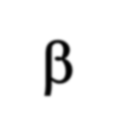

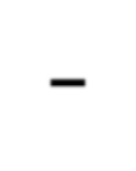
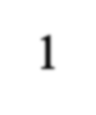
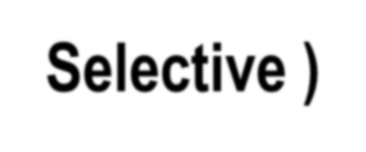
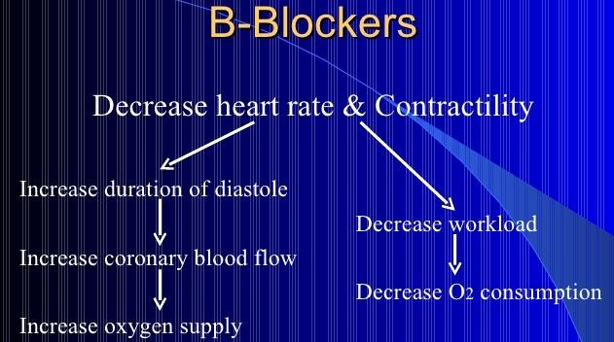
Beta Adrenoceptor Blockers
Examples Atenolol, Bisoprolol, Metoprolol (β₁ –
Selective )
Antianginal Mechanism

Slide 7






Beta Adrenoceptor Blockers
Indications in angina
In stable angina
Regular prophylaxis, selective are prefered? First choice for chronic use?
Can be combined with nitrates?
Can be combined with dihydropyridine CCB?
Verapamil?
In variant angina
Contraindicated?

Slide 8



Beta Adrenoceptor Blockers
Indications in angina
In Unstable angina
Halts progression to MI, improve survival
In Myocardial infarction
Reduce infarct size
Reduce morbidity & mortality
→reduce O2 demand
→reduce arrhythmias

Slide 9
Beta Adrenoceptor Blockers
β- blockers should be withdrawn gradually?
Given to diabetics with ischemic heart disease?

Slide 10



Minicase
Which antianginal drug is the best choice for the case of Helmi? And Why?

Slide 11
Minicase
If Helmi does not respond to monotherapy, what other drug should be added to his regimen?

Slide 12
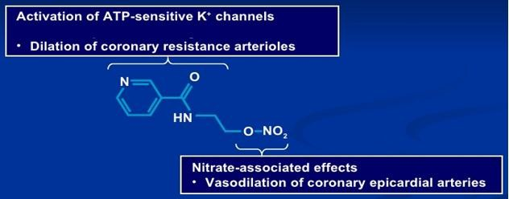

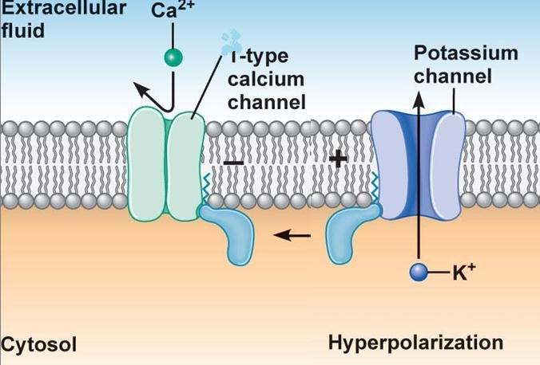

Potassium channel openners
Nicorandil
Mechanism
It has dual mechanism of
action;
L
1. Opens K_{ATP} channels (>
arteriolar dilator)
2. NO donner as it has a nitrate moiety (> venular dilator

Slide 13

Pharmacodynamic Effects
As K channel openner
O^{A}n^{s} v^{n}a^{i}s^{tr}c^{i}u^{c}laºr^{x}sm^{id}o^{e}ot^{d}hºm^{n}uºs^{r}cles opening of K channels
hyperpolarization  vasodilatation
NO  cGMP/PKG  vasoditation
On cardiomyocytes opening of K channels repolarization
 cardiac work

Slide 14


Indications
Prophylactic 2nd line therapy in stable angina & refractory
variant angina
ADRs
Flushing, headache,
Hypotension, palpitation, weakness
Mouth & peri-anal ulcers, nausea and vomiting.

Slide 15

Think-pair-share
A 5 5 - year - old woman complained to her physician of palpitations, flushing of the face, and vertigo. The woman, suffering from diabetes mellitus, was giving herself three daily doses of insulin. She had been recently diagnosed with exertional angina for which nitrate therapy was started with transdermal nitroglycerin and oral isosorbide mononitrate.
After 3 weeks of therapy, her anginal attacks were less frequent but not completely prevented. Which would be an appropriate next therapeutic step for this patient?

Slide 16

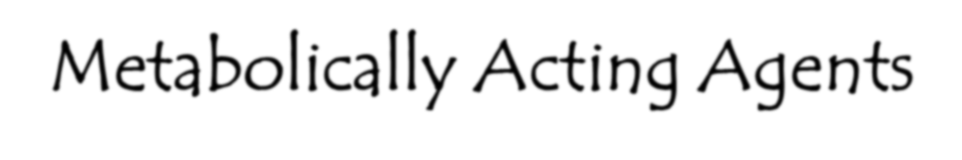


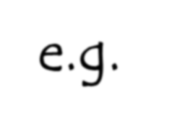
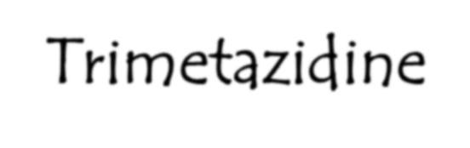

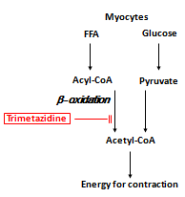
ftetabolically Acting Agents
e.g. Trimetazidine
O2 requirement of glucose pathway is
lo
Duri ls rise,
blun
wer than FFA pathway
ng ischemia, oxidized FFA leve
ting the glucose pathway
Reduces O2 demand without altering hemodynamics

Slide 17

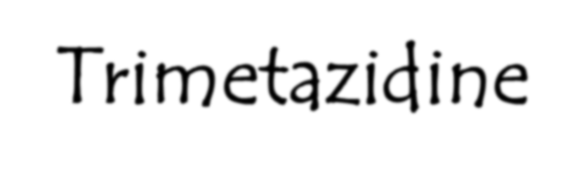



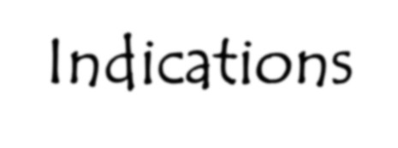

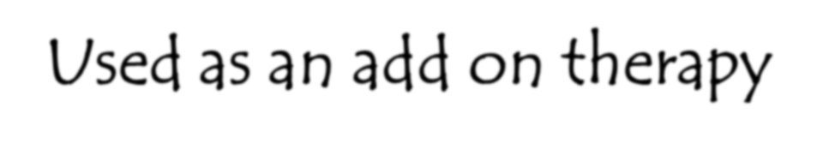

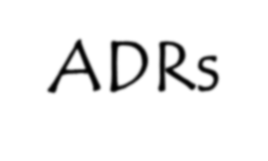
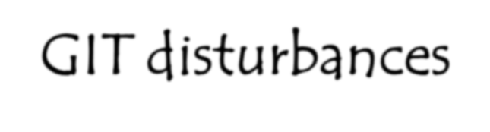

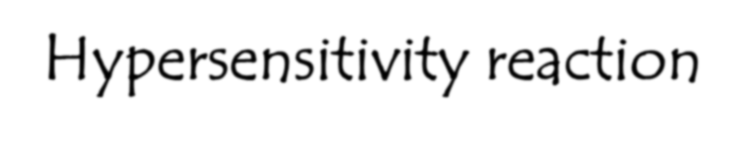

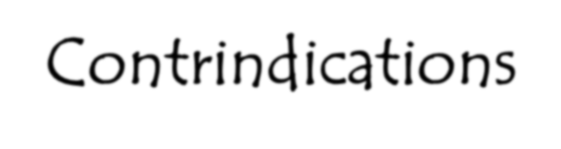

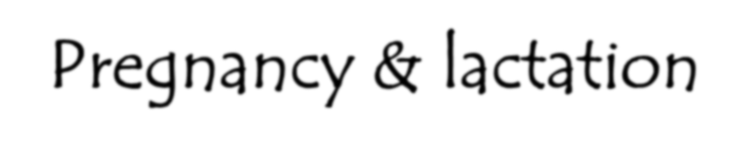
Trimetazidine
Indications
ADRs
Contrindications
Used as an add on therapy
GIT disturbances
Hypersensitivity reaction
Pregnancy & lactation

Slide 18

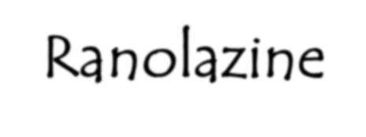

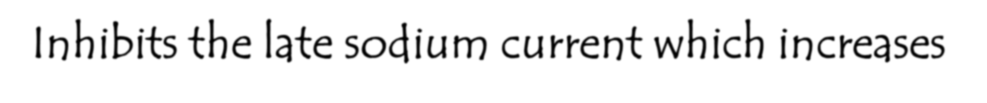
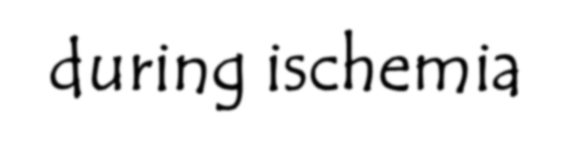
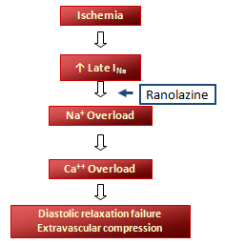
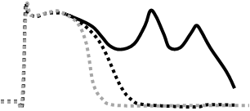
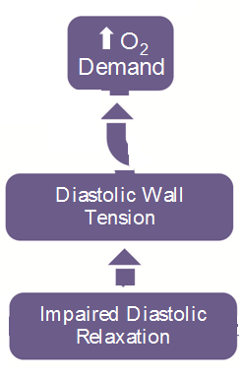


ftetabolically Acting Agents Ranolazine
Inhibits the late sodium current which increases
during ischemia
the QT interval so contraindicated wit II antiarrhthmics
velops due to interaction with CYT 450 m, verapamil, ketoconazole, macrolide grapefruit juice
It prolongs Class Ia & I
Toxicity de as; diltiaze antibiotics,
ADRs:- dizziness , constipation
h;
inhibitors
Used in chronic angina concommitanly with other drugs

Slide 19

Minicase
Which antihyperlipidemic drug
should be prescribed to Helmi?

Slide 20

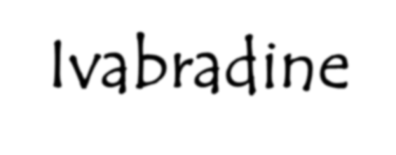

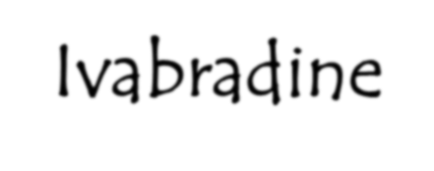


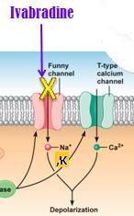
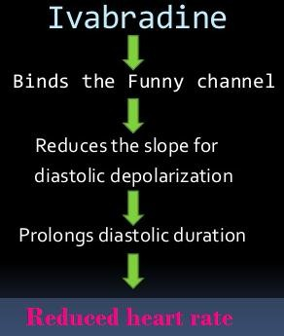

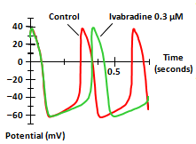




Ivabradine
Ivabradine Selectively blocks I_{f}
Ivabradine reduces slope of depolarization, slowing HR,reducing myocardila work & O2 demand
U_{U}s_{s}e_{e}d_{d}i_{i}n_{n}t_{c}re_{o}a_{m}tm_{bin}e_{a}n_{t}t_{io}o_{n}f c_{w}h_{i}r_{t}o_{h}n_{b}ic_{et}s_{a}ta_{b}b_{lo}le_{ck}a_{e}
^{p}hªe^{t}a^{ie}r^{n}t ^{t}f^{s}ai^{w}lu^{i}r^{t}e^{h} w^{no}it^{r}h^{m}LªV^{l}E^{s}F^{in}l^{u}ow^{s} e^{rh}r^{y}t^{t}h^{h}a^{m}n ^{w}35 ^{ß}i⁻n^{b}a^{lo}d^{c}e^{k}q^{e}u^{r}a^{s}tely controlled by beta bloc whose heart rate exceeds 70/min
ADR:- luminous phenomena
I_{f} current is a pacemaker
^{n}r^{g}s^{ina}in p^{in}eople with
k
that activates
n inward Na+/K+ current cells of the SA node
ho_{per}cann_{cen}o_{t}t take
ers alone and

Slide 21
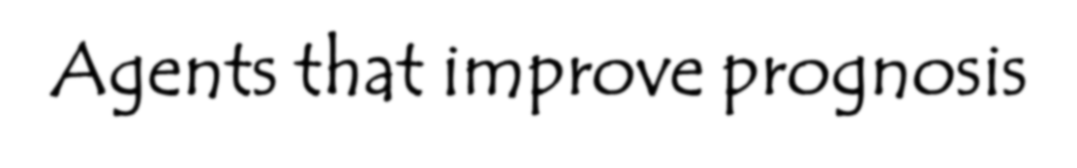

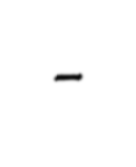
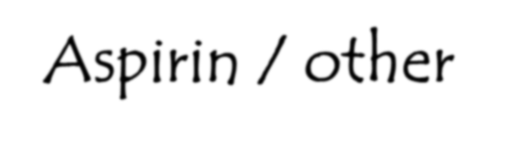

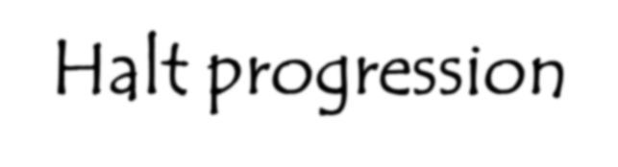

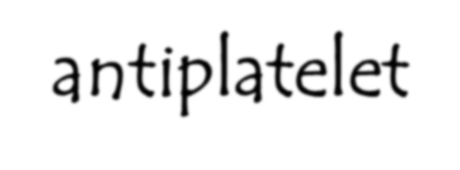
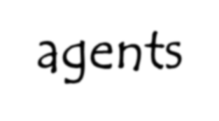
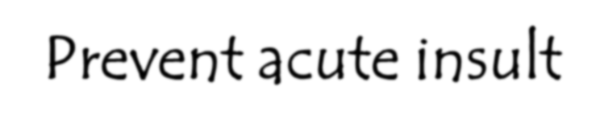
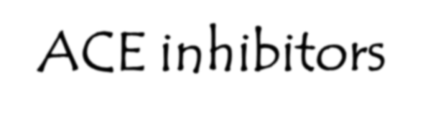
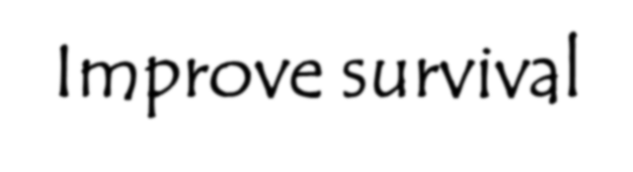
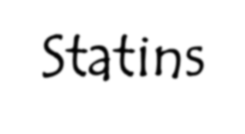
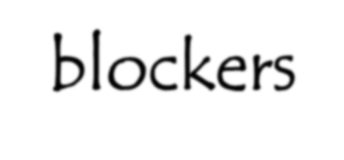
Agents that improve prognosis
-Aspirin / other
antiplatelet agents
-ACE inhibitors
-Statins
-β -blockers
Halt progression Prevent acute insult Improve survival

Slide 22

Memory matrix
In the following table indicate increase, decrease
or no effect with signs ↑, ↓, ─ respectively
Drug/Class | HR | BP | Wall Tension | Contract- ility | O₂ Suppl y
Beta-blockers
CCBs
Verap/Dilt
Dihydropyridines
Nitrates
Ranolazine

