Slide 1
Drug Therapy
of
Heart Failure
Prof. Abdulrahman Almotrefi

Slide 2
Learning objectives
By the end of this lecture, students should be able to:
- Describe the different classes of drugs used for treatment of acute & chronic heart failure and their mechanism of action
Understand their pharmacological effects, clinical
uses, adverse effects and their interactions with
other drugs

Slide 3
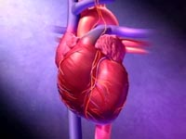
HEART FAILURE
?
Inability of the heart to maintain an adequate cardiac output to meet the metabolic demands of the body.

Slide 4
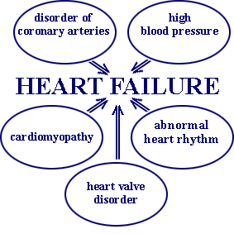
CAUSES OF HEART FAILURE

Slide 5
Symptoms of Heart failure
- Tachycardia
- Decreased exercise tolerance (rapid fatigue)
- Dyspnea ( pulmonary congestion )
- Peripheral edema
- Cardiomegaly

Slide 6
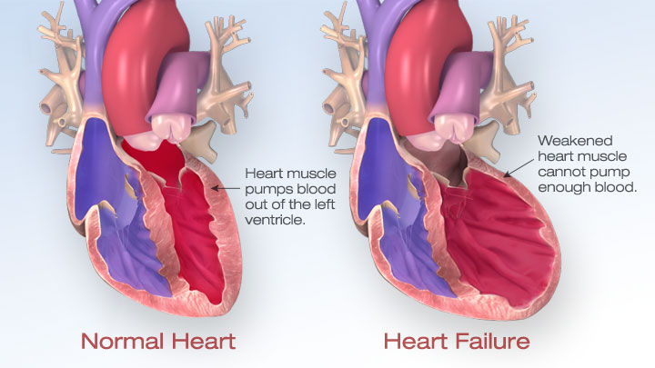

Slide 7
Pathophysiology of CHF
↓ Force of contraction
Low C.O.
↓ Carotid sinus firing
↓ Renal blood flow
Activate renin-angiotensin-
Aldosterone system
Activate sympathetic system
↑ Sympathetic discharge
ALDOST.
Ag. II
Remodeling
Salt & Water
Retention
Volume expansion
Vasoconstriction
↑ Force of
Cardiac .cont.
Venous VC
Arterial VC
↑ HR
↑ Preload
↑ Preload
↑ Afterload

Slide 8
Factors affecting cardiac output and
heart failure
1- Preload
2- Afterload
3- Cardiac contractility

Slide 9
Drugs used in treatment of heart failure
I- Drugs that decrease preload:
1 - Diuretics
2 - Aldosterone antagonists
3 - Venodilators
II- Drugs that decrease afterload:
1 - Arteriodilators

Slide 10
Drugs used in treatment of heart failure
III- Drugs that decrease both preload & afterload:
( Combined arteriolo- & venodilators )
1- Angiotensin converting enzyme (ACE) inhibitors
2- Angiotensin receptor antagonists
3- α₁-adrenoceptor antagonists
4- Direct vasodilators

Slide 11
Drugs used in treatment of heart failure
IV- Drugs that increase contractility:
1- Cardiac glycosides (digitalis)
2- β- adrenoceptor agonists
3- Phosphodiesterase inhibitors

Slide 12
I- Drugs that decrease preload
1-Diuretics:
Mechanism of action in heart failure :
reduce salt and water retention
⬇
decrease ventricular preload and venous pressure
⬇
reduction of cardiac size
⬇
Improvement of cardiac performance

Slide 13
I- Drugs that decrease preload
1-Diuretics:
Chlorothiazide
- first-line agent in heart failure therapy
- used in volume overload ( pulmonary and/ or
peripheral edema )
- used in mild congestive heart failure

Slide 14
I- Drugs that decrease preload
1-Diuretics:
Furosemide
- a potent diuretic
used for immediate reduction of pulmonary congestion & severe edema associated with :
- acute heart failure
- moderate & severe chronic failure

Slide 15
I- Drugs that decrease preload
2-Aldosterone antagonists:
Spironolactone
- nonselective antagonist of aldosterone receptor
- a potassium sparing diuretic
- improves survival in advanced heart failure

Slide 16
I- Drugs that decrease preload
2-Aldosterone antagonists:
Eplerenone
- a new selective aldosterone receptor antagonist
( does not inhibit other hormones such as
estrogens & androgens)
- indicated to improve survival of stable patients with congestive heart failure

Slide 17
I- Drugs that decrease preload
3-Venodilators:
Nitroglycerine
Isosorbide dinitrate
used I.V. for severe heart failure when the
main symptom is dyspnea due to pulmonary
congestion
dilates venous blood vessels and reduce
preload

Slide 18
II- Drugs that decrease afterload
1- Arteriodilators:
Hydralazine
- used when the main symptom is rapid
fatigue due to low cardiac output
reduce peripheral vascular resistance

Slide 19
III- Drugs that decrease both
preload & afterload
1-Angiotensin converting enzyme (ACE) inhibitors:
- considered as first-line drugs for
chronic heart failure along with diuretics
first-line drugs for hypertension therapy

Slide 20
Angiotensin converting enzyme inhibitors
MECHANISM OF ACTION
VASOCONSTRICTION
VASODILATATION
ALDOSTERONE
VASOPRESSIN
SYMPATHETIC
Angiotensinogen
RENIN
BRADYKININ
Angiotensin I
A.C.E.
Inhibitor
Breackdown
ANGIOTENSIN II

Slide 21
ACE Inhibitors
Pharmacological actions:
1 - Decrease peripheral resistance ( Afterload )
2 - Decrease Venous return ( Preload)
3 - Decrease sympathetic activity
4- Inhibit cardiac and vascular remodeling
associated with chronic heart failure
⬇
Decrease in mortality rate

Slide 22
ACE Inhibitors
Pharmacokinetics:
Captopril, Enalapril and Ramipril
- rapidly absorbed from GIT after oral administration.
- food reduce their bioavailability
Enalapril , Ramipril
- prodrugs, converted to their active metabolites in liver
- have long half-life & given once daily

Slide 23
ACE Inhibitors
Adverse effects:
1- acute renal failure, especially in patients
with renal artery stenosis
2- hyperkalemia, especially in patients with
renal insufficiency or diabetes
3- severe hypotension in hypovolemic patients
(due to diuretics, salt restriction or
gastrointestinal fluid loss)

Slide 24
ACE Inhibitors
Adverse effects:
4- dry cough sometimes with wheezing
5- angioneurotic edema ( swelling in the
nose , throat, tongue, larynx)
6- dysgeusia ( reversible loss or altered taste)

Slide 25
ACE Inhibitors
Contraindications:
- during the second and third trimesters
of pregnancy
( due to the risk of : fetal hypotension
renal failure & malformations )
- renal artery stenosis

Slide 26
III- Drugs that decrease both
preload & afterload
2- Angiotensin receptor blockers (ARBs) :
Losartan, Valsartan , Irbesartan
Mechanism of action:
- block AT₁ receptors
- decrease action of angiotensin II

Slide 27
III- Drugs that decrease both
preload & afterload
3- α-ADRENOCEPTOR BLOCKERS :
Prazosin
- blocks α- receptors in arterioles and venules
- decrease both afterload & preload

Slide 28
III- Drugs that decrease both
preload & afterload
4- Direct acting vasodilators:
Sodium nitroprusside
- given I.V. for acute or severe heart failure
- acts immediately and effects lasts for 1-5 min.

Slide 29
IV- Drugs that increase contractility
1- Cardiac glycosides ( digitalis) :
Digoxin
-increases the force of myocardial contraction ( +ve inotropic effect )
Mechanism of action :
- Inhibit Na⁺ / K⁺ ATPase enzyme
( the sodium pump )

Slide 30
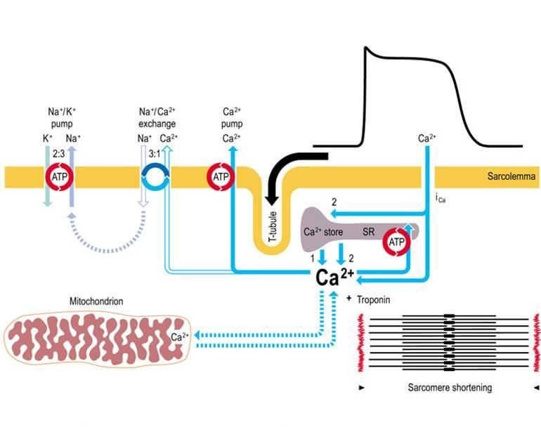
MECHANISM OF ACTION OF DIGOXIN

Slide 31
IV- Drugs that increase contractility
1- Cardiac glycosides ( digitalis) :
Digoxin
Therapeutic uses:
- Congestive heart failure
- has narrow therapeutic index

Slide 32
IV- Drugs that increase contractility
1- Cardiac glycosides ( digitalis) :
Digoxin
Adverse effects (Cardiac):
- digitalis-induced arrhythmias
- extrasystoles
- coupled beats (Bigeminal rhythm)
- ventricular tachycardia or fibrillation
- cardiac arrest

Slide 33
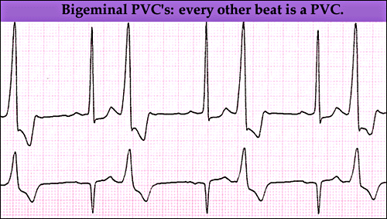

Slide 34
IV- Drugs that increase contractility
1- Cardiac glycosides ( digitalis) :
Digoxin
Adverse effects (non-cardiac) :
GIT :
anorexia ,nausea, vomiting, diarrhea
CNS:
headache, visual disturbances, drowsiness

Slide 35
IV- Drugs that increase contractility
1- Cardiac glycosides ( digitalis) :
Digoxin
Factors that increase its toxicity:
- Renal diseases
- Hypokalemia
- Hypomagnesemia
- Hypercalemia

Slide 36
IV- Drugs that increase contractility
2- β-Adrenoceptor agonists:
Dobutamine
Selective β₁ agonist
Uses : Treatment of acute heart failure in
cardiogenic shock

Slide 37
IV- Drugs that increase contractility
3- phosphodiesterase -III inhibitors:
Milrinone
Mechanism of action:
Inhibits phosphodiesterase -III ( cardiac & B. Vessels)
⬇ ⬇
Increase cardiac dilatation of arteries & veins
Contractility (reduction of preload & afterload )

Slide 38
IV- Drugs that increase contractility
3- phosphodiesterase -III inhibitors :
Milrinone
Therapeutic uses:
- used only intravenously for management of
acute heart failure
not safe or effective in the longer ( > 48 hours) treatment of patients with heart failure

Slide 39
IV- Drugs that increase contractility
3- phosphodiesterase -III inhibitors :
Milrinone
Adverse effects:
- Hypotension and chest pain (angina?)
Chemical interaction:
- furosemide should not be administered in I.V. lines containing milrinone due to formation of a precipitate
Enoximone & Vesnarinone
new drugs in clinical trials

Slide 40
The use of β-adrenoceptor blockers
in heart failure
The elevated adrenergic activity in chronic
heart failure patients cause structural
remodeling of the heart (cardiac dilatation &
hypertrophy)
β-blockers:
- reduce the progression of chronic heart failure
not used in acute heart failure

Slide 41
The use of β-adrenoceptor blockers
in heart failure
Mechanism of action of β-blockers in HF:
1- attenuate cardiac remodeling
2- slow heart rate, which allows the left ventricle
to fill more completely
3- decrease renin release
⬇
reduce mortality & morbidity of patients with HF

Slide 42
The use of β-adrenoceptor blockers
in heart failure
Second generation:
cardioselective ( β₁-receptors )
e.g. Bisoprolol, Metoprolol
- Third generation:
have vasodilator actions ( α- blocking effect)
e.g. Carvedilol , Nebivolol

Slide 43
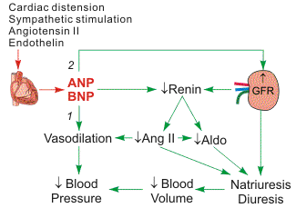
New drugs for heart failure
1- Natriuretic Peptides:
Nesiritide
BNP is secreted by
the ventricules in
response to stretch
elevated BNP is associated with advanced heart failure ( compensatory mechanism in HF )

Slide 44
Natriuretic Peptides
Nesiritide
a purified preparation of human BNP, manufactured by recombinant DNA technology
↑ cyclic-GMP in vascular smooth muscle, leading to smooth muscle relaxation & reduction
of preload and afterload
indicated for the treatment of patients with acute decompensated heart failure (ADHF) who have dyspnea at rest or with minimal activity

Slide 45
New drugs for heart failure
2- Calcium sensitisers:
Levosimendan
mechanism of action:
Calcium sensitization
(improves cardiac contractility without increasing
oxygen consumption)
potassium-ATP channel opening
(cause vasodilation, improving blood flow to vital organs)
These effects reduce the risk of worsening CHF or death compared with dobutamine

Slide 46
Management of chronic heart failure
Reduce work load of the heart
- Limit patient activity
- Reduce weight
- Control hypertension
Restrict sodium
Stop smoking

Slide 47
Heart Failure Functional Classification
NYHA Class | Symptoms
I | Cardiac disease, but no symptoms and no limitation in ordinary physical activity, e.g. no shortness of breath when walking, climbing stairs etc.
II | Mild symptoms (mild shortness of breath and/or angina), slight limitation during ordinary activity.
III | Marked limitation in activity due to symptoms, even during less-than-ordinary activity, e.g. walking short distances (20–100 m).Comfortable only at rest.
IV | Severe limitations. Experiences symptoms even while at rest. Mostly bedbound patients.

Slide 48
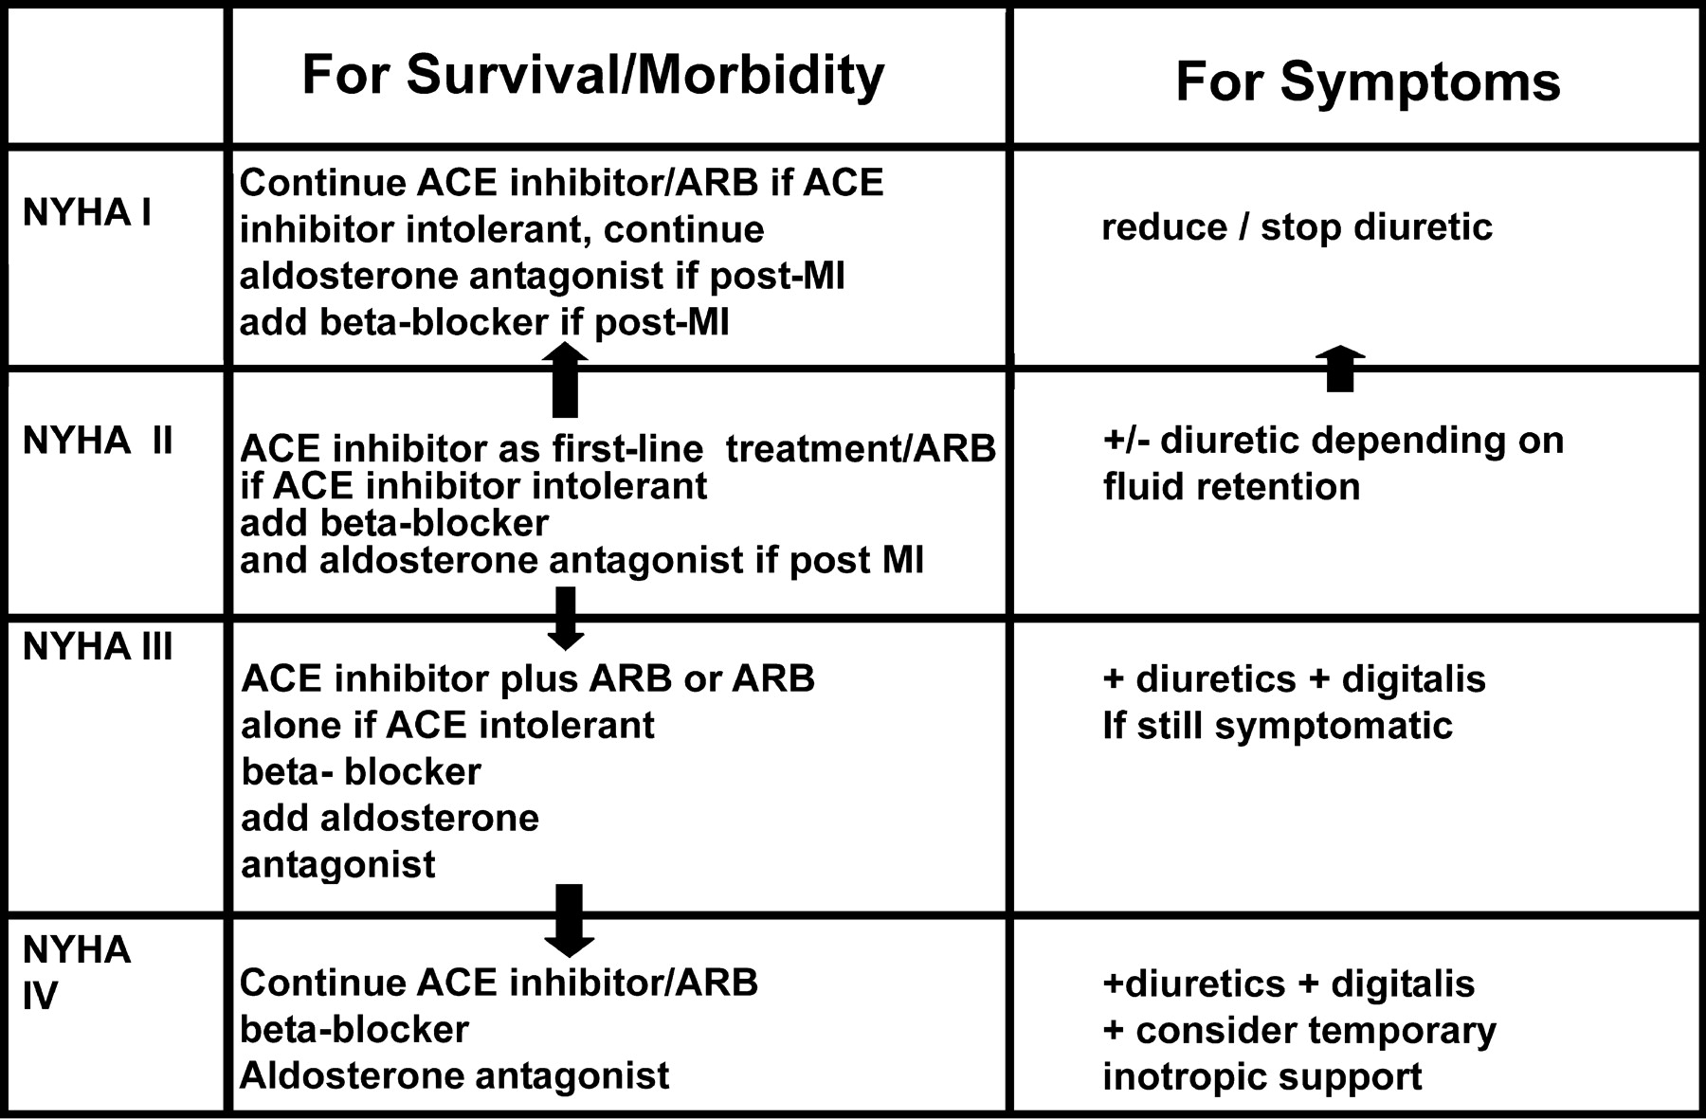
Management of chronic heart failure

Slide 49
Congestive Heart Failure in Black patients
Hydralazine/isosorbide dinitrate
fixed dose combination
FDA approved to add to standard therapy for
black Americans with congestive heart failure
( due to poor response to ACE inhibitors )
should be considered for patients intolerant
to ACE inhibitors & ARBs due to
renal dysfunction
.

Slide 50
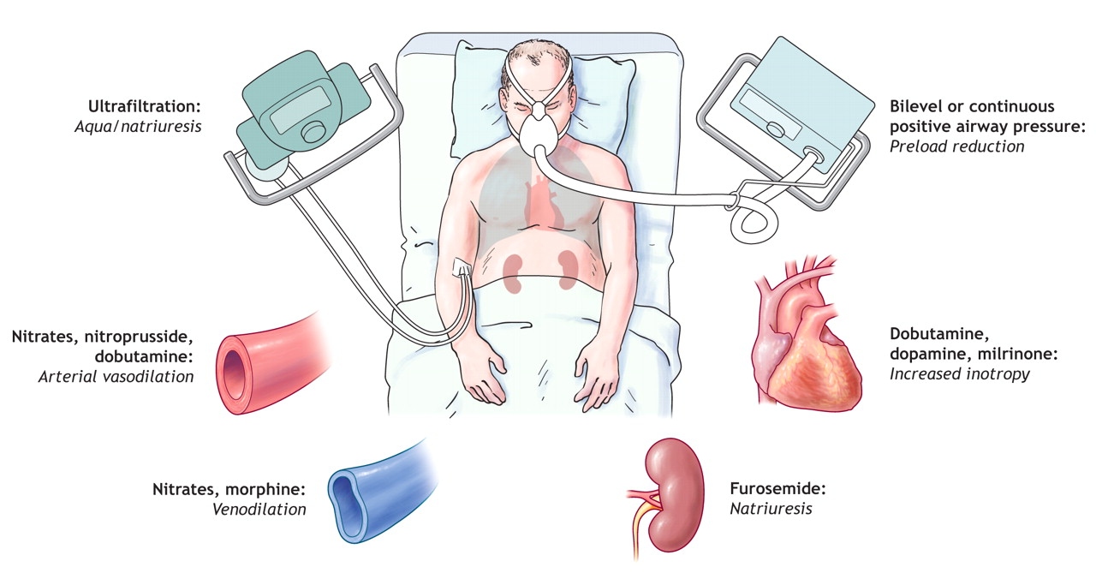
Management of acute heart failure

Slide 51
Thank you

