Slide 1

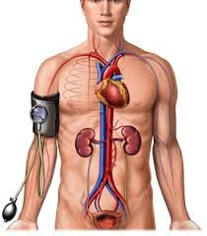


Cardiovascular Physiology
Arterial Blood Pressure
Dr. Abeer A. Al-Masri, PhD
A. Professor,
Consultant Cardiovascular Physiologist, Faculty of Medicine, KSU.

Slide 2

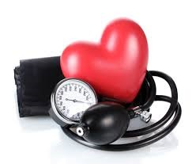


Lecture Outcomes
Dr. Abeer A. Al-Masri, Faculty of Medicine, KSU

Slide 3

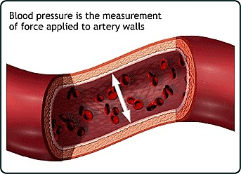
What is meant by Arterial Blood Pressure?
= Lateral pressure created by the heart as it pumps blood, against any unit area of the vessel wall.
In normal adult ≈ 120/80 mmHg
q Top number (Systolic):
= Pressure while the heart is beating.
q Bottom number (Diastolic):
= Pressure while the heart is relaxing.
Dr. Abeer A. Al-Masri, Faculty of Medicine, KSU

Slide 4
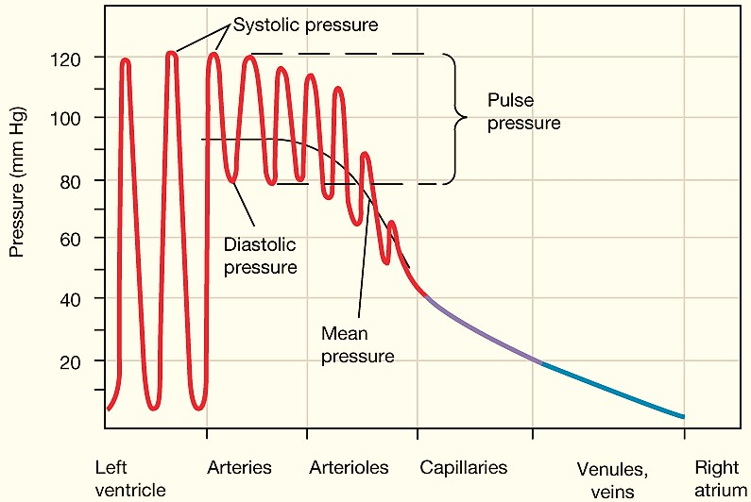
Pressure changes throughout the systemic circulation

Slide 5
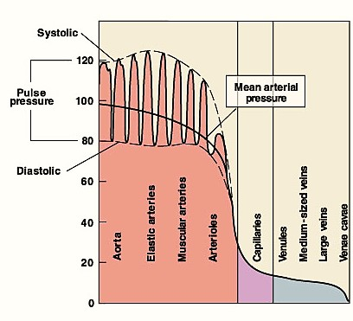
Pressure changes throughout the systemic circulation
q Blood flows down a pressure gradient.
q Highest at the heart.
q ↓ over distance.
q ↓ 90% from aorta to vena cava.
q Greatest drop in pressure occurs in arterioles.
q No large fluctuations in capillaries & veins.
q BP averages 120 mm Hg in aorta & drops to 0-2 mm Hg in RA.
Dr. Abeer A. Al-Masri, Faculty of Medicine, KSU
5

Slide 6
Variations in Arterial Blood Pressure
q Aortic pressure:
120 mmHg systolic.
80 mmHg diastolic.
q Normal arterial pressure:
110 – 130 mmHg systolic.
70 – 85 mmHg diastolic.
Dr. Abeer A. Al-Masri, Faculty of Medicine, KSU
6

Slide 7
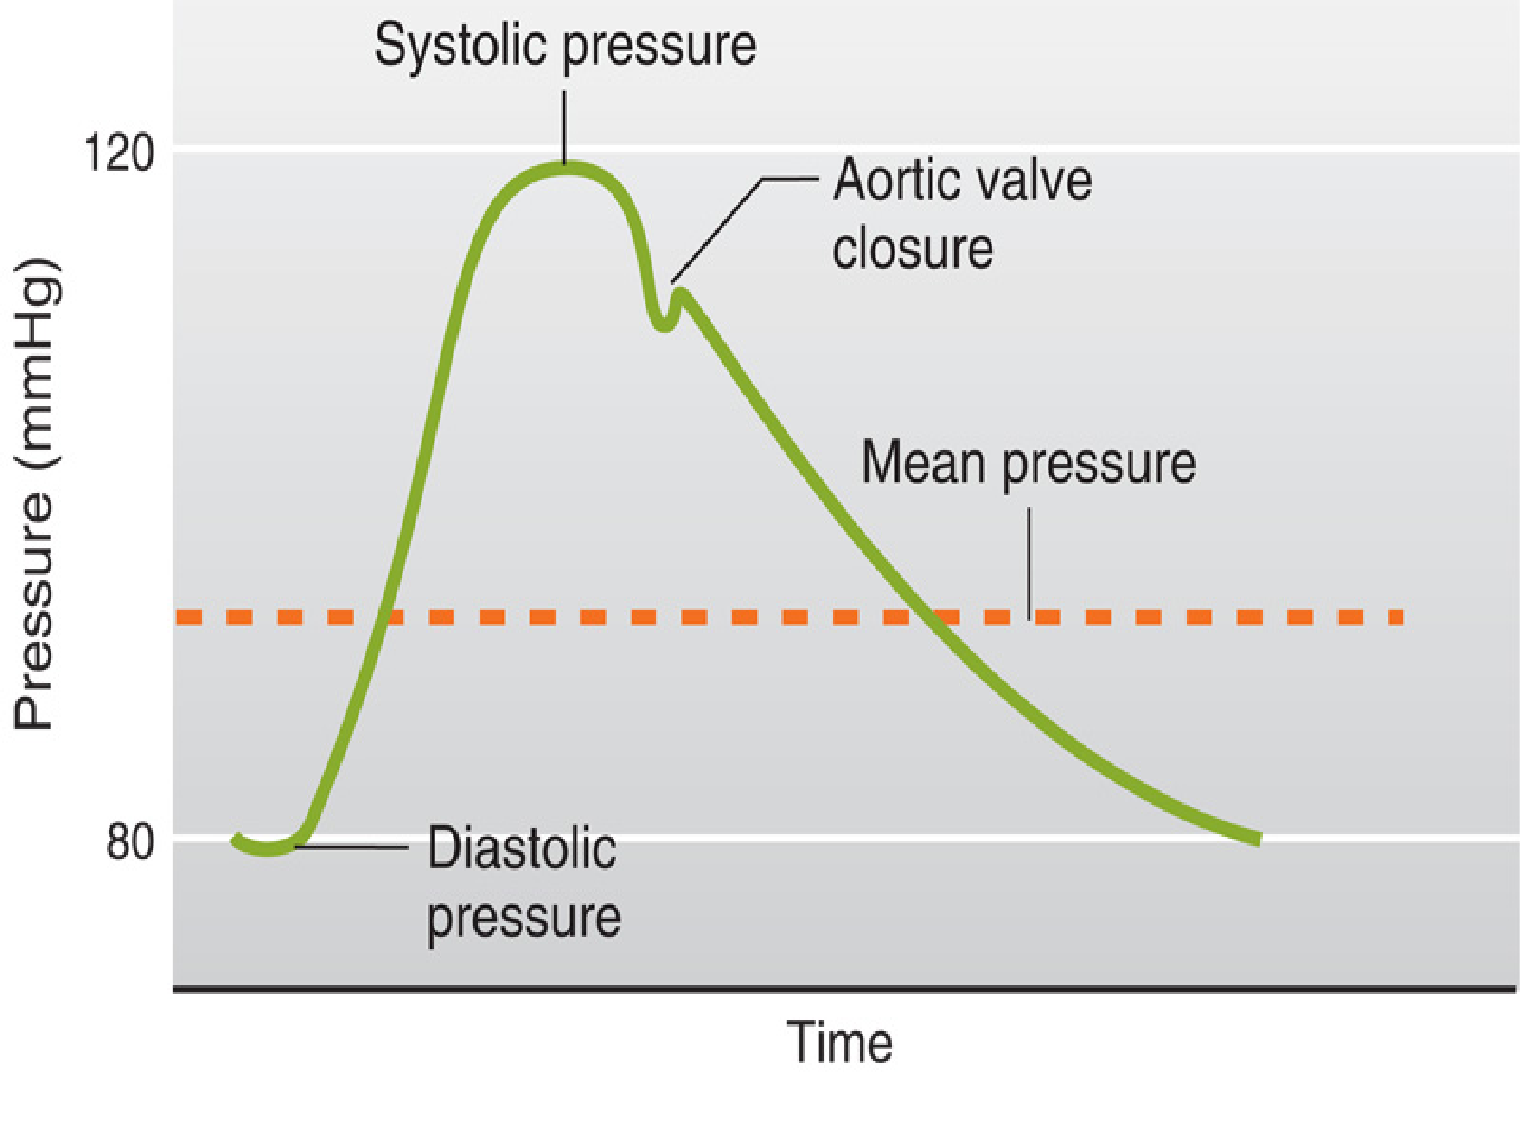
Aortic pressure changes … 120/80
Mean Pressure = diastolic P + 1/3 (systolic P - diastolic P)
Pulse pressure = Systolic P – Diastolic P
Adapted from Guyton
7

Slide 8



















American Heart Association
Recommended Blood Pressure Levels
Adult BP range 110 – 130 / 70 – 85 mmHg
BP
Category
Systolic (mmHg)
Diastolic (mmHg)
Follow-up
Optimal
< 120
&
< 80
Recheck 2 years
Normal
< 130
&
< 85
Recheck 2 years
High Normal
(Pre-hypertension)
130-<140
or
85-<90
Recheck
1 year
Dr. Abeer A. Al-Masri, Faculty of Medicine, KSU
7

Slide 9
Factors Affecting ABP
Sex:
Age:
Emotions:
Exercise:
Hormones:
Gravity:
Race:
Sleep:
Pregnancy:
■
Male > Female … (equal @ menopause)
Elderly > children …(due to atherosclerosis, diabetes, …)
BP (↑) due to neural & hormonal factors. (↑) BP due to ↑ venous return.
Some hormones like adrenaline, noradrenaline & thyroid H (↑) BP. BP is higher in lower limbs than upper limbs.
(? dietary factors, or stress)
BP (↓) due to ↓ venous return. BP (↑) due to ↑ in metabolism.
Temperature: BP (↓) with Heat due to vasodilatation, & (↑) with Cold due to vasoconstriction.
9
Dr. Abeer A. Al-Masri, Faculty of Medicine, KSU

Slide 10
Factors Determining ABP
Cardiac output (Flow.)
Peripheral Resistance.
Blood volume.
Blood Pressure = Cardiac Output
X Peripheral Resistance
(MABP)
(CO)
Blood Flow
(PR)
Peripheral resistance
Dr. Abeer A. Al-Masri, Faculty of Medicine, KSU

Slide 11
Cardiac Output (CO)
Cardiac output (CO) is the amount of blood pumped by ventricles per minute.
Factors determining CO:
  Stroke volume
  Heart rate
Cardiac Output = Stroke Volume X Heart Rate
Cardiac Output
(CO)
Stroke Volume
(SV)
Heart Rate
(HR)
= Output of ventricles / minute
= Output of ventricles / beat
= beats/ minute
≈ 5 L/min
(av. 5-6 L/min)
70 ml/beat
(av. 70-80 ml/beat)
≈ 70-75 beats/min
(N. 60-100 beats/min)
Dr. Abeer A. Al-Masri, Faculty of Medicine, KSU

Slide 12
Blood Flow
q Amount of blood moving through a vessel in a given time period.
q Generally is equal to Cardiac output (CO.)
q Affected by: pressure & resistance.
_{Q =} ∆P
R
q Directly proportional to pressure differences.
q Inversely proportional to resistance.
Dr. Abeer A. Al-Masri, Faculty of Medicine, KSU
13

Slide 13

Resistance (R)
= tendency of vascular system to oppose flow.
1
Flow =
R
Influenced by:
Length of the tube (L), radius of the tube (r), & viscosity of the blood (η)
q In a normal human, length of the system is fixed, so blood viscosity & radius of the blood vessels have the largest effects on resistance..
Poiseuille’s Law
R = 8ηL/ πr
4

Slide 14
Poiseuille’s Law
Fluid Flow (Q) through Cylindrical Tubes.
Flow decreases (↓) when resistance increases.
Flow resistance decreases (↓) when vessel diameter increases.
(Pi - Po) π r⁴
Q =
8ηL
Difference in Pressure
Viscosity
Length
Radius

Slide 15


Total Peripheral Resistance (TPR)
∆P
Q
R =
Systemic
Circulation:
Pulmonary Circulation:
TPR =
Aortic Pressure - RAP Flow
120 - 2 mmHg
83.3 ml/sec (5 L/min)
_{Pul. R. =} Pulmonary Art. P. - LAP
Flow
15 - 3 mmHg
83.3 ml/sec (5 L/min)
0.12 (PRU’s)
TPR =
Pul. R. =
TPR =
1.2 (PRU’s)
Pul. R. =

Slide 16



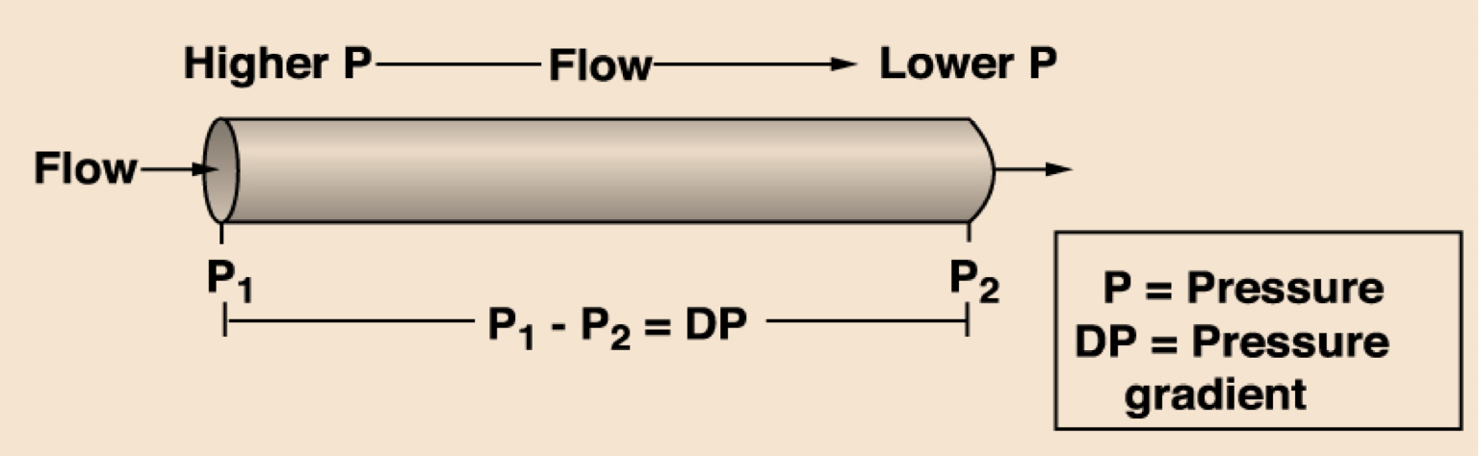

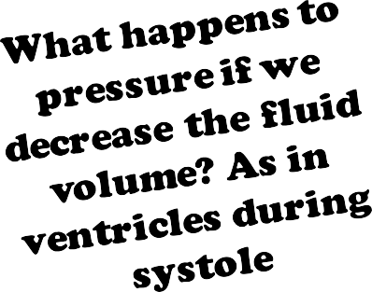

Blood Flow and Pressure
P directly proportional to F
Blood flows down a pressure gradient.
Absolute value of pressure is not important to flow, but the difference in pressure (DP or gradient) is important to determining flow.
Resulting pressure is called the driving pressure in vascular system

Slide 17

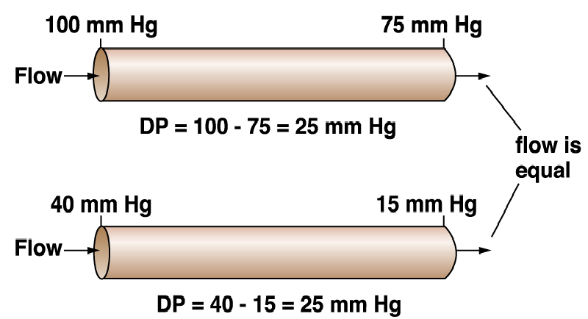
How does the flow differ in these two vessels?
Dr. Abeer A. Al-Masri, Faculty of Medicine, KSU
18

Slide 18










Resistance to Flow in the Cardiovascular System
Basic Concepts
Rt = R1 + R2 + R3 ….
1/Rt = 1/R1 + 1/R2 + 1/R3 ….
Series Resistance
Parallel Resistance
R1 R2 R3
Series
Parallel
R1
R2 R3
What Really Happens in the CVS?
Lower R
Higher R
Lower R
Artery
Capillaries
Dr. Abeer A. Al-Masri, Faculty of Medicine, KSU
Arterioles
19

Slide 19

Resistance to Flow in the Cardiovascular System
If: R₁ = 2;
R₂ = 4;
R₃ = 6 Peripheral Resistance Units (PRU’s)
q Series arrangement gives:
R_{T} = R₁ + R₂ + R₃ R_{T} = 12 (PRU’s)
q
Parallel arrangement gives:
1
R_{T} =
= 1.94 (PRU’s)
1 ₊ 1 1
R₁ R₂ R₃
+
20

Slide 20

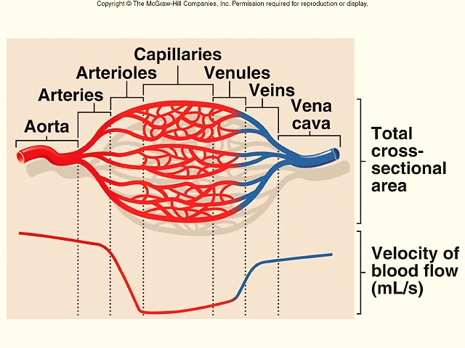
Cross-Sectional Area
As diameter of vessels ↓, the total cross-sectional area
↑ & velocity of blood flow ↓
21

Slide 21



Velocity and Cross Sectional Area
A = 2cm² 10cm² 1cm²
Q =10ml/s
a
b
c
V = 5cm/s 1cm/s 10cm/s
V = Q / A
Dr. Abeer A. Al-Masri, Faculty of Medicine, KSU
22

Slide 22
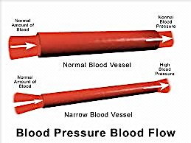
Effect of Radius on Pressure
Dr. Abeer A. Al-Masri, Faculty of Medicine, KSU
23

Slide 23
Compliance of Blood Vessels
q Compliance = distensibility.
q Compliance is the volume of blood that the vessel can hold at a given pressure.
C = V
P
24

Slide 24
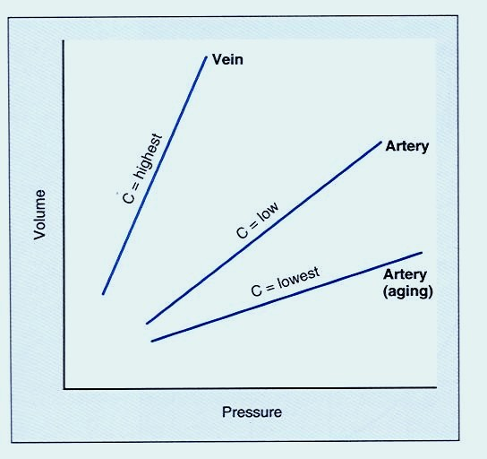

Venous system has a large compliance & acts as a blood reservoir (high volume & low pressure)
C = Compliance
V = Volume
P = Pressure
C = V
P
Dr. Abeer A. Al-Masri, Faculty of Medicine, KSU
25

Slide 25
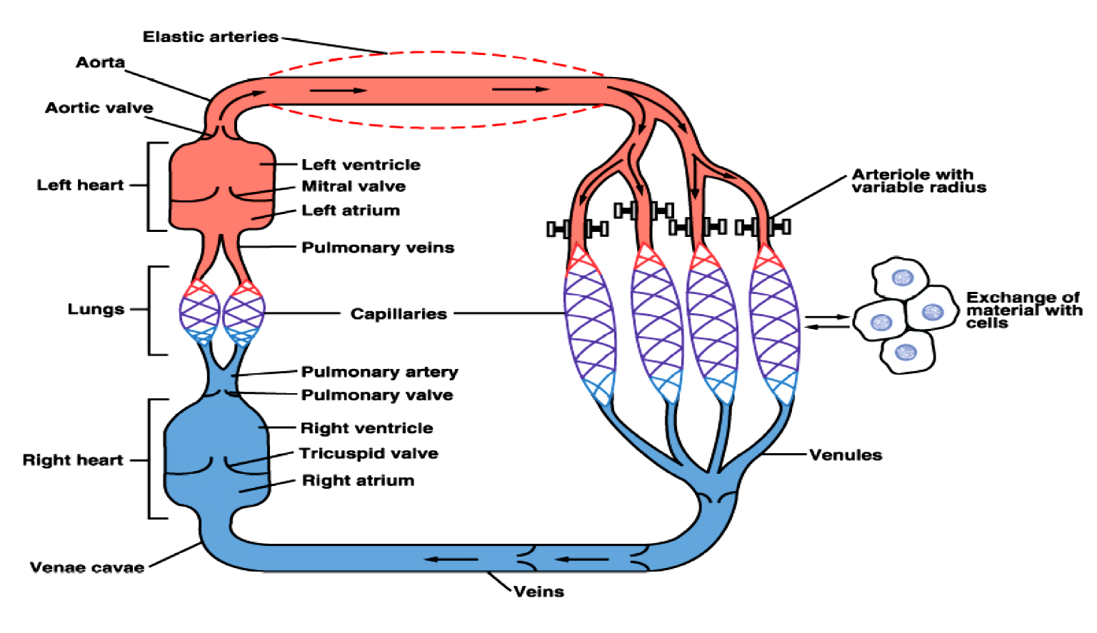
Vascular system possesses different mechanisms for
promoting continuous flow of blood to the capillaries:
Elastic recoil
Smooth m. regulation of diameter
Sphincters
Valves
Muscular arteries
Dr. Abeer A. Al-Masri, Faculty of Medicine, KSU
26

Slide 26





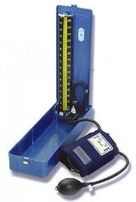
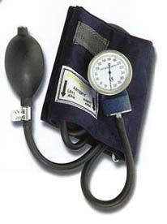
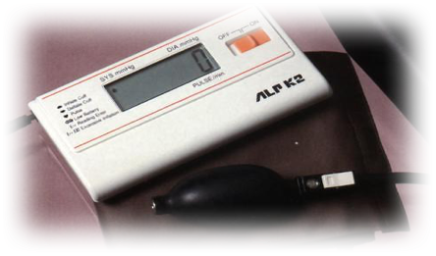
Measurement of Arterial Blood Pressure
q Two methods: Direct & indirect
q Sphygmomanometer:
Indirectmethod, "Estimate of pressure"
Many types:
  Mercury sphygmomanometer
  Aneroid equipment
  Automatic equipment
Blood Pressure Cuff Size:
  Small – children & small adults
  Average
  Large – overweight & large adults

Slide 27
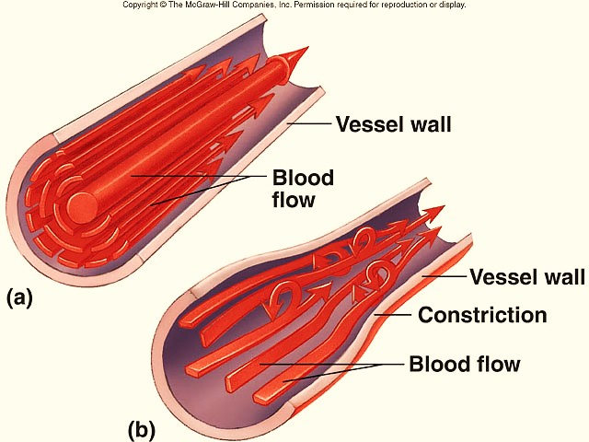
Laminar and Turbulent Flow
q Laminar flow
Stream-lined
Outermost layer moving slowest & center moving fastest
q Turbulent flow
Interrupted
Fluid passes a constriction, sharp turn, rough surface
Rate of flow exceeds critical velocity
Dr. Abeer A. Al-Masri, Faculty of Medicine, KSU
27

Slide 28
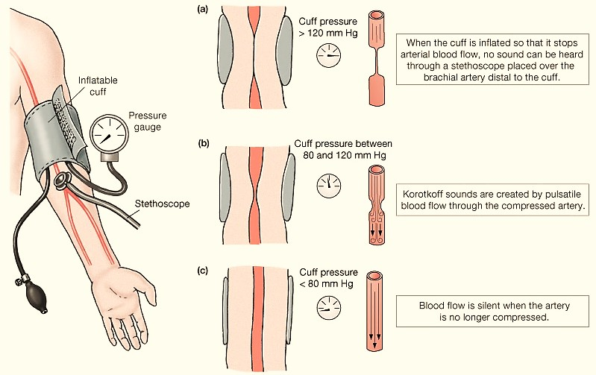
Blood Pressure (BP): Measurements
BP is measured by listening for Korotkoff sounds produced by turbulent flow in arteries:
Systolic pressure
= when 1st sound is heard.
Diastolic pressure
= when last sound is heard.
28

Slide 29
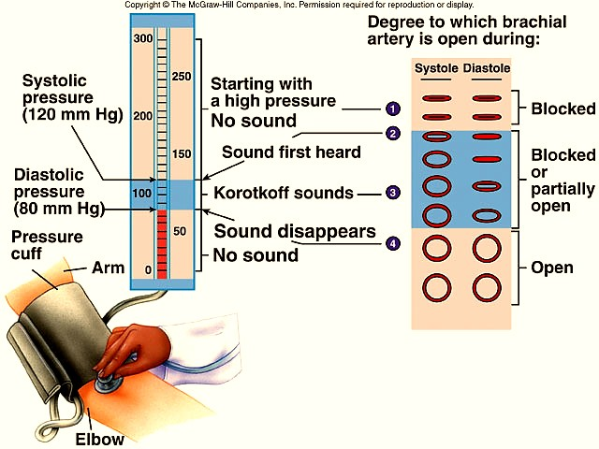
Blood Pressure (BP): Measurements

Slide 30
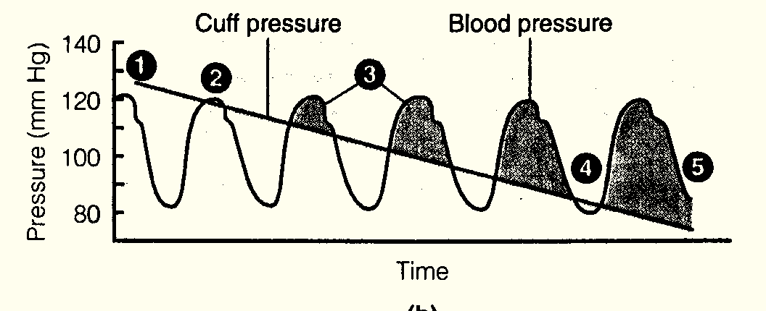
Measuring Blood Pressure Turbulent Flow
Cuff pressure > systolic blood pressure.. No sound
The first sound is heard at peak systolic pressure.
Sounds are heard while cuff pressure < blood pressure.
Sound disappears when cuff pressure < diastolic pressure.

Slide 31
Thank You

